Slide 1
SAMPLE HANDLING TECHNIQUES
IN IR SPECTROSCOPY

Slide 3
INTRODUCTION
IR Spectroscopy is concerned about the absorption of IR radiation by a molecule,
which results in vibrational transitions and exhibit characteristic absorption spectra³.
IR region range – 0.8-200µ. (12500-4000cm-1)
Analytical useful range –4000-400cm⁻¹ (Fundamental region).

Slide 4
Possibility of chemical identification.
Valuable tool for the determination of organic, and to a lesser extent, inorganic structure.

Slide 5
Sample Holders & Sampling of Substances
State of the sample i.e., Solid, Liquid or Gas.
The intermolecular forces of attraction are most operative in solid phase
least in case of gases.
The sample of same substance shows shift in frequencies of absorption
as it passes from solid to the gaseous state.

Slide 6
In some cases additional bands are also observed with the change in state of the sample.
Important to mention the state of the sample & solvent for scanning in IR region for correct interpretation of spectra.

Slide 7
Sample should be placed in sample holder or cell or cuvettes.
sample cell windows should be transparent in the spectral region
There is no rugged window material for cuvettes that is transparent and also inert over this region.

Slide 8
The alkali halides are widely used, particularly NaCl,
which are transparent at wavelengths as long as 4000- 625cm⁻¹. (667)
4000-1300cm-1 functional gp
1300-667 cm-1 --- finger print

Slide 9
Cell windows are easily fogged by exposure to moisture and require frequent repolishing.
AgCl₃ is often used for moist samples or aqueous solutions.
But it is soft, is easily deformed, and darkens on exposure to visible light.

Slide 10
Teflon has only C-C and C-F absorption bands.
For frequencies less than 600cm⁻¹, a polyethylene cell is useful.

Slide 11
SAMPLING OF SOLIDS
The solid whose IR spectra are to be recorded can be sampled in various ways:
Solid films
B. Solids run in solution
c. Nujol or Mull Technique
D. Pressed Pellet Technique

Slide 12
Solid Films:-
Useful only when the material can be deposited from solution or cooled from a melt as microcrystals or as a glassy film.
Polymers, resins and amorphous solids
Dissolve them in reasonable volatile solvent and solution is formed.
Pour solution on rock-salt Plate (KBr or Nacl)
Evaporate solvent by gentle heating.
Care must be taken to free the sample from solvent.

Slide 13
Films of crystalline solid generally lead to excessive light scattering .
Specific crystal orientation may lead to spectra differing (on comparison) from those observed for randomly oriented particles
such as exist in a mull or a halide disk.
This technique is useful for rapid qualitative analysis
but is not suitable for quantitative analysis.

Slide 14
Solids Run in Solution:-
Solids may be dissolved in a non-aqueous solvent.
No chemical interaction between solute and solvent
and also solvent does not absorb in the studied range.
A drop of the solution is placed on an alkali metal disk and the solvent allowed to evaporate,
leaving a thin film of the solute, or
the entire solution is placed in a liquid sample cell.

Slide 15
If the solution can be prepared in a suitable solvent
then the solution is run in one of the cells for liquids.
But this method is not for all solids
as suitable solvents are limited and no single solvent
is transparent throughout the IR region.

Slide 16
Solvents
Solvent must be dry and transparent in the region of interest.
A common pair of solvents is CCl₄ and CS₂.
CCl₄ is relatively free of absorption at frequencies above 1333cm⁻¹, whereas CS₂ shows little absorption below 1333cm⁻¹.
Solvent and solute combinations that react must be avoided.

Slide 17
For example, CS₂ cannot be used as a solvent for primary or secondary amines.
Amino alcohols react slowly with CS₂ and CCl₄.
To obtain the spectra of polar materials that are insoluble in CCl₄ and CS₂,
chloroform, methylene chloride, acetonitrile and acetone are useful solvents.

Slide 18
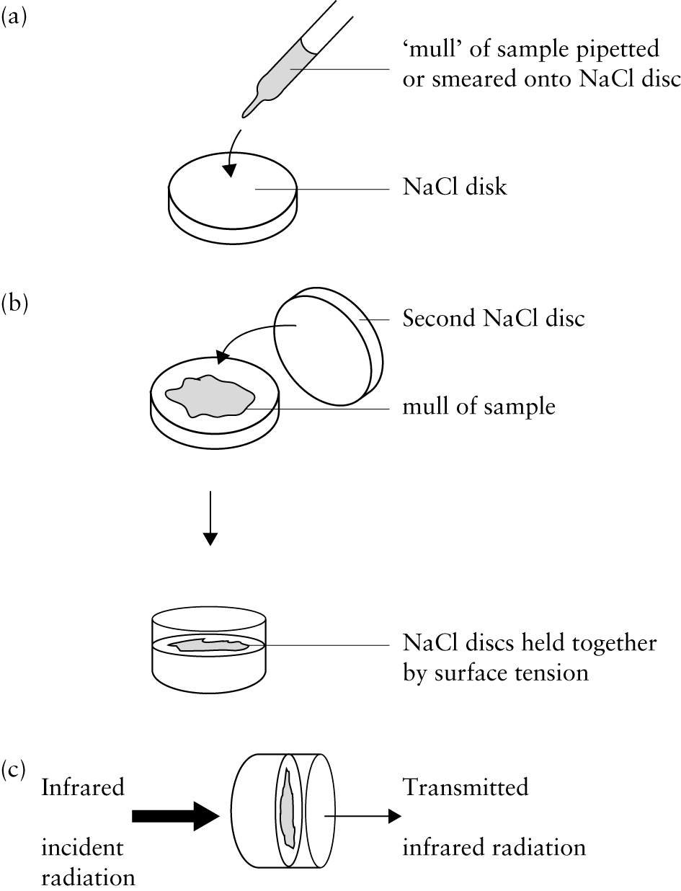
Nujol Mull Technique:-
Mulls are prepared by thoroughly grinding a small amount of sample (2-5mg) in smooth agitate mortar.

Slide 19
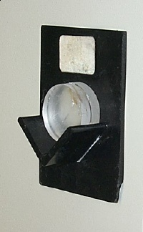
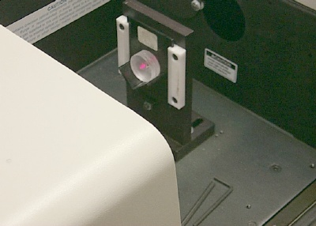

Slide 20
Nujol shows characteristic absorption of C-C & C-H vibrations of hydrocarbons at 2915, 1462, 1376 & 719cm⁻¹.
When hydrocarbons bands interfere with the spectrum, Fluorolube or hexachlorobutadiene may be used.
The use of both Nujol and Fluorolube mulls makes possible a scan,
essentially free of interfering bands, over the 4000-250cm⁻¹ region.

Slide 21
Multiple reflections and refractions of
the particles are reduced by grinding the particles to a size an order of magnitude
less than the analytical wavelength and by surrounding the particles with a medium whose index of refraction is a close match.

Slide 22
This technique is good for qualitative analysis but not for quantitative analysis.
Disadvantage:-
Although Nujol is transparent in most part of the IR spectra but it has characteristic absorption of
C-C & C-H vibrations of hydrocarbons at 2915, 1462, 1376 & 719cm⁻¹.
This is the major drawback in using Nujol for certain compounds which may have absorption in the region similar to Nujol.

Slide 23
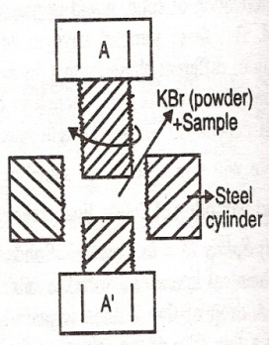
Pressed Pellet Technique:-`
Finely grinded solid sample is mixed with about 100 times its weight of powdered KBr.
This mixture is pressed under very high pressure in a press
(at least 25,000 psi) to form a small pellet
which is very fragile and transparent to IR radiation.

Slide 24
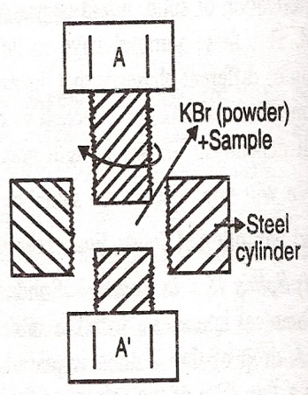
The powder (KBr+sample) is introduced
and then the upper screw ‘A’ is tightened until the powder is compressed into a thin disc.
After compressing the sample, one removes the bolts (A and A’) and places the steel cylinder with the sample disc inside it in the path of the beam of IR spectrometer & a blank KBr pellet of identical thickness is kept in the path of reference beam.

Slide 25
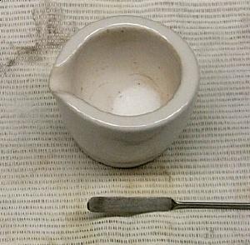
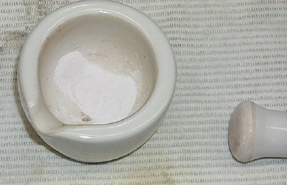
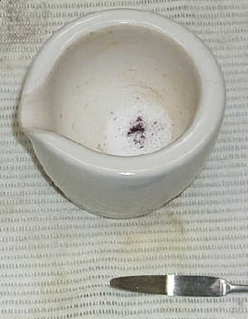
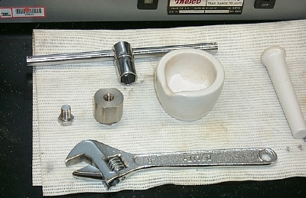

Slide 26
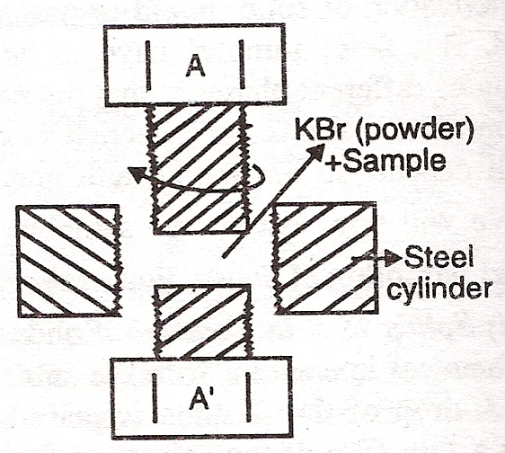
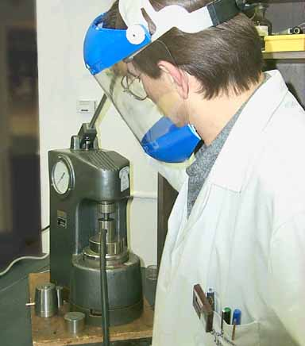

Slide 27
Advantages over Nujol Mull Technique:-
  KBr eliminates the problem of bands which appear in the IR spectrum due to the mulling agent.
  In this case, no such bands appear.
  2. KBr pellets can be stored for long time.
  3. As the concentration of sample can be suitably adjusted in the pellets,
  4. it can be used for quantitative analysis.
  5. The resolution of the spectrum in the KBr is superior to that obtained with mulls.

Slide 28
Disadvantages:-
  It always has a band at 3450cm⁻¹, from the OH group of moisture present (always) in the sample.
  Thus, care must be observed in investigations concerning the region of the OH band in the sample.
  3) The high pressure involved during the formation of pellets may bring about polymorphic changes in crystalline in the samples,
  (especially inorganic complexes) which may cause complications in IR spectrum.
  4. This method is not successful for some polymers which are difficult to grind with KBr.

Slide 29
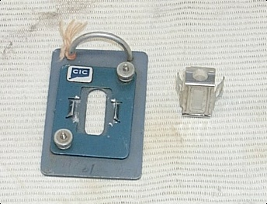
Sampling of Liquids:-
Liquids at room temperature
Rectangular cells made of NaCl , KBr or ThBr
Sample thickness should be 0.01-0.05mm to give transmittance between 15% and 70%.
If a cell possesses good quality windows, flat and parallel, its thickness, t, in cm can be calculated from the following equation:
2t=N/w₁-w₂
Where, N is the number of fringes between wave numbers w₁ & w₂

Slide 30
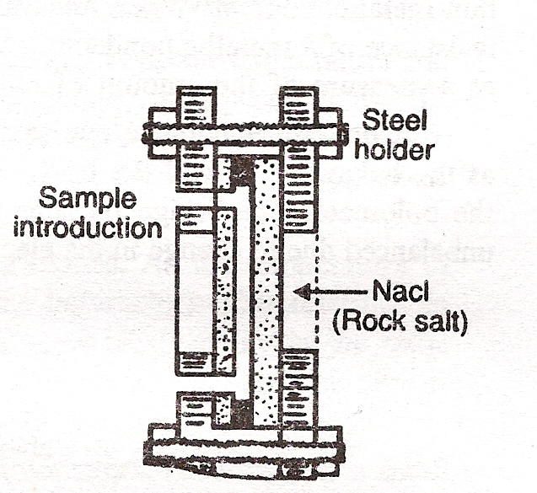
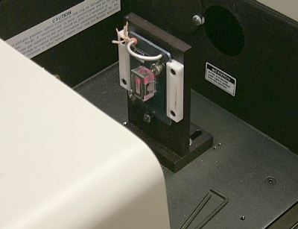

Slide 31
For double beam work, “matched cells” are generally employed.
One cell will contain the sample while the other will have solvent used in the sample.
Matched cells must have same thickness.
All cells should be protected from moisture because they dissolve in water.
For similar reasons organic liquid samples must be dried before pouring into cells.

Slide 32
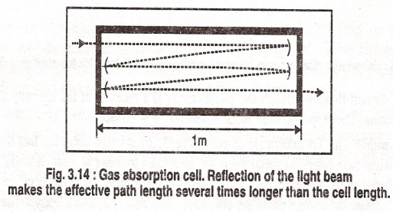
Sampling of Gases:-
The gas sample cell is similar to cell for liquid samples and made of KBr, NaCl & so on.
To compensate for the small number of molecules of a sample that is contained in a gas,
the cells are larger; they are about 10cm long, but they may be up to 1m long.
Multiple reflections can be used to make effective path length as long as 40m,
so that constituents of the gas can be determined.

Slide 33
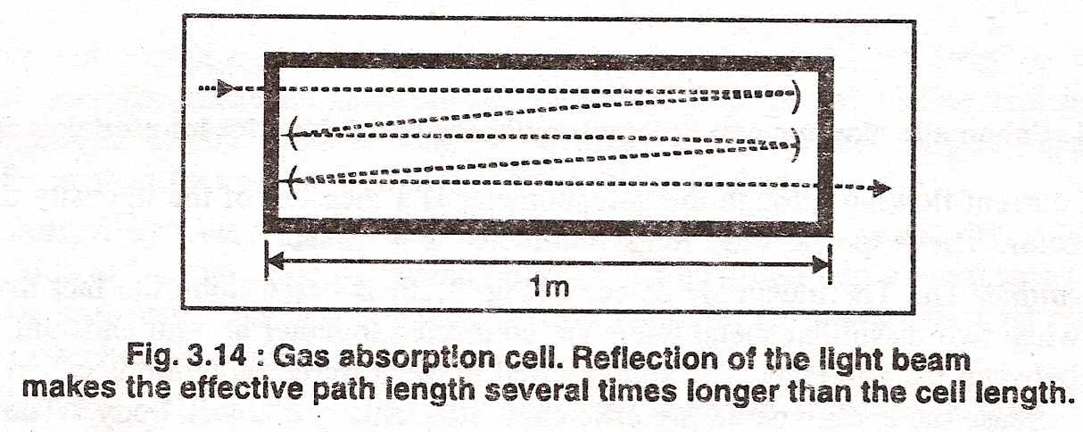
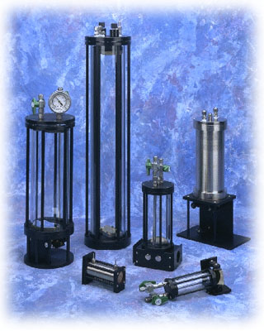
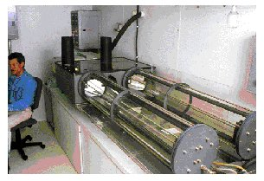

Slide 35
Gas must not react with the cell windows or the reflecting surfaces.
Gas analysis are performed with IR but the method is not commonly used because of its lack of sensitivity.
Moisture can be avoided.
Its strong absorption bands at 3710cm⁻¹ and 1625cm⁻¹ may interfere in the analysis.
In addition, the windows and other instrument components which are constructed of soluble salts may be damaged.

Slide 36
THANKS

Slide 37
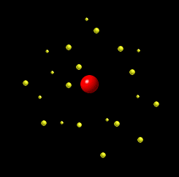
Detectors requirments;
Shorter response time
Long term stability for quantitative determination
High sensitivity
Produce signal which is amplified easily
14.03.2011

Slide 38
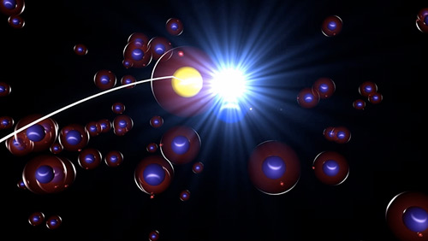
Detectors
Near-infrared : lead sulfide photoconductive
Mid-infrared: Thermocouple, Thermistor or Pyroelectric
Far –infrared: Golay, pyroelectric.
At the shorter- wavelength end , below about 1.2 microns, the preferred detection methods are the same as those used for visible and U V radiation.

Slide 39
The detectors can be classified into 2 groups
Photon detectors or selective detectors
( response depend on wavelength of incident radiation)
which use the quantum effects of the IR radiations to change the electric properties of a semiconductor
Ex: photocell or photon detector

Slide 40
14.03.2011
. Thermal detectors or Non selective detectors
( response is directly proportional to incident energy)
in which the infrared radiation produces a heating effect that alters some physical property of detector
Ex: thermocouples, Bolometer, golay detectors, thermistors
& Pyroelectric detectors

Slide 41

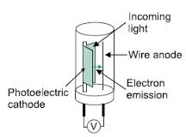
Photon detectors
Construction:
1. evacuated glass tube
2. Material: Cathode: lead telluride or lead sulphide
Photon detectors consists of thin layer of lead telluride or lead sulphide supported on a glass and enclosed in a evacuated glass envelope.
Lead sulphide photoconductive cells are sensitive to infrared radiation upto 3 microns.
3. window: ii ( IR transmitting material) ex: Nacl, KBr
Mechanism:
when radiation incident on cathode photoelectrons are emitted
attracted and collected by anode return to external circuit generation of current amplified and recorded
( gives amount of radiation strikes the cathode)

Slide 42
Mechanism:
When IR radiation is focused on lead sulphide A sufficiently energetic photon that strikes in the detector can raise that
electron from a non conducting state into a conducting state,
its conductance increases and causes more current to flow,
which is amplified and measured.

Slide 43
Photon detectors
Advantage :
1. Response time is 0.5milli sec.
2. Sensitive, but restricted to wavelength
3. Fast.
Disadvantage:
1. When operated at room temperature, it has a restricted range ( near IR)
2. it is cooled to liquid Nitrogen temperature or below

Slide 44
Thermal detectors
heating effect of IR towards black bodies changes the
physical property of the detector ( P.D)
Generally thermal detectors are used in IR spectroscopy.
Radiations above 1 micron are detected by its heating-effects, either by a sensible thermocouple or by resistance thermistors.
When either of these instrument is connected to a galvanometer,
a deflection is noted which is in proportion to the transmitting radiant power.
14.03.2011

Slide 45
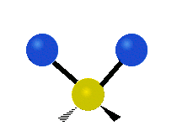
Thermal detectors
So thermal detectors give response for all frequencies,
the radiant power is low for IR region, i.e. The detector signal will also be low. In order to locate these low signals,
a preamplifier is fixed to the detector and the radiant beam is modulated with a low frequency light interrupt 10- 26 cps.
Thus to detect such signals, thermal detector must posses a short response time and the absorbed heat must be lost rapidly
14.03.2011

Slide 46
Thermal detectors
The active element in any thermal detector is as small as possible to maximize its temperature change for any level of infrared radiant energy.
For the same reason, the
element is blackened and thermally insulated from its substrate.
14.03.2011

Slide 48
Thermal detectors
Material properties affected in thermal detectors include
1. Voltage induced at the junction of 2 dissimilar materials (Thermocouple and thermopile)
2. An expansion of a solid or fluid ( Golay cell)
3. Electrical resistance ( Thermistor)
4. Electric polarization ( Pyroelectric)
14.03.2011

Slide 49
Thermal detectors
Advantage
1. Thermal detectors are usable over a wide range of wavelength, which includes both visible and infrared radiation, and
2.They operate at room temperature.
Disadvantage
1. Slow response time ( milliseconds)
2. Lower sensitivity relative to other types of detectors.
14.03.2011

Slide 50
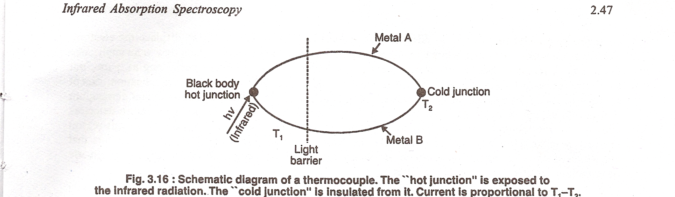
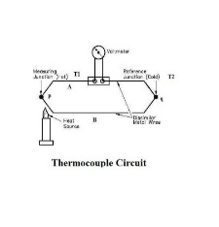
thermocouple
It is based on fact that an
electric current will flow in two dissimilar metals (like bismuth & antimony).
Wires are connected together at both ends, a small voltage is produced proportionally to the temperature differential exists between the two ends.
14.03.2011

Slide 52

thermocouple
Several thermocouples like this connected in series forms a thermopile so that their voltage adds.
14.03.2011

Slide 53
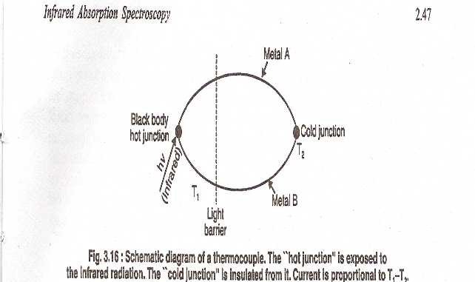
Thermocouple
Construction:
The end exposed to IR radiation is called the
hot junction (blackened gold foil in order to increase the energy gathering efficiency).
It is a usually a black body. The other connection, the cold junction and is thermally insulated and carefully screened from stray light.
14.03.2011

Slide 54
the 2 dissimilar metals ( thermo electric efficiency) welded at each end
When kept at 2-different temperature ( cold + Hot)
small potential difference is developed
Enclosed in evacuated steel with KBr window
( to avoid loss of energy by Convection)

Slide 55

Thermocouple Working:
One welded joint is (cold junction) = kept at constant temperature ( not exposed to IR)
Another welded joint ( hot Junction) Exposed to IR( increase the temperature of the junction)
The temperature difference b/w 2 junction generate PD = depend on IR radiation fall on hot junction
The electricity which flows is directly proportional to the energy differential between two junctions.
The thermopiles offer the simplest and most direct means for converting radiant energy into electric signal.

Slide 56
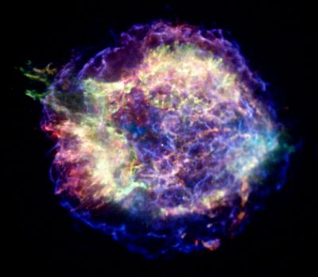
Thermocouple
Advantage:
  Can be used over a wide range of wavelength.
  Response time is about 60 msec.
Disadvantage:
Low sensitivity.

Slide 57
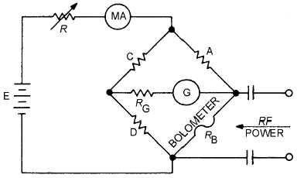
Bolometer.
A bolometer is based upon the fact that the
electrical resistance of a metal changes with
increase of temperature.
It is consists of a resistors made up of sintered oxides of manganese, cobalt `and nickel,
which have high temperature coefficient of resistance.

Slide 59
Bolometer.

Slide 60
They constructed by metal or semiconductor that exhibits a large change in electrical resistance as a function of temperature.
When radiation falls on the bolometer, its temperature changes and hence the resistance of conductor also changes.
The degree of changes in resistance is a measure of amount of radiation falls on the bolometer.

Slide 61
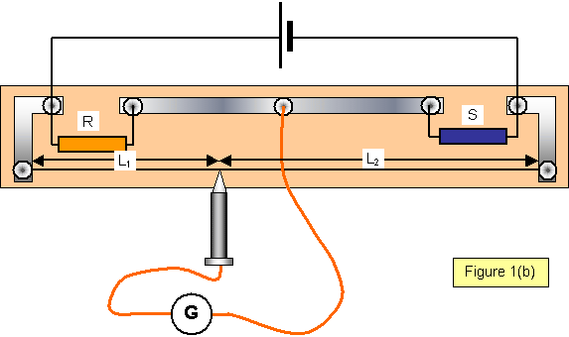
construction
It consists of 4 arms R₁ R₂R₃R₄
R₃R₄ are made up of Pt
Connected to galvanometer form wheat stone bridge
Thro sliding contact galvanometer shows zero deflection = Balanced
This is fitted in KBr or Cesium iodide window
R= E/ I R= resistance E= PD
I= current in amperes

Slide 62
Principle
Based on the principle that as Increase in the temperature = increase in electrical resistance of a metal

Slide 63
working
When bridge is balanced = no current flows
( not exposed IR)
When bridge is unbalanced ( Light or heat) (IR)
There is change in electric resistance
The current flows through galvanometer = intensity of the radiation falling on the detector
R2/R1=R4/R3

Slide 64
One arm (Indicator) exposed to IR
Other arm (reference) = protected from IR
Connected to galvanometer then to a battery
Form Wheatstone bridge
When radiation falls on indicator resistors temperature increased = change in degree of resistance= bridge unbalanced = current flows thro galvanometer
Amount of current flowing is proportional to amount of radiation falling on the platinum

Slide 65
Advantage
1. Response time is 4 milliseconds
2. high sensitivity
Disadvantage :
Highly fragile (delicate)
Cannot be used when fast response required

Slide 66
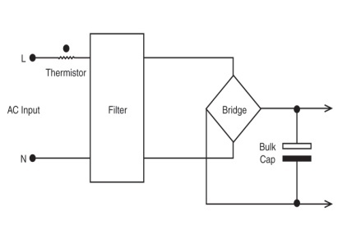
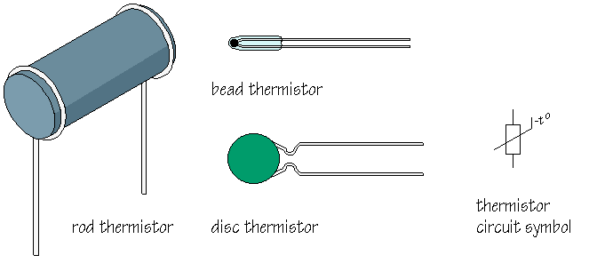
Thermistor:
Is a resistor made by fusing together several metallic oxides of manganese , cobalt and nickel
which have a high temperature coefficient of resistance .
Similar to bolometer
Negative thermal co-efficient of electrical resistance
Increase in temperature = decrease in electrical resistance

Slide 67
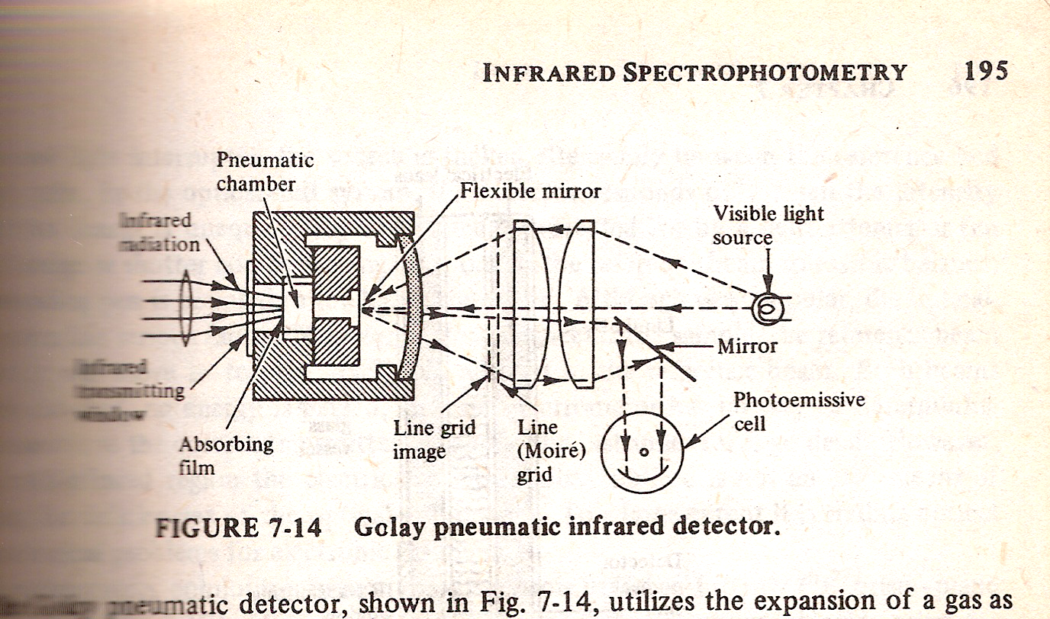
Golay cell

Slide 69
Golay cell
Construction:
The unit consists of a small metal cylinder closed by a rigid blackened metal plate at one end
and by a flexible silvered diaphragm at other end act as mirror ( reflection)
The chamber is filled with xenon.
The blackened is exposed to IR

Slide 70
Principle:
There is expansion of Xenon gas which affects the metal cylinder ( movement of the diaphragm)
Cause the change in out put

Slide 71
Golay cell
Working :
when IR is allowed to fall on blackened metal plate
it heats the Xe gas ---------- expand the Xe gas ----------
result in increase in pressure of Xe gas --------
deform the flexible diaphragm (mirror) or bulges --------
reflects the light on photocell----- the flexible diaphragm passes the reflected light thro Moris grid
Roll of Moris grid : when no distortion of flexible surface ( there is no radiation falling on metal plate) the reflected light from the source is blocked)

Slide 72
Golay cell
Advantage:
wide range of wavelength
Response time is faster then other thermal detector
response time is approximately 20 msec).
It is significantly superior as a detector for the far IR region
Disadavantage:
Expensive + bulky

