Slide 1

Schizophrenia

Slide 2
Schizophrenia is one of the most complex and challenging of psychiatric disorders.
Schizophrenia is characterized by delusions, hallucinations, disorganized, bizarre thoughts and speech, abnormal motor behavior, and negative symptoms.

Slide 3
DSM-IV-TR, Diagnostic and Statistical Manual of Mental Disorders, 4th ed., text revision. Adapted from American Psychiatric Association.
The DSM-IV-TR classifies the symptoms of schizophrenia into two categories: positive and negative.
Recently greater emphasis has been placed on a third symptom category, cognitive dysfunction

Slide 4
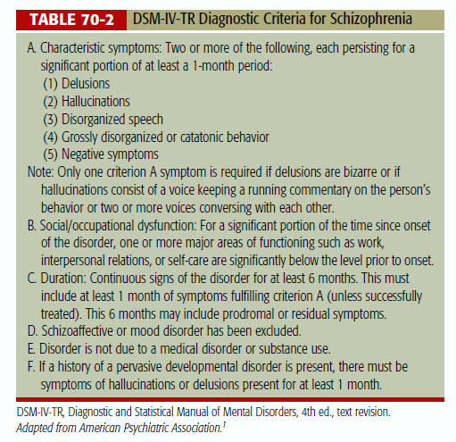

Slide 5
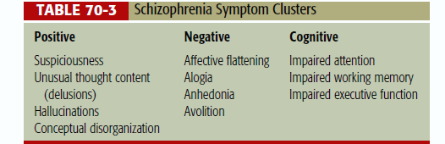

Slide 6






















Impact of Schizophrenia Symptoms on Functional Outcomes
Positive Symptoms Negative Symptoms
Social/Occupational Dysfunction
work
interpersonal relationships
self-care
Cognitive Symptoms
Am J Psychiatry 1997;154:1;Lancet 1995;346:477;Practitioner 1992;236:255.

Slide 7

Etiopathogenesis
Increased ventricular size and decreased gray matter, have been reported.
Schizophrenia causation theories include
  Genetic predisposition-
    Polymorphism in the VAL/MET alleles of the catecholamine- O-methyl transferase gene
    Alleles with decreased dysbindin(dysbindin is a neurodevelopmental protein gene that is found on chromosome 6) RNA in the dorsolateral prefrontal cortex

Slide 8
Etiopathogenesis
Schizophrenia causation theories include
2. Obstetric complications-
  In-utero disturbance, upper respiratory infections in second trimester
  Obstetric complications or neonatal hypoxia
  Low birth-weight
Increased neuronal pruning
  Decreased number of basal neurons and Glutamatergic activation can exaggerate neuronal pruning

Slide 9
4. Immune system abnormalities
Neurodevelopmental disorders,
  A deficiency of glial growth factors––such as NRG (Neuroglin
)–– predisposes to synaptic destabilization
  Abnormalities in synaptic plasticity due to overexpression of Neuregulin-1
Neurodegenerative theories,

Slide 10
Dopamine receptor defect,
  Regional brain abnormalities including hyper- or hypo- activity of dopaminergic processes in specific brain regions.
  Positive symptoms may be more closely associated with dopamine receptor hyperactivity in the mesocaudate.
  Negative and cognitive symptoms may be most closely related to dopamine receptor hypofunction in the prefrontal cortex.

Slide 11
Glutamatergic dysfunction.
  A deficiency of glutamatergic activity produces symptoms similar to those of dopaminergic hyperactivity and possibly schizophrenic symptoms.
Serotonin (5-hydroxytriptamine [5-HT]) abnormalities.
  Schizophrenic patients with abnormal brain scans have higher whole blood 5-HT concentrations, which correlate with increased ventricular size.

