Slide 1
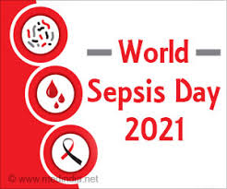
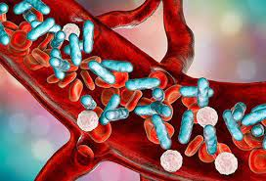
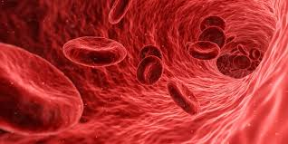
Septicemia
Infection disease
By Animesh Das

Slide 2
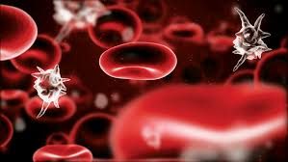
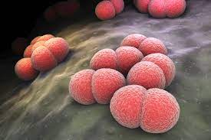
Definition
It is an infection of a life threatening complication , also called as Sepsis , it occur when chemicals released in the blood stream to flight an infection trigger inflammation through out the body .
Causative Agent -- Staphylococcus aureus

Slide 3
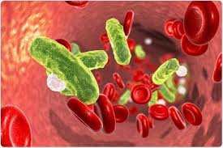
Type / Classification
There are three type of Septicemia --
postoperative Septicemia
Bacterial Septicemia
Meningococcal Septicemia

Slide 4
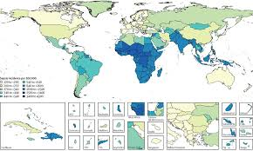
Epidemiology
Sepsis is present in 30% to 50% of hospitalizations that culminate in death.
Sepsis affects approximately 1.7 million adults in the United States each year.
Sepsis zone – united sates , Russia , Africa , India .

Slide 5
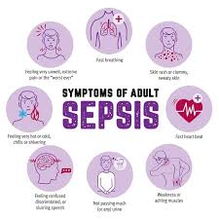
Sings and symptoms
Fever or abnormal low body temperature
Rapid breathing
Rapid heartbeats
Changes in mental status
low blood pressure
Skin discolouration
Dyspnoea
Thrombocytopenia
Chilis
Pneumonia
Urinary infection

Slide 6
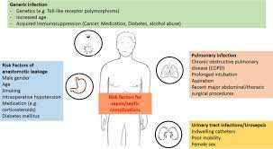
Risk factor
Older age.
Infancy.
Compromised immune system.
Diabetes.
Chronic kidney or liver disease.
Admission to intensive care unit or longer hospital stays.
Invasive devices, such as intravenous catheters or breathing tubes.
Previous use of antibiotics or corticosteroids

Slide 7
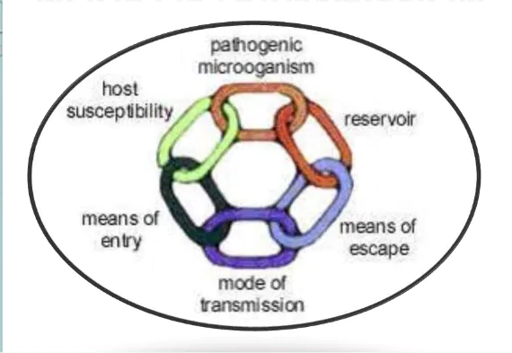
Mode of transmission
Incubation period -- develop within 24 hours of birth
Direct person to person contact
Indirect transmission through
Transmission through air

Slide 8
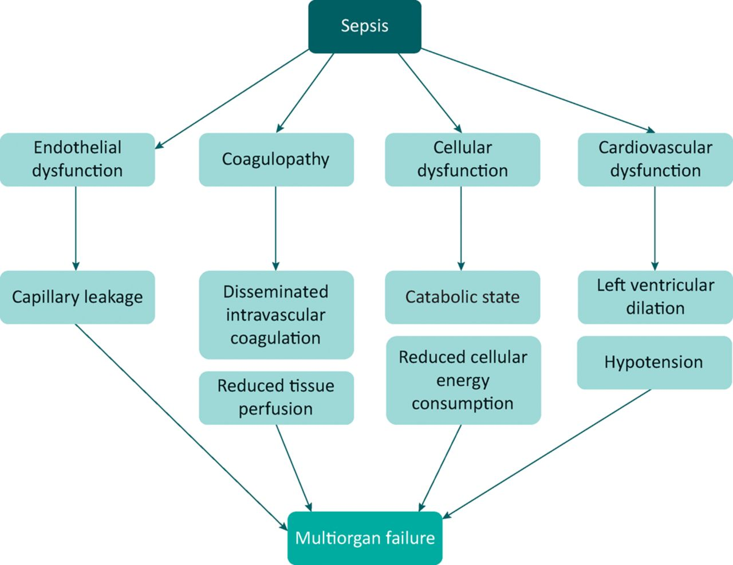
Pathophysiology

Slide 9
Management
Diagnosis
Treatment

Slide 10
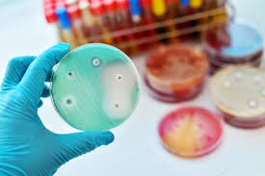
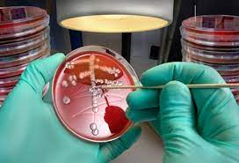
Diagnosis
Physical examination
low blood pressure
Low body temperature
Microbiological analysis
blood culture
Urine culture
Blood test
Arterial blood gas
platelet count CBC

Slide 11
Treatment
Category | Drug Name
Antibiotics | Ampicillin , penicillin's, fluoroquinolones, cephalosporins, macrolides, beta-lactams

Slide 12
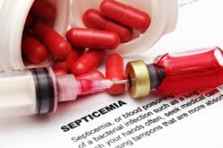
Complication
Cardiopulmonary complication
Renal complication
Coagulopathy
Neurological complications

Slide 13
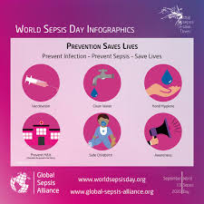
Prevention
Treating Wounds
Treating infection
Regular dental check up

Slide 14
Thank
you

