Slide 1
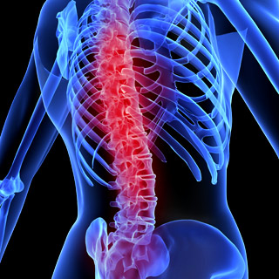
Spondylitis

Slide 2
Introduction
Definition:
Spondylitis: Inflammation of one or multiple bony vertebrae of the spine.
These diseases are forms of inflammatory arthritis that primarily affect the spine, although other joints and organ.

Slide 3
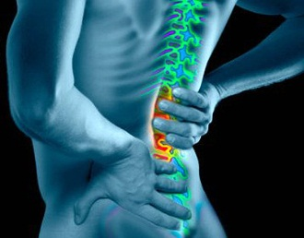
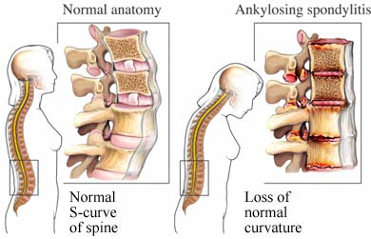
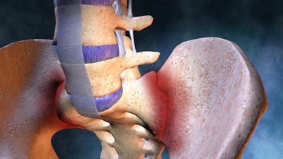
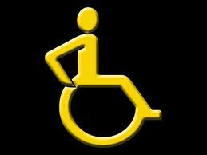
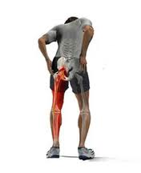
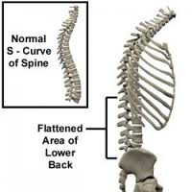
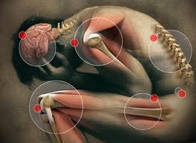
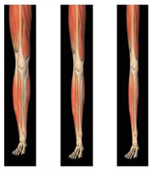
Symptoms
Back pain
Leg pain
Hip pain
Spinal deformity
Abnormal spinal curvature
Back paraesthesiae
Thigh paraesthesiae
Leg paraesthesiae
Bowel incontinence
Bladder incontinence
Sexual dysfunction
Decreased mobility
Pain on movement
Decreased leg muscle strength

Slide 4
Types of Spondylitis
Ankylosing Spondylitis
Hypertrophic spondylitis
Post-traumatic spondylitis
Traumatic spondylitis - caused by vertebral injury.
Tuberculous spondylitis - caused by spinal tuberculosis.

Slide 5
Diagnosis
Typical symptoms, family history, and the presence of HLA-B27 strongly suggest ankylosing spondylitis.
CONFIRMING DIAGNOSIS
Confirmation requires these characteristic X-ray findings:
blurring of the bony margins of joints in the early stage.
bilateral sacroiliac involvement.
patchy sclerosis with superficial bony erosions.
eventual squaring of vertebral bodies.
bamboo spine with complete ankylosis.

Slide 6
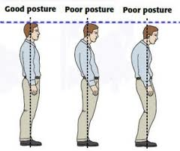
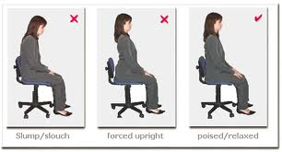
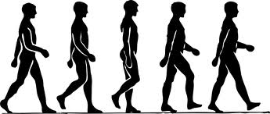
Treatment
No treatment reliably stops progression of this disease.
So management aims to further deformity .
[good posture, stretching and deep breathing exercises.]

Slide 7
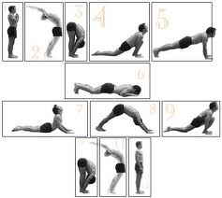
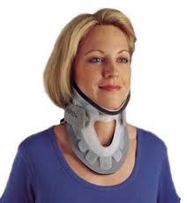

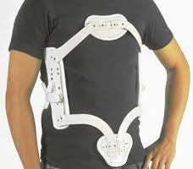
Yoga.
Surya Namaskar
(salutation to the sun)
In some patients braces and lightweight support.

Slide 8
Medication
Anti-inflammatory analgesics.
(aspirin, indomethacin, sulfasalazine, salindac)
TNF inhibitors have been shown to improve symptoms.
Corticosteroid medication/therapy.
Cytotoxic drugs that block cell growth are use to patients are not responding/dependent on high dose of corticosteroids.

Slide 9
Severe hip involvement usually necessitates surgical hip replacement.
Severe spinal involvement may require a spinal wedge osteotomy to separate and reposition the vertebrae.

Slide 10
Special Consideration
Administer medications as ordered.
Apply local heat and provide massage to relieve pain.
Assess mobility and degree of discomfort frequently.
If treatment includes surgery, provide good postoperative nursing care.

Slide 11
ADVISE TO PATIENT
avoid any physical activity that places undue stress on the back such as lifting heavy objects.
stand upright; to sit upright in a high, straight chair; and to avoid leaning over a desk
sleep in a prone position on a hard mattress and to avoid using pillows under neck or knees .
avoid prolonged walking, standing, sitting, or driving .

Slide 12
perform regular stretching and deep-breathing exercises and to swim regularly, if possible.
have height measured every 3 to 4 months to detect any tendency toward kyphosis.
seek vocational counseling if work requires standing or prolonged sitting at a desk.

Slide 13
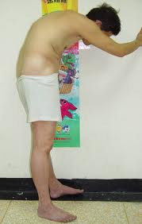
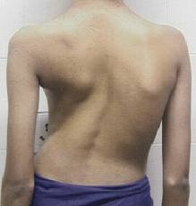
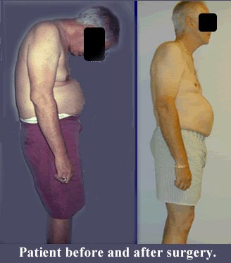

Slide 14
THANK YOU

