Slide 1
BIOSTATISTICS AND RESEARCH METHODOLOGY
Statistical methods in epidemiology
14-09-2024
1

Slide 2
Epidemiology is the study of the distribution and determinants of health-related states or events in specified populations and the translation of study results to control health problems at the group level.
The major objectives of epidemiologic studies are to describe the extent of disease in the community, to identify risk factors (factors that influence a persons risk of acquiring a disease), to determine etiology, to evaluate both existing and new preventive and therapeutic measures (including health care delivery), and to provide the foundation for developing public policy and regulatory decisions regarding public health practice.
Epidemiologic studies provide research strategies for investigating public health questions in a systematic fashion relating a given health outcome to the factors that might cause and/or prevent this outcome in human populations
Disease frequency is measured through estimating incidence rates or disease risk. Several measures are used for assessing exposure–disease association, with adjusted estimates based on standardization, stratification, or more flexible regression techniques. Several measures are available to assess an exposure impact in terms of disease occurrence at the population level, including the commonly used attributable risk (AR). Adjusted AR estimation relies on stratification or regression techniques. Sequential and partial ARs have been proposed to handle the situation of multiple exposures and circumvent the associated non-additivity problem.
A major aim of epidemiologic research is to measure disease occurrence in relation to various characteristics such as exposure to environmental, occupational, or lifestyle risk factors, genetic traits or other features. The generic term exposure will be used throughout this chapter to denote these characteristics.
14-09-2024
2

Slide 3
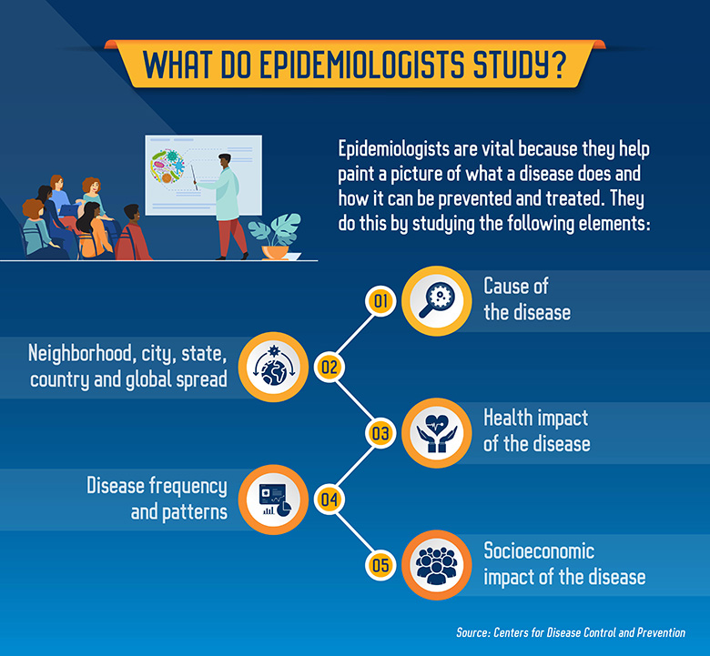
These include measures that quantify disease occurrence, associations between disease occurrence and exposures as well as their consequences in terms of disease risk .
Emphasis will be placed on measures based on occurrence of new disease cases, referred to as disease incidence. Measures based on disease prevalence, i.e., considering previously existing disease cases as well as new cases, will be mentioned only in passing.
14-09-2024
© R R INSTITUTIONS , BANGALORE
3

Slide 4
Epidemiological Markers
Epidemiological markers are biological markers that are used to characterize microorganisms or discriminate between genomes based on the genetic variation among microbial isolates.
Uses of Epidemiological Markers
Epidemiological markers are mostly used for strain typing. It is used to:
Classify isolates of microorganisms
Catalogue genetic variation
Define relatedness or lack of it between microbial species or genera
It can be applied in infection control to:
Confirm an outbreak in an institution
Identify an outbreak in what appears to be sporadic cases of infection
Identify risk factors for recent infections or rapidly progressing disease
Design intervention in the spread of disease
Assess the efficacy of the intervention
Define mode of spread of pathogenic organisms e.g. MRSA, VRE, and ESBL producing organisms
Track geographical spread of pathogens of public health importance.
It is usually performed to clarify whether two isolates from different sources represent the same strains or distinct ones in order to provide data for epidemiological purposes.
14-09-2024
4

Slide 5
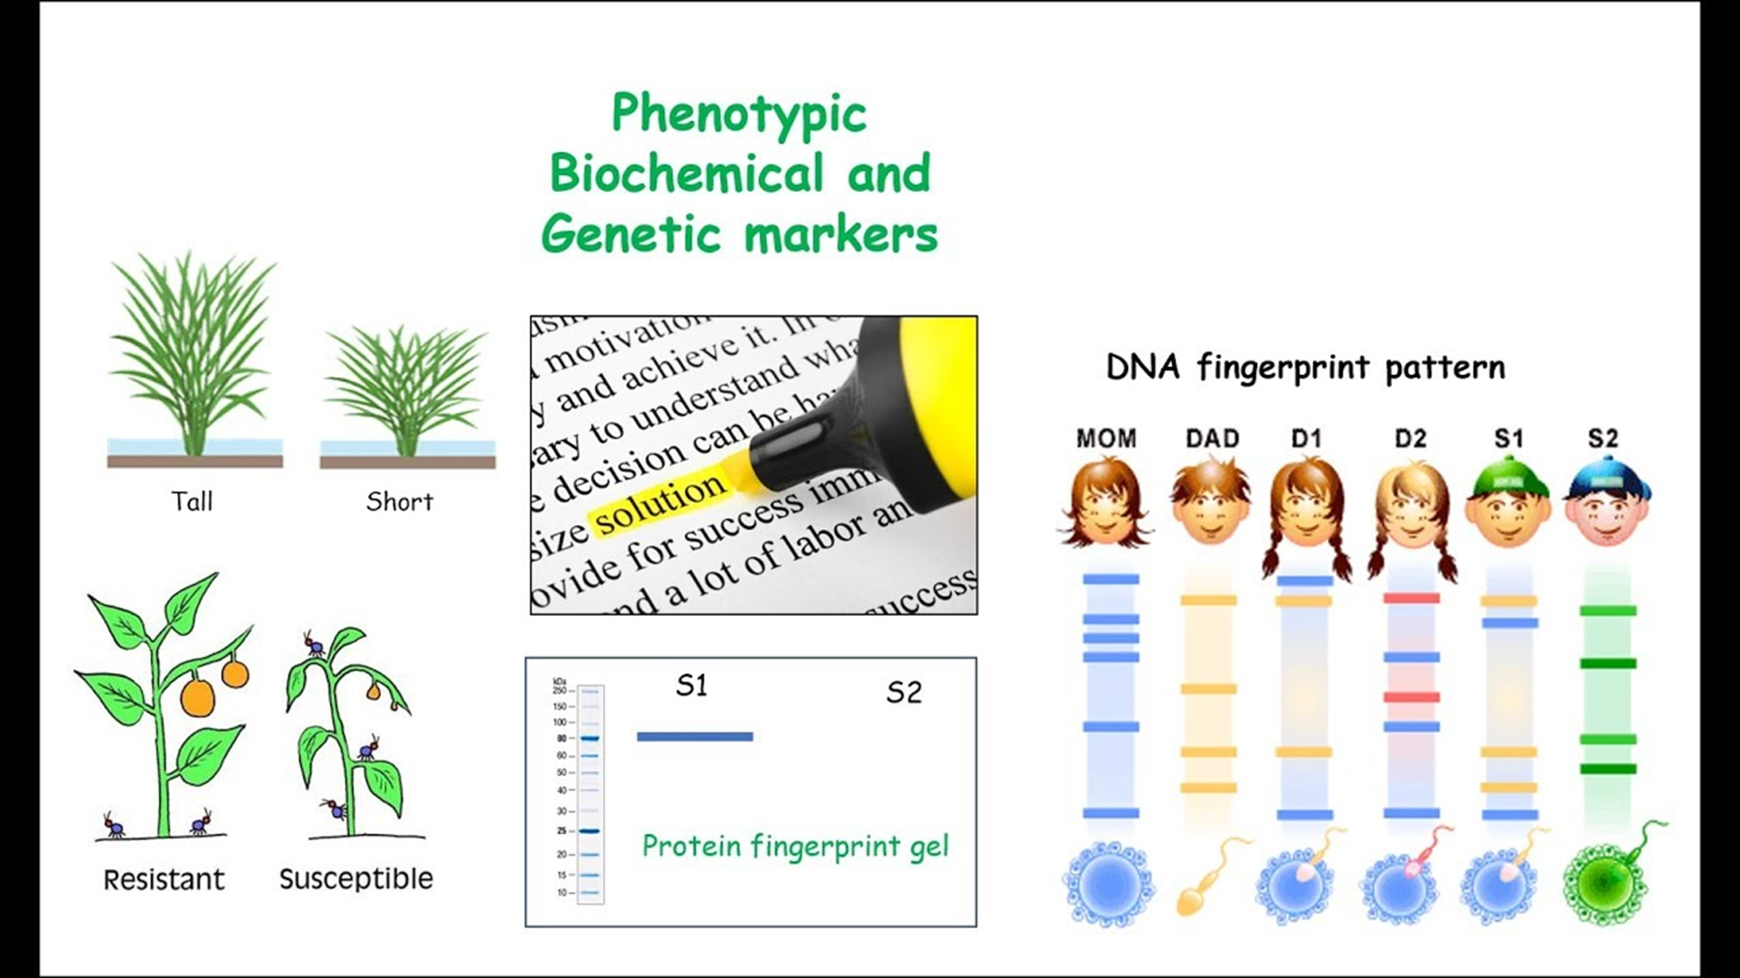
Features of Epidemiological Markers :- epidemiological markers should be:
Generally stable to discriminate between related and unrelated strains
Widely available
Easy to detect
Common among strains
14-09-2024
5

Slide 6
TYPES OF TYPING MARKERS :
Phenotypic Markers
Genotypic Markers
Phenotypic markers and Phenotypic methods
The phenotype of an organism is the composite of the organism’s observable characteristics or traits, including its morphology or physical form and structure; its developmental processes; its biochemical and physiological properties; its behavior, and the products of behavior.
The markers that are used to characterize such features of an organism are termed as phenotypic markers.
Biotyping
Antimicrobial susceptibility testing (antibiogram)
Serotyping
Bacteriophage typing
Multilocus enzyme electrophoresis
Polyacrylamide gel electrophoresis of cellular proteins
Immunoblot fingerprinting
14-09-2024
6

Slide 7
Disadvantages of Phenotypic Markers
Poor discrimination between strains
Labor intensive, long procedures
Produce variable results, some not available for all microorganism.
B. Genetic markers and Genetic (DNA based) methods (Genotyppic)
Genetic markers are variants in the DNA sequence that can be typed directly.
It is a gene or DNA sequence with a known location on a chromosome that can be used to identify individuals or species.
Markers are transmitted from parent to offspring clearly following regular Mendelian patterns, and the chromosomal locations of genetic markers are generally known.
The ultimate purpose of mapping studies is to identify genes associated with susceptibility to disease to enhance our understanding of disease pathogenesis and to facilitate the development of appropriate preventive strategies.
It is a gene or DNA sequence with a known location on a chromosome that can be used to identify individuals or species.
Markers are transmitted from parent to offspring clearly following regular Mendelian patterns, and the chromosomal locations of genetic markers are generally known.
The ultimate purpose of mapping studies is to identify genes associated with susceptibility to disease to enhance our understanding of disease pathogenesis and to facilitate the development of appropriate preventive strategies.
Plasmid fingerprinting.
14-09-2024
7

Slide 8
Restriction endonuclease analysis of chromosomal
DNA with conventional electrophoresis
Ribotyping
Pulsed-field gel electrophoresis (PFGE)
Amplification methods- PCR
Multilocus sequence typing
Genome sequencing– a most reliable method.
Advantages
Stable, avoid problems associated with gene expression.
Widely applicable to a range of microorganisms.
Disadvantage
Expensive startup cost.
Labor intensive.
14-09-2024
8

Slide 9
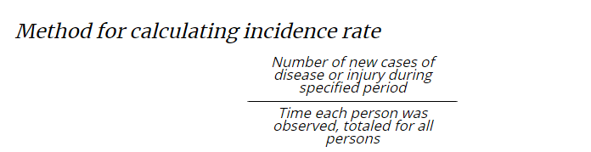
1. Incidence rate or person-time rate
Definition of incidence rate :- Incidence rate or person-time rate is a measure of incidence that incorporates time directly into the denominator.
A person-time rate is generally calculated from a long-term cohort follow-up study, wherein enrollees are followed over time and the occurrence of new cases of disease is documented.
Typically, each person is observed from an established starting time until one of four “end points” is reached: onset of disease, death, migration out of the study (“lost to follow-up”), or the end of the study. Similar to the incidence proportion, the numerator of the incidence rate is the number of new cases identified during the period of observation.
Thus, the incidence rate is the ratio of the number of cases to the total time the population is at risk of disease.
14-09-2024
9

Slide 10
Properties and uses of incidence rates
An incidence rate describes how quickly disease occurs in a population. It is based on person-time, so it has some advantages over an incidence proportion.
Because person-time is calculated for each subject, it can accommodate persons coming into and leaving the study. As noted in the previous example, the denominator accounts for study participants who are lost to follow-up or who die during the study period. In addition, it allows enrollees to enter the study at different times.
Person-time has one important drawback. Person-time assumes that the probability of disease during the study period is constant, so that 10 persons followed for one year equals one person followed for 10 years. Because the risk of many chronic diseases increases with age, this assumption is often not valid.
Long-term cohort studies of the type described here are not very common. However, epidemiologists far more commonly calculate incidence rates based on a numerator of cases observed or reported, and a denominator based on the mid-year population. This type of incident rate turns out to be comparable to a person-time rate
14-09-2024
10

Slide 11
EXAMPLES: Calculating Incidence Rates
Example A: Investigators enrolled 2,100 women in a study and followed them annually for four years to determine the incidence rate of heart disease. After one year, none had a new diagnosis of heart disease, but 100 had been lost to follow-up. After two years, one had a new diagnosis of heart disease, and another 99 had been lost to follow-up. After three years, another seven had new diagnoses of heart disease, and 793 had been lost to follow-up. After four years, another 8 had new diagnoses with heart disease, and 392 more had been lost to follow-up.
The study results could also be described as follows: No heart disease was diagnosed at the first year. Heart disease was diagnosed in one woman at the second year, in seven women at the third year, and in eight women at the fourth year of follow-up. One hundred women were lost to follow-up by the first year, another 99 were lost to follow-up after two years, another 793 were lost to follow-up after three years, and another 392 women were lost to follow-up after 4 years, leaving 700 women who were followed for four years and remained disease free.
Calculate the incidence rate of heart disease among this cohort. Assume that persons with new diagnoses of heart disease and those lost to follow-up were disease-free for half the year, and thus contribute ½ year to the denominator.
14-09-2024
11

Slide 12
Denominator = person-years of observation
= (1 × 1.5) + (7 × 2.5) + (8 × 3.5) + (100 × 0.5) + (99 × 1.5) + (793 × 2.5) +
(392 × 3.5) + (700 × 4)
= 6,400 person-years of follow-up
Person-time rate =Number of new cases of disease or injury during specified period divided byTime each person was observed, totaled for all persons
= 16 ⁄ 6,400
= .0025 cases per person-year
= 2.5 cases per 1,000 person-years
In contrast, the incidence proportion can be calculated as 16 ⁄ 2,100 = 7.6 cases per 1,000 population during the four-year period, or an average of 1.9 cases per 1,000 per year (7.6 divided by 4 years). The incidence proportion underestimates the true rate because it ignores persons lost to follow-up, and assumes that they remained disease-free for all four years.
14-09-2024
12

Slide 13
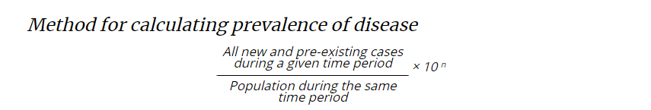
2. Prevalence
Prevalence, sometimes referred to as prevalence rate, is the proportion of persons in a population who have a particular disease or attribute at a specified point in time or over a specified period of time. Prevalence differs from incidence in that prevalence includes all cases, both new and preexisting, in the population at the specified time, whereas incidence is limited to new cases only.
Point prevalence refers to the prevalence measured at a particular point in time. It is the proportion of persons with a particular disease or attribute on a particular date.
Period prevalence refers to prevalence measured over an interval of time. It is the proportion of persons with a particular disease or attribute at any time during the interval.
14-09-2024
13

Slide 14
Properties and uses of prevalence
Prevalence and incidence are frequently confused. Prevalence refers to proportion of persons who have a condition at or during a particular time period, whereas incidence refers to the proportion or rate of persons who develop a condition during a particular time period. So prevalence and incidence are similar, but prevalence includes new and pre-existing cases whereas incidence includes new cases only. The key difference is in their numerators.
Numerator of incidence = new cases that occurred during a given time period
Numerator of prevalence = all cases present during a given time period.
The numerator of an incidence proportion or rate consists only of persons whose illness began during the specified interval. The numerator for prevalence includes all persons ill from a specified cause during the specified interval regardless of when the illness began. It includes not only new cases, but also preexisting cases representing persons who remained ill during some portion of the specified interval.
Prevalence is based on both incidence and duration of illness. High prevalence of a disease within a population might reflect high incidence or prolonged survival without cure or both. Conversely, low prevalence might indicate low incidence, a rapidly fatal process, or rapid recovery.
Prevalence rather than incidence is often measured for chronic diseases such as diabetes or osteoarthritis which have long duration and dates of onset that are difficult to pinpoint.
14-09-2024
14

Slide 15
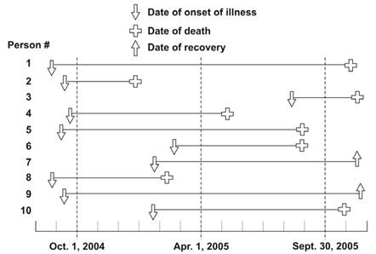
EXAMPLES: Incidence versus Prevalence
Figure 3.1 represents 10 new cases of illness over about 15 months in a population of 20 persons. Each horizontal line represents one person. The down arrow indicates the date of onset of illness. The solid line represents the duration of illness. The up arrow and the cross represent the date of recovery and date of death, respectively.
14-09-2024
15

Slide 16
Example A: Calculate the incidence rate from October 1, 2004, to September 30, 2005, using the midpoint population (population alive on April 1, 2005) as the denominator. Express the rate per 100 population.
Incidence rate numerator = number of new cases between October 1 and September 30
= 4 (the other 6 all had onsets before October 1, and are not included)
Incidence rate denominator = April 1 population
= 18 (persons 2 and 8 died before April 1)
Incidence rate = (4 ⁄ 18) × 100
= 22 new cases per 100 population
Example B: Calculate the point prevalence on April 1, 2005. Point prevalence is the number of persons ill on the date divided by the population on that date. On April 1, seven persons (persons 1, 4, 5, 7, 9, and 10) were ill.
Point prevalence = (7 ⁄ 18) × 100
= 38.89%
Example C: Calculate the period prevalence from October 1, 2004, to September 30, 2005. The numerator of period prevalence includes anyone who was ill any time during the period. In Figure 3.1, the first 10 persons were all ill at some time during the period.
Period prevalence = (10 ⁄ 20) × 100
= 50.0%
14-09-2024
16

Slide 17
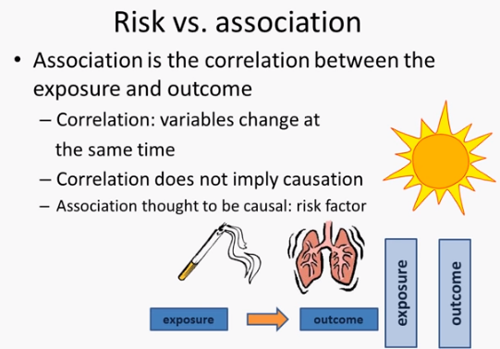

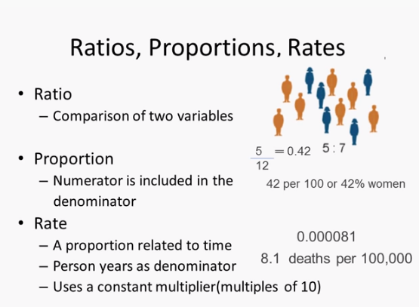
14-09-2024
© R R INSTITUTIONS , BANGALORE
17

Slide 18
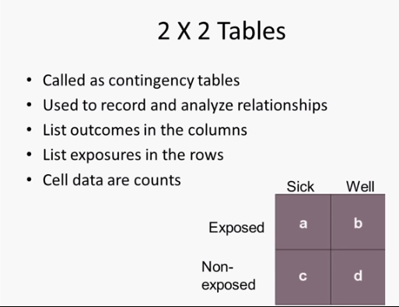
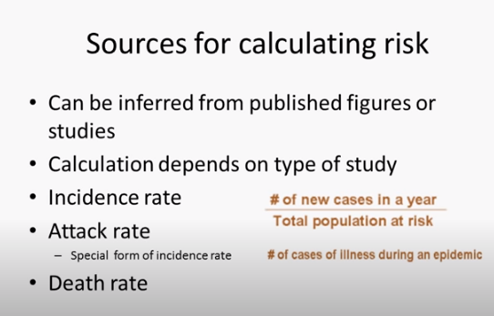
14-09-2024
18

Slide 19
3. Relative Risk - Risk ratio
A risk ratio (RR), also called relative risk, compares the risk of a health event (disease, injury, risk factor, or death) among one group with the risk among another group. It does so by dividing the risk (incidence proportion, attack rate) in group 1 by the risk (incidence proportion, attack rate) in group 2. The two groups are typically differentiated by such demographic factors as sex (e.g., males versus females) or by exposure to a suspected risk factor (e.g., did or did not eat potato salad). Often, the group of primary interest is labeled the exposed group, and the comparison group is labeled the unexposed group.
Method for Calculating risk ratio
The formula for risk ratio (RR) is:
Risk of disease (incidence proportion, attack rate) in group of primary interest
Risk of disease (incidence proportion, attack rate) in comparison group
A risk ratio of 1.0 indicates identical risk among the two groups. A risk ratio greater than 1.0 indicates an increased risk for the group in the numerator, usually the exposed group. A risk ratio less than 1.0 indicates a decreased risk for the exposed group, indicating that perhaps exposure actually protects against disease occurrence.
14-09-2024
19

Slide 20
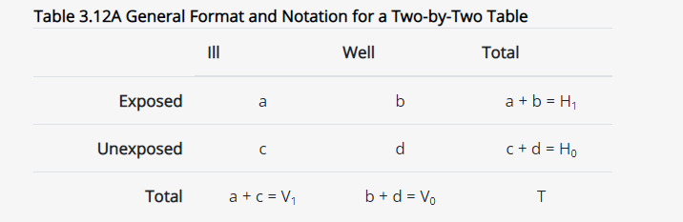
In this example, the exposure is the dormitory wing and the outcome is tuberculosis) illustrated in Table Calculate the risk ratio.
Table --- Incidence of Mycobacterium Tuberculosis Infection Among Congregated, HIV-Infected Prison Inmates by Dormitory Wing — South Carolina, 1999
 | Developed tuberculosis?
 | Yes | No | Total
Total | 32 | 262 | T = 294
East wing | a = 28 | b = 129 | H₁ = 157
West wing | c = 4 | d = 133 | H₀ = 137
14-09-2024
20

Slide 21
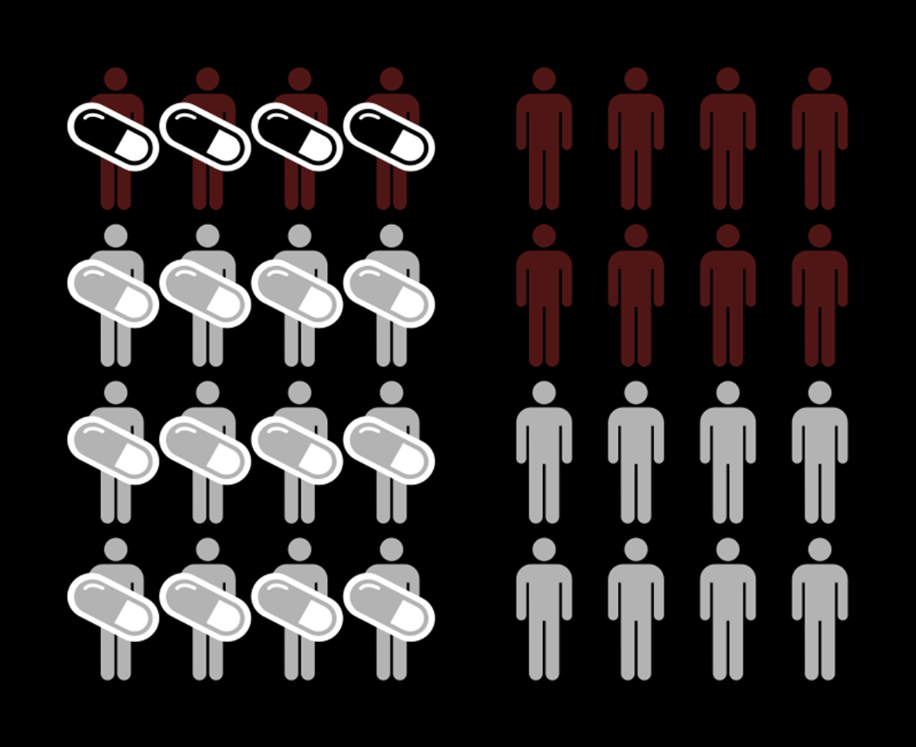

Slide 22
To calculate the risk ratio, first calculate the risk or attack rate for each group. Here are the formulas:
Attack Rate (Risk)
Attack rate for exposed = a ⁄ a+b
Attack rate for unexposed = c ⁄ c+d
For this example:
Risk of tuberculosis among East wing residents = 28 ⁄ 157 = 0.178 = 17.8%
Risk of tuberculosis among West wing residents = 4 ⁄ 137 = 0.029 = 2.9%
The risk ratio is simply the ratio of these two risks:
Risk ratio = 17.8 ⁄ 2.9 = 6.1
Thus, inmates who resided in the East wing of the dormitory were 6.1 times as likely to develop tuberculosis as those who resided in the West wing.
14-09-2024
22

Slide 23
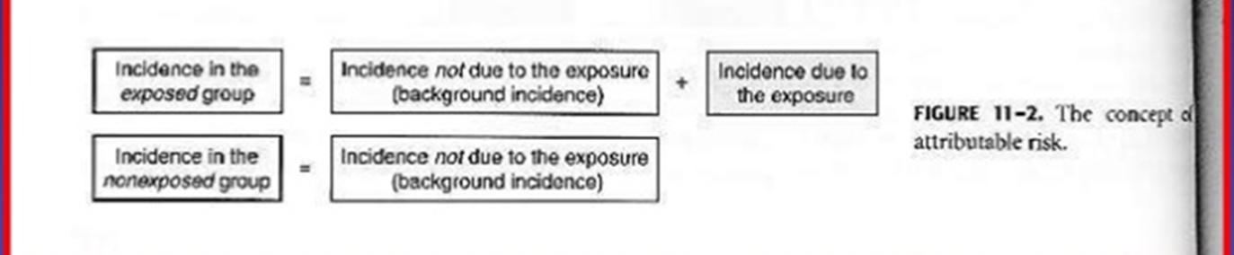
Attributable Risk(AR) (sometimes called Attributable Proportion or Attributable Fraction) is a measure of the prevalence of a condition or disease. Given a group of people exposed to a risk, it’s the fraction who develop a disease or condition. Put another way, AR is the cases that would be eliminated if the exposure were also eliminated.
Often, attributable risk is given as a percentage (called the attributable risk percent or AR%). For example, lung cancer has many causes, including smoking cigarettes and exposure to indoor radon. One study showed that the AR% for cigarette smoking and lung cancer was 85%. That means 85% of lung cancers are caused by cigarette smoking. Another study showed that the AR% for radon gas exposure and lung cancer is between 3% and 20%, depending on factors like sex and smoking status.
14-09-2024
23

Slide 24
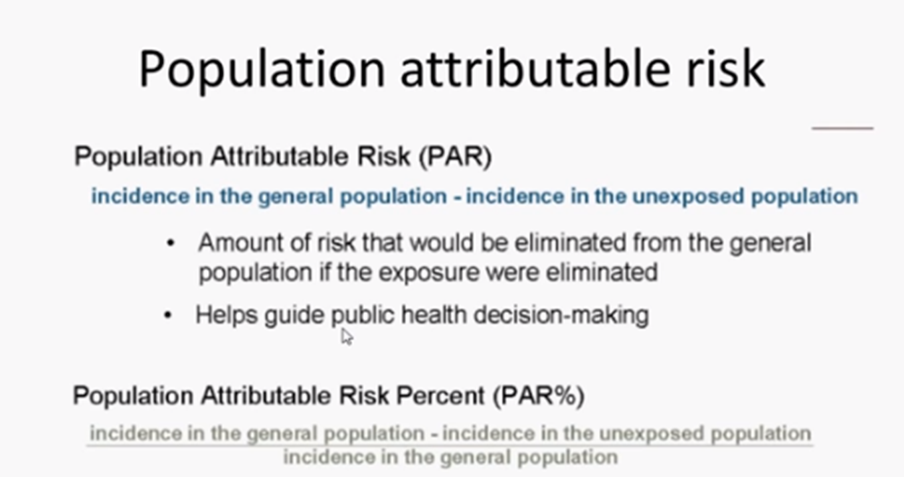
14-09-2024
24

Slide 25
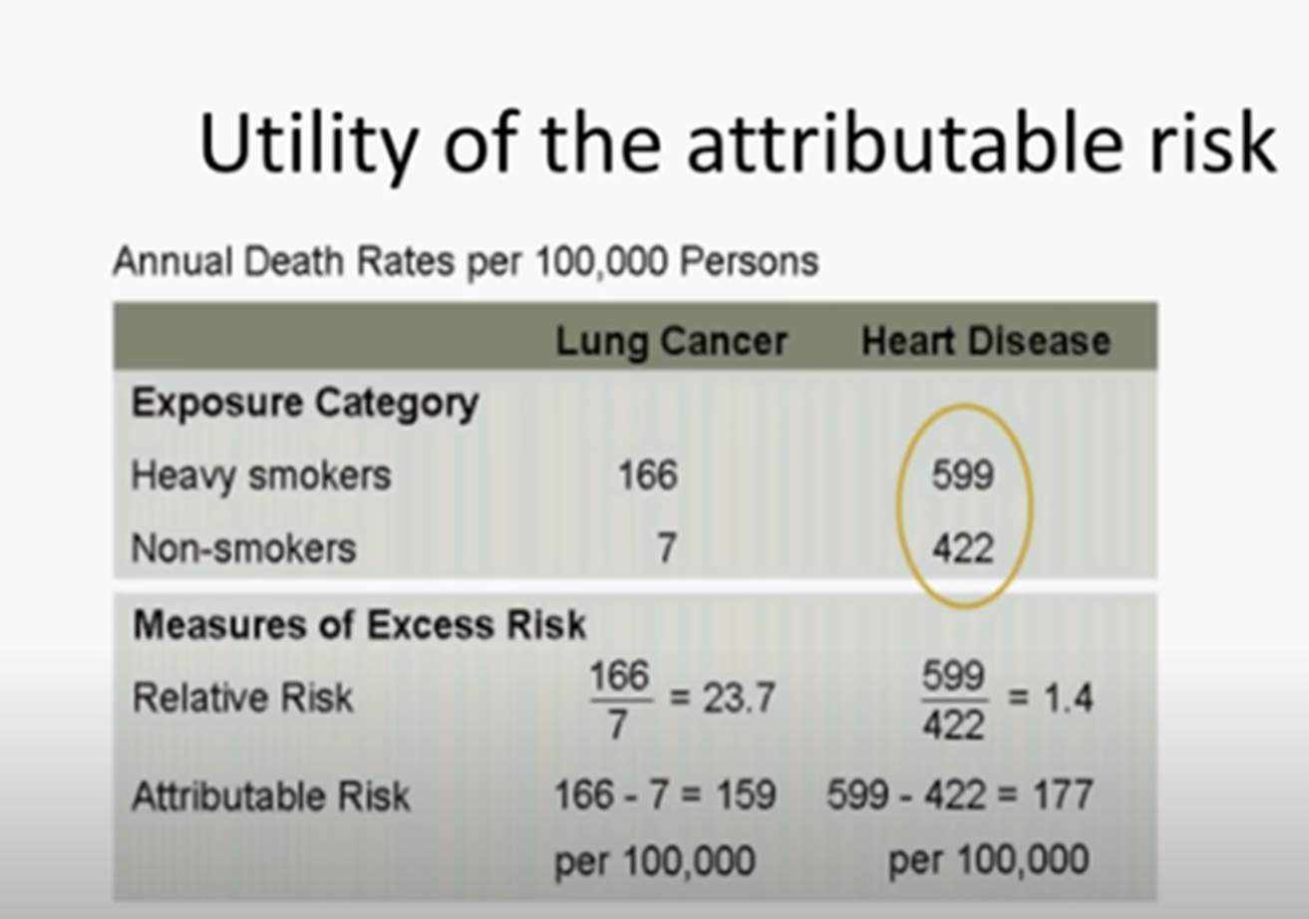
Attributable risk (AR) = R exposed – R unexposed
% AR = R exposed – R unexposed X 100
R exposed
14-09-2024
© R R INSTITUTIONS , BANGALORE
25

Slide 26
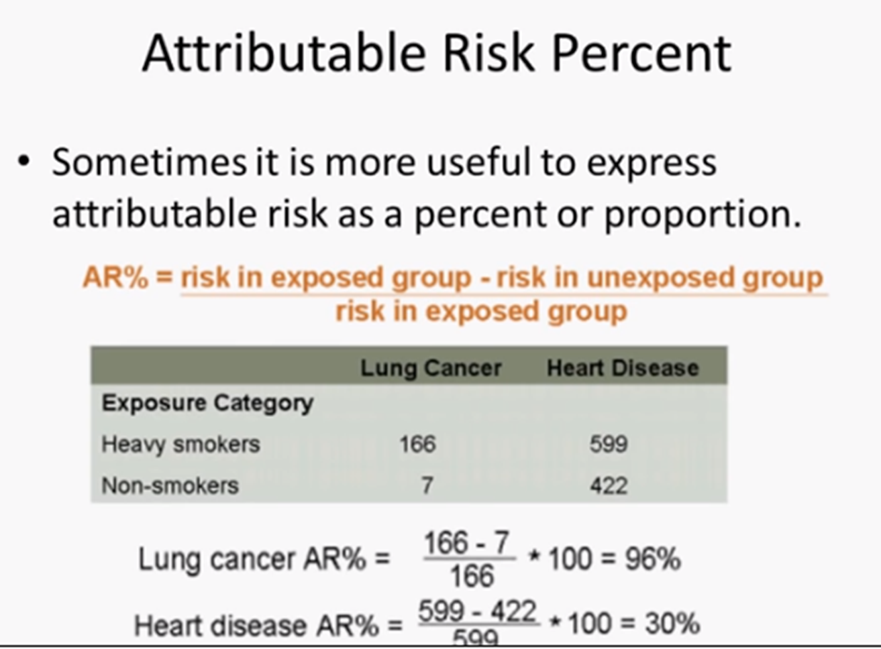
14-09-2024
26

Slide 27
In a Study of Smoking and Lung cancer, The lung cancer mortality rate among non smokers was 0.07 per 1000 persons per year. The lung cancer Mortality rate who smoked 1.14 cigarettes per day was 0.57 per 1000 persons per year
Calculate the Attributable proportion
% AR = 0.57-0.07 X 100 = 87.7 %
0.57
About 88 % of the lung cancer among the smokers of 1.14 cigarettes per day might be attributable to their smoking.
14-09-2024
27

