Slide 1

Stroke

Slide 2
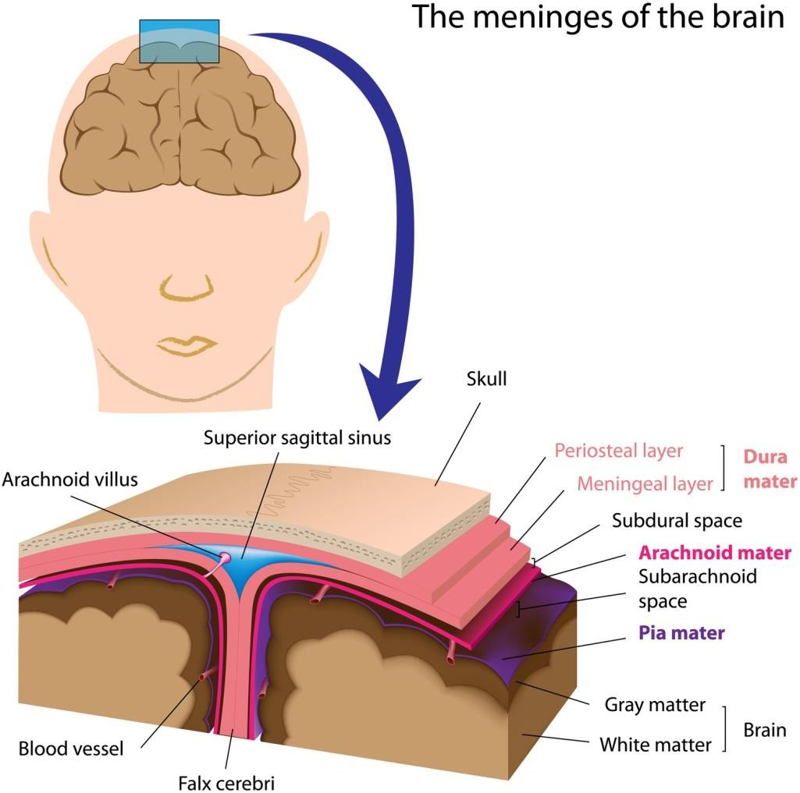

Slide 3
Stroke is defined as sudden onset of a focal neurologic
deficit from a vascular mechanism
Strokes are broadly classified as either hemorrhagic or ischemic
  85% of strokes are ischemic
  15% are primary hemorrhages
    Subarachnoid hemorrhage
    Intra parenchymal/cerebral hemorrhage

Slide 4
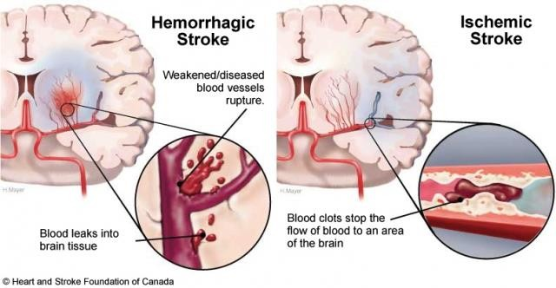
Ischemic & hemorrhagic Stroke

Slide 5
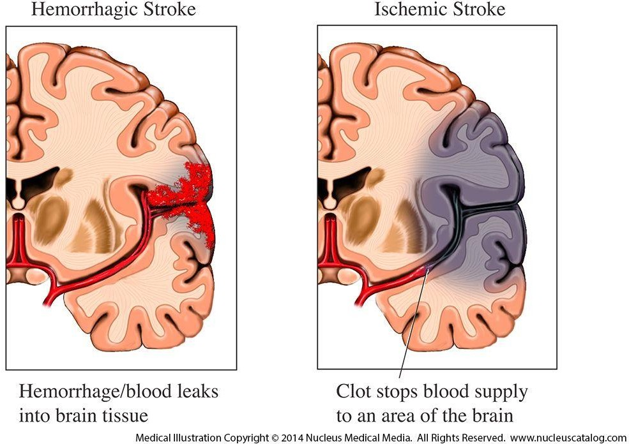

Slide 6
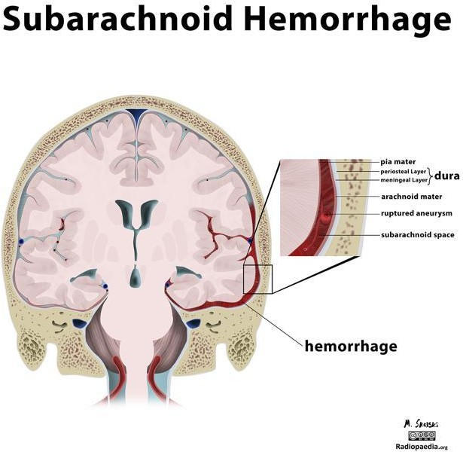

Slide 7
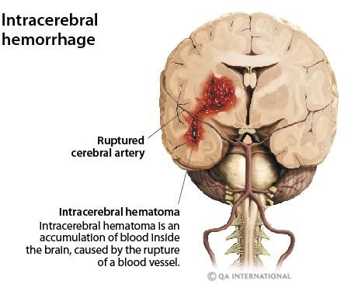

Slide 8
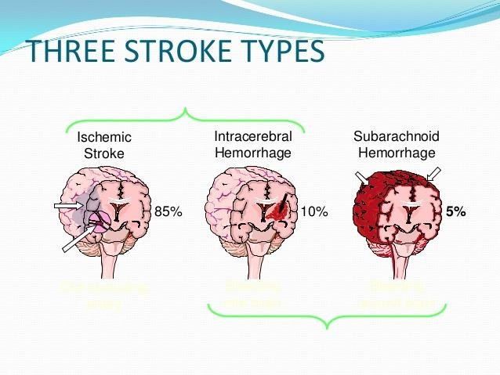

Slide 9
Strokes are the leading cause of serious long-term
disability and the second leading cause of death world wide
Men are at higher risk for stroke than women;

Slide 10
Ischemic Stroke
Ischemic strokes are caused either by local thrombus formation or by embolic phenomenon, resulting in occlusion of a cerebral artery
Atherosclerosis, particularly of the cerebral vasculature, is
important cause, although 30% are cryptogenic
Emboli can arise either from intra- or extracranial arteries

Slide 11
Cardiogenic embolism is presumed to have occurred if the
patient has concomitant
Atrial fibrillation,
Valvular heart disease, or
Any other condition of the heart that can lead to clot formation

Slide 12
Risk factors
Non-modifiable risk factors or risk markers
  Age - Although stroke often is considered a disease of elderly 1/3rd of strokes occur in persons < 65 years
  Gender - Men are at higher risk
  Race - African Americans, Asian-Pacific Islanders, and
Hispanics experience higher death rates
  Family history of stroke

Slide 13
Modifiable, well-documented
  Hypertension—single most important risk factor for ischemic stroke
  Atrial fibrillation—most important and treatable cardiac cause of stroke
  Diabetes—independent risk factor
  Dyslipidemia

Slide 14
Cigarette smoking & Alcohol abuse
Sickle cell disease
Asymptomatic carotid stenosis
Postmenopausal hormone therapy
Lifestyle factors—associated with stroke risk →
Obesity, physical inactivity, diet

Slide 15
Potentially modifiable, less-well documented
  Oral contraceptives
  Migraine
  Drug abuse (coccaine)
  Hemostatic and inflammatory factors—fibrinogen linked to increased risk
  Homocysteine

Slide 16
Signs and Symptoms
The patient may complain of weakness on one side of the
body, inability to speak, loss of vision, vertigo, or falling

Slide 17
Pathogenesis
On the macroscopic level, ischemic stroke most often is caused by extracranial embolism or intracranial thrombosis, but it may also be caused by decreased cerebral blood flow
On the cellular level, any process that disrupts blood flow to a
portion of the brain initiates an
Ischemic cascade → death of neurons → cerebral infarction

Slide 18
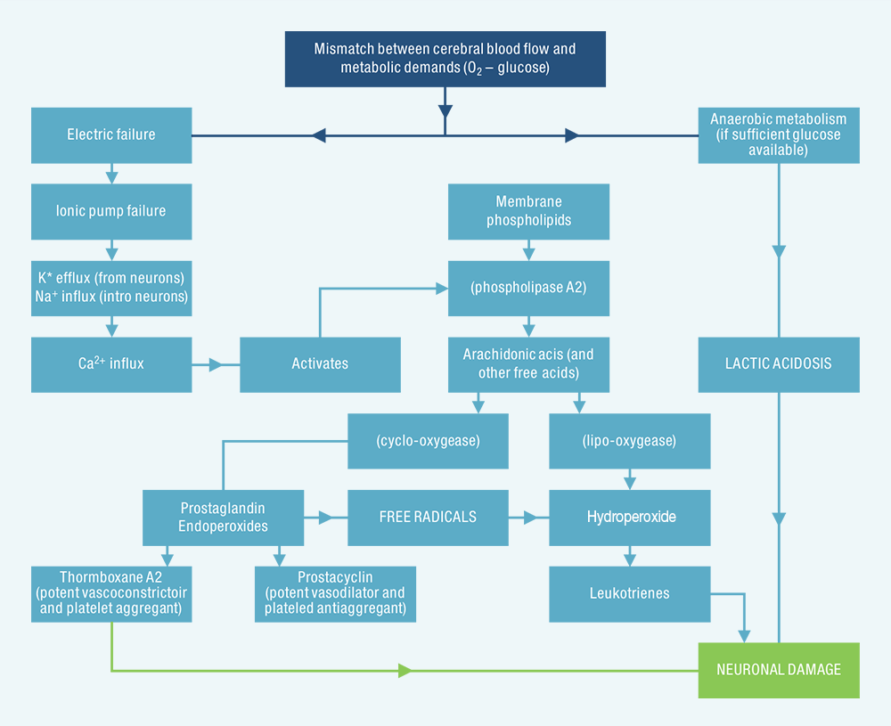

Slide 19
Normal cerebral blood flow averages 50 mL/100g/min and
is maintained by a process called cerebral autoregulation
Cerebral blood vessels dilate and constrict in response to changes in blood pressure, but this process can be impaired by atherosclerosis and acute injury, such as stroke

Slide 20
When local cerebral blood flow decreases below 20
mL/100g/min, ischemia ensues,
further reductions below 12 mL/100g/min persist →
infarction
Tissue that is ischemic but maintains membrane integrity is referred to as the ischemic penumbra - potentially salvageable through therapeutic intervention

Slide 21
Ischemic cascade
Reduction in blood flow → ischemia → reduction in nutrients to the ischemic cell → depletion of the high-energy phosphates (ATP) necessary for the maintenance of membrane integrity
Subsequently, extracellular K⁺ accumulates; at the same time that Na⁺ and water are sequestered intracellularly → cell swelling and eventual lysis
Electrolyte imbalance → depolarization of the cell and influx of calcium into the cell

Slide 22
The depolarization of the neuron → excess release of excitatory
amino acids, such as glutamate and aspartate → neuronal damage
Increased intracellular calcium → activation of lipases, proteases, and endonucleases and the release of FFA from membrane phospholipids
The accumulation of FFA, including arachidonic acid, results in the formation of PGs, LTs, and free radicals
•

Slide 23
In ischemia, the magnitude of free-radical production
overwhelms normal scavenging systems → reactive molecules
→ attack cell membranes and contribute to the mounting intracellular acidosis
All these events occur within 2 to 3 hours of the onset of ischemia and contribute to the ultimate cell death
Later processes include influx of activated inflammatory cells, starting from 2 hours after the onset of ischemia and lasting for several days
Also, the initiation of apoptosis, is thought to occur many hours after the acute insult and can interfere with recovery and repair of brain tissue

Slide 24

Hemorrhagic Stroke
It is the third leading cause of death and the first leading
cause of disability
Morbidity is more severe and mortality rates are higher for hemorrhagic stroke than for ischemic stroke;
Approx 50% of all deaths occur within the first 48 hours

Slide 25
Types
– ICH – 85%
– SAH – 15%

Slide 26
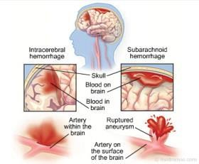

Slide 27
Causes
Hypertension (up to 60% of cases)
•
Advanced age (risk factor)
•
Cerebral amyloidosis (in elderly up to 10%)
Coagulopathies
Anticoagulant therapy
Thrombolytic therapy for acute MI and acute ischemic stroke (can cause iatrogenic hemorrhagic stroke)

Slide 28
Abuse of cocaine and other sympathomimetic drugs
•
Arteriovenous malformation
Intracranial aneurysm
Vasculitis
Intracranial neoplasm
History of prior stroke (risk factor)

Slide 29
Pathophysiology
In HS, bleeding occurs directly into the brain parenchyma
Presence of blood in the brain parenchyma causes damage to the surrounding tissue through the mechanical effect it produces and the neurotoxicity of the blood components and their degradation products
Because of the mass effect, increase in intra-cranial pressure
results

Slide 30
Hemorrhage volumes >60 mL are associated with 71% to
93% mortality at 30 days
Much of the early mortality of hemorrhagic stroke (up to 50% at 30 days) is caused by the abrupt increase in intracranial pressure that can lead to herniation and death
Early and late edema contributes to worsened outcome after
intra-cerebral hemorrhage

Slide 31
Signs and Symptoms
Vary depending on the area of the brain affected and the
extent of the bleeding
More likely to exhibit symptoms of increased intracranial pressure
  Headache, often severe and sudden onset
  Nausea and/or vomiting
Seizures are more common in hemorrhagic stroke

Slide 32
Focal neurologic deficits
  The type of deficit depends upon the area of brain involved
  If dominant hemisphere is involved → right hemiparesis, right hemisensory loss, left gaze preference, right visual field cut, and aphasia may result; and vice versa
  If the cerebellum is involved, the patient is at high risk of herniation and brainstem compression
  Other signs of cerebellar or brainstem involvement include the following:
    Gait or limb ataxia
    Vertigo or tinnitus
    Nausea and vomiting

Slide 33
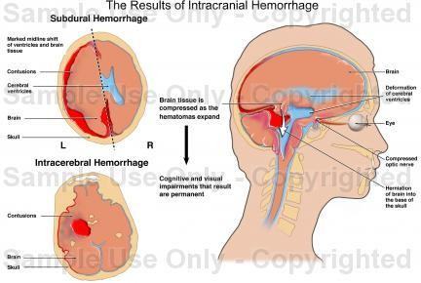

Slide 34
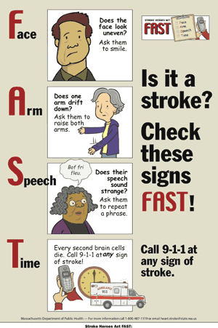

Slide 35
