Slide 1




Slide 2
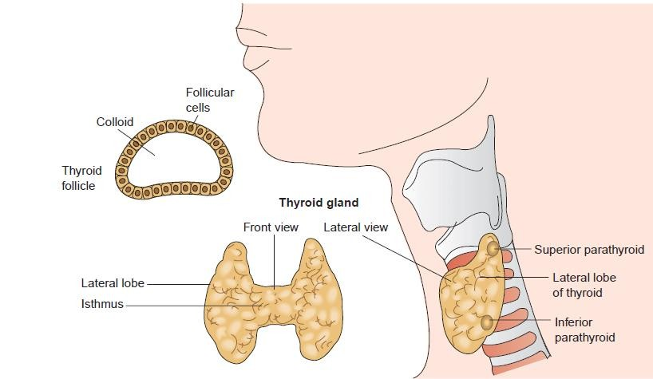

Slide 3
Thyroid disease: Under active or overactive of thyroid gland
*Hypothyroidism
*Hyperthyroidism

Slide 4
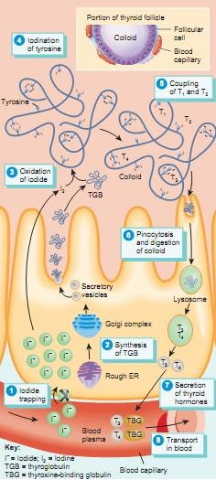
Physiology of thyroid hormone
Iodide trapping
Oxidation of iodide
Synthesis of thyroglobulin
Iodination of tyrosine.
Coupling of T 1 and T 2
Pinocytosis and digestion of colloid
Secretion of thyroid hormones.
transport in the blood

Slide 5
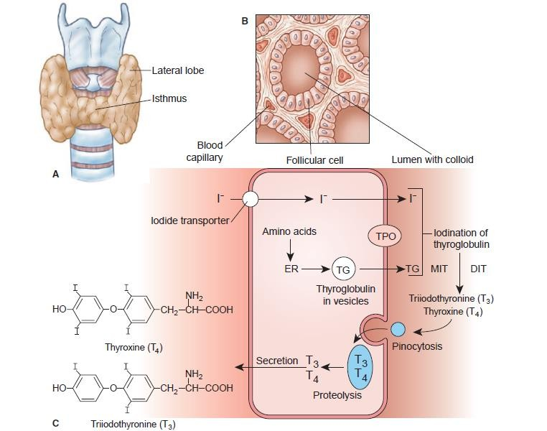

Slide 6
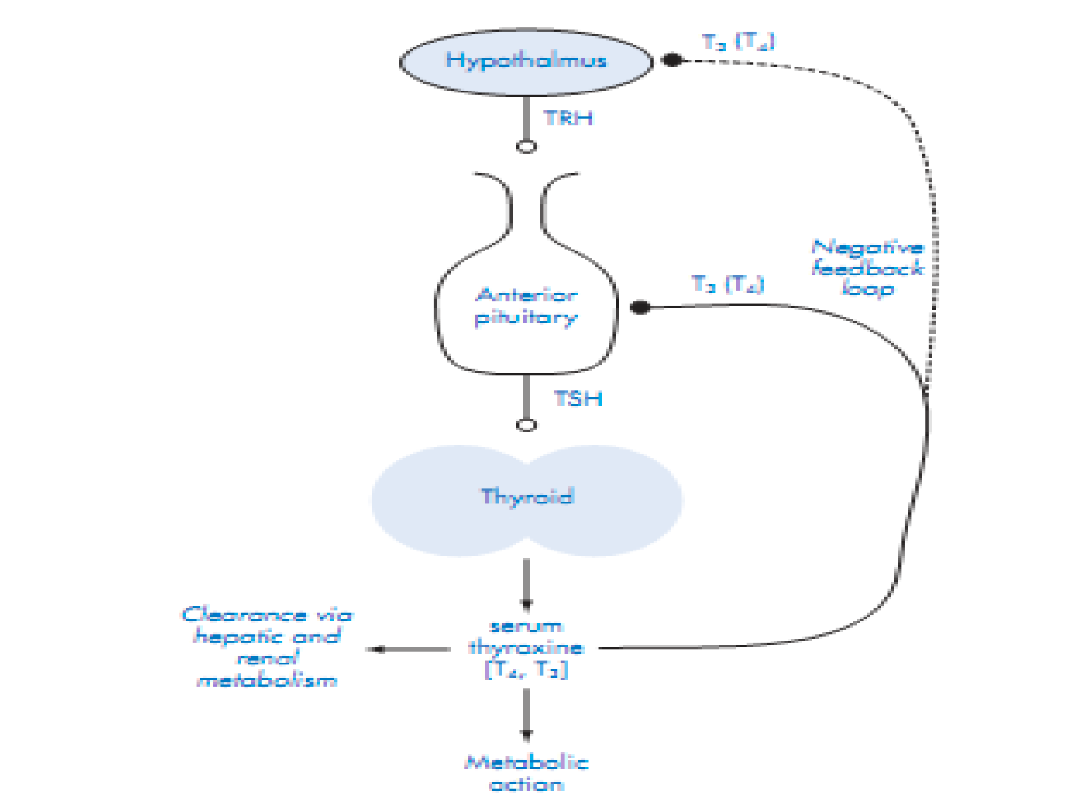

Slide 7
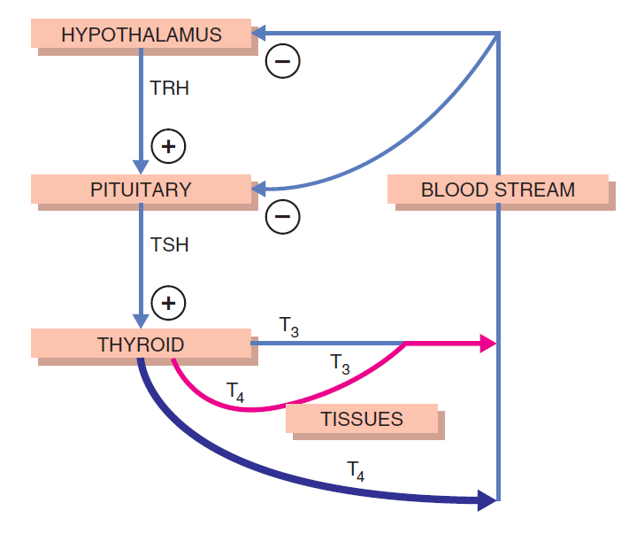

Slide 8
Actions of thyroid hormone
Metabolism and growth
Cardiovascular
CNS
Reproductive system
Body temperature

Slide 9
Hypothyroidism

Slide 10
*Hypothyroidism is defined as the clinical and biochemical syndrome resulting from decreased thyroid hormone production.
Definition
Epidemiology
*Hypothyroidism occurs in 1.5% to 2% of women and 0.2% of men, and its incidence increases with age

Slide 11


*
*Hypothyroidism has several causes, including
*Hashimoto’s disease (Autoimmune thyroid disease )
*Thyroiditis, or inflammation of the thyroid gland
*Congenital hypothyroidism, or hypothyroidism that is present at birth
*Surgical removal of part or all of the thyroid gland (Thyroidectomy)

Slide 12
*Radiation treatment of the thyroid
*Some medications (Certain goitrogenic agents, such as lithium Carbonate and Antithyroid drugs propylthiouracil and methimazole)

Slide 13
*Large amounts of iodine
*Administration of iodide- containing radiographic contrast
*Media cardiac antiarrhythmic class III drug amiodarone, which contains 75 mg of iodine per 200- mg tablet
*Iodide-containing cough syrups

Slide 14


*Congenital
*Acquired hypothyroidism can result from destruction or dysfunction of the thyroid gland (i.e., primary hypothyroidism),
*Secondary disorder caused by impaired pituitary function
*Tertiary disorder caused by a hypothalamic dysfunction.
*

Slide 15
Primary Hypothyroidism
Autoimmune
*Hashimoto’s thyroiditis
Iatrogenic
*¹³¹ I therapy
*Thyroidectomy
Drug-induced
*Iodine deficiency
*Iodine excess
*Lithium
*Amiodarone
*Antithyroid drugs

Slide 16
Secondary Hypothyroidism
Hypothalamic dysfunction
*Neoplasms
*Infiltrative disease
*Radiation
Pituitary dysfunction
*Neoplasms
*Pituitary surgery
*Postpartum pituitary necrosis
*Idiopathic hypopituitarism
*Radiation

Slide 17


*Hashimoto thyroiditis, an autoimmune disorder in which the thyroid gland may be totally destroyed by an immunologic process
*Present with either goitrous thyroid gland enlargement and mild hypothyroidism
*Thyroid gland atrophy and more severe thyroid hormone deficiency
*
A goiter is an abnormal
enlargement
of the thyroid gland

Slide 18


*Specific defects in suppressor T-lymphocyte directed against normally occurring antigens on the thyroid membrane.
*Once these T lymphocytes interact with thyroid membrane antigen, B lymphocytes are stimulated to produce thyroid antibodies
*

Slide 19
*These antibodies are capable of fixing complement and inducing cytotoxic changes in thyroid cells.
*Antibodies that stimulating thyroid growth through interaction with the TSH receptor can be found particularly in goitrous hypothyroidism
*Antibodies that inhibit the trophic effects of TSH are present in the atrophic type

Slide 20


*Thyroiditis is an inflammation of the thyroid gland, usually caused by an autoimmune attack (in postpartum thyroiditis or silent thyroiditis) or by a viral infection.
*The transient hyperthyroid state is caused by leakage of preformed thyroid hormone from damaged cells of the gland
*

Slide 21
*once all of the stored hormone has been released, the thyroid becomes underactive
*Subacute thyroiditis (autoimmune) : This condition involves painful inflammation and enlargement of the thyroid.
*Postpartum thyroiditis (autoimmune) : About 8 percent of women who have been pregnant develop postpartum thyroiditis within a few months of giving birth.

Slide 22




*Iatrogenic (induced by therapy) hypothyroidism follows exposure to excessive amounts of radiation (radioiodine or external radiation) or surgery.
*Hypothyroidism occurs within 3 months to a year after 131I therapy in most patients treated for Graves’ disease.
*

Slide 23
*External radiation therapy to the region of the thyroid using doses of greater than 2,500 cGy for therapy of neck carcinoma also causes hypothyroidism.
*Total thyroidectomy causes hypothyroidism within 1 month.

Slide 24




*A few babies are born without a thyroid or with a partly formed thyroid
*A few babies have part or all of their thyroid in the wrong place (ectopic thyroid).
*In some babies, the thyroid cells or their enzymes don’t work right
*

Slide 25

*Pituitary insufficiency can be caused by destruction of thyrotrophs by either functioning or non functioning pituitary tumors, surgical therapy, external pituitary radiation, postpartum pituitary necrosis (trauma, and infiltrative processes of the pituitary such as metastatic tumors, tuberculosis, histiocytosis, and autoimmune mechanisms
*

Slide 26




*Hypothalamic Hypothyroidism TRH deficiency also causes a rare form of central hypothyroidism. In both adults and children it can occur as a result of cranial irradiation, trauma, infiltrative diseases, or neoplastic diseases.
*

Slide 27


*Myxedema implies the presence of a nonpitting mucus type of edema caused by an accumulation of a hydrophilic mucopolysaccharide substance in the connective tissues throughout the body
*

Slide 28

*Myxedematous coma is a rare life-threatening, end-stage expression of hypothyroidism.
*It is characterized by coma, hypothermia, cardiovascular collapse, hypoventilation, and severe metabolic disorders that include hyponatremia, hypoglycemia, and lactic acidosis.
*

Slide 29





The pathophysiology of myxedema coma involves three major aspects:
Carbon dioxide retention and hypoxia,
Fluid and electrolyte imbalance, and
Hypothermia
*

Slide 30

*

Slide 31


*Thyrotoxicosis results when tissues are exposed to excessive levels of T4, T3, or both.
*The most common cause of hyperthyroidism is Graves disease, which is accompanied by ophthalmopathy (or dermopathy) and diffuse goiter
*

Slide 32


Primary
*Graves disease
*Multinodular goiter
*Adenoma and carcinoma (tumors)
*Iodine-induced hyperthyroidism
Secondary
*TSH-secreting pituitary adenoma (rare)*
*

Slide 33


*Graves’ disease includes hyperthyroidism, diffuse thyroid enlargement, and exophthalmos, and less commonly pretibial myxedema and thyroid acropachy
*Pathogenesis. Graves disease is an autoimmune disorder in which a variety of antibodies may be present in the serum, including antibodies to the TSH(main) receptor, thyroid peroxisomes, and thyroglobulin.
*

Slide 34
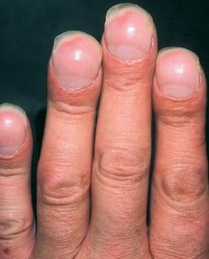
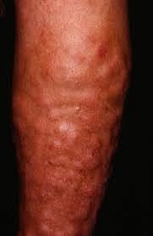
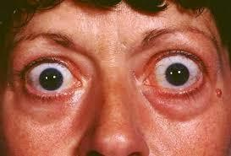







Slide 35


*Multinodular goiters reflect impaired synthesis of thyroid
hormone, most often caused by dietary iodine deficiency
Impairment of thyroid hormone synthesis leads to a compensatory rise in the serum TSH level, which, in turn, causes hypertrophy and hyperplasia of thyroid follicular cells and, ultimately, gross enlargement of the thyroid gland.
Mutations in proteins of the TSH-signaling pathway
*

Slide 36


*Follicular carcinoma
*Thyroid adenoma
*

Slide 37


*Thyroiditis is an inflammation of the thyroid that causes stored thyroid hormone to leak out of the thyroid gland. At first, the leakage raises hormone levels in the blood, leading to hyperthyroidism that lasts for 1 or 2 months. Most people then develop hypothyroidism
*Subacute thyroiditis
*Postpartum thyroiditis.
*Silent thyroiditis
*

Slide 38


*Consuming large amounts of iodine may cause the thyroid to make excess thyroid hormone
*

Slide 39


*Thyroid storm is a life-threatening medical emergency characterized by decompensated thyrotoxicosis, high fever (often >39.4°C [103°F]), tachycardia, tachypnea, dehydration, delirium, coma, nausea, vomiting, and diarrhea.
*

Slide 40
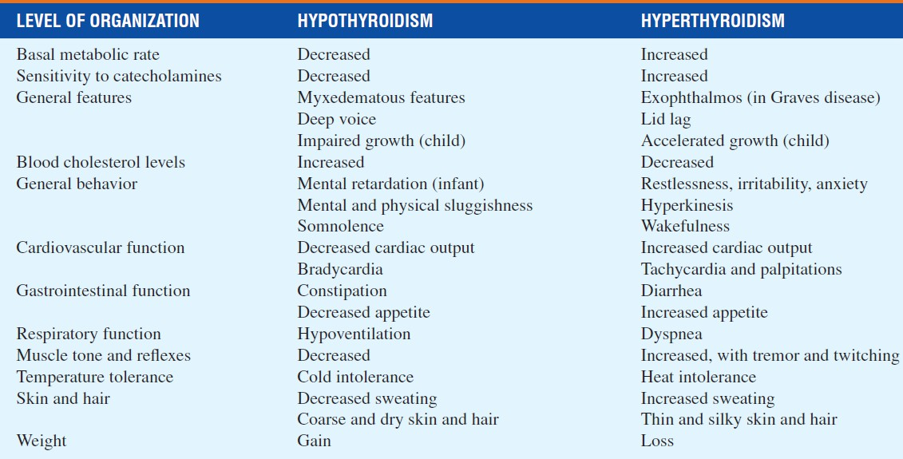

Slide 41
Normal
Diagnosis
T.T4: 4.5–10.9 mcg/dL
FT4: 0.8–2.7 ng/dL
TT3: 60–181 ng/Dl
TSH: 0.5–4.7 mIU/L

Slide 42
*Elevated serum TSH and low free T3 and T4
Primary hypothyroidism
Secondary hypothyroidism
*TSH levels will be within or below the reference range
*Free and/or total T 4 and T 3 serum concentrations will be low.
*Subclinical hypothyroidism (serum TSH >4.5 mIU/L; and T 4normal)
*“Clinically significant” hypothyroidism (TSH >4.5 mIU/L; and T 4 <4.5 mcg/dL).

Slide 44


*

