Slide 1
Tuberculosis

Slide 2
Introduction
Tuberculosis is airborne infection caused by the mycobacterium tuberculosis
Pulmonary Tuberculosis is one of the deadliest disease
in the world
Wordwide nearly 1billion people will be newly infected with tuberculosis

Slide 3
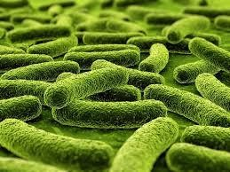
Organism
Mycobacterium tuberculosis
Slender, rod-shaped, aerobic bacteria that do not form spores.
Similar to other bacterial organisms except for an outer waxy capsule that makes them more resistant to destruction.

Slide 4
Organism cont…..
Organism can persist in old necrotic and calcified lesions and remain capable of reinitiating growth.
The waxy coat also causes the organism to retain red
dye when treated with acid in acid-fast staining
Thus, the mycobacteria are often referred to as acid-fast bacilli.

Slide 5
Organism cont…..
The tubercle bacilli are strict aerobes that thrive in an oxygen-rich environment.
This explains their tendency to cause disease in the upper lobe or upper parts of the lower lobe of the lung, where the ventilation and oxygen content are greatest.

Slide 6
Spread
Tuberculosis is an airborne infection spread by minute, invisible particles, called droplet nuclei, that are harbored in the respiratory secretions of persons with active tuberculosis.
Coughing, sneezing, and talking all create respiratory droplets;
These droplets evaporate, leaving the organisms (droplet nuclei), which remain suspended in the air and are circulated by air currents.

Slide 7
Spread cont…
Living under crowded and confined conditions increases the risk for spread of the disease

Slide 8
Pathogenesis
Inhaled droplet nuclei
Deposit in alveoli
Phagocytosed by alveolar macrophages
But bacilli resist killing
Initiate the cell mediated immunity
Though bacilli multiply, macrophages degrade the bacilli and present the antigens to CD4+ T lymphocytes
CD4+ T lymphocytes stimulate macrophages inturn increase the
concentration of lytic enzymes and ability to kill bacilli

Slide 9
Pathophysiology cont….
CD4+ T lymphocytes release IL2, INF gamma, recruit more macrophages and develop cell mediated delayed type hypersensitivity reaction
These lytic enzymes also damage lung tissue
In 2-3days macrophages undergo structural changes which resembles
epithelial cells called epithelioid cells
Epithelioid cells aggregate in to tight clusters called granulomas
(called as Ghon focus)
Single, gray-white, circumscribed granulomatous lesion, called as Ghon’s focus, that contains the tubercle bacilli, modified macrophages, and other immune cells

Slide 10
Release of cytokines in response to CD4+ T lymphocytes activation play a role in formation of granuloma
Around the mass of epithelioid cells and a few giant cells (macrophages fuse together to form multinucleated giant cells), zone of lymphcytes, plasma cells, further surrounded by fibroblasts (hard granloma/tubercule)
Within 10-14 days,the centre of cellular mass begin to undergo caseation necrosis, characterised by cheesy appearance and high lipid content
This is soft tubercle/granuloma

Slide 11
This caseationis due to
  IFN-gamma released by CD4+
  By Direct CD8+
  Toxicity of mycobacteria on macrophages
Soft tubercle is fully developed granuloma with caseous centre does not allow bacilli to grow

Slide 12
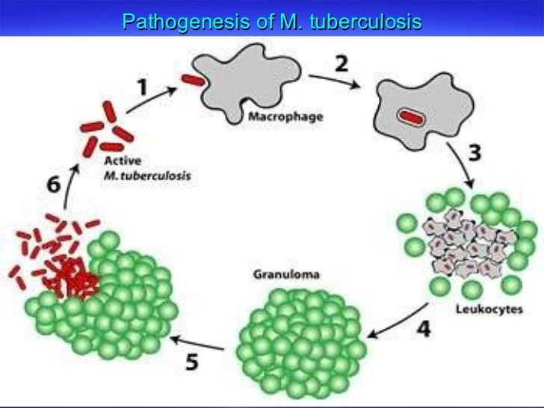

Slide 13
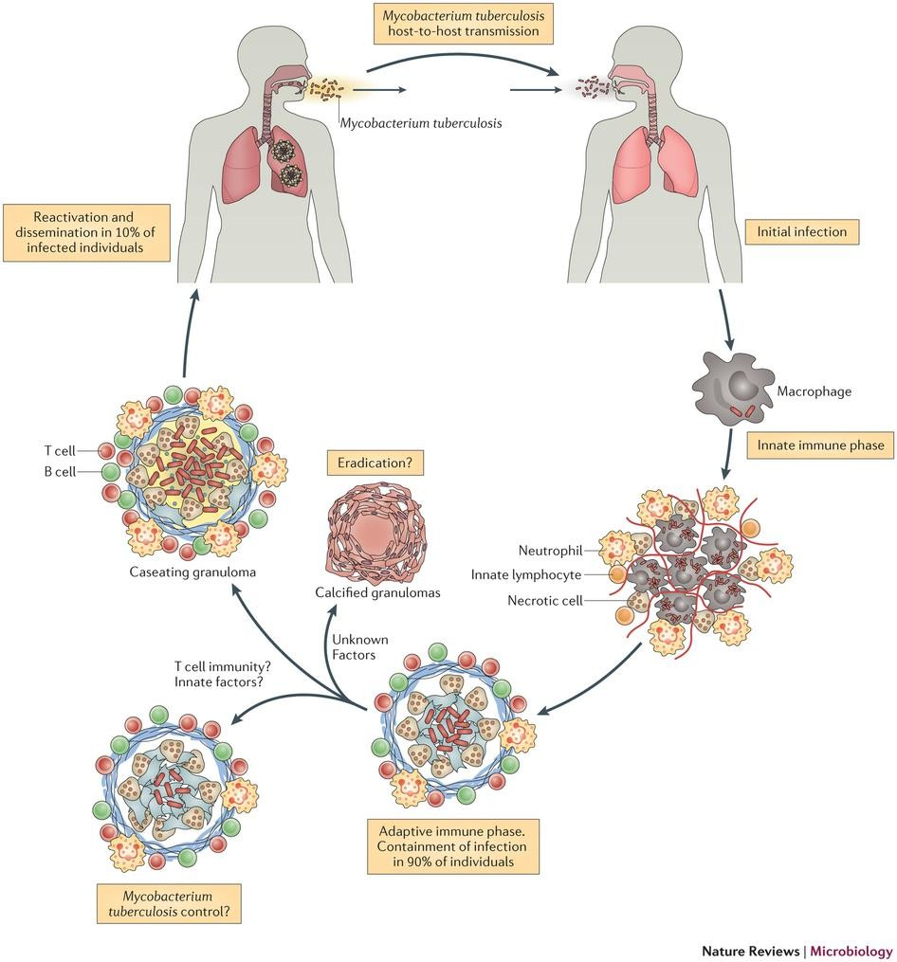

Slide 14
Fate of granuloma
Caseous material may undergo liquification and extend to surrounding tissue, discharge the contents on surface called cold absecss
Free or inside macrophages, drain along the lymph channels to the tracheobronchial lymph nodes of the affected lung and there evoke the formation of caseous granulomas.

Slide 15
The combination of the primary lung lesion and lymph node granulomas is called Ghon’s complex
Ghon’s complex eventually heals, undergoing shrinkage,
fibrous scarring, and calcification.

Slide 16
Small number of organisms may remain viable for years
Later, if immune mechanisms decline or fail, latent tuberculosis infection has potential to develop in to secondary tuberculosis.

Slide 17
Types
Primary
secondary

Slide 18
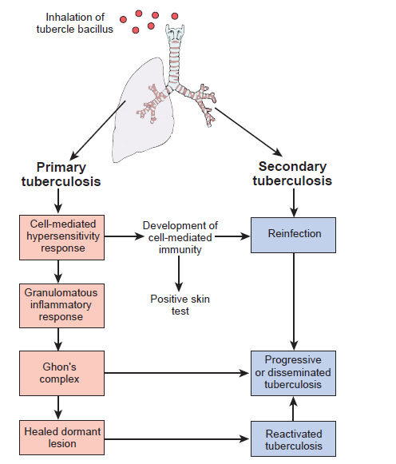

Slide 19
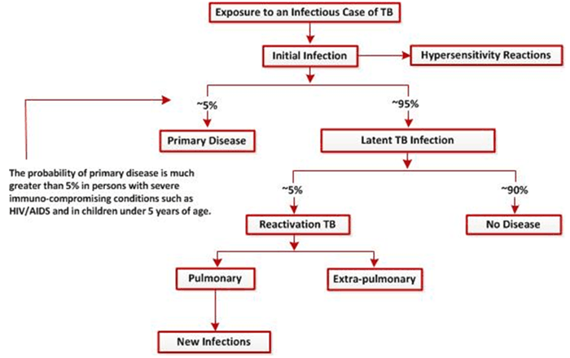

Slide 20
Primary TB
Primary tuberculosis is a form of disease that develops in a
previously unexposed & unsensitized persons
Most people with primary tuberculosis are asymptomatic and go on to develop latent tuberculosis infection
Latent tuberculosis do not have active disease and cannot transmit the organism to others.
Approx 5% of newly infected people develop to progressive Primary TB with pulmonary tissue damage especially in young children, hiv patients, immunodeficiency diseases.

Slide 21
Symptoms of primary progressive TB
FEVER
WEIGHT LOSS
FATIGUE
NIGHT SWEATS
PLEURITIS
LYMPHADENITIS

Slide 22
Secondary Tuberculosis:
It arises in a previously sensitised host
Reactivation may be due to exogenous re-infection or
endogenous
5% of the persons with primary tuberculosis get
secondary tuberculosis
Secondary tuberculosis is classically localized to the apex of one or both upper lobes
Secondary tuberculosis is always be an important
consideration in HIV positive patients

Slide 23
Symptoms of Secondary TB
PLEURAL EFFUSION
TUBERCULOUS EMPYEMA
LOW GRADE FEVER
NIGHT SWEATS
FATIGABILITY
ANOREXIA
WEIGHT LOSS
PRODUCTIVE COUGH ( Sometimes Blood Tinged
Sputum)

Slide 24
Miliary/Disseminated TB
In rare cases TB may erode in to blood vessels, giving rise to hematogenic dissemination
Dissemination involve any organ, particularly the brain,
meninges, liver, kidney and bone marrow.

