Slide 1
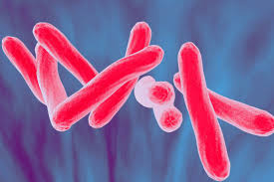
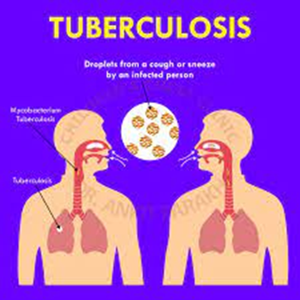
Tuberculosis
Infection disease
By Animesh
Das

Slide 2
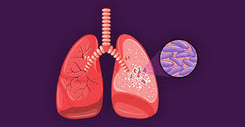
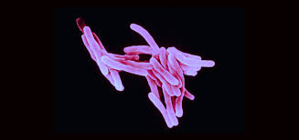
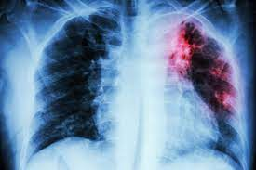
Definition
Tuberculosis is the serious infection bacterial disease to affect the lungs , caused an organism macrobacterium tuberculosis , it is bacterial transmission disease to infected by any person through cough and sneezes .
Causative agent – Macrobacterium tuberculosis

Slide 3
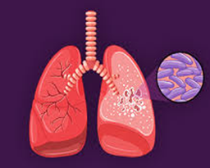
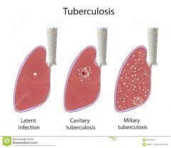
Type
There are the three type of tuberculosis --
Active TB disease
Miliary TB disease
Latent TB disease

Slide 4
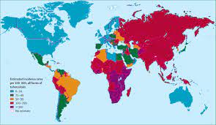
Epidemiology
in 2011 there were an estimated 8.7 million incidence case of TB globally .
Its equivalent to 125 cases in 100000 population .
Tuberculosis zone – Asia , African , eastern part , European region , America .

Slide 5
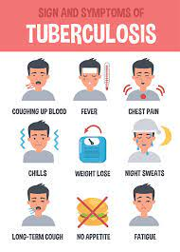
Sings and symptoms
persistent cough
Chest pain
Breathlessness
Breathing sounds
Coughing eith bloody sputum
Fatigue
Fever and chills
Urine discoloration

Slide 6
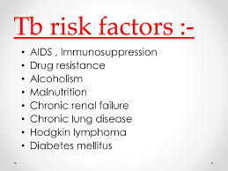
Risk factor
smoking
Immune compromised status
close contact with active patient
Living in substandard condition
Occupation
Institutionalization
People lacking adequate heath care

Slide 7
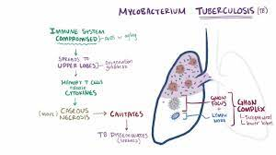
Mode of transmission
Droplet infection and direct contact.
Direct conmtact with TB patient .
Contaminated urinr and stool .
coughing .
Sneezes .
Speaks .
Sings .
Incubation period – 2 to 6 weeks

Slide 8
Pathophysiology
Mycobacterium bacilli inhales
Transmitted through airways to alveoli
Multiplication
Transfer to lymph system and blood stream
Immune system responds

Slide 9


Phagocytes engulf to many bacteria
TB lymphocytes bacilli spreads in normal tissues
Accumulation of exudate in alveoli
Bronchopneumonia

Slide 10
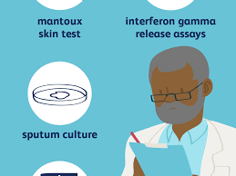
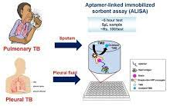
Management
Diagnosis
Treatment
Diagnosis
Bacteriological test –-
zeihl neelsen stain
auramine stain
Sputum culture test –
liquid medium
agar medium

Slide 11

Radiography –
chest X ray
Nucleic acid amplification --
species identification
low sensitivity
Tuberculine skin test --
diagnosis is based on the size of the wheal .
Other biological examination

Slide 12
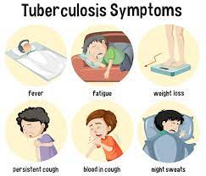
Clinical manifestation
Anorexia
low grade fever
night sweats
fatigue
weight loss

Slide 13
Treatment
Category | Drug name
Anti tubular drug | Isoniazid , Rifampicin , Ethambutol
aminoglycoside | Kanamycin , streptomycin
Amino acid | Cycloserine
Antibiotic | Ethionamide , thioacetazone
fluoroquinolones | levofloxacin
nitroimidazole | delamanid
oxazolidinones | linezolid

Slide 14
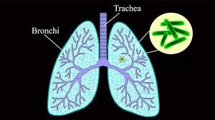
Complication
Meningitis
Spinal pain
Joint damage
Damage to the liver or kidney
Heart disorder

Slide 15
Prevention
wash your hand after sneezing , coughing or holding your hand near your nose or mouth .
Avoided close contact with others .
do not go any curved place like school , collehe , office , market etc .
sleep in a room away from other family members .
vaccination .
wear mask .

Slide 16
Thank
you

