Slide 1
BIOSTATISTICS AND RESEARCH METHODOLOGY
UNIT – 2 BIOSTATISTICS
2 .1(b)Types of data distribution.
14-09-2024
1

Slide 2
(B)TYPES OF DATA DISTRIBUTION
A data distribution is a function or a listing which shows all the possible values (or intervals) of the data. It also (and this is important) tells you how often each value occurs. Often, the data in a distribution will be ordered from smallest to largest, and graphs and charts allow you to easily see both the values and the frequency with which they appear.
From a distribution you can calculate the probability of any one particular observation in the sample space, or the likelihood that an observation will have a value which is less than (or greater than) a point of interest.
Classification of Data
At the highest level, data can be broadly classified as qualitative data (also known as categorical data) or quantitative data (also known as numerical data).
Qualitative or categorical data answers the question ‘What type’ or ‘Which category’. Gender (male/female), marital status (married/divorced/widowed/single), severity of pain on visual analog scale (mild/moderate/severe) are examples of qualitative or categorical data. Within categorical data, there are subtypes. Nominal data is data that does not follow any particular natural order, e.g. marital status (married / divorced/ widowed/ single). Here, there is no sequence between the various categories. In contrast, severity of pain can be ranked in ascending order as none/mild/moderate/severe/unbearable. This is known as ordinal data. Categorical data can also be classified depending on the number of categories. If only two categories are present e.g., dead/alive, married/unmarried – then the data is binary or dichotomous. If more than two categories are present e.g., married/divorced/widowed/single then this is non-binary data. In summary, qualitative data deals with characteristics, traits or descriptors or judgements.
14-09-2024
2

Slide 3
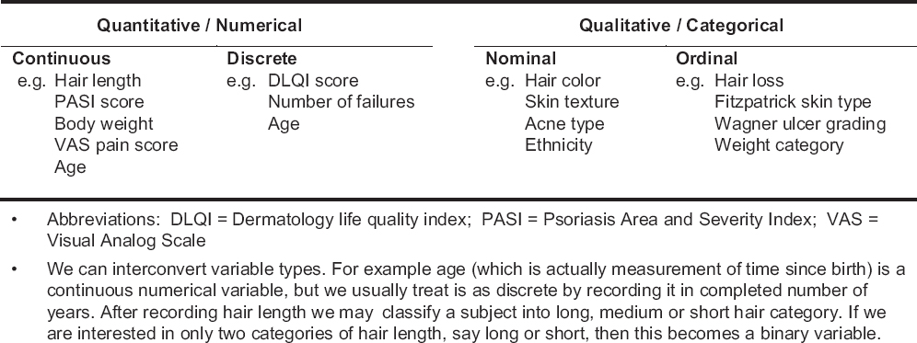
Quantitative or numerical data is data that can be counted and answers the question ‘How many’ or ‘How much”. For example, age, height, weight, blood pressure, number of children, number of hospital visits. Numerical data can be further classified into discrete data and continuous data. Discrete data is data that can only be counted in whole numbers. e.g., number of hospital visits, number of ward rounds per day. Continuous data is data that theoretically has no gap between data points can be counted in decimals (depending on the precision of the measuring instrument) e.g., blood glucose, hemoglobin, serum lipids. In summary, quantitative data deals with objective measurements.
14-09-2024
3

Slide 4
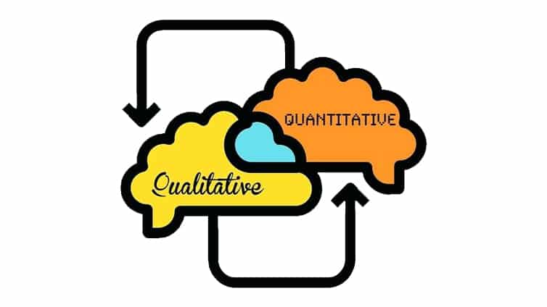
Quantitative and qualitative research both have their place in market research, and a blended approach should be carried out whenever you’re extending product lines or launching something new because it can give you a holistic viewpoint on what your customers are thinking, rather than just from one data point. Both methods can work hand-in-hand; brands can use qualitative research for developing concepts and theories, and quantitative for testing pre-existing ones.
Technology advances like open-response video and heat mapping also mean that qualitative research is getting closer to the quantitative price point. As a result, more and more organizations are able to use both approaches during their work.

Slide 5
Qualitative research methods are the most suitable for this approach because of their emphasis on people’s lived experience. They are considered to be well suited for locating the meanings that people place on the events, processes, and structures of their lives and their perceptions, presuppositions and assumptions.
Qualitative health researchers respond by stating that the choice of method and how it is used can perfectly well be matched to what is being studied rather than to the methodological leanings of the researcher.10 It has been suggested that incorporating qualitative research method experts into health research teams enriches research and ensures that the right methodology is used for answering the right questions. Finally, using qualitative methods in health-related research has resulted in more insight into health professionals’ perceptions of lay participation in care and identification of barriers to changing healthcare practice.
Qualitative research instruments used for data collection include interviews, observations, and analysis of documents. Interviews are the most common techniques used to gather research information. There are three types of interviews: structured, semi-structured and unstructured, described in some books as structured, informed and guided, respectively.
The semi-structured interview is more commonly used in health care-related qualitative research. Such an interview is characteristically based on a flexible topic guide that provides a loose structure of open-ended questions to explore experiences and attitudes. It has the advantage of great flexibility, enabling the researcher to enter new areas and produce richer data. In addition, it helps the researcher to develop a rapport with the informants. Semi-structured interviews elicit people’s own views and descriptions and have the benefit of uncovering issues or concerns that have not been anticipated by the resaecher.

Slide 6
Another qualitative research instrument that can be used in health care research is the focus group. Focus group interviews have the advantage of being more time efficient as more people can be interviewed for the same amount of time. They also provide a richer source of data. On the other hand, focus group interviews tend to document the ‘public’ rather than the ‘private’ views of the individuals. In addition some people do not interview well in-group situations.
COMPUTER USE IN QUALITATIVE DATA ANALYSIS :-
Qualitative research studies typically produce very large amount of data that needs to be managed efficiently. Computer packages can improve the efficiency of data management.
Computer programs provide a way of storing and retrieving material. They are therefore useful in locating cases, statements, phrases or even words, thereby replacing the tedious and time-consuming process of “cutting and pasting” and “colour coding”.
Using a computer programme can lead to quantitative analysis instead of qualitative, for example, counting occurrences, giving more weight to more frequent events, and ignoring isolated incidences.
.The researcher also has to be aware of the limitations of computer programmes. While computer packages can help with the intensive process of analysis and the management of large data sets, they are not a substitute for “immersion” in the data, and thorough knowledge that can enable the researcher to make comparisons, identify patterns and develop interpretations.6 There are different packages available: Ethnograph, Atlas and NUD.IST are the mostly used.

Slide 7
THE ROLE OF THE RESEARCHER IN QUALITATIVE RESEARCH
Qualitative methods depend on both critical and creative thinking and the balance between the two in conducting the study and interpreting its results. The role of the researcher is approached differently according to the type of research tradition used. A phenomenologist researcher is required to bracket his/her own assumptions when collecting data. On the other hand, in an ethnographic study, the effect of the researcher on the interview and the interaction is seen as inevitable and important in shaping the results of the study.
Although practicing clinicians routinely interview patients during their clinical work, interviewing is a well-established technique in sociology and related disciplines.
Researchers in qualitative research need to consider how they are perceived by interviewees and the effect of features related to the researcher, such as class, race, and sex on the interview. This question is more important if the interviewee knows that the interviewer is a doctor. It has been described that a patient, or someone who is likely to be become one, may give what he or she thinks is a desirable response, thinking that the doctor will be pleased.

Slide 8
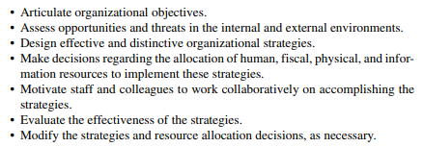
The purpose of quantitative research is to generate knowledge and create understanding about the social world. Quantitative research is used by social scientists, including communication researchers, to observe phenomena or occurrences affecting individuals. Social scientists are concerned with the study of people. Quantitative research is a way to learn about a particular group of people, known as a sample population. Using scientific inquiry, quantitative research relies on data that are observed or measured to examine questions about the sample population.
The results of quantitative research specify an explanation into what is and is not important, or influencing, a particular population. Quantitative research also provides answers to questions about the frequency of a phenomenon, or the magnitude to which the phenomenon affects the sample.
The objectives of quantitate research are :-

Slide 9
Quantitative research in medical education tends to be predominantly observational research based on survey or correlational studies. As researchers strive towards making inferences about the impact of education interventions, a shift towards experimental research designs may enhance the quality and conclusions made in medical education. The establishment of experiment research designs, where interventions (i.e. curriculum, teaching or assessment interventions) are tested with an experimental group and either a comparison or controlled group of learners, may allow researchers to overcome validity concerns and infer potential cause–effect generalizations.
There are a number of internal and external validity concerns that researchers need to be conscious of when designing their own or looking at others’ experimental research studies. The selection of a research design for any study should fit within the parameters of the stated research question or hypothesis.
In quantitative research, the findings will reflect the reliability and validity (psychometric characteristics) of the measured outcomes or dependent variables (such as changes in knowledge, skills, or attitudes) used to assess the effectiveness of the medical education intervention (the independent variable of interest).
Quantitative studies provide data that can be expressed in numbers—thus, their name. Because the data is in a numeric form, we can apply statistical tests in making statements about the data. These include descriptive statistics like the mean, median, and standard deviation, but can also include inferential statistics like t-tests, ANOVAs, or multiple regression correlations (MRC). Statistical analysis lets us derive important facts from research data, including preference trends, differences between groups, and demographics.

Slide 10
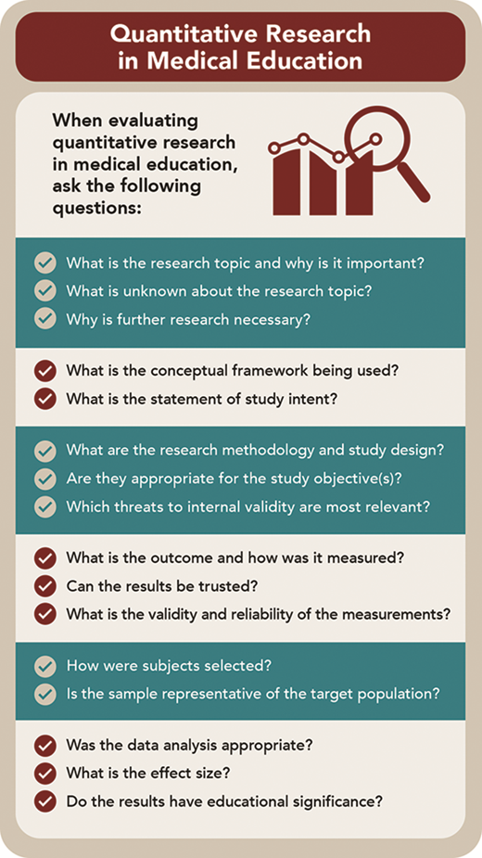

Slide 11
Some of the tools used in quantitative analysis include the following:
SPSS (Statistical Package for the Social Sciences) allows for many types of statistical analysis like chi square, T-test, ANOVA, factor analysis, etc. It is appropriate for complex types of data and applicable to fields of medicine or social science.
R is an open-source language for manipulating and visualizing data.
STATA works best with simpler datasets in econometrics and has an easy-to-use interface offering “graphs” and “statistics” features. Like SPSS, it also allows for programming.
SAS is helpful in business contexts because you can use it for forecasting, improving efficiency and quality, and measuring performance.
Excel has many formulas that can lead to data-driven insights. You can also learn specific data programming languages within Excel like VBA.
Once data needs to be taken to the next level and re-created, data scientists or data engineers use programming tools like Python, R, and Matlab/ID for coding.

