Slide 1
BIOSTATISTICS AND RESEARCH METHODOLOGY
UNIT 1 – RESAERCH METHODOLOGY
15-09-2024
1

Slide 2
RESEARCH METHODOLOGY
a) Types of clinical study designs:
Case studies, observational studies, interventional studies,
b) Designing the methodology
c) Sample size determination and Power of a study
Determination of sample size for simple comparative experiments, determination of sample size to obtain a confidence interval of specified width, power of a study
d) Report writing and presentation of data
15-09-2024
2

Slide 3
RESEARCH
Research in common parlance refers to a search for knowledge. Once can also define research as a scientific and systematic search for pertinent information on a specific topic. In fact, research is an art of scientific investigation.
Research is, thus, an original contribution to the existing stock of knowledge making for its advancement. It is the persuit of truth with the help of study, observation, comparison and experiment. In short, the search for knowledge through objective and systematic method of finding solution to a problem is research. The systematic approach concerning generalization and the
formulation of a theory is also research.
As such the term ‘research’ refers to the systematic method consisting of enunciating the problem, formulating a hypothesis, collecting the facts or data, analyzing the facts and reaching certain conclusions either in the form of solutions(s) towards the concerned problem or in certain generalizations for some theoretical formulation.
The purpose of research is to discover answers to questions through the application of scientific procedures. The main aim of research is to find out the truth which is hidden and which has not been discovered as yet.
To gain familiarity with a phenomenon or to achieve new insights into it (studies with this object in view are termed as exploratory or formulative research studies);
To portray accurately the characteristics of a particular individual, situation or a group (studies with this object in view are known as descriptive research studies);
To determine the frequency with which something occurs or with which it is associated with something else (studies with this object in view are known as diagnostic research studies);
To test a hypothesis of a causal relationship between variables (such studies are known as hypothesis-testing research studies).
15-09-2024
3

Slide 4
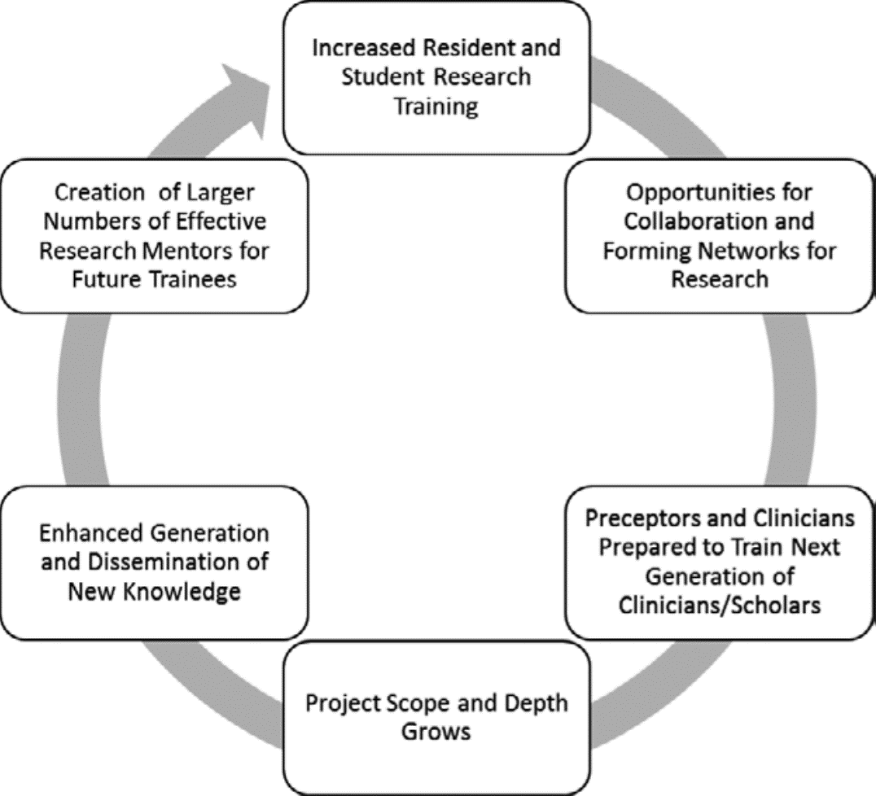
Identify relevant problems and gaps in Pharmacotherapeutics knowledge.
Generate a research hypothesis and Design a study to test the hypothesis.
Analyze data results using appropriate statistical tests.
Interpret and apply results of research study to practice.
Effectively communicate research and clinical findings to pharmacy, medical, and basic science audiences.
Interpret and effectively communicate research and clinical findings to patients and caregivers.
Apply regulatory and ethical principles when conducting research, or when using the research results.

Slide 5
The research opportunities include lab-based pharmaceutical sciences and basic science research in drug discovery and development; clinical and translational research that applies new discoveries in clinical and community settings; and research that advances the practice of pharmacy and improves education to make meaningful health care interventions to enhance patient care.
Most hospital pharmacists need to work on and design new projects, Doing research has helps develop and become more competent in project design, data collection, and projecting outcomes. These are skills that can really further my career as a pharmacist
“Once you’re involved in research and in generating new knowledge, you get a knack for asking the right questions, Student also get familiar with primary literature and methods. A Pharm D student might end up running clinical trials or collaborating with researchers to oversee applications of new drugs.
Working on pharmaceutical sciences research, while introducing students to a possible career path, also helps Pharm D students understand the connection between drug development and delivery and their role as pharmacists. As the field is becoming increasingly complex, it’s important for today’s pharmacists to have that scientific context. But pharmaceutical sciences is just one piece of the research pie.
One can know so many things, but knowing how to communicate them is different. It’s good for pharmacists to understand and have an appreciation for how difficult it is to find and isolate products that hold potential for drug development, but that research also involved learning how to communicate the results and methods

Slide 6
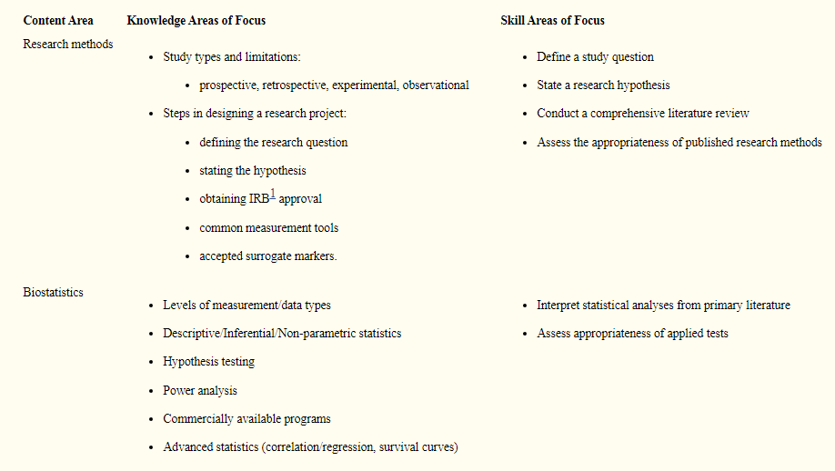

Slide 7
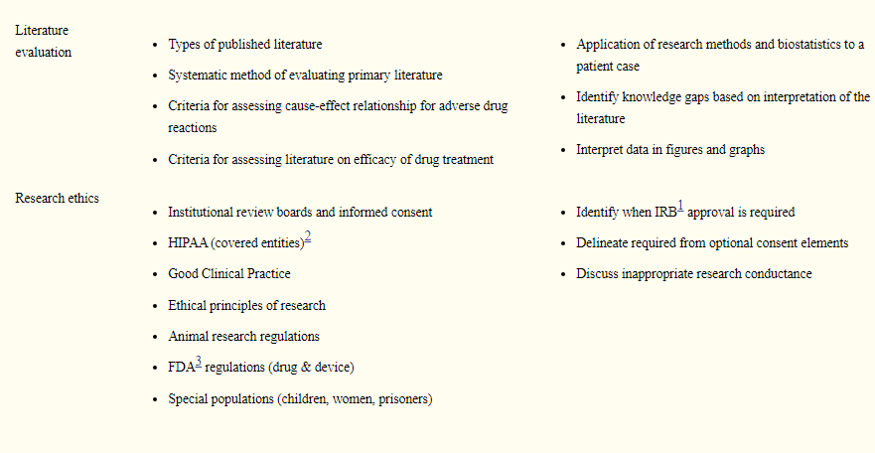

Slide 8

Types of clinical study designs: Case studies, observational studies, interventional studies.
15-09-2024
© R R INSTITUTIONS , BANGALORE
8

Slide 9
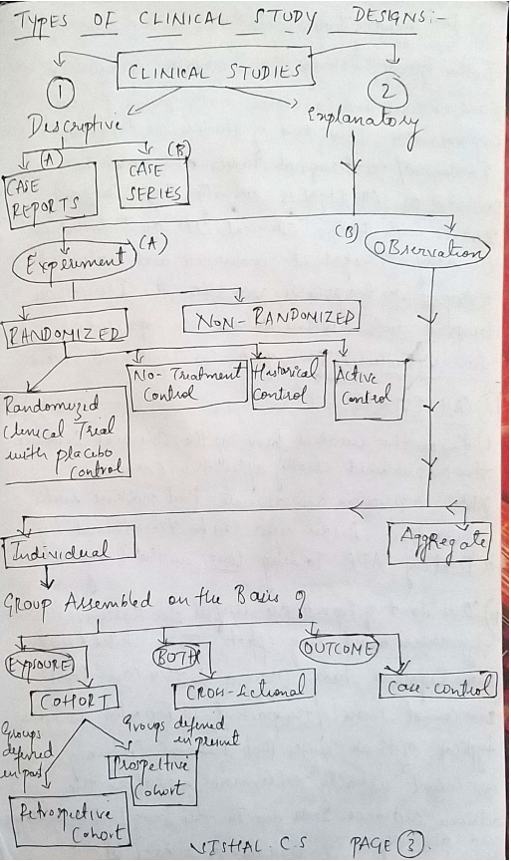
15-09-2024
9

Slide 10
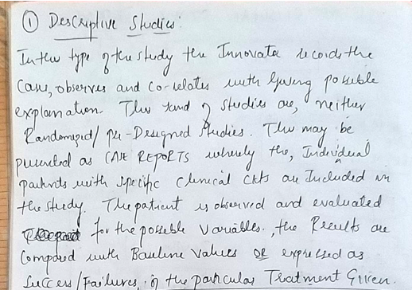
15-09-2024
10

Slide 11
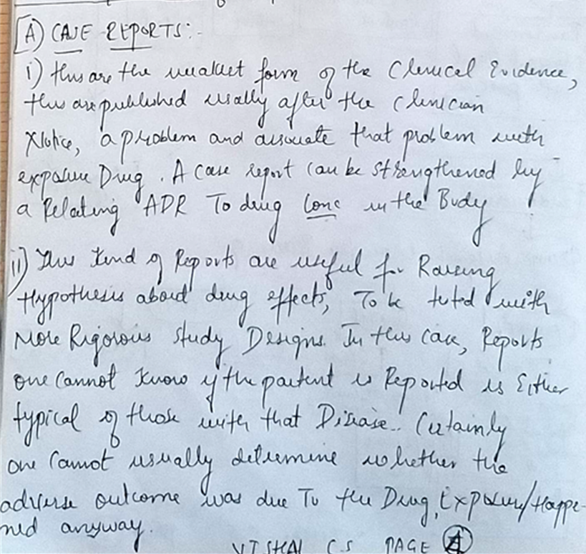

15-09-2024
© R R INSTITUTIONS , BANGALORE
11

Slide 12

15-09-2024
12

Slide 13
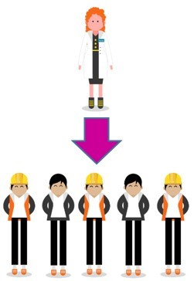
15-09-2024
13

Slide 14
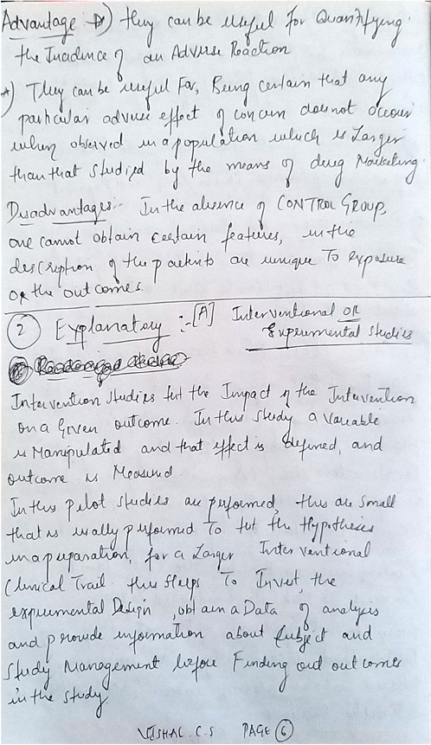
15-09-2024
14

Slide 15
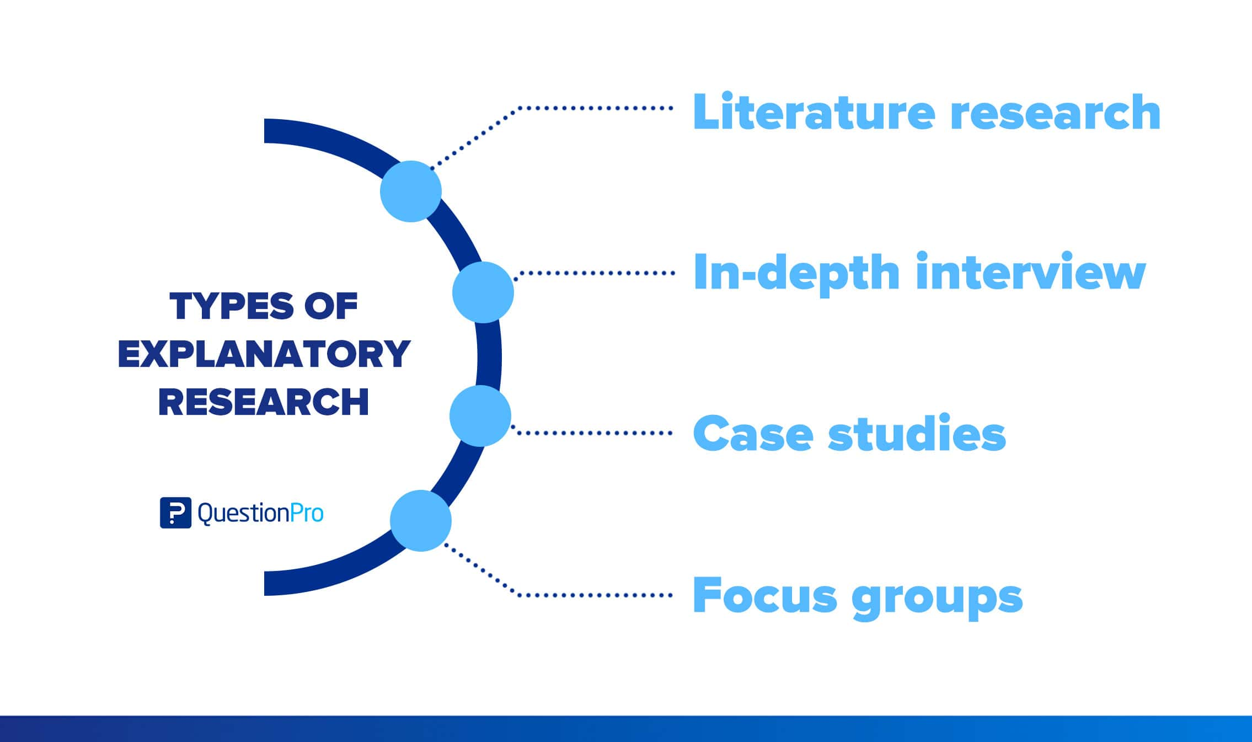
15-09-2024
15

Slide 16
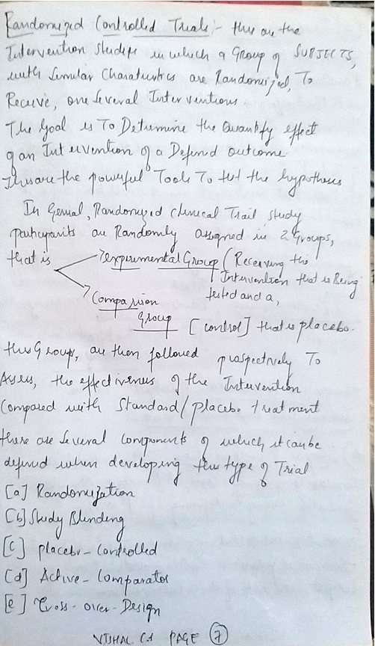
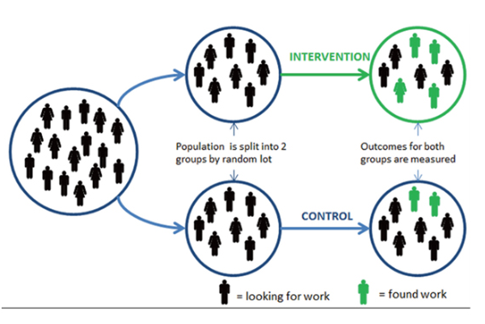
15-09-2024
16

Slide 17
15-09-2024
17

Slide 18
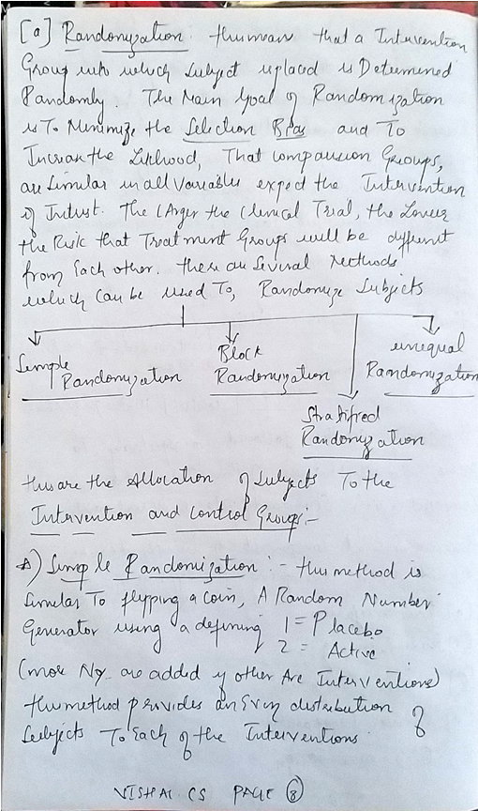
15-09-2024
18

Slide 19
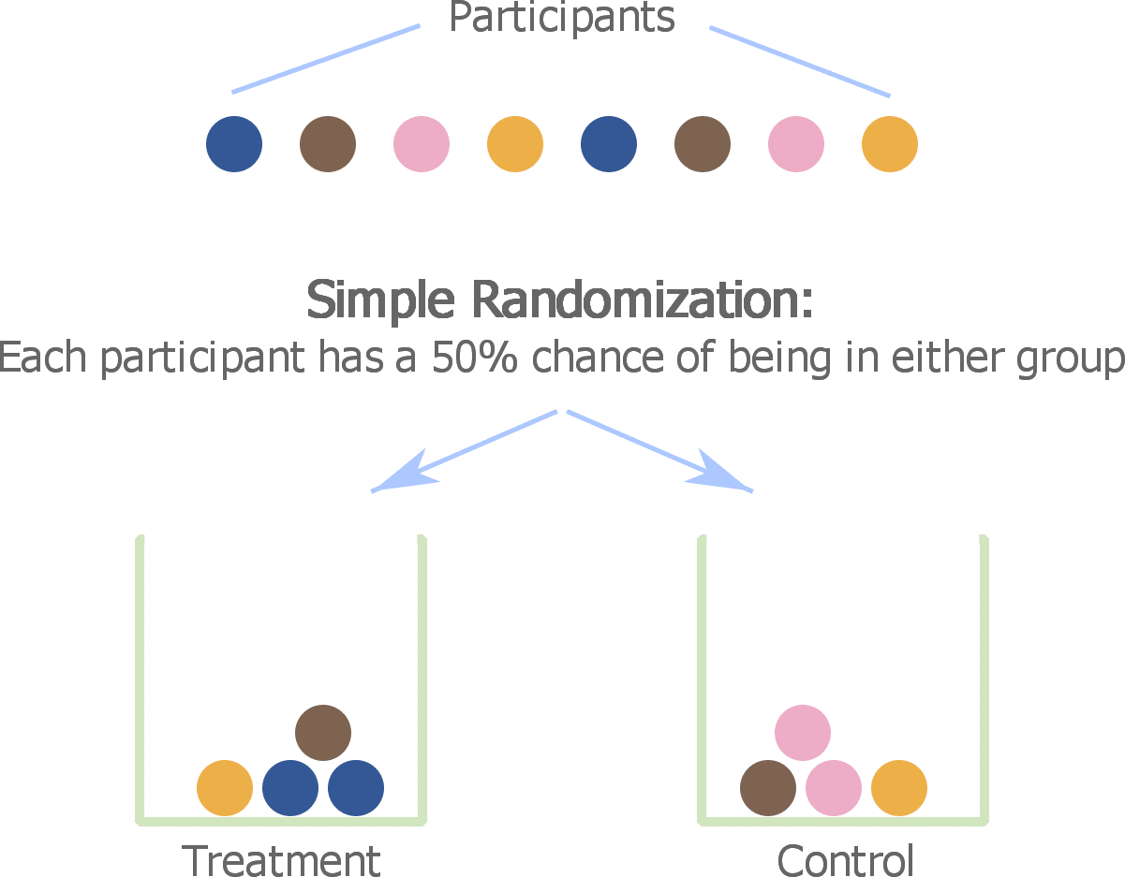
15-09-2024
19

Slide 20

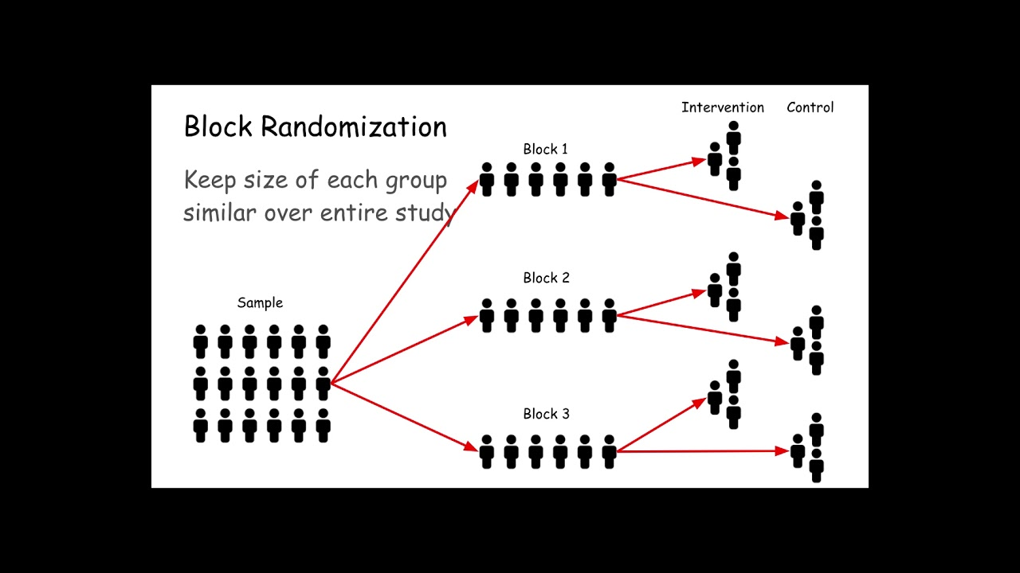
15-09-2024
20

Slide 21

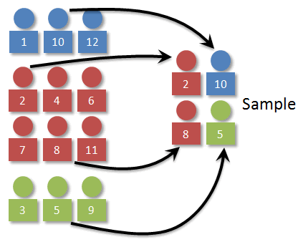

15-09-2024
21

Slide 22
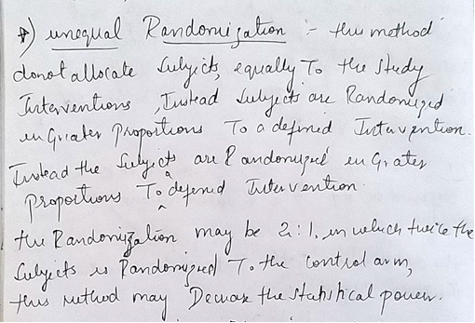
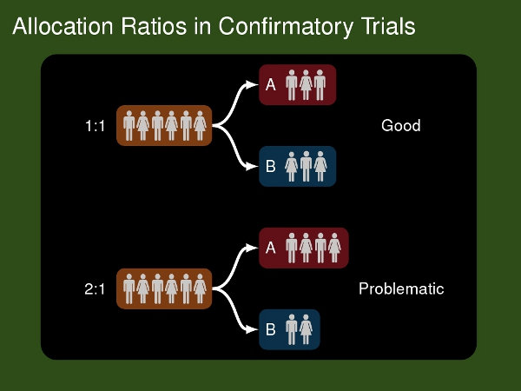
15-09-2024
22

Slide 23
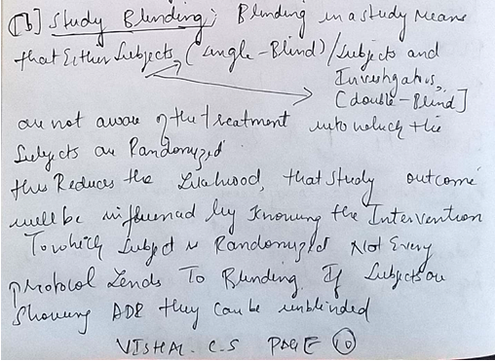

15-09-2024
23

Slide 24
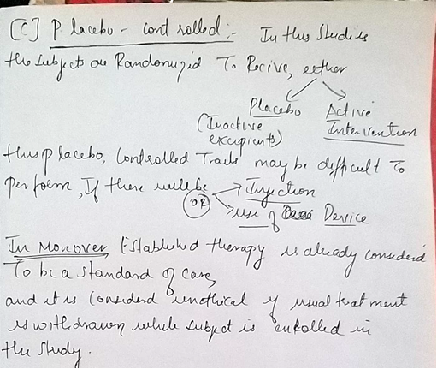
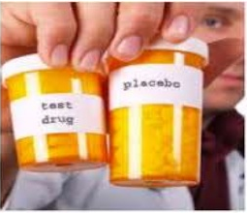
15-09-2024
24

Slide 25
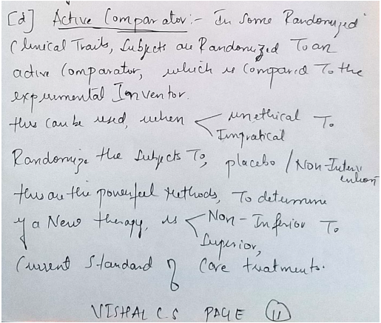

15-09-2024
25

Slide 26
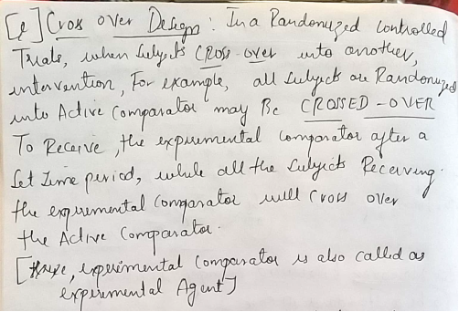
15-09-2024
26

Slide 27

15-09-2024
27

Slide 28
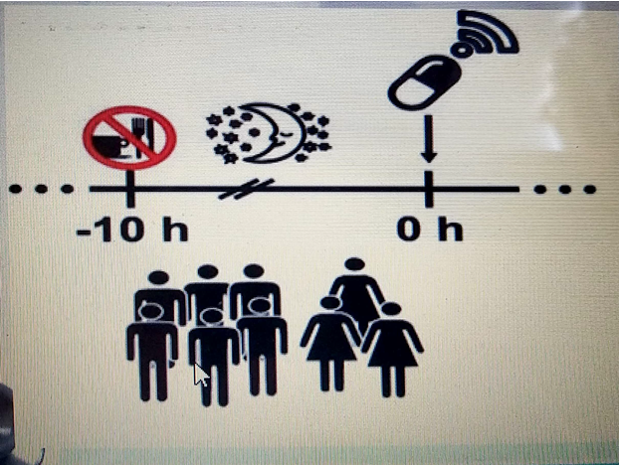
15-09-2024
28

Slide 29
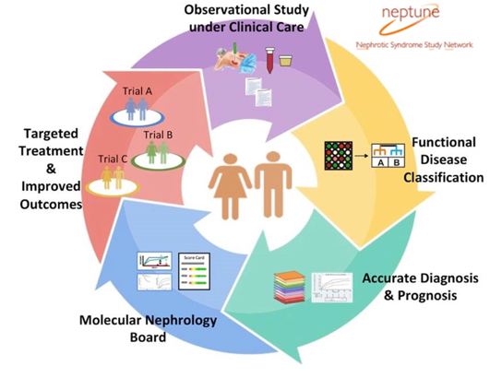
Observational Studies
Observational studies are a fundamental part of epidemiological research.
They are called observational studies because the investigator observes individuals without manipulation or intervention.
This is in contrast to randomised controlled trials where investigators do intervene and look at the effects of the intervention on an outcome. Although randomised controlled trials are useful in determining causal relationships between treatment and outcome, there are often instances where randomised controlled trials are not appropriate, so observational studies are needed
15-09-2024
29

Slide 30
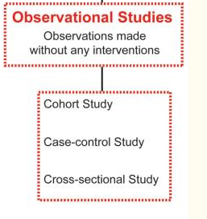
Observational studies fall under the category of analytic study designs and are further sub-classified as observational or experimental study designs .The goal of analytic studies is to identify and evaluate causes or risk factors of diseases or health-related events. The differentiating characteristic between observational and experimental study designs is that in the latter, the presence or absence of undergoing an intervention defines the groups. By contrast, in an observational study, the investigator does not intervene and rather simply “observes” and assesses the strength of the relationship between an exposure and disease variable.
Three types of observational studies include cohort studies, case-control studies, and cross-sectional studies .
Case-control and cohort studies offer specific advantages by measuring disease occurrence and its association with an exposure by offering a temporal dimension (i.e. prospective or retrospective study design). Cross-sectional studies, also known as prevalence studies, examine the data on disease and exposure at one particular time point.
Because the temporal relationship between disease occurrence and exposure cannot be established, cross-sectional studies cannot assess the cause and effect relationship. In this review, we will primarily discuss cohort and case-control study designs and related methodologic issues.
15-09-2024
30

Slide 31
A. COHORT STUDY
The term “cohort” is derived from the Latin word cohors.
The word “cohort” has been adopted into epidemiology to define a set of people followed over a period of time. W.H. Frost, an epidemiologist from the early 1900s, was the first to use the word “cohort” in his 1935 publication assessing age-specific mortality rates and tuberculosis.
The modern epidemiological definition of the word now means a “group of people with defined characteristics who are followed up to determine incidence of, or mortality from, some specific disease, all causes of death, or some other outcome.
A well-designed cohort study can provide powerful results. In a cohort study, an outcome or disease-free study population is first identified by the exposure or event of interest and followed in time until the disease or outcome of interest occurs .Because exposure is identified before the outcome, cohort studies have a temporal framework to assess causality and thus have the potential to provide the strongest scientific evidence.
Cohort studies are study designs that compare two groups, such as the subjects with exposure/risk factor to the subjects without exposure/risk factor, for differences in incidence of outcome/disease. Most often, cohort study designs are used to study outcome(s) from a single exposure/risk factor. Thus, cohort studies can also be hypothesis testing studies and can infer and interpret a causal relationship between an exposure and a proposed outcome, but cannot establish it.
15-09-2024
31

Slide 32
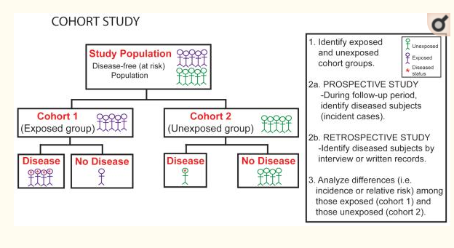
Cohort studies are a type of medical research used to investigate the causes of disease and to establish links between risk factors and health outcomes.
The word cohort means a group of people. These types of studies look at groups of people. They can be forward-looking (prospective) or backward-looking (retrospective).
15-09-2024
32

Slide 33
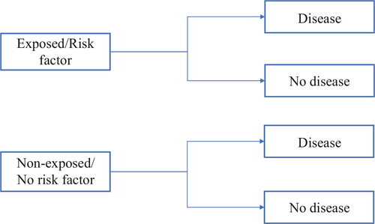
Thus, the study design for prospective and retrospective cohort studies are similar as we are comparing populations with and without exposure/risk factor to development of outcome/disease.
Prospective” studies are planned in advance and carried out over a future period of time.
Retrospective cohort studies look at data that already exist and try to identify risk factors for particular conditions. Interpretations are limited because the researchers cannot go back and gather missing data.
The cohort study design is the best available scientific method for measuring the effects of a suspected risk factor.
In a prospective cohort study, researchers raise a question and form a hypothesis about what might cause a disease.
Then they observe a group of people, known as the cohort, over a period of time. This may take several years. They collect data that may be relevant to the disease.
In this way, they aim to detect any changes in health linked to the possible risk factors they have identified.
For example, scientists may ask participants to record specific lifestyle details over the course of a study. Then, they can analyze any possible correlations between lifestyle factors and disease.
15-09-2024
33

Slide 34
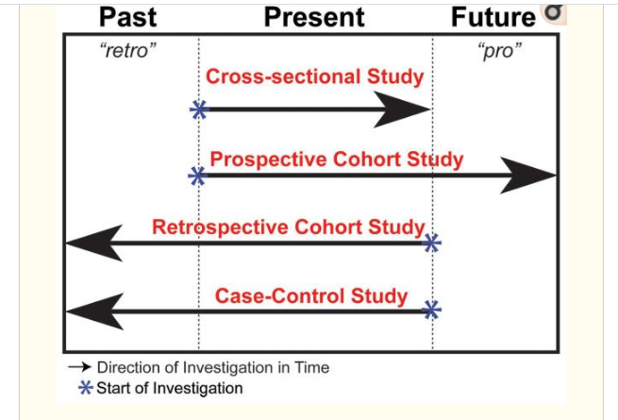
Temporal Design of Observational Studies: Cross-sectional studies are known as prevalence studies and do not have an inherent temporal dimension. These studies evaluate subjects at one point in time, the present time. By contrast, cohort studies can be either retrospective (latin derived prefix, “retro” meaning “back, behind”) or prospective (greek derived prefix, “pro” meaning “before, in front of”). Retrospective studies “look back” in time contrasting with prospective studies, which “look ahead” to examine causal associations. Case-control study designs are also retrospective and assess the history of the subject for the presence or absence of an exposure.
Cohort studies typically observe large groups of individuals, recording their exposure to certain risk factors to find clues as to the possible causes of disease.
They can be prospective studies and gather data going forward, or retrospective cohort studies, which look at data already collected.
The Nurses’ Health Study is one example of a large cohort study, and it has produced many important links between lifestyle choices and health by following hundreds of thousands of women across North America.
Such research can also help identify social factors that influence health.
15-09-2024
34

Slide 35

15-09-2024
35

Slide 36
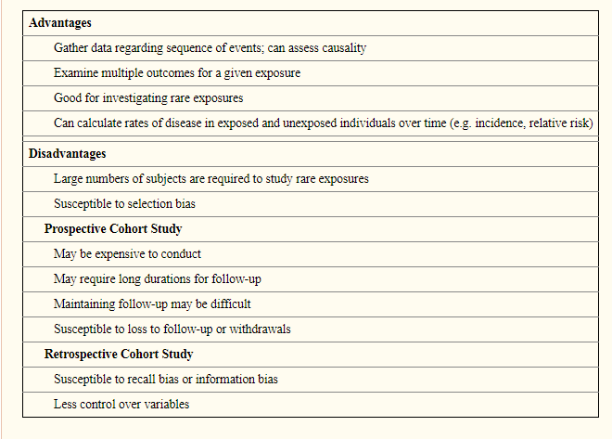
15-09-2024
36

Slide 37
B. CASE-CONTROL STUDIES
Case-control studies were historically borne out of interest in disease etiology. The conceptual basis of the case-control study is similar to taking a history and physical; the diseased patient is questioned and examined, and elements from this history taking are knitted together to reveal characteristics or factors that predisposed the patient to the disease.
Reasons of practicality and feasibility inherent in the study design typically dictate whether a cohort study or case-control study is appropriate. This study design was first recognized in Janet Lane-Claypon's study of breast cancer in 1926, revealing the finding that low fertility rate raises the risk of breast cancer.
Case-control studies identify subjects by outcome status at the outset of the investigation. Outcomes of interest may be whether the subject has undergone a specific type of surgery, experienced a complication, or is diagnosed with a disease . Once outcome status is identified and subjects are categorized as cases, controls (subjects without the outcome but from the same source population) are selected. Data about exposure to a risk factor or several risk factors are then collected retrospectively, typically by interview, abstraction from records, or survey.
Case-control studies are well suited to investigate rare outcomes or outcomes with a long latency period because subjects are selected from the outset by their outcome status. Thus in comparison to cohort studies, case-control studies are quick, relatively inexpensive to implement, require comparatively fewer subjects, and allow for multiple exposures or risk factors to be assessed for one outcome
15-09-2024
37

Slide 38
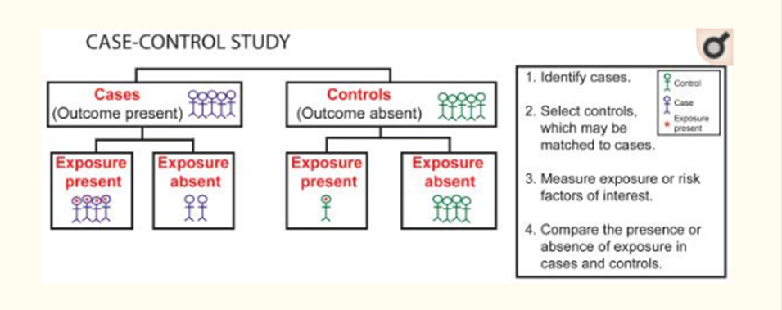
15-09-2024
38

Slide 39
C. CROSS‐SECTIONAL STUDY
Cross‐sectional studies are study designs used to evaluate an association between an exposure and outcome at the same time. It can be classified under either descriptive or analytic, and therefore depends on the question being answered by the investigator. Since, cross‐sectional studies are designed to collect information at the same point of time, this provides an opportunity to measure prevalence of the exposure or the outcome. For example, a cross‐sectional study design was adopted to estimate the global need for palliative care for children based on representative sample of countries from all regions of the world and all World Bank income groups.
The limitation of cross‐sectional study design is that temporal association cannot be established as the information is collected at the same point of time. If a study involves a questionnaire, then the investigator can ask questions to onset of symptoms or risk factors in relation to onset of disease. This would help in obtaining a temporal sequence between the exposure and outcome
15-09-2024
39

Slide 40
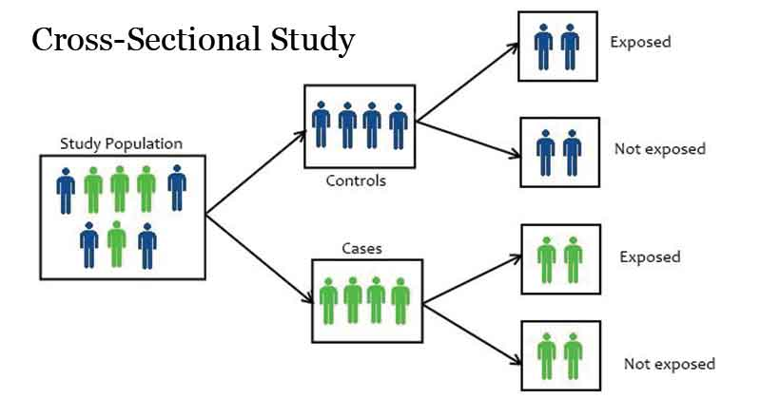
15-09-2024
40

Slide 41
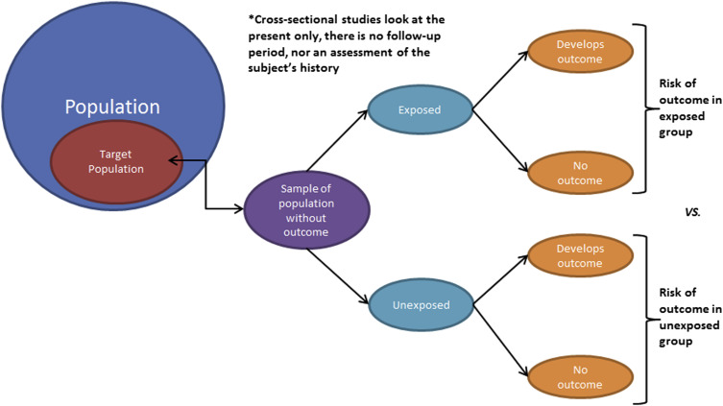
15-09-2024
41

Slide 42
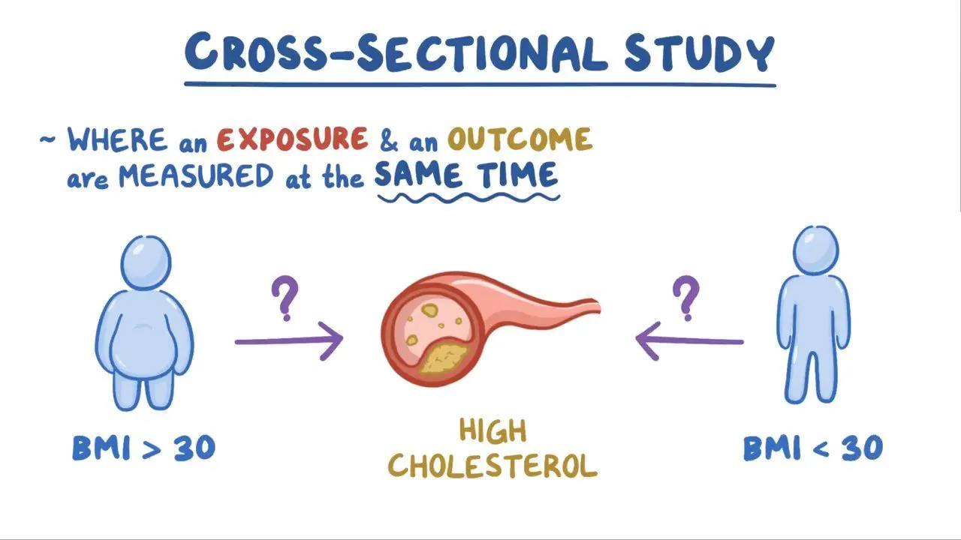
15-09-2024
42

Slide 43
A cross- sectional study is a study design where an exposure and an outcome are measured at the same time.
For example, let’s say you want to figure out if people who are obese – which means having a body mass index or BMI of 30 or higher - have higher serum cholesterol levels compared to people who are not obese – having a body mass index below 30.
To do this, you might look at the medical records of 100 people to see who has high cholesterol levels and who has low cholesterol levels and compare that to how many people in each group are obese or not obese.
You can think about a cross-sectional study like a snapshot of the population at a certain point in time.
Since you can only collect the information you see in that one moment, you don’t know what happens before or after the snapshot was taken.
So, we can only collect information on prevalence – the proportion of exposures or outcomes that already exist at a certain time – and not incidence – the proportion of new exposures or outcomes that occur in a certain time period.
In terms of prevalence, there’s an outcome prevalence and an exposure prevalence.
The outcome prevalence is the proportion of people who have an outcome in the exposed group and the non-exposed group.
In a cross-sectional study this can be organized in a 2 by 2 table, with the exposure – obesity or no obesity – on the side and the outcome – high or low cholesterol levels – on the top, and each box is labeled a, b, c, or d.
15-09-2024
43

Slide 44
Cell a includes individuals who have high cholesterol and who are obese; cell b includes individuals who have low cholesterol and who are obese; cell c includes individuals who have high cholesterol and who are not obese; and cell d includes individuals who have low cholesterol and who are not obese.
We can calculate an outcome prevalence to figure out if high cholesterol – the outcome – is more prevalent for people who are obese or not obese – the exposure.
Let’s say that there are 50 people in cell a, 15 in cell b, 5 in cell c, and 30 in cell d.
To find the outcome prevalence, we first calculate the proportion of people who have high cholesterol in the group that is obese – so “a” divided by “a plus b”, or 50 divided by 65, which rounds to 0.77.
Then we compare it with the proportion of people who have high cholesterol in the group who are not obese – so “c” divided by “c plus d”, or 5 divided by 35, which rounds to 0.14.
And, 0.77 divided by 0.14 equals 5.5, which means that the people who are obese have about 5.5 times the prevalence of high cholesterol compared to people who are not obese.
We can similarly calculate the exposure prevalence, which is a comparison of the proportion of people who have an exposure in the outcome group and the no outcome group.
15-09-2024
44

Slide 45
DESIGNING THE METHODOLOGY
Once you are well into your literature review, it is time to start thinking about the study you will design to answer the gap you identified. Which methodology will you use to gather the data for your research? Will you use a qualitative, quantitative, or mixed methods methodology? You will choose a research method that best aligns with your research question.
To evaluate which type of methodology will be most appropriate, you will work closely with your Dissertation Chair. However, as you are reading the literature, take a look at past studies that focus on your topic, or a similar topic. What kind of research methodology do you see being used most often? Once you have an idea about the general methodology type that would suit your research, consult with your Dissertation Chair on the possibility of using that methodology.
Finding a research design strategy is similar to the research process as a whole: first, locate general information on research design and methodologies, then gain background knowledge on the methodology you feel would most appropriately address the type of data you will be collecting, and finally choose a methodology and test/measurement to use in your research. The following techniques outline how to locate information about research methodology from reference books, scholarly articles and dissertations.
15-09-2024
45

Slide 46
VARIOUS STAGES OF RESAERCH PROCESS
RESEARCH TOPIC
IDENTIFICATION OF RESAERCH PROBLEM
REVIEW PROCESS FINDING
FORMULATE HYPOTHESIS
COMPUTER AND STATISTICS
DATA COLLECTION
DATA ANALYSIS AND INTERPRETATION
RESEARCH DEGSIN
FINAL REPORT AND PRESENTATION
SAMPLE DEGSIN
METHODS AND TOOLS OF DATA COLLECTION
SCIENTIFIC WRITING
15-09-2024
46

Slide 47

Research process consists of series of actions or steps necessary to effectively carry out research and the desired sequencing of these steps. The chart shown in Figure well illustrates a research process. The chart indicates that the research process consists of a number of closely related activities.
STEP – 1 - Identify and defining the Research Problem The first step in the process is to identify a problem or develop a research question. The research problem may be something the agency identifies as a problem, some knowledge or information that is needed by the agency or the desire to identify a recreation trend nationally. However, the research problem comes up with the ongoing phenomenon or issues. Formulate Your Question : Your research may start as a general idea or a specific question, statement or thesis. Know what you want to focus on before you begin. A research problem is a statement about an area of concern, a condition to be improved, a difficulty to be eliminated, or a troubling question that exists in scholarly literature, in theory, or in practice that points to the need for meaningful understanding and deliberate investigation. In some social science disciplines the research problem is typically posed in the form of a question. A research problem does not state how to do something, offer a vague or broad proposition, or present a value question
15-09-2024
47

Slide 48
Intuitively, researchable problems are those who have a possibility of thorough verification investigation, which can be effected through the analysis and collection of data, while the non-research problems do not need to go through these processes.
Researcher need to identify both;
Non-research Problem, and
Research Problem.
A non-research problem is one that does not require any research to arrive at a solution. Intuitively, a non-researchable problem consists of vague details and cannot be resolved through research.
Example :-
A hospital treated a large number of cholera cases with penicillin, but the treatment with penicillin was not found to be effective. Do we need research to know the reason?
Here again, there is one single reason that Vibrio cholera is not sensitive to penicillin, and therefore, this is not the drug of choice for this disease.
In this case, too, as the reasons are known, it is unwise to undertake any study to find out why penicillin does not improve the condition of cholera patients. This is also a non-research problem
15-09-2024
48

Slide 49
A research problem is a perceived difficulty, a feeling of discomfort, or a discrepancy between the common belief and reality.
A problem will qualify as a potential research problem when the following three conditions exist:
There should be a perceived discrepancy between “what it is” and “what it should have been.” This implies that there should be a difference between “what exists” and the “ideal or planned situation”;
A question about “why” the discrepancy exists. This implies that the reason(s) for this discrepancy is unclear to the researcher (so that it makes sense to develop a research question).
Other Issues of Problem Identification
To identifying, defining, and analyzing a problem, there are several ways of obtaining insights and getting a clearer idea about these issues.
Exploratory research is one of the ways of accomplishing this. The purpose of the exploratory research process is to progressively narrow the scope of the topic and to transform the undefined problems into defined ones, incorporating specific research objectives.
The exploratory study entails a few basic strategies in gaining insights into the problem. It is accomplished through such efforts as:
Pilot survey
Case studies
Focus group interview and
Experience survey
15-09-2024
49

Slide 50

STEP 2 - Reviewing of Literature
A review of relevant literature is an integral part of the research process. It enables the researcher to formulate his problem in terms of the specific aspects of the general area of his interest that has not been so far researched.
Such a review, not only provides him exposure to a larger body of knowledge but also equips him with enhanced knowledge to efficiently follow the research process. Through a proper review of the literature, the researcher may develop the coherence between the results of his study and those of the others.
Get Background Information.
Read about your topic using websites or encyclopedias.
It introduces you to the topic, helps you to focus on its key elements and can help you decide to broaden or narrow your focus.
These sources often include bibliographies that you can “piggyback” to find more sources on your topic.
In the obesity study, the review of literature enables the programmer to discover horrifying statistics related to the long-term effects of childhood obesity in terms of health issues, death rates, and projected medical costs. In addition, the programmer finds several articles and information from the Centers for Disease Control and Prevention that describe the benefits of walking 10,000 steps a day.
The information discovered during this step helps the programmer fully understand the magnitude of the problem, recognize the future consequences of obesity, and identify a strategy to combat obesity (i.e., walking).
15-09-2024
50

Slide 51

Step 3: Formulating a Hypothesis
In this step, the researcher makes the problem precise.
The research work is topic focused and refined.
Then the researcher steps forward to how the problem would be approached? The nature of the research problem can decide to formulate a definite hypothesis.
A hypothesis is tested. Effective research work formulates a hypothesis in such a way that collected factual data will provide evidence that either supports or disproves them. Formulation of Hypothesis in Research will make you more expert.
In the end, the hypothesis turns into a practical theory. In order to develop working hypotheses researcher should adopt the following approach,
a. Discussions with colleagues and experts about the problem, its origin and the objectives in seeking a solution;
b. Examination of data and records, if available, concerning the problem for possible trends, peculiarities and other clues;
c. Review of similar studies in the area or of the studies on similar problems; and
d. Exploratory personal investigation which involves original field interviews on a limited scale with interested parties and individuals with a view to secure greater insight into the practical aspects of the problem.
15-09-2024
51

Slide 52

Step -4: Choosing the study design
The research design is the blueprint or framework for fulfilling objectives and answering research questions.
It is a master plan specifying the methods and procedures for collecting, processing, and analyzing the collected data. There are four basic research designs that a researcher can use to conduct his or her study;
survey,
experiment,
secondary data study, and
observational study.
The type of research design to be chosen from among the above four designs depends primarily on four factors:
The type of problem
The objectives of the study,
The existing state of knowledge about the problem that is being studied, and
The resources are available for the study.
15-09-2024
52

Slide 53
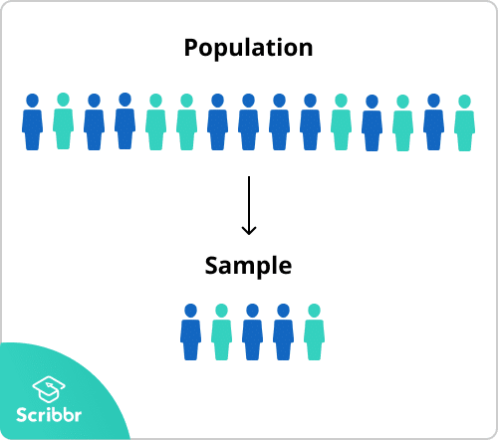
STEP 5 :- Deciding on the sample design
Sampling is an important and separate step in the research process. The basic idea of sampling is that it involves any procedure that uses a relatively small number of items or portions (called a sample) of a universe (called population) to conclude the whole population.
It contrasts with the process of complete enumeration, in which every member of the population is included.
Sample design refers to the methods to be followed in selecting a sample from the population and the estimating technique, vis-a-vis formula for computing the sample statistics.
These methods are basically of two types: probability sampling and non-probability sampling. Probability sampling ensures every unit a known nonzero probability of selection within the target population.
The most widely used probability sampling methods are simple random sampling, stratified random sampling, cluster sampling, and systematic sampling. They have been classified by their representation basis and unit selection techniques.
15-09-2024
53

Slide 54

Step – 6: Collecting data
The gathering of data may range from simple observation to a large-scale survey in any defined population. There are many ways to collect data.
The approach selected depends on the objectives of the study, the research design, and the availability of time, money, and personnel.
With the variation in the type of data (qualitative or quantitative) to be collected, the method of data collection also varies.
The most common means for collecting quantitative data is the structured interview.
Studies that obtain data by interviewing respondents are called surveys. Data can also be collected by using self-administered questionnaires. Telephone interviewing is another way in which data may be collected.
Other means of data collection include the use of secondary sources, such as the census, vital registration records, official documents, previous surveys, etc.
15-09-2024
54

Slide 55

Step-7: Processing and Analyzing Data
Data processing generally begins with the editing and coding of data. Data are edited to ensure consistency across respondents and to locate omissions, if any.
In survey data, editing reduces errors in the recording, improves legibility, and clarifies unclear and inappropriate responses. In addition to editing, the data also need coding.
Because it is impractical to place raw data into a report, alphanumeric codes are used to reduce the responses to a more manageable form for storage and future processing.
This coding process facilitates processing the data. The personal computer offers an excellent opportunity in data editing and coding processes.
Data analysis usually involves reducing accumulated data to a manageable size, developing summaries, searching for patterns, and applying statistical techniques for understanding and interpreting the findings in the light of the research questions.
Further, the researcher, based on his analysis, determines if his findings are consistent with the formulated hypotheses and theories.
The techniques to be used in analyzing data may range from simple graphical technique to very complex multivariate analysis depending on the objectives of the study, research design employed, and the nature of data collected.
As in the case of methods of data collection, an analytical technique appropriate in one situation may not be appropriate for another.
15-09-2024
55

Slide 56

Step-8: Writing the report – Developing Research Proposal, Writing Report, Disseminating and Utilizing Results
The entire task of a research study is accumulated in a document called a proposal.
A research proposal is a work plan, prospectus, outline, an offer, a statement of intent or commitment from an individual researcher or an organization to produce a product or render a service to a potential client or sponsor.
The proposal will be prepared to keep in view the sequence presented in the research process. The proposal tells us what, how, where, and to whom it will be done.
It must also show the benefit of doing it. It always includes an explanation of the purpose of the study (the research objectives) or a definition of the problem.
It systematically outlines the particular research methodology and details the procedures that will be utilized at each stage of the research process
15-09-2024
56

Slide 57
The end goal of a scientific study is to interpret the results and draw conclusions.
To this end, it is necessary to prepare a report and transmit the findings and recommendations to administrators, policymakers, and program managers for the intended purpose of making a decision.
There are various forms of research reports: term papers, dissertations, journal articles, papers for presentation at professional conferences and seminars, books, and so on. The results of a research investigation prepared in any form are of little utility if they are not communicated to others.
The primary purpose of a dissemination strategy is to identify the most effective media channels to reach different audience groups with study findings most relevant to their needs.
The dissemination may be made through a conference, a seminar, a report, or an oral or poster presentation.
The style and organization of the report will differ according to the target audience, the occasion, and the purpose of the research. Reports should be developed from the client’s perspectives.
A report is an excellent means that helps to establish the researcher’s credibility. At a bare minimum, a research report should contain sections on:
An executive summary;
Background of the problem;
Literature review;
Methodology;
Findings;
Discussion;
Conclusions and
Recommendations.
The results of the study can also be disseminated through peer-reviewed journals published by academic institutions and reputed publishers both at home and abroad.
15-09-2024
57

Slide 58
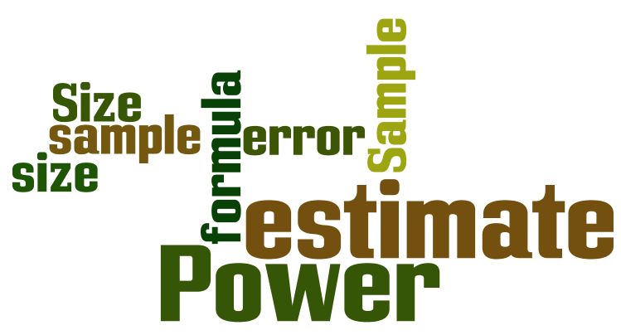
SAMPLE SIZE DETERMINATION AND POWER OF A STUDY
The power of a statistical test is the probability that a test will reject the null hypothesis when the null hypothesis is false. That is, power reflects the probability of not committing a type II error. The two major factors affecting the power of a study are the sample size and the effect size.
A sample is a set of data collected or selected from statistical population by a defined procedure. The elements of sample known as sample points, sampling units or observation.
The determination of sample in critical in planning clinical research because that is most important factor for determining and funding to do experiment. Sample size calculations must take into account available for all available data funding, support facilities and ethics of subjecting patients to research.
The larger the sample size is the smaller the effect size that can be detected. The reverse is also true; small sample sizes can detect large effect sizes. While researchers generally have a strong idea of the effect size in their planned study it is in determining an appropriate sample size that often leads to an underpowered study. This poses both scientific and ethical issues for researchers.
15-09-2024
58

Slide 59
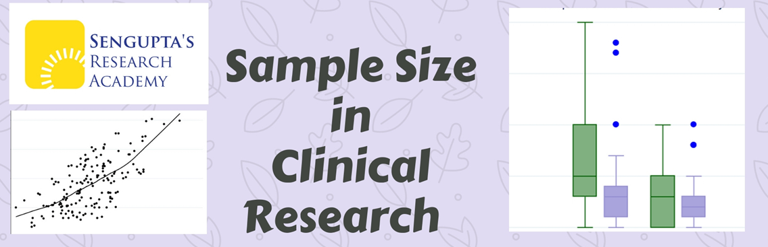
Sample size estimation is a critical aspect of clinical research and influences every aspect that follows, including study execution, data analysis and the overall results and conclusions as you will see in this blog. Most importantly, sample size influences the most important thing we rely on in drawing inferences i.e. P – value. It is important to calculate sample size before you start the study and not midway through it or at completion. Remember that it is impossible to enrol the entire population of patients with disease and hence we choose an appropriate sample, in characteristics and numbers, to represent the patient population. The key word here is appropriate.
It is a misconception that sample size estimation is essential only for randomized clinical trials, since outcomes of every study, including a retrospective one is influenced by the sample size enrolled
15-09-2024
59

Slide 60
A study that has a sample size which is too small may produce inconclusive results and could also be considered unethical, because exposing human subjects or lab animals to the possible risks associated with research is only justifiable if there is a realistic chance that the study will yield useful information.
Similarly, a study that has a sample size which is too large will waste scarce resources and could expose more participants than necessary to any related risk. Thus an appropriate determination of the sample size used in a study is a crucial step in the design of a study.
WHY SAMPLE SIZE IS IMPORTANT:
The two major factors affecting the power of a study are the sample size and the effect size
A study should only be undertaken once there is a realistic chance that the study will yield useful information
A study that has a sample size which is too small may produce inconclusive results and could also be considered unethical by exposing human subjects or lab animals to needless risk
A study that is too large will waste scarce resources and could expose more participants than necessary to any related risk
Thus an appropriate determination of the sample size used in a study is a crucial step in the design of a study
The purpose of the study may be to obtain enough tissue to analyze, to use a small number of animals for a pilot experiment, or to test a hypothesis. There is a statistical basis for estimating the number of animals (sample size) needed for several classes of hypotheses. The formula to be used depends on whether a dichotomous or continuous variable is observed and on the experimental design. Often, too few animals are used to make it possible to detect a significant effect.
Most animal experiments involve formal tests of hypotheses. It is possible to estimate the number of animals required for such an experiment if a few items of information are available.

Slide 61
Broadly, three types of variables can be measured: DICHOTOMOUS VARIABLES, often expressed as rates or proportions of a yes-no outcome, such as occurrence of a disease or survival at a given time; CONTINUOUS VARIABLES, such as the concentration of a substance in a body fluid or a physiologic function, such as blood flow rate or urine output; and time to occurrence of an event, such as the appearance of a disease or death.
Many statistical models have been developed to test the significance of differences among means of these types of data.
Most animal experiments involve formal tests of hypotheses. In contrast to pilot experiments and the other types of experiments described above, it is possible to estimate the number of animals required for these experiments if a few items of information are available. Broadly, there are three types of variables that an investigator may measure: (1) dichotomous variable, often expressed as a rate or proportion of a yes/no outcome, such as occurrence of disease or survival at a given time; (2) continuous variable, such as the concentration of a substance in a body fluid or a physiological function such as blood flow rate or urine output; and (3) time to occurrence of an event, such as the appearance of disease or death. Many statistical models have been developed to test the significance of differences among means of these types of data.
In general, several factors must be known or estimated to calculate sample size: the effect size (usually the difference between two groups), the population standard deviation (for continuous data), the desired power of the experiment to detect the postulated effect, and the significance level.
The first two are unique to the particular experiment; the last two are generally fixed by convention. The magnitude of the effect that the investigator wishes to detect must be stated quantitatively, and an estimate of the population standard deviation of the variable of interest must be available from a pilot study, from data obtained in a previous experiment in the investigator’s laboratory, or from the scientific literature.
15-09-2024
61

Slide 62
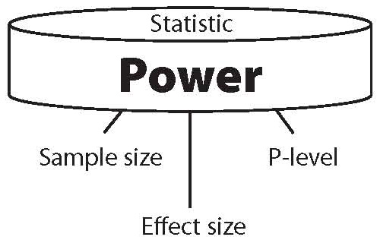
POWER OF THE STUDY
Power is the probability of detecting a difference between treatment groups and is defined as 1-ß, where ß is the probability of committing a Type II error (concluding that no difference between treatment groups exists, when, in fact, there is a difference). Significance, denoted as a, is the probability of committing a Type I error (concluding that a difference between treatment groups exists, when, in fact, there is no difference).
Once values for power and significance level are chosen and the statistical model (such as chi-squared, t-test, analysis of variance, or linear regression) is selected, sample size can be computed by using the size of the effect that the investigator wishes to detect and the estimate of the population standard deviation of the factor to be studied.
Using, for example, randomized block, Latin square, or factorial experimental designs and the analysis of variance, it is possible to control for the effect of strain differences on such a factor as survival or response to an intervention and to obtain a more significant result than would be possible with more elementary methods. However, the simplified designs discussed here yield sample sizes close to what would be obtained with more complex analyses and therefore should help the investigator to be self-sufficient in planning experiments.
15-09-2024
62

Slide 63



If the aim is to determine whether an event has occurred (for example, whether a pathogen is present in a colony of animals), the number of animals that need to be tested or produced is given by
where ß is the probability of committing a Type II error (usually 0.10 or 0.05) and p represents the proportion of the animals in the colony that are not infected. Note that the proportion not infected is used in the formula. For example, if 30% of the animals are infected and the investigator wishes to have a 95% chance of detecting that infection, the number, n, of animals that are need is:
Thus nine animals should be examined to have a 95% chance of detecting an infection that has affected 30% of the animals in the colony. If the prevalence of infection is lower—say, 10%—then
7 animals that has been not infected + 2 animals
That has been infected =9
and about 30 animals would be needed. More animals are needed if the prevalence of the pathogen is low

Slide 64
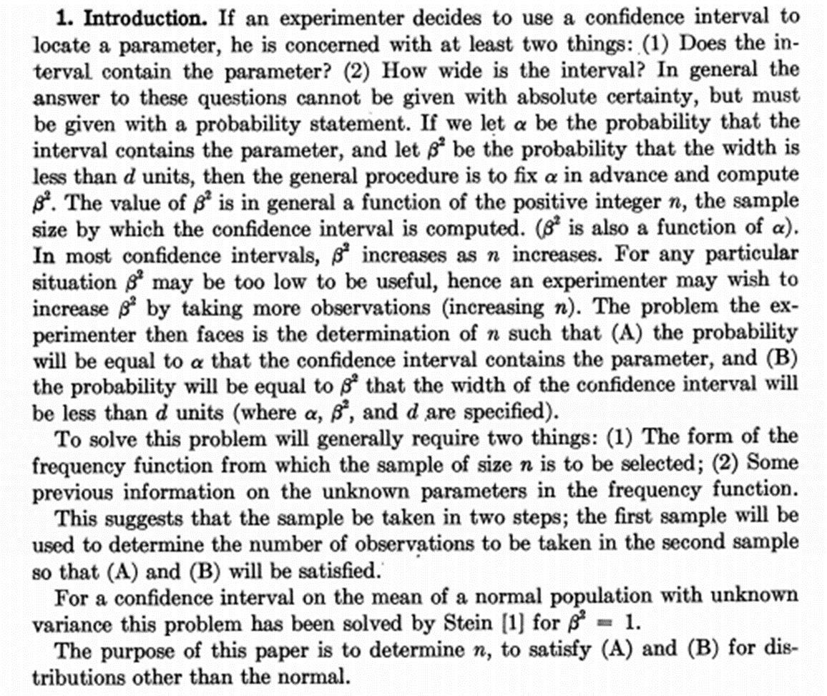
DETERMINATION OF SAMPLE SIZE TO OBTAIN A CONFIDENCE INTERVAL OF SPECIFIED
WIDTH
Apha = 95
Beta square = 92(integer , n)
Alpha ls = 95 %
How many samples (n) I need to make beta square to 95 % or else more than 95%
How many samples I took (n) in order to increase the value from 92 tro 95 % , is the specified width /..
15-09-2024
© R R INSTITUTIONS , BANGALORE
64

Slide 65
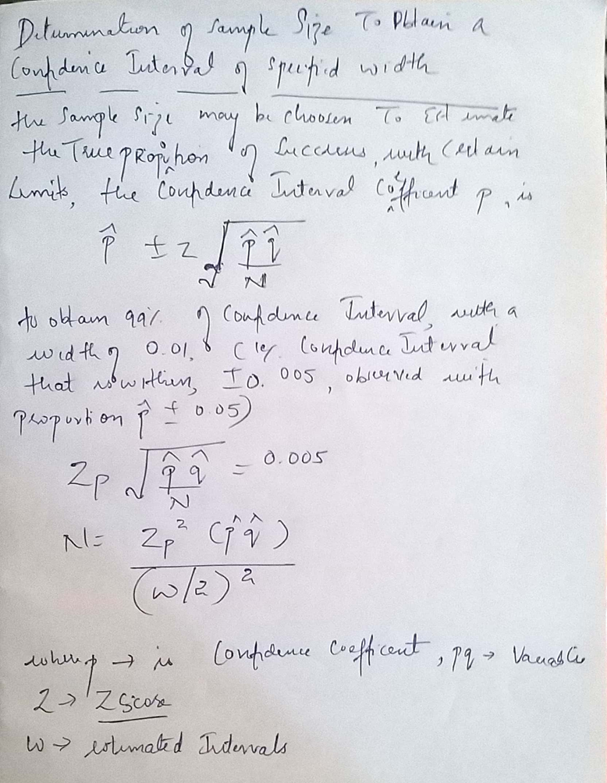
15-09-2024
65

Slide 66

REPORT WRITING AND PRSENATAION OF DATA
A research report is considered a major component of any research study as the research remains incomplete till the report has been presented or written. No matter how good a research study, and how meticulously the research study has been conducted, the findings of the research are of little value unless they are effectively documented and communicated to others. The research results must
invariably enter the general store of knowledge. Writing a report is the last step in a research study and requires a set of skills somewhat different from those called for in actually conducting a research.
After reading this unit you will be able to:
Follow the various steps involved in writing a research report.
Explain the various components of a research report
identify common mistakes committed while writing a research report.
15-09-2024
66

Slide 67
TYPES OF REPORT
Research reports vary greatly in length and type depending on the subject. For example banks and other financial institutions prefer short balance sheet type of tabulations for their annual report. The news items found in newspapers are also a form of report writing..
Any research investigation may be presented in like a technical report, a popular report, an article, a monograph, or, at times, even in the form of an oral presentation. The technical report is prepared for specialists who have interest in understanding the technical procedure and terminology used in the research project. The report will be in technical language. In the technical report, the main emphasis is on:
the methods employed;
assumptions made in the course of study and;
the detailed presentation of the findings, including their limitations and supporting data.
Popular data is intended for persons who have limited interest in the technical aspects of the research methodology and research findings. The popular report is one which gives emphasis on simplicity and attractiveness. The simplification should be sought through clear writing, minimizing of technical, particularly mathematical details, and liberal use of charts and diagrams. Attractive layouts along with large print and many subheadings is another feature of a popular report. In such a report, emphasis is given on practical aspects and policy implications.
15-09-2024
67

Slide 68

WRITING THE RESEARCH REPORT
Once the data collection and analysis work is over, the researcher will start writing
the research report. Social and development research reports need to have a logical, clear structure be to the point use simple language, and have a pleasant layout Just as an architect has to draw a layout plan for a house that is being designed, you first have to make an outline for your report. This outline will contain a head, a body, and a tail.
The head consists of a description of your problem within its context (the country and research area), the objectives of the study and the methodology followed. This part should not comprise more than one quarter
of the report, otherwise it becomes top-heavy.
The body will form the bigger part of your report: it will contain the research findings.
The tail, finally, consists o f the discussion of your data, conclusions, and recommendations.
The research report will have, broadly, three parts.
Part I : The Preliminary Pages
Part II : The Main Text of the Research Report
Part III : The End Matter
15-09-2024
68

Slide 69
THE PRELIMINARY PAGES OF RESEARCH REPORT
• Title and cover page
• A foreword
• Preface
• Acknowledgements
• Table of contents
• List of tables
• List of figures
• List of abbreviations
15-09-2024
69

Slide 70

Title and Cover page
The cover page should contain the title, the names of the authors with their designations, the institution that is publishing the report with its logo, (e.g., Rajiv Gandhi university of health sciences), the month, and the year of publication. The title could consist of a challenging statement or question, followed by an informative subtitle covering the content of the study and indicating the area where the study was implemented
15-09-2024
70

Slide 71
Foreword
A foreword is usually a short piece of writing found at the beginning of a book or other piece of literature, before the introduction. This may or may not be written by the primary author of the work.
Preface
A preface, by contrast, is written by the author of the book. A preface generally covers the story of how the book came into being, or how the idea for the book was developed; this is often followed by thanks and acknowledgments to people who were helpful to the author during the time of writing
Acknowledgements
It is good practice to thank those who supported you technically or financially in the design and implementation of your study. You should not forget to thank your research guide and your employer, too, who has allowed you to invest time in the study; and, the respondents may be acknowledged
Table of Contents
A table of contents is essential. It provides the reader a quick overview of the chapters with major sections and sub sections of your report, and page references, so that the reader can go through the report in a different order, or skip certain sections. The sections and sub sections within each chapter may be given numbers that are specific to the chapter. For example, a section in chapter III may be given no as 3.1; and, a sub section as 3.1.1. An example of a table of contents is given below.
15-09-2024
71

Slide 72
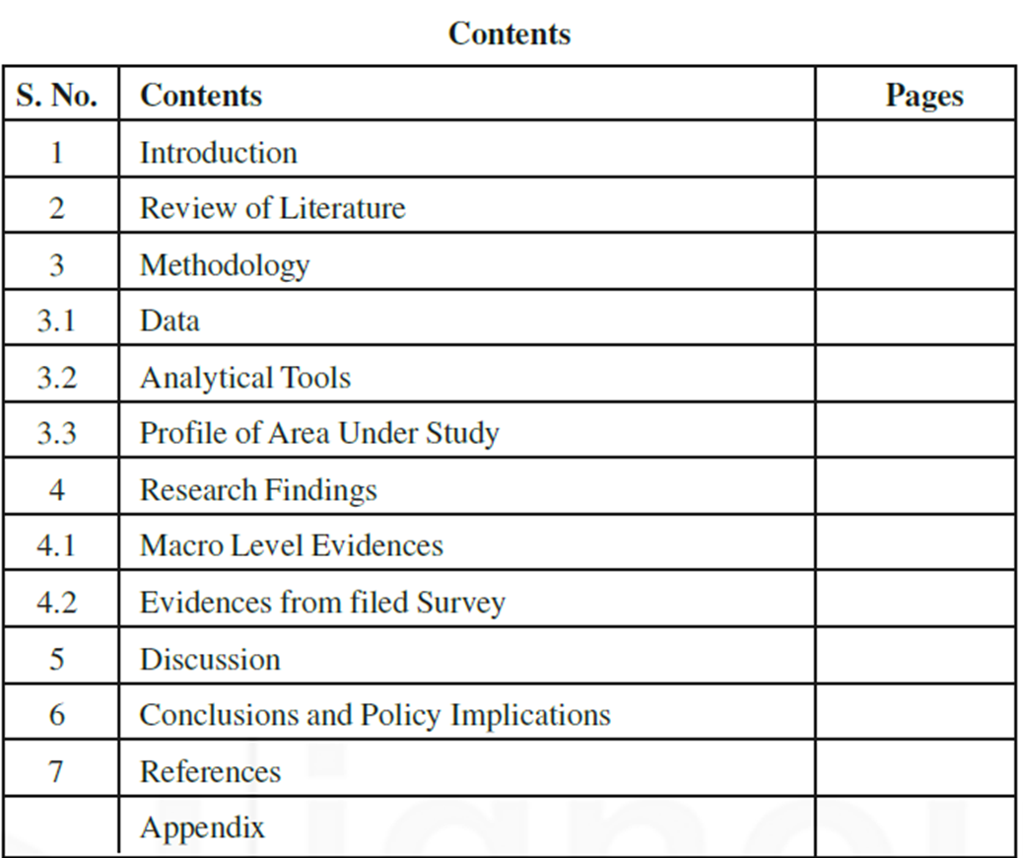
15-09-2024
72

Slide 73
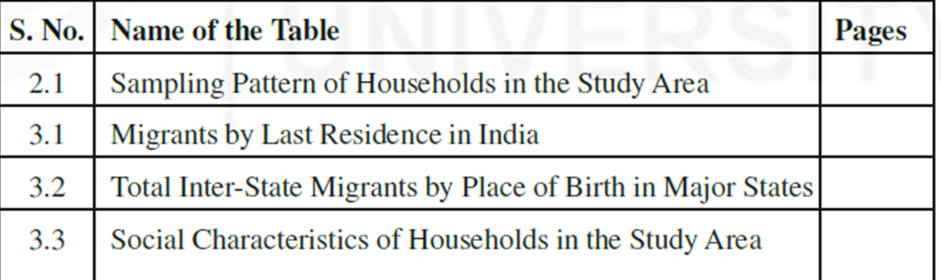
List of Tables
If you have many tables or figures, it is essential to list these also in a table of contents with formatted with page numbers. The initial letters of the key words in the title are capitalized and no terminal punctuation is used. An
example is given below.
List of Figures
The list of figures appears in the same format as the list of tables, titled List of Figures.
List of Abbreviations
If abbreviations or acronyms are used in the report, these should be stated in full in the text the first time that they are mentioned. If there are many, they should be listed in alphabetical order as well. The list can be placed before the first chapter of the report.
15-09-2024
73

Slide 74
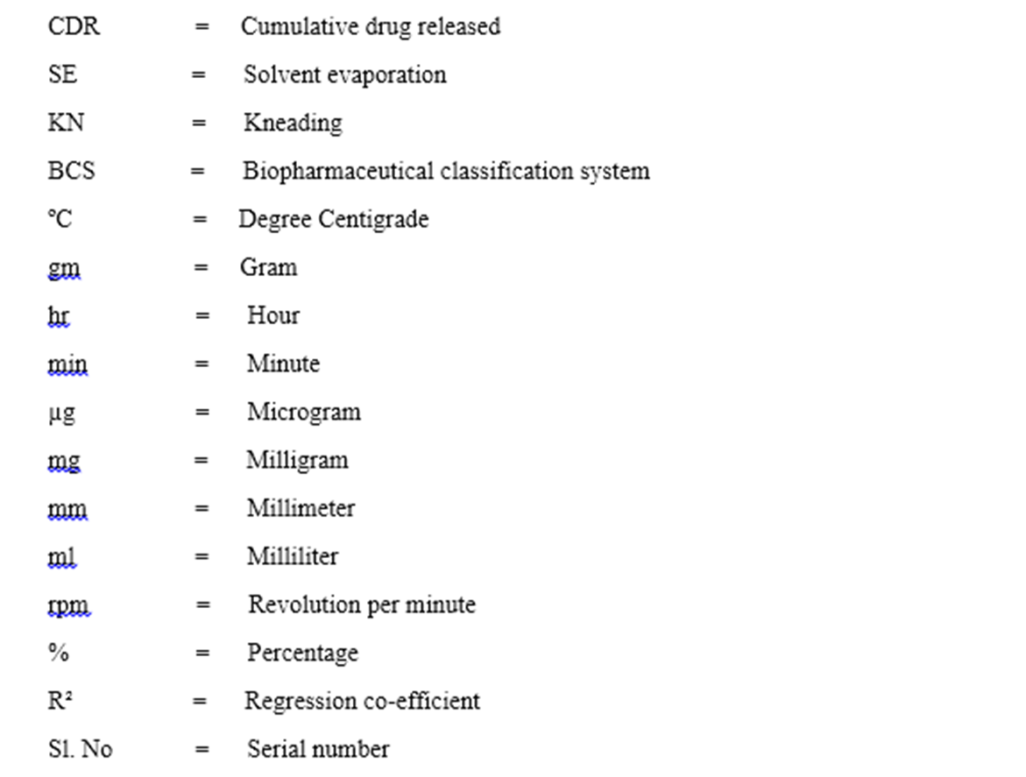
15-09-2024
74

Slide 75
MAIN COMPONENTS OR CHAPTERING OF RESEARCH REPORT
The Main Text includes the following
• Introduction
• Review of Literature
• Methodology
• Research Findings
• Discussion
• Conclusion and Recommendations
• Summary
15-09-2024
75

Slide 76
INTRODUCTION
The introduction is a relatively easy part of the report that can best be written after a first draft of the findings has been made. It should certainly contain some relevant background data and information about the topic on which you are carrying out research it should be need to be described. You may make additions to the corresponding section in your research proposal, including additional literature,
and use it for your report.
Then, the statement of the problem should follow, again, revised from your research proposal with additional comments and relevant literature collected during the implementation of the study. It should contain a paragraph on what you hope/ hoped to achieve from the results of the study. Enough background
should be given to make clear to the reader why the problem was considered worth investigating.
15-09-2024
76

Slide 77
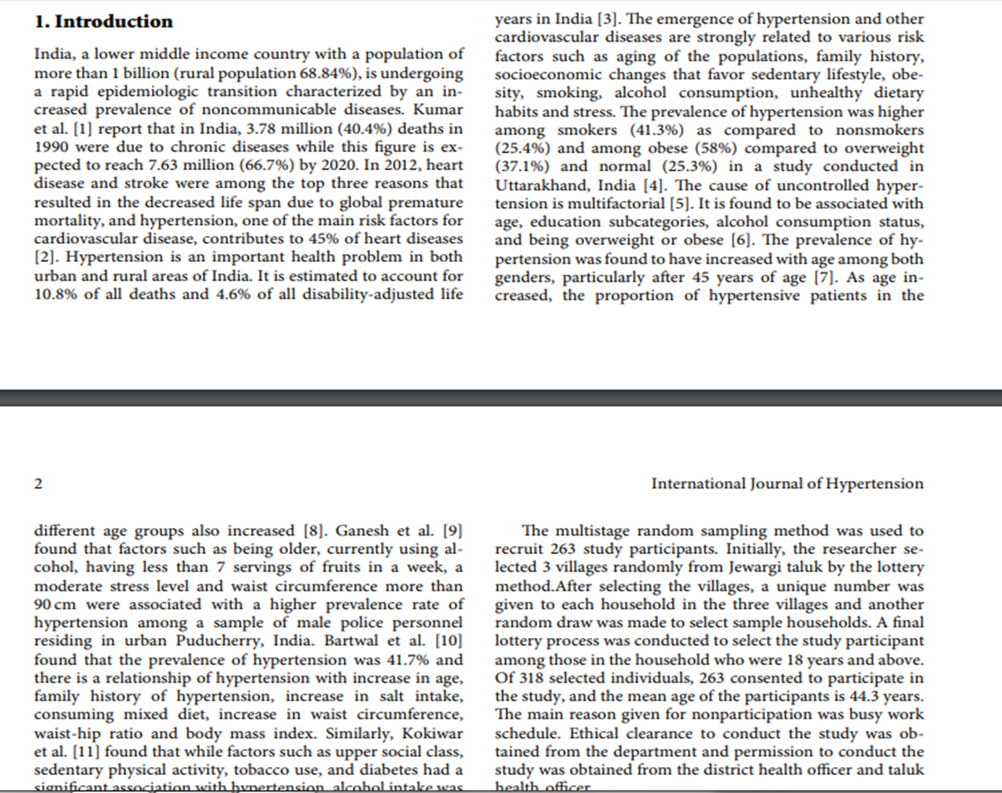
15-09-2024
77

Slide 78
REVIEW OF LITERATURE
Global literature can be reviewed in the introduction to the statement of them problem if you have selected a problem of global interest. Otherwise, relevant literature from individual countries may follow as a separate literature review after the statement of the problem. A literature review is a body of text that aims to review the critical points of current knowledge and or methodological
approaches on a particular topic.
Literature reviews are secondary sources, and, as such, do not report any new or original experimental work. Its ultimate goal is to bring the reader up to date with current literature on a topic, and forms the
basis for another goal, such as future research that may be needed in the area.
A well-structured literature review is characterized by a logical flow of ideas; current and relevant references with consistent, appropriate referencing style; proper use of terminology; and an unbiased and comprehensive view of the previous research on the topic.
15-09-2024
78

Slide 79
METHODOLOGY
The methodology adopted in conducting the study must be fully explained. The scientific reader would like to know about the basic design of the study, the methods of data collection, information regarding the sample used in the study, the statistical analysis adopted and the factors limiting the study .The methodology section should include a description of
• the study type
• major study themes or variables (a detailed list of variables on which data was collected may be annexed)
• the study/ target population(s), sampling method(s) and the size of the sample(s)
• data collection techniques used for the different study populations
• duration of data collection
• how the data was collected and by whom
• procedures used for data analysis, including statistical tests (if applicable)
• any constraints and its management
• limitations of the study.
15-09-2024
79

Slide 80
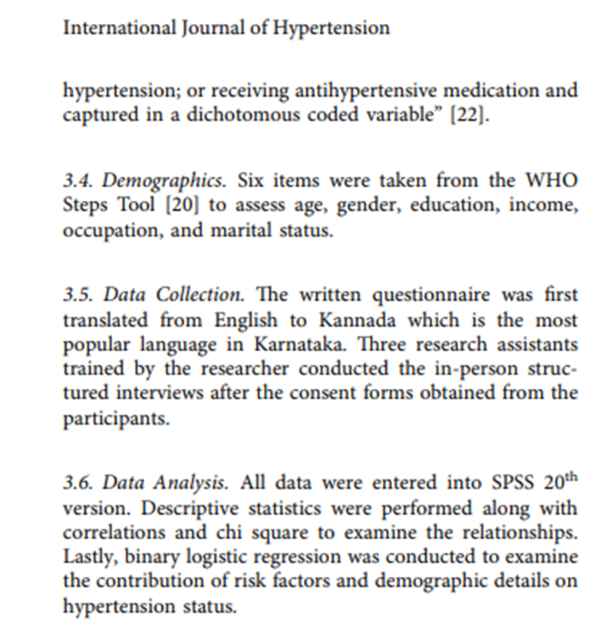
15-09-2024
80

Slide 81
RESEARCH FINDINGS
A detailed presentation of the findings of the study with supporting data in the form of tables and charts, together with a validation of the results is the next step in writing the main text of the report. The result section of the study should contain the statistical summaries and reductions of data, rather than raw data.
All the results should be presented in a logical sequence and split into readily identifiable sections. The systematic presentation of your findings in relation to the research objectives is the crucial part of your report. The list of data by objectives will help you to decide how to organize the presentation of data. The decision concerning where to put what can best be made after all data have been fully processed and analysed, and before the writing Report Writing starts. When all data have been analysed, a detailed outline has to be made for the presentation of the findings.
This will help the decision-making on how to organize the data, and is an absolute precondition for optimal division of tasks among group members in the writing process. At this stage you might as well prepare an outline for the whole report, taking the main components of a research report as a point of departure.
15-09-2024
81

Slide 82
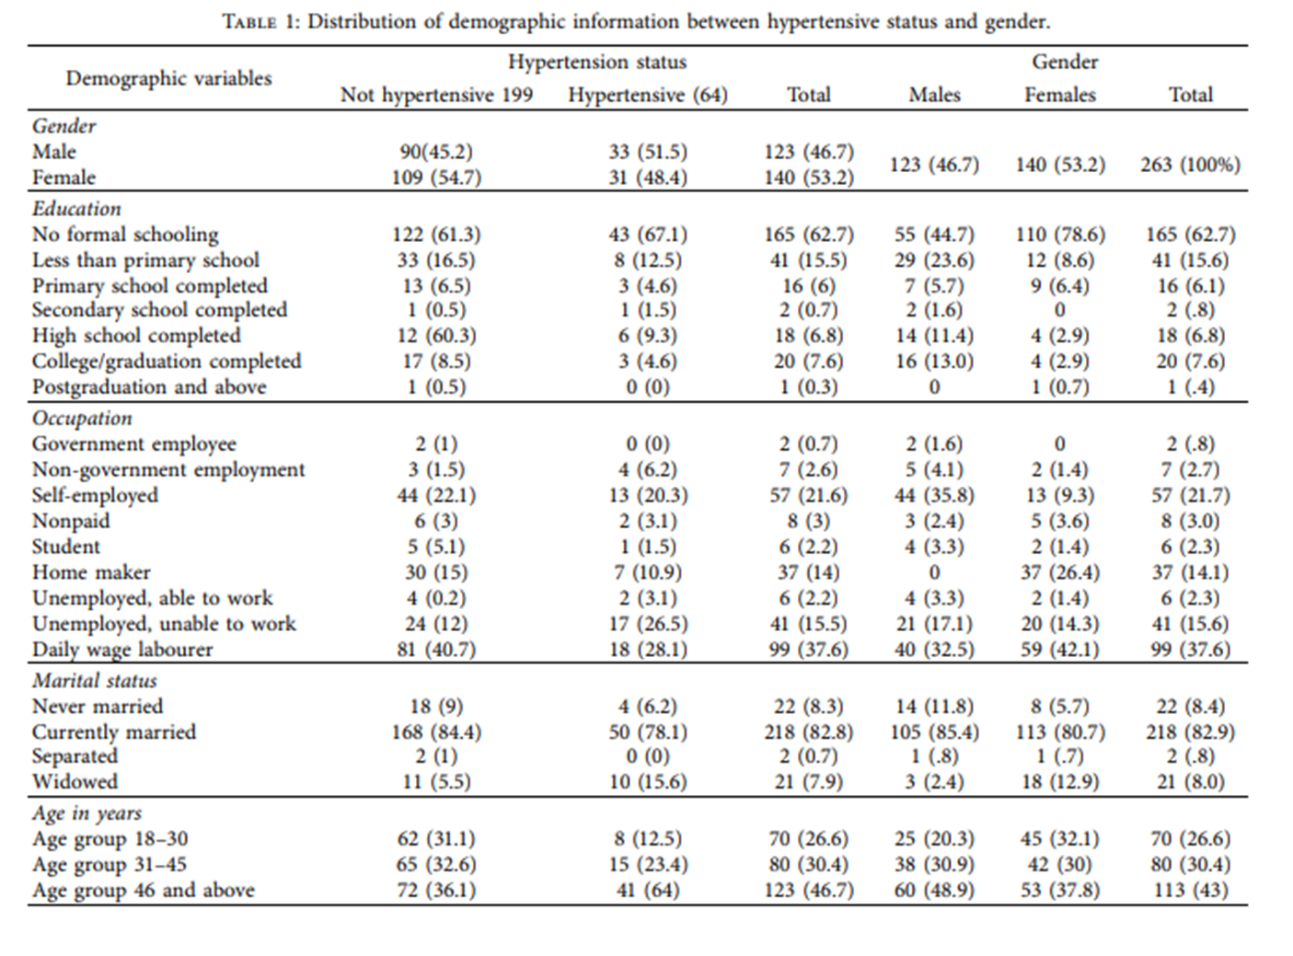
15-09-2024
82

Slide 83
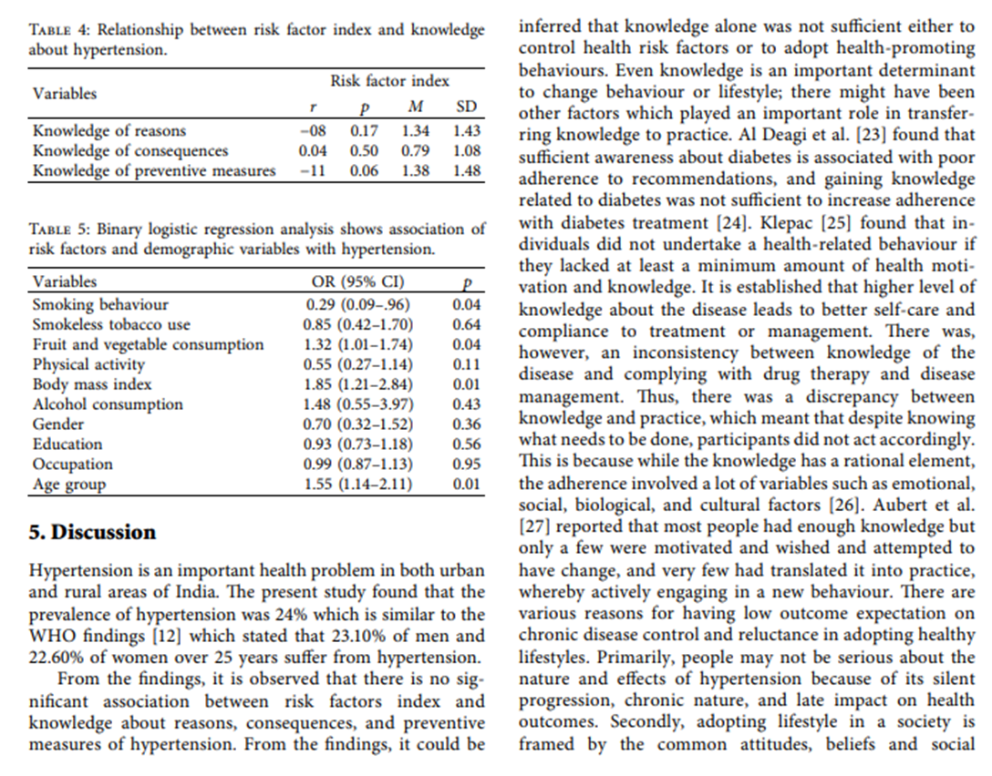
DISCUSSION
The findings can now be discussed by objective or by cluster of related variables or themes, which should lead to conclusions and possible recommendations. The discussion may also include findings from other related studies that support or contradict your own. For easy understanding, the discussion of the table given in findings is given below.
15-09-2024
83

Slide 84
CONCLUSIONS AND RECOMMENDATIONS
The conclusions and recommendations should follow logically from the discussion of the findings. As the discussion will follow the sequence in which the findings have been presented (which in turn depends on your objectives) the conclusions should logically follow the same order. Sometimes, it is advisable to present conclusion and recommendations in specific sections related to issues of importance/under investigation/objectives of the study for better clarity to different stake holders. The conclusions should be given in bullets so that it can easily catch the attention of the reader.
Remember that action-oriented groups are most interested in this section. The conclusions should be followed by suggestions or recommendations. While making recommendations, use not only the findings of your study, but also supportive information from other sources.
The recommendations should be generated from the findings and conclusions. It should not be generalized; rather it should be specific to particular stake holders in pure, actionable term which is feasible in relation to social context, policy and constitution of country, political acceptability, budget, time, etc.
15-09-2024
84

Slide 85
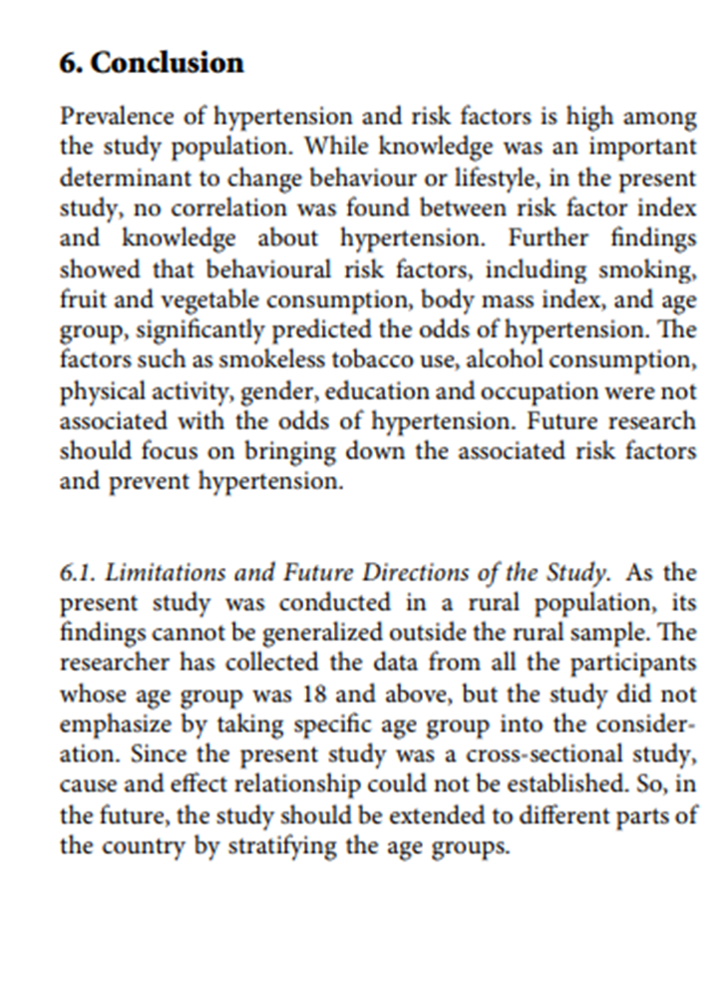
15-09-2024
85

Slide 86
PRESENATION OF DATA
The objective of classification data is to make data simple, concise, meaningful and interesting for further analysis.
There are two methods of presenting data they are
TABULATION
DIAGRAMS
1. TABULATION :- Guidelines for tables
Statistical tables are a vital part of the report and deserve special attention. We illustrate the guidelines for tables using data from the data.
15-09-2024
86

Slide 87
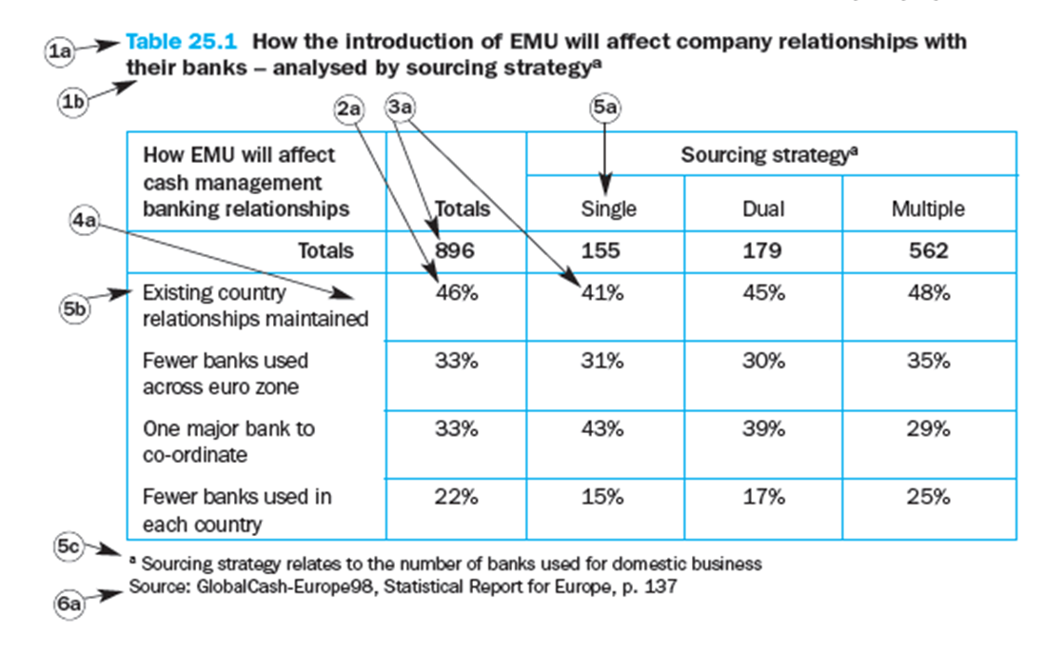
Title and number. Every table should have a number (1a) and title (1b). The title should be brief yet clearly descriptive of the information provided. Arabic numbers are used to identify tables so that they can be referenced in the text.
Arrangement of data items. The arrangement of data items in a table should emphasize the most significant aspect of the data. For example, when the data pertain to time, the items should be arranged by appropriate time period. When order of magnitude is most important, the data items should be arranged in that order (2a). If ease of locating items is critical, an alphabetical arrangement is most appropriate.
Leaders, rulings and spaces. The reader’s eye should be guided to be able to read across the table clearly. This can be achieved with ruled lines (4a), alternate shaded rows, or white spaces with dotted lines leading from the row headings to the data.
Basis of measurement. The basis or unit of measurement should be clearly stated (3a). the totals sample size is shown and the sub-sample sizes of the different sourcing strategies. The main body of data is shown in percentages. The % signs would normally be removed, with a note to tell the reader that the main body is based upon column percentages or row percentages, or percentages related to the total sample size.
Sources of the data. If the data contained in the table are secondary, the source of data should be cited (6a).
15-09-2024
87

Slide 88
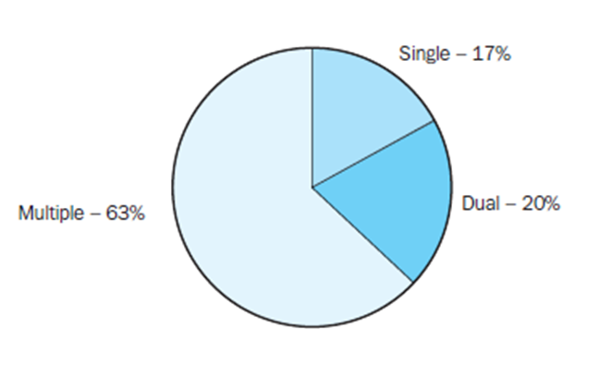
Explanations and comments: headings, stubs and footnotes. Explanations and comments clarifying the table can be provided in the form of captions, stubs and footnotes. Designations placed over the vertical columns are called headings (5a). Designations placed in the left-hand column are called stubs (5b). Information that cannot be incorporated in the table should be explained by footnotes (5c). Letters or symbols should be used for footnotes rather than numbers. The footnotes that are part of the original source should come after the main table, but before the source note.
2. DIAGRAMS
Guidelines for graphs:- As a general rule, graphical aids should be employed whenever practical. Graphical display of information can effectively complement the text and tables to enhance clarity of communication and impact.
Round or pie charts. In a pie chart, the area of each section, as a percentage of the total area of the circle, reflects the percentage associated with the value of a specific variable. Pie charts are very useful in presenting simple relative frequencies in numbers or percentages. A pie chart is not useful for displaying relationships over time or relationships among several variables. As a general guideline, a pie chart should not require more than seven sections
15-09-2024
88

Slide 89
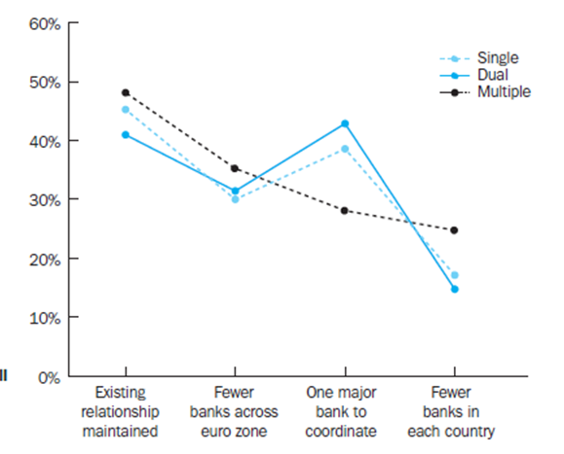
Line charts. A line chart connects a series of data points using continuous lines. This is an attractive way of illustrating trends and changes over time. Several series can be compared on the same chart, and forecasts, interpolations and extrapolations can be shown. If several series are displayed simultaneously, each line should have a distinctive color or form.
Histograms and bar charts. A bar chart displays data in various bars that may be positioned horizontally or vertically. Bar charts can be used to present absolute and relative magnitudes, differences and change. A histogram is a vertical bar chart in which the height of the bars represents the relative or cumulative frequency of occurrence of a specific variable Other variations on the basic bar chart include the stacked bar chart and the cluster bar chart Stacked and cluster bar charts can work well with a few data items presented, to qualitatively represent differences between groups. As noted with pie charts, 3D charts should be used with great caution as they can distort the message and confuse an audience. Most graphics packages have a great array of 3D options; however, there are few circumstances where they can be used to present data in a clear and unbiased manner.
15-09-2024
89

Slide 90


15-09-2024
90

Slide 91

15-09-2024
91

