Slide 1
BIOSTASTICS AND RESAERCH METHODOLOGY
UNIT 3- COMPUTER APPLICATIONS IN PHARMACY
15-09-2024
1

Slide 2
COMPUTER APPLICATIONS IN PHARMACY
Computer System in Hospital Pharmacy: Patterns of Computer use in Hospital Pharmacy – Patient record database management, Medication order entry – Drug labels and list – Intravenous solution and admixture, patient medication profiles,
Inventory control, Management report & Statistics.
Computer In Community Pharmacy :Computerizing the Prescription Dispensing process Use of Computers for Pharmaceutical Care in community pharmacy , Accounting and General ledger system.
Drug Information Retrieval & Storage :
Introduction – Advantages of Computerized Literature Retrieval, Use of Computerized Retrieval.
15-09-2024
2

Slide 3

Computer System in Hospital Pharmacy
Computer is mandatory in this advanced era and pharmacy and related subjects are not exception to it. This review mainly focuses on the various applications, software's and use of computers in pharmacy. Computer science and technology is deeply utilized in pharmacy field everywhere like in pharmacy colleges, pharmaceutical industries, research centers, hospital pharmacy and many more.
Computer significantly reduces the time, expenditure, and manpower required for any kind of work. Development of various software's makes it trouble-free to handle huge data. In short, computers are playing critical role in pharmacy field, without computers pharmacy research will be long-lasting and expensive.
Hospital pharmacy is division of hospital which monitors on the receiving and allotment of drugs and medicines and professional supplies, stores them and dispenses to inpatient, outpatient and may have a manufacturing extension to manufacture pharmaceuticals and parenteral in bulk.
15-09-2024
3

Slide 4
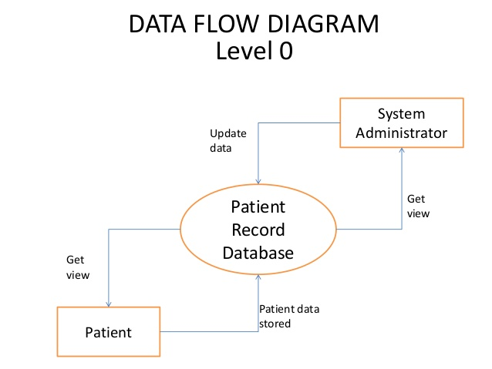
A. Patterns of Computer use in Hospital Pharmacy -
PATIENT RECORD DATABASE MANAGEMENT
In a Hospital setting a critical role is to be played by a Pharmacist. A major work is analysis of Drug Interactions by both retail and hospital pharmacists. Medical reference and information system providing access to database through computer-based software are capable of analyzing medications prescribed by physicians
Inventory control is an essential task to be performed in a long-term care Pharmacy of hospitals.
PATIENT RECORD DATABASE MANAGEMENT - Patients recording management is an integral component in modern day healthcare management system. If proper records are kept in secure and safe place within the hospital helps healthcare professionals compare and contrast certain illnesses based on certain features. It can also be used for research purposes if guaranteed of security and privacy issues. The patient’s records kept include patient data, which helps to maintain patient’s medical records. The medical records must be accurate, efficient and correct that reflect the patient’s medical history. Medical professionals maintain impeccable records as it serves numerous purposes.
15-09-2024
4

Slide 5
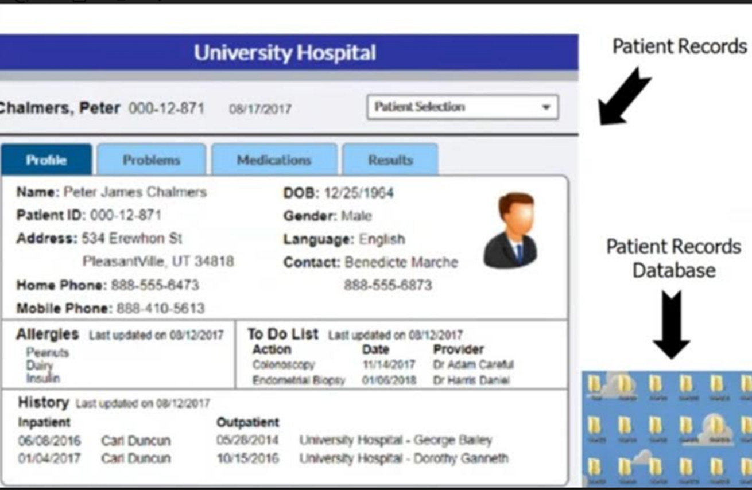

Slide 6
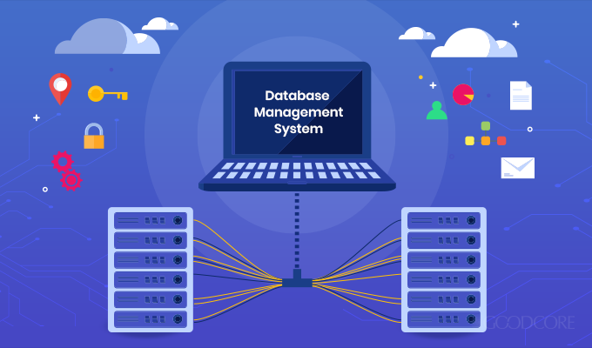
The chief characteristics defined for this system were to be:
1. The storage of medical records containing information of both disciplined and unrestricted nature.
2. The handling of data flow around the hospital.
3. The gathering of statistics for a management information service.
To provide a generalized solution to these objectives establish a database which would provide:
1. A day-to-day, patient-based medical information system gradually to replace much of the paper-based medical records, and to speed the flow of information throughout the health care services.
2. A longer-term information storage system supporting the patient medical record for life and interfacing with all forms of medical care.
3. An information base suitable for various types of clinical and administrative analysis.
15-09-2024
6

Slide 7
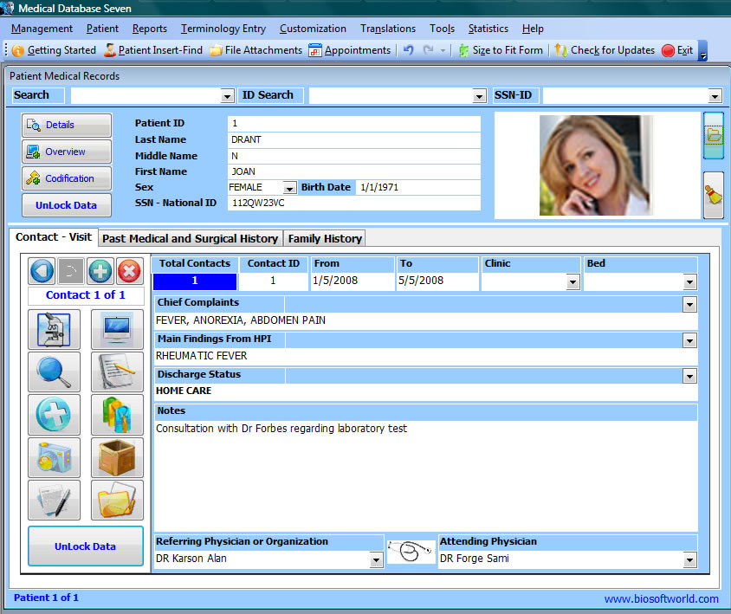
Patient record maintenance is vital job in hospitals but with the help of computers, data can be maintained easily and also updated time to time. Maintenance of stock means inventory control can be achieved very well by using computers. For this purpose, periodic or perpetual inventory control systems may be adapted. Computers can play role like,
To detect the items which have reached minimum order level.
To prepare list of items to be purchased and their quantities.
To prepare purchase orders for vendors and to avoid duplication.
To detect the infrequently purchased items for possible return or elimination from pharmacy’s drug supply.
To produce periodic summary and purchasing and inventory control statistics.
Maintaining patient medical record.
Drug information services.
Patient monitoring.
15-09-2024
7

Slide 8
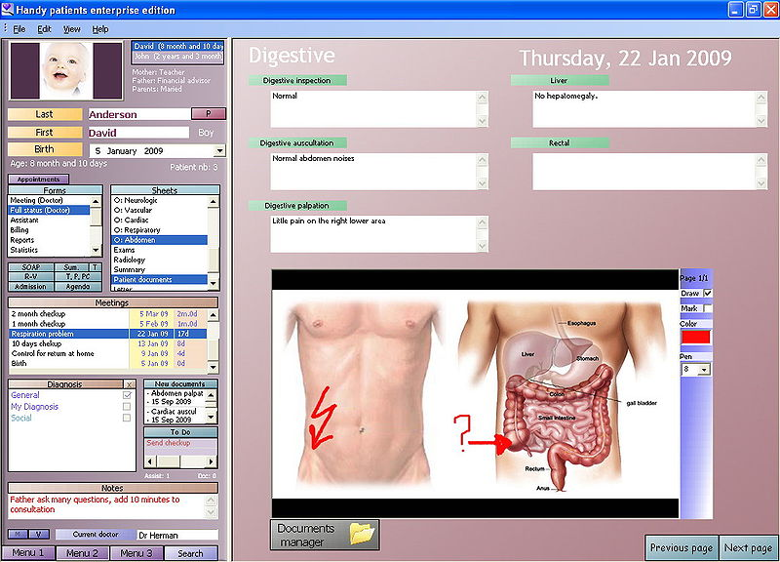
Health information could be stored as individual indexed items of information that could be abstracted into reports and compare among patients.
Record could be accessed and easily duplicated when necessary. Information anywhere within the record could be access by minimal delay. Data could be located from any one delivery medium and digital device that access them could be designed with a wide variety of capability and capacity
A page from a paper base patient record could be stored electronically in many different ways. The information could be scanned and store as an image (much like a fax) that is the picture of a paper form but is not searchable or editable document imaging system are widely available that use computer and optical disk to store such image and make them available to clinicians on workstation with graphic terminals.
These system reduces the amount of physical storage space require for patient record and they allow the record to be shared by clinicians and administrative officers without physically transporting the records.
15-09-2024
8

Slide 9
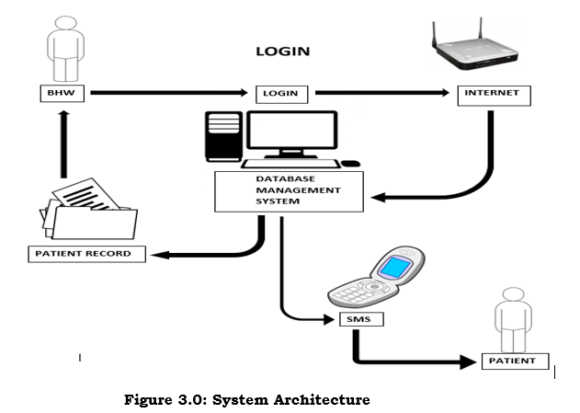
Handwritten medical record can be associated with poor legibility which can contribute to medical error, pre-printed firms, the standardization of abbreviation and standard for penmanship were encouraged to improve reliability of paper medical records.
Electronic record help with the standardization of forms terminology and abbreviation and data input. Digitization of form facilitates the collection of data for epidemiology and clinical studies.
Duplication of lab tests, diagnostic imaging, and other services can be prevented by good record-keeping of any type. However, because database records can be available at many locations at once, integration of services and awareness of duplication can be reduced.
Database management system enable health organization to access old records instantly, thereby allowing the health work to send to another health organization in the event of an emergency.
15-09-2024
9

Slide 10

Patient’s record and procedure vary greatly according to patient data received and the extension of automation in processing data.
These are some fundamental step which is common to patient record in all clinics and hospitals. According to some of these steps taken at each treatment of patient
and assessment in clinical procedure include:
Assessment: To get the information and the assessment of patient’s symptom and signs.
Data entry : recording of data into a patient’s record (which may be a complex electronic data written records results etc.)
Data retrieval: extracting data for interpretation.
Information interpretation: governance of interpretation of individual patient data utilization of existing knowledge and guidelines. Therefore, when these fields are put together they produce a medical record.
The proposed system is design for medical professionals to monitor patient’s medical details (diagnosis, prescription, admission, discharged etc.). It eliminate the problems faced by the old system and improve on the efficiency of patient record management system that is cost-effective, less time consuming and renders accuracy and privacy as only authorized users can gain access to the records as opposed by the old system.
15-09-2024
10

Slide 11
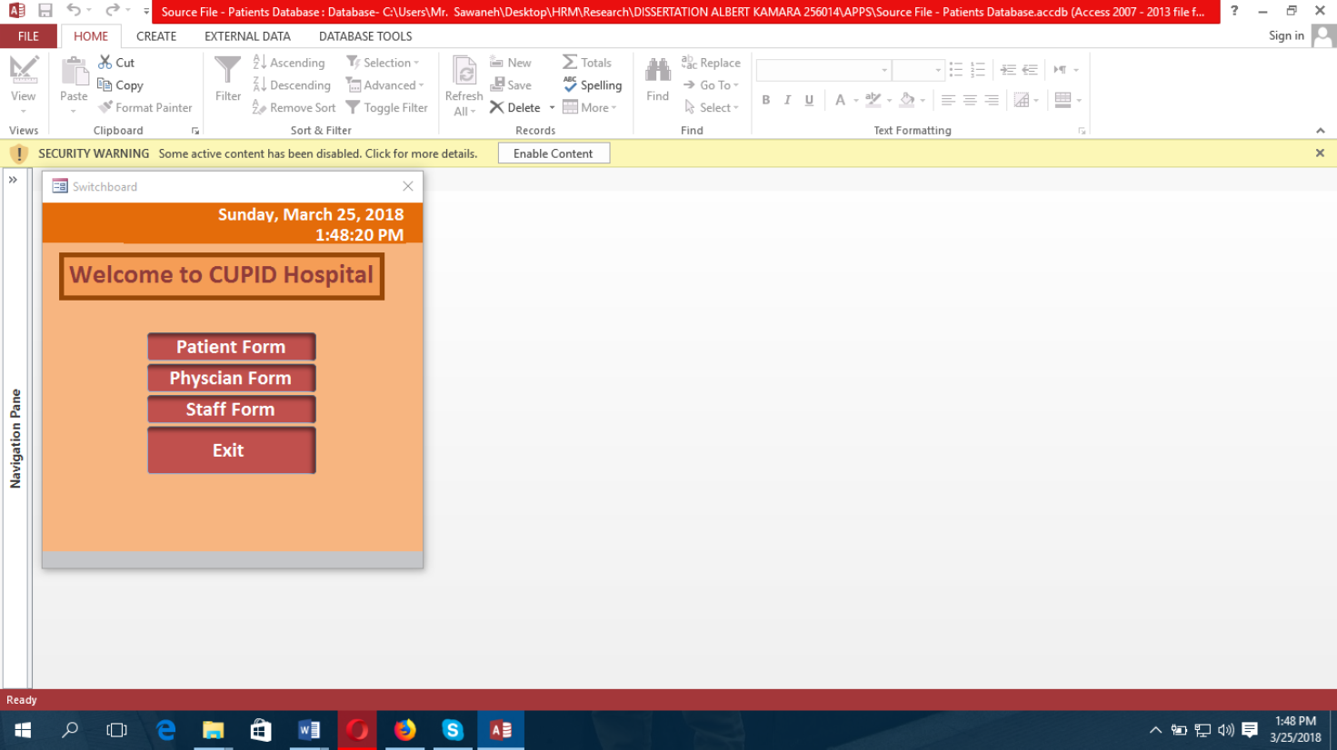
Paitent registration form
A Medical application is designed known as CUPID consisting the Patient Form, Physician Form, Staff Form and Exit as the home page.
15-09-2024
11

Slide 12
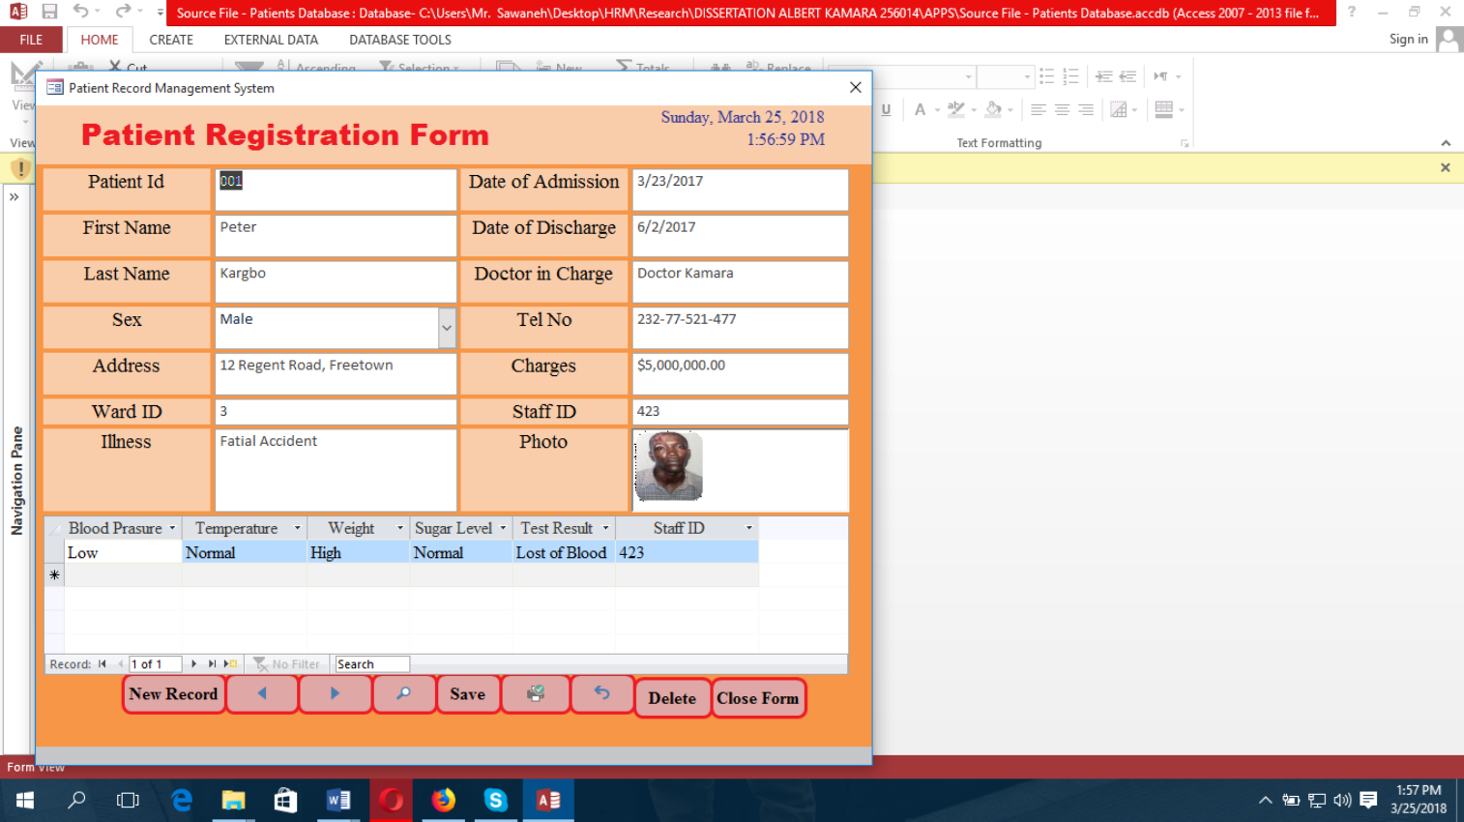
(b) Patient Registration Form :- Use to view patient details
15-09-2024
12

Slide 13
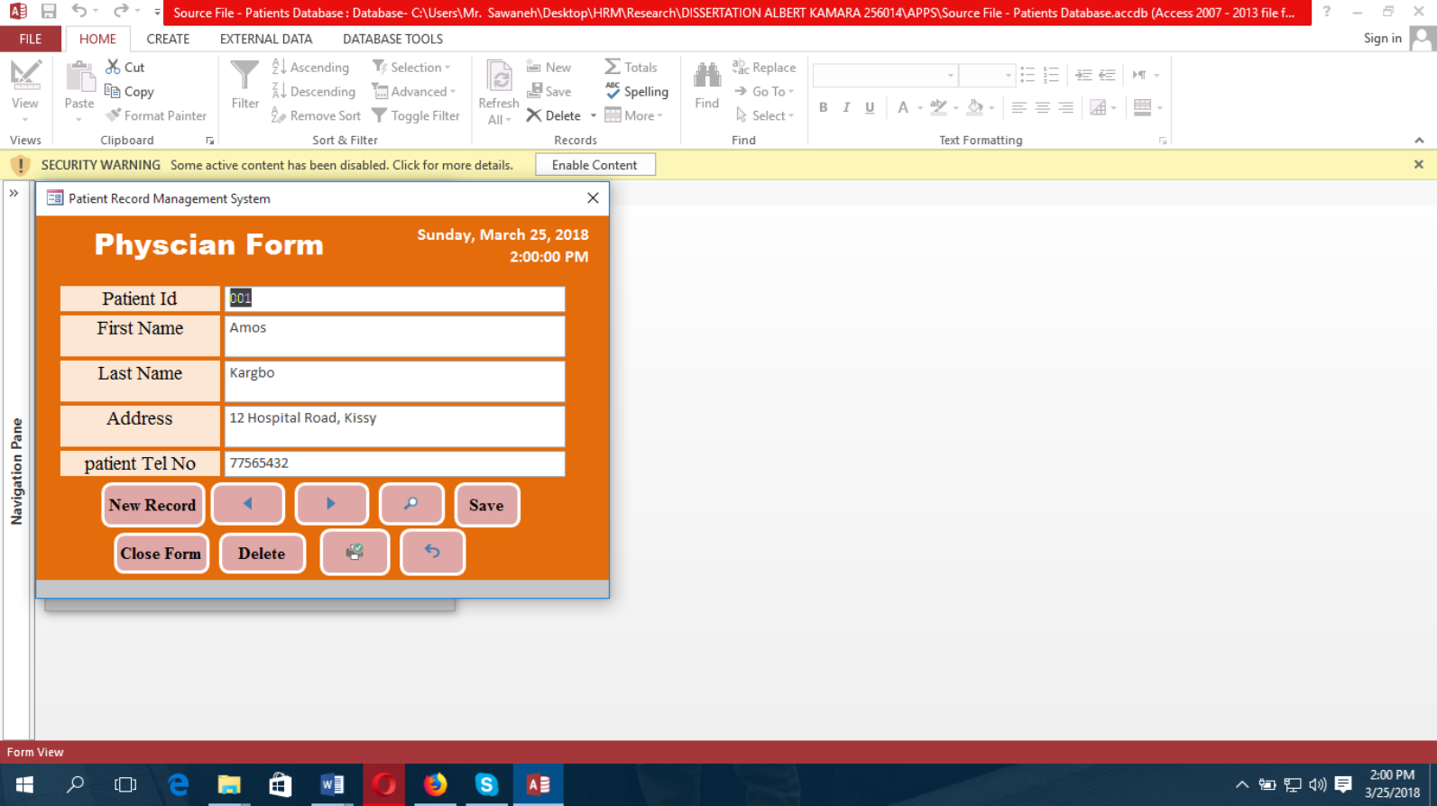
(c) Physician Form :- use to view the details of each physician work in the clinic
15-09-2024
13

Slide 14
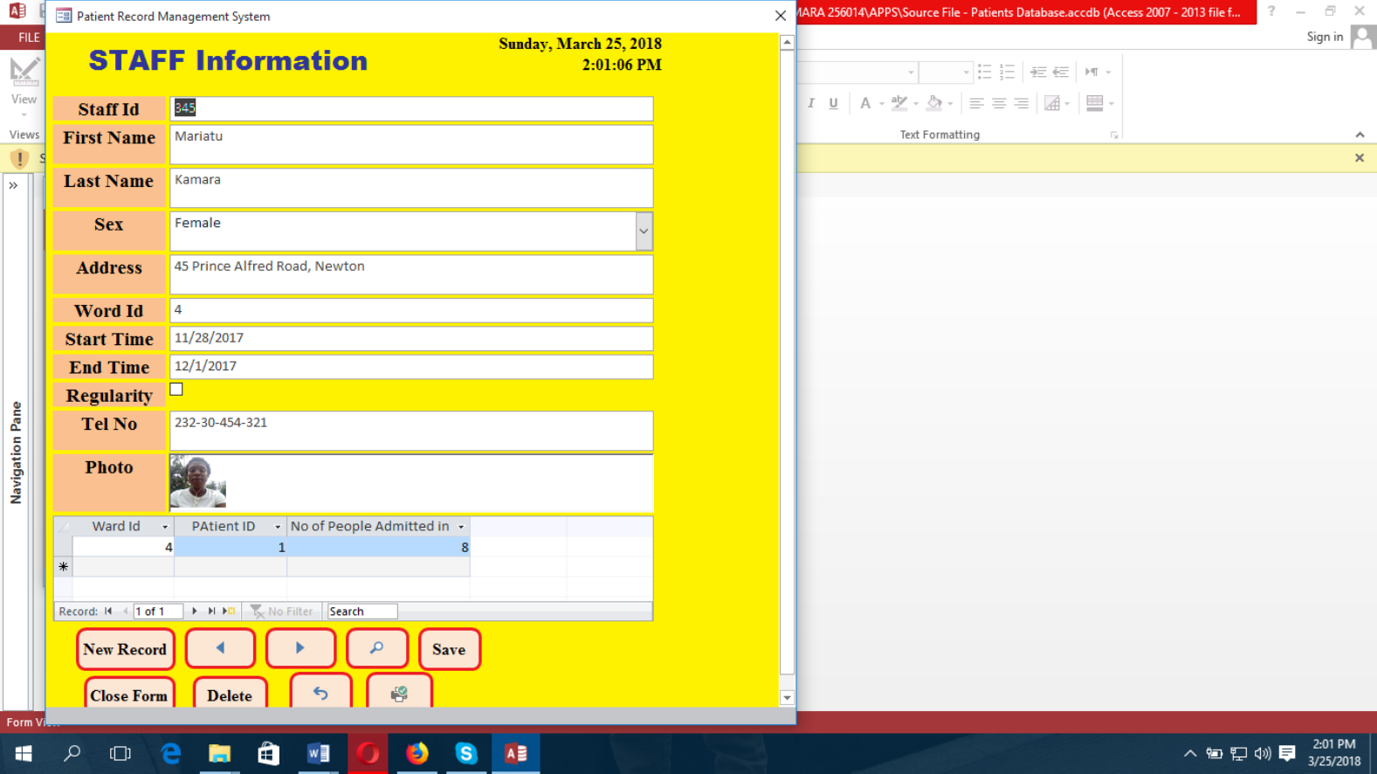
(d) Staff Form :- use to know the details of each staff in the clinic.
15-09-2024
14

Slide 15
Advantages of staff form
Facilities to view once medical records at any time;
Allows healthcare professionals to always monitor their patients;
Rendering safe and secure diagnosis and prescriptions with accuracy;
Reduces data transmission rate;
Hinders third parties or unauthorized users;
Automatically update patient’s medical records (admission and discharge);
Disadvantages of staff form
Requires regular training session for healthcare workers;
Requires continuous power supply (not frequent in most hospitals in developing nations);
Provisions of computers to all departments in all the hospitals across the country;
15-09-2024
15

Slide 16
The research presents a patient medical record system that can be manipulated (sort data, data handling, search, update and store patient medical records securely).
This portrays the prominence and essential features with computer application that manages medical records in hospitals.
It reduces paperwork, reduces time spent by patients in the course of waiting for their files to be retrieved, reduce the storage space, increase the transmission rate of data flow, it is cost-effective and possible reduce hospitalization by allowing patient to be monitored by healthcare professionals whilst at home or at work.
The proposed system provides solution to the conventional system. Furthermore, the system renders accuracy and correctness in medical data as no files are mission in the process and enhance the retrieval of patient data easy.
15-09-2024
16

Slide 17
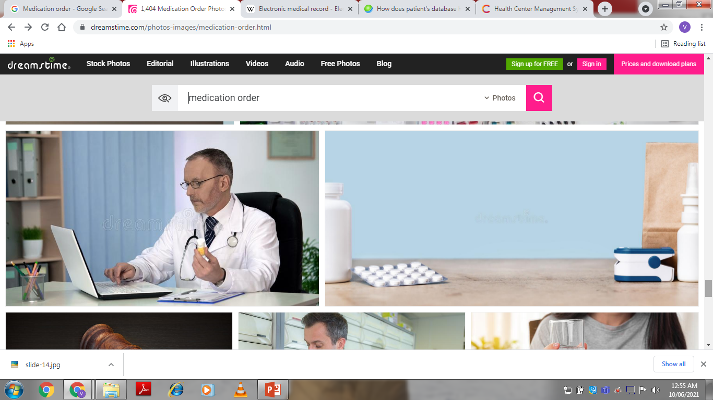
B. MEDICATION ORDER - DRUG LABELS AND LIST – INTRAVENOUS SOLUTION AND ADMIXTURE
A medication order is written directions provided by a prescribing practitioner for a specific medication to be administered to an individual. The prescribing practitioner may also give a medication order verbally to a licensed person such as a pharmacist or a nurse.
Examples of some different types of medication orders are:
• Copy of a written prescription
• Written order on a consultation form, signed by the practitioner
• Written list of medication orders, signed by the practitioner
• Copy of a pharmacy call-in order, given to you by the pharmacist*
• A verbal order given to a licensed person*
• Electronic prescriptions signed electronically via a secured system
prescribing practitioner - This is a term that describes the various health care professionals who can give medication orders.
The following health care professionals are "prescribing practitioners":
• Physicians (MD, DO)
• Nurse Practitioners (APRN, NP)
• Dentists (DMD, DDS)
• Physician's Assistants (PA)
• Optometrist (OD)
• Podiatrist (DPM)
15-09-2024
17

Slide 18
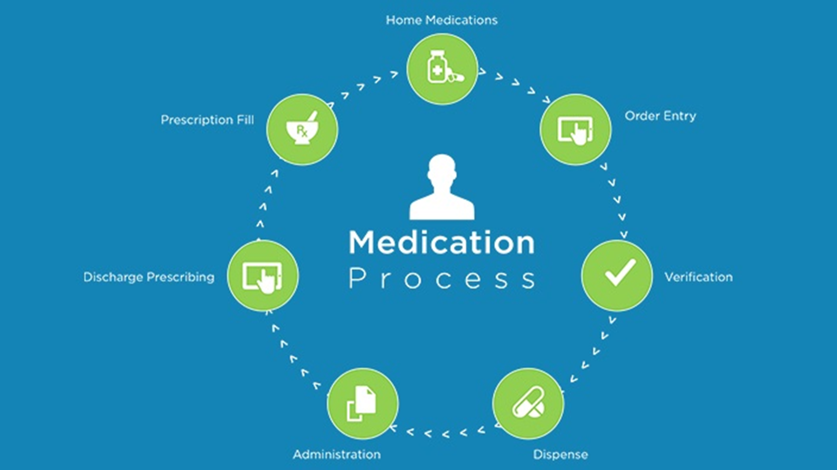
15-09-2024
18

Slide 19
HOSPITALS HAVE LONG FACED CHALLENGES ASSOCIATED WITH getting handwritten medication orders from the prescriber to the pharmacist. Some have installed pneumatic tube systems to transport the paper orders, but because these systems do not electronically track the movement of orders from the patient ward to the pharmacy, orders have a way of getting lost in the shuffle.
Others have chosen fax machines to electronically send orders to the pharmacy, but there is always the risk of visual “noise” on the printed fax that can result in dispensing inaccuracies.
Vital decimal points can be lost in translation – or even mysteriously appear in the wrong places – leading to the pharmacy dispensing an inappropriate and possibly dangerous dose.
CPOE (computerized physician order entry) has often been touted as the ultimate solution to medication order management efficiency and patient safety, but implementation is costly and requires long term planning, and doctor buy-in can be difficult to achieve, as well.
Fortunately, another option exists: medication order management systems, or MOMS. These systems provide the accuracy and tracking your safety initiatives require, while being relatively easy to implement.
Furthermore, relative to CPOE, these systems are not encumbered by a hefty price tag, making an investigation into their impact on your institution well worth the effort.
15-09-2024
19

Slide 20

Medication Order Entry and Filling
Pharmacy Technician Tasks
• Accepting new prescriptions from patient (New telephoned prescriptions in some states, NY included, are not permitted to be accepted by pharmacy technicians )
Receiving refill requested from the patient
• Calling doctor’s office for refill authorizations
• Collecting patient’s data
• Maintaining patient’s profiles
15-09-2024
20

Slide 21
STEPS INVOLVED IN ORDER ENTRY
STEP 1 :- Receiving the prescription. a prescription may be transmitted to the pharmacy in the following ways (controlled substances may differ and state laws also apply
In the form of • Written • Telephoned • Faxed • Electronically, e-prescribing
STEP 2:- OBTAIN PATIENT AND PRESCRIBER INFORMATION
Patient information includes full name, address, contact, date of birth, any drug and food allergies, medical history
Prescriber’s information
• Name and address with contact • DEA (required for controls) • NPI (required for most insurances) • Registration/license (required by some insurances)
STEP 3 :- Data input into electronic patient profile
Includes Name, address and other demographic data, DOB ,Medical history, Drug allergy information and Food, Prior Medication/OTC/Herbal use, Drug selection, NDC of the drug chosen must match the one entered into the computer, Determining if a generic can be used, Keying in direction data, Entering refills, DAW codes.
15-09-2024
21

Slide 22
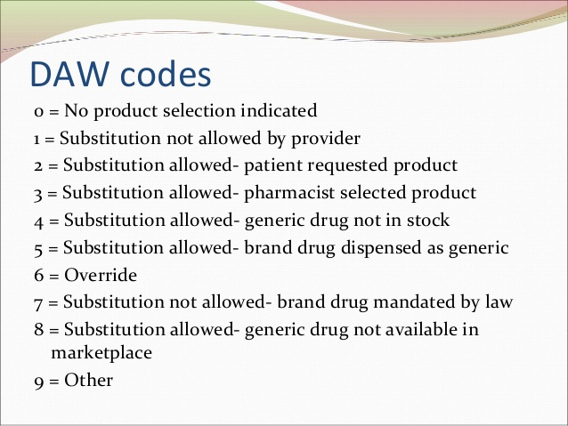
DAW codes are used by insurances companies to help determine the reimbursement to the pharmacy and if the medication is eligible for full or partial coverage
These codes are universal and used by all pharmacies and insurance companies Codes are not required to be memorized for the exam but know the following
DAW=0 means no DAW is indicated (generic ok)
DAW=1 means prescriber indicates brand drug to be dispensed
DAW= 5 means Pharmacy dispenses the brand but realizes it may be reimbursed at the generic rate
DAW= 7 means Federal Law mandates Brand drug
STEP 4 :Submitting the prescription claim to the insurance company for payment. This online claim processing is called adjudication .
15-09-2024
22

Slide 23
STEP 5: GENERATING THE LABEL
• Federal pharmacy Law (FDCA of 1938) requires the following on all retail prescription labels affix to the container
• Pharmacy full information, including telephone
• Patient, prescriber, and drug name (state)
• Strength of the medication
• Direction for use
• Quantity dispensed
• Date prescription was filled or refill
• Rx number
• Initials of the RPH
• Cautionary statement, if needed.
STEP 6 :SELECT THE CONTAINER OF DISPENSING.
Most drugs are light sensitive and their dispensing in amber colored containers are required
• Vials for capsules and tablets
•“Ovals” are wide mouthed containers for compounded creams and ointments
• Glass or plastic amber bottles for liquid medications
• Some drugs require the original manufacturer labeled container to be dispensed.
STEP 7 PHARMACIST CHECK.
Labeled container with the pulled bulk medication and the original prescription
15-09-2024
23

Slide 24
STEP 8: DISPENSING TO PATIENT
For all new patients to your pharmacy it is important to give them a copy of the HIPPA notice of privacy practices and to document that the patient received it; same holds true for doctor’s office
Use of teaching sheets that provide preset information in layman’s term of the medication
Some medications require a patient package insert or PPI to be dispensed with the prescription as per Federal law. These medication classes include:
• Oral contraceptives (birth control)
• Estrogen and progesterone products (menopausal products)
• Isotretinoin (Accutane) • Metered dose Inhalers
• PPI are laymen terms for what is contained in the Package Insert.
All dispensed prescriptions must comply with the poison prevention packaging act of 1970 :Child resistant caps on all dispensed vials
• Except when patient (blanket authorization) or prescriber (single prescriptions at a time) requests non resistant caps (i.e EZ caps)
• Exception drugs (i.e Sublingual Nitroglycerin, oral doses of isosorbide, some erythromycin products)
15-09-2024
24

Slide 25
DRUG LABELS AND LIST
System – Should be capable of generating medication container labels and report in the form
1. Patient medication Profile
2. “Fill list” for the preparation of individual doses in medication charts
3. List of medication changes since the last “Fill list “ was prepared.
4. Drug order renewal list for the prescriber
5. Medication administration record (MAR) :- MAR – Designed to provide nurses with a document for administering drugs to
Patients more easily and accurately and It contains
Name
Bed number
Diagnosis
Sex
Weight
Height
Allergies
Medication Currently Scheduled for administration are listed and Contains - Drug, Strength and Dosage Scheduled and Start and Stop Date
15-09-2024
25

Slide 26
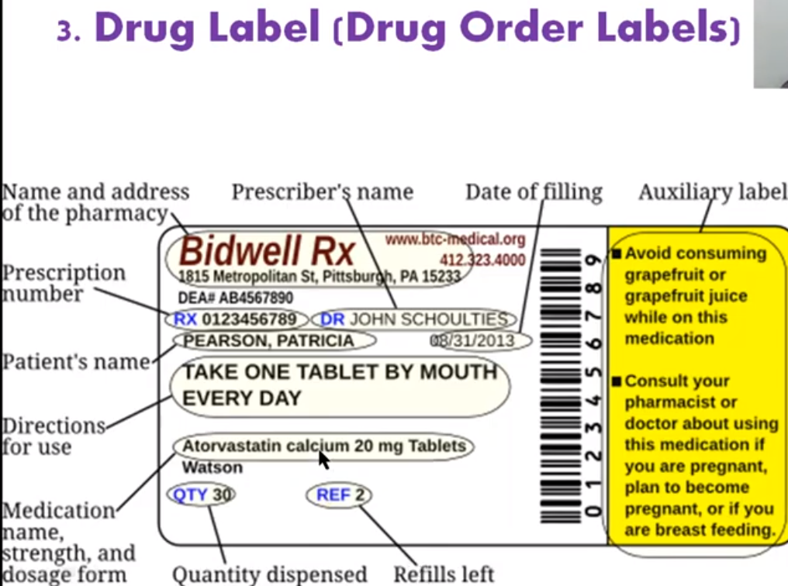

Slide 27
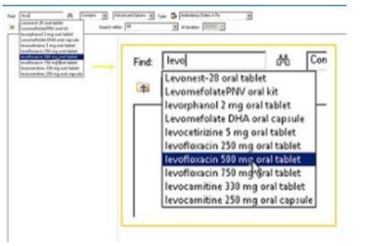
15-09-2024
27

Slide 28
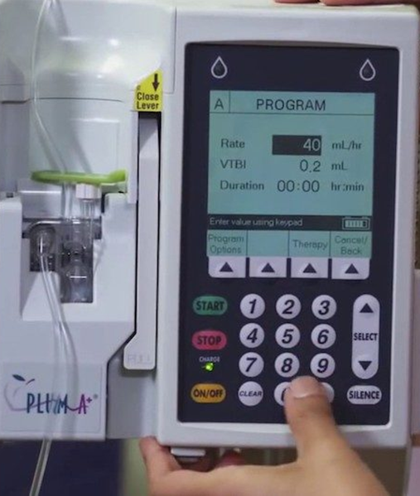
INTRAVENOUS SOLUTION AND ADMIXTURE
The medication process is composed of vital medication activities performed by a collaborative team of clinical professionals practicing across the entire health system and continuum, from patient intake through community monitoring. Pharmacist team members play key roles within this process, and the clinical pharmacist can positively impact cost and waste within the intravenous (IV) medication therapy process.
Hospital pharmacists have long been responsible for the management of compounded IV preparation. Timely delivery of an adequate supply of medication to the bedside is important for care of the patient. Pharmacists also serve as stewards of the medication cost to both the patient and health care organization. Unfortunately, too often, ensuring adequate supply while minimizing the cost of waste can be opposing goals resulting in conflicting outcomes.
One potential solution for this is using smart IV pumps in the medication process. When connected to the electronic health record (EHR), smart IV pumps improve awareness of medication levels and communication among members of the care team. These pumps can also streamline processes, getting closer to a true just-in-time preparation and driving down the cost of medication waste. With reduced reimbursement rates and decreasing margins, this can create a significant impact on a hospital pharmacy’s budget.
15-09-2024
28

Slide 29
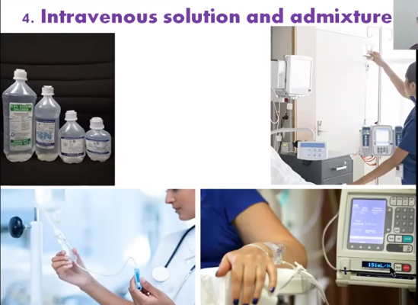

Slide 30
Since the emergence of hospital centralized IV admixture services in the 1960s, and expanded with the current United States Pharmacopeia (USP), there have been 797 regulatory standards for sterile preparation put in place. Many IV therapies ordered for acute care hospital patients must be prepared in a compliant IV compounding room located within the hospital pharmacy. These compounds require pharmacy staff to obtain materials, prepare the medication and be reviewed by a pharmacist prior to delivery to the patient care area for use.
Due to the time needed to prepare, pharmacies use various strategies to prioritize and schedule doses to be prepared in advance. The timing of preparation must be early enough to allow for preparation time prior to the dose being required, but late enough to account for the stability time and expiration dating. A lack of visibility to current IV therapy status often leads to waste or delays in therapy and impacts staffing.
There are two common approaches to combatting this issue: batch processing and on-demand preparation. Each pose their own challenges.
Batch processing relies on the ordered infusion rate of the IV bag and the scheduled start time of the order for the pharmacy information system to calculate when the bag would be empty and schedule one or more bags to be prepared in advance. However, the pharmacy information system has historically been unable to have knowledge of delays in the start of the infusion, pauses in the infusion or changes in the IV rate when adjusting to clinical parameters.
These variations, which occur directly on the IV pump, often result in doses being prepared and delivered prior to being needed, resulting in expired or unused doses – which means waste.
15-09-2024
30

Slide 31
On-demand preparation, in which the nurse would contact the pharmacy when the next dose is needed, is a common approach to address batch preparation barriers.
The nurse at the bedside takes the current infusion rate, volume remaining and overall patient status for titration or pending orders to discontinue the IV into account when requesting the next dose.
While this approach can eliminate some of the issues associated batch processing, new failure points are created when the request for the next bag may not occur with enough advance notice, requiring an emergency preparation.
Frequent unplanned emergency preparations impact the pharmacy workflow, as pharmacists are not able to plan and prioritize workload. This can cause delays in treatment, as the next dose may not reach the patient care area in adequate time.
15-09-2024
31

Slide 32

PATIENT MEDICATION PROFILES
A Patient Medication Profile (PMP) is a written summary of all the medicines you take regularly, including over-the-counter and complementary medicines. It can assist you to understand and manage your medicines by informing you how, why and when to take your medicine.
Benefits of a PMP:
• Helps you to better manage your medicines;
• Reduces the chance of experiencing any unexpected side effects from your medicines;
• Ensures that all members of your health care team know what medicines you are on, especially over the counter and other medicines they may not be aware of.
PMP is more than just a printed list. A PMP has specific information about each of your medicines and may include pictures to help you know which medicines you are taking.
15-09-2024
32

Slide 33
PMP will provide you with an up to date list of your medication including:
• Medication Name
• Brand name
• Other brand names
• Dose
• Time to take the tablet
• Description & colour photo
• Why the tablet is taken
• Precautions that need to be taken while using this medicine
PMP useful if you:
• want an easy to keep record of what each of your medicines are;
• would like to better understand your medicines;
• take a lot of medicines;
• would like to give your doctor a list of all your medicines;
• travel regularly;
• see more than one health professional; and/or are going into hospital
15-09-2024
33

Slide 34
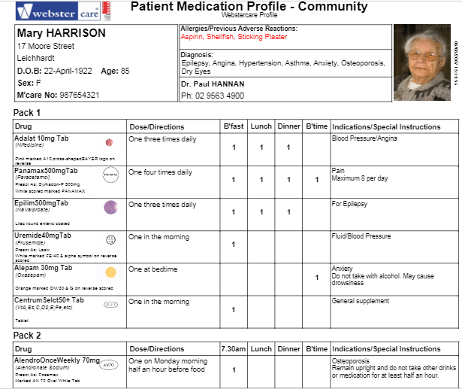
15-09-2024
34

Slide 35
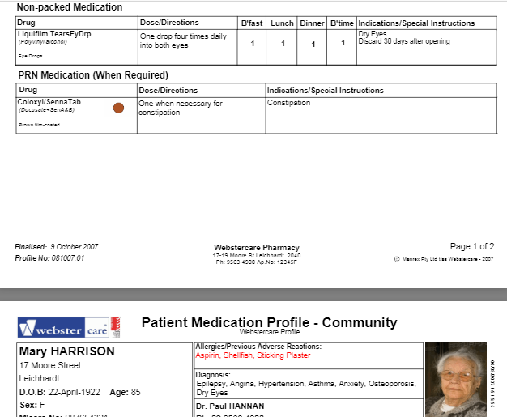
15-09-2024
35

Slide 36
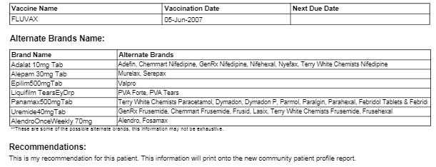
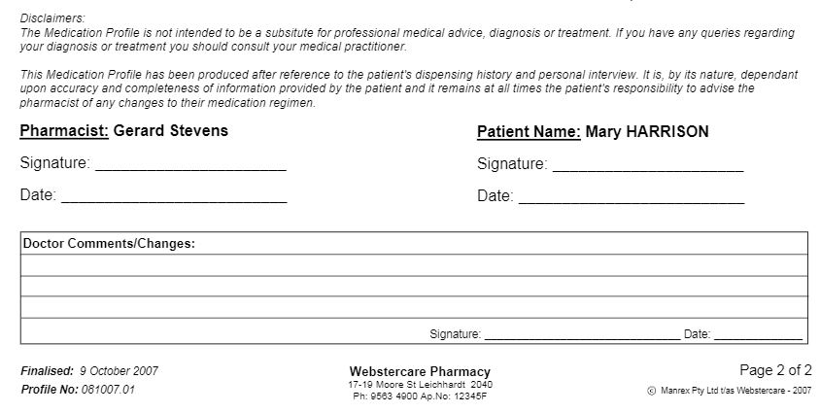
15-09-2024
36

Slide 37
SUBPART 1. SYSTEM REQUIRED.
Patient profile record system must be maintained in all pharmacies for persons for whom filled prescription drug orders are dispensed. The patient profile record system must be designed for the immediate retrieval of information necessary for the dispensing pharmacist to identify previously dispensed medication at the time a prescription drug order is presented for dispensing. One profile record may be maintained for all members of a family living at the same address and possessing the same family name.
SUBPART . 2. MINIMUM INFORMATION REQUIRED;
Generally. a reasonable effort must be made by the pharmacy to obtain, record, and maintain at least the following information regarding individuals obtaining prescription services at the pharmacy:
A. name, address, telephone number, date of birth or age, and gender;
B. individual history where significant, including disease state or states, known
allergies and drug reactions, and a comprehensive list of medications and relevant devices being used showing the prescription number, the name and strength of the drug or device, the quantity and date received by the patient, and the name of the prescriber; if this information is obtained by someone other than the pharmacist, the pharmacist must review the information with the patient; and
15-09-2024
37

Slide 38
C. pharmacist comments relevant to the individual's drug therapy, including, where appropriate, documentation of the following for each prescription:
(1) the pharmaceutical care needs of the patient;
(2) the services rendered by the pharmacist; and
(3) the pharmacist's impression of the patient's drug therapy.
This documentation is not required for residents of a licensed nursing home where a
consultant pharmacist is performing regular drug regimen reviews.
SUBPART . 3. Drug interactions, generally. Upon receiving a prescription drug order, a pharmacist shall examine the patient's profile record before dispensing the medication to determine the possibility of a harmful drug interaction or reaction. Upon recognizing a potentially harmful interaction or reaction, the pharmacist shall take appropriate steps to avoid or resolve the problem which shall, if necessary, include consultation with the prescriber.
SUBPART . 4. Drug use review for patients. Upon receiving a prescription drug order, or prescription refill request for a patient, a pharmacist shall examine the patient's profile record and conduct a prospective drug review to identify:
A. overutilization or underutilization;
15-09-2024
38

Slide 39
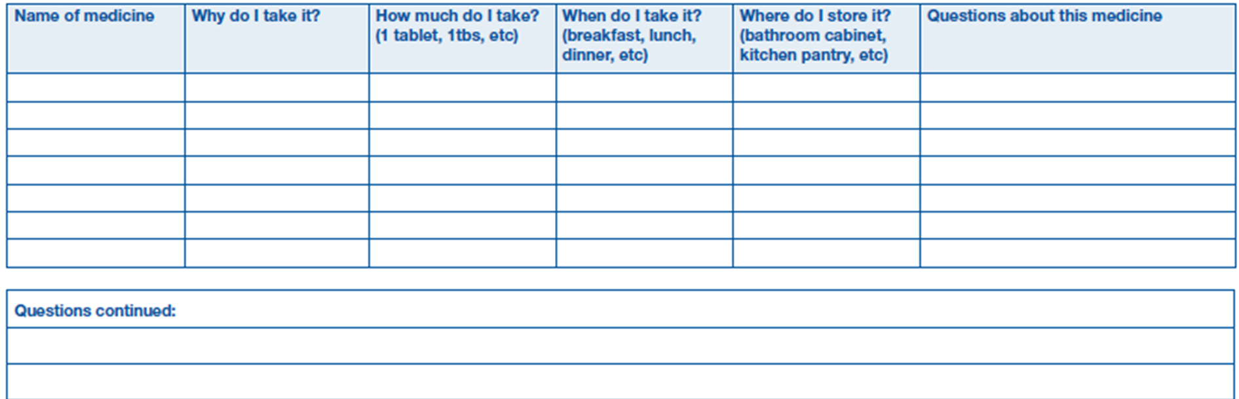
15-09-2024
39

Slide 40

INVENTORY CONTROL
Pharmacy inventory management is a complex but critical process within the healthcare delivery system. Without adequate pharmacy inventory management practices, hospitals run the risk of not being able to provide patients with the most appropriate medication when it is most needed.
Additionally, pharmacies dispensing patterns and drug selection choices may have a direct effect on the affordability of care. Utilizing drugs that are non-contracted or not on the formulary may be more costly to the patient or may result in a lower than expected reimbursement, patient safety and financial considerations, stringent regulatory requirements pertaining to drug traceability, inventory reporting and inventory management elevate the importance of maintaining effective control over drug inventories in today’s ever-expanding healthcare compliance environment
Inventory control of drugs plays a pivotal role in hospital management. Drug inventory control of hospital pharmacy is very essential in order to provide continuous supportive services. The inventory management of drugs is very essential, as it is adversely affected by the consumption rate and purchasing cost of drugs
15-09-2024
40

Slide 41
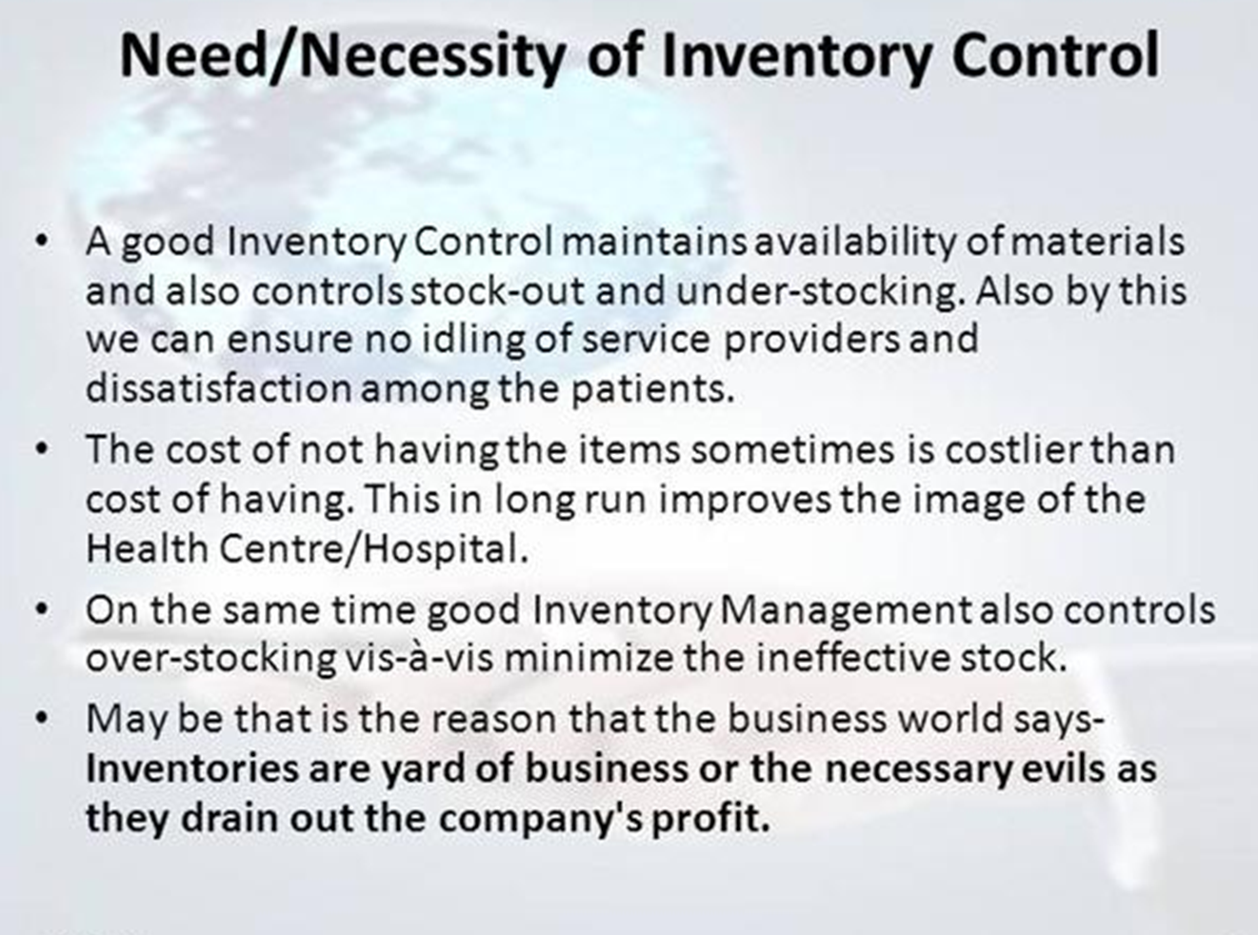
15-09-2024
41

Slide 42
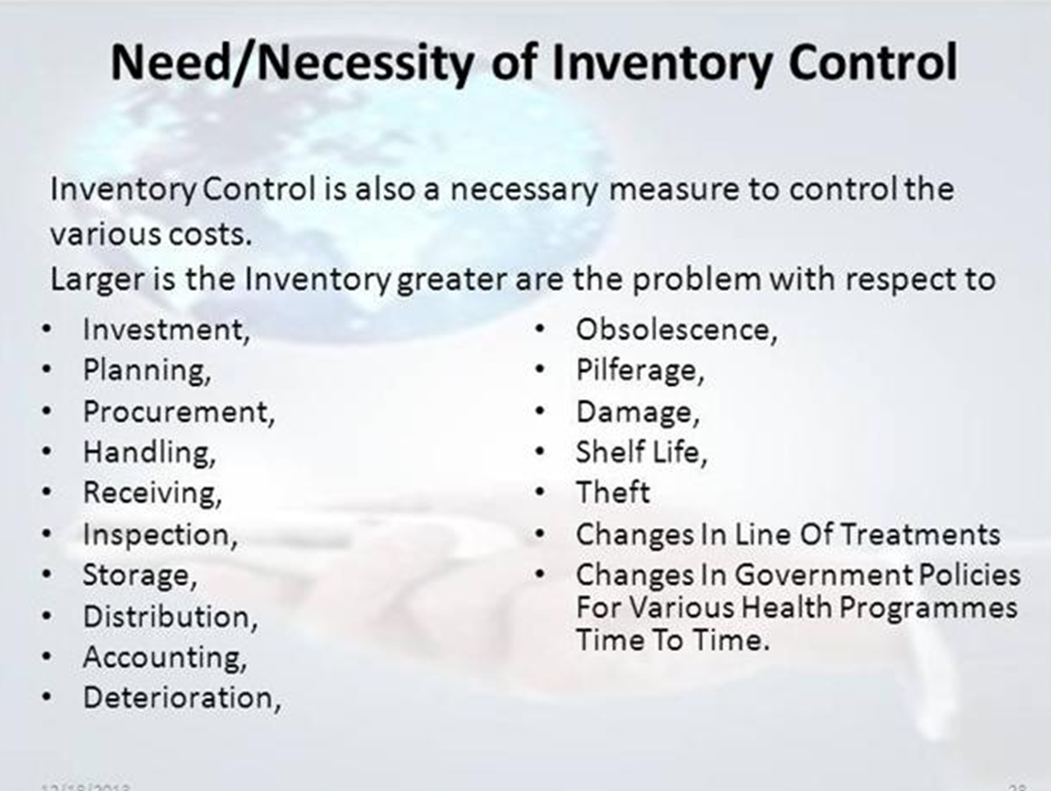
15-09-2024
42

Slide 43
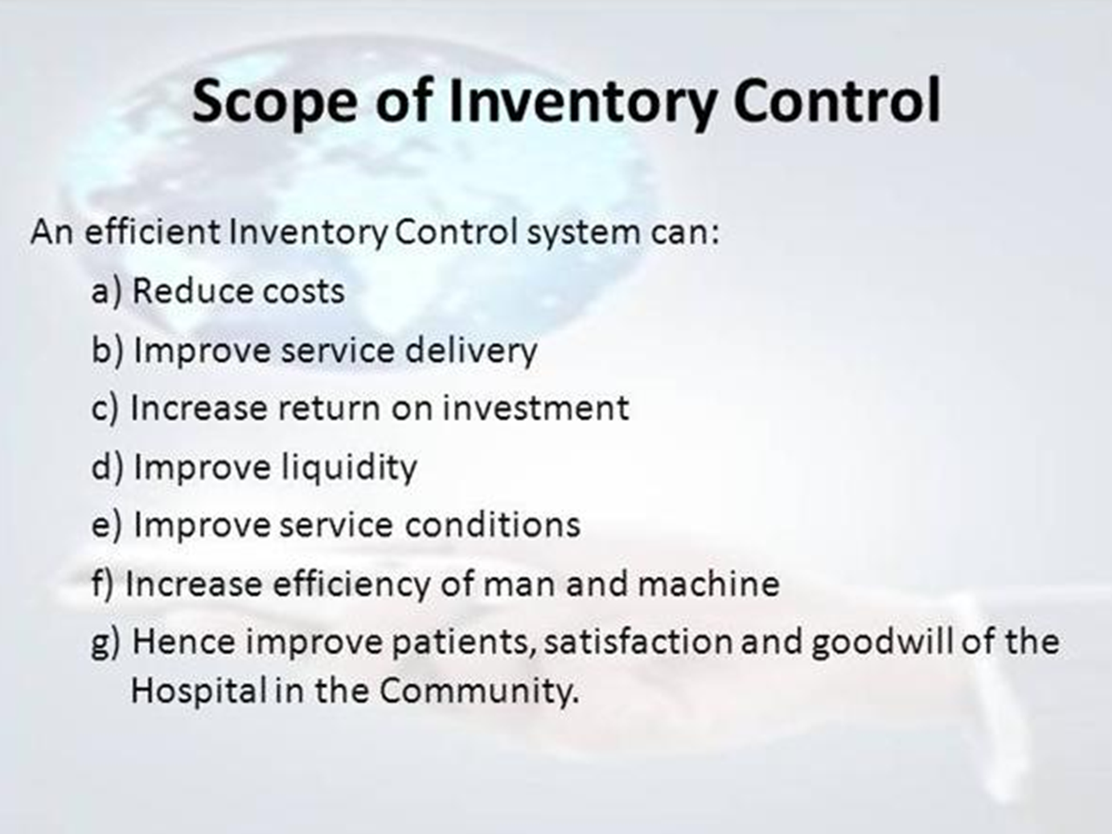
15-09-2024
43

Slide 44
Drug inventory is a delicate balance between not ordering too much and avoiding out-of-stock Here we can use – Perpetual and Periodic inventory control system, Perpetual system is most sophisticated system
Perpetual system – It is impossible to main in a pharmacy except by computer .It involves maintaining running balance of all drug in stocks, But hospital pharmacy starts with Periodic control system All drugs are entered into the data base as they are received in the Pharmacy
Added to beginning inventory level It will reflect the current stock level of each drug and Quantity of all drugs leaving the pharmacy are similarly subtracted from the inventory balance
This is done automatically done whenever drug order is processed Residual inventory balance can be checked by inventory system manager to verify the current balance with minimum order balance List of the drug that need to be ordered is produced on demand
Perpetual Inventory system is a remarkable labor saving device
Helpful in avoiding costly stock outs
Here physical inventory should be accurate in computer maintained file
Pharmacy personnel must be careful to assure that all drugs leaving or entering the pharmacy are entered into the computer
15-09-2024
44

Slide 45
Finally the Periodically checked against the self inventory to assure accuracy and Usually checked once in a week.
The amount of inventory on hand is compared to minimum and maximum stock levels
The existing stock level should be entered into computer manually , then it will generate
Placement order copy.
Then Purchase order may be then generated for each supplier determining minimum order quantity for each supplier
Computer Provides reports of drug purchase history information that are invaluable in hospital inventory control management
Sophisticated computer system can perform Purchasing order processing and Inventory management functions
Detects items that have reached pre-determined minimum order levels and list of those items and sorted by suppliers, in the form of a purchase order
Track purchase order through the hospital and vendor purchasing system to avoid duplicate order
Display requested drug to know current stock and gives necessary information for processing orders
Provides aggregate drug usage statistics
5. Provide periodic drug order history report - ( 6 months) – Contains information of price and stock number
6. Automatically recalculate and update optimum reorder point based on order history and lead time from suppliers
7. Detects and reports infrequently purchased items
8 Automatically print Physical inventory reconciliation and inventory shrinkage reports for perpetual inventory control system
9. Gives reports of inventory in hand, stock turnover and value of drug purchased from individual supplier
10 .Update the cost information in database.
15-09-2024
45

Slide 46

15-09-2024
46

Slide 47
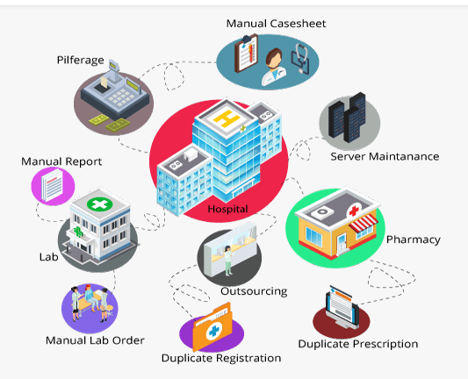
MANAGEMENT REPORT & STATISTICS
HOSPITAL MANAGEMENT REPORT
Hospital Management report is a system for patient care and hospital management. It automates financial, administrative and patient care activities of hospital, generates extensive management reports, operational statistics & offers a powerful query module.
It generates as well as maintains Electronic Medical Record (EMR) and makes it available across the hospitals. It has been envisaged to not only help the administrators to have better monitoring and control of the functioning of hospitals using decision support indicators but also assist the doctors and medical staff to improve health services with readily reference patient’s EMR.
It also provides work flow enabled process and parameterized alarms and triggers while patient treatment cycle.
It monitors pre-defined health indicators and uses exception reporting to enable efficient decision making by the hospital management, top management and administrators for policy and strategic decisions.
15-09-2024
47

Slide 48
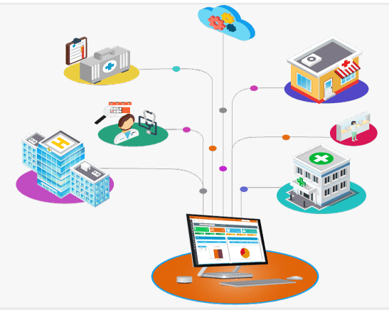
OBJECTIVES
Streamline overall operations and increase efficiency of government hospitals
Maintaining high patient satisfaction index through quality health care services
Consolidated patient EMR made readily available at any point of time
Effective management of available resources (manpower, machine, space)
15-09-2024
48

Slide 49
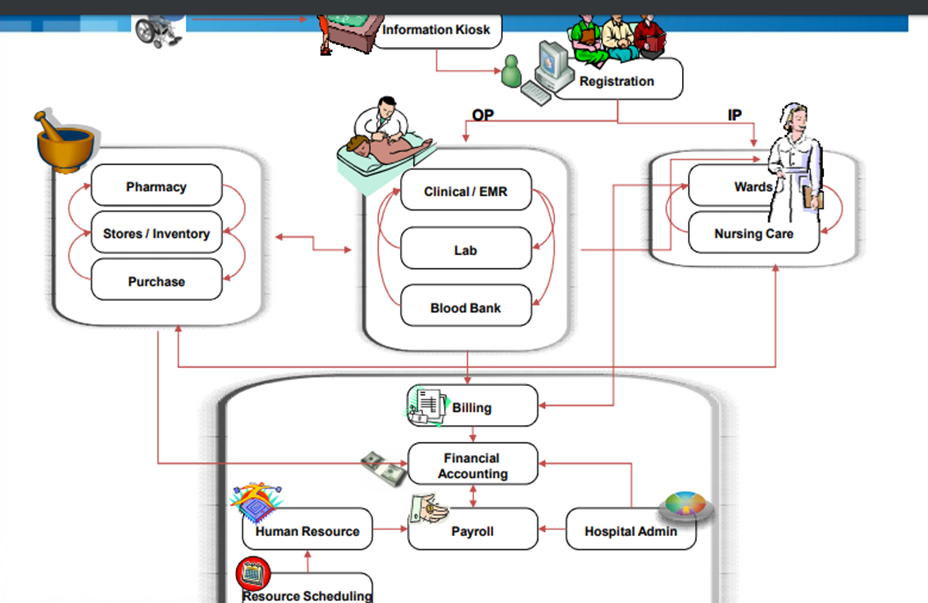
15-09-2024
49

Slide 50
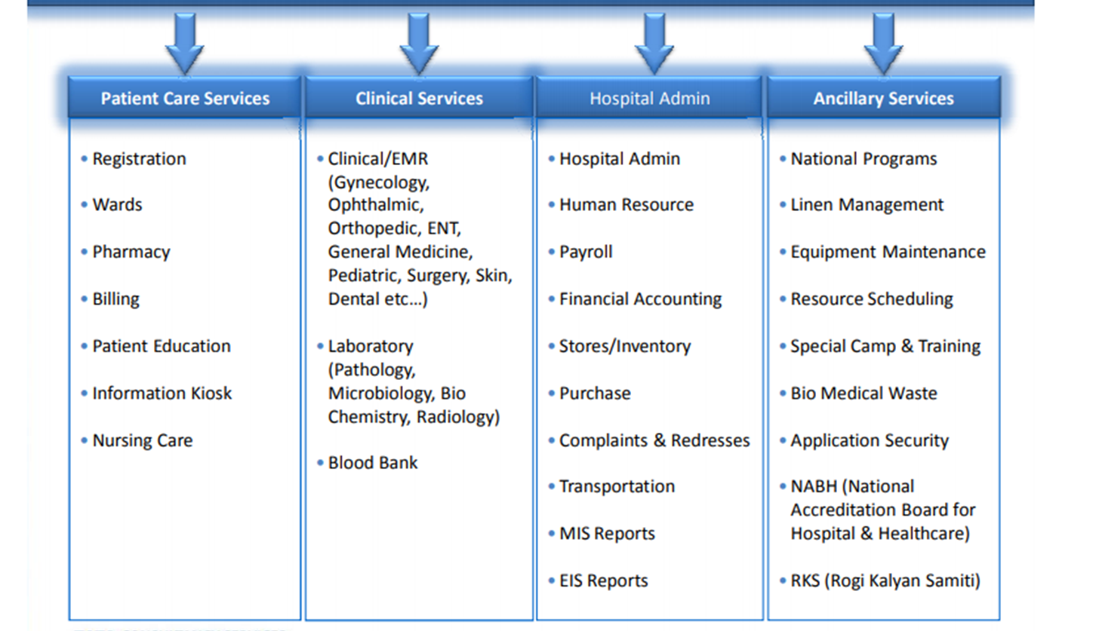
FUNCTIONALTIES OF MANAGEMENT REPORT
15-09-2024
50

Slide 51
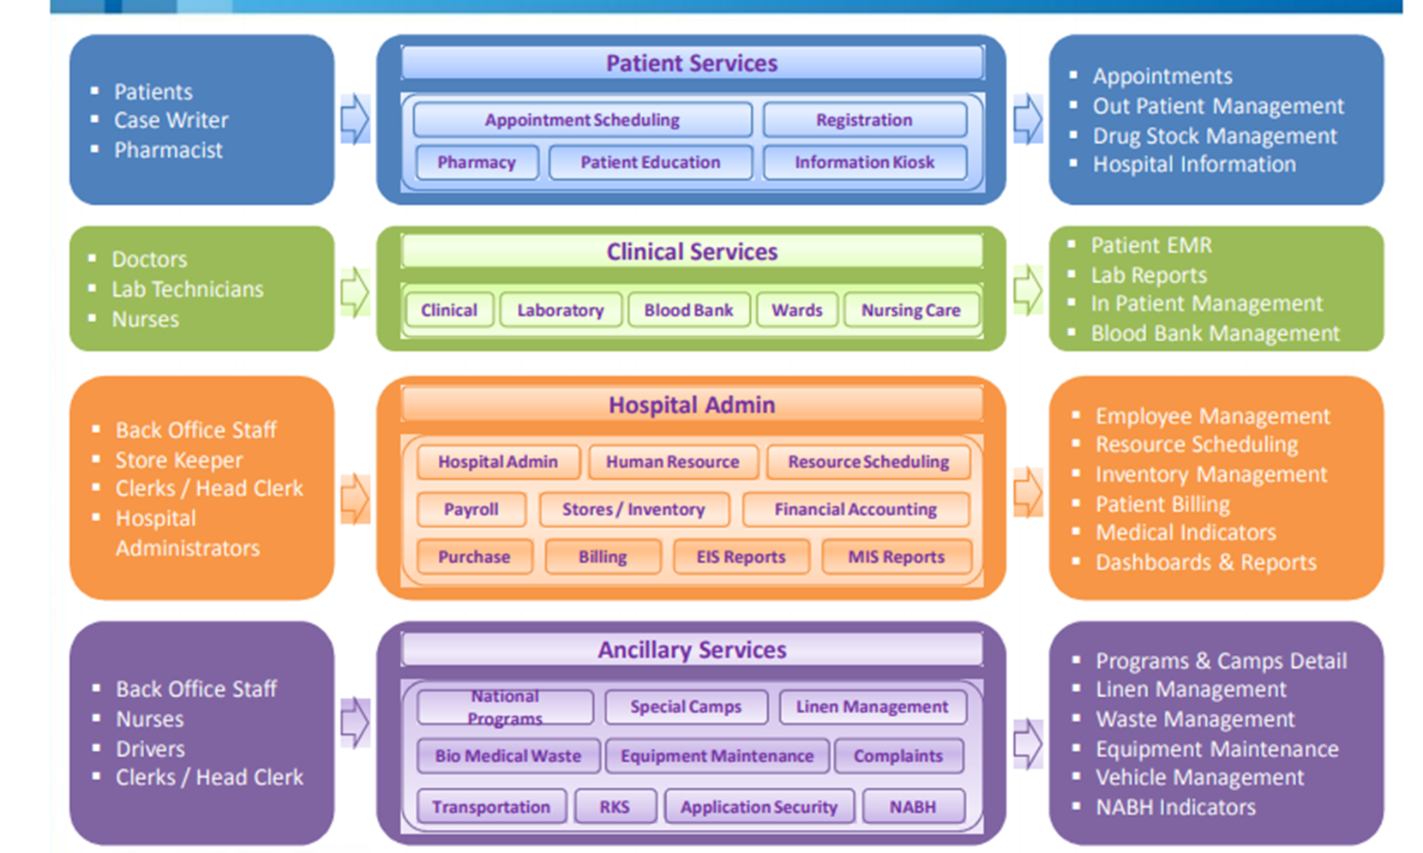
15-09-2024
51

Slide 52
These reports help pharmacy managers to plan and monitor work schedule and budget and Improve operational efficiency
HOSPITAL CENSUS DATA :
Number of admission
Discharges
Patients days
AGGREGATE DRUG USAGE ---
Total drug orders and doses produced
Types of drug order (Oral and topical, Injectable)
Pharmacy preparation hours
3. DRUG USE PER PATIENTS BY DRUG, DIAGNOSIS OR HOSPITAL SERVICE UNIT
Aggregate drug usage – Number of patients receiving drugs
Average number of doses and total cost
Usage by drug category -Average number of doses and total cost
15-09-2024
52

Slide 53
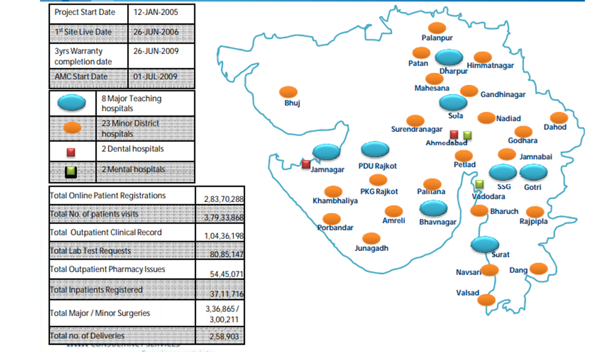
15-09-2024
53

Slide 54
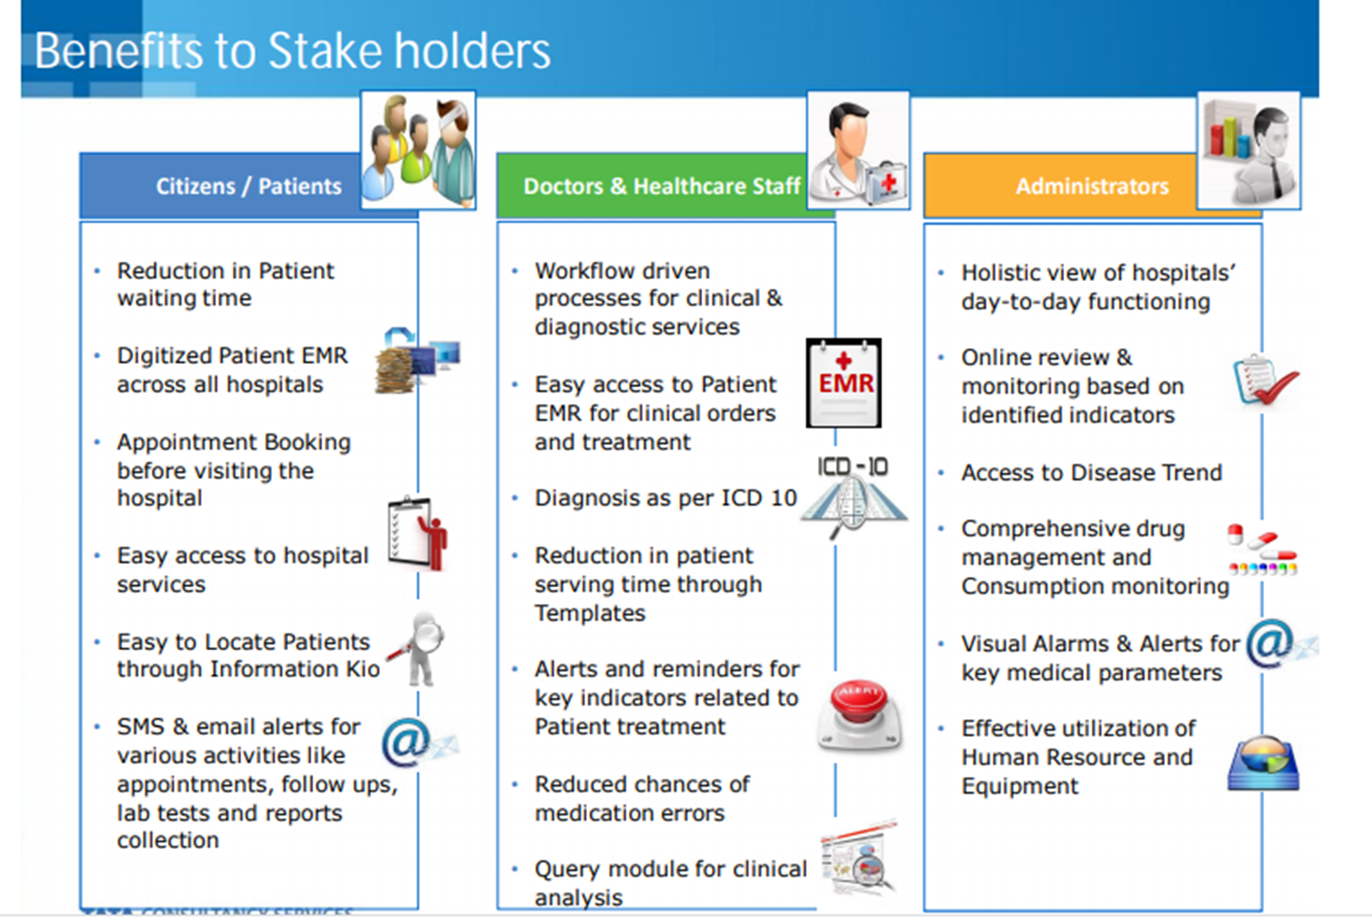
15-09-2024
54

Slide 55

HOSPITAL STASTISTICS
The information obtained through indoor and outdoor facilities regarding Quality care , Utilization of services, Quality of services, Hospital related Administrative and logistic affairs includes the hospital statistics.
Average Daily Census (ADC) Average number of patients in the hospital at a given time per day.
This is the ratio of the total number of in-patient days (Excluding new born) to total number of days in the same period.
ADC= Total Patient Days ÷ Number of calendar days in a period
TYPES
Reports related to hospital bed
Reports related to Admission, discharge and deaths
Work load statistics
Hospital care Evaluation rate.
15-09-2024
55

Slide 56
1. REPORTS RELATED TO HOSPITAL BED includes Daily censes, Daily average attendance, Bed occupancy rate, Bed turnover interval and rate , Total patient day care, Vacancy rate, Hospital beds – Sanctioned, functional beds and bed supply rate.
2. REPORTS RELATED TO ADMISSION, DISCHARGE AND DEATHS
ADMISSION DISCHARGE DEATH
Daily admission 1. Daily discharge 1. Daily deaths per day
Daily admission over a period 2. Daily discharge over a period 2. Total deaths over a period of time
3. Average length of the stay 3. Net and gross death rate
3. WORK LOAD STATISTICS
It includes total number of output patients, New reported cases, Total number of X- Rays and scanning per day, Average number of food supplied per day.
4. HOSPITAL CARE EVALUATION RATE
It includes post operative complication rate, Autopsy rate, Percentage aggregate between Final and pathological disease and gross results of treatment
15-09-2024
56

Slide 57
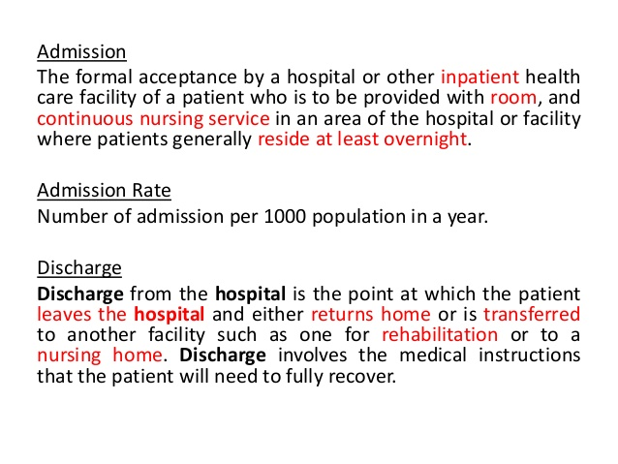
15-09-2024
57

Slide 58
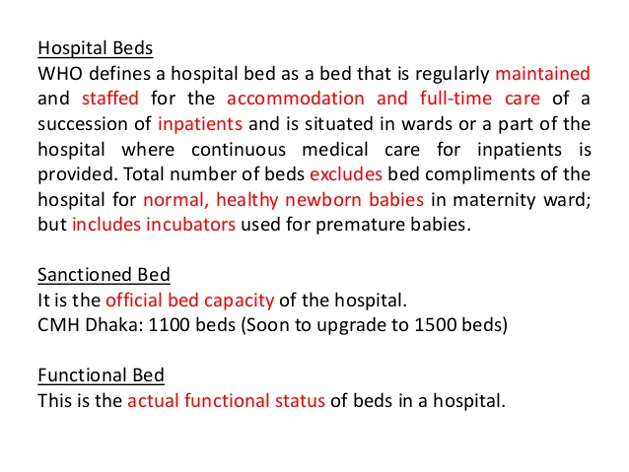
15-09-2024
58

Slide 59
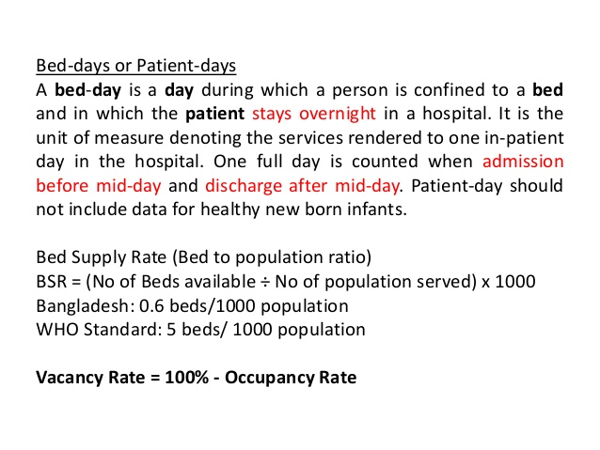
15-09-2024
59

Slide 60
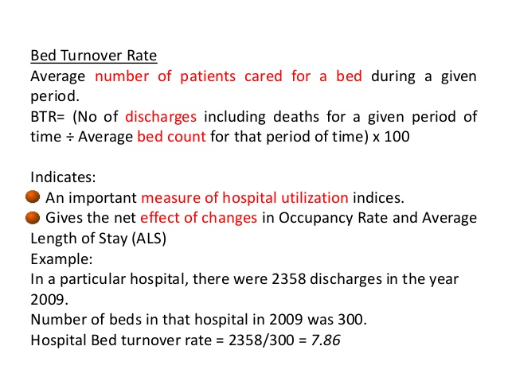
15-09-2024
60

Slide 61
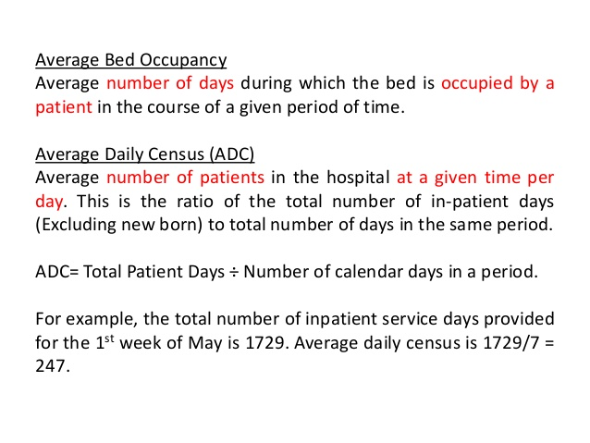
15-09-2024
61

Slide 62
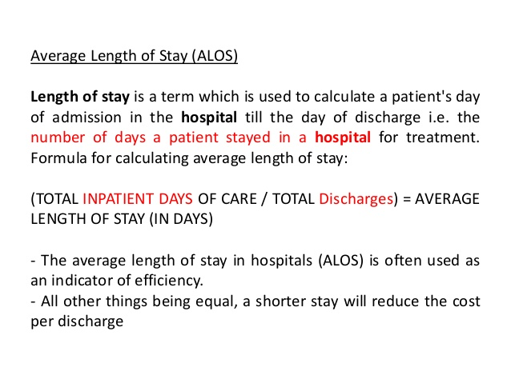
15-09-2024
62

Slide 63
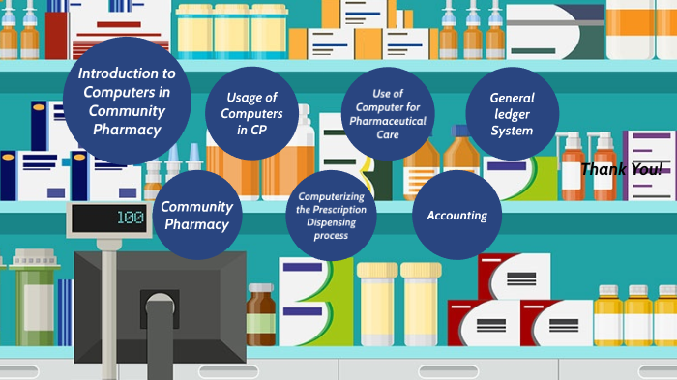
II . Computer in Community Pharmacy
Community pharmacies and their staff process a significant amount of highly sensitive personal data. The nature of the business means that customers are likely to be local to the pharmacy they attend and possibly seen or known by staff outside of work.
Information held is traditionally related to drugs prescribed to a customer, however with the recent expansion in services offered by community pharmacies larger volumes of more detailed information are being recorded and held.
While the PMR will generally hold the greatest amount of patient identifiable data, physical paperwork is also kept in branch for filing that contains information.
The computer systems used in the community pharmacy setting may be
wholly based on-site or may form part of an extensive networked solution. Requests for information may be received from the police or other authorities.
There may often be a friend, relative or guardian involved in a patient’s care that is relevant to the work of the pharmacy and requires the sharing of information. Customers may be in residential care homes and information passed between the organizations to support patient care.
15-09-2024
63

Slide 64
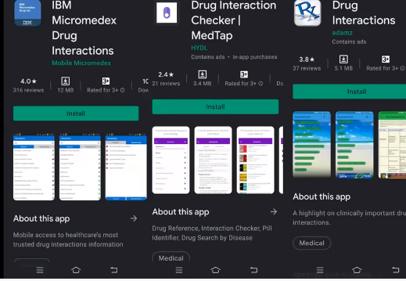
15-09-2024
64

Slide 65
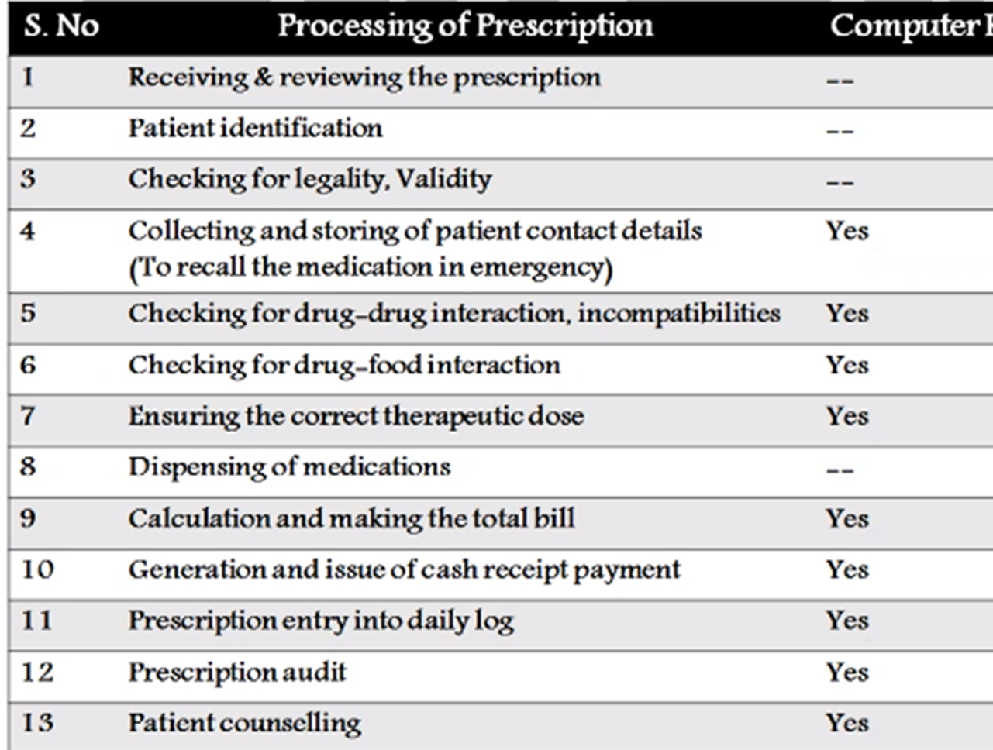
15-09-2024
65

Slide 66
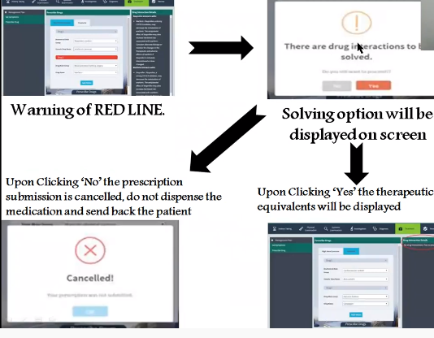
15-09-2024
66

Slide 67
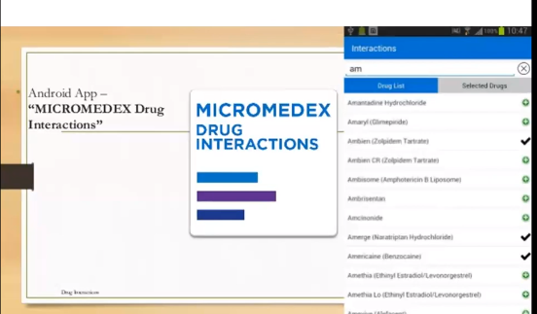
15-09-2024
67

Slide 68
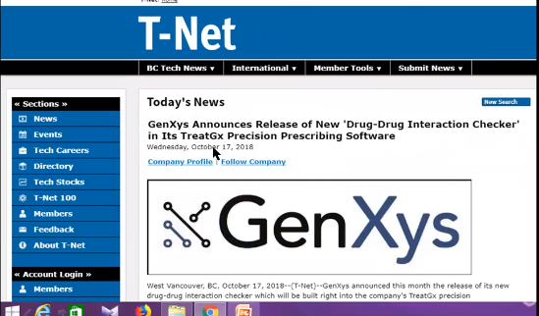
15-09-2024
68

Slide 69
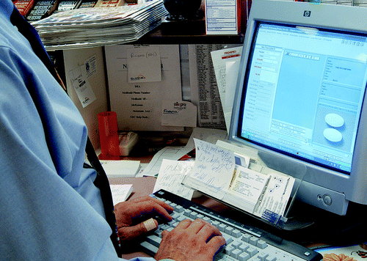
COMPUTERIZING THE PRESCRIPTION DISPENSING PROCESS
A new computerized dispensing system which reduces the time needed to dispense medicines. This system is so designed to assist the pharmacist with various tasks.
These include receiving prescriptions, dispensing of medicines, checking for accuracy. and payment. This system consists of automated dispensing devices, a tray-transfer line. a reception number indicator screen installed in the waiting room, and a terminal to provide patients with additional information.
The prescription data arc instantly transmitted to the respective dispensing positions and the prescriptions are dispensed simultaneously.
The trays travel efficiently on the tray-transfer line. The host computer performs such functions as input of information of prescriptions. accounting calculations. integrating prescription audit, and preparation of printing data for medicine bags.
The control computer, which receives prescription data from the host computer, sorts and sends instruction data on prescriptions to the automated dispensing machines, outputs instructions on the preparation of medicines in the manual dispensing sector. And controls the tray-transfer line, the turn tables and the reception number indicator screen.
15-09-2024
69

Slide 70
This computerized dispensing system has produced the following results:
(1)improvement in the quality of the dispensing work;
(2) reduction in the time required for dispensing medicines:
(3) improvement in the quality of service to patients;
(4) improvement in the efficiency of the clerical work in non-dispensing work;
(5) improvement in work efficiency.
Electronic prescription (EP) services have made the drug dispensing processes more efficient for community pharmacist. Maintaining patient record systems will help pharmacists in providing patient-centric services. Accurate transmission of patient discharge prescription prevents errors due to miscommunication of drug information. It is important to provide efficient health care services to the patient.
Currently most of hospitals and community pharmacy are adopting electronic discharge systems. But these electronic prescription systems have inadequate support functions, and as a result of which data is not in a standard form. A major drawback of the EP system is that it does not share the discharge information to community pharmacists.
15-09-2024
70

Slide 71
Generally electronic prescriptions are shared electronically to the community pharmacist, to gap the bridge between hospitals and pharmacists regarding patient safety. In addition to dispensing drugs and medication counselling, the duties and responsibilities of pharmacists in community are continuously expending.
The pharmacist need support by additional information and knowledge, to council the patients about the prescribed medication use and to evaluate efficacy, and safety of drugs.
USE OF COMPUTERS FOR PHARMACEUTICAL CARE IN COMMUNITY PHARMACY
Pharmaceutical care is the responsible provision of drug therapy for the purpose of achieving definite outcomes which improve a patient’s Quality of Life
The focus of pharmaceutical care is on the preventability of drug misadventures. These misadventures are also called medication errors (when occurring within the prescribing and dispensing chain), or drug-related problems (when occurring in the whole medication-use chain).
Such problems can often be prevented or corrected by a thorough analysis of the medication and patient characteristics, and subsequent interventions.
15-09-2024
71

Slide 72
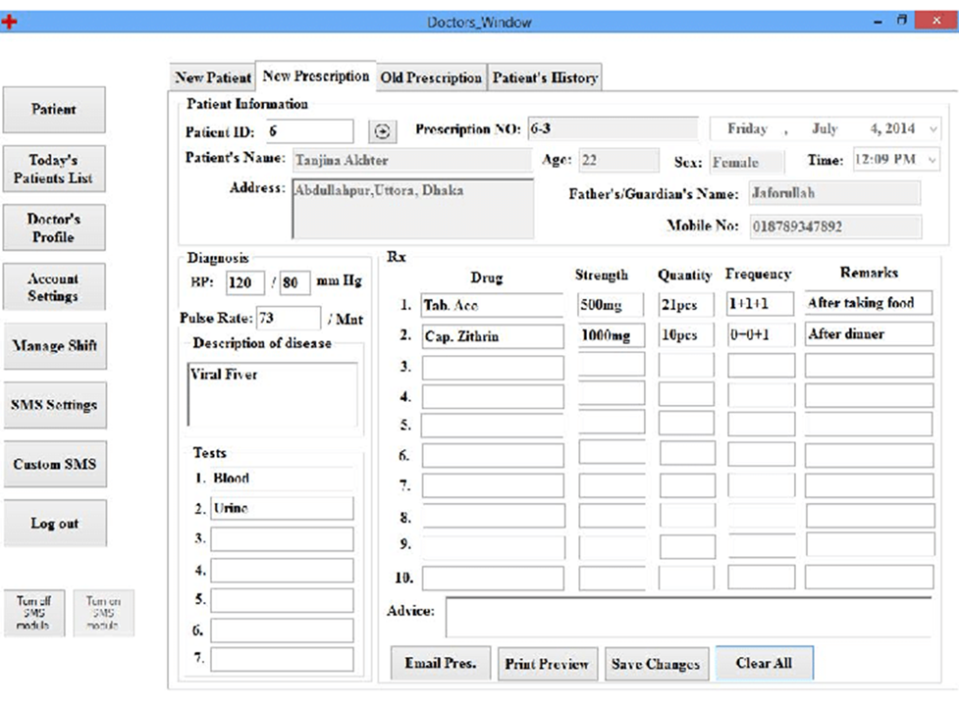
15-09-2024
© R R INSTITUTIONS , BANGALORE
72

Slide 73
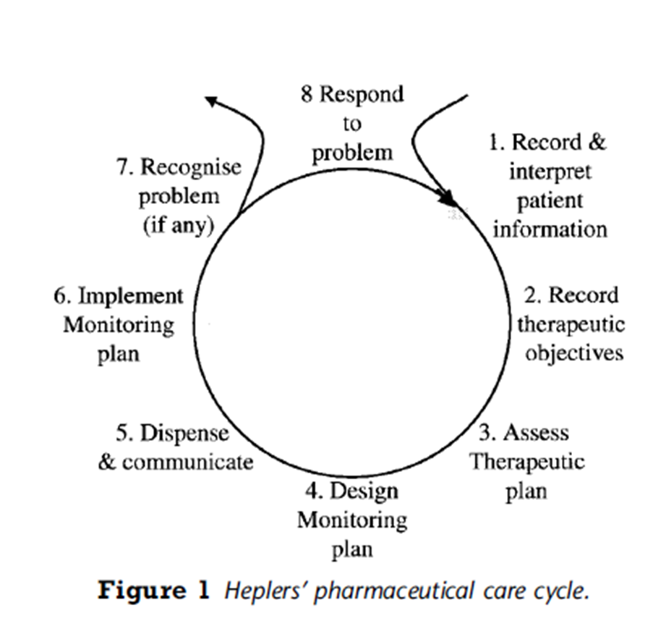
15-09-2024
73

Slide 74
Using technology in pharmacy is very useful for the pharmaceutical profession, It improves the pharmacists work, It gives them more time to help the customers, Using the computers reduce the time, expenditure and the manpower required for any kind of work, The research will be long-lasting and expensive without using the computers.
Using computers is useful for the patient profile monitoring, drug interactions, medication, database management, material management, drug information services, patient counseling, billing & purchasing.
The bar codes on the bottles and the containers allow the pharmacies to record the drugs and the compounds which they have on hand and the quantities of them, they help to confirm that the right product has been delivered, stored, retrieved and dispensed to the customers.
The pharmaceutical companies developed the drug information database system to manage the various information generated during the development of the new products and after the launch of the products, So, they provide safety and quality of drugs to the medical professionals and finally to the patients.
15-09-2024
74

Slide 75
The computers can help run the business operations efficiently, They make it easier to handle the routine business tasks such as recording, tracking and paying the vendor bills,
The computers can improve the patient safety, they help to provide high-quality care, and they help the patients make the most of their medicines as they provide the tools for monitoring the efficacy and safety of medicines in use.
The computer is very useful for the pharmaceutical industry, As it is very useful for drug design, crude drug identification, drug information, storage and retrieval, the bulk drug and pharmaceutical manufacture.
The computers provide the prices for the medications as possible substitutes automatically update the prices, the scans prices from the bar codes.
15-09-2024
75

Slide 76

ACCOUNTING AND GENERAL LEDGER SYSTEM
ACCOUNTING :- USE IN COMMUNITY PHARMACY
Accrual and cash accounting
Accrual accounting recognizes revenue and expenses when they are earned or incurred, regardless of when the provider gets paid. For example, a patient in a bed receives a service, for which the hospital bills them. Under accrual accounting, the associated expenses and revenue would be recorded at that point.
The main advantage of doing so is accuracy, as it offers a good picture of what’s occurring during a given quarter. Large organizations will usually default to accrual accounting for this reason. The downside is complexity that requires software that can handle complicated functions including accounts payable and receivable.
In contrast, cash accounting is much simpler. Revenue and expenses are only recorded when actually paid. While this model works in some industries, it’s often a poor fit for many health providers, since payment can take months to be received, if it’s received at all.
15-09-2024
76

Slide 77
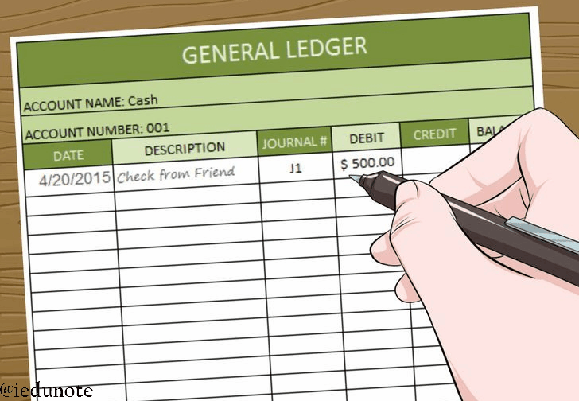
TERMINOLOGIES RELATED TO ACCOUNTS
Entry 13. Capital – Excess of assets of liabilities.
Narration – Short Notes on end of any entry.
Ledger – Bound volume of accounts, final book of all accounts
Folio – Transactions Page Number
Posting – Act of recording transaction in ledger
Costing – Totaling the amount
Double entry – To check in all entries in note book before entering into ledger
Debitor – Who own something our commodity , Loan / Advance, Who is having due
Creditor – Whose something own, not payed yet
Goods – Commodities ( Medicines )
Asset – All commodities except goods.
Liabilities – Payable to personal
15-09-2024
77

Slide 78
Reporting
healthcare organizations produce financial reports indicating their performance. Relevant audiences for this information include the public, hospital trustees and senior management.
Details in these reports may include cash flows, balance sheets, and statements of operations and changes in net assets. Tax-exempt hospitals are also required to itemize uncompensated community care benefits such as charity care.
Depreciation
Healthcare providers are major users of IT infrastructure, capital equipment and commercial buildings, all of which depreciate with time. As with depreciation accounting in other sectors, this process involves calculating the cost of the asset in question as well as its useful life.
From there, the asset’s depreciation expense will be recorded across each accounting period. Events such as land appreciation do not appear in depreciation calculations.
15-09-2024
78

Slide 79
Payments and receivables related to medical services
Hospitals can be reimbursed in multiple ways. They might receive capitation, which involves a fixed amount per patient per month/year. In this system, providers receive payment regardless of service utilization, but are on the hook for all overruns. Alternatively, they could be paid per diem (day), at an amount typically set by the payer, or on a case basis, for example through Medicare Severity Diagnosis Related Groups (MS-DRGs).
Value-based payments regulated by the Centers for Medicare and Medicaid Services are also an increasingly important consideration for providers, especially doctor’s offices. These payments are alternatives to traditional fee-for-service, which is tied to the number of visits.
Notably, when hospitals receive payment from insurers, those funds are usually only a portion of the services rendered, leaving the rest as a receivable. It’s also common for payers to have their own fee schedules, meaning accountants regularly face the complexity of keeping track of a huge web of different billings, receivables and allowances.
15-09-2024
79

Slide 80
Credit balances and outstanding checks
A common situation that healthcare accountants run into is an accumulation of credits in accounts receivable. This happens when the amount collected via payers and/or patients for a service is greater than the amount owed. It is easy for all such credits to total in the millions of dollars.
Writing a check is one response to this credit accumulation. However, providers like hospitals often end up with numerous outstanding checks due to recipients who have died or moved. In some states, funds from such uncollected checks must be turned over to state government.
GENERAL LEDGER SYSTEM
Healthcare Integrated General Ledger Accounting System (HIGLAS), a component of the Department of Health and Human Services (DHHS), Unified Financial Management System (UFMS). HIGLAS is a single, integrated dual-entry accounting system that standardizes and centralizes federal financial accounting functions.
HIGLAS currently supports four lines of CMS business which include the Medicare Fee-for-Service (FFS), Medicare Secondary Payer (MSP), Federal Facilitated Marketplace (FFM), and the Administrative Program Accounting (APA) activities. The APA line of business (LOB) includes Medicaid and Children’s Health Insurance Program (CHIP) grants, Part C Managed Care and Part D Prescription Drug, federal payroll, travel, and myriad of other activities.
HIGLAS continues to enhance oversight of all financial operations in order to achieve accurate, reliable, and timely financial accounting and reporting for all of programs and activities.
15-09-2024
80

Slide 81
CMS’s Healthcare Integrated General Ledger Accounting System (HIGLAS), a component of the Department of Health and Human Services (DHHS), Unified Financial Management System (UFMS). HIGLAS is a single, integrated dual-entry accounting system that standardizes and centralizes federal financial accounting functions for all of CMS’s programs.
HIGLAS currently supports four lines of CMS business which include the Medicare Fee-for-Service (FFS), Medicare Secondary Payer (MSP), Federal Facilitated Marketplace (FFM), and the Administrative Program Accounting (APA) activities. The APA line of business (LOB) includes Medicaid and Children’s Health Insurance Program (CHIP) grants, Part C Managed Care and Part D Prescription Drug, federal payroll, travel, and myriad of other activities.
HIGLAS continues to enhance CMS’s oversight of all financial operations in order to achieve accurate, reliable, and timely financial accounting and reporting for all of CMS’s programs and activities.
Demonstrated compliance with accounting standards and requirements
Eliminated redundant accounting systems
Improved accountability for Medicare FFS payments to physicians, hospitals, and other providers servicing Medicare beneficiaries
Provides timely, reliable, and complete financial reporting
Supports the Federal Payment Levy Program (FPLP) to collect overdue taxes through a continuous levy on certain Federal payments; this includes the Medicare FFS Payments
Meets the Financial Systems Integration Office (FSIO), previously the Joint Financial Management Improvement Program (JFMIP), developed and issued core financial system requirements that provides compliance with Federal Financial Management Improvement Act of 1996 (FFMIA)
15-09-2024
81

Slide 82
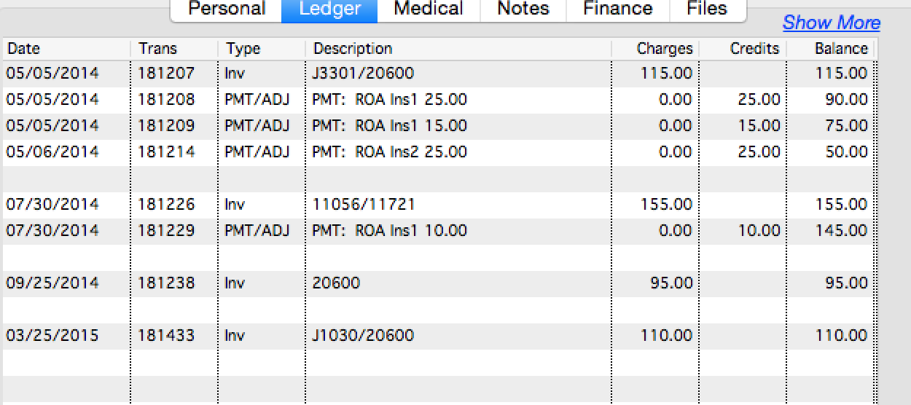
15-09-2024
82

Slide 83
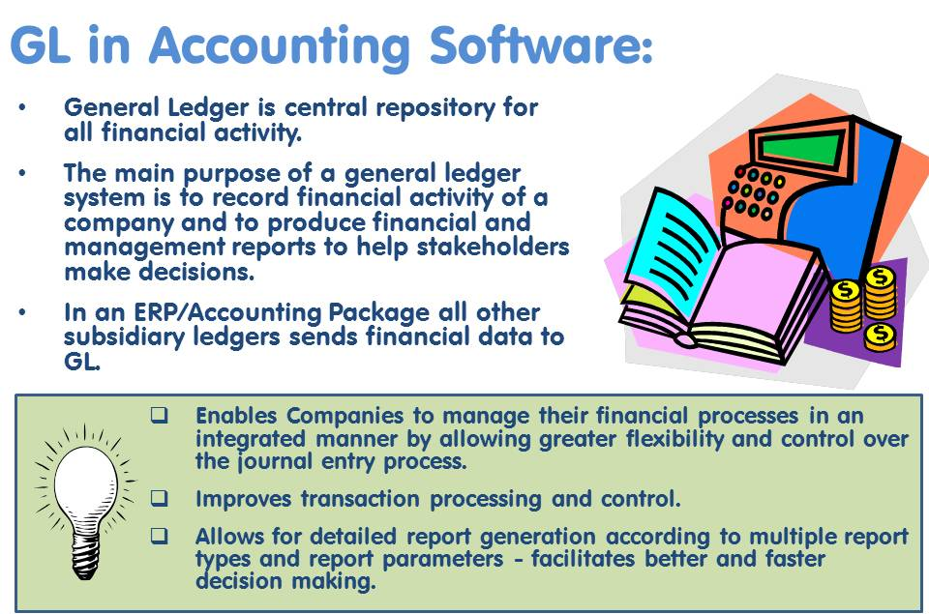
15-09-2024
83

Slide 84

15-09-2024
84

Slide 85

15-09-2024
85

Slide 86

15-09-2024
86

Slide 87

15-09-2024
87

Slide 88

15-09-2024
88

Slide 89

15-09-2024
89

Slide 90

15-09-2024
90

Slide 91
ADVANTAGES :-
Demonstrated compliance with accounting standards and requirements
Eliminated redundant accounting systems
Improved accountability for Medicare FFS payments to physicians, hospitals, and other providers servicing Medicare beneficiaries
Provides timely, reliable, and complete financial reporting
Supports the Federal Payment Levy Program (FPLP) to collect overdue taxes through a continuous levy on certain Federal payments; this includes the Medicare FFS Payments.
15-09-2024
91

Slide 92
III. Drug Information Retrieval & Storage
OVERVIEW OF DRUG INFORMATION RESOURCES – DRUG LITERATURE
A. The efficient use of drug information (DI) is an important skill for all pharmacists to have regardless of their practice site. In all pharmacy settings, pharmacists are recognized as drug experts and as providers of DI. It is imperative, therefore, that pharmacists know how to provide accurate and complete responses to DI requests.
Keeping current with DI resources is challenging for the clinician because of the vast amount and the variable quality of available resources. Technology has also brought DI to the patient’s bedside.
Pharmacists should know what DI resources are available and be able to use these sources effectively and efficiently. The chapter reviews the types of literature used in the synthesis and provision of DI.
B. Primary literature is the most up-to-date resource available to the clinician and consists of journal articles reporting original research, new ideas, or opinions. These resources are useful for research, education, and current awareness. Not all articles found in journals are considered primary literature; for example, review articles that summarize the literature are classified as tertiary resources.
15-09-2024
92

Slide 93
C. Secondary resources include indexing and abstracting systems that organize and provide easy retrieval of primary resources. Indexing systems include the article citation, with or without access to the abstract; some include a link to the full-text article. Abstracting systems provide not only the citation but also the abstract and often a link to the full-text article.
Examples of secondary resources include MEDLINE (through PubMed, EBSCO, Ovid), Academic Search Premier, Cochrane Database of Systematic Reviews, Iowa Drug Information Service (IDIS), International Pharmaceutical Abstracts (IPA), Embase/Excerpta Medica, Biosis Previews/Biological Abstracts, CancerLit, SedBase, Reactions, Clin-Alert, Current Contents, and Toxline. Proper training is required for efficient use of these resources.
D. Tertiary resources are sources that condense and summarize data from the primary literature. These include not only textbooks and compendia but also electronic databases (e.g., Micromedex, Lexicomp) and review articles. The best tertiary resources are written by experts in the field and are peer reviewed. If the tertiary resource is not current or comprehensive, a secondary resource should be consulted to locate primary literature on the topic. However, some questions can only be answered by using tertiary sources
15-09-2024
93

Slide 94
A complete search of the drug information is necessary for the clinical pharmacist so as to satisfy the queries about pharmacology, drug interactions, adverse drug reactions, toxicology etc. This job of searching can be simplified by using computers.
In 1964, National Library of medicine created a computerized medical information retrieval system MEDLARS (Medical Literature Analysis and Retrieval System). In 1971, they developed a fast working system MEDLINE (MEDLARS ON-LINE).
The computerized information retrieval has following advantages over the manual search.
(i) It is time saving and pleasant.
(ii) It is more thorough and timely than manual search.
To operate the information retrieval system, the equipments needed include a microcomputer, a printer, a telephone line and a modem.
For information retrieval, the choice of a database is also very important. The databases
may be
(a) Bibliographic database,
(b) Journal information and
(c) Textbook material.
Generally, bibliographic database is adopted, as usually there is a medical library nearby from where one can get the articles.
15-09-2024
94

Slide 95

Although most work in Healthcare Data Analytics focuses on mining and analyzing data from patients, another vast information for use in this process includes scientific data and literature.
The techniques most commonly used to access this day include those from the field of information retrieval (IR), sometimes called search.
IR is the field concerned with the acquisition, organization, and searching of knowledge-based information, which is usually defined as information derived and organized from observational or experimental research.
INTERNET SOURCES OF DRUG INFORMATION
Patients rely on the Internet for health and DI when they may not have access to a knowledgeable health care professional (HCP). Studies have shown that the younger population will use the Internet as one of their primary sources of DI. Older adults (60 years and older) prefer to talk to an HCP as their primary source of DI, but these
patients will also access the Internet.
15-09-2024
95

Slide 96

Compared with an HCP, members of the public may have fewer skills to evaluate the validity of the DI that they receive from the Internet. The National Library of Medicine (NLM) has created a 16-minute video intended to help consumers distinguish a good Internet source of information (www.nih.gov/MEDLINEplus/webevalu.html)
As the video points out, anyone can create an Internet site, and it is essential to determine the creator of the site, the creator’s credibility, and the way to contact the organization who has ownership of the site.
As with any Internet source, pharmacists should evaluate the credibility, validity and reliability of the information. Health care professionals can rely on the same NLM concepts provided for consumers when searching the Internet.
Many Internet services, either available free or for a paid subscription, can be invaluable sources of high-quality, evidence-based medicine. Many sites provide HCPs with fast results to DI questions and even access to professional journals. The skill of the researcher is essential in getting to the best information, and studies have documented that skill level can make a difference in the quality of the information obtained, whether from commercial sites or from free professional sites such as PubMed.
15-09-2024
96

Slide 97


A. Search Engines
When searching for specific words or phrases, a search engine (e.g., Google, Yahoo!, Bing, AOL Search, Ask) is useful.
Different search engines often produce different results for the same term; therefore, the use of more than one search engine can improve results. For searches that require broad or nonspecific terms,
using an online subject director such as World Wide Web Virtual Library may help identify more appropriate terms. A free resource on Internet searching is available http://www.SearchingTheInternet.info/.
B. Search Strategies
The most efficient search for a particular article often uses the article title or author name. Searching by journal name can locate a specific article or series of articles in one journal issue.
When searching by journal name, the specific title as indexed by the National Library of Medicine (NLM) is required. Likewise, when
searching by author name, the last name and first initial (or first and second initial) of the author are needed. A search by article title or author name can be performed with the single citation matcher available in PubMed.
15-09-2024
97

Slide 98
The limit function in MEDLINE provides a means of filtering unwanted articles from a set of search results. The search parameters are limited according to the criteria the searcher selects. Examples of limits include language, human or animal species, gender, age group, review articles, latest updates, publication type, publication year, and local holdings.
C. Obtaining High-Quality DI
Published articles provide helpful tips on how a busy practitioner can search a database such as MEDLINE and narrow the results to only high quality randomized controlled trials (RCTs). Researchers have found that the use of filters can provide clinicians with better searching strategies. The two most prominent filters being researched are content filters and validity filters.
Content filters are specific to the drug or disease state being searched and ensure that the clinician is searching the most appropriate content. PubMed and MEDLINE allow the researcher to explode terms like antibiotics to get better content results
15-09-2024
98

Slide 99

15-09-2024
99

Slide 100

15-09-2024
100

Slide 101
Use of Computerized Retrieval
Today computers provide us with powerful tools for information handling - for collection, organization, classification, retrieval and distribution.
Computers have been used since the late 1960s for the storage of large databases such as library catalogues and bibliographic references.
Development of optical storage media such as CD-ROM has given us the possibility of storing large quantities of text, graphics, pictures, and sound at a low cost.
These new optical memories can function as distributed stores for encyclopedias, databases, books etc.
This has stimulated the development of local information systems. The three aspects of computerized information retrieval:
Library Catalogues
Online Databases
Databases On CD-ROM
15-09-2024
101

Slide 102

Computerized library catalogues
Computerized library catalogues were first introduced during the late 1960s.
The online catalogue, known as the Online Public Access Catalogue, or OPAC, has gradually become more user friendly with the use of menus and simple commands.
Access for users is now often in the form of a Web (World Wide Web) interface. Computerized library catalogues usually form an integral part of an automated library system, which includes circulation routines as well as acquisition processing.
Computerized library catalogues contain the details of books, conference publications, reports, periodical titles, etc. Note: OPACs do not, as a rule, contain details of individual journal articles.
The computerized library catalogues allow you to:
Check to see if a certain book or journal is available at the library or
See which books are available on a specific subject
See whether or not a book is currently available or out on loan.
15-09-2024
102

