Slide 1
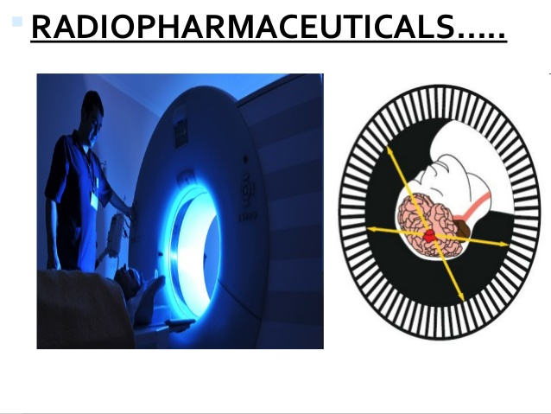

Slide 2
Definition
Radiopharmaceuticals are the radioactive substances or radioactive drugs used for diagnostic or therapeutic interventions.
or
Radiopharmaceuticals are medicinal formulations containing radioisotopes which are safe for administration in humans for diagnosis or for therapy.

Slide 3
Composition
a radioactive isotope that can be injected safely into the body, and
a carrier molecule which delivers the isotope to the area to be treated or examined

Slide 4
Principle
Unstable or radioactive isotopes have a property to decompose or decay by emission of nuclear particles and some of them are used in diagnostic or therapeutic interventions.
The three main types of radiation decay are α particles, β particles, γ photons.

Slide 5
α particles have the largest mass. However, due to large charge, it does cause a great deal of damage to the immediate area by breaking down DNA.
β particles are electrons. β particles are not as destructive as α particles but can be used therapeutically.
γ rays are electron magnetic vibrations comparable with light but of shorter wavelength. Because of their shorter wavelength and high energy, they are very penetrating.

Slide 6
APPLICATIONS / USES OF RADIOPHARMACEUTICALS
Diagnosing
Therapeutic

Slide 7
Diagnostic uses
Radiopharmaceuticals are used to diagnose the presence of disease or evaluate the progression of disease following a specific therapy intervention. Radiopharmaceuticals can also be used to evaluate drug induced toxicity and to a lesser extent have been used to treat diseased tissue with radiation.
For example, to analyse thyroid function, a tracer dose of radioactive iodine is administered orally; the agent concentrates in the thyroid gland. The thyroid is then scanned to determine radioiodine concentration and location. Greater than normal up-take by the thyroid indicates hyperthyroidism.

Slide 8
Therapeutic uses
Radioisotopes are used as internal or external radiation sources to treat disorders such as hyperthyroidism and cancer.
Internal radiation source- A radioisotope administered orally or intravenously or implanted in the target tissue or organ will produce radiation that destroys diseased cells and prevents new tissue growth.
External radiation source- Radiation may be used for therapy in cancer patients.

Slide 9
USES OF RADIOPHARMACEUTICALS IN DIFFERENT ORGAN SYSTEMS
Pulmonary system : Radioisotope are commonly used in lung perfusion scans, which help to detect acute pulmonary embolism, and ventilation scans, which helps to differentiate pulmonary embolism from chronic obstructive pulmonary disease (COPD).
Eg: Xenon 133 (¹³³Xe) gas– In a ventilation scan, this gas may be administered via spirometer or a special breathing apparatus to distribute with respiratory air. A decreased uptake of radioisotope during a perfusion scan indicates a problem with blood flow, including occlusion of pulmonary artery.

Slide 10
Skeletal system : Nuclear bone scans are particularly valuable for detecting cancer metastases, which appear as areas of increased radionuclide phosphate uptake. ^{99m}Tc methylene diphosphonate may be used in skeletal system.
Hepatobiliary system : The introduction of radioactive colloids has made possible both liver visualization and functional evaluation of reticulo-endothelial cells. The use of radiopharmaceutical reactive dyes permits visualization of the liver and biliary duct and assessment of hepatocyte function. Example: Iodine 131 (¹³¹I) sodium rose bengal.

Slide 11
Renal system : Radiopharmaceuticals allow both static and dynamic evaluation of the kidneys.
Nervous system : Nerve brain scans serve two main purposes: To evaluate changes in the blood brain barrier and to assess cerebral blood flow.
Cardiovascular system : Nuclear imaging studies of the heart may be static or dynamic. A static scan localizes the site of myocardial infarction and analyses myocardial perfusion. A dynamic study evaluates cardiac function.

Slide 12
Miscellaneous agents:
Sodium iodide 123 (Na¹²³I): This is the preferred radioisotope in thyroid function studies and imaging studies of the thyroid, liver, brain and lung.
Gallium citrate 67 (⁶⁷Ga): This agent helps to localize tumours and infections of soft tissues and bone (eg, lymphoma, hepatoma).

Slide 13
NUCLEAR PHARMACY
It’s a relatively newer branch of pharmacy that involve the procurement, compounding, dispensing and quality control of radioactive pharmaceuticals intended to be used for investigation or treatment of some diseases in humans or animals.

Slide 14
Role of Radio pharmacist
The radio pharmacist’s main responsibility is the procurement, preparation, quality control and supply of radio-pharmaceuticals.
Radio pharmacists also have a clinical role to play. E.g. providing advice on the use of radiopharmaceuticals and having input to patient care in the nuclear medicine department. In addition they may provide education and training to their own staff as well as other health care professions. There is a scope to get involved in the research and development of new radio- pharmaceuticals including clinical trials.

Slide 15
Procurement of radiopharmaceuticals
Because of the short life of the radiopharmaceuticals the nuclear pharmacist will order the drug directly from manufacturer usually through overnight delivery. Isotope storage areas should be as per the rules.
There should be a separate lab for the manipulation and preparation of radio pharmaceutical dosage and another for calibration of doses.

Slide 16
Preparation of the radio pharmaceutical
Formulation of radio pharmaceuticals is more complex than normal pharmaceuticals. Good Radiation Practices (GRPs) and Good Manufacturing Practices (GMPs) should be strictly followed during manufacturing and dispensing operations.

Slide 17
Quality Assurance
Radiopharmaceuticals are generally expected to conform to specifications under the following heading:
Radionuclide concentration
Radiochemical purity
Sterility
Apyrogenicity
Absence of foreign particulate matter
Particle size (if appropriate)
pH

Slide 18
Packaging of radio pharmaceutical
The most effective way to reduce the risk associated with transporting radioactive materials is to follow the appropriate packaging standards specified by DOT and, when required, NRC or DOE regulations.
Three types of containers.
Industrial packaging
Type A packaging
Type B packaging

Slide 19

Industrial Packaging: Materials that present little hazard from radiation exposure, due to their low level of radioactivity, are shipped in industrial packages.

Slide 20
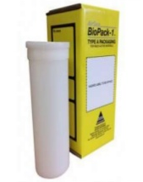
Type A Packages: Radioactive materials with higher specific activity levels are shipped in Type A packages. Typically, Type A packages are used to transport radiopharmaceuticals (radioactive materials for medical use) and certain regulatory qualified industrial products.

Slide 21
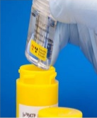
Type B Packages: Radioactive materials that exceed the limit of type A packages requirements must be shipped in type B packages. These packages are used to transport materials with high levels of radioactivity such as nuclear power plant, spent fuel.

Slide 22
Labelling of Radioactive Substances
Every radiopharmaceutical preparation must comply with the labelling requirements established under Good Manufacturing Practice.
The label on the primary container should include:
A statement that the product is radioactive or the international symbol for radioactivity
The name of the radiopharmaceutical preparation
The route of administration;
The expiry date and, where necessary, time;
The batch (lot) number assigned by the manufacturer;
For solutions, the total volume.

Slide 23
The label on the outer package should include:
A statement that the product is radioactive or the international symbol for radioactivity
The name of the radiopharmaceutical preparation;
Where appropriate, that the preparation is for diagnostic or for therapeutic use;
The route of administration;
The expiry date and, where necessary, time;
The batch (lot) number assigned by the manufacturer;
For solutions, the total volume;
Any special storage requirements with respect to temperature and light;

Slide 24
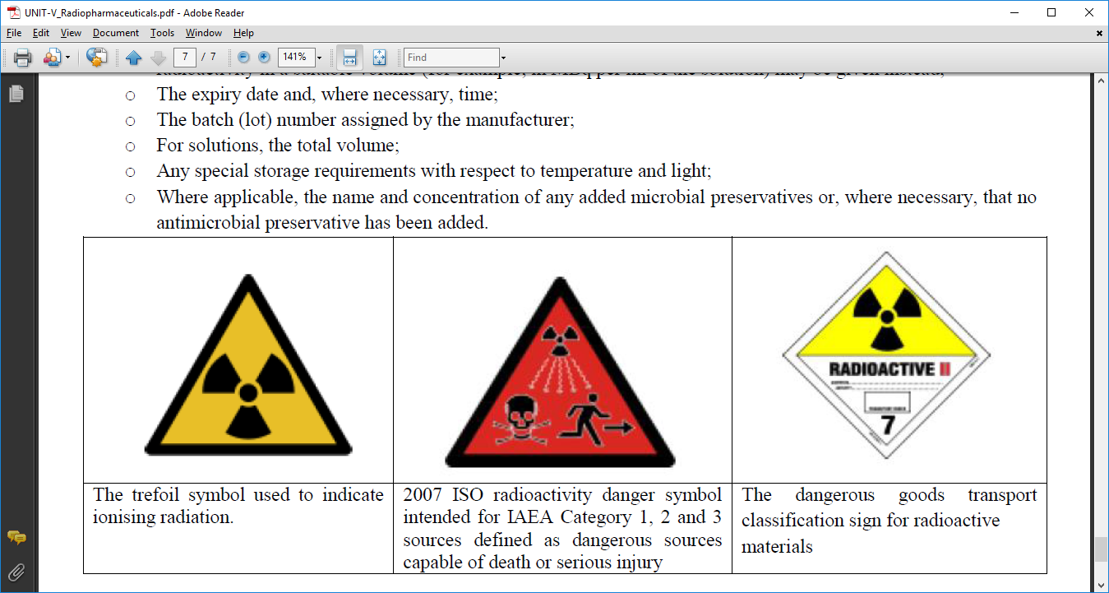

Slide 25
Storage of Radioactive Substances
Radiopharmaceuticals should be kept in well-closed containers and stored in an area assigned for the purpose.
Care should be taken to comply with national regulations for protection against ionizing radiation.

Slide 26
Dispensing of radiopharmaceuticals
The dispensing of radio pharmaceuticals should be safe, reliable and straight forward.
Make sure the recommended dose is based on the patient history, weight of the patient, body surface area and other factors
Develops policies and procedures to ensure that correct drug with correct dosage and dosage form are received by the correct patient at the correct time via route of administration.

Slide 27
Precautions For Handling Radioactive Substances

Slide 28
The radioactive substances used should comply with the following characteristics:
Radio toxicity must be as low as possible.
The amounts used must be kept to a minimum.
When handling radioactive materials, always wear the appropriate protective clothing (wear a lab coat, gloves, shoe covers).
To avoid internal contamination, strict hygiene is essential when handling radioactive materials
Wash your hands thoroughly when you leave the lab.
Never pipette by mouth. Use pipetting devices instead.
Regularly check the radiation level of your working area and all objects used, or at least at the end of each working day.
Dispose of all radioactive waste in the appropriate containers.

