Slide 1
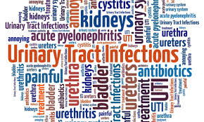


Urinary Tract Infection
[ UTIs ]
Infection Disease
By Animesh Das

Slide 2
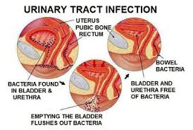
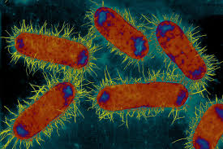
Definition
It is a infection in any part of the urinary system , kidneys , bladder or urethra .there are more common in women , associated with inflammation of urinary tract .
Causative agent -- Escherichia coli (E. coli)

Slide 3
Terminology
Uncomplicated – UTI without underlying renal or neurologic diseased.
Complicated – UTI with underlying structural medical or neurologic disease .
Recurrent -- >3 symptomatic UTIs within 12 months following clinical therapy .
Reinfection – Recurrent UTI caused by different pathogen at any time .
Relapse – Recurrent UTI caused by same species causing original UTI within weeks after therapy .

Slide 4
Type / Classification
There are two type UTIs --
Upper UTIs
Lower UTIs
In Upper UTIs –
Acute pyelonephritis
Chronic pyelonephritis
Interstitial pyelonephritis
Renal abscess
Perirenal abscess
In Lower UTIs –
Cystitis
Prostatitis
Urethritis

Slide 5
Routes of Infection
Ascending
Iatrogenic
Hematogenous
Lymphogenous
Extraction from neighing organs
From a focus in the kidney or prostate

Slide 6
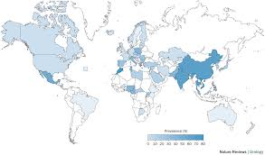
Epidemiology
Seen in all ages , 7 million new cases of lower UTI .
Incidence of UTI increase in old age 10 % of men and 20 % of women .
UTIs zone – US , Europe , Russia , India , UK .

Slide 7
Sings and symptoms
A strong, persistent urge to urinate.
A burning sensation when urinating.
Passing frequent, small amounts of urine.
Urine that appears cloudy.
Urine that appears red, bright pink or cola-colored
Strong-smelling urine

Slide 8
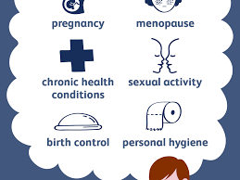
Risk factor
Aging
Females
Males
Site of infection
Pregnancy
Residual urine
Sexual intercourse

Slide 9
Mode of Transmission
Incubation Period --Three to eight days
travel to the bladder

Slide 10
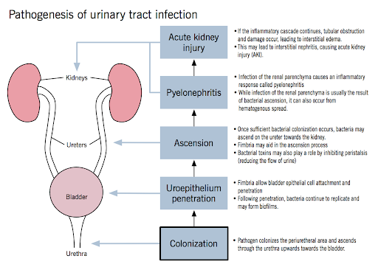
Pathophysiology

Slide 11
Management
Diagnosis
Treatment

Slide 12
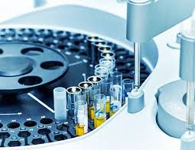
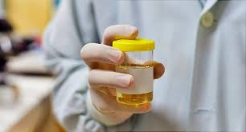
Diagnosis
Acute pyelonephritis
Acute Cystitis
Urethritis
Acute prostatitis .
Pelvic inflammatory disease

Slide 13
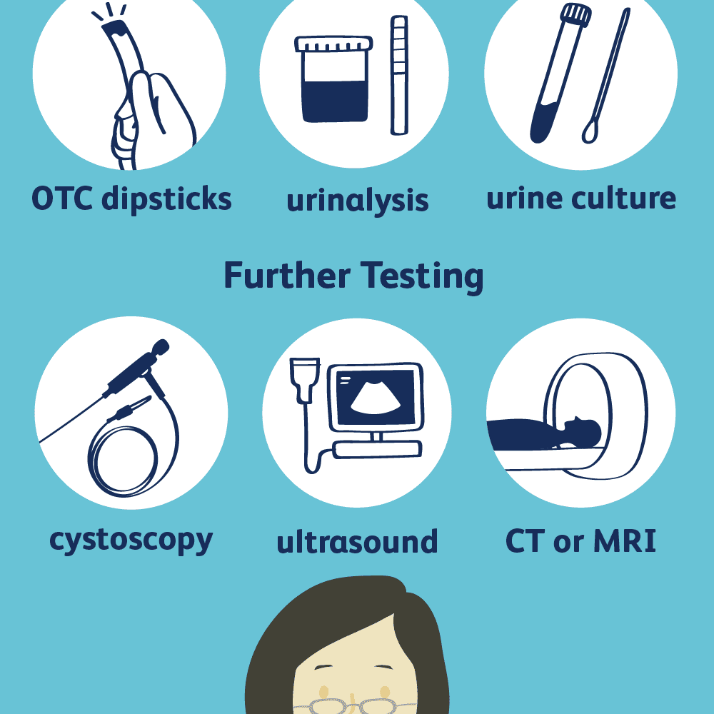
Investigation
Microscopic examination
Urinalysis
Urine culture
CT scan and MRI

Slide 14
Treatment
Category | Drug Name
Antibiotics | Trimethoprim , Fosfomycin
cephalosporins | Cephalexin

Slide 15
Complication
Recurrent Infection
Permanent
Low birth Weight
Urethral narrowing
Sepsis

Slide 16

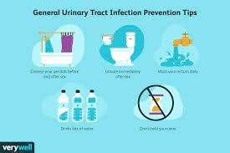
Prevention
Drink plenty of liquids, especially water.
Drink cranberry juice.
Wipe from front to back.
Empty your bladder soon after intercourse.
Avoid potentially irritating feminine products.
Change your birth control method

Slide 17
Thank
you

