Slide 1
PHARMACEUTICAL MICROBIOLOGY
3 VIRUS
17-09-2024
1

Slide 2
VIRUS
A virus is a submicroscopic infectious agent that replicates only inside the living cells of an organism.
Viruses infect all types of life forms, from animals and plants to microorganisms, including bacteria and archaea.
Since Dmitri Ivanovsky's 1892 article describing a non-bacterial pathogen infecting tobacco plants and the discovery of the tobacco mosaic virus by Martinus Beijerinck in 1898, more than 9,000 virus species have been described in detail of the millions of types of viruses in the environment.
Viruses are found in almost every ecosystem on Earth and are the most numerous type of biological entity.
The study of viruses is known as virology, a subspeciality of microbiology.
When infected, a host cell is forced to rapidly produce thousands of copies of the original virus.
When not inside an infected cell or in the process of infecting a cell, viruses exist in the form of independent particles, or virions, consisting of:
(i) the genetic material, i.e., long molecules of DNA or RNA that encode the structure of the proteins by which the virus acts; (ii) a protein coat, the capsid, which surrounds and protects the genetic material; and in some cases
(iii) an outside envelope of lipids. The shapes of these virus particles range from simple helical and icosahedral forms to more complex structures. Most virus species have virions too small to be seen with an optical microscope, as they are one-hundredth the size of most bacteria.
17-09-2024
2

Slide 3
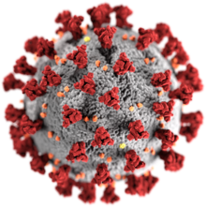
The origins of viruses in the evolutionary history of life are unclear: some may have evolved from plasmids—pieces of DNA that can move between cells—while others may have evolved from bacteria. In evolution, viruses are an important means of horizontal gene transfer, which increases genetic diversity in a way analogous to sexual reproduction.
Viruses are considered by some biologists to be a life form, because they carry genetic material, reproduce, and evolve through natural selection, although they lack the key characteristics, such as cell structure, that are generally considered necessary criteria for life. Because they possess some but not all such qualities, viruses have been described as "organisms at the edge of life", and as self-replicators.

Slide 4
Viruses spread in many ways. One transmission pathway is through disease-bearing organisms known as vectors: for example, viruses are often transmitted from plant to plant by insects that feed on plant sap, such as aphids; and viruses in animals can be carried by blood-sucking insects.
Influenza viruses are spread by coughing and sneezing. Norovirus and rotavirus, common causes of viral gastroenteritis, are transmitted by the faecal–oral route, passed by hand-to-mouth contact or in food or water. The infectious dose of norovirus required to produce infection in humans is less than 100 particles.
HIV is one of several viruses transmitted through sexual contact and by exposure to infected blood. The variety of host cells that a virus can infect is called its "host range". This can be narrow, meaning a virus is capable of infecting few species, or broad, meaning it is capable of infecting many.
Viral infections in animals provoke an immune response that usually eliminates the infecting virus.
Immune responses can also be produced by vaccines, which confer an artificially acquired immunity to the specific viral infection. Some viruses, including those that cause AIDS, HPV infection, and viral hepatitis, evade these immune responses and result in chronic infections. Several antiviral drugs have been developed.

Slide 5
Microbiology
Life properties
Scientific opinions differ on whether viruses are a form of life or organic structures that interact with living organisms
They have been described as "organisms at the edge of life", since they resemble organisms in that they possess genes, evolve by natural selection, and reproduce by creating multiple copies of themselves through self-assembly.
Although they have genes, they do not have a cellular structure, which is often seen as the basic unit of life. Viruses do not have their own metabolism and require a host cell to make new products.
They therefore cannot naturally reproduce outside a host cell although some bacteria such as rickettsia and chlamydia are considered living organisms despite the same limitation.
Accepted forms of life use cell division to reproduce, whereas viruses spontaneously assemble within cells.
They differ from autonomous growth of crystals as they inherit genetic mutations while being subject to natural selection. Virus self-assembly within host cells has implications for the study of the origin of life, as it lends further credence to the hypothesis that life could have started as self-assembling organic molecules.

Slide 6
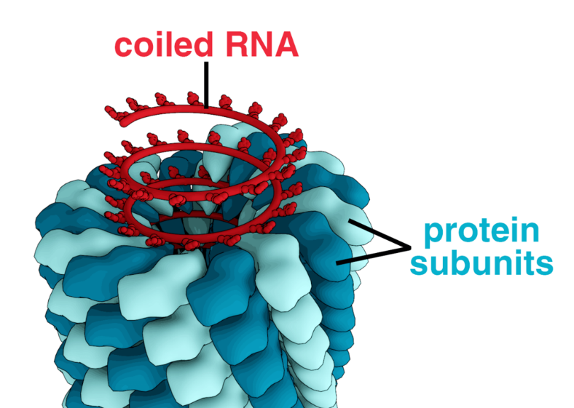
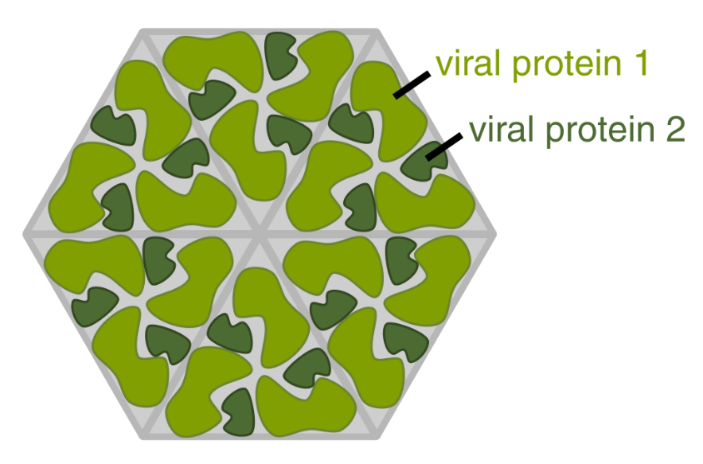
Structure
Viruses display a wide diversity of shapes and sizes, called 'morphologies’.
In general, viruses are much smaller than bacteria. Most viruses that have been studied have a diameter between 20 and 300 nanometres. Some filoviruses have a total length of up to 1400 nm; their diameters are only about 80 nm.
Most viruses cannot be seen with an optical microscope, so scanning and transmission electron microscopes are used to visualise them.
To increase the contrast between viruses and the background, electron-dense "stains" are used.
These are solutions of salts of heavy metals, such as tungsten, that scatter the electrons from regions covered with the stain. When virions are coated with stain (positive staining), fine detail is obscured. Negative staining overcomes this problem by staining the background only.

Slide 7
A complete virus particle, known as a virion, consists of nucleic acid surrounded by a protective coat of protein called a capsid.
These are formed from protein subunits called capsomeres. Viruses can have a lipid "envelope" derived from the host cell membrane.
The capsid is made from proteins encoded by the viral genome and its shape serves as the basis for morphological distinction.
Virally-coded protein subunits will self-assemble to form a capsid, in general requiring the presence of the virus genome. Complex viruses code for proteins that assist in the construction of their capsid.
Proteins associated with nucleic acid are known as nucleoproteins, and the association of viral capsid proteins with viral nucleic acid is called a nucleocapsid. The capsid and entire virus structure can be mechanically (physically) probed through atomic force microscopy. In general, there are five main morphological virus types:

Slide 8
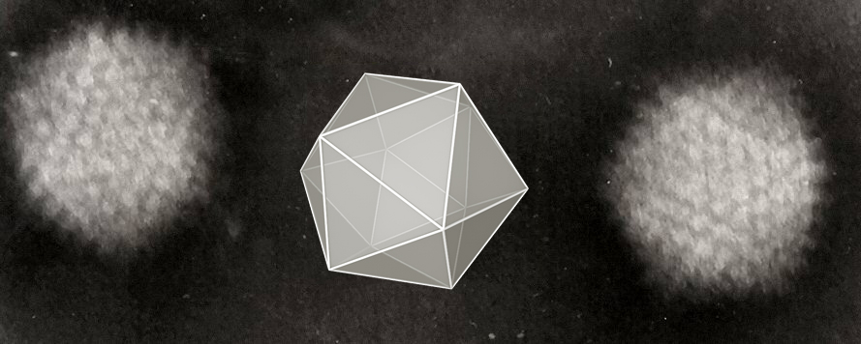
1. Helical
These viruses are composed of a single type of capsomere stacked around a central axis to form a helical structure, which may have a central cavity, or tube.
This arrangement results in virions which can be short and highly rigid rods, or long and very flexible filaments. The genetic material (typically single-stranded RNA, but single-stranded DNA in some cases) is bound into the protein helix by interactions between the negatively charged nucleic acid and positive charges on the protein.
Overall, the length of a helical capsid is related to the length of the nucleic acid contained within it, and the diameter is dependent on the size and arrangement of capsomeres. The well-studied tobacco mosaic virus and inovirus are examples of helical viruses.

Slide 9
2. Icosahedral
Most animal viruses are icosahedral or near-spherical with chiral icosahedral symmetry.
A regular icosahedron is the optimum way of forming a closed shell from identical sub-units. The minimum number of capsomeres required for each triangular face is 3, which gives 60 for the icosahedron.
Many viruses, such as rotavirus, have more than 60 capsomers and appear spherical but they retain this symmetry. To achieve this, the capsomeres at the apices are surrounded by five other capsomeres and are called pentons.
Capsomeres on the triangular faces are surrounded by six others and are called hexons
Hexons are in essence flat and pentons, which form the 12 vertices, are curved. The same protein may act as the subunit of both the pentamers and hexamers or they may be composed of different proteins.
3. Prolate
This is an icosahedron elongated along the fivefold axis and is a common arrangement of the heads of bacteriophages. This structure is composed of a cylinder with a cap at either end.

Slide 10
Enveloped
Some species of virus envelop themselves in a modified form of one of the cell membranes, either the outer membrane surrounding an infected host cell or internal membranes such as nuclear membrane or endoplasmic reticulum, thus gaining an outer lipid bilayer known as a viral envelope.
This membrane is studded with proteins coded for by the viral genome and host genome; the lipid membrane itself and any carbohydrates present originate entirely from the host. Influenza virus, HIV (which causes AIDS), and severe acute respiratory syndrome coronavirus 2 (which causes COVID-19)[use this strategy. Most enveloped viruses are dependent on the envelope for their infectivity.

Slide 11
Viral culture
Viral culture is a laboratory technique in which samples of a virus are placed to different cell lines which the virus being tested for its able to infect.
If the cells show changes, known as cytopathic effects, then the culture is positive.
Traditional viral culture has been generally superseded by shell vial culture, in which the sample is centrifuged onto a single layer of cells and viral growth is measured by antigen detection methods.
This greatly reduces the time to detection for slow growing viruses such as cytomegalovirus, for which the method was developed. In addition, the centrifugation step in shell vial culture enhances the sensitivity of this method because after centrifugation, the viral particles of the sample are in close proximity to the cells.
Human and monkey cells are used in both traditional viral culture and shell vial culture.

Slide 12
Human virus types that can be identified by viral culture include adenovirus, cytomegalovirus, enteroviruses, herpes simplex virus, influenza virus, parainfluenza virus, rhinovirus, respiratory syncytial virus, varicella zoster virus, measles and mumps.
For these, the final identification method is generally by immunofluorescence, with exception of cytomegalovirus and rhinovirus, whose identification in a viral culture are determined by cytopathic effects.
Preliminary research (i.e. not yet peer reviewed at the time of writing, 29 September 2020) exploring the potential suitability of viral culture testing of SARS-CoV-2 has been conducted.

Slide 13
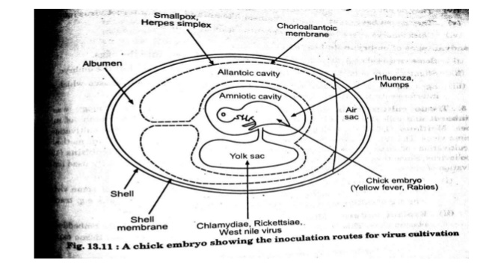

Slide 14
There are three methods employed for the cultivation of animal viruses 1. Animal inoculation 2. Embryonated eggs or chick embryo method. 3. Tissue culture or cell culture.
Animal Inoculation – Susceptible experimental animals like Mice, Monkey, Rabbits, Guinea Pigs etc. are used for the cultivation of viruses.
Virus sample to be cultivated should injected into the experimental animal.
It is important to select specific host animal for particular viruses. Route of inoculation of viral sample in the host cell also play important role in cultivation of viruses. Other factors such as age and immunity of host animal also affect the growth of viruses in the host.
Eg. Mice are the most widely employed animals in virology. It can be inoculated by routes like intracerebral, subcutaneous, intraperitoneal or intranasal. The growth of the virus in inoculated animals may be indicated by death, disease or visible lesion. Disadvantages of animal inoculation are that immunity may interfere with viral growth

Slide 15
2. Embryonate Eggs or Chick embryo method Good pasture (1931) was the first who used hen’s embryonated egg for the cultivation of viruses. Embryonated egg provides several sites for the cultivation of viruses. Viz 1. Chorio- allantoic membrane 2. Allantoic cavity 3. Amniotic cavity 4. Yolk sac 5. Embryo
Different site is used for growth of different viruses. Eg. Chorio-allantoic membrance is used for the cultivation of pox virus. Allantoic cavity is employed for the Influenza virus. There are several advantages, chick embryos are packed in their shells and have natural resistant against bacterial contamination. Chick embryomethod is cheaper and easy to handle.
Chorioallontoic membrane (CAM):
Pox virus are cultured in choriallontoic membrane.
The growing virus produce grey-white lesions called Pocks.
Each Pock is developed by a single virus.
The number of pocks indicates the number of virus present in inoculated sample.
such as Chlamydia and Rickettsia

Slide 16
ii. Allantoic cavity:
Viruses such as Influenza virus, Mumps virus, Yellow fever virus and Rabies virus are cultivated in allantoic cavity.
Allantoic cavity culture of virus is mainly done for vaccine preparation, to obtain large amount of virus load.
iii. Amniotic cavity:
Influenza virus are cultured in amniotic cavity for isolation of virus from clinical sample.
iv. Yolk sac:
Herpes virus is cultured by inoculating in yolk sac.
This is also used for cultivation of some bacteria

Slide 17
3.Tissue Culture Steinhardt and colleagues (1913), was the first who used bits of tissue or organ for the cultivation of viruses. Now advance techniques are develop in Tissue culture. Three types of tissue cultures are available. 1. Organ culture:- Small bits of organs are used for the cultivation of virus. 2. Explants culture:- Fragments of minced tissue can be grown as ‘explants’ embedded in plasma clots. 3. Cell culture:- This is most common method for viral cultivation and growth of viruses. Different types of cell cultures are used for different viruses. General method is as follows :-
1 )Tissue like Monkey Kidney, Rabbit Kidney is taken and treated with proteolytic enzymes such as Trypsin and by mechanical shaking, tissues are dissociated into the component cells. Trypsin, the protecolytic enzyme digest the binding material that binds the cells together in a tissue and results into free cells. He La cells (i.e. human cells from cervical cancer region) are also commonly used cell system for the cultivation of viruses3
2. After treatment with trypsin, cells are washed, counted and suspended in the growth medium.
3. Growth medium constitutes all those essential elements required for the growth of cell viz. essential amino acids, vitamins, salts, glucose, bicarbonates (buffer) with atmosphere containing 5% CO2 and supplemented with 5% calf serum.
4. Antibiotics are added into the growth medium to prevent bacterial contaminants. Some indicators like phenol red, neutral red etc. are added into the growth medium, Change in indicator colour in growth medium, indicates the growth of virus in cell culture.

