Slide 1
PHARMACOTHERAPEUTICS-III
UNIT NO- 01 GASTROINTESTINAL SYSTEM
17-09-2024
1

Slide 2
TOPIC NAME -ZOLLINGER ELLISON SYNDROME
HISTORY:
Almost 63 years ago, in 1955, Zollinger and Ellison reported the clinical course of two women with severe ulcer diatheses who presented with perforated jejunal ulcers. Both had massive gastric acid hyper secretion and each was ultimately found to have a non‐insulin secreting islet cell tumour. The investigators postulated that an unknown hormone secreted from these islet cell tumours was the cause of the massive gastric acid output that resulted in these intractable peptic ulcer syndromes
17-09-2024
2

Slide 3
DEFINITION
ZES is caused by the uncontrolled secretion of abnormal amounts of gastrin by a duodenal or pancreatic neuroendocrine tumour (i.e gastrinoma)
Incidence of ZES varies from 0.01 to 1% of individuals with PUD.
Males are more commonly affected than females
Majority of patients are diagnosed between ages of 30 and 50

Slide 4
PATHOPHSIOLOGY
The gastrinoma secretes gastrin, which in turn stimulates acid secretion through gastrin receptors on parietal cells and by inducing histamine release from ECL cells.
Acid output may be so great that it reaches the upper small intestine
Pancreatic lipase is inactivated and bile acids are precipitated
90% of tumours occur in the pancreatic head or proximal duodenal wall
Gastrinomas can develop in the presence of MEN 1 (Multiple endocrine neoplasia type 1) syndrome in ~25% of patients.
This autosomal dominant disorder involves primarily three organ sites: the parathyroid glands (80-90%), pancreas (40-80%), and pituitary gland (30-60%).

Slide 5
TUMOR DISTRIBUTION
Majority of gastrinomas occurred within the pancreas, a significant number of these lesions are extrapancreatic.
Over 80% of these tumors are found within the hypothetical gastrinoma triangle.
Duodenal tumors constitute the most common nonpancreatic lesion, between 50 and 75% of gastrinomas.
Duodenal tumors are smaller, slower growing, and less likely to metastasize than pancreatic lesions.
Less common extrapancreatic sites include stomach, bones, ovaries, heart, liver, and Iymph nodes.
60% of tumors are considered malignant, with up to 30-50% of patients having multiple lesions or metastatic disease at presentation.

Slide 6
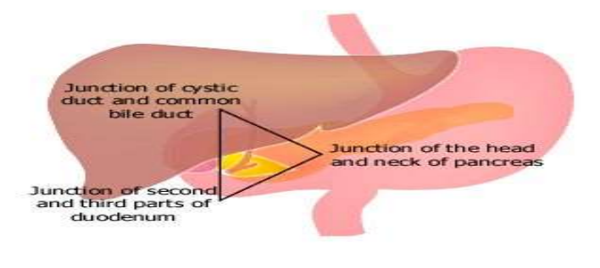
PASSARO'S TRIANGLE OR TRIANGLE OF GASTRINOMA

Slide 7
CLINICAL MANIFESTATIONS
Severe and often multiple peptic ulcers in unusual sites, such as the post-bulbar duodenum, jejunum or oesophagus
Poor response to standard ulcer therapy
Bleeding and perforations are common
Diarrhoea and steatorrhoea
Abdominal pain
Nausea and vomiting
Weight loss and decreased appetite.

Slide 8
DIAGNOSIS
Biochemical test
Fasting gastrin levels obtained using a dependable assay are usually <150 pg/ml.
A pH can be measured on gastric fluid obtained either during endoscopy or through nasogastric aspiration; a pH <3 is suggestive of a gastrinoma.
A BAO > 15 meq/h in the presence of hypergastrinemia is considered for ZES.
BAO/MAO ratio >0.6 being highly suggestive of ZES.
An increase in gastrin of < 120pg within 15 mins of secretin injection has a sensitivity and specificity of 90% for ZES
Imaging
An abdominal CT scan or MRI to exclude metastatic disease
Endoscopic ultrasound (EUS) permits imaging of the pancreas with a high degree of resolution.

Slide 9
TREATMENT
PPls are the treatment of choice and have decreased the need for total gastrectomy.
  Initial PPI doses tend to be higher than those used for treatment of GERD or PUD
  Dosage = 60 mg in divided doses in a 24-h period
Somatostatin analogue has inhibitory effects on gastrin release from receptor bearing tumors and inhibits gastric acid secretion to some extent
Ultimate goal of surgery would be to provide a definitive cure
  cure rates as high as 60% with 10 - year disease-free intervals as high as 34% in sporadic gastrinoma.

