Slide 1
Breast Cancer

Slide 2


Slide 3
Proliferation – Cell Multiplication
Essential for normal growth & development of the breast
Important factor in breast cancer
The key event during tumor promotion
Allows less time for mutation repair

Slide 4
Proliferation Decreases Mutation Repair
Time For Repair Before DNA Duplication
Within a Cell
Little Time For Repair Before DNA Duplication
In Each Daughter Cell
In Each Daughter Cell

Slide 5
Proliferation – Cell Multiplication
Essential for normal growth & development of the breast
Important factor in breast cancer
Decreases time for mutation repair
Key event during the tumor promotion
Proliferating cells at risk to undergo initiation, promotion and progression stages of cancer formation
Estrogen and other reproductive hormones cause proliferation of breast cells

Slide 6
Breast Cancer Risk Factors
Risk Factors do not cause breast cancer but are associated with an increased chance of getting breast cancer
The number one risk factor for breast cancer is being a women
Age is a risk; the chance of getting breast cancer increases with age

Slide 7
Age as a Risk Factor
RISK
By age 30 1 out of 2,000
By age 40 1 out of 233
By age 50 1 out of 53
By age 60 1 out of 22
By age 70 1 out of 13
By age 80 1 out of 9
Lifetime risk 1 out of 8
NCI SEER Program, 1995-1997

Slide 8
Risk Factors
Controllable
Alcohol drinking
Being overweight
Never having children
1st child >30yrs of age
Hormone Replacement
Birth control pills (very slight)
ACS Breast Cancer Facts 2001-02
Uncontrollable
Getting older
First degree relative with breast cancer
A previous breast biopsy showing atypical changes

Slide 9
Risk Factors
Controllable
Being exposed to large amounts of radiation
Uncontrollable
Being young (<12) at the time of menses
Starting menopause after age 55
Having an inherited mutation in the breast cancer genes (BRCA 1 or 2)
ACS Breast Cancer Facts 2001-02

Slide 10
Breast Cancer Screening Methods For Healthy Women
1. Breast Self Exam — Status
  Guiding principal “Know your breasts — they are not land mines”
2. Clinical Breast Exam
  Age 20-39: every 3 years
  Age after 40: every year
3. Mammography
  Age after 40: every year

Slide 11
Mammography
Use a low-dose x-ray system to examine breasts
Digital mammography replaces x-ray film by solid-state detectors that convert x-rays into electrical signals. These signals are used to produce images that can be displayed on a computer screen (similar to digital cameras)
Mammography can show changes in the breast up to two years before a physician can feel them

Slide 12
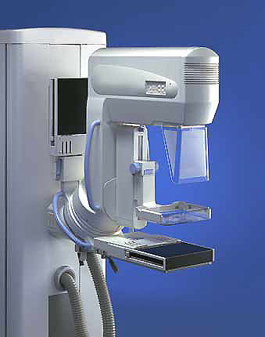
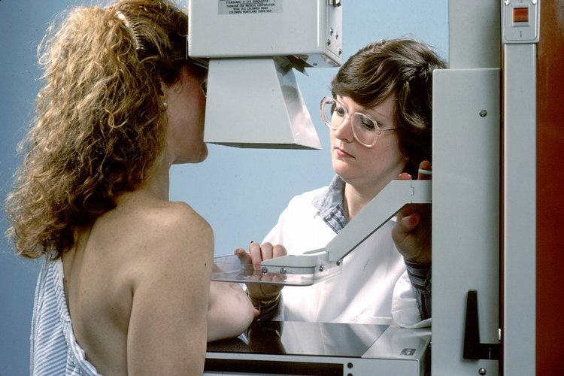
Mamogram equipment

Slide 13
Computer-Aided Diagnosis
Mammography allows for efficient diagnosis of breast cancers at an earlier stage
Radiologists misdiagnose 10-30% of the malignant cases
Of the cases sent for surgical biopsy, only 10-20% are actually malignant
CAD systems can assist radiologists to reduce the above problems

Slide 14
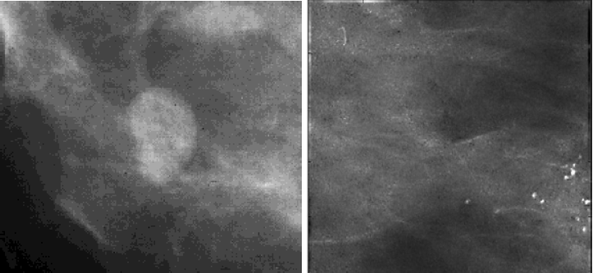
What Mammograms Show
Two of the most important mammographic indicators of breat cancers
  Masses
  Microcalcifications: Tiny flecks of calcium – like grains of salt – in the soft tissue of the breast that can sometimes indicate an early cancer.

Slide 15
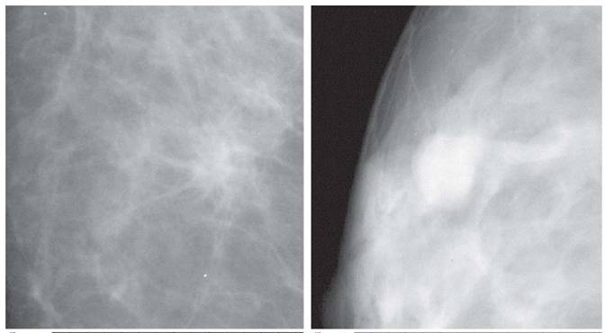
Detection of Malignant Masses
Malignant masses have a more spiculated appearance

Slide 16
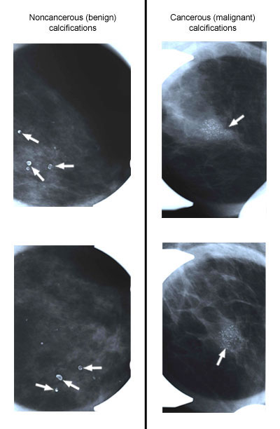
Calcification Features
The morphology of individual calcification, e.g., shape, area, and brightness
The heterogeneity of individual features characterized by the mean, the standard deviation, and the maximum value for each feature.
Cluster features such as total area, compactness

Slide 17
Trouble Signs That Should Not Be Ignored
Finding a lump, hard knot or thickening
Unusual swelling, warmth, redness or darkening
Change in size or shape of your breast
Dimpling or puckering of the skin of your breast
Finding an itchy, scaly sore or rash on the nipple
Pulling in of the nipple or other parts of the breast
Nipple discharge that starts suddenly

Slide 18
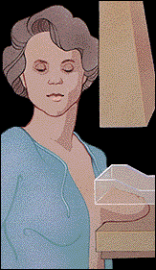
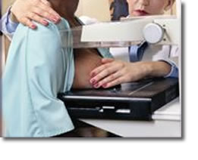
Breast Cancer Screening Methods For Healthy Women
How do you do a Breast Self Exam?
What is a mammogram
and is it enough to screen
for Breast Cancer?

Slide 19
When you discover a breast lump
What do you do?
1. Don’t Panic — most breast lumps are not cancer (Benign Breast Changes - Cysts and Fibroadenomas)
2. See your primary health care provider for a full assessment and recommendations
3. You may need a fine needle aspiration procedure and or a diagnostic mammogram or ultrasound

Slide 20
When you discover a breast lump
What do you do?
4. If the breast lump turns out to be solid, what happens then?
5. If after a biopsy, the tissue is found to be cancerous, what happens then?
6. If after a biopsy the tissue is found to not be cancerous, but not entirely normal, what happens then?

Slide 21
DIAGNOSIS
. Patient feels a breast mass or has an abnormal radiologic screening exam
. Surgical biopsy or aspiration
. Observation (LCIS), lumpectomy or mastectomy
. Staging
. Delivery of adjuvant therapies—radiation and/or chemotherapy,hormonal therapies

Slide 22
TUMOR CHARACTERISTICS
Invasive vs. Non-invasive .
Histologic Type-Ductal (85%) vs. Lobular .
Grade (estimate of the aggressiveness under microscope) .
Size .
Margins .
Lymph Nodes .
Estrogen/ Progesterone Receptor (2/3 positive) .
Her-2/ neu

Slide 23
Established Prognostic Markers for Breast Cancer
Axillary lymph nodes
Tumor size
Histological grade
Histological tumor type
Steroid receptor status
Age

Slide 33
Radiation Treatment
Conventional whole breast treatment: mastectomy or radiation therapy
Recent innovations
  Revisit the concept of partial breast treatment only
    Smaller volumes
    Shorter treatment course
  Balloon catheter / multi-catheters

Slide 34
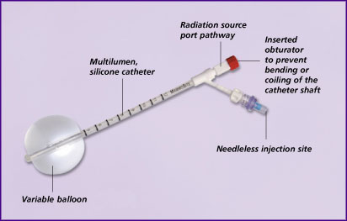

Slide 35
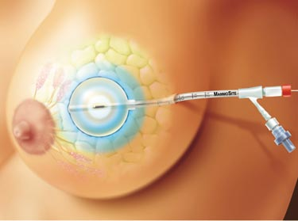
Balloon and lumpectomy

Slide 36
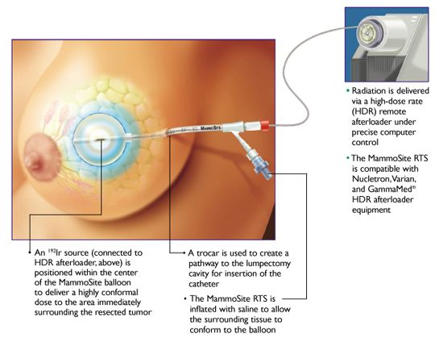

Slide 37
WHO Essential Medicine List for Adults 18th Edition (April 2013)
Antineoplastics relevant to treatment of breast/cervical cancer
  Tamoxifen
  Doxorubicin (Adriamycin)
  Cyclophosphamide (Cytoxan)
  Paclitaxel (Taxol)
  Docetaxel (Taxotere)
  Fluorouracil (5-FU)
  Methotrexate
  Carboplatin
  ??Trastuzumab (Herceptin) – proposed for addition

Slide 38
Treatment
  No “treatment”
  Mastectomy cuts risk by 90%
  Tamoxifen
    anti-estrogen drug
    Lowers risk of diagnosis of benign tumors Influenced by estrogen
    Reduces risk about 28%
    May reduce need for biopsies in high-risk women
    Intervenes before invasive cancer begins

Slide 39
The checklist
Age 20-39
  Monthly self breast exam
  Yearly breast exam by doctor
  Mammogram every
  2-3 years
Age 40+
  Monthly self breast exam
  Breast exam by doctor every 6 month
  Mammogram once a year
  Skin exam yearly

Slide 40
Adjuvant (Early Stage) Targeted Therapy
Anti-HER2 monoclonal antibody trastuzumab (Herceptin) for 1 year is standard
  Reduces recurrence by 1/2 & deaths by 1/3 when added to chemo in early stage breast cancer
  Trastuzumab going off patent soon, and prices will drop
All regimens include chemotherapy in addition to HER2 targeting therapy

Slide 41
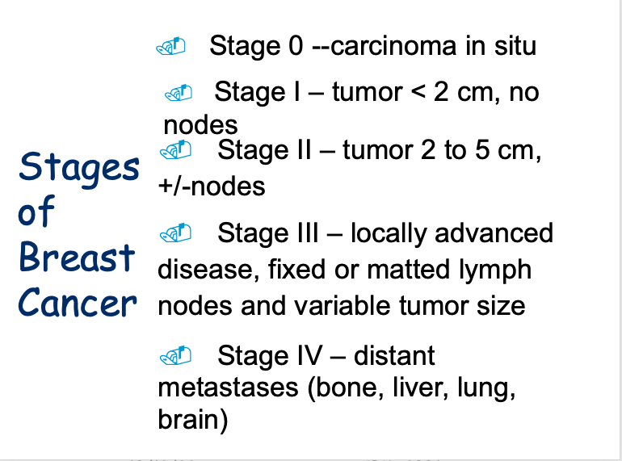

Slide 42
How is breast cancer treated
ADJUVANT THERAPY: Medical therapy to decrease the chance of tumor recurrence - to improve the chances for cure
Chemotherapy - many different therapies
Hormonal therapy - tamoxifen, aromatase inhibitors
4. RADIATION THERAPY - to prevent tumor recurrence in the remaining breast tissue; required for breast preserving therapy

Slide 43
Adjuvant Therapy
Radiation Therapy (local)
Chemotherapy (systemic)
Hormonal agents (systemic)
Each therapy adds to reduction of recurrent disease
Therapy is individualized, discussion with health care provider.

Slide 44
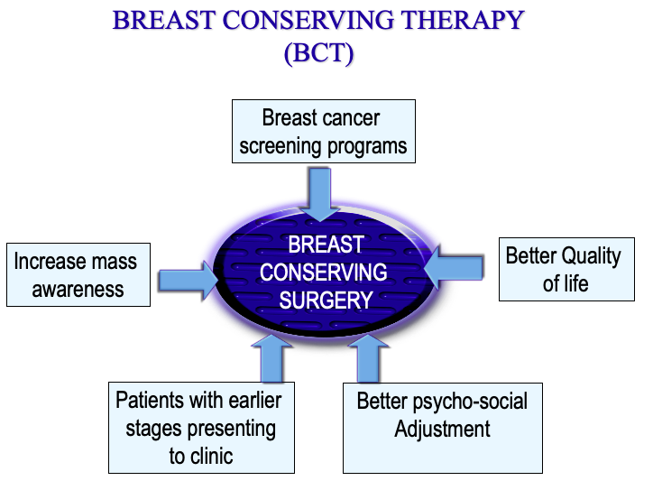

Slide 45
Chemotherapy Drugs
Adriamycin, Epirubicin
. Taxol, Taxotere
Navelbine
Cytoxan
Methotrexate, 5-fluorouracil
Nausea, hair loss, low blood counts, cardiac toxicity, bladder toxicity, nerve damage
Given for adjuvant or recurrent disease

Slide 46
Tamoxifen*
. Works by blocking estrogen receptors in breast cells, inhibiting their growth
Can be given to pre or post menopausal women
Side effects include hot flashes, depression, increased risk of uterine cancer and blood clots
Taken daily by mouth for 5 years

Slide 47
Aromatase Inhibitors
Aromatase is the enzyme that converts androgens to estrogen
AIs are only given to postmenopausal women
Examples: Anastrozole/Arimidex, Letrozole/Femara, Exemestane/Aromasin
May” be more effective than Tamoxifen
Side effects include hot flashes, depression, osteoporosis, joint pains
Taken daily by mouth for variable periods of time

Slide 48
Trastuzumab/Herceptin
. Given to patients whose cancer cells overexpress Her-2-neu as measured by IHC or FISH (25 to 30% of patients)

Slide 49
Bisphosphonates
Bone strengtheners
Given for therapy-induced osteoporosis or for cancer that has spread to bone
Zometa (Zoledronic acid)
Aredia (Pamidronate)
Each lowers calcium and has been shown to reduce the risk of fracture in pts with cancers metastatic to bone.

