Slide 1



Chapter-1
CELL CŸCLE
CELL

Slide 2
For ati of zygote

Slide 3
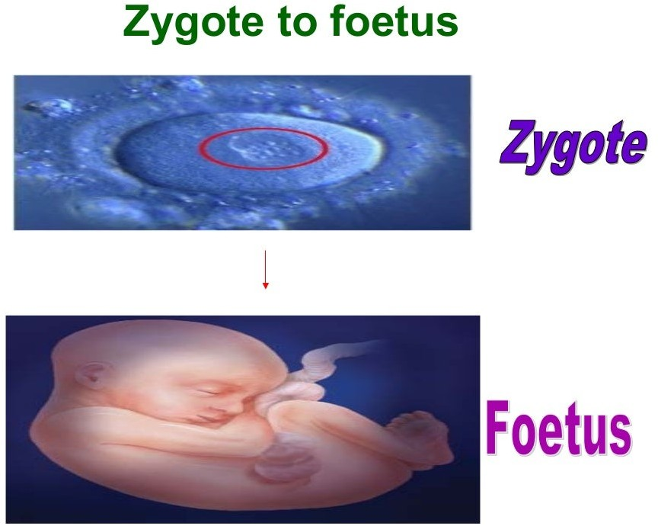

Slide 4




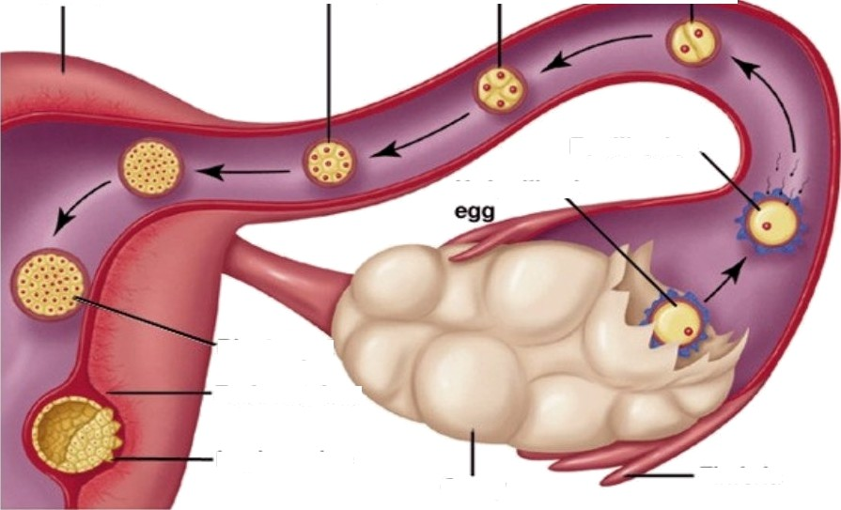
Dyer ShaInDerp’GaIIIano
LHrr›ene›ons W /-lumen Sexr/a/rty , be. Copyr IgLn ' \ 0e9. TI\e McGravr-r\III Companiea. inc. A II Hiqhle fleaerved.
Devel pment-Ea bryo
Stages
Uterus
4-cell) stage
2-stage
8-Cell stage
Fertilization
Unfertilized
Blastecyst
Endometrium
Implantation
Ovary
Fimbria

Slide 5
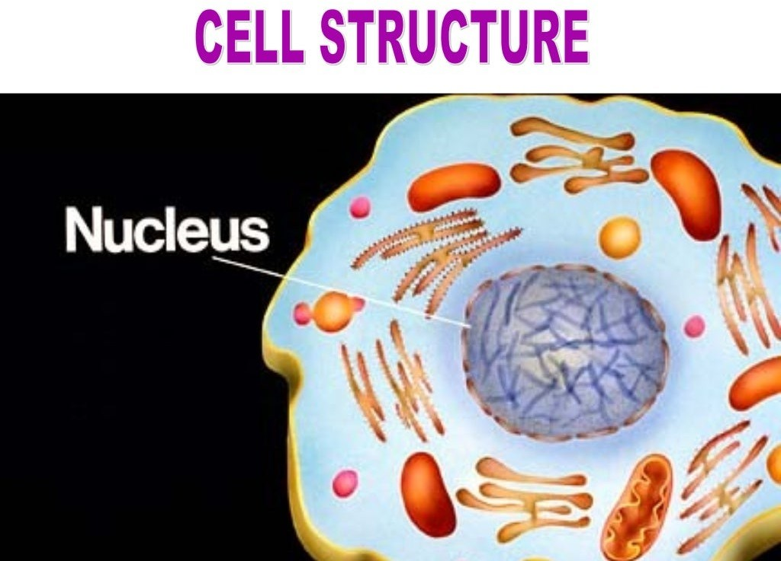

Slide 6
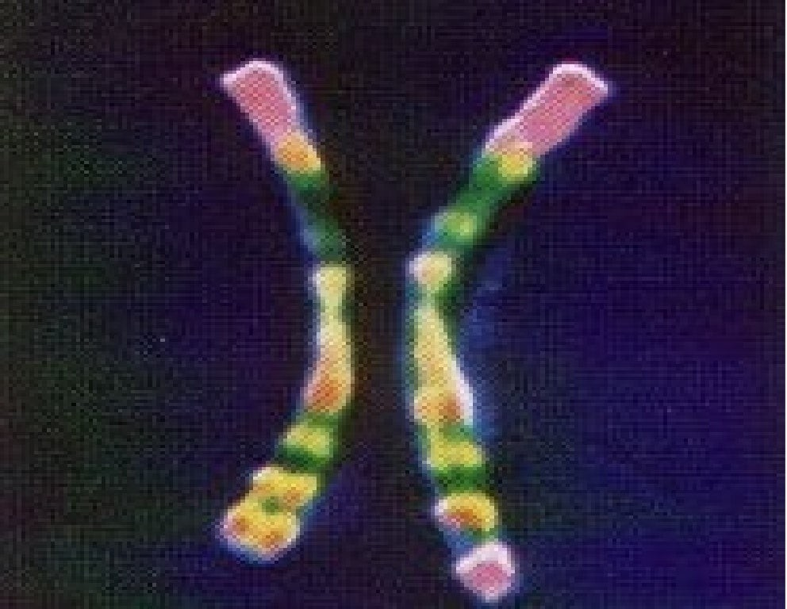

Slide 7





OSO
be
Fruit fly | 8 | Guinea Pip | 16
Dove | 16 | Snail | 24
Earthworm | 36 | Tibetan box | 36
Cat | 38 | Pig | 38
Mouse | 40 | Rat | 42
Rabbit | 44 | Syrian hamster | 44
Hare | 46 | Human | 46
Gorilla | 48 | Sheep | 54
Elephant | 56 | Cow | 60
Donkey | 62 | Horse | 64
Dog | 78 | Chicken | 78
Carp | 104

Slide 8
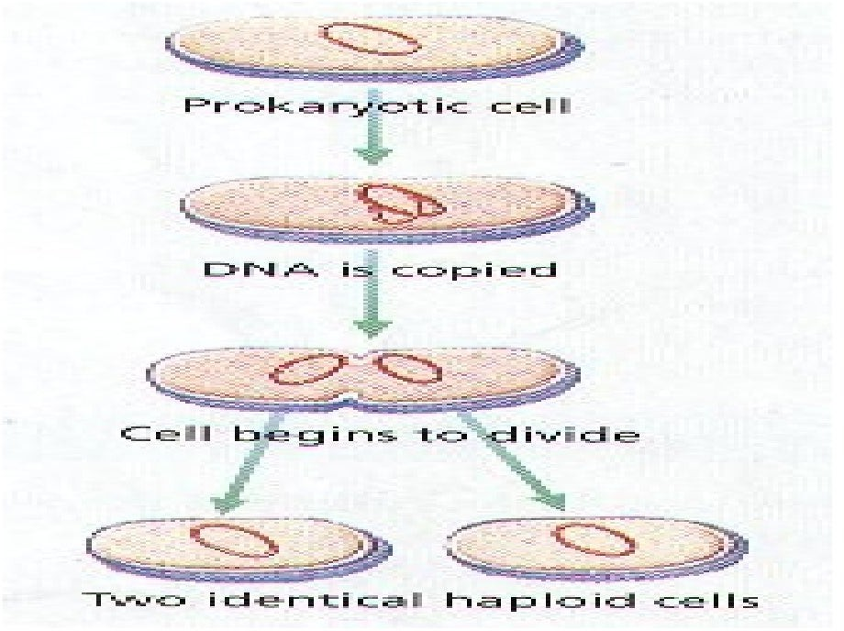

Slide 9
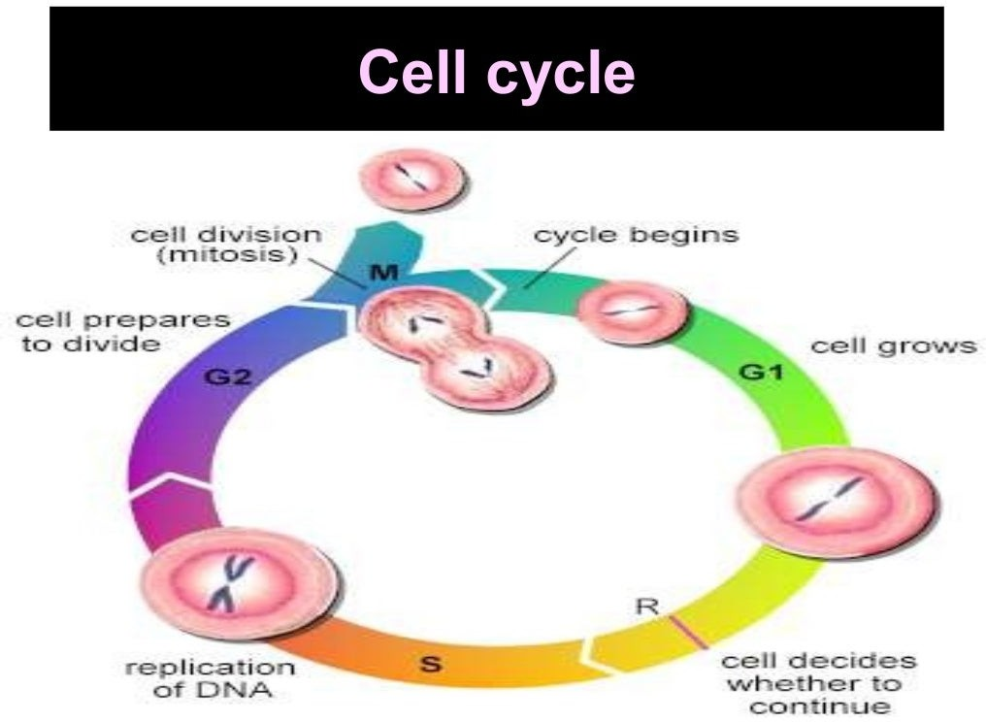

Slide 10


. lnterphase
itosi

Slide 11
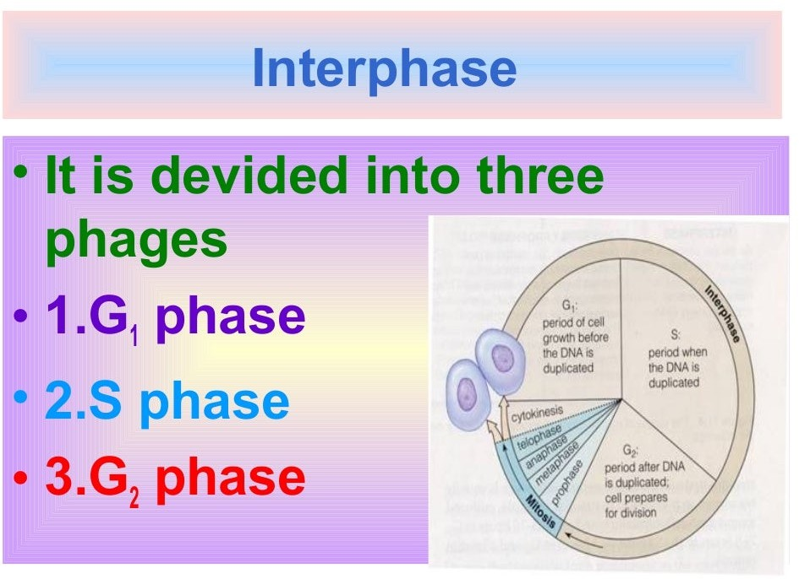

Slide 12
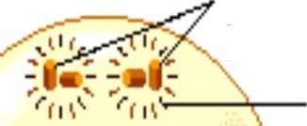

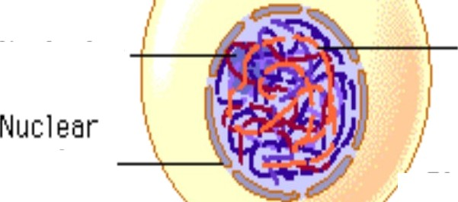
Centr0somes
(with centr1oł
Nucłe0lus
Chromatin (¢ìspersed chr0m0s0mes)
Plasma membrane
envelope

Slide 13


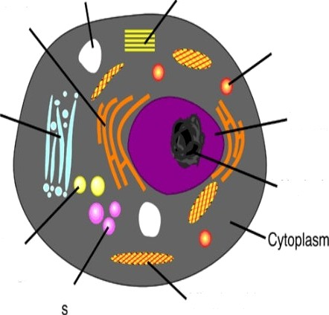
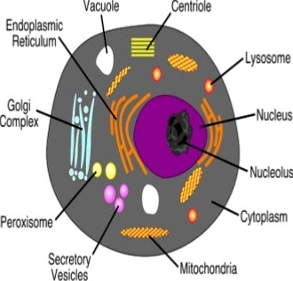


ase
›
rows in its size
the synthesis
Vacuole CenT‹oIe
Cell
proteins
ErdOÿldSlflÏC
Réticulum
L Osome
G0lgÏ
Û0IîI§l6X
Rucleolvs
ParOWwmO
Sec‹etog
V6sÏcle

Slide 14


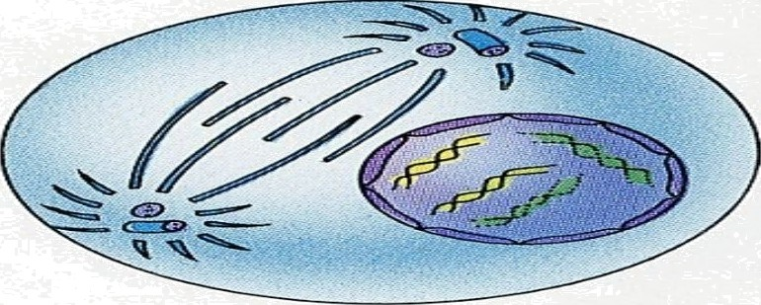

ve i
ase
•Centrio
nd rgoes re IIcatIo

Slide 15

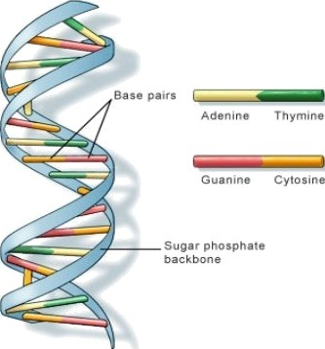
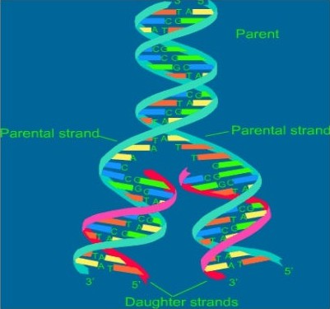
ase
During S phase DNA undergoes replication DNA molecule forms two DNA molecules
each

Slide 16


Synthe i ase
Each chromosome has single DNA.
ring phase DNA ndergoes replication each DNA molecu forms two DNA molecu
Centriole ndergoes replication
There are the changes in animal cel

Slide 17
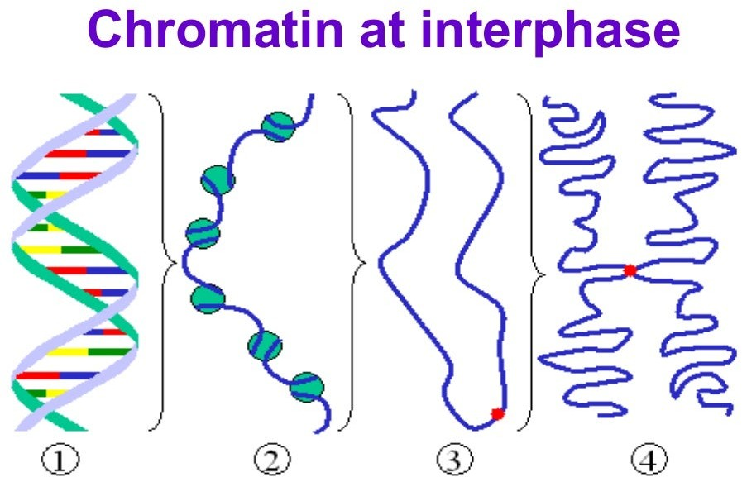

Slide 18




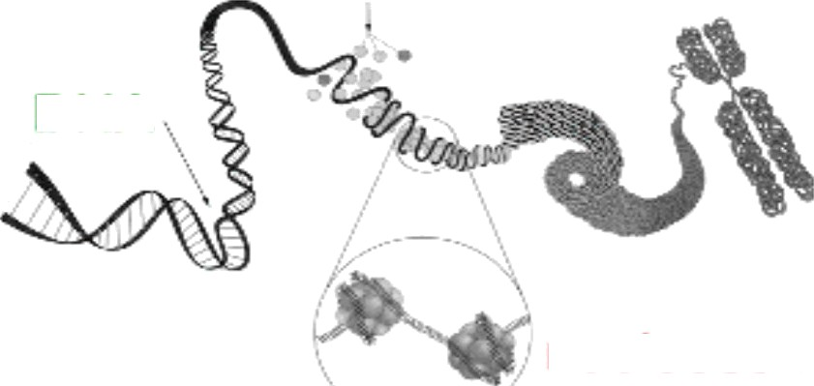
RO ATI
StO
DNA
nucleosom

Slide 19


Slide 20


HAS
Proteins are synthesized i
preparation itosi

Slide 21



i OSi
has two steps
.Karyokinensis
is the sion of nuc
C@okinensis
is the division of the cytoplasm

Slide 22
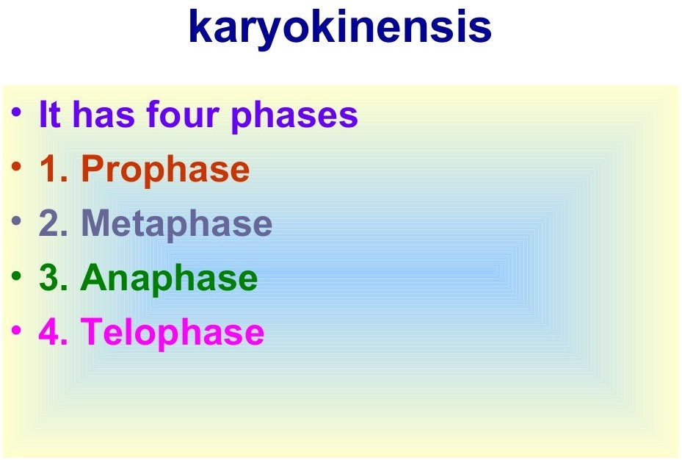

Slide 23
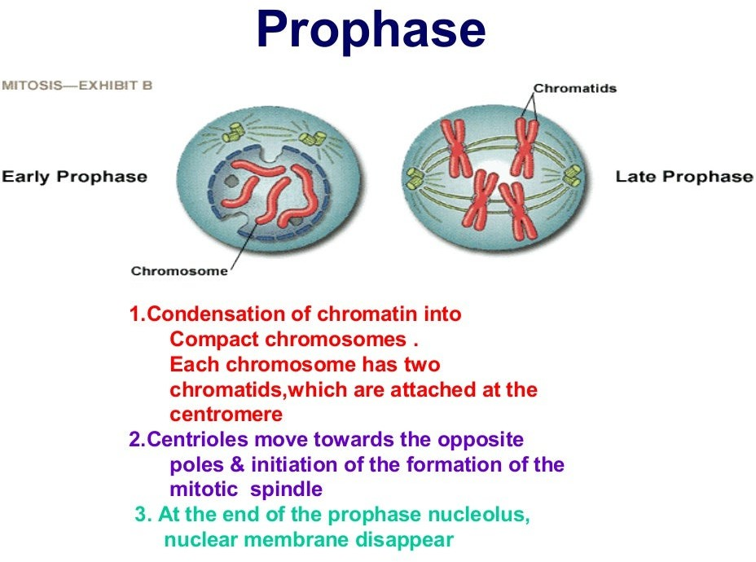

Slide 24
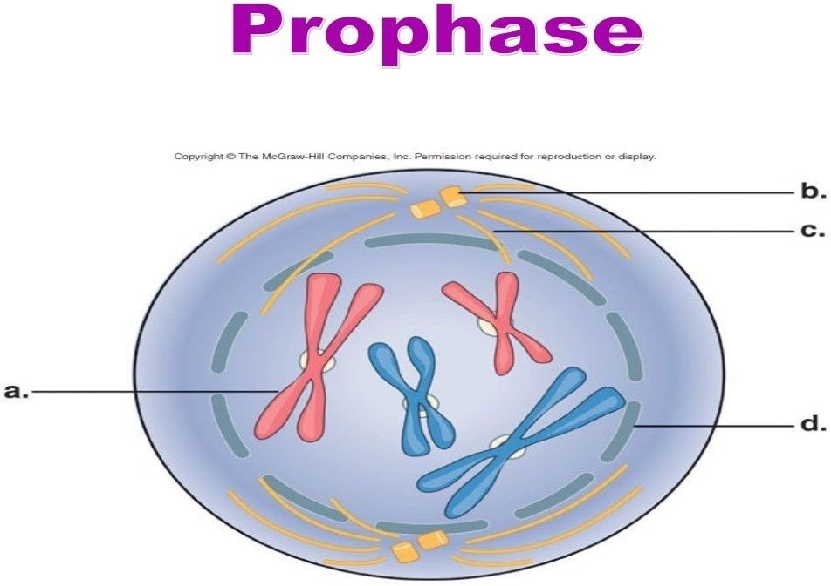

Slide 25
Events in prophase
1.Condensation of chromatin into
Compact chromosomes .
Each chromosome has two
chromatids,which are attached at the centromere
2.CentrioIes move towards the opposite
poles & initiation of the formation of the
mitotic spindle
3. At the end of the prophase nucleolus, nuclear membrane disappear

Slide 26
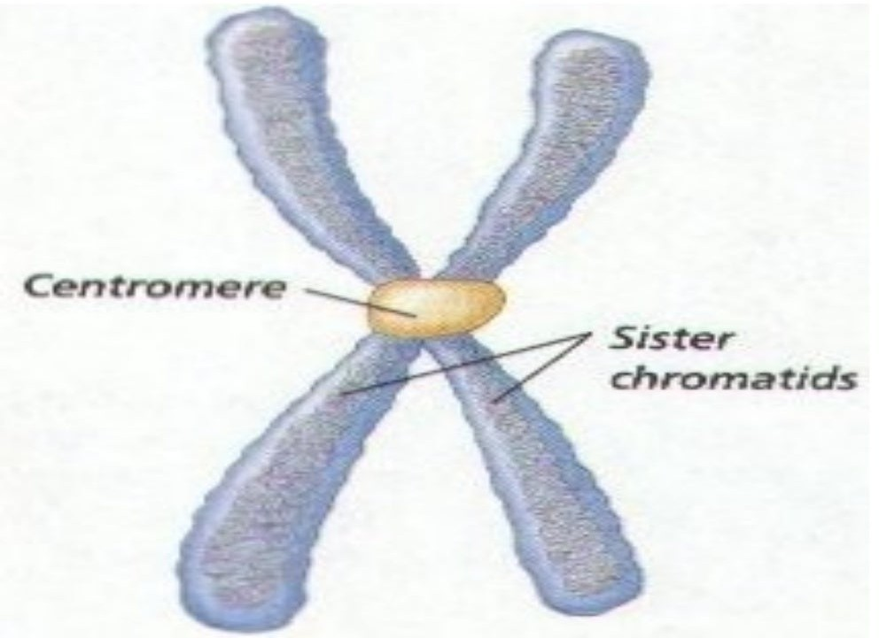

Slide 27
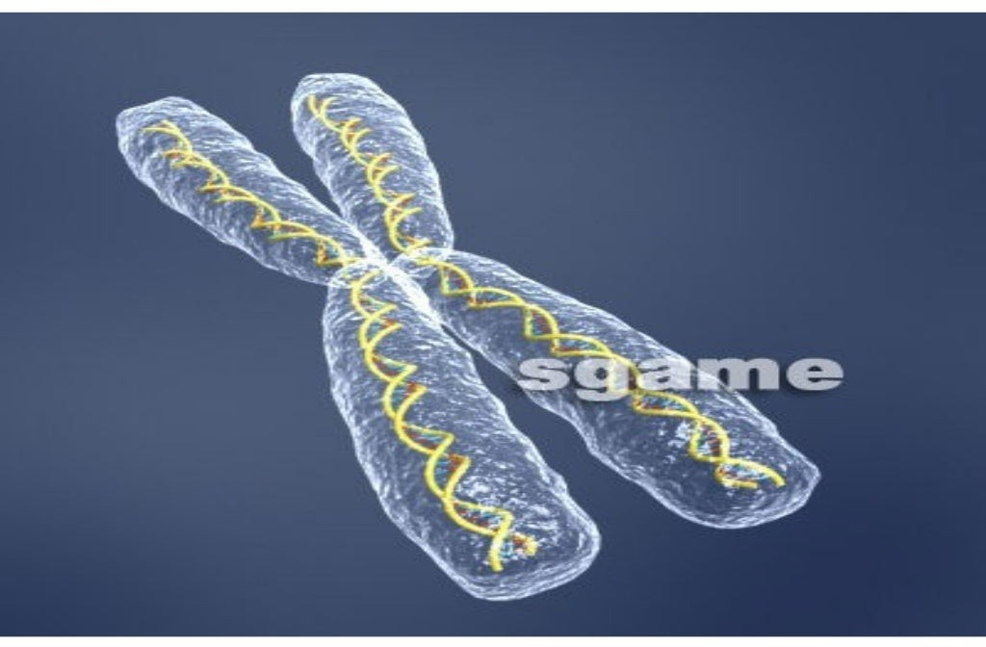

Slide 28
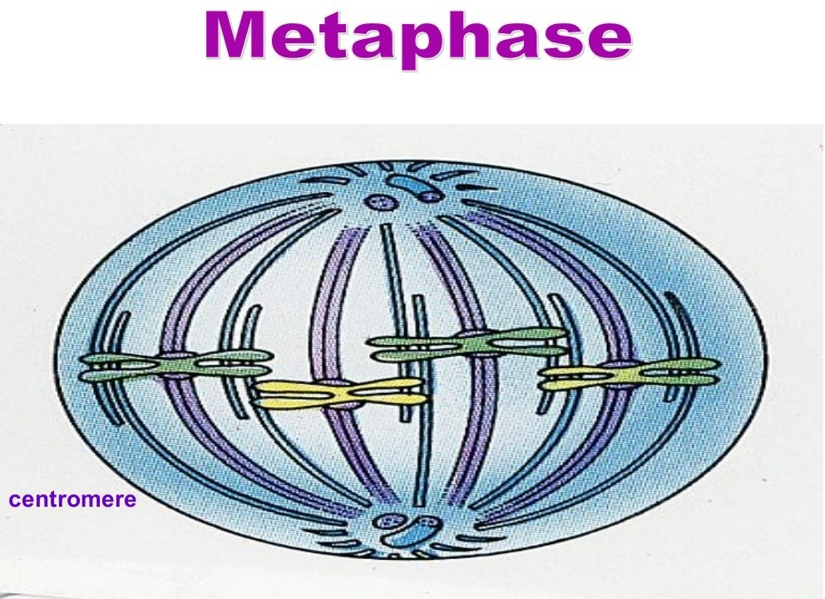

Slide 29


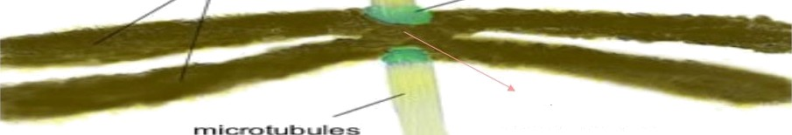

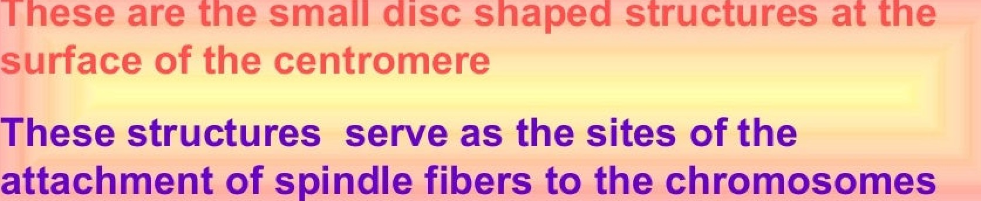
etoc re
centromere

Slide 30
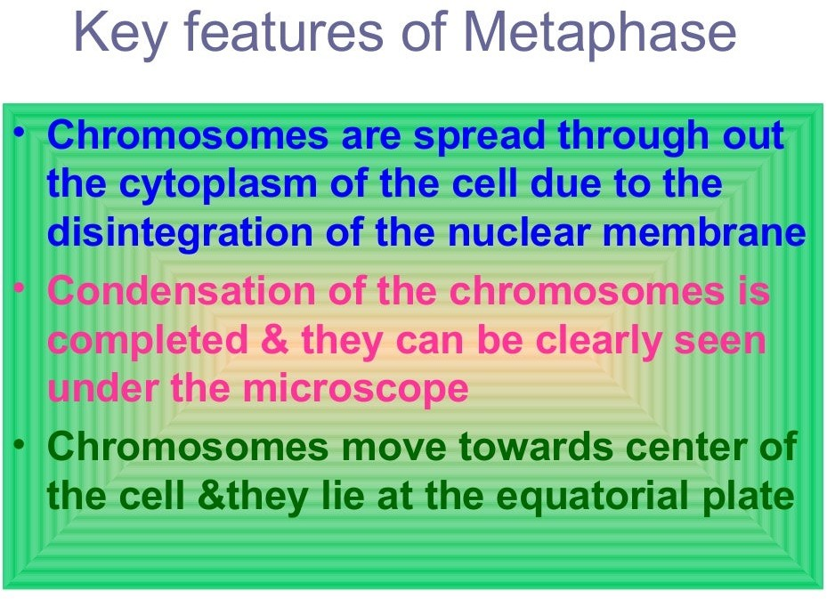

Slide 31




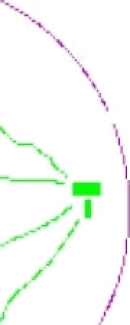

Meta
ase late
The plane
nment of the chromosomes at metaphase is referred metaphase plate
Metaphase
I'detaghase plated

Slide 32
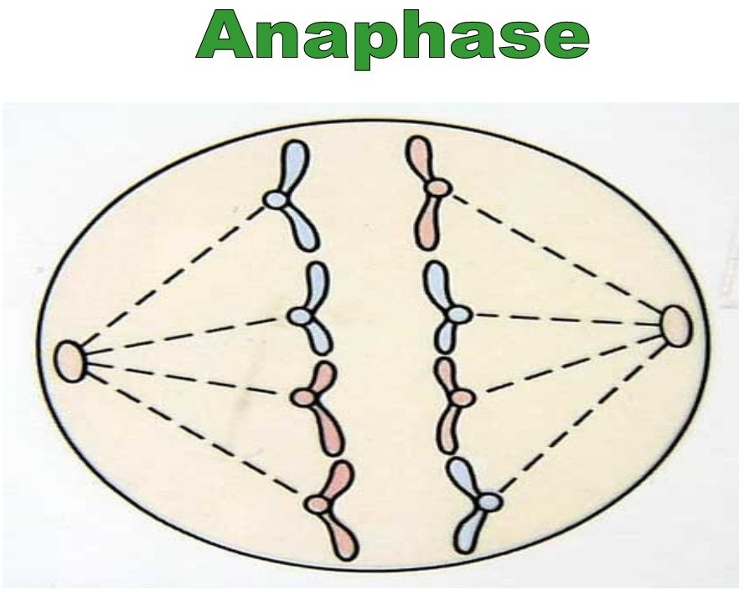

Slide 33
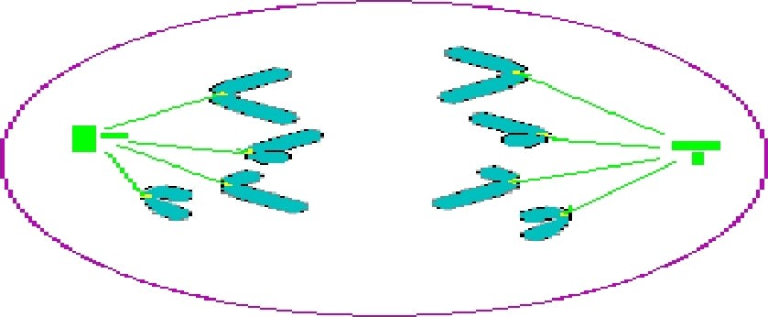


Centromere split &chromatids
separate
Chromatids move ite poles

Slide 34


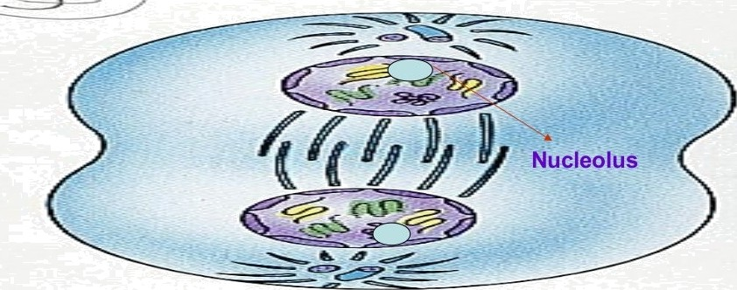
Tel ase
Chromosomal clusters are seen at opposite poles Nuclear envelop assembles around the chromosomal clusters

Slide 35
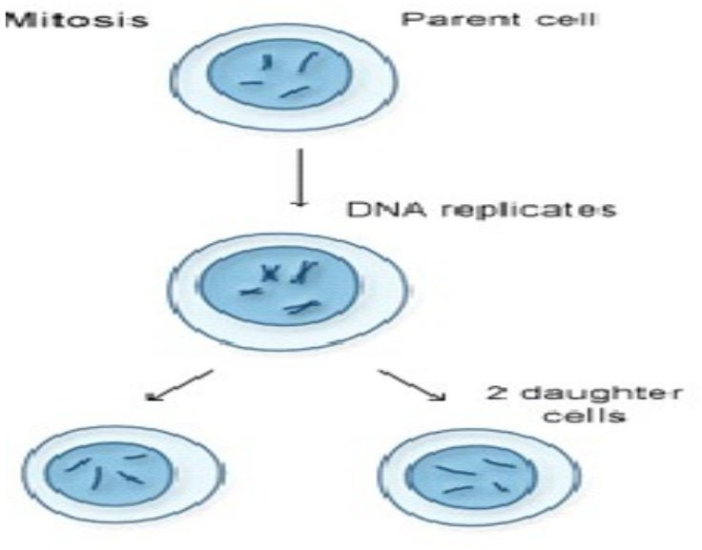

Slide 36


Slide 37
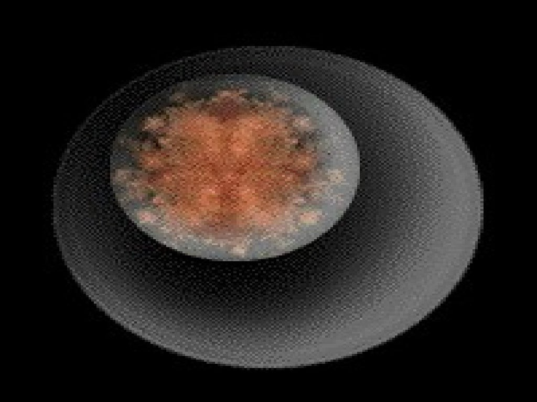

Slide 38
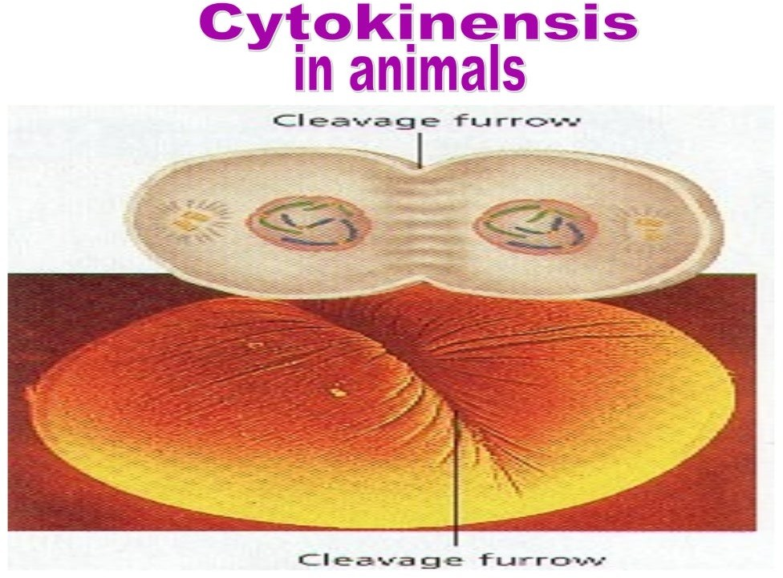

Slide 39



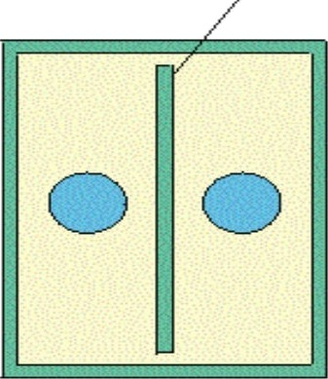
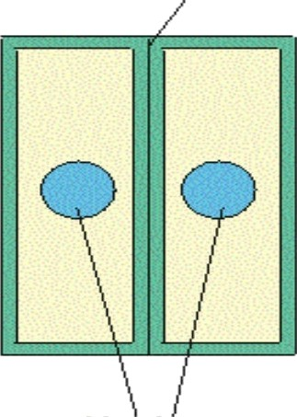
i i I cell
Cell Plate
N Cell Wall
N ucl eus

Slide 40
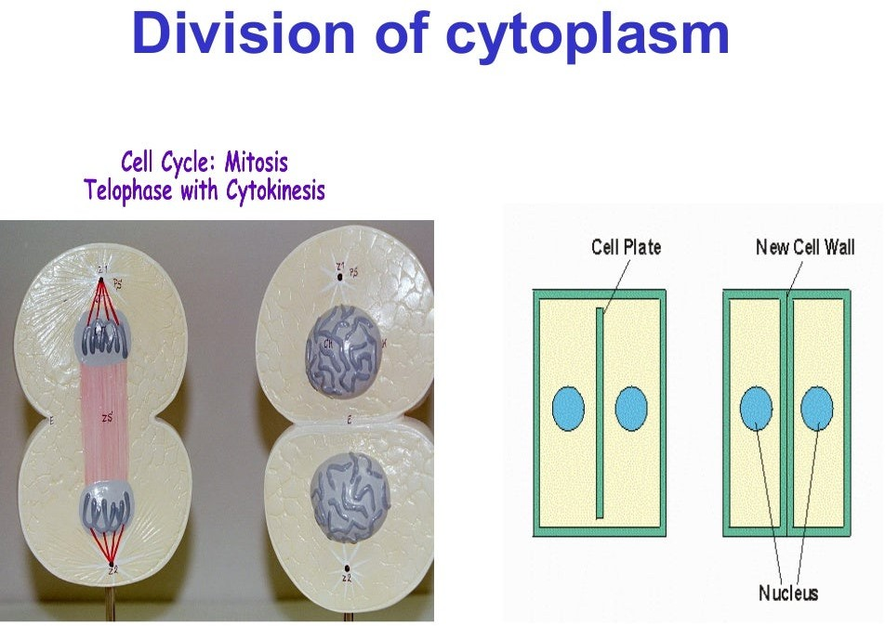

Slide 41
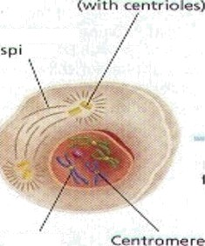
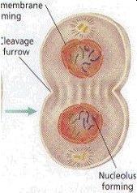
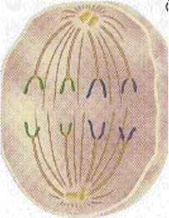
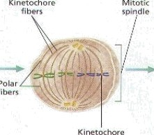
Find out the correct sequence of diflerent
stages of mitosis
ndle
Copied shrmnosmœe

Slide 42
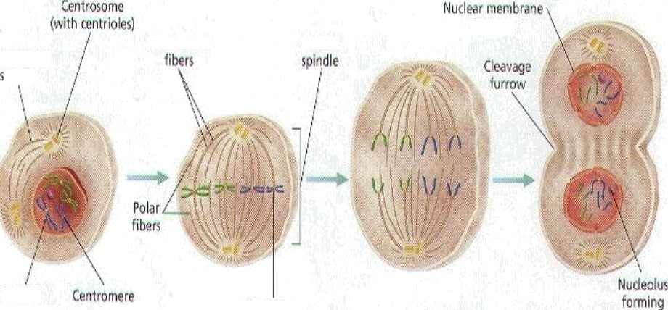








Correct seq ce
îaily mitotic pirdlt
CopzJ
‹Womowm+

Slide 43


es i
.General
cell has single nucleus.Why some cells
have many nuclei?
A.Nuclear division is not followed cytoplasmic
ivision
Q2.Human cell which is undergoing mitosis has 46 chromosomes. How many chromosomes will the cell have at G_{l}phase, after S phase,aRer M phase
In all phases 46 chromosomes
Q3 A cell has 14 DNA molecules. How many DNA molecules does the cell consist in G,phase,G,phase respectively
•
G2 phase -28
phase- 4

Slide 44


Slide 45
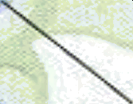




-
IVłetaphase
lnterpYaxe
—
Tełophase

Slide 46
