Slide 1

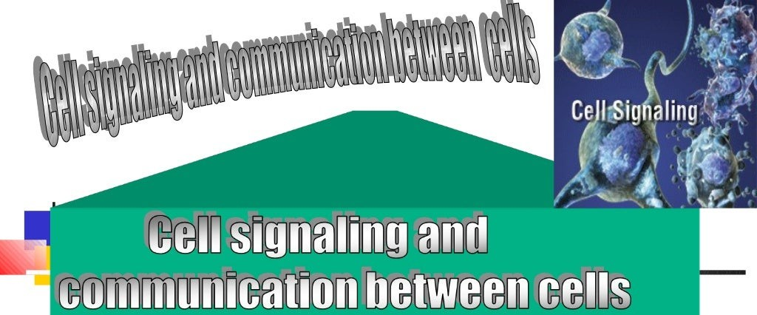

Slide 2









- Introduction
Modes of cell signaling Communication between cells Signal transduction
Ion channels

Slide 3



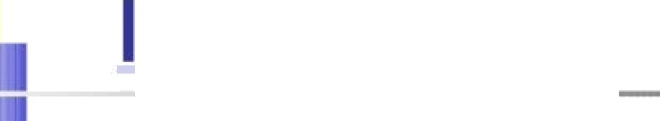


*Cells must be ready to respond to essential signals in their environment. These
are often chemicals in the extracellular fluid (ECF) from:
distant locations -4 signaling by hormones:
nearby cells cytokines:
OF
even secreted by themselves .
Long-range allostery is often a significant component of cell signaling events.

Slide 4


I ALI
Cell signaling is part of a system of communication that governs basic
cellular activities and coordinates cell actions.
*The ability of cells to perceive and correctly respond to their microenvironment is the basis of development, tissue repair, and immunity as well as normal tissue homeostasis
*Errors in cellular information processing are responsible for diseases such as cancer, autoimmunity, and diabetes. By understanding cell signaling, diseases may be treated effectively and, theoretically, artificial tissues may be created.

Slide 5







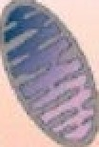
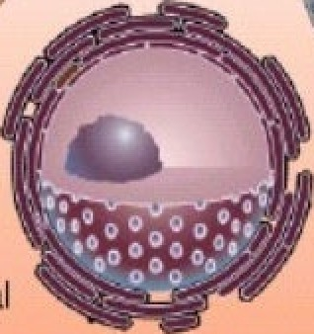



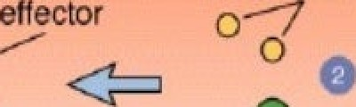
CELL SICNALINS AND SICNAL TRANSDUCTION
Stimulus (ligand)
Receptor
Effector
Ac!vafed eñeCo
YOU SIGNALING is about communication between different 8roups of cells and tissues...how one group of cells informs another group of cells what to do.
@ G protein
refers to how the presence of an extracellular signal can produce a change in the intracellular state of the cell without the initial signal crossing the membrane.
Activated
Effectors
Stimulus
Activated
Receptor
(inactive)
^{tligandl} receptor k case
5

Slide 6
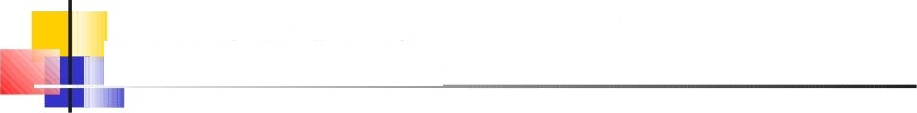
CELL SIGNALING & SIGNAL TRANSDUCTTION
› Why do cells communicate
How are signals transmi#ed between cells
How are signals transmi#ed across cell membranes into cell interior
How are signals transmi#ed within a cell
How do signals affect a cell function

Slide 7
WHY DO CELLS COMMUNICATE?
a During development. cells differentiate to
adopt specialized roles.
Cells need to know whether to live, die, or divide.
a Neurotransmission.
a Regulation of metabolism.
Contraction-expansion.
M Secondarg sexual characteristics.
7

Slide 8




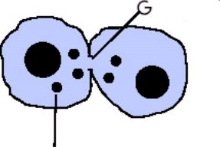

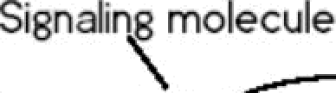

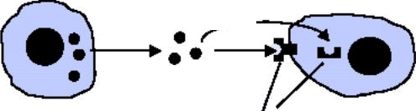

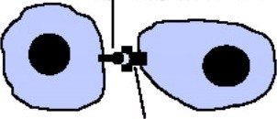
OD£S
OELL
ONALI
ap junction
Signaling by
cytoplasmic briclge
Signaling by secreted molecules
Si8nalin8 cell
Receptor
Target cell
Signalin8 molecule
Signaling by
plasma membrane-bound molecules
Si8nalingcell
Receptor
Target cell
8

Slide 9

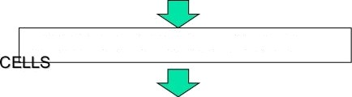


jSTEPS I ELL I
NALING
SYNTHESIS OF SIGNALLING
bUC—the
RELEASE OF SIGNALLING MOLECUL
ES
TRANSPORT OF SIGNAL TO TARGET
DETECTION
BINDING OF SIGNAL BY SPECIFIC RECEPTOR
CHANGES DUE TO RECEPTOR-SIGNAL COMPI,EX
SIGNAL REMOVAL &
RESPNOS E TERMINATICN
9

Slide 10
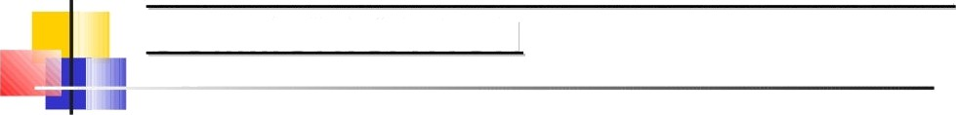
CLASSIFICATION OF INTERCELLULAR
COMMUNICATION
Intercellular signaling is subdivided into the following classifications:
Autocrine signals target the cell itself. Sometimes autocrine cells can target cells close by if they are the same type of cell as the emitting cell. An example of this are immune cells.
PvrrcrIne signals target cells in the vicinity of the emitting cell. neurotransmitters
represent an example.
“Endocrine signals target distant cells. Endocrine cells produce hormones that travel through the blood to reach all parts of the body.
“Juxtacrine signals target adjacent (touching) cells. These signals are transmitted along cell membranes via protein or lipid components integral to the membrane and are capable of affecting either the emitting cell or cells immediately adjacent.

Slide 11




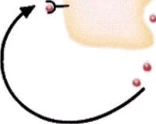
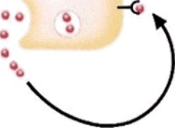
AUTOCRI
NALI
Extracellular
signal
Receptor
Membranæattached
signal
Target sites on same cell
Examples• cçîokines/immune cells. growth factors

Slide 12



PARACRI
6NAL
”“
, - . . .. -
.
..-
•
“ ₋
.
Secreto
cedí
Adjacen tar et cell
Examples: nerve-nerve, nerve-muscle cells. CU!okines

Slide 13



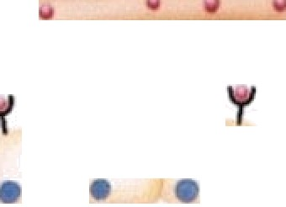



ENDOCRI
I?NAL
I-
Blood vessel
Hormone secretion
into blood by endocrine gland
Examples: peptide and steroid hormones

Slide 14




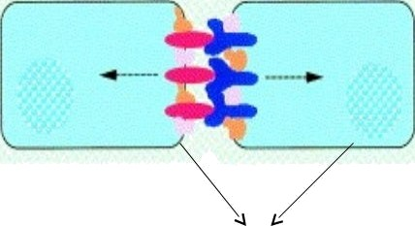
UXTAC I
I NALI
,
MEMBRANE-ANCHORED LIGANDS
e.g.*Notch signalling.
NEIGHBOURING CELLS

Slide 15

EXAMPLES OF SIGNALING MOLECULES
rupe of molecule Local mediafor Neurofransmilfer fJormone
Peptides Kinin
heuropeptides Vasopressin
Polgpepfides
Insulin
Amino acids and
Derivatives
Histamine
G!olamate
Epinephrine
Fatfy acid
Derivatives
Prostaglandns Leukotrienes
Testosterone
Other small
Molecules
Cytokines Chemokines
Acefplcholine

Slide 16





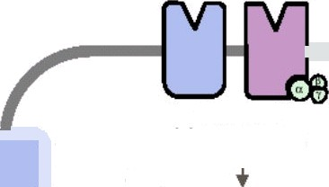



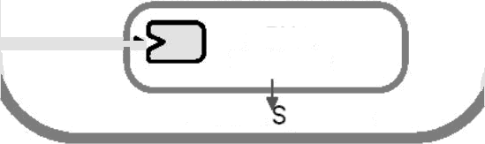

OVERVIEW CELL CNALI
CNAL TRANSDUCTION
fransmiffers
Hormones
Transmitters
”FIRGT MEOSENGER/”
Second Messangers I
Growth
ractors
Ion
Tyrosine kinase
Channels
Protein Kinases
Hormones: Steroids
mRNA
Sgnfhesis
Protein unfhesis
thyroid
CELLULAR
16

Slide 17



6NAL TRANSDUCTION PATXWAYS
SIC>NAL RECOC>NITION
  ligand binding: cell contact
SI¢?NAL TRANSDUCTION
  transfer of '8naIÏo cell interior
  modulate the activity of protein kinases
and phosphatases
RESPONSE
  phosphorylation state of targets
  modulation of effector activity
  reversibilitg of response

Slide 18

WHAT ARE RECEPTORS?
Receptors are proteins associated with cell
membranes or located within the cell
Receptors "recognize signaling molecules
binding to them
Binding of receptors signaling molecules ---› Cell behavior changes

Slide 19
C£LL-SURFACE RECEPTOR CATE6ORI£S
Can be separated into */ classes:
C> protein-linked receptors !C>PCRs*
Ion-channel receptors
Receptors lacking intrinsic catalUtiCactivity but directly associated with cgtosolic protein tyrosine kinases
*/. Receptors with intrinsic enzgmatic activity tRTKs/

Slide 20

G-PROTEIN COüPLED RECEPTORS (CPCR»)
treceptors for epinephrine, glucagon, serotoninf
lay G pretelrr-œuplad receptors łepineplvlne, lucagon. sefotcninï
Extr›s
Ligands
R9¢ sl»r
protein
Ißa¢t z c si naI transducing protein
lßz¢tix‹ off ¢tOr enzyme ladenyltl cyclase, hosÇh0- lipase r, or atheist
tivavd form of G protein
Active effector generates ’second messengers’ (cAMP; inosšcl 1,4,îî- Friphoshata;
1,a-die<yIglycsroi¡
20

Slide 21
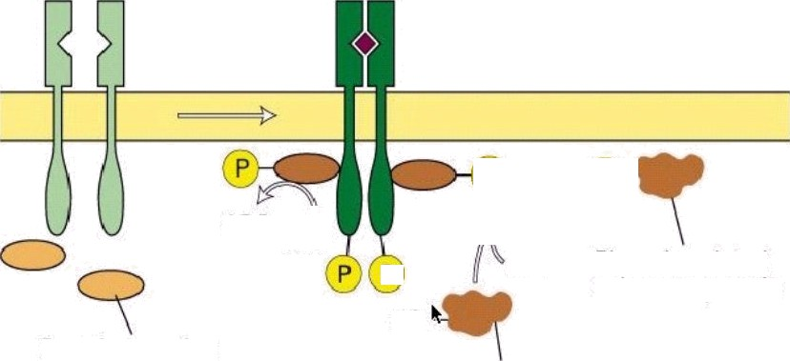

treceptors for erythropoietin, interferonsf
Ligand
ADP
ATP
ADP
ATP
PhDsp horylated
substrate protein
HO
Protein-tyrosine
kinase (inactiveT
Substrate protein
21

Slide 22

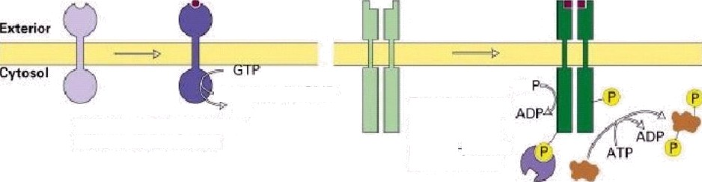
RECEPTORS WITHINTRINSIC ACTIVITY
tReceptor Tyrosine Kinases- for growth faclorst
Ligand e
Ligand
-r• 3'.5'-cyclic GMP PP,
Guanylate cyclase activity
(aerial naturetic factory
AT
Tyrosine kinase activity 1nerve growth facio‹. platelet derived growth factorl
22

Slide 23




fA) CELL—SURFAC6RECEPT0P5
cell-surface
pJasm a membrsne
hqdroph!IlC signal
molecule
be transcription factors enhancing or suppressing gene expression
'
ntrecelluler
recepI or
23

Slide 24

INTERACTION BETWEEN LICAND AND RECEPTOR CAUSES THE N 0 OF SECOND MESSENGERS
Examples of Second Messenger SUstems
Ca² /caImoduIin
adenglate cyclase/cAMP
guanylyl cyclase/c¢?MP
NO/guanglgl cyclase
PLCS C
PI/IPS/DC>
Cell surface
receptor
r i
messenger
Second
messen8er
Nuclear
effecf
Intracellular
effect
24

Slide 25


FAMILIES
G-PROTEINS
Unique structure of their «-subunits
§/ subunits appear to be similar across families
Main families
stimulation of adenglgl cyclase
- inhibition of adenglgl cyclase
stimulation of phospholipase
stimulation of ion channels
C>c›s

Slide 26

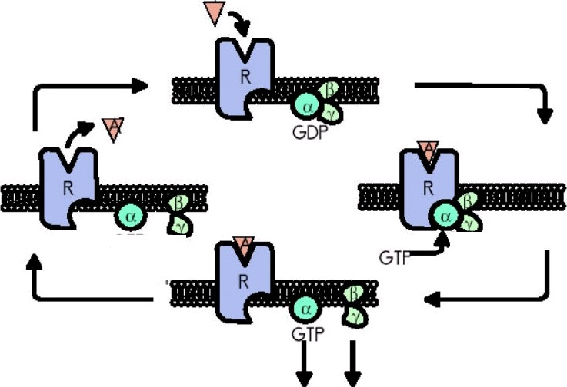

G-PROTEI
CYCLI
GDP
Second Messen8er Systems

Slide 27
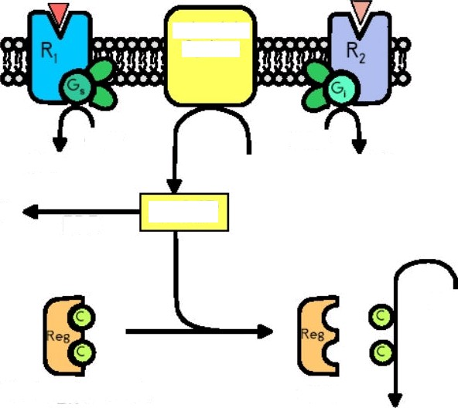
A,
A,
Aden\jlate
Cyclase
ú•TP
OTP
ATP—Mg
ODP
”DP
AMP
cAMP
PDE
Protein
Protein Kinase A
‹PKA›
PKA
Protein—P

Slide 28
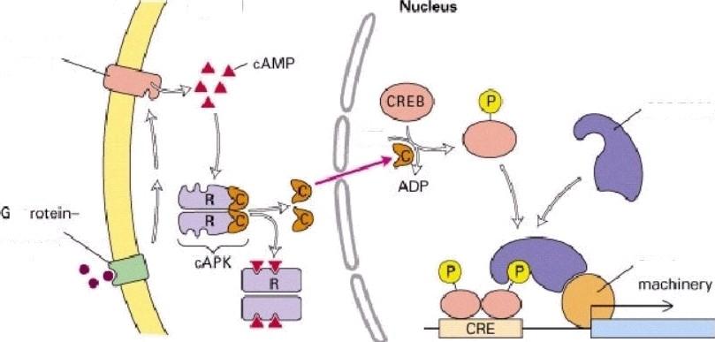

PROTEIN
cAMP PATXWAY
Emeñer
Cytesel
C BP/P3IX)
ATP
coupled
receptor
Basal transcription
CRE = cAMP Response Element
CREB = cAMP Response Element Binding Protein
CBP = CREb Bindin8 Protein
28

Slide 29
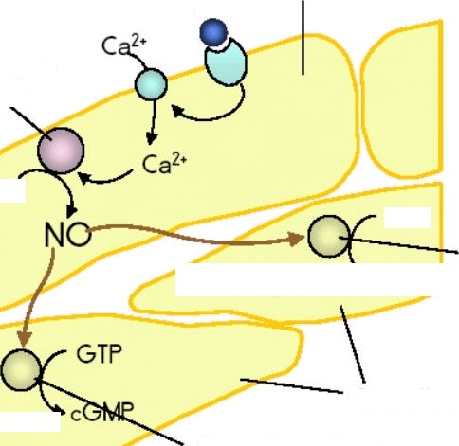
SIGNAL 7RANSDUCTION PATHWAY INVOLVING AND c0MP THAT LEADO TO VAOODILATION
Endothelial cell
ACh
%Wc oxde
synthase
Lumen
Arg
C>TP
Wuanglgl
Relaxation
COMP
C C a e
Smooth muscle cells
luanylgl cyclase
Relaxation

Slide 30
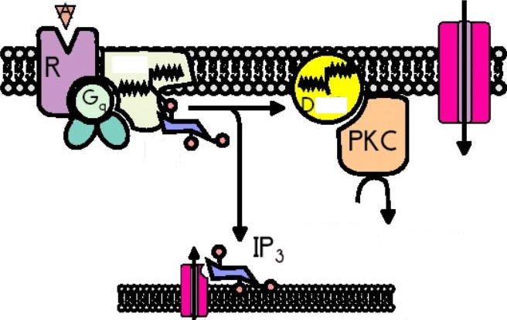
PHOSPHOLIPASE
SYSTEM
Ca
PLC
AG
Protein
Protein-P
Ca
Endoplasmic reticulum

Slide 31


Channels

Slide 32


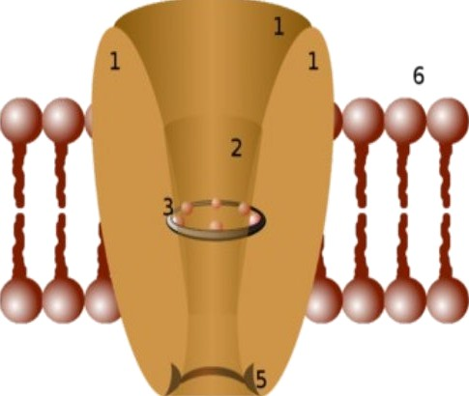
Schematic
iagram
an chan
- Channel domains(typically four per channel),
- Outer vestibule,
Selectivity filter,
- Diameter of selectivity filter,
Phosphorylation site,
- Cell membrane.
32

Slide 33

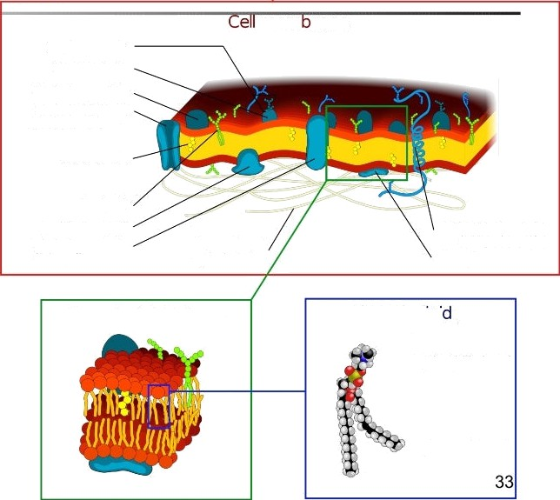
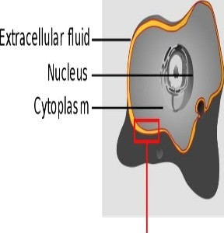
I membrane
mern rane
Carbohyd rate Glycoprotein
G lo bu la r protein
Protein Cha nnel ITransport pi otein}
Cho les tero I
GJycolipid S urfa ce prote in
Globula r protein
\In tegraI}
Alpha -helix protein Integral protein )
Peripheral prote in
Filaments of cytos ke leton
Phos pholipid bilayer
Phospholipi
I Pho spha t idyl c ho'ine)
Hyd roph ilic head
Hyd ropbobic tail

Slide 34
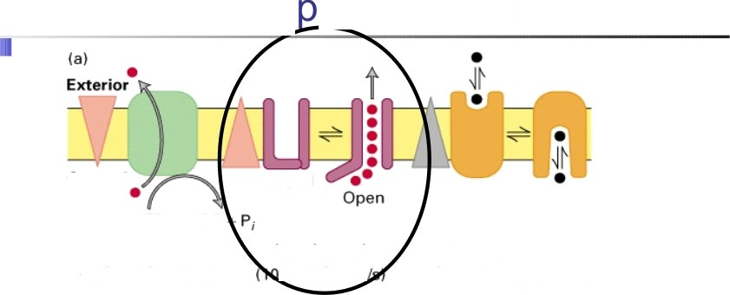


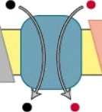
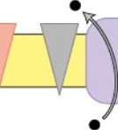

jMembrane trans ort proteins
Closed
BTP ADP
ATP pooeredpurnp | lonchannel |  | Transposer
(100 l0³ionss) | Î— 10*ions | 1102 | l0*molecuess)
Uniporter
Symporter
Antipo rter
34

Slide 35



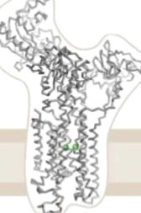
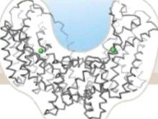
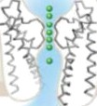


channels are not pumps
Only ion channels have an aqueous pore that crosses the
membrane
Qltm
Na-dependent glutamate transporter
K” Channel
Highly selective K ion channel
CIG
Chloride
channel
35

Slide 36




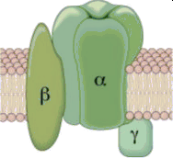
{Channels are made of
its
Ion channels are made from 2-6 similar proteins or homologous structural units - PORE-FORMING SUBUNITS - they associate creating the functional ion channel
In addition, many channels contain the auxiliary regulatory subunits

Slide 37
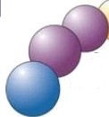
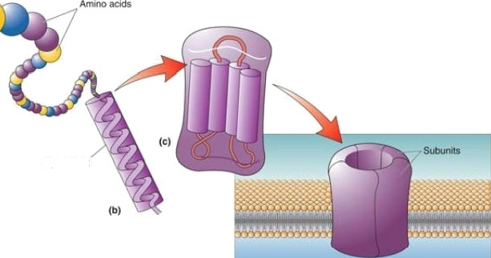
jChannels a
made
bu its
Saline
L*'uc in
Pore-forming subunits contain an c‹-helix made by -20 hydrophobic amino acids which interact with the annular phospholipids of the lipid bilayer

Slide 38
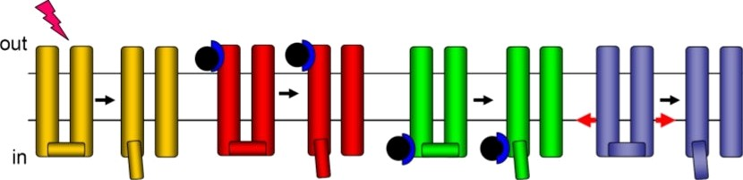
cha
types (by gating)
Voltage
gated
Ligand
gated
Signal gated
Stretch
gated
Opens in response to change in the membrane potential
Opens in response to a
SpE2C ifiC
extracellular
signal
Opens or closes in response to a specific intracellular molecule
Opens in response to change membrane stretch

Slide 39
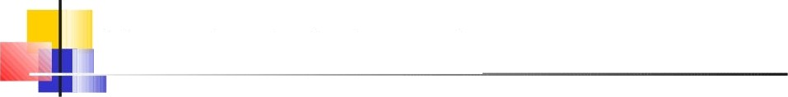
ligand-gated channels
Typically, these are ion channels located on the postsynaptic (receiving) side of the neuron
Some act in response to a secreted (external) ligand- typically a neurotransmitter such as
Acetylcholine (ACh)
GABA
Glycine
Glutamate
Some act in response to internal ligands such as G-proteins, cGMP and cAMP, and are also regulated by internal metabolites such as phosphoinositides, arachidonic acid, calcium.

Slide 40
nal-gated channels
i
tñal m2 ixxv to C copied K’ Channels
M muecarlnlc receptor
I I ‹•,
rotein-
•A h channel
GDP
GTP
K*
40

Slide 41
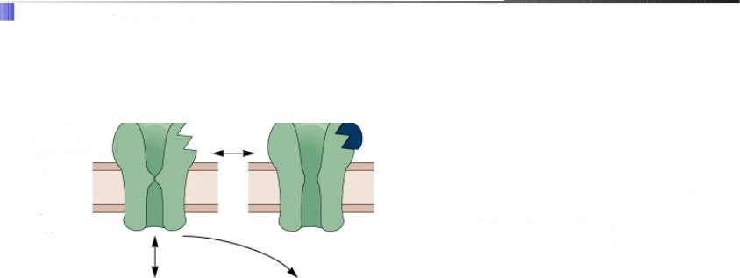



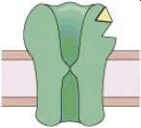
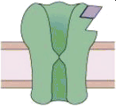
modifiers of Channel Gating
Reversible
antagonist
Endogenous
agonist
(ACh)
Irreversible
antagonist )
Cytoplasmic
Reversible
reaction
Irreversible
reaction
41

Slide 42


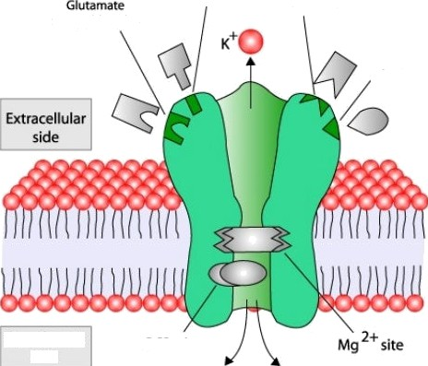

/vIodifiers
Cha
Polyamlne site +
Gati
reœgnitlon sÆ
G ne%te
Ion paizneaion oan ba paventod by pea bockem,
e.g. voka nden
block of NMDAR by Mg²*
Na”
42

Slide 43

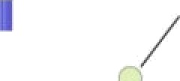


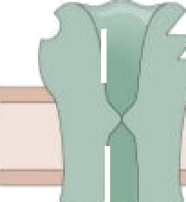
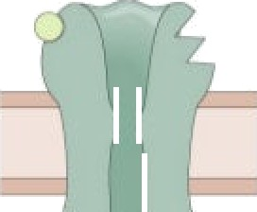
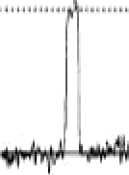

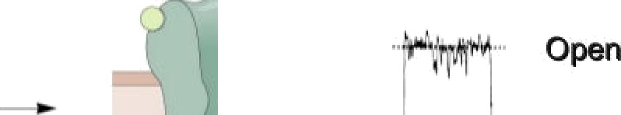


/7Iodifiers
GABA
Channel Gating
Brief Opening
“ Opan
Closed
Pentobarbitol
Long Opening
enous
odulato
can body the aeon of end
enous i ands
4

Slide 44

*’Bu Z, Callaway DJ (2011). "Proteins MOVE! Protein dynamics and long-range allostery in cell signaling". Advances in Protein Chemistry and Structural Biology. Advances in Protein Chemistry and Structural Biology 83: 16 221.
Rang & Dale's Pharmacology
h iki e i or ki si a n
"http:fAisers.rcn. jkimball.ma.uIbaneVBiologyPages/C/CellSignaIing.html
’www.authorstream.com/.../shona6685-645587-ppt-cell-9IgnaIIng
*’http://www.ncbi.mm.nd.gov/pmcfarticIes/PMC151254/
Congreve M, Marshall F (March 2010). "The impact of GPCR structures on
pharmacology and structure-based drug design". Br. 1. Pharmacol. 159 (5):
98a
96.doi:10.1111/j.1476-5381.2009.00476x PMC 2839258 PMID19912230
44

Slide 45

resenter
45

Slide 46


