Slide 1
SUBJECT NAME –PHARMACEUTICAL MICROBIOLOGY
UNIT NO & NAME 1 STUDY OF BACTERIAL CELL
08-09-2024
1

Slide 2
TOPIC NAME – BACTERIAL CELL WALL
Cell wall is a rigid structure which gives definite shape to cell, situation between the capsule and cytoplasmic membrane
It is about 10-20 nm in thickness and constitutes 20-30% of the dry weight of the cell
The cell wall cannot be seen by direct light microscopy and does not stain easily by different staining reagents
It can be demonstrated by plasmolysis, microdissection and electron microscopy
The cell wall of bacteria contains diaminopimelic acid (DAP), muramic acid and teichoic acid
These substances are joined together to give rise to a complex polymeric structure known as peptidoglycan or murein or mucopeptide
08-09-2024
2

Slide 3
Peptidoglycan consist of three parts :
A backbone, composed of alternating N-acetyl glucosamine and N-acetyl muramic acid
A set of tetrapeptide side chains attached to N-acetylmuramic acid
A set of pentapeptide cross-bridges

Slide 4
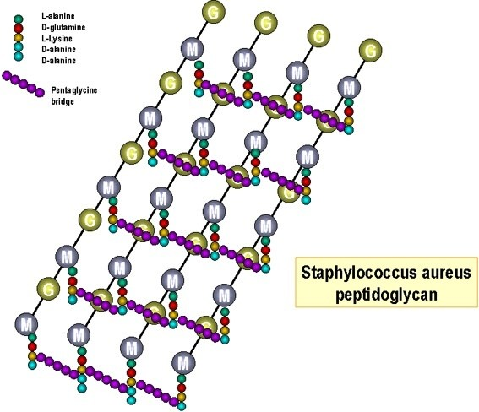

Slide 5
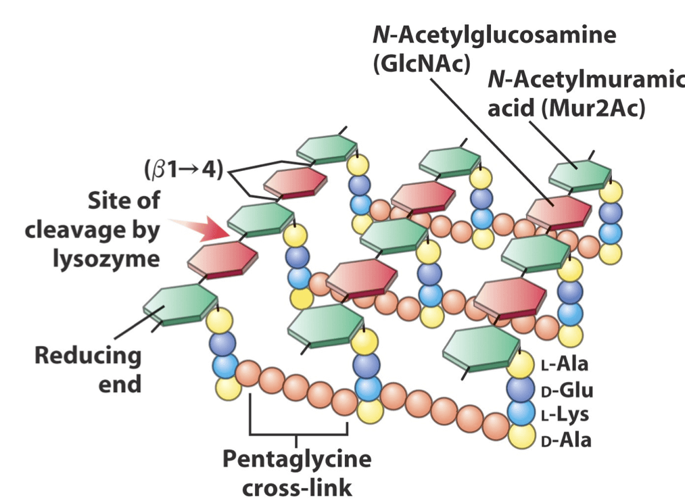

Slide 6
Component | Gram-positive | Gram-negative
Thickness | Thick (20 to 25nm) | Thin (10 to 15 nm)
Peptidoglycan | More (50 –90%) | Less (5 to 10%)
Teichoic acid | Present | Present
Polysaccharide | Present | Present
Lipids | Less or absent | More
Cell wall | Simple | Complex

Slide 7
Outer membrane and periplasmic space | Absent | Present
Effect of lysozyme | Easily destroyed | Resistant
Type of amino acids | Few | Several
Susceptibility to streptomycin and tetracycline | Slight | Marked
Susceptibility to penicillin and sulphonamides | Marked | Much less
Examples | Bacillus antracis Clostridium tetani Staphylococcus aureus Corynebacterium diphtheriae | Escherichia coli salmonella typhi vibrio cholerae haemophilus influenzae

Slide 8
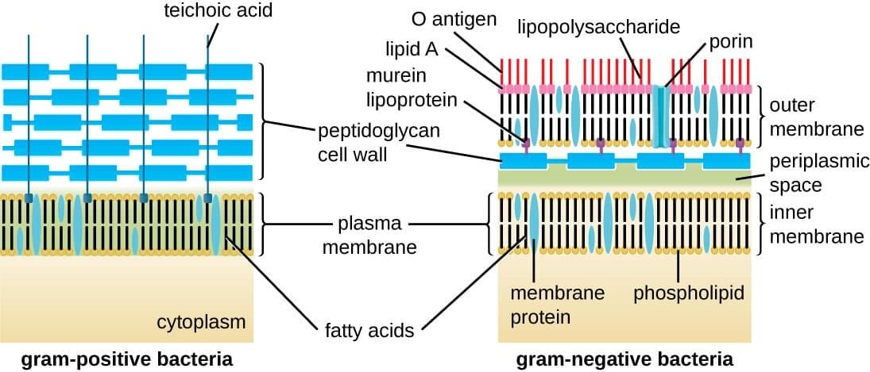

Slide 9
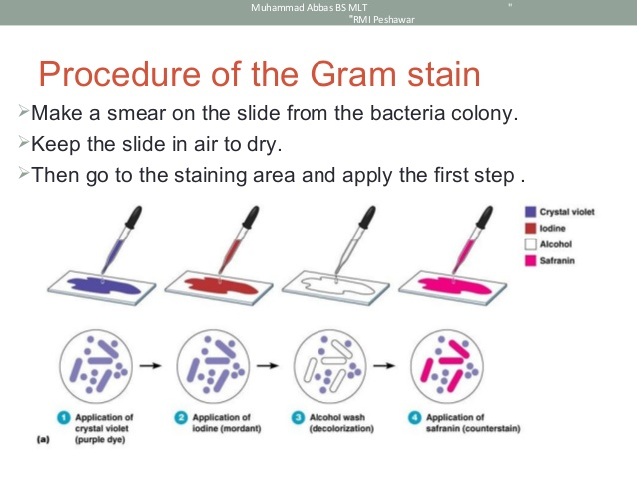

Slide 10
Capsule
Many prokaryotic microorganisms synthesize amorphous slime layer or glycocalyx or sugar coat
The term capsule refers to the layer tightly attached to the cell wall while the slime layer is the loose structure that often diffuses into the growth medium
Capsule layer may be thin of a size less than 0.2µm called microcapsule and thick layer of size more than 0.2µm to 10µm called microcapsule
Capsulated bacteria produced smooth colonies on the surface of agar media
These bacteria are usually non-motile as flagella remains unfunctional in the presence of capsule
Development of capsule is dependent on the existence of favourable environmental conditions such as sugar concentration, blood serum or growth in a living host

Slide 11
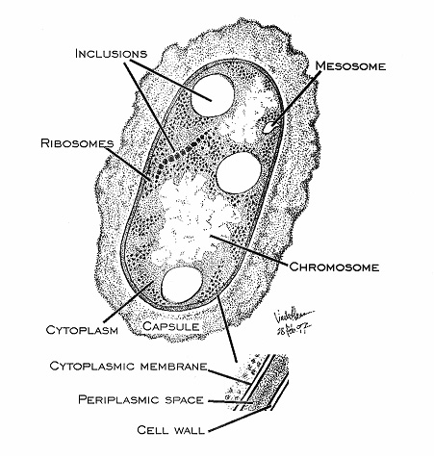

Slide 12
