Slide 1
Chemotherapy-induced nausea and vomiting

Slide 2
Chemotherapy-induced nausea and vomiting
Most feared side-effect
Medical complications: dehydration, electrolyte imbalance, risk of aspiration pneumonia
Many treatments palliative intent = maintain QOL
Effective management of N + V is essential

Slide 3
Patient risk factors
Age <50 years
Female
Alcohol intake
Prone to N +V

Slide 4
Substance P
GABA
Serotonin
Nausea
Acetylcholine
Dopamine
Vomiting
Histamine
???????
Cannabinoid

Slide 5
Categories of CINV
Acute
- within 24 hours of chemotherapy
Delayed
- 24 hours to 7 days post chemo
The most effective way of controlling CINV is to prevent symptoms of acute and delayed CINV by using a combination of an 5HT3 antagonist and dexamethasone.

Slide 6
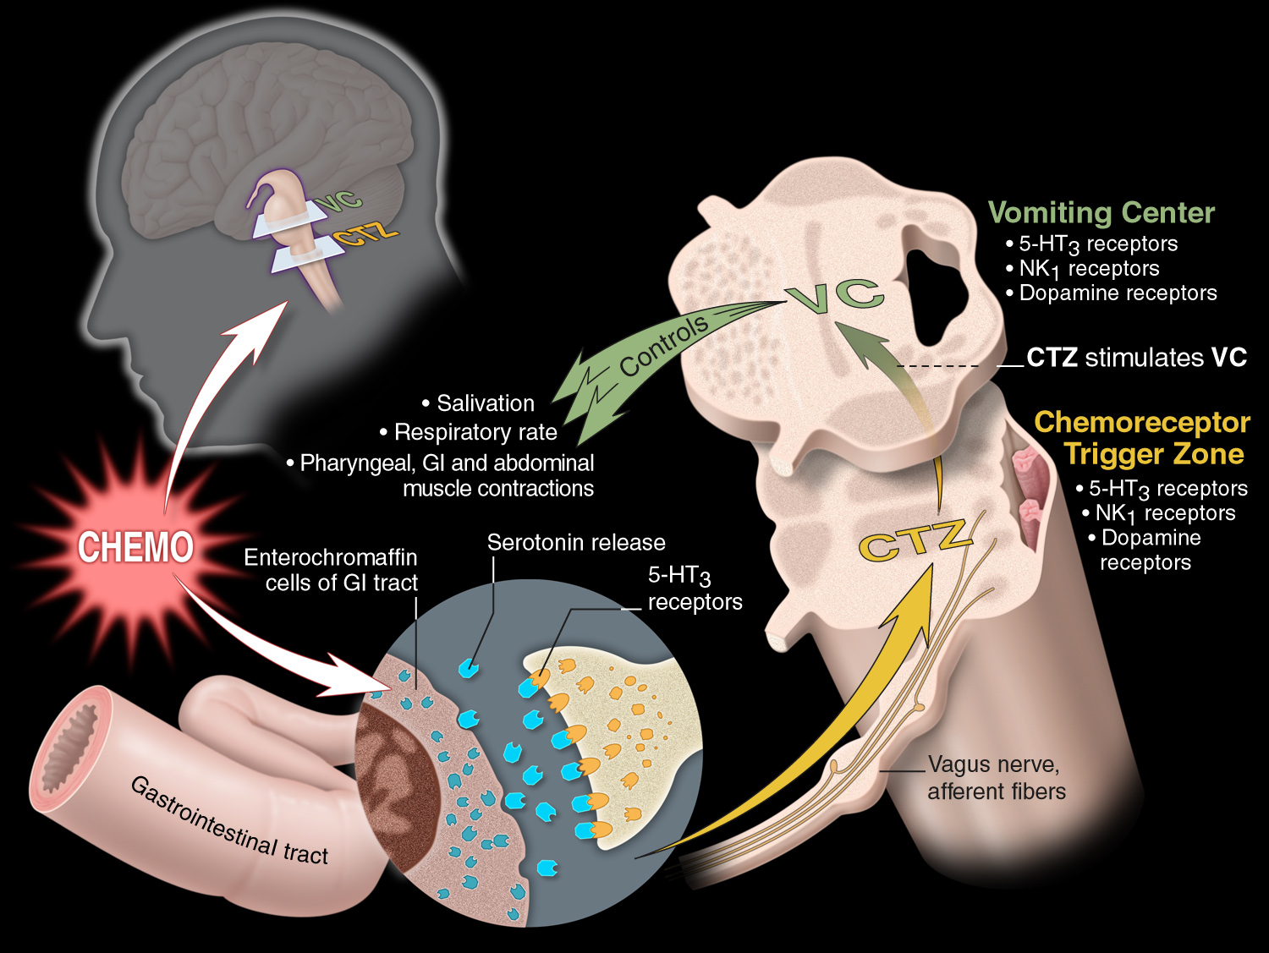
Pathophysiology of
Chemotherapy-Induced Emesis
Notes:
Two sites in the brainstem—the vomiting center and the chemoreceptor trigger zone—are important to emesis control. The vomiting center consists of an intertwined neural network in the nucleus tractus solitarius that controls patterns of motor activity. The chemoreceptor trigger zone, located in the area postrema, is the entry point for emetogenic stimuli.
Enterochromaffin cells in the gastrointestinal tract respond to chemotherapy by releasing serotonin. Serotonin binds to 5-HT₃ receptors, which are located not only in the gastrointestinal tract, but also on vagal afferent neurons and in the nucleus tractus solitarius and the area postrema.
The activated 5-HT₃ receptors signal the chemoreceptor trigger zone via pathways that
may include the afferent fibers of the vagus nerve. Serotonin also may bind with 5-HT₃ receptors in the brainstem.
Other neurotransmitters, including dopamine and substance P, also influence the chemoreceptor trigger zone. Afferent impulses from the chemoreceptor trigger zone stimulate the vomiting center, which initiates emesis.¹
1. Grunberg SM, Hesketh PJ. Control of chemotherapy-induced emesis. N Engl J Med. 1993;329:
1790-1796.

Slide 7
Serotonin and 5­HT₃ receptor pathway
Introduction of 5-HT₃ receptor antagonists offered an improved treatment option.²
  Effective in acute vomiting; very limited efficacy for delayed events
Primary mechanism of action appears to be peripheral.²
1. Berger AM, Clark-Snow RA. In: DeVita VT Jr et al. 7th ed. Cancer: Principles & Practice of Oncology. Lippincott Williams & Wilkins; 2005:2515–2523.
2. Hesketh PJ et al. Eur J Cancer. 2003;39(8):1074–1080.

Slide 8
Substance P and NK₁ receptor pathway
Substance P relays noxious sensory information to the brain
High density of substance P/NK₁ receptors located in brain.
NK₁ receptor blockade effective for delayed vomiting:
Less effective for acute vomiting: needs a 5HT₃ antagonist
Less effective for nausea: needs dexamethasone

Slide 9
NK1 antagonists
Aprepitant 125mg 1 hour before chemotherapy on Day 1, 80mg Day 2 and Day 3
Some interactions: clinical significance

Slide 10
5HT3 Antagonists
Block release of serotonin release from entero chromaffin cells in GI tract
Most effective for acute vomiting
Best given as a stat dose pre-chemo
Oral and IV equally effective
Side effects: constipation, abdominal spasms, headaches

Slide 11
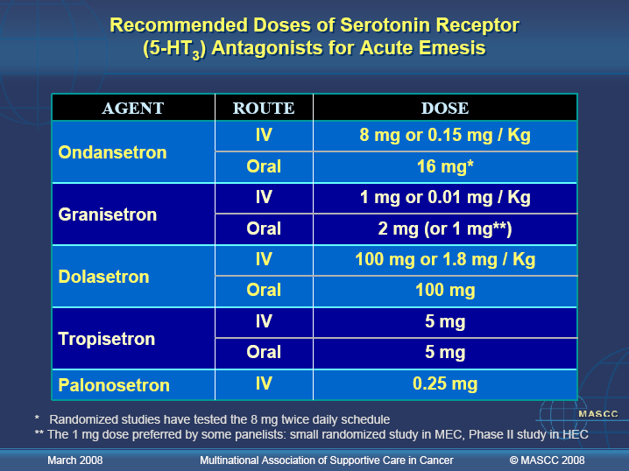
Multi-Association of Supportive Cancer Care (MASCC) (See Handout)

Slide 12
Dexamethasone
Very effective for nausea, acute and delayed vomiting
Acute: pre-dose before chemo
Delayed: 2-4 days after
Side effects: heartburn/indigestion, agitation, hiccups, abnormal BM’s (all manageable in most instances)

Slide 13
DEXAMETHASONE
HIGH | 20mg (12mg with aprepitant) | 8mg bd 3-4 d (8mg od 3-4d with aprepitant)
MODERATE | 8mg (12mg with aprepitant) | 8mg od 2-3 d
LOW | 4-8mg | N/A
MINIMAL | N/A | N/A

Slide 14
Anticipatory N + V
Conditional response
Sights and smells
Involves higher cortical centres of brain
Occurs in 30% of patients
Lorazepam is an effective treatment

Slide 15
Anti-emetic | Dose | Indication | Contra-indication | Other advice
Metoclopramide | 10mg tds (oral) 30 minutes pre-meals 30mg via SD | Nausea or vomiting with constipation Nausea or vomiting with reduced gastric turnover (inc. chemo or radiotherapy) | Parkinsons disease Gastric outlet obstruction Caution if associated diarrhoea | Higher doses can cause dyskinetic reactions. May cause drowsiness- crosses blood barrier. Ensure domperidone stopped
Ondansetron | 8mg bd or 16mg od (oral or IV) | Vomiting (chemo or radiotherapy induced) | Avoid if constipated | Use for minimum time- long duration can cause abdom spasms and constipation, also increase in LFT’s. Reduce to “when required” where possible.
Cyclizine | 50mg tds (oral) 150mg via SD | Nausea or vomiting with diarrhoea Nausea or vomiting in gastric outlet obstruction. | Avoid if constipated. Avoid if reduced gastric turnover is cause. Reduces GI effect of metoclopramide/ Domperidone. | Maximum dose by any route is 150mg in 24 hours.

Slide 16
Anti-emetic | Dose | Indication | Contra-indication | Other advice
Dexamethasone | 8mg od (oral) 8mg via SD | Delayed CINV Severe XRT Brain mets Liver mets Appetite- low dose | Previous intolerance | Caution in diabetic patients (not CI)- monitor BM’s Tailor dose if agitated/ aggresive. Nausea started when dex course finished?
Levomepromazine | 3-6mg bd (oral) 3.125mg SC prn 6.25-12.5mg via SD | Chemotherapy Radiotherapy Unknown cause | Caution may cause drowsiness May prolong QT interval. | Tailor dose to patient- frail patients 6.25mg via syringe driver. Oral tabs unlicensed- difficult to obtain outwith hospital.
Lorazepam | 0.5-1mg bd. (oral/SL/IV) | Anticipatory nausea and vomiting. | Caution if elderly and frail- increased risk of falls. If necessary- lowest dose. | Useful for anxiety issues, smells and taste of food problematic. Triple therapy- ond/dex and lorazepam useful

Slide 17

Any Questions?

