Slide 1
PHARMACOTHERAPEUTICS
UNIT NO- 01(d) & NAME- DRUG INDUCED LIVER DISORDERS
16-09-2024
1

Slide 2
INTRODUCTION
Drug induced liver diseases (DILD) is defined as Injury to liver that is associated with impaired liver function caused by exposure to a drug or another non-infectious agent.
A number of drugs can cause (acute or chronic) liver damage, most of them are associated with ADRs.

Slide 3
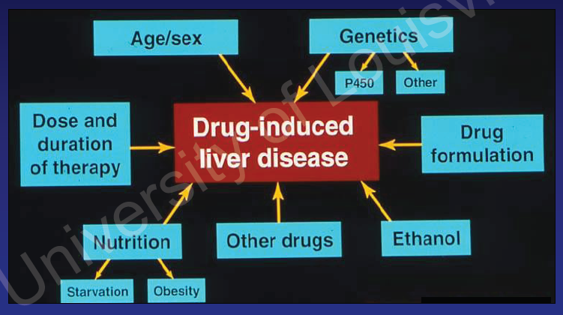
RISK FACTORS

Slide 4
SIGNS AND SYMPTOMS
Jaundice
Nausea
Anorexia
Dark Urine
Fever
Itching
Vomiting
Rash

Slide 5
CLASSIFICATION
Acute liver injury: < 6 months
Acetaminophen(7.5-10g)
Isoniazid (1.5g)
Methyldopa (7.5g)
Chlorpromazine (25mg/kg)
Chronic liver injury: > 6 months
Isoniazid (10 mg/kg/day for >12months)
Chlorpromazine (25 to 75 mg daily in divided doses for >2yr)
Methotrexate (2.5mg/day >1yr)
Carbamazapine (800 mg-1.2 g daily)
Oral contraceptives (>2-3yr) (Oestrogens – 0.025mg/day)

Slide 6
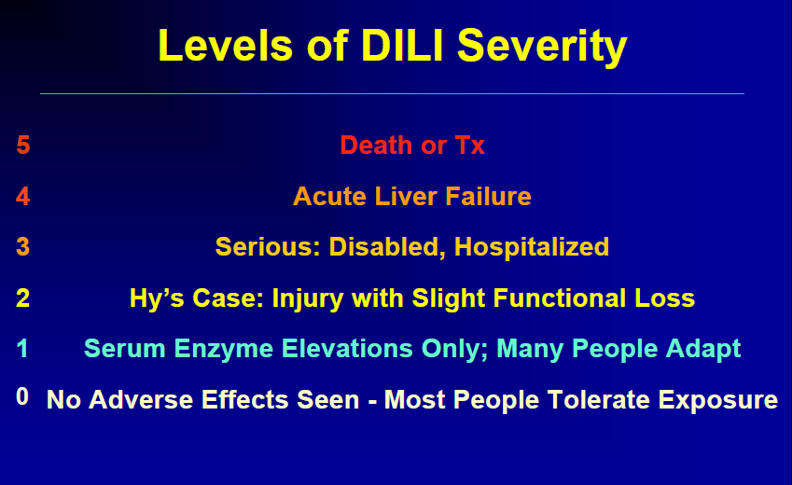
LEVEL OF DILI SEVERITY.
SEV- LIK SCALE…..

Slide 7
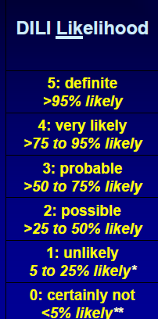

Slide 8
PATTERNS OF DILD
Idiosyncratic Reactions :
Genetic / acquired abnormalities in a particular metabolic pathway for a toxic reaction to take place or drug concentration related toxicities.
e.g. : Sulfonyl urea, antibiotics
Allergic Hepatitis :
Allergic reactions of drugs in liver can cause liver damage. Onset of symptoms may be after 1-6 weeks of initiation of therapy.
e.g. : amoxicillin – clavulanic acid, allopurinol, erythromycin.

Slide 9
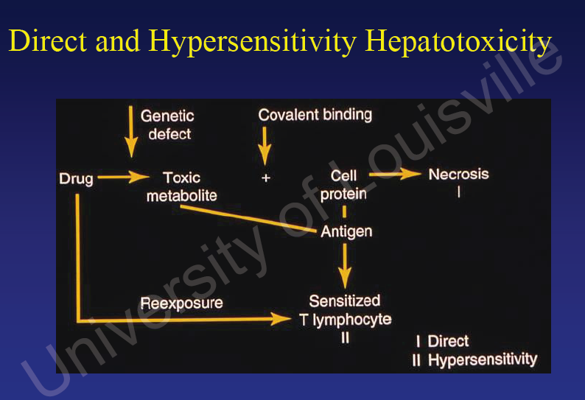

Slide 10
CONT…
Chronic Active Toxic Hepatitis :
It is a autoimmune mediated liver disease. It is a progressive disease with high mortality rate. Drug will produce anti-organelle antibodies.
e.g. : Isoniazid, Phenytoin, Nitrofurantoin and Trazadone.

Slide 11
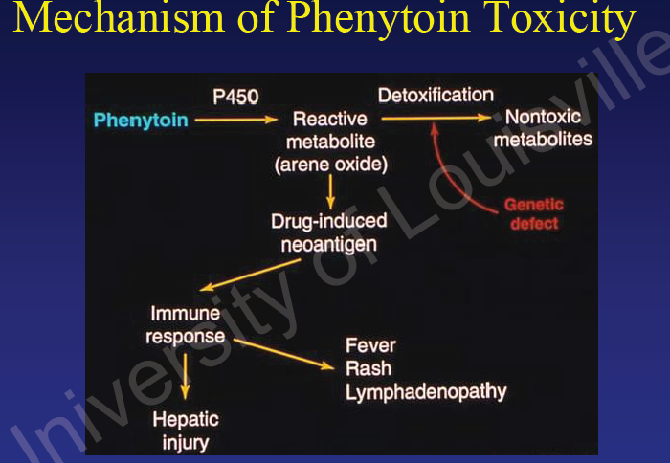

Slide 12
Adverse reaction | Drugs associated
Hepatocellular necrosis | Paracetamol , salicylate,iron salts, allopurinol ,halothaine,ketakonazole,isoniazide
Fatty liver | Amiodarone, tetracyclines,steroids,sodium valproate,L-asperginase.
Cholestasis | Oral contraceptives, carbimazole,cyclosporin.
Cholestasis with hepatitis | Chlorpromazine,tricyclicantidepressants,erythromycine,ACE inhibitors,sulphonamides,NSAID’s, cimetidine,ranitidine
Granulomatous hepatitis | phenytoin,allopurinol,carbamazepine,clofibrate
Acute hepatitis | Dantrolene ,isoniazid,phentoin.
Chronic active hepatitis | Methyldopa ,nitrofurantoin,isoniazide.
Fibrosis and cirrhosis | Vit A, methotrexate,methyldopa.

Slide 13
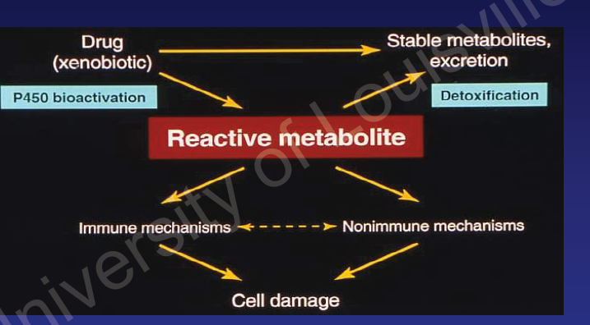
MECHANISM OF DILD

Slide 14
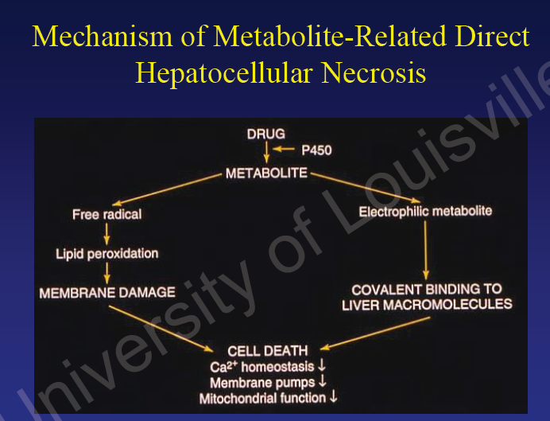
CONT…..

Slide 15
MECHANISM OF DILD
Centrolobular Necrosis:
Also called Direct or Metabolite related Hepatotoxicity.
Dose related.
Common pattern is Idiosyncratic reactions.
Symptoms includes nausea, vomiting, upper abdomen pain, jaundice.
e.g. : Halothane

Slide 16
CONT…
Steatohepatitis :
Acute necrosis because of accumulation of fatty acids in hepatocytes.
Metabolite affects the fatty acid metabolism.
e.g. :
Alcohol - Acetaldehyde fatty acid synthesis cell enlargement cell lyses.
Valporic acid D-4-valporic acid Potent inducer of fatty acid synthesis

Slide 17
CONT...
Phospholipidosis :
Phospholipidosis is the accumulation of phospholipids instead of fatty acids.
e.g. :Amiodarone & its metabolite N-desethyl-amiodarone. The patient can present with either elevated aminotransferases or hepatomegaly.

Slide 18
CONT…
Generalized hepatocellular necrosis :
Drug/metabolite act as haptens, which when combine with a specific cell protein it induces the autoimmune reaction.
e.g. : Isoniazid, ketaconazole.
Isoniazid produces this type liver injury in 10-20% of chronic isoniazid users.

Slide 19
CONT…
Cholestatic Injury:
Cholestatic injury, also known as cholestatic jaundice or cholestasis. It can be classified by the area of the bile canalicular or ductal system that is impaired.
This will cause intrahepatic accumulation of toxic bile acids and excretion products.
Clinically, these patients are often asymptomatic and present with mild to moderate elevations of serum bilirubin.
e.g. : long-term high-dose estrogen therapy.

Slide 20
CONT…
Neoplastic Diseases:
Hepatic tumors are formed because of long tem use of hormones such as Androgens, Estrogens.

Slide 21
ASSESSMENT
Patients History
Social habits – alcohol
Previous medications/ previous reactions
Occupation/Environmental factors
Arsenic, CCl4 – lab, agriculture, construction
Vinal chlorides – plastic workers
Alternative/ Non-drug therapy
Clove oil, maragosa oil, pennyroyal oil etc..

Slide 22
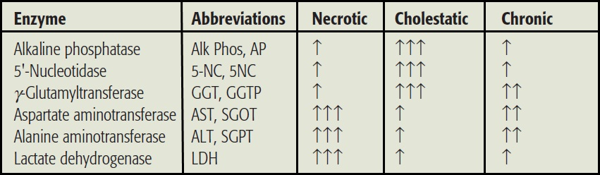
CONT…

Slide 23
INVESTIGATION
Serum Proteins: albumin, transferrin indicates impaired liver function.
Prothrombin Time:
Liver Biopsy:
Nutritional status:
Low serum levels of vitamins E and C are associated with asymptomatic elevations in transaminases.
High serum iron, transferrin, and selenium levels are also associated with asymptomatic elevations of transaminases

Slide 24
TREATMENT
Goal :
Withdrawal of the drug.
Attempt to remove it from the body.
ANTIDOTE:
N-acetylcysteine and methionine for paracetamol poisoning.
Desferrioxamine 5-10g in 50-100ml of water is administered orally for iron poisoning.

Slide 25
CONT…
Supportive therapy:
Nothing to do, only attaintion to fluid and electrolyte balance.
Coagulation disorder:
Should be treated by correcting vitamin K deficiency with intravenous phytomenadion injection.
Menadiol sodium phosphate 10mg po daily.

Slide 26
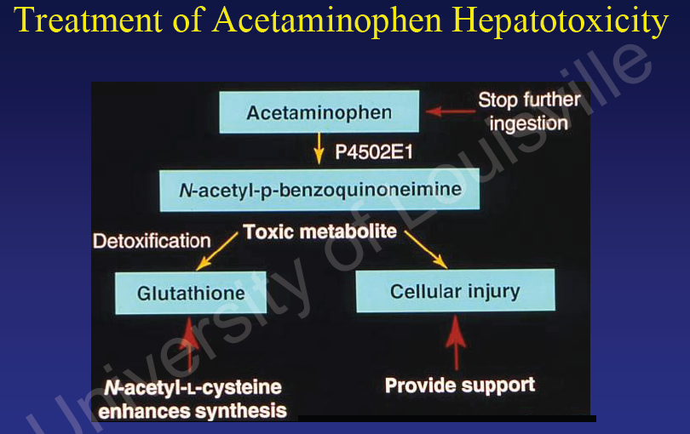

Slide 27
PATIENT COUNSELLING
All patients should be advised of potential side effects.
Patients and their care giver should be helped to recognize sings of liver disorders and known to report immediately symptoms such as malaise, nausea, fever, abdominal discomfort etc.
Avoid alcohol consumption
Parents should be reminded to store all medicine in child resistant container and out of reach

Slide 28
CONT…
Referances:
Drug-Induced Liver Disease Richard A. Wright, M.D.Professor and Chief Division of Gastroenterology/HepatologyDepartment of Medicine University of Louisville Louisville, Kentucky, Farrell, Drug-Induced Liver Disease 1994:85-99
Drug-Induced Liver Injury (DILI) CLINICAL INVESTIGATOR TRAINING COURSE Holiday Inn, College Park MD November 15, 2012 www.fda.org
Clinical pharmacy and therapeutic, edited by Roger walker and Cate whittlesea pg no 222-234

Slide 29
THANK YOU….

