Slide 1
PHARMACOTHERAPEUTICS-III
UNIT NO- 02 DRUG INDUCED HAEMATOLOGICAL DISORDER
16-09-2024
1

Slide 2
INTRODUCTION:
Haematological disorders have long been a potential risk of modern pharmacotherapy. Some agents causes predictable haematological disorders (e.g ,antineoplastics), but others induce idiosyncratic reactions not directly related to the drug’ pharmacology
Because of seriousness of drug-induced haematological disorders, it is necessary to track the development of these disorders in order to predict their occurrence

Slide 3
DRUG-INDUCED HAEMATOLOGICAL DISORDERS
Drug-induced Aplastic Anaemia
Drug-induced Agranulocytosis
Drug-induced Hemolytic Anaemia
Drug-induced Megaloblastic Anaemia
Drug-induced Thrombocytopenia

Slide 4
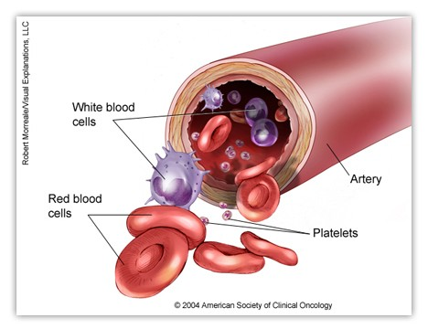
DRUG-INDUCED APLASTIC ANAEMIA

Slide 5
DRUG-INDUCED APLASTIC ANAEMIA
Definition:
When Drug causes decrease in all three cell lines (RBCs,WBCs, and Platelets) characterised by pancytopenia, condition is called as drug-induced aplastic anaemia.
Accounts for 70% to 86% of cases of aplastic anemia.

Slide 6
Diagnosis: A diagnosis is made by the presence of two of the following criteria:
WBC count of 3500/mm³ or less,
or Platelet count of 55,000/mm³ or less,
or hemoglobin value of 10 g/dL or less with a reticulocyte count of 30,000/mm³ or less.
Severe Aplastic anemia is defined by at least two of the following three peripheral blood findings.
Neutrophils count of less than 500/mm³
or Platelets count of less than 20,000/mm³
And anemia with a corrected reticulocyte index of less than 1%.

Slide 7
Symptoms:
The onset of drug-induced aplastic anemia is variable and insidious.
Symptoms appear on the average about 6.5 weeks after the initiation of the offending agent or sometimes after the drug is discontinued.
Patient may present with,
Anaemia: pallor, fatigue, weakness
Neutropenia: fever, chills, pharyngitis or other infection

Slide 8
MECHANISM:
The cause of drug-induced aplastic anaemia is damage to the pluripotent hematopoietic stem cells, before their differentiation to committed stem cells. This damage effectively reduces the normal levels of circulating erythrocytes, neutrophils and platelets.
Direct, dose-dependent drug toxicity-.e.g. anti-neoplastics, chloramphenicol, radiation
Idiosyncratic and operates through toxic metabolites-. e.g phenytoin, carbamazepine, chloramphenicol
Drug-or metabolite-induced immuno reaction specific to the stem cell population.

Slide 9
MANAGEMENT:
First step in treatment is to remove the suspected offending agent as early removal of the agent may allow for reversal of the aplastic anemia.
Provide adequate supportive care, including symptomatic treatment of infection and transfusion support with erythrocytes and platelets.
Major causes of mortality in patients are infection and bleeding so same should be managed properly.
Fever of unknown origin should be aggressively managed in patients on immunotherapy

Slide 10
TREATMENT OPTIONS:
Hematopoietic Stem cell transplantation (HSCT).
Immunosupression -Current options for this approach include antithymocyte globulin,
cyclosporine,
glucocorticoids
Granulocyte colony stimulating factor

Slide 11
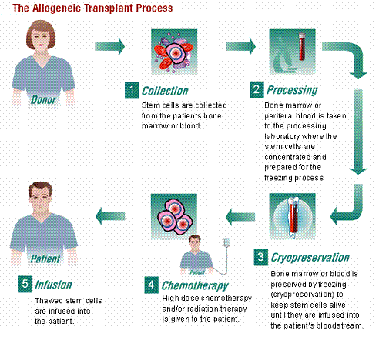
HUMAN STEM CELL TRANSPLANTATION

Slide 12
IMMUNOSUPPRESSION
Anti-thymocyte globulin(ATG): 10-20 mg/kg once daily for 14 days or every alternative day up to 21 doses if needed.
Cyclosporin: 5 mg/kg/day and titrated up to 500ng/mL(oral)
Methyl prednisolone: 1mg/kg/day for 4 week

Slide 13
DRUG-INDUCED AGRANULOCYTOSIS

Slide 14
Definition: It is drug mediated reduction in the number of mature myeloid cells in the blood (granulocytes and immature granulocytes) to a total count of 500/mm3 or less.
Symptoms: Sore throat, fever, malaise, weakness and chills. Generally symptoms occur within 10-14 days after the initiation of offending agent. In majority of cases symptoms will resolve over time.
It occurs more in female than males, with an overall estimated incidence of 1.6 to 3.4 million persons per year.
The overall mortality rate in agranulocytosis is 16% and rate increases among the patients with agranulocytosis when they develop bacteremia or renal failure.

Slide 15
MECHANISM:
Drug induced agranulocytosis can be classified in to three types.
Type 1 reaction is immune mediated and involves drug, drug metabolite, antibodies, and neutrophils.
Type 2 reaction is associated with accumulated drug toxicity in hypersensitive individuals.
Type 3 reaction results from combination of both immune and toxic mechanisms.
Examples: Penicillin, Quinine,Quinidine, Anti-thyroid drugs, Ticlopidine, Anti-psychotics ,carbamezepine digoxin dipyrimidamole, indomethacin, propanolol, propylthiouracil, zidovudine, ticlopidine, clorpromazine, clozapine, dapsone gentamicin,

Slide 16
MANAGEMENT:
First step involves in the treatment is removal of offending agent.
Following discontinuation of the drug , most cases resolves overtime and only symptomatic treatment ( anti microbial for infections) is given.
Sargramostim (GM-CSF) and filgrastim (G_CSF) have been used to shorten the duration of neutropenia with varying degrees of success.
Recovery of granulocyte count occurs within 3 to 15 days.

Slide 17
Sargramostim: 250mcg/m² / day IV or SC over 4 hours
Monitoring parameters: renal functions
hepatic functions
hydration status
Body weight
CBC
Special Monitoring: Dyspnea, renal failure, CHF, Tachycardia, pleural or pericardial effusion, allergic reactions, Radiation or chemotherapy
ADRs: myalgia, arthralgia, fever, chills, dyspnea, tachycardia, bone pain

Slide 18
Filgrastim: 5 mcg/kg/day IV or SC
Monitoring parameters: ARDS
Alveolar hemorrhage,
Allergic reactions, cutanous vasculitis
Splenic rupture

Slide 19
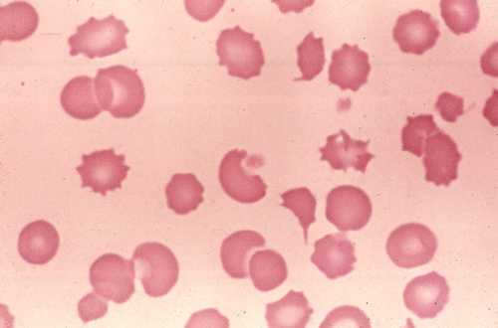
DRUG-INDUCED HEMOLYTIC ANAEMIA

Slide 20
Definition: The process of premature destruction of RBC is referred as haemolysis which may occur due to defective RBC or abnormal changes in the RBC.
Patients with drug-induced hemolytic anemia can present with signs of intravascular or extravascular hemolysis.
The onset of drug-induced haemolytic anemia is variable and depends on the drug and mechanism of the hemolysis.
Diagnosis is made by coomb’s test.

Slide 21
MECHANISM:
Drug-induced Hemolytic Anaemia:
Immune mediated red cell destruction
    Hapten induced haemolysis Eg :pencillin, cephalosporin
    Drug induced autoantibody production Eg: methyldopa
    Innocent bystander phenomenon e.g. quinine, quinidine
    Non immunological protein adsorption eg :cephalosporin
Drug-induced oxidative Hemolytic Anaemia:
It occurs due to glucose 6-phosphate dehydrogenase deficiency.
E.g: primaquine, sulphonamides

Slide 22
MANAGEMENT:
The treatment of drug-induced immune hemolytic anemia includes the removal of the offending agent and supportive care.
The use of glucocorticoids is usually unnecessary, and has not proved efficacy.
A recent development in the treatment of autoimmune hemolytic anemia is the use of the chimeric, human anti-CD20 monoclonal antibody rituximab.
The role of immunoglobulin treatments in drug induced hemolytic anemia has yet to be clearly defined.

Slide 23
For drug-induced oxidative hemolytic anemia, usually no therapy is necessary, as most cases of drug-induced oxidative hemolytic anemia and mild in severity. Patients with these enzyme deficiencies should be advised to avoid medications capable of inducing the hemolysis.

Slide 24
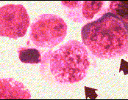
DRUG-INDUCED MEGALOBLASTIC ANAEMIA

Slide 25
Definition: Drug induced megaloblastic anemia is defined as the development of abnormal RBC precursors called megaloblasts in the bone marrow.
These megaloblasts changes are due to the direct toxic or indirect effects (vitaminB12) of the drug on DNA synthesis.
Deficiency of vitaminB12 is the main responsible factor which cause impaired proliferation and maturation of hematopoietic cells.
Eg:Methotrexate, cotrimoxazole, phenytoin

Slide 26
MANAGEMENT:
When drug-induced megaloblastic anemia is related to chemotherapy, no real therapeutic option is available, and the anemia becomes an accepted side effect of therapy.
If drug-induced megaloblastic anemia results from cotrimoxazole, a trial course of folic acid, 5 to 10 mg upto four times a day, may correct the anemia.
Folic acid supplementation of 1 mg every day often corrects the drug-induced megaloblastic anemia produced by either phenytoin or Phenobarbital.

Slide 27
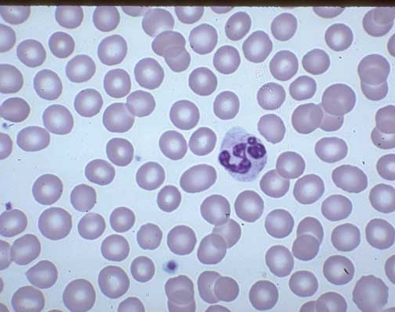
DRUG-INDUCED THROMBOCYTOPENIA

Slide 28
Definition: It is defined as a platelet count below 1,50,000/mm³.
Mechanism:
There are three types of drug-induced thrombocytopenia:
direct toxicity reactions,E.g. chemotherapeutic agents, amrinone,pesticides,organic solvents
hapten-type immune reactions, E.g. Penicillin, Abciximab, gold salts, Heparin
innocent bystander type immune reactions. E.g. Quinine

Slide 29
MANAGEMENT:
Primary treatment of drug-induced thrombocytopenia is removal of offending agent and symptomatic treatment of the patient.
The use of corticosteroids is controversial.
In gold salt-induced thrombocytopenia, prednisolone in a dose of 60 mg daily is beneficial in correcting the thrombocytopenia.
In case of heparin–induced thrombocytopenia with thrombosis, all forms of heparin must be discontinued; and anticoagulation with danaparoid, argatroban, or lepirudin should be initiated.

Slide 30
These agents also should be considered for patients having acute drug-induced thrombocytopenia without thrombosis because of increased risk of thrombosis in such patients.
The relatively high risk of continued thrombocytopenia with thrombosis is a contraindication for the use of low molecular-weight heparin. Abciximab-induced acute profound thrombocytopenia is effectively treated with platelet transfusion if clinical indicated.

Slide 31
CONCLUSION:
Drug-induced hematologic disorders are rare but potentially life-threatening conditions.
Clinicians should recognize the medications with the potential of causing hematologic disorders, and educate patients to recognize the symptoms associated with such events.
Frequent laboratory monitoring of patients taking medications associated with severe hematologic events can facilitate diagnosis and treatment.
Identifying the etiology of the event and documenting the causative agents may serve to prevent a recurrence secondary to the use of a related medication

Slide 32
REFERENCES:
A book of Clinical pharmacy and Therapeutics 5th edition by Roger walker, pg no 775-782
A text book of pharmacotherapy by Dipiro,pg no :1781-1793

Slide 33
Thank you

