Slide 1
Molecular luminescence
FLUORiMETRY AND PHOSPHORIMETRY
Radiation due to temperature = incandescence
All other form of light emission is called as luminescence
luminescence
phosphorescence
chemoluminescence
photoluminescence
fluorescence
radioluminescence

Slide 2
What makes a compound UV active?
Ones that do are said to be 'UV-active' and ones that do not are 'UV-inactive'.
To be UV-active compounds must possess a certain degree of conjugation, most commonly aromatic compounds.

Slide 3
What are fluorescent compounds?
A fluorophore (or fluorochrome, similarly to a chromophore) is a fluorescent chemical compound that can re-emit light upon light excitation.
Fluorophores typically contain
several combined aromatic groups,
or planar
or cyclic molecules with several π bonds

Slide 4

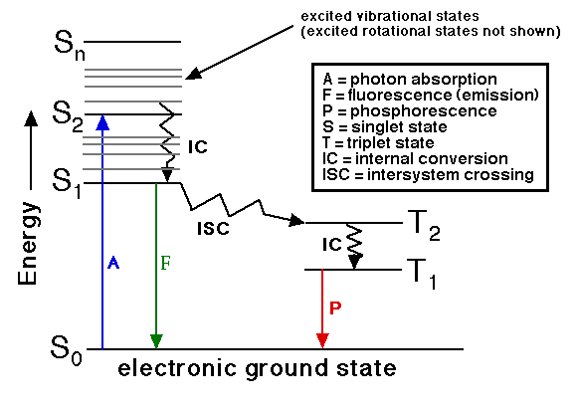
Principles of Fluorescence
Energy level diagram (Jablonski diagram)

Slide 5
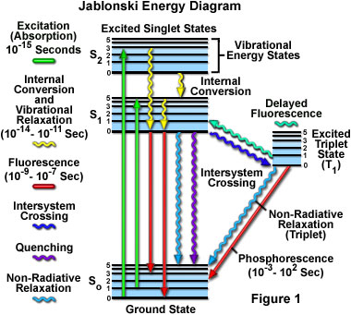
Energy level diagram
(Jablonski diagram)

Slide 6
FLUOROSENCE QUENCHING
Self quenching or concentration quenching:
Chemical quenching : (due to pH,O2,halides, heavy metals)
Static quenching : (complex formation, caffeine as quencher for riboflavin)
Collision quenching:(Halide, heavy metals, Increase in temperature, decrease in viscosity)

Slide 7
Factors affecting the fluorescence
Nature of the molecule: able to absorb uv or visible radiation
2. Nature of the substituent‘s (electron donating group, electron donating group, SO₃H, NH4, alkyl group OH NH₂ &
withdrawing gp COOH,NO2, Halides, C=O)
3. Polarity
4. Effect of PH;
(ANILINE Alkali pH; ---visible fluorescence, acidic—uv fluorescence
PHENOLS: alkali: fluorescence, acidic : no fluorescence,
5. Effect of dissolved gasses (it oxidizes fluorescent to non fluorescent )

Slide 8
6. Temperature
7. Effect of structural rigidity
8. Quantum efficiency
9.Atomic number( phenol=18, toluene=17, benzene = 10)
10. Photochemical decomposition (due to polychromatic light, no fluorescence)
11. Formation of metal complex

Slide 9
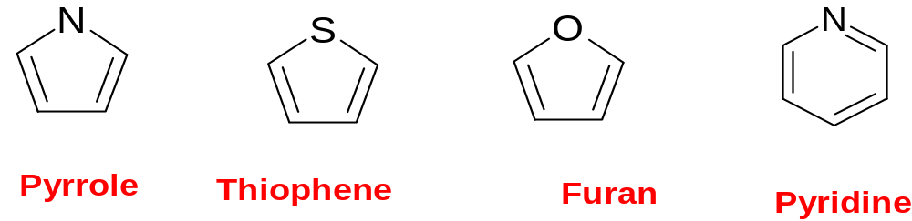
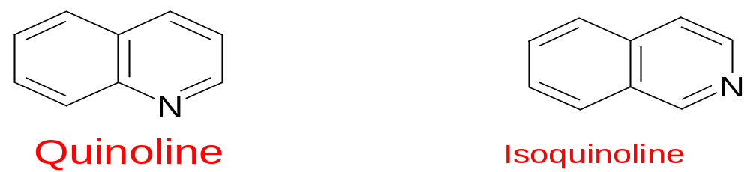
Nature of the substituents

Slide 10
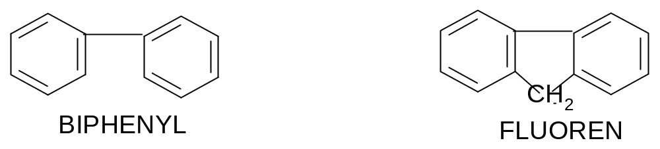
. Effect of structural rigidity
QUANTUM EFFECIENCY= 0.2 1.0
QUANTUM EFFECIENCY = NUMBER PHOTON EMITTED
------------------------------------------
NUMBER OF PHOTON ABSORBED

Slide 11
Quantum efficiency
Quantum yield:
the ratio of the number of molecules that luminescence to the total number of excited molecules.
f = k_{f}/ (k_{f} + k_{i} + k_{ec} + k_{ic} + k_{pd} + k_{d})
k_{f}: Fluorescence constant
k_{i}: Intersystem crossing constant
k_{ec}: External conversion constant ( deactivation of excited electronic state , b/w solvent & solutes)
k_{ic}: Internal conversion constant ( intermole process mole—lower electronic state without emission of radiation)

Slide 12
k_{pd}: Pre dissociation constant ( due to internal conversion electrons move from higher ES to upper vibrational state of lower ES where energy is low)
k_{d}: Dissociation constant ( after absorption chromophoric electrons directly to higher vibrational level----- rupture of bonds)

Slide 14
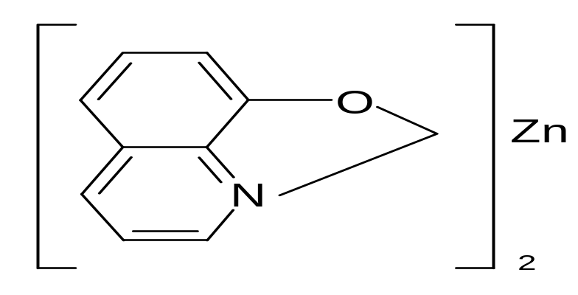
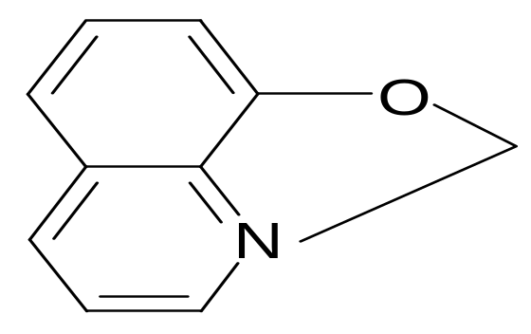
Formation of metal complex
Increase in fluorescence of chelating agents, when they complexed with a metal due to rigidity:
Ex: 8 hydroxy quinoline AND hydroxy quinoline zinc complex

Slide 15
Fluorescence measurement
Filter fluorimeters
Spectrofluorometers
Fluorescent microscopes
Fluorescent scanners &
Flow cytometry
Notes:
diffraction grating monochromators
Flow cytometry is a technique for counting, examining, and sorting microscopic particles suspended in a stream of fluid

Slide 16
instrumentation
Components of a fluorometer:
Light sources; (mercury and xenon lamp)
wavelength selection: ( filters and monochromators)
detectors; photomultiplier tube (PMT)
sample cell.
Recorders;

Slide 17
Block diagram of fluorometer
excitation monochromator
sample
source
emission monochromator
detector
Read-out

Slide 18
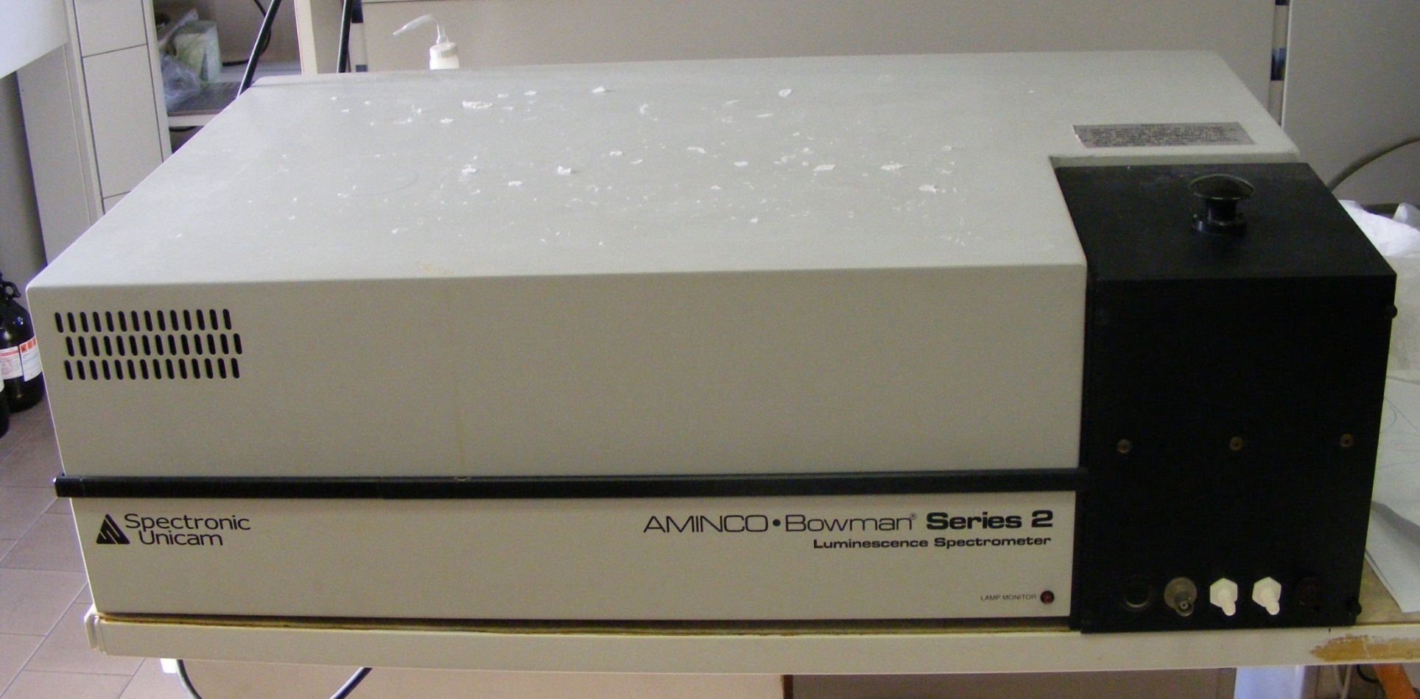
Spectrofluorometer

Slide 19
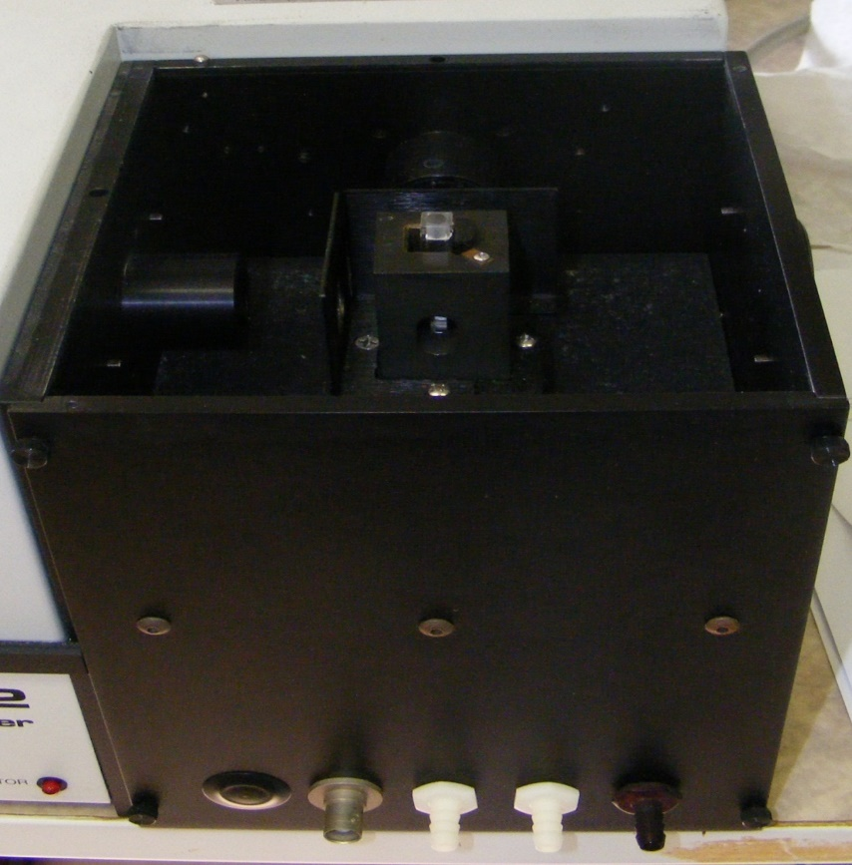
Spectrofluorometer

Slide 20
source
Mercury vapour lamp: metallic arc they are designed to operate at high temperature and low pressure the emission of the lamp is at wavelength at 365, 398, 436, 546,579,690 & 734 nm
Low pressure lamps: equipped with a silica envelop provide the additional radiation at 254nm

Slide 21
Xenon lamp : produce a radiation by the passage of current through an atmosphere of xenon.
Tungsten lamp: to produce a strong excitation band above 450
Hydrogen & deuterium arc lamp: not employed because they are not intense

Slide 22
Filter and monochromators: (absorption + interference filters + gratings)
Detector: PMT
Cells cell compartment: cylindrical, rectangular, made up of silica or glass, they are designed to reduce amount of scattered radiation reaching the detector
Baffles: to prevent the scattered light

Slide 23
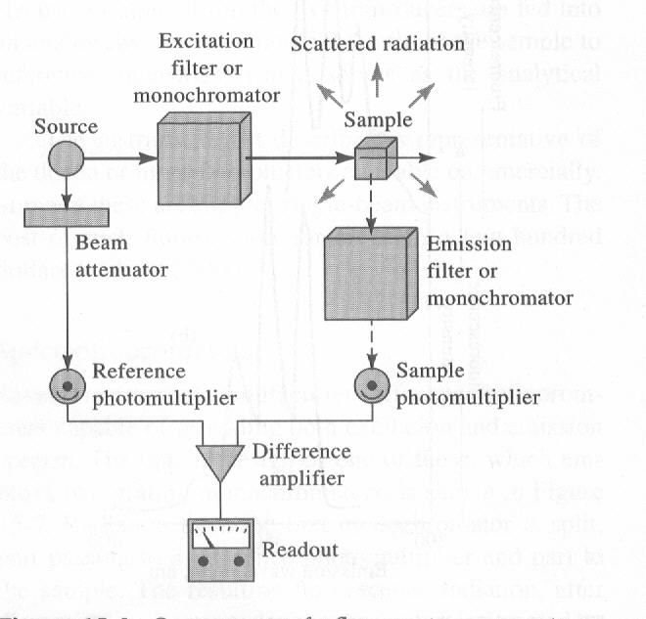
Components of a fluorometer of a spectro-fluorometer.

Slide 24
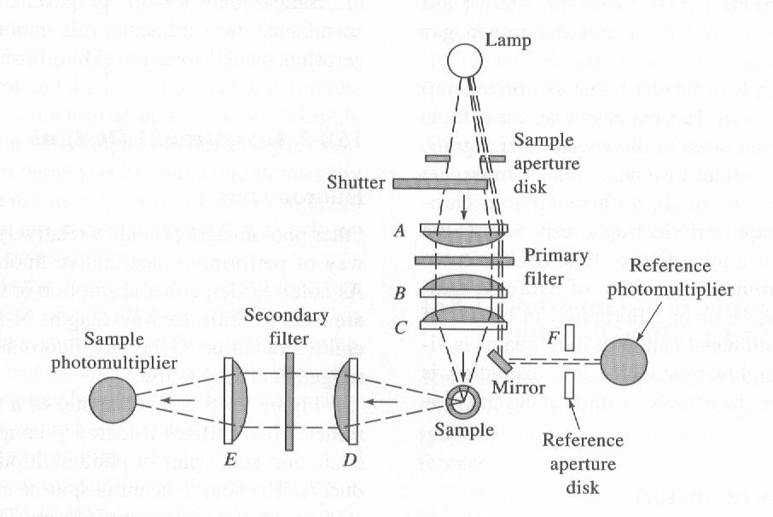
typical fluourometer

Slide 25
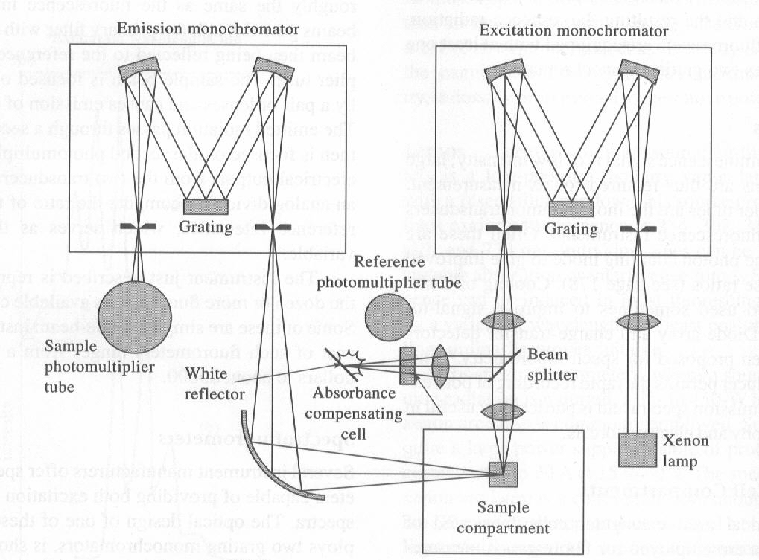
spectrofluorometer.

Slide 26
application
Determination of uranium salts by fluorometer
Determination of inorganic salts
Fluorescent indicators
Fluorometric reagent
Aromatic structure
Organic analysis
Pharmaceutical analysis
Determination of thiamine

Slide 27
Determination of riboflavin
Determination of quinine sulphate
Determination of tetracycline in serum
Special application:
Investigation of chemical structure and process
Chemical analysis
Detection of impurities
Estimation of single component

Slide 28
Determination of uranium salts by fluorometer
Uranium + HNO3 -------- oxidation + NaF
Determination of inorganic salts ( transition elements)
Not exhibit the fluorescence with non fluorescence organic molecule :
Ex:, ruthenium ions + 5 methyl 1,10 PTL ---- complex ----- fluorescence
cadnium + 2 OH phenyl benzoxazole + glacial acetic acid -- blue fluorescence

Slide 29
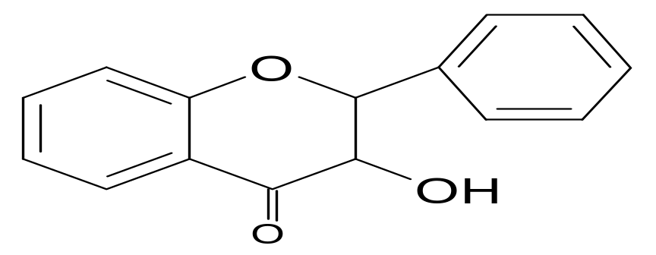
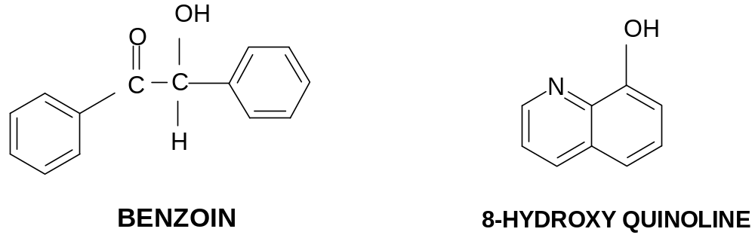


Fluorometric reagent:
used for cation metal ion analysis Ex: , flavanol
Aromatic structure: determination of two or more functional group
Ex: benzoin and 8 hydroxy quinoline

Slide 30
Fluorescent indicators:
Used in acid base titration specially for coloured substances.
Eosin : pH: 3-4 : color less to green
Fluorescein : pH: 4-6 : color less to green
Quinine sulphate: pH: 3-5 : blue to violet
2-napthaquinone pH: 4.4-6.3 :blue to colour less

Slide 31
Organic analysis:
Determination of many organic compounds present in cigrate, smoke, automobile exhaust.
Ex: benzopyrene

Slide 32
Pharmaceutical analysis:
Compound converted to fluorescent products by chemical reaction.
excitation emission
hydrocortisone: ethanol : 460 520
Nicotinamide : cyanogen 250 430
Reserpine : oxidation 250 430

Slide 33
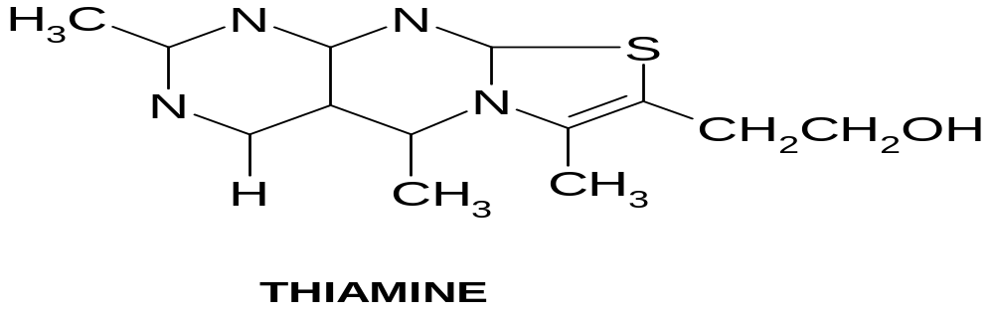
Determination of thiamine vitamin B1
( it is non fluorescent on oxidation produce florescence)
Method: sample is treated with phosphatase ------- brings the (hydrolysis of PO4 ester of thiamine) ------ filtration
( remove PO4 + insoluble matter) ------- dilute to known volume with water -------
divide into 2 group-----
one is used as blank -----
to another add NaOH + alcohol ------ + potassium ferricyanide ( oxidizing agent) + on shaking
( alcoholic extraction is separated from aqueous layer) ------ examined in fluorometer

Slide 34
Determination of riboflavin
Treat with acid + KMNO4 (OA) ----- FA
Add sodium dithionate ----- measure the fluorescence intensity (FB)
standard substance ---- measure the fluorescence intensity (FC)
Measure the concentration of fluorescent material
FB-FA mx
--------- = -------- = mass of riboflavin in sample + standard
FC-FA mx+ ms

Slide 35
Determination of quinine sulphate
quinine sulphate in 0.1N H2SO4 --- on serial dilution --- measure the fluorescence--- by plotting the graph
fluorescence v/s concentration

Slide 36
Determination of tetracycline in serum
Tetracycline is converted to anhydrotetracyclin ------------fluorescence (quantum yield is less)----- on subsequent complexation with aluminum ---- fluorescence with increase sensitivity
Special application:
Investigation of chemical structure and process
Hydrogen bonding , cis-trans isomers, polymerization, tautomersim

Slide 37
Chemical analysis: quantitative and qualitative analysis
Detection of impurities:
Cyclohexane ------ purified until it shows no trace of benzene at 2600A^{O}
Estimation of single component ----- vitamin A

Slide 38
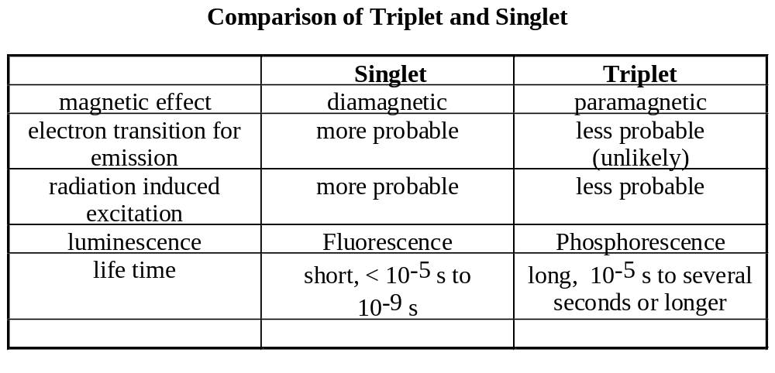
Fluorescence and Phosphorescence

Slide 39
Comparison of Fluorescence and Phosphorescence
Fluorescence Phosphorescence
life time short, < 10⁻⁵s long, several seconds
electron spin no yes
excited states singlet triplet
quantum yield high low
temperature most temperature low temperature more likely
Resonance fluorescence: absorbed radiation is re-emitted without a change in frequency.
Stokes shift: molecular fluorescence bands are shifted to wavelengths that are longer than the resonance line.

Slide 40
Luminescence:
Energy diagram and basic concepts
2. The factors affect fluorescence
3. Excitation and emission spectra
4. Instrumentation
5. Applications

Slide 41
Effect of Concentration on Fluorescence Intensity
Power of fluorescence emission F
F = K’ (I₀ –I)
I₀ and I are the intensities of excitation lights before and after absorbed by the analytes. K’ is the constant
related to the quantum yield
I/I₀ = 10^{-εbc}
F = K’ I₀ (1–10^{-εbc})
F = 2.3 K’ I₀ εbc, (when εbc<0.05)

