Slide 1

GENE EXPRESSION

Slide 2
Content
” Gene expression ” Transcription
RNA Processing.
” Translation.

Slide 3

Gene
ression
” The process by which DNA dire s protein synthesis, includes two stages, transcription and translation

Slide 4

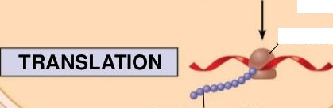
(a) Bacterial cell
DNA
mRNA
Ribosome
Polypeptide

Slide 5

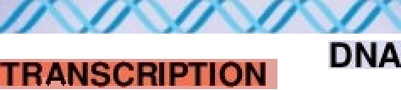
(b) Eukaryotic cell
Pre-mRNA

Slide 6

(b) Eukaryotic cell
TRANSCRI łON
DNA
IPr e-mRNA
RNA PROCESSING
mRNA

Slide 7
(b) Eukaryotic cell
Figure I T.2 b-2
DNA
TRAtłSCRł iON
IPr e-mRNA
RNA PROCESSING
ibosome

Slide 8
Transcription
The first stage of gene expression
One DNA strand serves as the template strand
It is always the same strand for a given gene
Other DNA strand non cording or antisense strand
RNA polymerase catalyzes the transcription

Slide 9
The three stages of transcription
° Initiation
Elongation
Termination

Slide 10

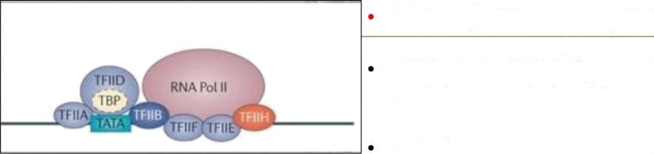
Pre initiation com
ex PI
First step of the transcription
PIC includes RNA Polymerase 2 and six transcriptional factors
Which are TF2A, TF2B, TF2D, TF2E, TF2F, TF2H

Slide 11

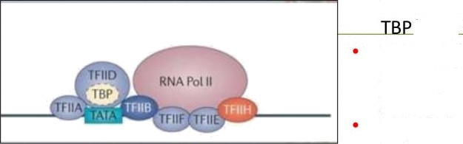
Pre initiation com
ex PI
TF2 D bind with promoter site
(TATA region) with help of the
{TATA BI Protein TF2 A and TF2B will help to recruit RNA Polymerace2 to promoter site
TF2 F brings and guides RNA
Polymerase 2 to promoter site
This is a closed system.
(Still two complementary strands
bind together)

Slide 12

Initiation complex
Helicase activity of TF2 H will help to unbind two strands in promoter site.
C terminal of RNA Pol. 2 enzyme will phosphorylated by kinase activity of TF2 H
It will cause to escape RNA Polymerase 2 from promoter region.

Slide 13
ongation
RNA polymerase 2 moves along the DNA, it unwind the double helix, 10 to 20 bases at a time
Transcription progresses at a rate of 40 nucleotides per second in eukaryotes
Nucleotides are added to the 3’ end of the growing RNA molecule
Synthesis occurred from 5’ to 3’ direction in newly synthesized
mRNA

Slide 14
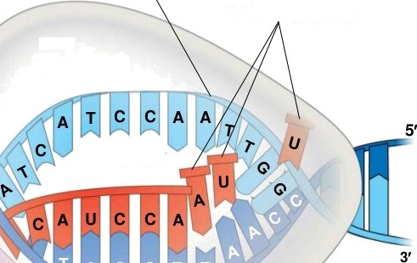



Fiqure I T. 9
Nontemplate strand of DNA
RNA nucleotides
RNA
polymerase
3’ end
5’
Direction of transcription
Template strand of DNA
Newly made
RNA

Slide 15
Termination
The mechanisms of termination are different in bacteria and eukaryotes
ln bacteria
  the polymerase stops transcription at the end of the terminator
° the mRNA can be translated without further modification
In eukaryotes,
  RNA polymerase II transcribes the polyadenylation signal sequence;
  the RNA transcript is released 10—35 nucleotides past this polyadenylatio sequence

Slide 16
RNA PROCESSING
Modify pre-mRNA (RNA processing) before the genetic messages are dispatched to the cytoplasm
During RNA processing, both ends of the primary transcript are usually
altered
  The 5’ end receives a modified nucleotide 5’ cap
  The 3’ end gets a poly-A tail
Also, usually some interior parts of the molecule are cut out, and the other parts spliced together. (RNA Splicing)

Slide 17

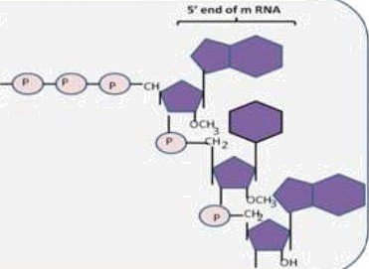
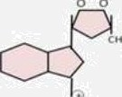
Ca ng
’””'""“" "
Guanine nucleotide connected to 5’ of mRNA and get methylated on its 7 th position by methyl transferase enzyme

Slide 18
Polyadenylation
Addition of long adenine nucleotide chain to pre mRNA at 3’ end.
25-200 adenylate residues attached.

Slide 19
Introns and exons
Most eukaryotic genes and their RNA transcripts have
  long noncoding stretches of nucleotides that lie between coding regions introns
  Coding sequences exons
usually translated into amino acid sequences
° RNA splicing removes introns and joins exons together, creating an mRNA molecule with a continuous coding sequence

Slide 20

Intron
s’ Exon Intron
Exon
Exon 3’
Pre-mRNA Codon numbers
1—30
31—104
105—
146
Introns cut out and exons spliced together
mRNA
5’Cap
3’ UTR
Coding segment

Slide 21
Translation
° The process where ribosomes synthesize proteins using the mature mRNA transcript produced during transcription
Translation requires,
° mRNA to be translated (Genetic codon)
° All amino acids
  t RNA
  Ribosomes
° Energy source
  Protein factors

Slide 22
The Genetic Code/ Codon
The three nucleotide base sequences in mRNA that act as a code word for amino acid in the protein chain
Four bases produce 64 different combinations
° These combinations code for 20 different amino acid and stop codon
AUG- initiation codon
UAA, UAG and UGA- nonsense codon

Slide 23
tRNA
Accurate translation requires two steps
° First: a correct match between a tRNA and an amino acid, done by the enzyme aminoacyl-tRNA synthetase
  Second: a correct match between the tRNA anticodon and an mRNA codon

Slide 24
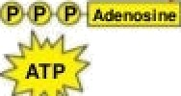
Figure f T.16-1
Aminoacyl-tRNA synthetase (enzyme)
Charged .min.acid
tRNA *
First is the adenylation of the amino acid, which forms aminoacyl-AMP
Amino acid + ATP Aminoacyl-AMP + PPi

Slide 25



Figure f T.16-2
Aminoacyl-tRNA synthetase (enzyme)
Charged .min.acid
tRNA *
First is the adenylation of the amino acid, which forms aminoacyl-AMP
Amino acid + ATP Aminoacyl-AMP + PPi

Slide 26
Charged ..iwwW
tRNA
Second, the amino acid residue is transferred to the tRNA
Amino
minoacyl-AMP + tRNA W Aminoacyl-tRNA + AMP

Slide 27
Charged .min.acid
tRNA
AminoacyI-tRNA synthetase
Second, the amino
acid residue is transferred to the tRNA
Amino
minoacyl-AMP + tRNA
AminoacyI-tRNA + AMP
Aminoacyl tRNA
(“charged tRNA”)

Slide 28
Ribosomes
Ribosomes facilitate specific coupling of tRNA anticodons with mRNA codons in protein synthesis
The two ribosomal subunits (large and small) are made of proteins and ribosomal RNA (rRNA)
° Bacterial and eukaryotic ribosomes are somewhat similar but have significant differences.

Slide 29
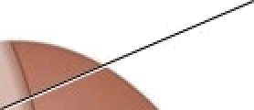
P site (Peptidyl-tRNA binding site)
Exit tunnel
A site (Aminoacyl- tRNA binding site)
E site
(Exit site)
Large
subunit
mRNA
binding site
Small
subunit

Slide 30
Ribosomes
A ribosome has three binding sites for tRNA
  The P site holds the tRNA that carries the growing polypeptide chain
  The A site holds the tRNA that carries the next amino acid to be added to the chain
  The E site is the exit site, where discharged tRNAs leave the ribosome

Slide 31
The three stages of translation
Initiation
Elongation
Termination
All three stages require protein ”factors” that aid in the translation process

Slide 32
initiation
Initiation complex
  mRNA,
  a tRNA with the first amino acid,
  the two ribosomal subunits
First, a small ribosomal subunit binds with mRNA and a
special initiator tRNA
Then the small subunit moves along the mRNA until it reaches the start codon (AUG)
Initiation factors bring in the large subunit that completes the translation initiation complex

Slide 33
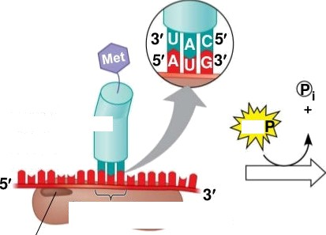
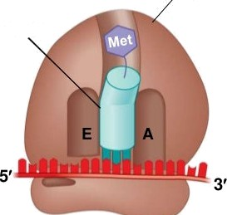
ribosomal subunit
P site
Initiator
tRNA
mRNA
GT GDP
Start codon
Small ribosomal subunit
mRNA binding site
Translation initiation complex

Slide 34
Elongation
Amino acids are added one by one to the preceding amino acid at
Each addition involves proteins called elongation factors and occurs
in three steps:
  codon recognition
  peptide bond formation
  translocation
Translation proceeds along the mRNA in a 5’ to 3’ direction

Slide 35
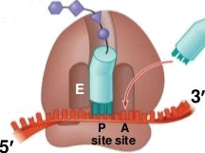
Figure f T.1 9-1
Amino end of
polypeptide
mRNA

Slide 36
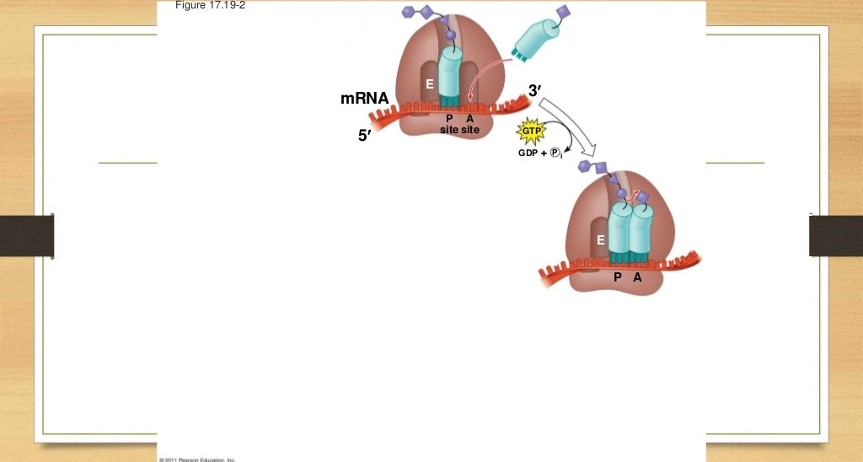
Amino end of
polypeptide

Slide 37
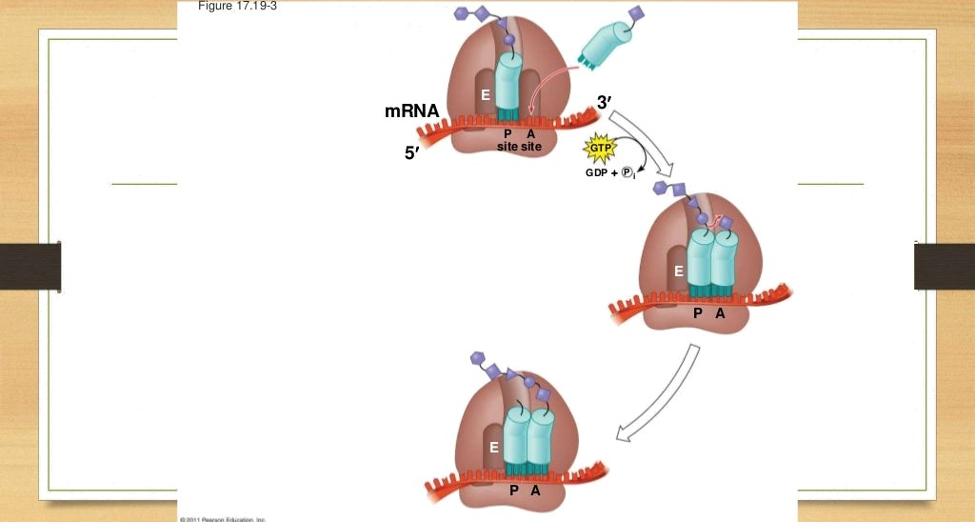
Amino end of
polypeptide

Slide 38
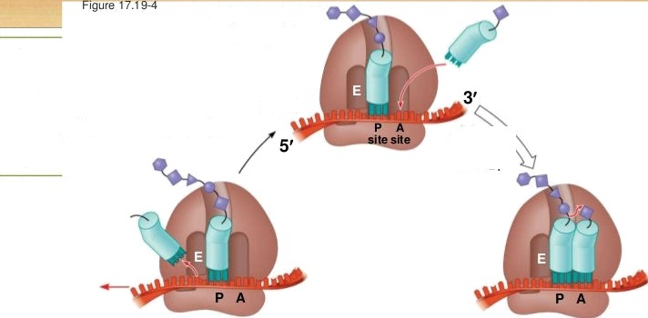


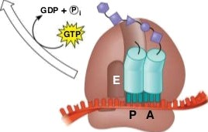
Amino end of
polypeptide
mRNA
Ribosome ready for next aminoacyl tRNA

Slide 39
Termination
Occurs when a stop codon in the mRNA reaches the A site of the ribosome
The A site accepts a protein called a release factor (eRF)
The release factor causes the addition of a water molecule instead of an amino acid
“ -
This reaction releases the polypeptide, and the translation
assembly then comes apart

Slide 40
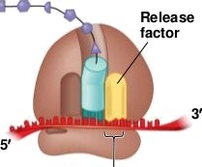
Stop codon
(UAG, UAA, or UGA)

Slide 41
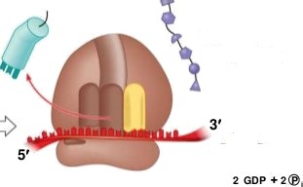


factor
Free
polypeptide
Stop co<Ion
(UAG, UAA, or UGA)

Slide 42
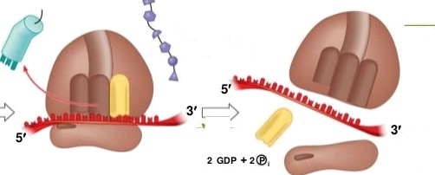


factor
Free
polypeptide
Stop co<Ion
(UAG, UAA, or UGA)

Slide 43
