Slide 1
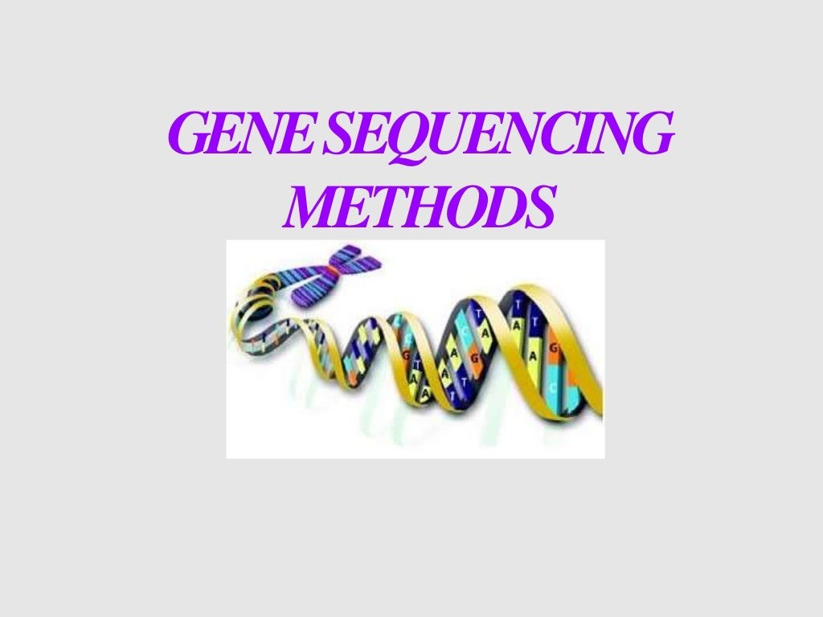


Slide 2

DNA - the hereditary material written in four-letter code of nucleotides.
sequencing, or "reading" the genetic code has become of increasing interest to scientists.
RNA sequencing — earliest form of nucleotide sequencing complete genome of Bacteriophage MS2.
Knowledge on genome organization was based on
reverse genetics.

Slide 3

Needo se
Understanding a particular DNA sequence can shed light on a genetic condition and offer hope for the eventual development of treatment.
An alteration in a DNA sequence can lead to an altered or non functional protein, and hence to a harmful effect in a plant or animal.
Simple point mutations can cause altered protein shape and function.

Slide 4
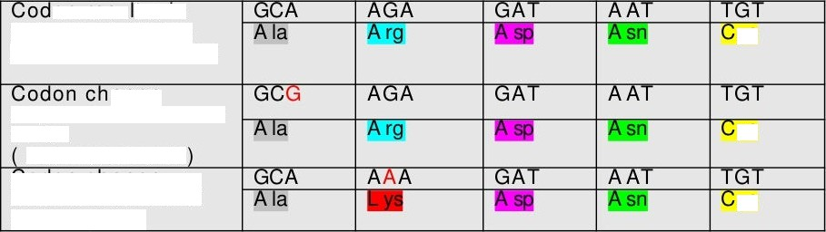
on resu t s in part icular Am in o Acid (A A) sequence
an ge
makes no diff erence in AA
redundant code
zoo on cn an ge result s in different AA sequence
ys
ys
ys

Slide 5

DNA
A nucleic acid, made up of four similar chemicals called bases
- A, T, C, and G that are repeated over and over in pairs.
DNA sc_{•i•}ciicing
Determination of the order of the nucleotide bases
Distinct portion of the DNA that codes for a type of protein or for an RNA chain.
ticiic scquciicing
Gene sequencing is a process in which the individual base nucleotides in an organism's DNA are identified.

Slide 6






sequencing — DNA sequencing — nucleotide sequencing — base sequencing
However, not
coding as there may,
DNA sequences are genes (i.e.
promoters,
tandem repeats, introns, etc. depending on organism and the source of the DNA

Slide 7
€ienome
Complete copy of chromosomal and extra chromosomal gene insrtuctions.
€ienome sequencing:
Breaking the whole genome into small pieces, sequencing the pieces and then reassembling them in proper order to arrive at the sequence of the whole genome.
Genomics:
Sequencing of genomes, determination of the complete set of proteins encoded by an organism and functioning of genes and metabolic path ways in an organism.

Slide 8
D i ffe r ent sequ en cing pro ceDures
Waiideriiig spot analy iLi: Sanger et nl.(1973)
DNA labelled with *²P at 5’ end, digested with snake venom phosphodiesterase - sequentially removes nucleotides from 3’ end. All the fragments containing radioactive label.
Fragments are subjected to electrophoresis, homo chromatography is performed.
Partial digests of DNA fragment is applied to cellulose acetate strip at pH 3.5 buffer. Electric field is applied across the strip.

Slide 9
Nucleotides G and T tend to have negative charges at this pH with T> G; A and C tend to have positive charges with C > A.
Fragments shorter by virtue of loss of T will move more slowly towards the anode pole since they lost some of the attracting cathode charge and so on.
Result is that loss of T or G causes a mobility shift towards the left, while loss of A or C causes a mobility shift to the right.
Fragments are found by means of autoradiographic detection of
locations of radioactivity in form of dark spot.
A line is drawn connecting the longest spot to the next longest and o on. These lines indicate the increasing number of nucleotides removed from the original fragment.

Slide 10
Clin mical clenvo E tfU lh€d.“
Maxam and Gilbert 1977
The single stranded DNA fragment to be sequenced is end-labeled by treatment with alkaline phosphatase to remove the 5’phosphate.
The labeled DNA fragment is then divided into four aliquots, each of which is treated with a reagent which modifies a specific base
Aliquot A + dimethyl sulphate, which breaks at guanine
Aliquot B + Acid (pH 2.0) , breaks at adenine and guanine
Aliquot C + Hydrazine, breaks at thymine + cytosine residues
Aliquot D + Hydrazine in salt, at cytosine

Slide 11
The four are incubated with pipendine which cleaves the sugar phosphate backbone of DNA next to Te residue that has been modified.
Load the reac£ons on polyacrylamide gels - exposed to X-ray film for autoradiography.
It yields a senes of dark bands each co<espondmg to a radiolaelled DNA 8agment, from w¥ch the sequence may be inferred.
The dark autora&ographic bands on ie film will represent the 5’- 3’ DNA sequence when read 8om bo8om totop.

Slide 12
Base calling - interpreting the banding pattern relative to the fow che%cal reactions.
For example, a band in the lanes correspondmg to the C only and the C + T reactions would be ca8ed a C.
If the band was present in the C + T reaction lane but not in the C only reaction lane it would be called a T.
%e same decision process would obta¥ for the G only and the G + A reaction lanes.

Slide 13
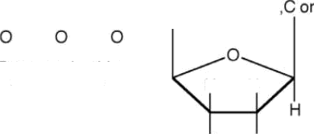

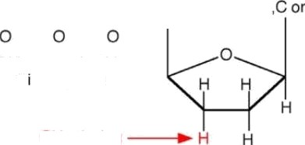
Uses dideoxynucleotides which resemble normal nucleotides but lack the normal -OH group.
O O o
II
HO —P O—P—O—P—O— CH₂ I
Base (A,T
II II
G)
I I I
Deoxynucleotide
triphosphate
H H
0
II II II
HO —P O—P O P O— CH₂
I I I
Base
(A,T
G)
I
Dideoxynucteotide
tr phosphate
OH missing

Slide 14

steps
Template DNA(ssDNA)
Pr%er annealing
Complementary strand synthesis
F abeling for the detection of fragments
Chain termination using ddNTPs
Resolution on denaturing PAGE
Visualization of bands by autoradiography

Slide 15
t e m p I a t e Dna (ssDna)
The template for a chain termination experiment is a single-stranded versiDn of the DNA molecule to be sequenced. There are several ways in which this can be Obtained;
The DNA can be cloned in a plas%d vector.
The DNA can be cloned in a bactenophage Ml3 vector.
The DNA can be cloned in a phage%d.
PCR can be used to generate single-standed DNA.

Slide 16
The first step in the copying process is the pairing of a primer with the homologous sequence on a segment of DNA.
DNA polymerase attaches to the primer and begins copying the DNA strand.
DNA polymerase uses a mixture of nucleotide triphosphates to synthesize a new DNA strand.
Dideoxy nucleotides are mixed at a low concentration with normal nucleotide triphosphates. Occasionally one is incorporated in place of a normal nucleotide triphosphate.
When that happens, the new DNA copy is terminated.

Slide 17
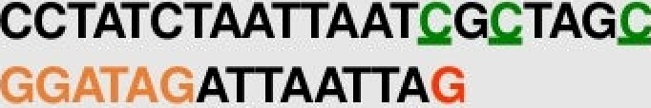



Because they lack the -OH (which allows nucleotides to join a growing DNA strand), replication stops.
ddG ddG ddG
ddG ddG
Polymerization reaction containing deoxy- and dideoxy- forms of a NTP generates fragments with different sizes ending with dideoxy nucleotide.
dG dG dG dG dG dG dG dG dG dG

Slide 18
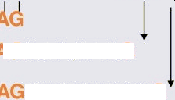
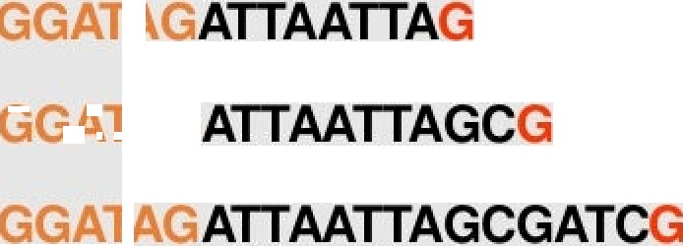

Fragments generated due to dideoxy guanosinetriphosphate termination reaction, contain G at the 3 -end
CCTATCTAATTAAT G TAG
Fragments generated due to dideoxy cytosinetriphosphate termination reaction, contain C at the 3 -end

Slide 19



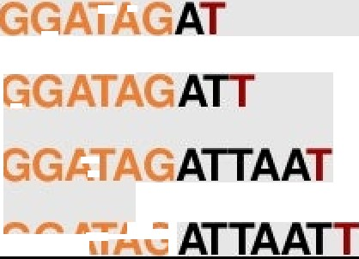
Fragments generated due to dideoxy adenosinetriphosphate termination reaction, contain A at the 3 -end
Fragments generated due to dideoxy thymidinetriphosphate termination reaction, contain T at the 3’-end

Slide 20
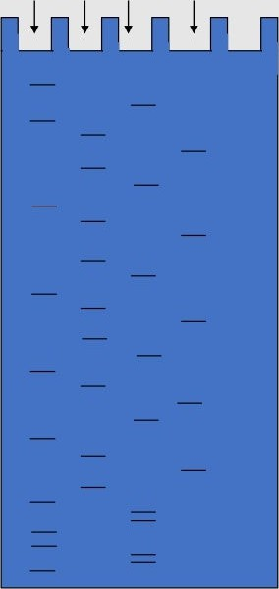
A G T G
HWhen the resulted fragments are electrophoresed on a gel, they will separate by size.
A T A
A
RECT ON OF READ NG
T
A
T
A
T A
A T T A A T T A
D

Slide 21
Reverse complement:
The sequence that is read 8om the sequencing gel is the reverse complement of the template stand. Because of complementary base pairing and the antipcallel nature of the double helix.
Thus the first base added to the newly synthesized strand corresponding to ie shortest fragment on the sequencing gel is complementcy to the extreme 3’- position of the template strand imme&ately adjacent to the site that ie pnmer hybridizes to

Slide 22
Advantages over chemical cleavage method
Unlike Maxam-Gilbe< method each lane would be base-
specific.
Autoradiography is same but base calling is easier.
The sequence 8agments on the gel were the complement of the actual template.
A major improvement ushered in by Sanger sequencing was the elimmation of some of the dangerous chemicals, like hy&azine.
Efficiency is more than che%cal cleavage method. When dealing with nucleic acids, enzymatic processes are more efficient than chemical processes.

Slide 23
Cycle sequencing
¥-Cycle sequencing is a modification of the traditional Sanger
sequencing melod.
HThe principles are ie same as in Sanger sequencmg; Dideoxynucleotides are used in a polymenzation reaction to create a nested set of DNA fragments with dideoxynucleotides at the 3’ terminus of each fragment.
HThe key &8erence is fat cycle sequencing employs a thermostable DNA polymerase which can be heated to 95^{O}C and still retain activity.
HThe advantage of using such a polymerase is fat
reaction can be repeated over and over again in ie
the sequencing same mbe by allowing it to cool
heaung ie mixture to denature the DNA and ten
to anneal the pnmers and polymenze new strands.

Slide 24
Cycle sequencing
HThus, less template DNA is needed than for conventional sequencing reactions.
Furthermore, the repeated heatmg and cooling can be done¥ a
DNA lermal cycler.
Advantages:
•Works with ssDNA and dsDNA and thus eliminates the need for M13 phage
•Requres only small amounts of template
•Can be set up in microtitre plates or %crotubes
•Can use internal labeling with [a-32P], [a-33P],or [35S]or with 5’-
end labeled primer
•Can be adapted for rapid screening

Slide 25
High-throue*R•t sequencing
The high demand for low-cost sequencing - development of high- t%oughput sequencmg - parllalize the sequencing process, producing thousands or millions of sequences at once.
An alternative to pnmer labelling is labelling of the chain terminators, a method commonly called 'dye-terminator sequencing’.
In 1986, Leroy Hood et al.,- radioactive labels, autoradiography, and manual base calling were all replaced by fluorescent labels, laser induced fluorescence detection, and computenzed base calling.

Slide 26
Dye-terminator sequencing
Labelling of the chain terminator ddNTPs - permits sequencing in
a single reaction.
First of all primer is labeled with one of four di8erent fluorescent dyes placed in a separate sequencing reaction with one of the four dideoxynucleotides plus all four deoxynucleotides.
each of the four ddNTP chain terminators is labelled with fluorescent dyes, each of which with different wavelengths of fluorescence and emission.
A8er completion of the reactions, the fow reactions were pooled
and run togeTer in one lane of a polyacrylamide sequencmg gel.

Slide 27
A four-color laser induced fluorescence detector scanned the gel as the reaction fragments migrated past.
The fluorescence signatwe of each 8agment was then sent to a computer where the softwce was trained to perform base calling.
The dye-terminator sequencing method, along with automated high-throughput DNA sequence analyzers, is now being used for the vast majority of sequencing projects.
set the stage for automated, high-throughput DNA sequencing.

Slide 28
dye label
clia›ntemñnat›on with ddGTF
chain termination th ddATF
5'-
3'-GGAGACTTACAGGAAAGAGA AGGA
CTCCGG?
AGGAGGCCTACCATGAAGATCAAG-5'
chs termñation with ddTTP
chainte rmination th ddCTP
5'-
3'-GGAGACTTA€AGGAAAGAGATITAGGA
TC’' AGGA
CTACCATGAAGATCAAG-5'

Slide 29

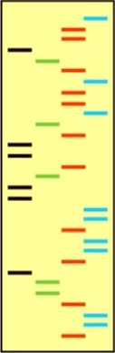
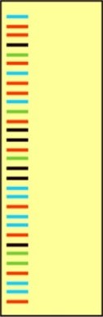
GAT C
G A T C
Here's what the products would look like in separate gel lanes.
Here's what the products
would look like in
a single gel lanes

Slide 30
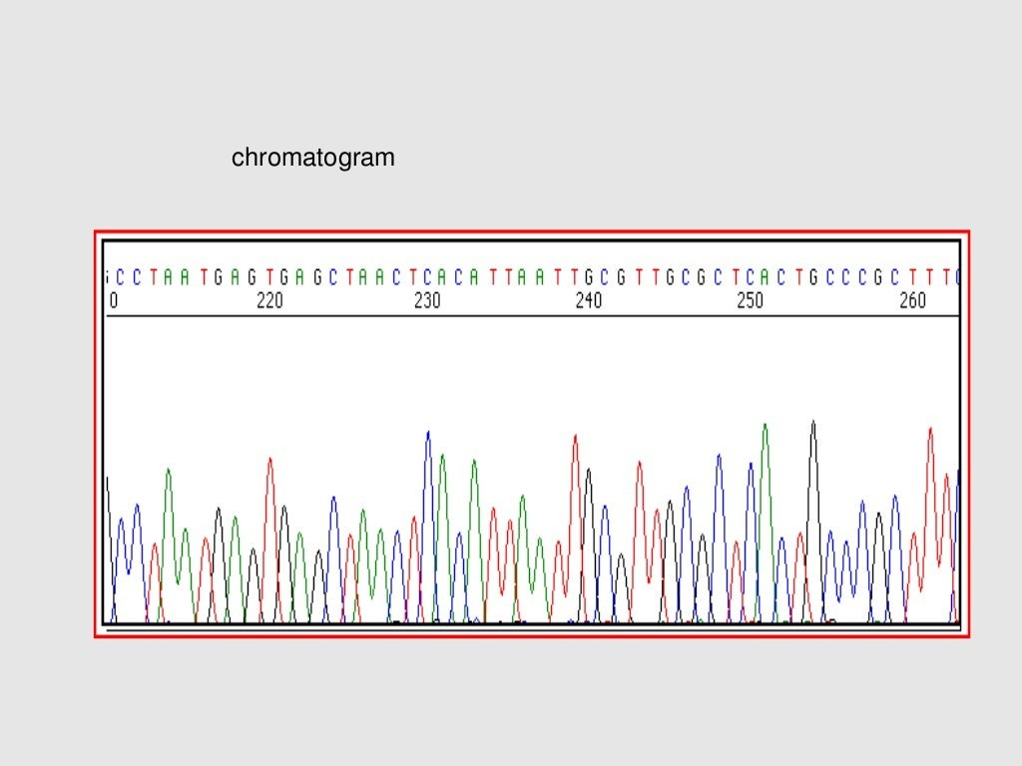

Slide 31
Capillary electrophoresis
Swerdlow e at., 1990
Capillaries ce small, a 50pm inner diameter - &ssipate heat rery efficiently. Can be run with much higher voltages thus lowenng ie run times.
Load the sequencing reaction into the capillary, apply a constant electrical current through the capillary, and have ie resolved 8agments migrate past an optical widow.
A laser would excite the dye terminator, a detector would collect the fluorescence e%ssion wavelengths, and software would interpret the e%ssion wavelengths as nucleotides.

Slide 32
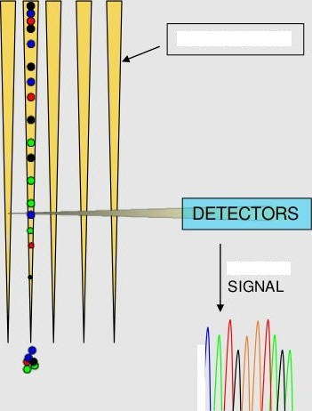

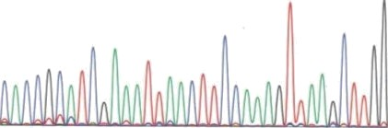
Automated DNA sequencer
ddA_{O} ddT
ddC
ddNTPs — each with a different fluorescent label
Sequencing reactions. fracrionarion of products
CAPILLARIES
ddT
ddA_{O}
ddA_{O}
ddG_{O}
ddC
Imaging system
—
De‹eccor
—ddC _{O}
ddG
Fluorescent bands move past the dezecror
OUTPUT
C A C CG C A T CGA A A T T A C T T/ ¢ A A AG T T AA GC T TGG
T0
20
30

Slide 33
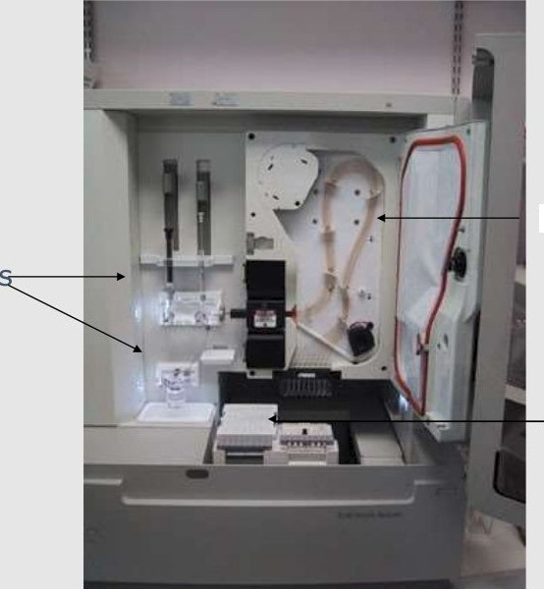
Reagent
Capil Mary tubes
Sample tray
goes here
Inside the sequencer

Slide 34
Pyrosequencing
Based on the “sequencing by synthesis”
Involves taking a single strand of the DNA to be sequenced and then synthesizing its complementary strand enzymatically.
solutions of A, C, G, and T nucleotides are added and removed after the reaction, sequentially.
Inorganic PPi is released as a result of nucleotide incorporation by polymerase.
The released PPi is subsequently converted to ATP by ATP sulfurylase, which provides the energy to luciferase to oxidize luciferin and generate light.
Light is produced only when the nucleotide solution complements the first unpaired base of the template.
Because the added nucleotide is known, the sequence of the template can be determined.

Slide 35
Pyrosequne-ing
ACCTT AGTA
AGGA--- --
^{F}ATCCT--- -—-—

Slide 36


Sequencing
DNA ligase is an enzyme that joins together ends of DNA molecules.
Sequencing by hgation relies upon the sensitivity of DNA
ligase for base-pairing %smatches.
Oligonucleotides ce annealed and liga>d; the preferential Lgation by DNA ligase for matching sequences results in a signal ñiformative of the nucleotide at that position.

Slide 37
Anchor
Ccnomi c D N A

Slide 38


Sequencing
It is a non-enzymatic method that uses a DNA microarray.
A single pool of DNA whose sequence is to be determined is fluorescently labeled and hybndized to an array conta%ng known sequences.
Saong hybridization signals from a given spot on ie array identifies its sequence in the DNA be¥g sequenced.

Slide 39
Next generation sequencing
method»
Mass Spectrophotometric Sequences.
Direct VisuaLzation of Single DNA Molecules byAto%c force Microscopy (AFNt
Single Molecule Sequencing Techniques
Single nucleotide Cutting
Readout of Cellul Gene Expression
Use of DNA chips or micro arrays
Nano sequencing

Slide 40
Some commercial sequencers
Rochel454F1,Xpyrosequencer pyrosequencing
Illumina genome analyzer — sequencing by synthesis
Applied biosystems SOLiD sequencer — sequencing by ligation.
Helicos Heliscope
Pacific Biosciences SMRT — zeromode waveguide

Slide 41


