Slide 1


ENOME
ALTERATION

Slide 2






MUYAYION
Mutations material; sequence
are chan es changes in the
DNA.
enetic nucleotide
In gene mutations, the DNA code will have a base more) missin added, exchan ed in a codon.

Slide 3



MUYAYION
may involve large sections chromosomes single base pairs
Mutations can change the readi frame a gene transcript.

Slide 4


How common are mutations?
M. utations occurs at a frequency o/ about
in every 1 billion base pairs.
Mutations happen regularly
Almost all mutations are neutral
Chemicals radiation cause
mutations
Many mutations are repaired enzymes

Slide 5




Manifestations mutation
Mutations are not always seen. The aNected gene may still function.
Mutations may be harmful.
Mutations may be beneficial.
Mutations may have no effect on the
organism.

Slide 6




How do mutations affect the ulation?
Mutations are a ma
source population
them to
enetic variation in a increasi biodiversity.
Some variations may hel rvive better.

Slide 7






How are mutations inherited?
mutations in gametes are assed
offspri
Mutations in somatic cel
the organism in which they occur and are assed offspring.

Slide 8
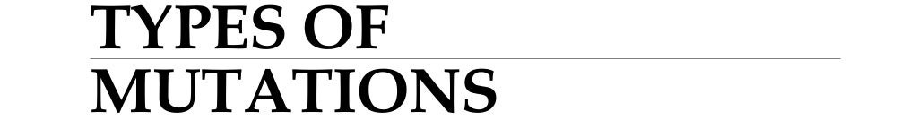

Slide 9
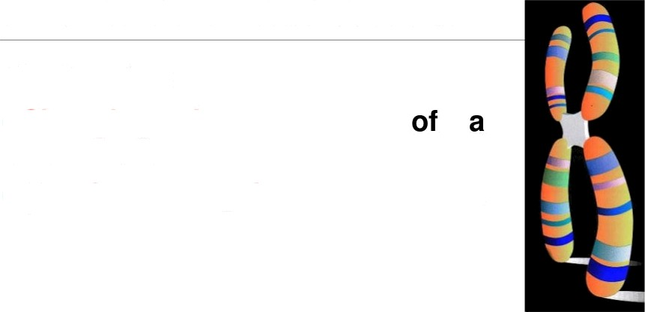
CHROMOSOME MUTATIONS
May Involve:
Changing the structure chromosome
The loss or gain of part of a chromosome

Slide 10
Chromosome Mutations
Five types exist:
Deletion
Inversion
Translocation
Nondisjunction
s. Duplication

Slide 11

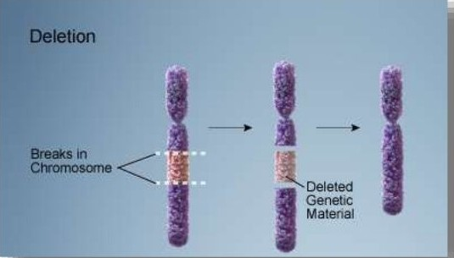
Deleúon
Due to breakage
A piece
chromosome is lost

Slide 12

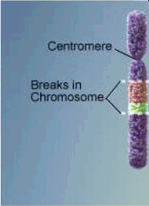
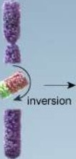
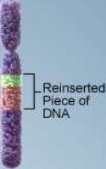
Inversion
Chromosome segment breaks off
Segment flips around backwards
Segment reattaches

Slide 13
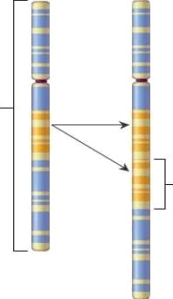
Duplication
Duplication mutation
Chromosome
A section of DNA
Occurs when a gene sequence is repeated.

Slide 14

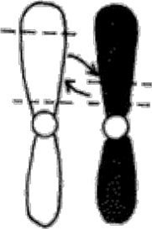

Yranslocation
Before
Translocation
After
Translocation
involves two chromosomes
that
aren’t homologous
Part of one chromosome is
transferred to another chromosomes
A
B A
Chromosomes
B

Slide 15
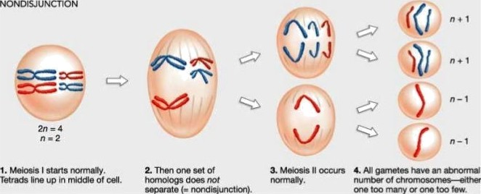
Nondisjunction
Failure
of
chromosomes to separate during meiosis
Causes gamete to have too many or too few chromosomes

Slide 16
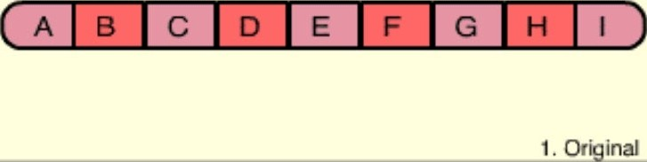
Chromosome Mutation Animation

Slide 17



GENE MUTATIONS
Change in the nucleotide sequence a gene
May involve a si nucleotide
May be due copyi errors, chemicals, viruses, etc.

Slide 18


Types Gene Muta8ons
nt Mutation Substitution Insertion Deletion

Slide 19

POINT MUTATION
Occurs when the base sequence a codon is changed.
•There are types:
  Substitution
  Deletion
  Insertion

Slide 20
The frenetic Code is a triplet code
-Normal mRNA
AUGtACA!CAU;AACGGC;UUC GUA,UGG’u a u,cxA
M e I T h r H i s A s n G I y P h e V a I Tr p C y s G I u
Amino acids
+ mutations
mRNA
UC G UA!U G G:UGU!GAA
Phe Val Trp Cys Glu
Amino acids M e t
Incorrect amino acids in polypeptide

Slide 21
Substitution Mutations
A single nitrogen base is substituted for another in a codon.
It may or may not ahect the amino acid or protein.
Normal DNA: CPA TGC ATC
Alanine - Threonine - stop
Mutated DNA: AGA TGL
Alanine - Threonine - Lysine

Slide 22


Mutations: Substitutions
Substitution mutation GGTCACCTCACGCCA
Normal gene GGTCTCCTCACGCCA
CCAGAGGAGUGCGGU
CCAGUGGA
Pro-GIu-GIu-Cys-GIy
Amino acids
Substitutions will only affect a single codon
Pro-Arg-GIu-Cys-GIy
Their effects may not be serious unless they affect an amino acid that is essential for the structure and functiDFl Oh the finished protein mDIecuIe (e.g. sickle cell anaemia)
6 2 0 \ O Paul Billiet .' . .”.

Slide 23

No change
NOFmaI gene GGTCTCCTCACGCCA
CCAGAGGAGUGCGOU
Pro-GIu-GIu-Cys-GIy
Amino acids
substitution mutation GGTCTTCTCACGCCA
GGAGAAGAGUGCGGU
Pro-GIu-GIu-Cys-GIy

Slide 24

Disaster
NOrmal gene GGTCTCCTCACGCCA
Substitution mutation GGTCTCCTCACTCCA
CGAGAAGAGUGAGGU
Pro-GIu-GIu-STOP
Pro-GIu-GIu-Cys-GIy
Ainino acids
20 \ O P auI Billiet .' .

Slide 25
Insertion Mutations
A nitrogen base is inserted/added to the sequence.
It causes the triplet “frames” to shit.
It always affects the amino acids and,
consequently, the protein.
Normal DNA: CPA TGC ATC
Alanine - Threonine - stop
Mutated DNA: AGA TAG CAT — C
Alanine Leucine - Valine

Slide 26

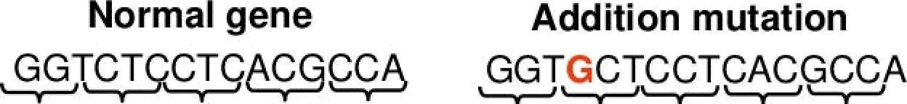
utations: Additions
A fr hif
CCAGAGGAGUGCGGU
Co0ons
CCACGAGGAGUGCGGU
Pro-GIu-GIu-Cys-GIy
AmiI)O Acids
Pro-Arg-GIy-Val-Arg

Slide 27
Deletion Mutations
A nitrogen base is deleted/removed
from the
sequence.
it causes the triplet “frames” to shift.
it always affects the amino acids andf
protein.
onsequent y the
Normal DNA: CPA TGC ATC
Alanine - Threonine - stop
Mutated DNA: AGA TCA TC
Alanine Serine

Slide 28

utations: Deletlons
A frame shift mutation
Normal gene GGTCTCCTCACGCCA
CCAGAGGAGUGCGGU
Codons
Pro-GIu-GIu-Cys-GIy
AMİI)O Acids
Deletion mutation GGTCïCCTCACGCCA
GGAGGGAGUGGGGU
Pro-GIy-Ser-AIa-Val

Slide 29






fci no neat line
T A C T T C A A A C C g C G Y
‹nRNA
Polypepti‹te
Meta
Phe
Gly
AJa
Tbl Bace deletion
A
T A C T T C A A C C G C G T A
T A C T
T C A A A C G C G T
Leu - Ala
His

Slide 30

Mutations
Substitution has the least effect because it changes only one amino acid or it may change no amino acid.
Deletion or insertion mutations are most disruptive because they change the reading frame, causing a frame shift.

Slide 31
Size of a genetic
code word (codon)
Original sequence
One base added Sequence disrupted
Two bases added
Sequence disrupted
Three bases added Sequence restored
GAC GAC GAC | GAC | GAC | GAC | GAC | ...
GAC U
GAC UUU GAC | GAC | GAC | GAC | GAC | ...
Wron9 triplet

Slide 32
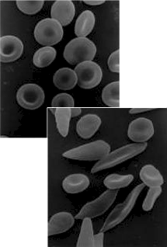

Gene Mutation
example of a
substitution
mutation is sickle cell anemia.
one amino acid changes in
the hemoglobin.
The hemoglobin still functions but it folds differently changing the shape of the RBC.

Slide 33
Mutation
o obin
MCA
Normal He
Sickle Cell He o obin
DNA GGA CA
mRNA CCU GAA CPU
GGA CAT MCA
CCU IUA CPU
PRO VAL ARG
A.A. PRO GLU ARG

Slide 34
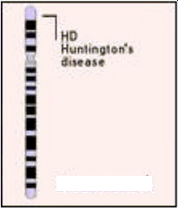

Gene Mutation
Huntington's Disease is caused
an insenion mutation.
People with this disorder have involuntary movement and loss of motor control. They eventually have memory loss and dementia.
The disease is terminal.
Huntington Disease LDcated
on chromosome 4
First Gene Disease Mapped

Slide 35
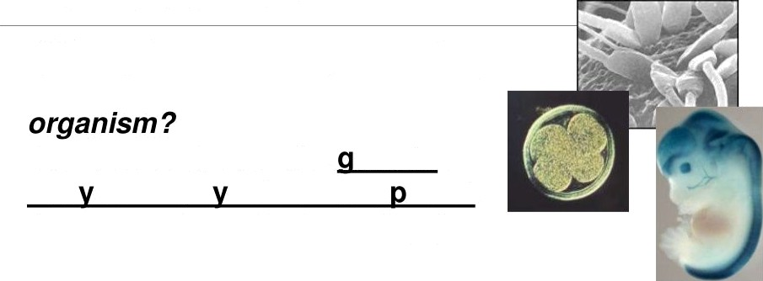
Gene Mutation
When does a gene mutation
have the greatest affect on an
When it occurs in the amete or earl in embr onic develo ment (in stem cells or first few days).

Slide 36

at causes Mutations?
Errors in DNA Replication
Errors in chromosome crossover in meiosis
Mutagens

Slide 37
Mutagens
Physical or chemical factors that causes the DNA code to change
(mutate);
May increase mutation rate.
  UV Radiation and X-Rays
  Chemicals like DDT
A variety of chemicals act as mutagens. E.g.
Bromouracil, are structurally similar to DNA bases, and are inserted in place of normal bases.
Ethidium bromide has a structure that allows it to wedge within the DNA double helix
Peroxides and mustard gas, chemically modify DNA.

Slide 38
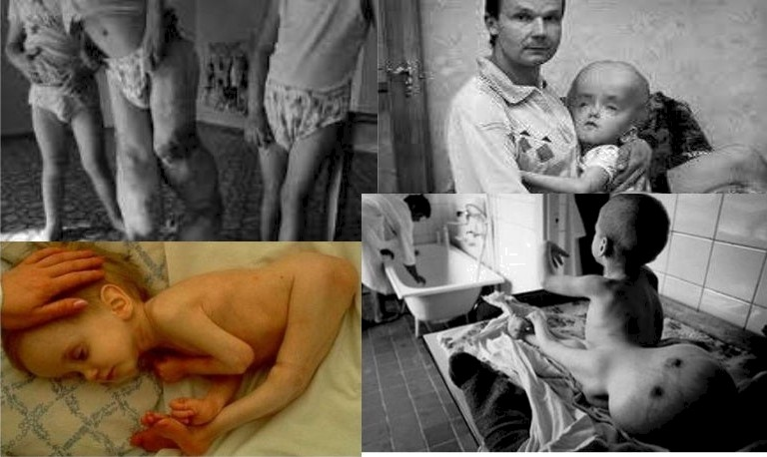
The Chernobyl Babies Radiation causes
birth defects

Slide 39
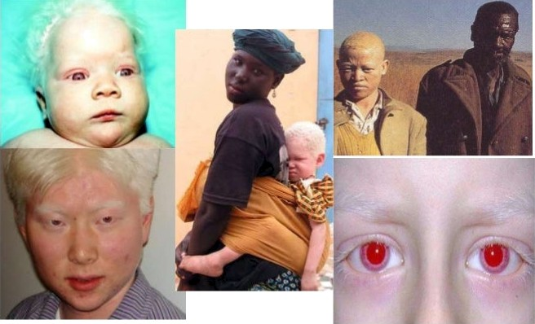
Albinism
Albinism results from a mutation which prevents the formation of enzyme 3 (Melanocyte tyrosinase).
As a result albinos fail to synthesize melanin.

