Slide 1
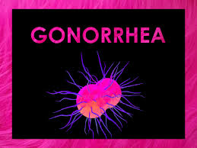
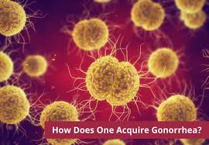
Gonorrhoea
Infection Disease
By Animesh Das

Slide 2
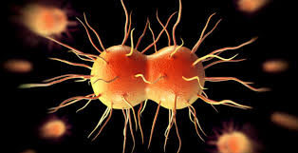
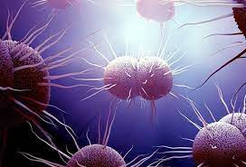
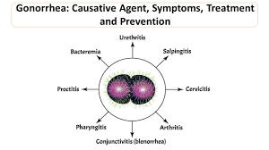
Definition
Gonorrhoea is the sexually transmitted bacterial infection causse by y- bacteria Neisseria gonorrhoeae cause urogenital ,anorectal , conjunctival and peripheral infection , in case there are urinary tract disorder is the common type disorder .
Causative organism -- Neisseria gonorrhoeae [ y-Bacteria ]

Slide 3
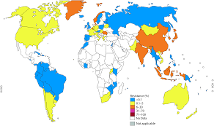
Epidemiology
it is the second most frequently raptured bacterial sexually transmitted infection after chlamydia trachomatous .
It can grow easily in the warm , moist areas of the reproductive .
Highly increase in cold country .
Gonorrhoea zone – USA , Russia , Europe , UK .

Slide 4
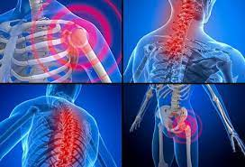
Affected Organ And Tissues
Cervix .
urethra
rectum
pharynx
conjunctivitis
vaginal epithelium

Slide 5
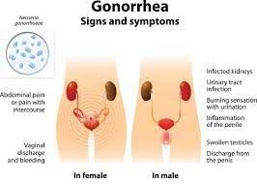
Sings and symptoms
Rectal discharge
Thermal infection
Endocervical infection
Pharyngeal infection

Slide 6
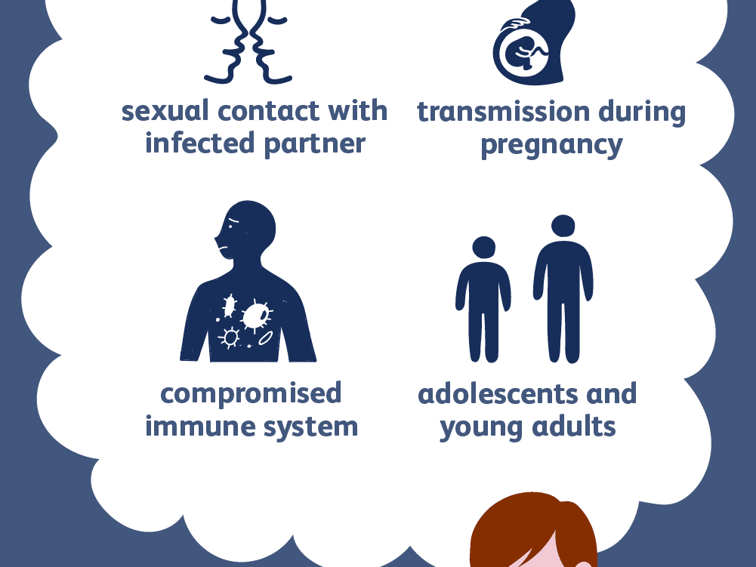
Risk Factor
Multiple / new sex partner .
Inconsistent condom use .
Urban residence .
Adolescents .
Lower socio – economic status
Drug affect
Exchange of sex for drug .

Slide 7

Mode of Transmission
Incubation period – 1 to 14 Days
Several contact with infected person .
Infected blood transfusion .
Moderno – facial transmission .
Oral sex .
Very close physical contact .
From mother to baby at birth .
touching parts of the with fingers .

Slide 8
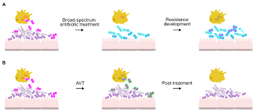
Pathogenesis
There are 4 step of gonorrhoea microorganism to attack host cell
Adherence
2. Invasion
3. Tissue Damage
4. Dismission

Slide 9
Pathogenesis
Adherence
Gonococci bacteria attack through OPA , PILI entry into the urinary track
Attack mucosal cell or mucosal plasma protein

Slide 10
Pathogenesis
Invasion
After attack or damage mucosal cell wall then it will damage Epithelial call wall with the Pinocytosed process
After attacking Epidermal cell wall it will release end cytotoxic hormone and movement ciliary which present in Epidermal cell wall

Slide 11


Tissue damage
In this stage bacteria damage Epidermal cell and this cause neutrophiles produce some toxic effect and there present tissue will damage
Damage tissue

Slide 12

Dissemination
In this final stage gonococci bacteria having ability to destroy antibody which produce notaphilies
Person or patient will death

Slide 13
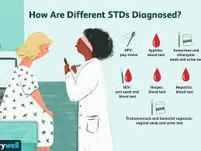
Management
Diagnosis
Treatment
Diagnosis
yam stained smear
ELISA
DNA probe techniques
nucleic acid amplification technique .
urine test
Swab of affected area .

Slide 14
Treatment
Category | Drug Name
Uncomplication infection | Ceftriaxone , offoxaime
Gonococcal infections | Ceftriaxone , Cefixime
Disseminated gonococcal | ceftriaxone
infect born to mother with gonococcal | Erythromycin , Tetracycline
Gonococcal conjunctivitis | Ceftriaxone
Ophthalmia neonatorum | Ceftriaxone

Slide 15
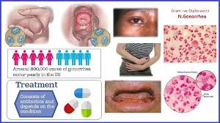
Complication
balanoposthitis
phimosis
paraphimosis
thysonitis
periurethral abscess
Littritis
Cowperitis
Prostatitis
Vesiculates
Epididymitis
cystitis

Slide 16
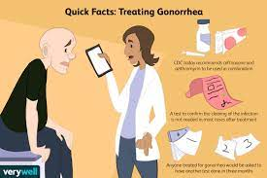
Prevention
Uses condoms with water based cebricants .
Uses dental doms for oral sex .
Just have sex with one partner .
Having regular STD check-ups .
Practice Safar intercourse .
Lining condition should be improve .
Impart heath educations .
Complete treatment should be taken .

Slide 17
Thank
you

