Slide 1
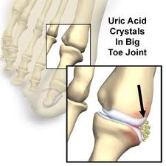
GOUT
Presented by;

Slide 2
Gout
Defination:
Gout is a heterogenous group of disease in which a defect in uric acid metabolism causes an excess of acid & its salts to accumulate in blood stream & joints.
It results in – acute gouty arthritis
- chronic destruction of joints
- deposition of urates (tophi) in skin & cartilage
- renal calculi.
Types:
¤ primary gout :-
In born error of metabolism-causes increased synthesis of purine nucleotides
eg; - PRPP synthetase & PRPP glutamylamido transferase
- HGPRT deficiency(Lesch-Nyhan syndrome)
- G6pd deficiency
- Elevation of glutathione reductase
¤ secondary gout:-
Diseases causing increased synthesis/decreases excretion of UA
eg; cancer, psoriasis & increased tissue break down (trauma)

Slide 3
¤ Epidemiology:
¤ Aetiology:
- Metabolic disorders of purine metabolism
- Development of gout is related to degree & duration of elevated uric acid
- concentration of urate in synovial fluide correlates closly with serum levels
- over production of uric acid (>4400µmol/24hrs) due to rare enzyme mutation (LNS) & diet
2/3rd of formed UA excreted by kidneys & 1/3rd is via git
- underexcretion of uric acid (<1500µmol/24hrs) occurs in 75% of patients with primary gout
Peak age(yrs) | M:40-50 ; F:>60
Sex distribution(M:F) | 2-7:1
Prevalence rate(/1000) | M:5-28; F:1-6
Annual incidence(/1000) | M:1-3; F:0.2
Geography | World wide (environmental & racial predisposition)
Genetic association | Inherited enzyme abnormalities Inherited urate excretion
Environmental association | Diet,drugs,toxins(lead)

Slide 4
- UA is filtered at glomerulus & complet rebsortion in proximal tubule then 50%is secreted distal to the proximal reabsorption site app 75% this secreted urate is reabsorbed. In case of hyperuricaemia , large loads are filtered.
clinical manifestations:
The natural h/o gout has 5 stages;-
• asymtomatic hyperuricaemia (10times more common then gout)
• acute gouty arthrities
• chronic gout
• chronic tophaceous gout: aggregation of urate crystals affecting monoarticular, periarticular & non-articular cart ilage (ears).
• gouty nephropathy (ARF/kidney stone formation)
• acute gouty arthritis
-monoarticular with only one joint affected in 90% of accute attacks & great toe is most frequently affected
- sever pain with hot, red, swollen & extremly tender joints
- wt of bed cloths/jar of the person walking on the floor is said to be agony to the pt
- effected joint has over lying erythema & signs of marked synovities
- leukocytosis & elevated ESR

Slide 5
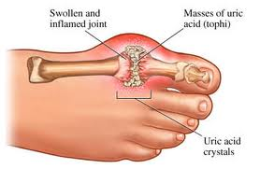
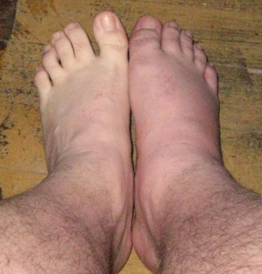
Acute gouty arthritis

Slide 6
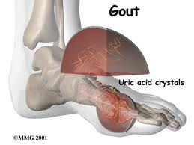
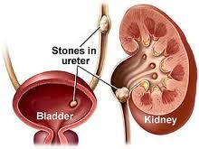
•Chronic tophaceous goute
- deposits of monosodium urate crystals, typically in sub-cutanious & peri-articular . region
- it is associated with presence of tophi & renal disease
•Gouty nephropathy (chronic interstitial nephritis)
- occurs typically in pts who have had hyperuricaemia for many years
- associated with hyper excretion of urate & urine hyper acidity
- crystals deposits around the renal tubules & incite inflammation
finally renal impairment occurs & formation of renal calculi

Slide 7
Events provoking acute gouty arthritis
•Trauma
•Unusual physical exercise
•Surgery
•Severe systemic illness
•Severe dieting
•Dietary excess
•Alcohol
•Drugs:
Diuretics
Initiation of uricosuric / allopurinol therapy
Initiation of B12 in pernitious anaemia
Following drug allergy
Cytotoxic drug therapy

Slide 8
Treatment
- Gout is often associated with obesity, hyper triglyceridaemia, hypertension & high alcohol intake. Also elderly women , taking diuretics has been recognised
stages of treatment:
- trtng acute attack
- prevent deposition of urate crystals into tissues ( joints)
- prophylactic treatment with hypouriceamic therapy
Treatment goals in the management of gout
Relieve pain & inflammation | Prevent joint damage
Terminate acute attack | Reduce the risk of uric acid calculi
Prevent exacerbation of further attacks | Prevent organ damage, Eg ; renal involvement
Reduce serum urate levels in symptomatic pts | Reduce the formation of tophi

Slide 9
Treatment of acute gout
→Confirm diagnosis
→ If 1 or 2 joints affected , consider intra-articular steroids
→ Initial treatment with full –dose NSAIDs ,early in the attack unless contra indicated
→ If severe attack or NSAIDs /colchicine are not tolerated, consider syst steroids
→ Consider oral colchicine if NSAIDs not appropriate. Use with in 24-48 h of acute attack
(use colchicine cautiously)
→ Do not treate hyperuricaemia in an acute attack
→eg:NSAIDs, COX-2 inhibitors, colchicine, & steroids
Treatment of chronic gout
→ Start urate-lowering drugs in pts who have two or more attacks per year
→ Consider concomitant colchicine until serum urate levels have been lowered & no acute attacks have recurred(6-12months)
→ Urate-lowering drugs should not be started during on acute attack
→ Monitor serum urate levels every 3-6 months & adjust therapy according to level in symptomatic pts
→ Allopurinol is a urate-lowering drug of choise in majority of pts
→ Use uricosuric drugs in pts allergic or intolerants to allopurinol & in under excreters with normal renal function
→eg:uricosurics-probenecid, sulfinepyrazone; synthesis inhibitor-allopurinol

Slide 10
Prophylactic treatment of asymptomatic hyperuricaemia
•Unnecessory to control hyperuricaemia with urate-lowering drugs
• Obese pts (BMI:>28kg/m2) should loss weight gradually & their BP & renal function should be monitored annually
Drug-induced gout
•Hyperuriceamia & gout occur with diuretics , especially thiazides→ allopurinol ( control urate levels)
• Other drugs that reduce renal urate excretion- Low dose aspirin & alcohol
•Cyclosporin- induced hyperuricaemia & gout
•Omeprazol produces acute gout
•Other drugs interfere with renal excretion of uric acid →ethambutol, pyrazinamide, nyacin & didanosine
•Radiotherapy & chemotherampy in pts with neoplastic disorder can cause hyperuricaemia

Slide 11
Patient care
→Advised about factors that contribute to hyperuricaemia ( fasting, obesity & alcohol excess)
If this are corrected- treatment may not required
→Asymptomatic hyperuricaemia need not be treated( check renal function)
→Patients at risk of recurrent gouty attack s should receive a supply of NSAIDs.They must be informed to start treatments at the first signs of an attack
→ Patients treated with allopurinol should understand the need to continue single daily treatment in the absence of any symptoms & must be warned of potential side effects & ask to report any adverse skin reactions.
→Need to maintain a good fluid intake to reduce the risk of renal calculi (uricosuric agents)

Slide 12
Algorithm for management of gout
Do not treat
Check renal function
Advise on weight reduction
Advise on alcohol consumption reduction
1st choice
Indomethacin high dose Intra-articular,oral or Low doses . Avoid in
Caution in the elderly, those Parentral preferred in renal insufficiency
with renal impairment, patients with co-morbidity
hypertension & peptic problems, caution in
ulceration diabetics
Asymptomatic hyperuricaemia
Acute attack of gouty arthritis
NSAIDs
Steroids
Colchicine

Slide 13
1st choice
Low doses. Caution in Low doses. Caution in
renal disease & peptic renal in sufficiency
Ulcer disease
1st choice
For recurrent attacks or Seldom effective in older
Tophaceous gout. Reduce patients due to renal disease
Dose based on creatinine clearance
Short-term prophylaxis
NSAIDs
Colchicine
Long-term hypouriceamic therapy
Allopurinol
Uricosuric agents

Slide 14
Common therapuetic problems in the treatment of gout
¤ Treatment of acute attacks & short Long-term prophylaxis:
→ Elderly patients
→ Patient with renal failure
→ Patients with heart failure
→ Patients with h/o Git problems
¤ Long-term prophylaxis:
→ Elderly patients
→ Patient with renal failure
→ Recurrent attacks

Slide 15
Thanking you

