Slide 1
PHARMACOTHERAPEUTICS-III
HEADACHE
9/16/2024
1

Slide 2

PAIN SENSITIVE STRUCTURE IN HEAD
Extra-cranial pain sensitive structures:
  Sinuses
  Eyes/orbits
  Ears
  Teeth
  TMJ
  Blood vessels
  5,7,9,10 cranial nerves carry pain from this structure
Intra-cranial pain sensitive structures:
  Arteries of circle oaf willis and proximal dural arteries,
  Dural Venous sinuses,
veins
  Meninges
  Dura

Slide 3
CLASSIFICATION OF HEADACHE
SECONDARY – structural or metabolic abnormality:
  Extracranial: sinusitis, otitis media, glaucoma, TMJ ds
  Inracranial: SAH, vasculitis, dissection, central vein thrombosis, tumor, abscess, meningitis
  Metabolic disorders: CO2 retention, CO poisoning
PRIMARY - NO structural or metabolic abnormality:
  Tension
  Migraine
  Cluster

Slide 4
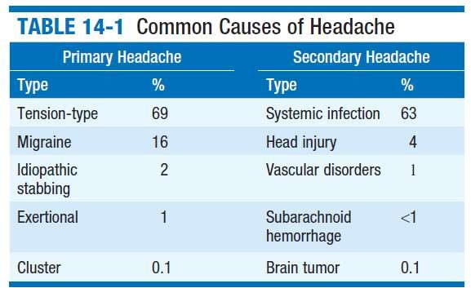

Slide 5
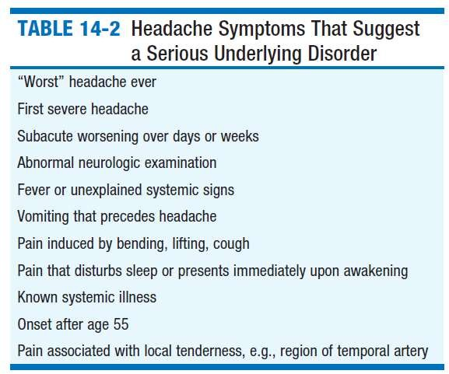

Slide 6
CLASSIFICATION OF PRIMARY HEADACHE
1. Migraine
2. Tension-type headache
3. Trigeminal autonomic cephalalgias
4. Other primary headache disorders

Slide 7
MIGRAINE
ICHD 3 CLASSIFICATION
  Migraine without aura
  Migraine with aura
    Migraine with typical aura
      Typical aura with headache
      Typical aura without headache
    Migraine with brainstem aura
    Hemiplegic migraine
      Familial hemiplegic migraine (FHM)
        Familial hemiplegic migraine type 1
        Familial hemiplegic migraine type 2
        Familial hemiplegic migraine type 3
        Familial hemiplegic migraine, other loci
      Sporadic hemiplegic migraine
    Retinal migraine
  Chronic migraine

Slide 8
1.4 Complications of migraine
    Status migrainosus
    Persistent aura without infarction
    Migrainous infarction
    Migraine aura-triggered seizure
1.5 Probable migraine
    Probable migraine without aura
    Probable migraine with aura
1.6 Episodic syndromes that may be associated with migraine
    Recurrent gastrointestinal disturbance
      Cyclical vomiting syndrome
      Abdominal migraine
    Benign paroxysmal vertigo
    Benign paroxysmal torticollis

Slide 9
PATHOPHYSIOLOGY
Theories on the pathogenesis of migraine include:
The vascular theory
The cortical spreading depression theory
The neurovascular hypothesis
The serotonergic abnormalities hypothesis
The integrated hypothesis.

Slide 10
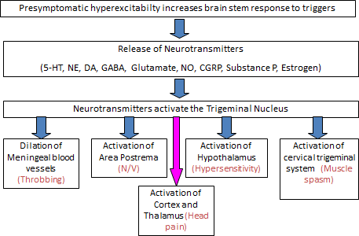

Slide 11
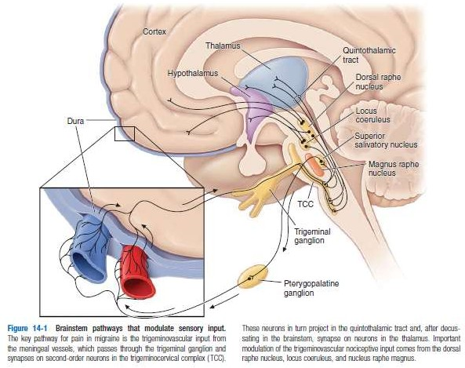

Slide 12
EPIDEMOLOGY
Migraine affects 10-15% of general population, F>M
Migraine accounts for 10-20% of all headaches in adults
1% chronic migraine (>15 days/months)
Mean frequency 1.2/month
Mean duration 24 h (untreated)
10% always with aura, >30% sometimes with aura
Usual age at onset is 15-35 years
Family History:
-70% of patients have relatives with Headache

Slide 13
MIGRAINE TRIGGERS
 Stress
 Foods containing
Emotion-(anger, anticipation, anxiety, depression, emotional letdown, exhilaration/excitement, frustration, stress)
Sex
Glare-flickering lights/light glare
Hypoglycemia
Altered Sleep Pattern- fatigue/sleep deprivation or excessive sleep
Menses
Physical exertion
Alcohol
Smoking
Excess caffeine /withdrawal
Odors (perfume, exhaust fumes, paint, solvents)
tyramine
nitrates
phenyl ethylamine
Aspartame
chocolate
Drugs
  Estrogen (e.g.. OCP)
  Nitroglycerin
  Excess analgesic use or withdrawal
  (cocaine, cimetidine,
estrogens, theophylline)

Slide 14
MIGRAINE WITHOUT AURA
Previously used terms:
Common migraine; hemicrania simplex. Description:
Recurrent headache disorder manifesting in attacks
Lasting 4-72 hours.
Typical characteristics of the headache are unilateral location, pulsating quality, moderate or severe intensity, aggravation by routine physical activity and association with nausea and/or photophobia and phonophobia

Slide 15
DIAGNOSTIC CRITERIA
A. At least five attacks fulfilling criteria B–D
B. Headache attacks lasting 4-72 hours (untreated or unsuccessfully
treated)
C. Headache has at least two of the following four characteristics:
  unilateral location
  pulsating quality
  moderate or severe pain intensity
  aggravation by or causing avoidance of routine physical
activity (e.g. walking or climbing stairs)
D. During headache at least one of the following:
  nausea and/or vomiting
  photophobia and phonophobia
E. Not better accounted for by another ICHD-3 diagnosis.

Slide 16
MIGRAINE WITH AURA
Previously used terms:
Classic or classical migraine; complicated migraine. Description:
Recurrent attacks, lasting minutes, of unilateral fully reversible visual, sensory or other central nervous system symptoms that usually develop gradually and are usually followed by headache and associated migraine symptoms.

Slide 17
DIAGNOSTIC CRITERIA
A. At least two attacks fulfilling criteria B and C
B. One or more of the following fully reversible aura symptoms:
  visual
  sensory
  speech and/or language
  motor
  brainstem
  retinal
C. At least two of the following four characteristics:
  at least one aura symptom spreads gradually over 5 minutes, and/or two or more symptoms occur in succession
  each individual aura symptom lasts 5-60minutes
  at least one aura symptom is unilateral
  aura is accompanied, or followed within 60 minutes, by headache
D. Not better accounted for by another ICHD-3 diagnosis, and transient ischemic attack has been excluded.

Slide 18
Aura is complex of neurological symptoms that occurs usually before the headache of but it may begin after the pain phase has commenced, or continue into the headache phase.
Visual aura is the most common type of aura, occurring in over 90% of patients.
It often presents as fortification spectrum
Is risk factor for ischemic stroke
Patent foramen ovale in patients with migraine with aura
4 Phases:
– Prodrome, Aura, Headache and Resolution/postdrome

Slide 19
MIGRAINE WITH BRAINSTEM AURA
Diagnostic criteria:
A. At least two attacks fulfilling criteria B-D
B. Aura consisting of visual, sensory and/or speech/ language symptoms, each fully reversible, but no motor or retinal symptoms
C. At least two of the following brainstem symptoms:
  dysarthria
  vertigo
  tinnitus
  hypacusis
  diplopia
  ataxia
  decreased level of consciousness

Slide 20
D. At least two of the following four characteristics:
  at least one aura symptom spreads gradually over 5 minutes, and/or two or more symptoms occur in succession
  each individual aura symptom lasts 5-60 minutes2
  at least one aura symptom is unilateral3
  aura is accompanied, or followed within 60 minutes, by headache
E. Not better accounted for by another ICHD-3 diagnosis, and
transient ischaemic attack has been excluded.

Slide 21
HEMIPLEGIC MIGRAINE
Diagnostic criteria:
A. At least two attacks fulfilling criteria B and C
B. Aura consisting of both of the following:
  fully reversible motor weakness
  fully reversible visual, sensory and/or speech/ language symptoms
C. At least two of the following four characteristics:
  at least one aura symptom spreads gradually over 5 minutes,
and/or two or more symptoms occur in succession
  each individual non-motor aura symptom lasts 5–60 minutes, and motor symptoms last <72 hours
  at least one aura symptom is unilateral
  the aura is accompanied, or followed within 60 minutes, by headache
D. Not better accounted for by another ICHD-3 diagnosis, and transient ischaemic attack and stroke have been excluded.

Slide 22
MIGRAINE IN WOMEN
Migraine 2-3x more common than in men
  Possibly some hormonal association
14% of women experience migraine associated with periods
  Usually during first 3 days
Risk of migraine increased 10x in women on OCP
  OCP increase frequency of migraines
  Almost half women experience improvement in migraine during pregnancy.
  Migraine frequency decreases in 2/3 women after menopause

Slide 23
CHILDHOOD MIGRAINE
Prevalence 5%
Sex ratio 1:1
Abdominal symptoms often predominant
Semiology of attacks as in adulthood except shorter duration of attacks
Children often respond to conservative management
Short sleep very effective

Slide 24
Severity levels:
Mild- Patient is aware of a headache but is able to continue daily routine with minimal alteration.
Moderate -headache inhibits daily activities but is not incapacitating.
Severe -headache is incapacitating.
Status - severe headache that has lasted more than 72 hours.

Slide 25
MANAGEMENT
Assess extent of a patient’s disease and disability- Migraine Disability Assessment Score (MIDAS)
NONPHARMACOLOGIC MANAGEMENT-
Identification and avoidance of specific headache triggers.
Healthful diet, regular exercise, regular sleep patterns, avoidance of excess caffeine and alcohol, and avoidance of acute changes in stress levels.

Slide 26
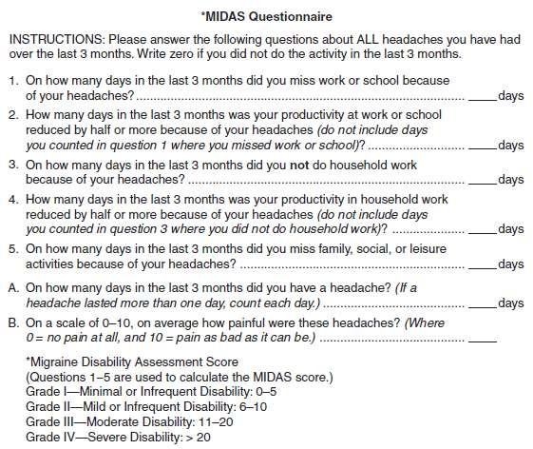

Slide 27
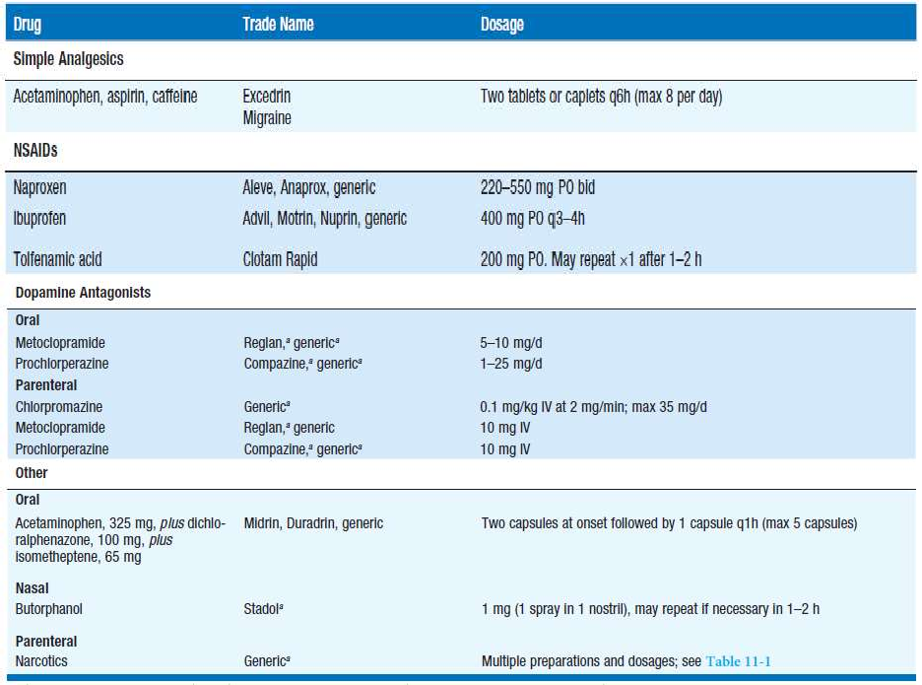
ACUTE ATTACK THERAPIES FOR MIGRAINE

Slide 28
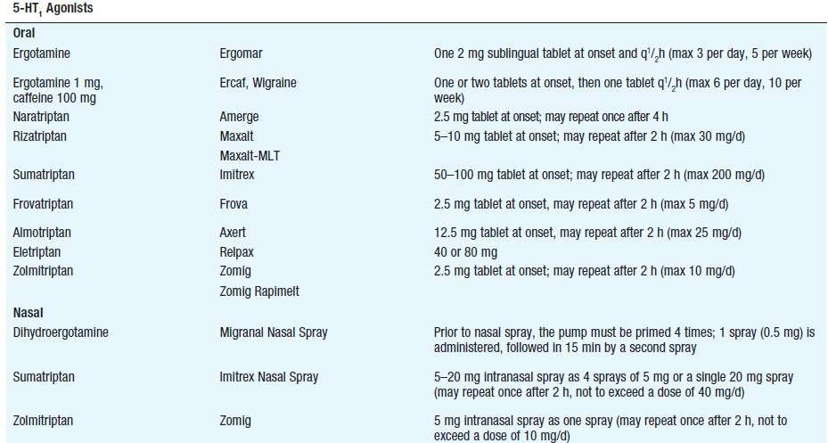

Slide 29
ANALGESICS
Useful in early stages or for mild-moderate migraine
Only if patient can tolerate oral medication
Aspirin 900 mg is recommended for acute treatment in patients with all severities of migraine.
Ibuprofen 400 mg is recommended for acute treatment in patients with migraine.
Other NSAIDs (tolfenamic acid, diclofenac, naproxen and flurbiprofen) can be used in treatment of acute migraine attacks.
Paracetamol 1,000 mg is recommended as acute treatment for mild to moderate migraine.

Slide 30
TRIPTANS
Proven efficacy
  Improvement in 70% in 1 hour, 85% in 2 hours
  Generally well tolerated
    Avoid with MAO-A inhibitors
    Avoid in pts with ischemic heart disease (IHD), angina, myocardial infarction (MI), uncontrolled hypertension (HT)
  Failure with one triptan does not preclude use of another
    Patients respond variably to different drugs
  Do not combine with ergot agents
  Adverse effects can include chest pressure, flushing, dizziness, drowsiness, and nausea.
Action - binds to serotonin 5-HT1B, 5-HT1D and 5-HT1F receptors in cranial blood vessels (causing their constriction) and subsequent inhibition of pro-inflammatory neuropeptide release (CGRP and substance P).

Slide 31
ERGOT ALKALOIDS
Serotonin (5HT1B/1D) receptor agonists
Ergotamin tartarate
2-4 mg per os, sublingual or rectal
1 mg nasal spray
Dihydrergotamin (DHE) (oral & parenteral, nasal spray)
Should not be used in patients with vascular disease, ischemic heart disease or hypertension
Used with caution in patients with vascular risk factors or prolonged or severe aura
Avoid ergotamine if triptan used in previous 6 hrs
Avoid triptan if ergotamine used in previous 24 hrs

Slide 32
Efficacy - 50-70 %
No longer first-line, superseeded by triptans
Side-effects:
  Ergotamine
    nausea, vomiting, drowsiness, fatigue
    ischaemia
    rebound headache (>3-4 doses per week)
  Dihydroergotamine
    less likely to cause rebound headache
    Low rate of headache recurrence (~17%) due to long duration of action
    does not prolong aura
  role of caffeine?
    the concurrent administration of caffeine improves both the rate and extent of absorption of ergotamine

Slide 33
ANTIEMETICS
Prevent and treat nausea
Improve GI motility
Enhance absorption of other anti-migraine medications
Promethazine
  Available PO, IM, PR
  Dose = 25-50 mg
  Blocks dopamine and histamine receptors
Prochlorperazine
  Available PO, IM, IV, PR
  Dose = 5-10 mg
  Blocks dopamine receptors

Slide 34
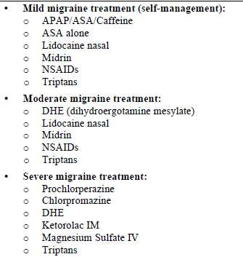
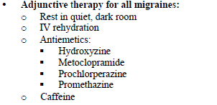

Slide 35
MIGRAINE PROPHYLAXIS
Preventive therapy may be more appropriately guided by one or more of the following circumstances:
  >2 attacks per week
  prolonged attacks (>48hrs)
  severe and disruptive (patient cannot function)
  Regular, predicted attacks (menstrual migraine)
  Patient preference or special circumstances
  Presence of uncommon migraine conditions, including hemiplegic migraine, basilar migraine, migraine with prolonged aura, and migrainous infarction

Slide 36
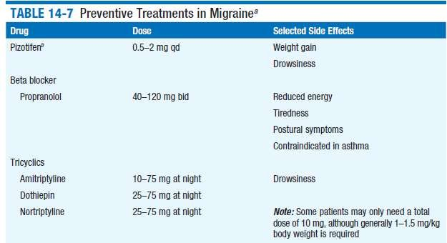
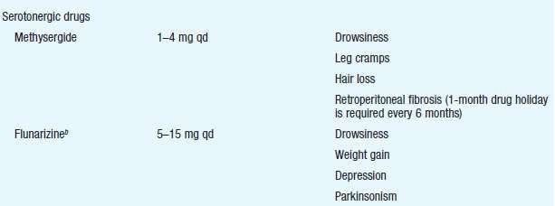

Slide 37
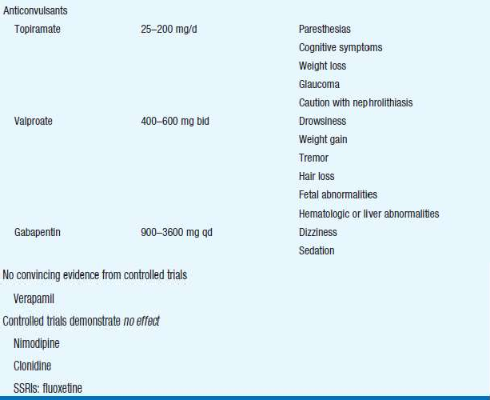

Slide 38
BOTOLINUM TOXIN A
Dose = 155-195 units injected into muscles of face, neck and head
Mecahnism of Action
  Blocks release of Substance P and CGRP
Inhibits peripheral signals to CNS and blocks central sensitization
Efficacy
  Botulinum Toxin superior to placebo in 2 large, double blind, randomized, controlled trials
  Botulinum Toxin similar to topiramate and amitriptyline in small, shorter duration studies
  Botulinum toxin = placebo for episodic migraine
Side effects = muscle weakness, injection site pain

Slide 39
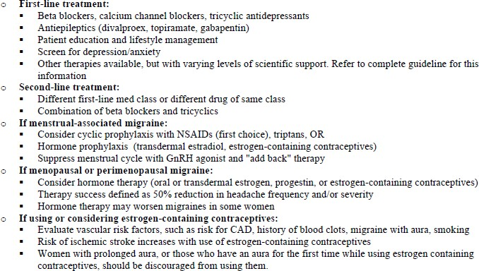

Slide 40
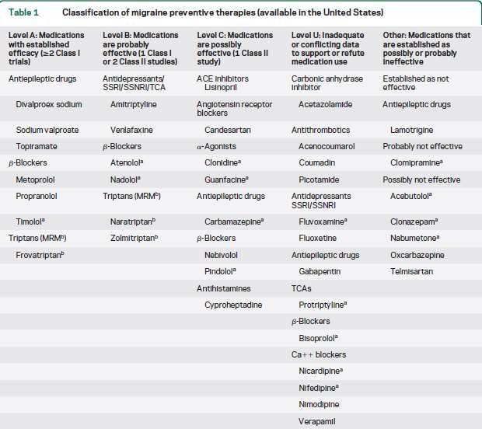

Slide 41
TENSION-TYPE HEADACHE
Tension-type headache (TTH) is chronic head-pain syndrome characterized by bilateral tight, bandlike discomfort.
Pain typically builds slowly, fluctuates in severity, and may persist more or less continuously for many days.
Headache may be episodic or chronic
Headaches are completely without accompanying features such as nausea, vomiting, photophobia, phonophobia, osmophobia, throbbing, and aggravation with movement.
Prevalence - 30% and 78%

Slide 42
ICHD 3 CLASSIFICATIONS
2.1 Infrequent episodic tension-type headache
2.2 Frequent episodic tension-type headache
2.3 Chronic tension-type headache
2.4 Probable tension-type headache

Slide 43
PATHOPHYSIOLOGY
Peripheral pain mechanisms are most likely to play a role in Infrequent episodic tension type headache and Frequent episodic tension-type headache.
Central pain mechanisms play more important role in Chronic tension-type headache.
Increased pericranial tenderness may be recorded by manual palpation.
Tenderness is typically present interictally, is further increased during actual headache and increases with intensity and frequency of headaches.

Slide 44
INFREQUENT EPISODIC TENSION-TYPE HEADACHE
Description:
Infrequent episodes of headache, typically bilateral, pressing or tightening in quality and of mild to moderate intensity, lasting minutes to days.
Pain does not worsen with routine physical activity and is not associated with nausea, but photophobia or phonophobia may be present.

Slide 45
DIAGNOSTIC CRITERIA:
A. At least 10 episodes of headache occurring on <1 day per month on average (<12 days per year) and fulfilling criteria B-D
B. Lasting from 30 minutes to 7 days
C. At least two of the following four characteristics:
  bilateral location
  pressing or tightening (non-pulsating) quality
  mild or moderate intensity
  not aggravated by routine physical activity such as walking or climbing stairs
D. Both of the following:
  no nausea or vomiting
  no more than one of photophobia or phonophobia
E. Not better accounted for by another ICHD-3 diagnosis

Slide 46
FREQUENT EPISODIC TENSION-TYPE HEADACHE
A. At least 10 episodes of headache occurring on 1-14 days per month on average for >3 months (12 and <180 days per year) and fulfilling criteria B-D
B. Lasting from 30 minutes to 7 days
C. At least two of the following four characteristics:
  bilateral location
  pressing or tightening (non-pulsating) quality
  mild or moderate intensity
  not aggravated by routine physical activity such as walking or climbing stairs
D. Both of the following:
  no nausea or vomiting
  no more than one of photophobia or phonophobia
E. Not better accounted for by another ICHD-3 diagnosis.

Slide 47
MANAGEMENT
Acute Treatment-
Simple analgesics such as acetaminophen, aspirin, or NSAIDs.
Behavioral approaches including relaxation can also be effective.
High risk of rebound headaches
Limit acute treatment to 2-3 days per week

Slide 48
PREVENTIVE TREATMENT (CHRONIC TTH)
more than 15 headaches/month
Non-Pharmacologic
Pharmacologic
TCAs
Proper sleep hygiene
Stress management
Acupuncture
Biofeedback
Physical therapy

Slide 49
TRIGEMINAL AUTONOMIC CEPHALALGIAS
TACs are characterized by relatively short lasting attacks of head pain associated with cranial autonomic symptoms, such as lacrimation, conjunctival injection, or nasal Congestion
Includes:
Cluster headache,
Paroxysmal hemicrania, and
SUNCT
Hemicrania continua
Probable trigeminal autonomic cephalalgia

Slide 50
CLUSTER HEADACHE
Diagnostic criteria:
A. At least five attacks fulfilling criteria B–D
B. Severe or very severe unilateral orbital, supraorbital and/or temporal pain lasting 15–180 minutes (when untreated)
C. Either or both of the following:
1. at least one of the following symptoms or signs, ipsilateral to headache:
  conjunctival injection and/or lacrimation
  nasal congestion and/or rhinorrhoea
  eyelid oedema
  forehead and facial sweating
  forehead and facial flushing
  sensation of fullness in the ear
  miosis and/or ptosis
2. a sense of restlessness or agitation
D. Attacks have a frequency between one every other day and eight per day for more than half of the time when the disorder is active
E. Not better accounted for by another ICHD-3 diagnosis.

Slide 51
ACUTE ATTACK TREATMENT
1. OXYGEN- 100% oxygen at 10–12 L/min for 15–20 min.
High flow and high oxygen content are important.
2. TRYPTAN- Sumatriptan 6 mg SC is rapid in onset and usually shorten attack to 10–15 min;
Sumatriptan (20 mg) and zolmitriptan (5 mg) nasal sprays are both effective in acute cluster headache.
3. DHE – IV provide prompt and effective relief

Slide 52
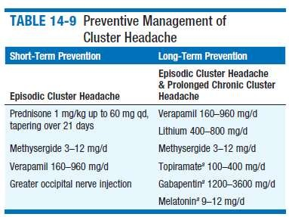
NEUROSTIMULATION THERAPY
NEUROSTIMULATION THERAPY-Deep-brain stimulation of the region of the posterior hypothalamic gray matter.
Less-invasive approach of occipital nerve stimulation

Slide 53
PAROXYSMAL HEMICRANIA
A. At least 20 attacks fulfilling criteria B-E
B. Severe unilateral orbital, supraorbital and/or temporal pain
lasting 2–30 minutes
C. At least one of the following symptoms or signs, ipsilateral to the pain:
  conjunctival injection and/or lacrimation
  nasal congestion and/or rhinorrhoea
  eyelid oedema
  forehead and facial sweating5. forehead and facial flushing
sensation of fullness in the ear
miosis and/or ptosis
D. Attacks have a frequency above five per day for more than half of
the time
E. Attacks are prevented absolutely by therapeutic doses of indomethacin
F. Not better accounted for by another ICHD-3 diagnosis.

Slide 54
Secondary PH-
Reported with lesions in the region of sella turcica, including arteriovenous malformation, cavernous sinus meningioma, and epidermoid tumor.
Secondary PH is more likely if the patient requires high doses (>200 mg/d) of indomethacin.
In patients with apparent bilateral PH, raised CSF pressure should be suspected.
When a diagnosis of PH is considered, MRI is indicated to exclude a pituitary lesion.
Occasionally PH can coexist with trigeminal neuralgia.

Slide 55
TREATMENT-
Indomethacin (25–75 mg tid), which can completely suppress attacks of PH, is the treatment of choice.
Others-Topiramate, Piroxicam

Slide 56
SUNCT/SUNA
Diagnostic criteria:
A. At least 20 attacks fulfilling criteria B–D
B. Moderate or severe unilateral head pain, with orbital, supraorbital, temporal and/or other trigeminal distribution, lasting for 1–600 seconds and occurring as single stabs, series of stabs or in a saw tooth pattern
C. At least one of the following cranial autonomic symptoms or signs, ipsilateral to the pain:
  conjunctival injection and/or lacrimation
  nasal congestion and/or rhinorrhoea
  eyelid oedema
  forehead and facial sweating
  forehead and facial flushing
  sensation of fullness in the ear
  miosis and/or ptosis
D. Attacks have a frequency of at least one a day for more than half of the time when the disorder is active
E. Not better accounted for by another ICHD-3 diagnosis.

Slide 57
Secondary (Symptomatic) SUNCT
Can be seen with posterior fossa or pituitary lesions.
All patients with SUNCT/SUNA should be evaluated with pituitary
function tests and a brain MRI with pituitary views.
(SUNCT)
A. Attacks fulfilling criteria for Short-lasting unilateral neuralgiform
headache attacks
B. Both of conjunctival injection and lacrimation (tearing).
(SUNA)
A. Attacks fulfilling criteria for Short-lasting unilateral neuralgiform
headache attacks, and criterion B below
B. Only one or neither of conjunctival injection and lacrimation (tearing).

Slide 58
TREATMENT
ABORTIVE THERAPY-
IV lidocaine, which arrests the symptoms, can be used in
hospitalized patients.
PREVENTIVE THERAPY-
Lamotrigine, 200– 400 mg/d.
Topiramate and gabapentin may also be effective.
Carbamazepine, 400–500 mg/d
Surgical approaches-
microvascular decompression or destructive trigeminal procedure
Greater occipital nerve injection
Occipital nerve stimulation
deep-brain stimulation of the posterior hypothalamic region

Slide 59
Differential diagnosis of primary headaches
Clinical feature | Migraine | Cluster headache | Tension headache
Family history | Yes | No | Yes
Sex | More females | More males | More females
Onset | Variable | During sleep | Under stress
Location | Usually unilateral in adults | Behind/around one eye | Bilateral in band around head
Character/severity | Pulsatile Throbbing | Excruciating/ sharp Steady | Dull Persistent Tightening/ pressing
Frequency/ duration | 2–72 h/attack 1 attack/year to >8 per month | 15–90 min/attack 1–8 attacks/day for 3–16 weeks 1–2 bouts/year | 30 min to 7 days 3–4 attacks/week
Associated symptoms | Visual aura Phonophobia Photophobia Pallor Nausea/vomiting | Sweating Facial flushing Nasal congestion Ptosis Lacrimation Conjunctival injection Pupillary changes | to 1–2 attacks/year Mild photophobia Mild phonophobia Anorexia

Slide 60
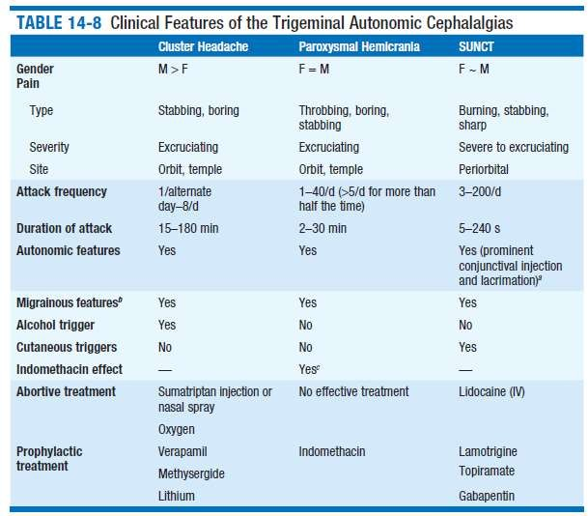


Slide 61
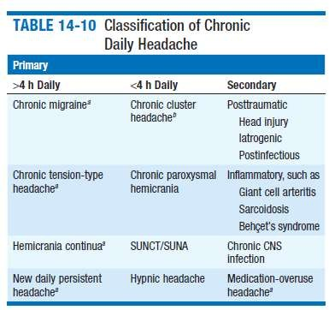
CHRONIC DAILY HEADACHE
Headache occurring on 15 or more days per month for more than 3 months
4% of adults have daily or near-daily headache. Daily headache may be primary or secondary

Slide 62
NEW DAILY PERSISTENT HEADACHE
Presents with headache on most if not all days and the patient can clearly, and often vividly, recall the moment of onset.
Headache usually begins abruptly, but onset may be more gradual;
Evolution over 3 days has been proposed as the upper limit for this syndrome.
Primary NDPH occurs in both males and females.
Some patients have a previous history of migraine.

Slide 63
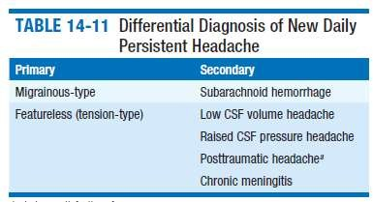
Treatment of migrainous-type primary NDPH- preventive therapies effective in migraine.
Featureless NDPH is most refractory to treatment.

Slide 64
MEDICATION-OVERUSE HEADACHE
Diagnostic criteria:
A. Headache occurring on 15 days per month in a patient with a pre-existing headache disorder
B. Regular overuse for >3 months of one or more drugs that can be taken for acute and/or symptomatic treatment of headache 1.Regular intake of ergotamine on 10 days per month for >3
months.
  Regular intake of one or more triptans, in any formulation, on 10
days per month for >3 months.
  Regular intake of one or more NSAIDs on 15 days per month for
>3 months.
  Regular intake of one or more opioids on 10 days per month for
>3 months.
C. Not better accounted for by another ICHD-3 diagnosis.

Slide 65
Management
Withdrawal of overused acute medication
- Abrupt
-Gradual
Transitional treatment
- Prednisolone 60-100 mg for 5 days
Preventive treatment

Slide 66
OTHER PRIMARY HEADACHES
Hemicrania continua
Description:
Persistent, strictly unilateral headache, associated with ipsilateral conjunctival injection, lacrimation, nasal congestion, rhinorrhoea, forehead and facial sweating, miosis, ptosis and/or eyelid oedema, and/or with restlessness or agitation.
The headache is absolutely sensitive to indomethacin.
Age of onset ranges from 11 to 58 years;
women are affected twice as often as men.
Treatment- indomethacin;
Other NSAIDs appear to be of little or no benefit.
Occipital nerve stimulation

Slide 67
Diagnostic criteria:
A. Unilateral headache fulfilling criteria B-D
B. Present for >3 months, with exacerbations of moderate or greater intensity
C. Either or both of the following:
1. at least one of the following symptoms or signs, ipsilateral to the headache:
  conjunctival injection and/or lacrimation
  nasal congestion and/or rhinorrhoea
  eyelid oedema
  forehead and facial sweating
  forehead and facial flushing
  sensation of fullness in the ear
  miosis and/or ptosis
2. a sense of restlessness or agitation, or aggravation of the pain by movement
D. Responds absolutely to therapeutic doses of indomethacin
E. Not better accounted for by another ICHD-3 diagnosis.

Slide 68
Primary cough headache
Diagnostic criteria:
A. At least two headache episodes fulfilling criteria BD
B. Brought on by and occurring only in association with coughing, straining and/or other Valsalva manoeuvre
C. Sudden onset
D. Lasting between 1 second and 2 hours
E. Not better accounted for by another ICHD-3 diagnosis.

Slide 69
Differential diagnosis-
Chiari malformation or any lesion causing obstruction of CSF pathways or displacing cerebral structures
Cerebral aneurysm, carotid stenosis, and vertebrobasilar disease.
Benign exertional headache
TREATMENT
Indomethacin 25–50 mg two to three times daily .
Some patients obtain pain relief with LP

Slide 70
Primary stabbing headache
Diagnostic criteria:
A. Head pain occurring spontaneously as a single stab or series of stabs and fulfilling criteria B–D
B. Each stab lasts for up to a few seconds
C. Stabs recur with irregular frequency, from one to many per
day
D. No cranial autonomic symptoms
E. Not better accounted for by another ICHD-3 diagnosis.
TREATMENT-indomethacin 25–50 mg two to three times daily

Slide 71
Primary exertional headache
Diagnostic criteria:
A. At least two headache episodes fulfilling criteria B and C
B. Brought on by and occurring only during or after strenuous physical exercise
C. Lasting <48 hours
D. Not better accounted for by another ICHD-3 diagnosis.

Slide 72
Differential diagnosis
cardiac cephalgia, Pheochromocytoma
Intracranial lesions and stenosis of the carotid arteries.
TREATMENT
Indomethacin (50 mg), ergotamine (1 mg orally), dihydroergotamine (2 mg by nasal spray), or methysergide (1– 2 mg orally given 30–45 min before exercise

Slide 73
Primary sex headache
Diagnostic criteria:
A. At least two episodes of pain in the head and/or neck fulfilling criteria B-D
B. Brought on by and occurring only during sexual activity
C. Either or both of the following:
  increasing in intensity with increasing sexual excitement
  abrupt explosive intensity just before or with orgasm
D. Lasting from 1 minute to 24 hours with severe intensity and/or up to 72 hours with mild intensity
E. Not better accounted for by another ICHD-3 diagnosis.

Slide 74
Headache can be prevented or eased by ceasing sexual activity
before orgasm.
Three types of sex headache are reported:
Dull ache in the head and neck that intensifies as sexual excitement increases;
Sudden, severe, explosive headache occurring at orgasm;
Postural headache developing after coitus that resembles the headache of low CSF pressure.
Are not always benign;
5–12% of cases of subarachnoid hemorrhage are precipitated by
sexual intercourse.
Men > women

Slide 75
TREATMENT
Reassurance and advice about ceasing sexual activity if a mild, warning headache develops
Propranolol - 40 to 200 mg/d.
Calcium channel–blocking -Diltiazem, 60 mg tid. Ergotamine (1 mg) or indomethacin (25–50 mg) taken about 30–45 min prior to sexual activity.

Slide 76
Primary thunderclap headache
Diagnostic criteria:
A. Severe head pain fulfilling criteria B and C
B. Abrupt onset, reaching maximum intensity in <1 minute
C. Lasting for 5 minutes
D. Not better accounted for by another ICHD-3 diagnosis.
Differential diagnosis – sentinel bleed of an intracranial aneurysm,
cervicocephalic arterial dissection, and cerebral venous thrombosis
ingestion of sympathomimetic drugs or of tyramine-containing foods in a patient who is taking MAOIs,
pheochromocytoma.
Reversible segmental cerebral vasoconstriction may be seen in primary thunderclap headache without an intracranial aneurysm
Treatment - nimodipine

Slide 77
Hypnic headache
Diagnostic criteria:
A. Recurrent headache attacks fulfilling criteria B-E
B. Developing only during sleep, and causing wakening
C. Occurring on 10 days per month for >3 months
D. Lasting 15 minutes and for up to 4 hours after waking
E. No cranial autonomic symptoms or restlessness
F. Not better accounted for by another ICHD-3 diagnosis.

Slide 78
Begins after age 50 years, but may occur in younger people.
Attacks usually last from 15 to 180 minutes
Most patients are female
TREATMENT
Bedtime dose of lithium carbonate (200–600 mg).
verapamil (160 mg) or methysergide (1–4 mg at bedtime)
One to two cups of coffee or caffeine, 60 mg orally, at bedtime may be effective.

Slide 79
REFERENCES
Bradley's Neurology in Clinical Practice, 6th Edition
Harrisons Principles of internal medicine
Guidelines for Diagnosis and Management of Migraine, Tension- Type Headache, Cluster Headache, Medication-Overuse Headache British Assoiciation for the Study of Headache 2010
The International Classification of Headache Disorders, 3rd edition
2013
Evidence-based guideline update: Pharmacologic treatment for episodic migraine prevention in adults American Academy of Neurology 2012
Diagnosis and Treatment of Headache, Eleventh Edition/January 2013 ICSI Health Care Guideline 2013

Slide 80
THANK YOU

