Slide 1
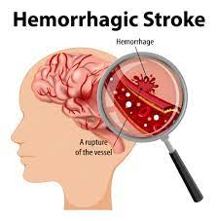
Stroke

Slide 2
Haemorrhage stroke
A hemorrhagic stroke occurs when blood from an artery suddenly begins bleeding into the brain .
An emergency condition in which a ruptured blood vessel causes bleeding inside the brain .
Hemorrhagic strokes occur when a blood vessel that supplies the brain ruptures and bleeds. When an artery bleeds into the brain, brain cells and tissues do not get oxygen and nutrients. In addition, pressure builds up in surrounding tissues and irritation and swelling occur, which can lead to further brain damage.

Slide 3
Epidemiology
Hemorrhagic stroke contributes to 10% to 20% of strokes annually.
The percentage of hemorrhage in stroke is 8-15% in the United States of America, the United Kingdom, and Australia, and 18% to 24% in Japan and Korea.
The incidence is around 12% to 15% of cases per 1,00,000 per year.

Slide 4
Classification / Types
There are the two types –
Intracerebral haemorrhage
Subarachnoid haemorrhage

Slide 5
Intracerebral haemorrhage
Rupture of abnormal artery or microaneurysm, bleeding into the substance of the brain
and formation of hematoma .
Intracerebral hemorrhage is usually caused by high blood pressure. Bleeding occurs suddenly and rapidly. There are usually no warning signs and bleeding can be severe enough to cause coma or death.

Slide 6
Cause / Etiology
Hypertension: chronic high blood pressure causes changes to the arteries of the brain which can make them much more likely to rupture.
Age: more common after age of 55, with buildup of protein in walls of arteries called amyloid angiopathy.
Gender: more common in men.
Race: affects African Americans and Asians more than whites; likely related to higher prevalence of Hypertension in those races.
Previous history of stroke: increases risk 23 times.
Alcohol use and street drugs: cocaine, amphetamines increases risk.
Liver disease: increases risk due to issues with blood clotting.
Use of blood thinners.
Primary brain causes: tumors, vascular anomalies, infection and venous sinus thrombosis

Slide 7
Risk factors
Hypertension (high blood pressure)
Diabetes mellitus
Menopause
Excessive alcohol consumption
Severe migraine

Slide 8
Clinical presentation
Headache, nausea, vomiting
Alterations in levels of consciousness
Weakness/numbness in face, arm or leg (usually on one side)
Vision loss
Seizures

Slide 9
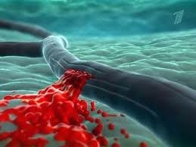
Pathophysiology
Acute hydrocephaly
Increased intracranial pressure Brain edema
Dislocation of brain structures Brainstem compression
Haematoma resolution occurs in 4-8 weeks, leaving a cystic
cavity

Slide 10
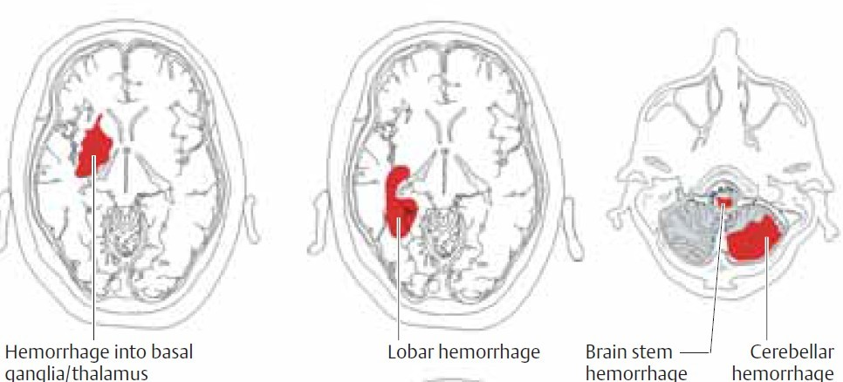
Localization of hematoma

Slide 11
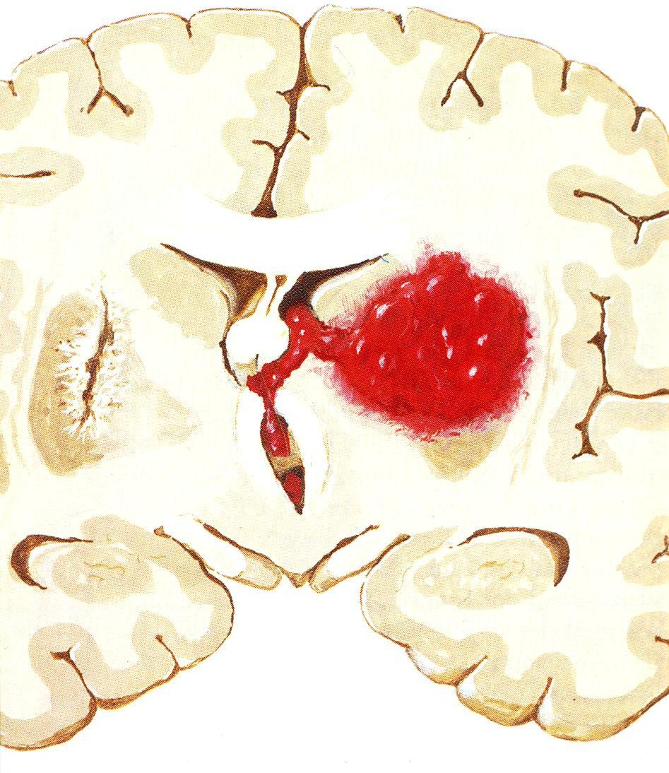
Intraceribral hemorrhage with rupture into the ventriculal system

Slide 12
Diagnosis
CT-scan
MR-angiography or contrast cerebral аangiography to identify a possible aneurysm or arteriovenous malformation
Later MRI

Slide 13
Complication
Impaired language skills
Fatigue
Problems with swallowing
Vision loss
Difficulty with sensations or movements on one side of the body
Pneumonia
Cognitive dysfunction (memory loss, difficulty reasoning), confusion
Swelling on the brain
Seizures
Depression, emotional problems
Fever

Slide 14
Prevention
Not smoking
Treating heart disease
Treating high blood pressure
Keeping diabetes under control
Maintaining a healthy lifestyle

Slide 15

Subarachnoid haemorrhage
Outbreak of blood in the subarachnoid space
Subarachnoid hemorrhage results when bleeding occurs between the brain and the membrane that covers the brain (meninges) in the subarachnoid space. This type of hemorrhage is often due to an aneurysm or an arteriovenous malformation (AVM). It can also be caused by trauma.

Slide 16
Cause / Etiology
Bleeding from a tangle of blood vessels called an arteriovenous malformation (AVM).
Bleeding disorders.
Use of blood thinners.
Use of cocaine and/or methamphetamine

Slide 17
Risk factor
Smoking
High blood pressure
Excessive alcohol consumption
A family history of the condition
Severe head injury

Slide 18
Sings and symptoms
Severe headache
Loss of consciousness
Meningeal syndrome (neck stiffness, Kernig’s sign, nausea, vomiting, photophobia)
Epileptic seizure
Psychomotor excitation
“Reactive hypertension”, hyperthermia, tachycardia

Slide 19
Diagnosis
CT scan
Lumbar puncture
MR-angiography or contrast cerebral аngiography

Slide 20
Management
Drug name | Category | MOA | ROA | Indication
Nimodipine | Calcium Channel Blockers | - Blocks voltage-gated L-type calcium channels in their inactive conformation to prevent vasoconstriction | Oral/Intra-arterial/Intravenous | Cerebral Vasospasm
Nicardipine | Calcium Channel Blockers | - Inhibits transmembrane influx of calcium ions into cardiac muscle and smooth muscle - Does not change serum calcium concentration | Intravenous/Intra-arterial | Cerebral Vasospasm
Fasudil | Vasodilator | - Improved coronary vasodilation - Inhibition of oxidative stress - Increased angiogenesis | Intravenous/Intra-arterial | Cerebral Vasospasm
Papaverine | Antispasmodics | - Increases cerebral blood flow - Decreases cerebral vascular resistance - Oxygen consumption is unaltered | Intra-arterial | Cerebral Vasospasm

Slide 21
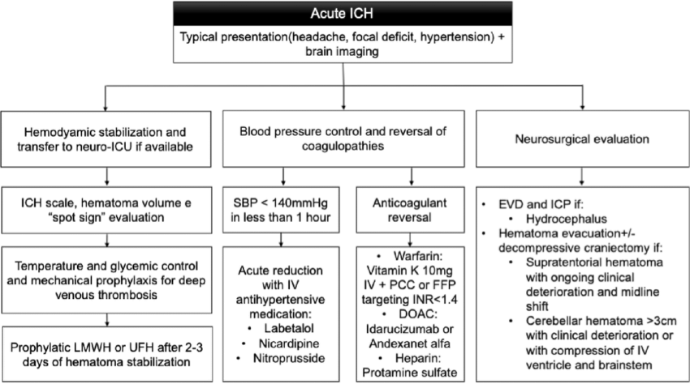
Treatment Algorithm

