Slide 1
BIOSTATISTICS & RESEARCH METHODOLOGY
UNIT 2 – 2.3 Basics of testing hypothesis
15-09-2024
1

Slide 2
BASICS OF TESTING HYPOTHESIS
a) Null hypothesis, level of significance, power of test, P value, statistical estimation of confidence intervals.
b) Level of significance (Parametric data)- students t test (paired and unpaired), chi Square test, Analysis of Variance (one-way and two-way)
c) Level of significance (Non-parametric data)- Sign test, Wilcoxan’s signed rank test, Wilcoxan rank sum test, Mann Whitney U test, Kruskal -Wall is test (one way ANOVA)
d) Linear regression and correlation- Introduction, Pearsonn’s and Spearmann’s correlation and correlation co-efficient.
e) Introduction to statistical software: SPSS, Epi Info, SAS.
15-09-2024
2

Slide 3
HYPOTHESIS
Hypothesis is an educated guess about something in the world around you. It should be testable, either by experiment or observation. For example:
A new medicine you think might work.
A way of teaching you think might be better.
A possible location of new species.
A fairer way to administer standardized tests.
It can really be anything at all as long as you can put it to the test.
The main purpose of statistics is to test a hypothesis.
For example, you might run an experiment and find that a certain drug is effective at treating headaches. But if you can’t repeat that experiment, no one will take your results seriously. A good example of this was the cold fusion discovery, which petered into obscurity because no one was able to duplicate the results.
What is a Hypothesis Statement?
If you are going to propose a hypothesis, it’s customary to write a statement. Your statement will look like this:
“If I…(do this to an independent variable)….then (this will happen to the dependent variable).”
15-09-2024
3

Slide 4
If I (decrease the amount of water given to herbs) then (the herbs will increase in size).
If I (give patients counseling in addition to medication) then (their overall depression scale will decrease).
If I (give exams at noon instead of 7) then (student test scores will improve).
If I (look in this certain location) then (I am more likely to find new species).
A good hypothesis statement should:
Include an “if” and “then” statement (according to the University of California).
Include both the independent and dependent variables.
Be testable by experiment, survey or other scientifically sound technique.
Be based on information in prior research (either yours or someone else’s).
Have design criteria (for engineering or programming projects).
15-09-2024
4

Slide 5

BASICS OF TESTING HYPOTHESIS
What is Hypothesis Testing?
Hypothesis testing in statistics is a way for you to test the results of a survey or experiment to see if you have meaningful results. You’re basically testing whether your results are valid by figuring out the odds that your results have happened by chance. If your results may have happened by chance, the experiment won’t be repeatable and so has little use.
Hypothesis testing can be one of the most tricky aspects, mostly because before you can even perform a test, you have to know what your null hypothesis is. Often, those tricky words problems that you are faced with can be difficult to decipher. But it’s easier than you think; all you need to do is:
Figure out your null hypothesis,
State your null hypothesis,
Choose what kind of test you need to perform,
Either support or reject the null hypothesis.
15-09-2024
5

Slide 6
Statistical Hypothesis Testing
Data alone is not interesting. It is the interpretation of the data that we are really interested in.
In statistics, when we wish to start asking questions about the data and interpret the results, we use statistical methods that provide a confidence or likelihood about the answers. In general, this class of methods is called statistical hypothesis testing, or significance tests.
The term “hypothesis” may make you think about science, where we investigate a hypothesis. This is along the right track.
In statistics, a hypothesis test calculates some quantity under a given assumption. The result of the test allows us to interpret whether the assumption holds or whether the assumption has been violated.
Two concrete examples that we will use a lot in machine learning are:
A test that assumes that data has a normal distribution.
A test that assumes that two samples were drawn from the same underlying population distribution.
The assumption of a statistical test is called the null hypothesis, or hypothesis 0 (H0 for short). It is often called the default assumption, or the assumption that nothing has changed.
15-09-2024
6

Slide 7
A violation of the test’s assumption is often called the first hypothesis, hypothesis 1 or H1 for short. H1 is really a short hand for “some other hypothesis,” as all we know is that the evidence suggests that the H0 can be rejected.
Hypothesis 0 (H0): Assumption of the test holds and is failed to be rejected at some level of significance.
Hypothesis 1 (H1): Assumption of the test does not hold and is rejected at some level of significance.
Before we can reject or fail to reject the null hypothesis, we must interpret the result of the test.
Statistical Test Interpretation
The results of a statistical hypothesis test must be interpreted for us to start making claims.
There are two common forms that a result from a statistical hypothesis test may take, and they must be interpreted in different ways. They are the p-value and critical values.
15-09-2024
7

Slide 8
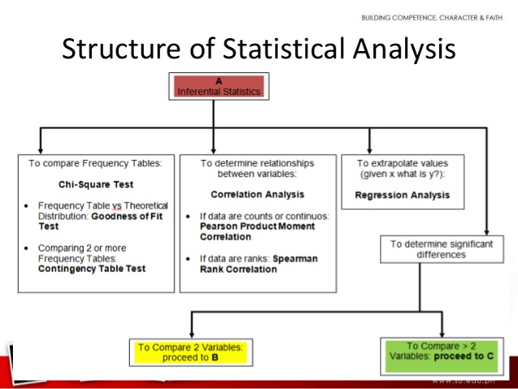
15-09-2024
8

Slide 9
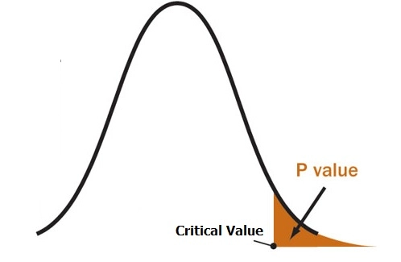
Interpret the p-value
We describe a finding as statistically significant by interpreting the p-value.
For example, we may perform a normality test on a data sample and find that it is unlikely that sample of data deviates from a Gaussian distribution, failing to reject the null hypothesis.
A statistical hypothesis test may return a value called p or the p-value. This is a quantity that we can use to interpret or quantify the result of the test and either reject or fail to reject the null hypothesis. This is done by comparing the p-value to a threshold value chosen beforehand called the significance level.
The significance level is often referred to by the Greek lower case letter alpha.
A common value used for alpha is 5% or 0.05. A smaller alpha value suggests a more robust interpretation of the null hypothesis, such as 1% or 0.1%.
The p-value is compared to the pre-chosen alpha value. A result is statistically significant when the p-value is less than alpha. This signifies a change was detected: that the default hypothesis can be rejected.
If p-value > alpha: Fail to reject the null hypothesis (i.e. not significant result).
If p-value <= alpha: Reject the null hypothesis (i.e. significant result).
For example, if we were performing a test of whether a data sample was normal and we calculated a p-value of .07, we could state something like:
15-09-2024
9

Slide 10
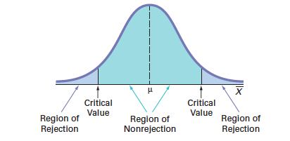
The test found that the data sample was normal, failing to reject the null hypothesis at a 5% significance level.
The significance level can be inverted by subtracting it from 1 to give a confidence level of the hypothesis given the observed sample data.
confidence level = 1 - significance level
Therefore, statements such as the following can also be made:
The test found that the data was normal, failing to reject the null hypothesis at a 95% confidence level.
Reject” vs “Failure to Reject”
The p-value is probabilistic.
This means that when we interpret the result of a statistical test, we do not know what is true or false, only what is likely
15-09-2024
10

Slide 11
NULL HYPOTHESIS
What is the Null Hypothesis? - If you trace back the history of science, the null hypothesis is always the accepted fact. Simple examples of null hypotheses that are generally accepted as being true are:
DNA is shaped like a double helix.
There are 8 planets in the solar system (excluding Pluto).
Taking Vioxx can increase your risk of heart problems (a drug now taken off the market).
A null hypothesis is a type of hypothesis used in statistics that proposes that there is no difference between certain characteristics of a population (or data-generating process).
How do I State the Null Hypothesis? - You won’t be required to actually perform a real experiment or survey in elementary statistics (or even disprove a fact like “Pluto is a planet”!), so you’ll be given word problems from real-life situations. You’ll need to figure out what your hypothesis is from the problem. This can be a little trickier than just figuring out what the accepted fact is. With word problems, you are looking to find a fact that is nullifiable (i.e. something you can reject).
Null Hypothesis Overview
The null hypothesis, H0 is the commonly accepted fact; it is the opposite of the alternate hypothesis. Researchers work to reject, nullify or disprove the null hypothesis. Researchers come up with an alternate hypothesis, one that they think explains a phenomenon, and then work to reject the null hypothesis.
Why is it Called the “Null”?
The word “null” in this context means that it’s a commonly accepted fact that researchers work to nullify. It doesn’t mean that the statement is null itself! (Perhaps the term should be called the “nullifiable hypothesis” as that might cause less confusion).
15-09-2024
11

Slide 12
Why Do I need to Test it? Why not just prove an alternate one?
The short answer is, as a scientist, you are required to; It’s part of the scientific process. Science uses a battery of processes to prove or disprove theories, making sure than any new hypothesis has no flaws. Including both a null and an alternate hypothesis is one safeguard to ensure your research isn’t flawed. Not including the null hypothesis in your research is considered very bad practice by the scientific community. If you set out to prove an alternate hypothesis without considering it, you are likely setting yourself up for failure. At a minimum, your experiment will likely not be taken seriously.
The null hypothesis is one of two mutually exclusive hypotheses in a hypothesis test. The null hypothesis states that a population parameter equals a specified value. If your sample contains sufficient evidence, you can reject the null hypothesis and conclude that the effect is statistically significant. The null hypothesis is often displayed as H0.
In every experiment, there is an effect or difference between groups that the researchers are testing. It could be the effectiveness of a new drug, building material, or other intervention that has benefits. Typically, the null hypothesis states that the true effect size equals zero—that there is no difference between the groups. Therefore, if you can reject the null hypothesis, you can favor the alternative hypothesis, which states that the effect exists (doesn’t equal zero) at the population level.
15-09-2024
12

Slide 13
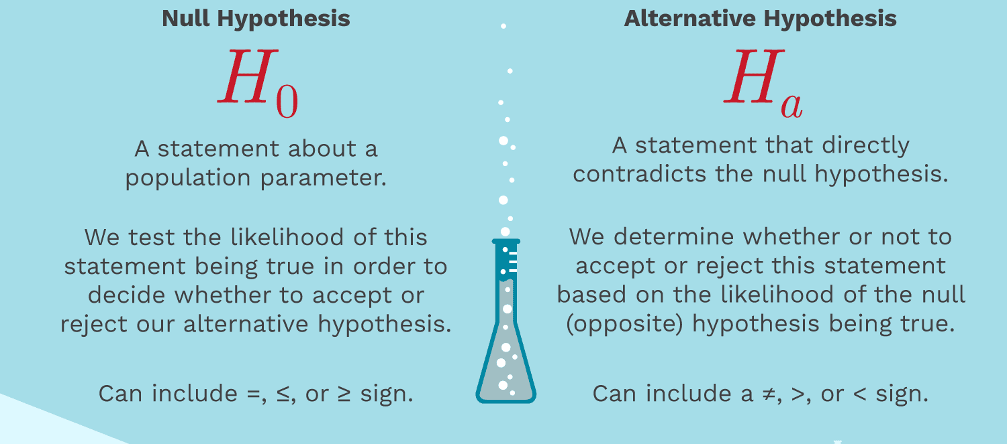
15-09-2024
13

Slide 14

A researcher thinks that if knee surgery patients go to physical therapy twice a week (instead of 3 times), their recovery period will be longer. Average recovery times for knee surgery patients is 8.2 weeks.
Step 1: Figure out the hypothesis from the problem. The hypothesis is usually hidden in a word problem, and is sometimes a statement of what you expect to happen in the experiment. The hypothesis in the above question is “I expect the average recovery period to be greater than 8.2 weeks.”
Step 2: Convert the hypothesis to math. Remember that the average is sometimes written as μ.
H1: μ > 8.2
Broken down into (somewhat) English, that’s H1 (The hypothesis): μ (the average) > (is greater than) 8.2
Step 3: State what will happen if the hypothesis doesn’t come true. If the recovery time isn’t greater than 8.2 weeks, there are only two possibilities, that the recovery time is equal to 8.2 weeks or less than 8.2 weeks.
H0: μ ≤ 8.2
Broken down again into English, that’s H0 (The null hypothesis): μ (the average) ≤ (is less than or equal to) 8.2
Hypothesis testing is vital to test patient outcomes
15-09-2024
14

Slide 15
But what if the researcher doesn’t have any idea what will happen?
Sample Problem: A researcher is studying the effects of radical exercise program on knee surgery patients. There is a good chance the therapy will improve recovery time, but there’s also the possibility it will make it worse. Average recovery times for knee surgery patients is 8.2 weeks.
Step 1: State what will happen if the experiment doesn’t make any difference. That’s the null hypothesis–that nothing will happen. In this experiment, if nothing happens, then the recovery time will stay at 8.2 weeks.
H0: μ = 8.2
Broken down into English, that’s H0 (The null hypothesis): μ (the average) = (is equal to) 8.2
Step 2: Figure out the alternate hypothesis. The alternate hypothesis is the opposite of the null hypothesis. In other words, what happens if our experiment makes a difference?
H1: μ ≠ 8.2
In English again, that’s H1 (The alternate hypothesis): μ (the average) ≠ (is not equal to) 8.2
That’s How to State the Null Hypothesis!
15-09-2024
15

