Slide 1
PHARMACOTHERAPEUTICS-III
UNIT NO- 02 HAEMATOLOGICAL SYSTEM

Slide 2
HEMATOLOGY
Cellular Components
Components of Blood
  Red Blood Cells
  White Blood Cells
  Inflammatory process
  Coagulation
Hemorrhage
Blood Typing
Clotting disorders
Transfusion Medicine

Slide 3


HEMATOLOGY
Spleen
Blood
Hematopoietic System
Kidneys
Bone
Liver
Marrow

Slide 4
CELLULAR COMPONENTS
Pluripotent Stem Cell
Myeloid Multipotent Stem Cells
Common Lymphoid Stem Cells
Unipotent Progenitors
Lymphocytes
WBC’s
Basophils Eosinophils Neutrophils Monocytes
RBC’s
Erythrocytes
Thrombocytes
Platelets
Erythropoietin

Slide 5
COMPONENTS OF BLOOD
Plasma
  Transport mechanism
    90-92% water.
    6-7% proteins
    2-3%
      Fats
      Carbohydrates (glucose)
      Electrolytes
      Gases (O₂, CO₂)
      Chemical messengers
Plasma Components
Water 90%
Other
3%
Protein
7%

Slide 6

COMPONENTS OF BLOOD
Red Blood Cells
  Erythrocyte
    Hemoglobin – O₂ bearing molecule
    Comprised of 4 subunits:
  Globin (binds to 1 O₂ molecule)
  Heme (iron)
  100% saturation = 4 globin subunits carrying O₂
  Each gram of hemoglobin = 1.34 ml O₂
Cellsalive.com

Slide 7
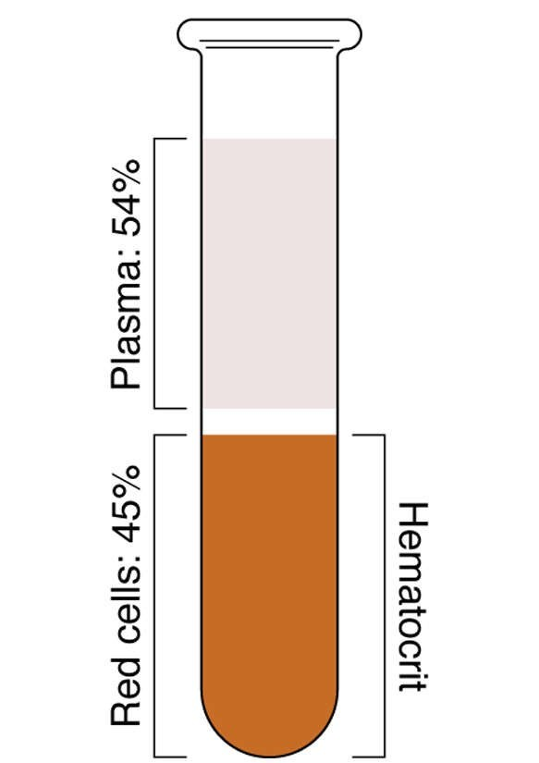
COMPONENTS OF BLOOD
Red blood cell production
  Erythropoiesis
    Erythropoietin
  Hemolysis
  Sequestration
  Laboratory analysis of red blood cells
    Red blood cell count
    Hematocrit
    Hemoglobin

Slide 8
COMPONENTS OF BLOOD
Platelets (Thrombocytes)
  Megakaryocytes
    Thrombopoietin
  Thrombocytopenia
  Thrombocytosis

Slide 9
HEMORRHAGE
 | Class I | Class II | Class III | Class IV
Blood Loss (ml) | Up to 750 | 750-1500 | 1500-2000 | >2000
Blood Loss (% volume) | Up to 15% | 15%-30% | 30%-40% | >40%
Pulse | <100 | >100 | >120 | >140
BP | Normal | Normal | Decreased | Decreased
Pulse Pressure | Normal or increased | Decreased | Decreased | Decreased
Resp. Rate | 14-20 | 20-30 | 30-40 | >35
Urine Output (ml/hr) | >30 | 20-30 | 5-15 | Negligible
Mental Status | Slightly anxious | Mildly anxious | Anxious, confused | Confused, lethargic
Fluid Replacement (3:1) rule | Crystalloid | Crystalloid | Crystalloid and blood | Crystalloid and blood

Slide 10
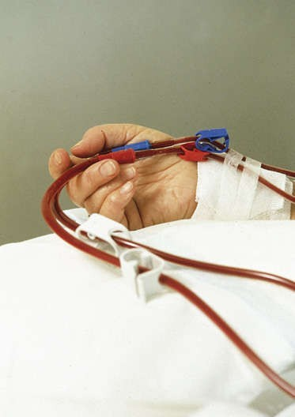
BLOOD PRODUCTS AND BLOOD TYPING
Blood Types
  Antigens
    A, B, AB, O
  Rh factor
    Rh+ = ~85%
    Rh- = ~15%
Blood transfusion

Slide 11
BLOOD PRODUCTS AND BLOOD TYPING
Blood Typing - ABO
Blood type | Antigen present on erythrocyte | Antibody present in serum
O | None | Anti-A, Anti-B
AB | A and B | None
B | B | Anti-A
A | A | Anti-B

Slide 12
BLOOD PRODUCTS AND BLOOD TYPING
Compatibility Among ABO Blood Groups
Donor Cells | Reaction with serum of Recipient
 | AB | B | A | O
AB | - | + | + | +
B | - | - | + | +
A | - | + | - | +
O | - | - | - | -
-= no reaction
+ = reaction

Slide 13
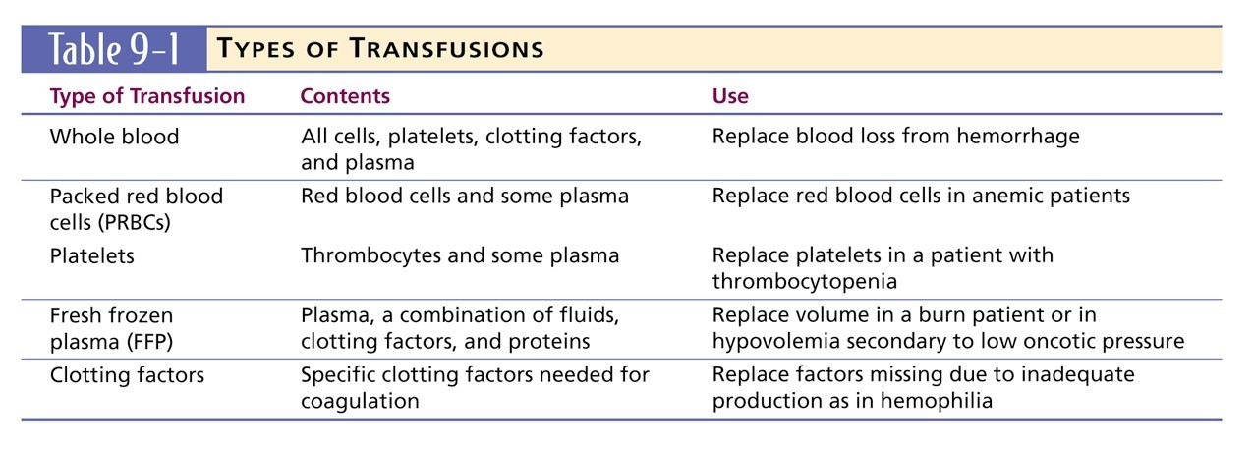
BLOOD PRODUCTS AND BLOOD TYPING
Brady; Paramedic Care Principles and Practice

Slide 14
DISEASES OF ERYTHROCYTES
Anemias
  Anemia is a sign, not a separate disease process.
    Signs and symptoms may not be present until the body is stressed.
    Differentiate chronic anemia from acute episode.
  Treat signs and symptoms.
    Maximize oxygenation and limit blood loss.
    Establish IV therapy if indicated.

Slide 15
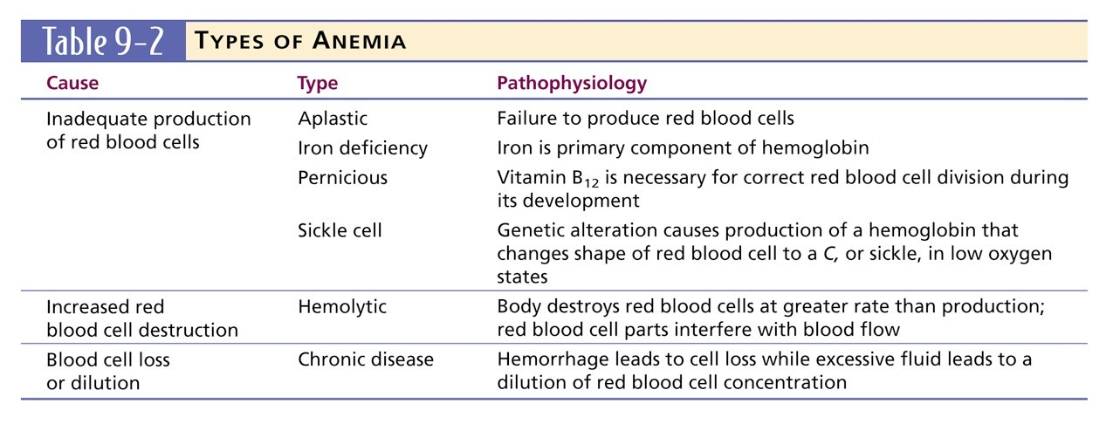
DISEASES OF ERYTHROCYTES
Brady; Paramedic Care Principles and Practice

Slide 16
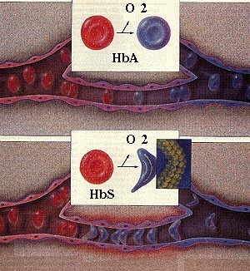
DISEASES OF ERYTHROCYTES
Sickle Cell Disease
Normal red cells maintain their shape as they pass through the capillaries and release oxygen to the peripheral tissues (upper panel). Hemoglobin polymers form in the sickle rell cells with oxygen release, causing them to deform. The deformed cells block the flow of cells and interrupt the delivery of oxygen to the tissues (lower panel).

Slide 17
DISEASES OF ERYTHROCYTES
Sickle cell crises
  Vaso-occlusive
    Musculoskeletal/abdominal pain
    Priapism
    Renal/cerebral infarctions
  Hematological
    Lowered hemoglobin
    Splenic sequestration
  Infectious
Management
  Follow general treatment guidelines.
  Consider analgesics.

Slide 18
DISEASES OF ERYTHROCYTES
Polycythemia
  Overproduction of erythrocytes.
    Occurs in patients > 50 years old or with secondary dehydration.
    Most deaths due to thrombosis
  Results in bleeding abnormalities:
    Epistaxis, spontaneous bruising, GI bleeding.
  Management:
    Follow general treatment guidelines.

Slide 19
DISEASES OF LEUKOCYTES
Leukopenia/Neutropenia
  Too few white blood cells or neutrophils.
  Follow general treatment guidelines and provide supportive care.
Leukocytosis
  An increase in the number of circulating white blood cells, often due to infection.
    Leukemoid reaction

Slide 20
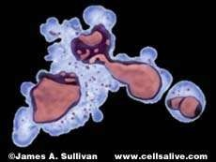
DISEASES OF LEUKOCYTES
Leukemia
  Cancer of hematopoietic cells
  Initial presentation
    Acutely ill, fatigued, febrile and weak, anemic.
    Thrombocytopenia
    Often have a secondary infection.
  Management
    Follow general treatment guidelines.
    Utilize isolation techniques to limit risk of infection.

Slide 21
DISEASES OF LEUKOCYTES
Lymphomas
  Cancers of the lymphatic system
    Hodgkin's
    Non-Hodgkins
  Presentation
    Swelling of the lymph nodes
    Fever, night sweats, anorexia, weight loss, fatigue, and pruritis
  Management
    Follow general treatment guidelines.
    Utilize isolation techniques to limit risk of infection.

Slide 22
CLOTTING DISORDERS
Thrombocytosis and Thrombocytopenia
  Thrombocytosis
    An abnormal increase in the number of platelets
  Thrombocytopenia
    An abnormal decrease in the number of platelets
      Sequestration
      Destruction (ITP)
      Decreased production
  Management
    Provide supportive care and follow general treatment guidelines.

Slide 23
CLOTTING DISORDERS
Hemophilia
  Deficiency or absence of a blood clotting factor
    Deficiency of factor VIII causes hemophilia A.
    Deficiency of factor IX causes hemophilia B.
    Deficiency is a sex-linked, inherited disorder.
      Defective gene is carried on the X chromosome.
  Signs & Symptoms
    Numerous bruises, deep muscle bleeding, and joint bleeding.

Slide 24
CLOTTING DISORDERS
Hemophilia (cont.)
  Management
    Treat the patient similarly to others.
    Administer supplemental oxygen. Establish IV access.
Be alert for recurrent or prolonged bleeding, and prevent additional trauma.
Von Willebrand’s Disease
  Deficient component of factor VIII
    Generally results in excessive bleeding.
    Generally is not serious; provide supportive care.

Slide 25
CLOTTING DISORDERS
Disseminated Intravascular Coagulation
  System activation of coagulation cascade.
  Results from sepsis, hypotension, OB complications, severe tissue or brain injury, cancer, and major hemolytic reactions.
Multiple Myeloma
  Cancerous disorder of plasma cells.
  Pathologic fractures are common.

