Slide 1
leukemias

Slide 2
definition
The leukemias are heterogeneous hematologic malignancies characterized by unregulated proliferation of the blood-forming cells of the bone marrow. These immature proliferating leukemia cells (blasts) physically “crowd out” or inhibit normal cellular maturation in bone marrow, resulting in anemia, neutropenia, and thrombocytopenia. Leukemic blasts may also infiltrate a variety of tissues such as lymph nodes, skin, liver, spleen, kidney, testes, and the central nervous system.

Slide 3
pathophysiology
Normal haematopoiesis
A pool of pluripotent stem cells undergoes differentiation, proliferation, and maturation, to form the mature blood cells seen in the peripheral circulation. These pluripotent stem cells initially differentiate to form two distinct stem cell pools. The myeloid stem cell gives rise to six types of blood cells (erythrocytes, platelets, monocytes, basophils, neutrophils, and eosinophils), while the lymphoid stem cell differentiates to form circulating B and T lymphocytes. Leukemia may develop at any stage and within any cell line.

Slide 4
Acute leukaemias
Two features are common to both AML and ALL: first, both arise from a single leukemic cell that expands and acquires additional mutations, culminating in a monoclonal population of leukemia cells.
Second, there is a failure to maintain a relative balance between proliferation and differentiation, so that the cells do not differentiate past a particular stage of hematopoiesis. Cells (lymphoblasts or myeloblasts) then proliferate uncontrollably. Proliferation, differentiation, and apoptosis are under genetic control, and leukemia can occur when the balance between these processes is altered.
In acute leukaemia, the normal bone marrow is replaced by a malignant clone of immature blast cells derived from the myeloid (in AML) or lymphoid (in ALL) series. More than 20% of the cellular elements of the bone marrow are replaced with blasts. This is usually associated with the appearance of blasts in the peripheral circulation accompanied by worsening pancytopenia as a result of the marrow's reduced ability to produce normal blood cells as the proportion of malignant cells increases. In ALL, the blasts may infiltrate lymph nodes and other tissues such as liver, spleen, testis and the meninges, in particular. In AML, blasts tend to infiltrate skin, gums, liver and spleen.

Slide 5
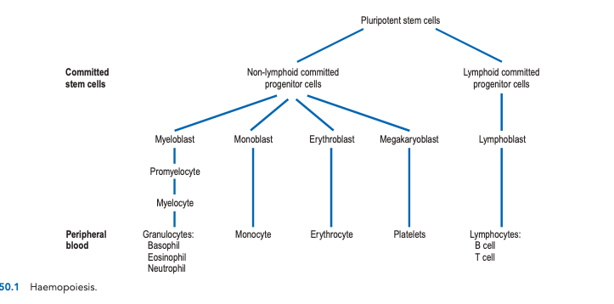

Slide 6
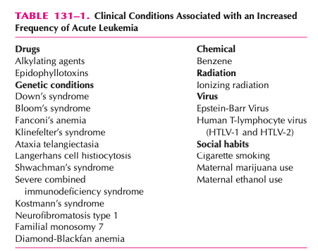
etiology
A multifactorial process involving genetics, environmental and socioeconomic fac- tors, toxins, immunologic status, and viral exposures

Slide 7
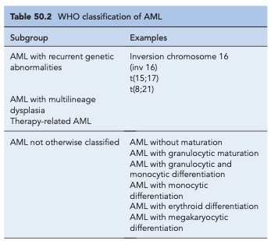
Classification of acute myeloblastic leukaemia
AML has traditionally been classified on the basis of morphological features of the disease. Subtypes displaying granulocytic, monocytic, erythroid and megakaryocytic differentiation can be demonstrated.

Slide 8
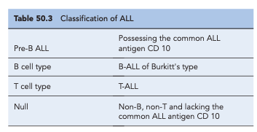
Classification of acute lymphoblastic leukaemia
As with AML, the WHO classification system takes account of morphological, genetic and immunological features.
The disease is, however, mainly classified immunologically, based on the presence or absence of B- or T-cell markers
Each subtype displays different clinical presentaions, response to treatment and, ultimately, prognosis, with pre-B having the best prognosis and B-ALL the worst.
It is worth noting that B-ALL (Burkitt's type), which is associated with translocations of the myc gene normally located on chro- mosome 8, seems to be a morphologically and biologically distinct form of leukaemia.

Slide 9
Clinical manifestations
Acute leukaemia
Most of the clinical manifestations of acute leukaemia are related to bone marrow failure.
The disease commonly presents with a short history, and left untreated, it is rapidly fatal. Symptoms of infection, anaemia and bleeding are common and life-threatening presenting problems.
Bleeding may be particularly severe in one subtype of AML, acute promyelocytic leukaemia (APL). This condition is associated with a translocation of genetic material between chromosomes 15 and 17, t(15;17). Disseminated intravascular coagulation (DIC) is commonly the presenting feature of this disease. Some patients with AML develop symptoms and signs due to infiltration of major organs by leukaemic cells.
The involvement of other tissues such as spleen, liver, lymph nodes and meninges is more common in ALL than AML. Involvement of the central nervous system (CNS) may give rise to headaches, vomiting and irritable behaviour. CNS disease is rare at presentation, but develops in up to 75% of children with ALL unless specific prophylactic treatment is given.
Less commonly, patients present with features of hypermetabolism, hyperuricaemia or generalised aches and pains.

Slide 10
PRESENTATION OF ACUTE MYELOID LEUKEMIA1,8,12
GENERAL
Typically a 1- to 3-month history of vague symptoms such as tiredness, lack of exercise tolerance, chest pain, and “feeling unwell,” but in no obvious distress.
SYMPTOMS
The patient may report weight loss, malaise, fatigue, and palpitations and dyspnea on exertion. They may also present with fever, chills, and rigors suggestive of infection; bruising (excessive vaginal bleeding, epistaxis, ecchymoses, and pe- techiae); gum hypertrophy (AML M4 and AML M5 subtypes); bone pain; seizures, headache, and diplopia.
SIGNS
Temperature may be elevated due to low neutrophil count; petechiae

Slide 11
LABORATORY TESTS
Complete blood cell count (with differential).
Anemia is usually present and is normochromic and normocytic (without a compensatory increase in reticulocytes).
Thrombocytopenia (severe, less than 50,000/mm3 platelets) is present
Leukopenia/leukocytosis: approximately 20% of patients will present with an elevated white blood cell (WBC) count, 20% with a low WBC count, and the rest with normal counts. Even patients with elevated counts can be considered functionally neutropenic.
Uric acid is elevated in 50% of patients due to rapid cellular turnover (more common in patients presenting with elevated WBC counts).
Electrolytes: potassium and phosphate are usually elevated.
Coagulation: elevated prothrombin time, partial thromboplastin time, D-dimers; hypofibrinogenemia.
OTHER DIAGNOSTIC TESTS
Bone marrow biopsy and aspirate: send for morphologic examination, cytochemical staining, immunophenotyping, and cytogenetic (chromosome) analysis. At diagnosis the marrow is typically hypercellular, with normal erythropoiesis being replaced by leukemic blasts.
To be diagnosed with AML, there needs to be more than 20% blasts.
For patients presenting with CNS signs, a diagnostic lumbar puncture should be performed. CNS involvement is common with AML M4 and M5 subtypes.

Slide 12
PRESENTATION OF ACUTE LYMPHOBLASTIC LEUKEMIA
GENERAL
Typically a 1- to 3-month history of vague symptoms such as tiredness, lack of exercise tolerance, chest pain, and “feeling unwell,” but in no obvious distress.
SYMPTOMS
The patient may report weight loss, malaise, fatigue, and palpitations and dyspnea on exertion. They may also present with fever, chills, and rigors suggestive of infection; bruising (excessive vaginal bleeding, epistaxis, ecchymoses, and petechiae); bone pain; seizures, headache, and diplopia.
SIGNS
Temperature may be notelevated due to low neutrophil count; petechiae; splenomegaly, hepatomegaly, and lymphadenopathy.
LABORATORY TESTS
Complete blood cell count (with differential). Anemia is usually present and is normochromic and normocytic (without a compensatory increase in reticulocytes). Thrombocytopenia (severe, less than 50,000/mm3 platelets) is present in ap- proximately 50% of cases. Leukopenia/leukocytosis: approximately 20% patients will present with an elevated white blood cell (WBC) count, 20% with a low WBC count, and the rest with normal counts. Even patients with elevated counts can be considered functionally neutropenic.
Uric acid is elevated in 50% of patients due to rapid cellular turnover (more common in patients presenting with elevated WBC counts).
Electrolytes: potassium and phosphate are usually elevated.

Slide 13
OTHER DIAGNOSTIC TESTS
Bone marrow biopsy and aspirate: send for morphologic examination, cytochemical staining, immunophenotyping, and cytogenetic (chromosome) analysis.
CNS involvement is common in all ALL patients, and is a common cause of relapse. All patients should have a screening lumbar puncture performed.

Slide 14
Chronic leukaemia
Chronic myelocytic leukaemia
Patients with CML commonly present with non-specific symptoms, such as malaise, weight loss and night sweats.
The main physical sign is an enlarged spleen that may give rise to abdominal discomfort.
Hepatomegaly is also detected in approximately 40% of newly diagnosed patients.
Neutropenia and thrombocytopenia are uncommon at presentation. Thus, unlike the acute leukaemias, patients with CML rarely present with symptoms of infection or haemorrhage.
In up to 30% of cases, patients are asymptomatic and the disease is detected as a result of a routine blood test performed for other reasons.
CML is a triphasic disease. The initial chronic phase may last from several months to 20 years; the median is around 5 years. During this time, treatment can alleviate symptoms and reduce the white blood count (WBC) and spleen size, allowing patients to lead near normal lives. An accelerated phase eventually occurs where the disease becomes more aggressive with progressively worsening symptoms: unexplained fevers, bone pain, anaemia, thrombocytopenia or thrombocytosis. Finally, after a period of weeks or months, a blast crisis occurs, resembling fulminating acute leukaemia. In a small percentage of patients, this occurs abruptly with no prior accelerated phase.

Slide 15
Chronic lymphocytic leukaemia
Symptomatic patients often suffer B symptoms: night sweats, unexplained fever and weight loss.
At diagnosis, findings may include generalised lymph- adenopathy and some enlargement of the liver and spleen.
Patients are immunocompromised with a reduction in serum gammaglobulin and are at increased risk of bacterial and viral infections. There is an increased susceptibility to autoimmune disease, particularly immune haemolytic anaemias and thrombocytopenia.
With progressive disease, bone marrow failure becomes apparent, resulting in fatigue, infection and bleeding, and the disease becomes less responsive to treatment. Patients with CLL also have an increased risk of developing a more aggressive malignancy such as high-grade non-Hodgkin's lymphoma (known as Richter's transformation) or prolymphocytic leukaemia (PLL).

Slide 16
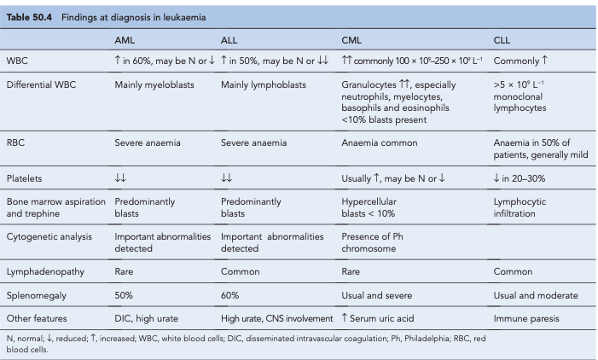

Slide 17
Goals of the treatment
The short-term goal of treatment for acute leukemia is to rapidly achieve a complete clinical and hematologic remission.
After a CR is achieved, the goal is to maintain the patient in continuous CR.

Slide 18
treatment
Acute lymphoblastic leukaemia
Therapy for ALL has historically been divided into three phases:
(1) remission induction
(2) consolidation therapy
(3) maintenance therapy
Central nervous system (CNS)
prophylaxis is a mandatory component of any ALL treatment regimen and is administered longitudinally during the induction and consolidation phases.
The combination of vincristine, prednisolone, anthracyclines and asparaginase induces CR in about 90% of children with ALL and 80% of adults, although sadly relapse is far more common in adults
Other active drugs in the treatment of ALL include methotrexate, 6-mercaptopurine, cyclophosphamide and mitoxantrone.

Slide 19
patients with ALL are at a high risk of developing CNS infiltration. Cytotoxic drugs penetrate poorly into the CNS which thus acts as a sanctuary site for leukaemic cells. For this reason, all patients with ALL receive CNS prophylaxis. Cranial irradiation plus intrathecal methotrexate or high- dose systemic methotrexate can be used.
Maintenance treatment is important to sustain a CR. It is usually milder than induction or consolidation chemotherapy, but is carried on for at least 18 months. Treatment usually consists of weekly methotrexate and daily 6-mercaptopurine with intermittent vincristine and prednisolone.
The treatment of relapsed disease varies with the site of relapse. Isolated CNS or testicular relapse may be successfully treated with radiation and reinduction therapy. Cure can still be achieved for some patients. Bone marrow relapse is much more difficult to cure, especially if it occurs early.
A small proportion of paediatric patients and a larger propor- tion of adult patients have the Philadelphia chromosome trans- location within their ALL blasts. Such patients have a relatively poor prognosis and therefore require more intensive therapy. There is some evidence that drug combinations including ima- tinib may enhance the response of these leukaemias to therapy.

Slide 20
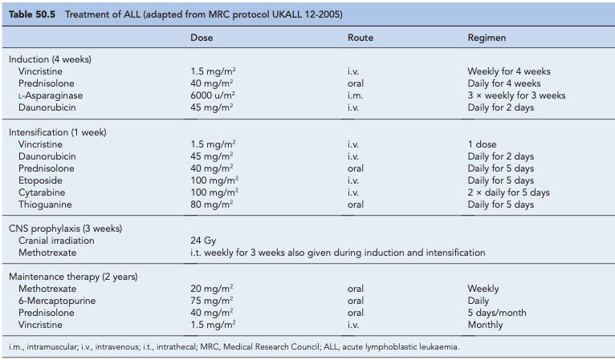

Slide 21
Acute myeloblastic leukaemia (non-acute promyelocytic leukaemia)
As for ALL, the treatment of AML involves induction and consolidation chemotherapy.
In AML therapy, however, the chemotherapy regimens used to achieve remission are much more myelotoxic, and patients require intensive supportive care to survive periods of bone marrow aplasia.
The addition of daunorubicin and oral thioguanine has achieved a CR rate of 75% in patients under the age of 60 years and about 50% in those over 60 years.
ACUTE LYMPHOBLASTIC LEUKEMIA IN INFANTS
Patients with infant ALL may have greater drug resistance to asparaginase and prednisone, but increased sensitivity to cytarabine. Although the use of intensive regimens such as high-dose methotrexate and high-dose cytarabine have improved survival rates, unacceptably high mortality rates have also been observed with some regimens. Lack of pharmacokinetic data for chemotherapy in infants has contributed to toxicity from inappropriate dosing of doxorubicin and vincristine. To reduce neuropsychological complications, most protocols avoid cranial irradiation. The use of HSCT for infants with ALL remains controversial .
ACUTE LYMPHOBLASTIC LEUKEMIA IN THE ELDERLY
the addition of imatinib to conventional chemotherapy in Ph+ ALL patients is an increasingly common approach.Whether this leads to any increase in EFS or overall survival (OS) remains to be seen. In general, older patients have a lower CR rate, and when achieved, the duration of remission is shorter than with younger patients.

Slide 22
TREATMENT OF RELAPSED ACUTE LYMPHOBLASTIC LEUKEMIA
The most common site for relapse is the bone marrow, although isolated relapses can occur in the CNS or testicles. Marrow relapse usually follows isolated CNS or testicular relapses. Therefore patients with isolated extramedullary relapses are treated with localized radiation (cranial or testicular) and aggressive systemic chemotherapy similar to that given to patients with a marrow relapse.
Patients who have completed treatment and who have stayed in remission for longer periods are more likely to be reinduced into remission again. Patients with more favorable risk factors initially, and those who received less intensive initial treatments, are more likely to respond well to reinduction/salvage regimens. In general, long-term survival after relapse is very poor, and aggressive therapies are used.
Treatment of AML in relapse is difficult and the prognosis is generally poor. Encouraging results have been seen using a combination of fludarabine, cytosine arabinoside and granulocyte colony-stimulating factor (G-CSF).
A combination of anti-CD33 antibody, which targets myeloid blasts, with calicheamicin, an anthracycline antibiotic, is a promising and effective approach, but appears most effective when given in combination with conventional chemotherapy.
A newly developed purine analogue, clofarabine, has also been shown to have activity against AML. This drug is a promising agent, particularly in the treatment of older patients, as pilot studies suggest that its toxic effects may be less severe than those associated with other chemotherapy regimens.
5-Azacytidine is also of interest, especially in older patients and those whose disease has evolved from myelodysplastic syndrome MDS. This agent inhibits DNA methyltransferase resulting in DNA hypomethylation. This process is thought to increase activity of some tumour suppressor genes resulting in anti- tumour effects. The agent has been shown to slow the rate of progression to AML in patients with high-risk myelodysplastic syndrome and is currently the subject of clinical trials in AML.

Slide 23
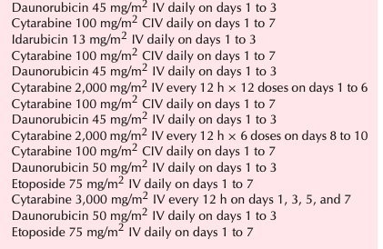
Representative chemotherapy regimens for adult aml
Induction therapy

Slide 24
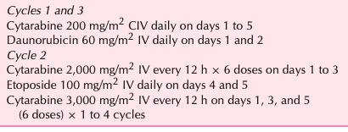
Post remmision chemotherapy of AML

Slide 25
CHRONIC LEUKAEMIA
Chronic leukemia includes at least four disease types: chronic myelogenous leukemia (CML), chronic lymphocytic leukemia (CLL), prolymphocytic leukemia, and hairy cell leukemia.
Chronic Myelogenous Leukemia
Cure of CML can be achieved only by eradication of the malignant clone (i.e., Ph-positive cells).
Treatment response can be defined depending on the tests used to measure response
Hematologic response is defined as the normalization of peripheral blood counts. Although hematologic response is the easiest type of response to measure, this type of response is not associated with changes in the percentage of cells positive for the Patient.
Cytogenetic responses evaluate the percentage of cells positive for Patient
complete cytogenetic remission defined as the elimination of Ph from bone marrow, and major cytogenetic response defined as fewer than 35% Ph-positive cells in the bone marrow.
Patients who have a cytogenetic response have an improved survival compared to those who fail to achieve a response. Conventional cytotoxic chemotherapy can be used in chronic-phase CML to attain a hematologic remission. However, low-dose chemotherapy used in chronic phase does not produce cytogenetic responses and has little or no effect on median survival. Interferon, imatinib, and hematopoietic stem cell transplantation (HSCT) can produce cytogenetic responses that are associated with longer median survivals. However, even complete cytogenetic response does not define cure.

Slide 26
CONVENTIONAL CHEMOTHERAPY
Busulfan (Myleran) and hydroxyurea (Hydrea) can be used to reduce white cell count shortly after diagnosis. These agents can be taken orally, are inexpensive, have reasonable side-effect profiles, and are able to rapidly normalize elevated WBC counts in chronic-phase CML.
Although both agents produce predictable declines in WBC count and hematologic remissions in 70% to 80% of chronic-phase CML patients, busulfan and hydroxyurea have very little effect on Ph-positive cells in bone marrow.
Based on results from a randomized study which showed that hydroxyurea treatment provided a significant survival advantage over busulfan, hydroxyurea is the preferred conventional agent in newly diagnosed chronic-phase CML.
hydroxyurea inhibits the enzyme ribonucleotide reductase, leading to suppression of DNA synthesis, elimination of cells in the S phase of the cell cycle, and synchronization in the G1 or pre-DNA synthesis phase.
The drug is usually administered daily and can be initiated at 40 to 50 mg/kg per day in divided doses until the WBC count falls below 10,000/mm3.
At that point, the dose can be decreased to a maintenance level of 20 mg/kg per day, but increasingly is tapered and stopped once imatinib therapy is started.
Imatinib normalizes blood counts based on suppression of the malignant clone in the bone marrow, an effect not seen with hydroxyurea. Suppression of the malignant clone in the bone marrow is the desired therapeutic effect because of its impact on survival.

Slide 27
INTERFERONS
Interferon was the first biologic therapy that showed important activity in cancer.
The exact mechanism of IFN-α activity in CML is unknown, but is complex with multiple effects on cellular function. Some of the proposed alterations include changes in gene transcription, substrate phosphorylation, antigen presentation, and apoptosis
The most predictable early toxicity is a flu-like syndrome characterized by fever, chills, myalgias, headache, and anorexia. These dose-dependent effects may be a result of IFN-α–induced leukocytosis and release of cytokines. This acute flu-like syndrome can be ameliorated by starting IFN-α dosing at 50% of the final dose during the first week, giving the drug at bedtime, and co administering acetaminophen or indomethacin with each IFN-α dose.
Reduction of initial WBC counts to around 10,000/mm3 with hydroxyurea may also reduce these symptoms.
Despite these methods of ameliorating toxicity, the flu-like syndrome is an important source of morbidity, occasionally requiring termination of therapy. Cardiovascular toxicities (tachycardia and hypotension) are seen in about 15% of patients in the first few weeks. Long-term adverse effects include weight loss, alopecia, neurologic effects (paresthesias, cognitive impairment, and depression), and immune-mediated complications (hemolysis, thrombocytopenia, nephrotic syndrome, systemic lupus erythematosus, and hypothyroidism).

Slide 28
IMATINIB
Inhibits the p210 tyrosine kinase, leading to differentiation and apoptosis of the CML clone.
Imatinib competitively binds to the ATP-binding site on the tyrosine kinase, which leads to inhibition of the phosphorylation of kinase substrates and inhibition of growth factor signals for the CML clone.
Dasatinib and nilotinib are second-generation tyrosine kinase inhibitors (TKIs) designed to overcome resistance to imatinib caused by mutations in the kinase domain of BCR- ABL. Both agents work well as second-line therapies, produc- ing complete cytogenetic responses in about 50% of patients. The use of dasatinib and nilotinib in newly diagnosed patients is currently being evaluated in ongoing clinical trial
Due to the effectiveness of imatinib therapy and the development of Second-generation agents, allogeneic stem cell transplantation is now rarely used to treat CML, but it does represent a potentially curative option for patients with resistant disease.
Transformation of CML into acute leukaemia can be treated in the same manner as de novo acute leukaemia, in an effort to achieve a second chronic phase. Treatment is slightly more successful if transformation is lymphoid rather than myeloid. Imatinib, typically at higher doses than are used in chronic phase disease, can also be used to attempt to return patients to chronic phase disease. In general, remissions are rare and the median survival is less than 6 months.

Slide 29
Chronic lymphocytic leukaemia
Currently, there is no cure for CLL. All treatment is, therefore, considered palliative. There is no evidence that early treatment of asymptomatic patients improves outcome. Indications for treatment are:
rapidly increasing WBC
increasing or troublesome lymphadenopathy
systemic symptoms
marrow failure
autoimmune complications.
The alkylating agent chlorambucil was the most common agent used in the treatment of CLL. Corticosteroids can reduce the lymphocyte count without contributing to myelosuppression and are used to treat autoimmune phenomena such as haemolytic anaemia and immune thrombocytopenia. The use of purine analogues, particularly fludarabine, marked the beginning of an exciting phase in the treatment of CLL. Although CRs were unusual, good responses were seen even in patients whose leukaemia was resistant to alkylating agents. With regard to initial therapy of CLL, fludarabine-treated patients show a higher response rate than patients treated with chlorambucil. However, no survival advantage for the use of fludarabine has been demonstrated.

Slide 30
Stem cell transplantation
Hematopoietic stem cell transplantation (HSCT) is a process that involves intravenous infusion of hematopoietic stem cells from a donor into a recipient, following the adminis- tration of chemotherapy with or without radiation. The ra- tionale is to increase tumor cell kill by increasing the dose of chemotherapy. Immune-mediated effects may also con- tribute to the tumor cell kill observed after allogeneic HSCT.
Hematopoietic stem cells used for transplantation can come from the recipient (autologous) or from a related or unrelated donor (allogeneic). If the related donor is a twin, the transplant is referred to as a syngeneic transplant.

Slide 31
The basic principle
This technique provides a means of rescuing the patient from the potentially lethal effects on the bone marrow of ablative therapy given in an attempt to eradicate all traces of disease. The conditioning regimen most commonly used is a combination of high-dose cyclophosphamide and total body irradiation. Other conditioning regimens include high-dose melphalan, etoposide, busulphan or cytarabine.
Following administration of conditioning therapy, 2–3 days elapse to allow its elimination from the body, and then previously harvested stem cells are reinfused peripherally. The stem cells will return to and repopulate the marrow, restoring normal haemopoiesis. Peripheral blood counts recover in 2–4 weeks. Throughout this time, patients require intensive supportive care and the procedure, particularly allogeneic stem cell transplantation, causes significant morbidity and has a mortality rate of 5–30%.
The source of stem cells
During allogeneic stem cell transplantation (allograft), stem cells are obtained from a human leucocyte antigen (HLA)-matched donor. These stem cells can be removed directly from the bone marrow, under general anaesthetic, or harvested from the peripheral blood. Under certain circumstances, in the absence of a matched donor, an autologous bone marrow or peripheral blood stem cell transplant (autograft) can be performed. Following conditioning, the patients receive their own cryopreserved marrow or peripheral blood stem cells, previously harvested from them while in CR. There is a potential risk, however, that stem cells obtained in this way may contain undetected, residual disease. Attempts have been made to purge the bone marrow of disease in vitro, but these have generally been unsuccessful.

Slide 32
Peripheral blood stem cell transplantation
This technique for rescuing bone marrow following ablative conditioning therapy is used to restore haemopoiesis. Patients receive the haematopoetic growth factor G-CSF, either alone or following an infusion of high-dose chemotherapy such as high-dose cyclophosphamide. Patients receive G-CSF for a period of about 7 days. This stimulates the release of stem cells into the peripheral circulation. Stem cells are then harvested from the peripheral circulation by a process of cell pheresis. The harvested cells can then be reinFused, fresh, into the patient following conditioning therapy or frozen and stored for later use.
Peripheral stem cell transplantation offers some advantages over conventional bone marrow transplant techniques; collection of peripheral stem cells negates the need for general anaesthesia and it has been found that the haemopoietic recovery period following transplantation is shortened by 5–10 days. This technique can also be used to harvest stem cells from allogeneic donors. In this case, G-CSF is used alone to stimulate stem cell release into the peripheral circulation. It is sometimes impossible to harvest enough stem

Slide 33
Complications
Infection is almost inevitable in patients undergoing bone marrow transplantation. Other significant complications of allografts include interstitial pneumonitis and hepatic veno- occlusive disease, but the major life-threatening complication is acute graft-versus-host disease (GVHD). The likelihood of graft-versus-host disease occurring increases with age, and for this reason, myeloblative allografts are largely restricted to patients under 45 years of age. Graft-versus-host dis- ease is caused by T-lymphocytes in the donated marrow reacting to host tissues.
Treatment of acute GVHD is often unsuccessful and the resulting complications can be fatal. Patients undergoing allogeneic HSCT are given prophylactic immunosuppressive therapy which inhibits T-cell activation and/or proliferation. The most commonly used GVHD prophylaxis regimens are cyclosporine or tacrolimus and methotrexate.
Treatment of chronic GVHD consists of prednisone alone, or alternate-day prednisone and either daily or alternate- day cyclosporine. Tacrolimus can be substituted for cyclosporine.

Slide 34
