Slide 1
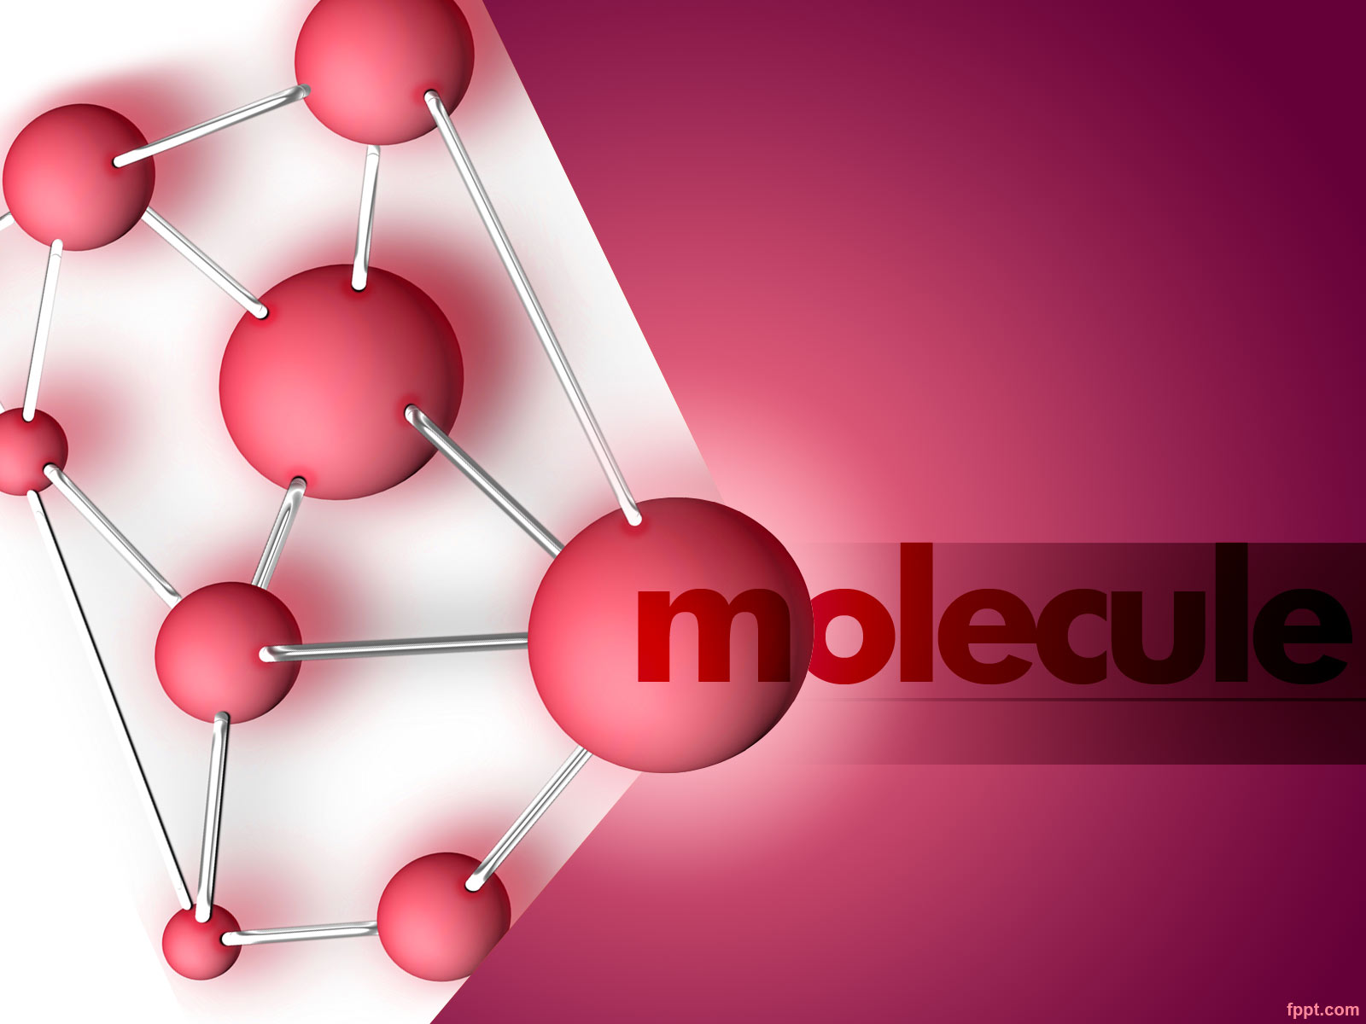
MASS SPECTROSCOPY

Slide 2
Mass Spectrometry
Mass spectrometry is an analytical tool used for measuring the molecular mass of a sample.
Structural information can be generated using certain types of mass spectrometers, usually those with multiple analyzers which are known as tandem mass spectrometers.
This is achieved by fragmenting the sample inside the instrument and analyzing the products generated.
This procedure is useful for the structural elucidation of organic compounds and for peptide or oligonucleotide sequencing

Slide 3
Introduction
Mass spectroscopy is an effective method to determine the molecular weight and structure compounds.
It is advantageous to other methods of analysis in its ability to separate and analyze mixtures of compounds.
It is an extremely sensitive technique with current levels of accuracy within the range of one mass unit.

Slide 4
In MS, the compound in gaseous state, is bombarded with a beam of electron
to produce an ionic molecule (Molecular ion) of the original species.
The molecular ion has the same M Wt as of the original compound, which further fragments.
The ions formed are then separated according to their masses (m/z).
The spectrum produced is known as mass spectrum.
This mass spectrum is a record of information regarding various masses produced and their relative abundances.
m/e=H²r²/2V

Slide 5
Theory and Principle of Mass Spectrometry
Mass spectrometry is a micro analytical technique, requiring only a few nanomoles of the sample,
involving the production and separation of ionized molecules and
their ionic decomposition products, finally the measurement of relative abundance of different ions produced¹
Mass spectrometry is not concerning with non destructive interaction between molecules and electromagnetic radiation¹.
Thus mass spectrum of each compound is unique¹

Slide 6
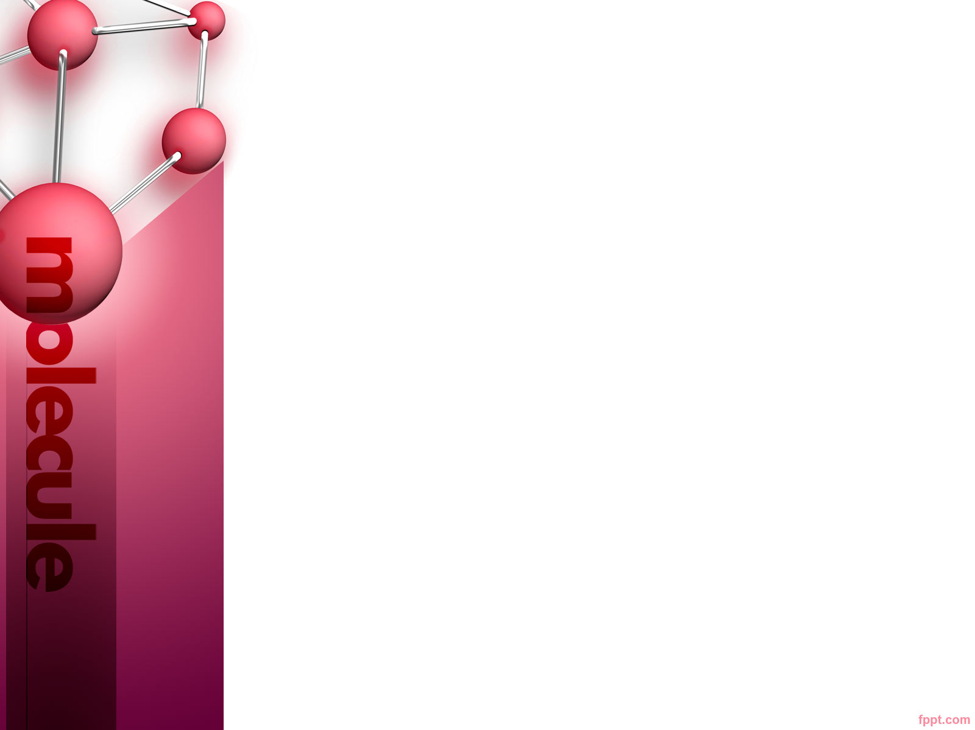
Slide Title
and can be used as a “chemical fingerprint” to characterize the sample .
Mass spectrum gives the information pertaining to the
Structure and molecular weight of the analyte (inorganic, organic, biological molecules).
Isotopic ratios of the atoms in the sample.
Qualitative and Quantitative composition of complex mixture .
Structure and composition of solid surfaces

Slide 7
Basic Principle of Mass spectrometry¹
1. Generating a beam of positively charged ions from the sample.
2. Separating these positively charged ions according to their mass to charge ratio.
Ion separation process must really accomplish two things such as
It must separate ions of different m/e values
It must sharply focus all ions of the same m/e values.
3. Recording the relative abundance of each species of ions

Slide 8
Principle of Mass Spectrometry
Mass spectrometers can be divided into three fundamental parts, namely the ionization source , the analyzer , and the detector.
The sample in the gaseous state has to be introduced into the ionization source under the pressure (10⁻⁷ to 10⁻⁵ mm Hg).
Then bombarded with a beam of energetic electron using tungsten or rhenium filament.
Once inside the ionization source, the sample molecules are ionized or broken up in to cations and many other fragments.

Slide 9
Principle of Mass Spectrometry
These cations are formed due to loss of an electron usually from the n or π orbital from a molecule, which further breaks into smaller ions.
All these ions are accelerated by an electric field.
where they are separated according to their mass (m) -to-charge (z) ratios (m/z) .
The separated ions are detected and this signal sent to a data system
where the m/z ratios are stored together with their relative abundance for presentation in the format of a m/z spectrum

Slide 10
Principle of Mass Spectrometry
When the ions are accelerated by the electric field in the ion source they acquire the energy
E = e V
where, e = Charge on the ions
V = Applied potential
When the ions are emerging out of ion source at that time the potential energy (electric energy) is converted into the kinetic energy (movement ) represented by the equation

Slide 11
Principle of Mass Spectrometry
e V =
½ mv²
Where,
V is Acceleration voltage
v is the velocity of ions
m is mass of ions
V² = 2 eV /m
When the ions enter the magnetic field (H) of the analyzer they
assume circular path and are subjected to magnetic force of Magnitude HeV.
At the equilibrium magnetic force will be equal to the centrifugal force mV²/r,
where r is radius of circular path and H is applied magnetic field strength.

Slide 12
How a Mass Spectrometer Works
The Sequence is
Ionization
Acceleration
Deflection
Detection
Source
Analyser
Detector

Slide 13
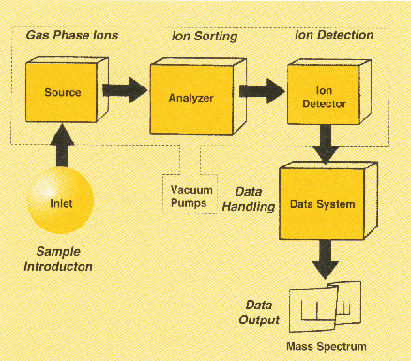
Different Components of a
Mass spectrometer
The three processes are
Ionisation
Sorting of ions
Detection

Slide 14
Sample studied in the mass spectrometry may be a gas, solid, or liquid.
Starting for the analysis is to introducing the sample into the ionization chamber.
Sample inlet system is partially evacuated as ionization chamber is itself at a lower pressure than sample inlet system .
The appearance of mass spectra for a given molecular species is highly dependent upon the method used for the ion formation.
Known as ion sources these methods fall into the two major categories³

Slide 15
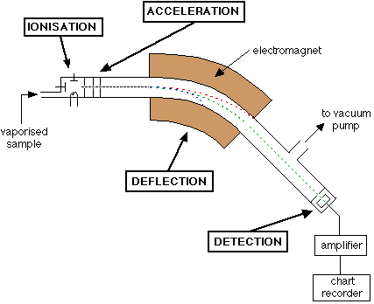
How a Mass Spectrometer Works
Mass Spectrometer

Slide 16
Instrumentation of Mass Spectrometer
The Essential Components are
Sample Inlet System
Ion Source
Mass Analysers
Ion Collecting System
Vacuum System
Data Handling

Slide 17

Ionization methods
Ionization methods are based on two modes
  1) Gas Phase Sources
  2) Desorption Sources
1) Gas Phase Sources
-In gas phase source sample is first vaporized and then ionized.
It is generally restricted to thermally stable compounds that have boiling points less than about 500°c³.
Electron Impact ionization. (EI).
Chemical ionization. (CI).
Field ionization. (FI).

Slide 18
b) Desorption sources
In Desorption ionization solid or liquid state is converted directly into gaseous ions.
An advantage of Desorption sources is that they are applicable to non volatile and thermally unstable samples.
  Field Desorption (FD).
  Electrospray Ionization (ESI).
  Matrix assisted laser desorption Ionisation (MALDI)
  Fast Atom Bombardment (FAB).
  Thermospray Ionization (TS).

Slide 19
Example as
Field Desorption. (FD).
Fast atom bombardment. (FAB).
Thermo spray ionization. (TS).
Matrix assisted Laser Desorption /ionization (MALDI).
  Electrospray Ionization (ESI).

Slide 20
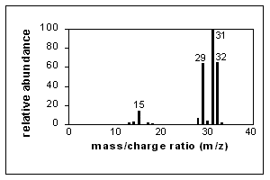
Interpreting spectra

Slide 21
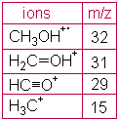
A simple spectrum that of methanol is shown here. CH₃OH⁺. (The molecular ion) and fragment ions appear in this spectrum. .
Major peaks are shown in the table next to the spectrum.

Slide 22
The x-axis of this bar graph is the increasing m/e ratio .
The y-axis is the relative abundance of each ion.
Which is related to the number of times an ion of that m/e ratio strikes the detector.

Slide 23
APPLICATIONS OF MASS SPECTROMETRY
    Determination of molecular weights of the organic compounds.
    Detection of drugs of abuse in sports.
    Determination of organic compounds like cholesterol, glucose, urea etc and trace elements in human body fluids.
    Structure determination of newly synthesised compounds.
    Monitoring of environmental pollutants example: pesticides, herbicides.
    Determination of drugs and their metabolites in human body fluids.
    Detection of adulteration of honey with corn syrup.

Slide 24
    Location of oil deposits by measuring petroleum precursors in rock.
    Composition of molecular species found in space.
    Determination of the age of the rocks and minerals and the half-lives of radioactive nuclides.
    Determination of isotopic composition of different elements.
    Discovering natural fission reactors.
    Identifying the irradiated and non-irradiated food materials.
    Precise and accurate determination of trace and ultra trace constituents in high purity matrices.

