Slide 1
CLINICAL PHARMACY
Microbiological culture sensitivity test
1

Slide 2


Microbiological culture
It is a method of multiplying microbial organisms by letting them reproduce in predetermined culture media under controlled laboratory conditions.
Microbial cultures are used to determine the type of organism
and its abundance in the sample being tested or both.

Slide 3

Sensitivity test
A laboratory test performed to check the effectiveness of a drug against a microorganism, to select the best drug regimen that is effective.
3

Slide 4
Microbiological culture sensitivity tests
It is a method of multiplying microbial organisms in a predetermined culture media with favourable conditions and tested to check the sensitivity of organism towards the drugs.

Slide 5
Purpose of culture sensitivity test
To guide the clinician in selecting the best drug for an individual patient.
To control the use of inappropriate drug in clinical practice.
To accumulate epidemiological information on the resistance of microorganism of public health importance within the community.
To reveal the changing trends in the local isolates. To overcome the microbial drug resistance.

Slide 6
How sensitivity analysis done ?
Sensitivity analysis starts with a sample.
The sample is obtained by swabbing the infected area or secretions of the infected area and from any area that has an infection.
Culturing sample may be sputum or blood or urine, swab or any body fluid.

Slide 7
How the method is selected
Selection of the appropriate method will depend on the intended degree of accuracy, convenience, urgency, availability of resources, availability of expertise and cost.

Slide 8
Steps in analysis
The doctor will send the specimen to a licensed laboratory in a special culture tube for testing.
There the sample of infective material spread onto a
plate of nutrient substance (culture media) and the Bacteria in the culture will grow and multiply.
The bacteria will form colonies-large groups of bacteria that will be exposed to different antibiotics.

Slide 9
With a sufficient population of bacteria grown on the plate in the form of a “lawn", the technicians will perform two main operations:
Identify the species of bacteria
Determine the bacterial populations sensitivity to antibiotics

Slide 10
Identify the species of bacteria
This is done with various techniques, including examination of lawn characteristics-color, texture, growth pattern, etc.
Gram staining, microscopic examination, metabolic requirements and even DNA sequencing.
Bacterial species commonly isolated depends on the
location and the cause of the infection.

Slide 11
Determine the bacterial populations sensitivity of antibiotics
.
This can be done by placing small disks of filter paper or the agar impregnated with various types of antibiotics onto the bacterial lawn.
The bacteria are allowed to incubate for a specified days and then is examined to see whether the bacterial growth is inhibited or not by the antibiotics on each disk.

Slide 12
Methods for Microbiological Culture Sensitivity Tests
DILUTION METHODS
DISC-DIFFUSION METHOD
E-TEST
AUTOMATED METHODS

Slide 13
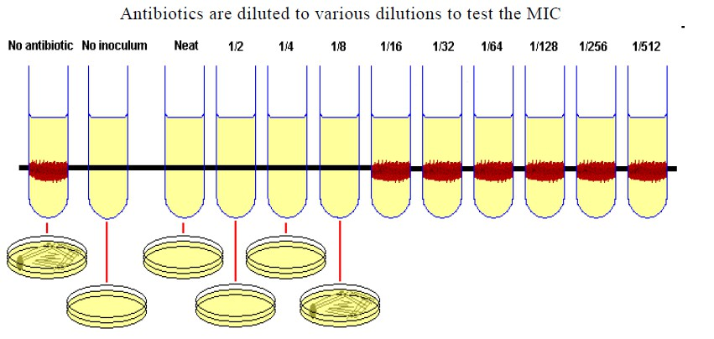
DILUTION METHOD

Slide 14
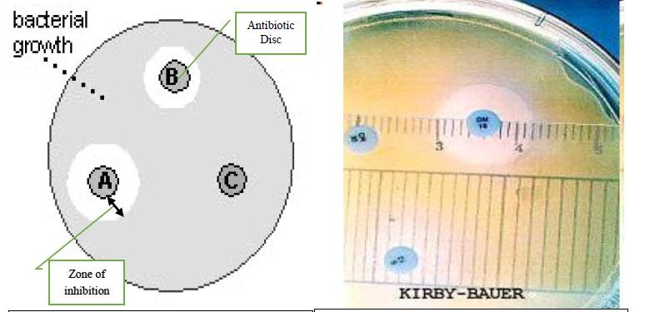
DISC-DIFFUSION METHOD
14

Slide 15
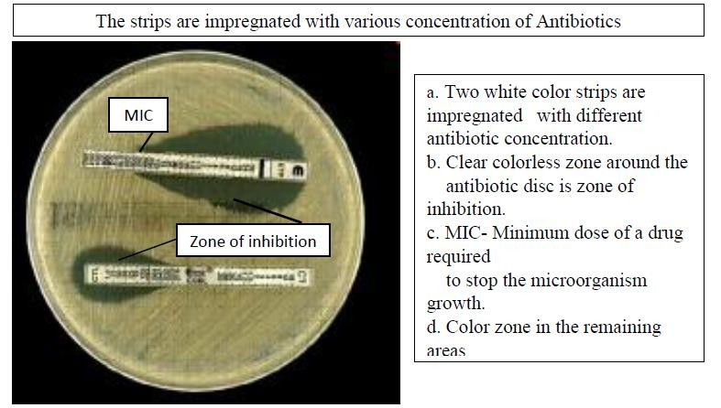
E-TEST

Slide 16
AUTOMATED METHODS
Most automated antimicrobial susceptibility testing systems provide automated inoculation, reading and interpretation.
These systems have the advantage of being rapid and
convenient, but one major limitation for most laboratories is the cost entailed in initial purchase, operation and maintenance of the machinery.

Slide 17
Results for a sensitivity analysis
The colonies show up as: Susceptible and/or Resistant and/or Intermediate.
Susceptible: In this case, a clear, circular “halo”-technically known as a “plaque” or zone of inhibition- will appear around the antibiotic disc, indicating an absence of bacteria. The antibiotic has inhibited their growth and/or killed them, means that they can not grow if the drug is present. This indicates an effective antibiotic.

Slide 18
Resistant: In this case, the filter Paper will have no discernible plaque around it, meaning that the bacteria can grow even in the presence of a antibiotic. This indicates an ineffective anti-biotic .
Intermediate: A somewhat cloudy plaque indicates that not all the bacteria in the area around the disc have been killed. this means that a higher dose of the antibiotic is needed to prevent the growth.

Slide 19
Microbial culture sensitivity report
Name of the patient: Culturing Sample: Susceptible microorganism:
Age: Gender: IP No: Date and time of collection:
S.NO | ANTIBIOTIC | SENSITIVE | INTERMEDIATE | RESISTANT
1. | A
2. | B
3. | C
4. | D
5. | E
6. | F
7. | G
IMPRESSION:

Slide 20
THANK YOU

