Slide 1

PHARMACOTHERAPEUTICS-III
UNIT NO- 03 NERVOUS SYSTEM

Slide 2
INTRODUCTION:-
Nervous system is the chief controlling & co-ordinating system of the body.
It adjust the body both voluntary & involuntary

Slide 3













CLASSIFICATION:-
Nervous System
Central Nervous System (CNS)
Peripheral Nervous System (PNS)
Brain
Spinal Cord
Motor Neurons
Sensory Neurons
Somatic Nervous System
voluntary movements via skeletal muscles
Autonomic Nervous System
organs, smooth muscles
Sympathetic
- “Fight-or-Flight” responses
Parasympathetic
- maintenance

Slide 4
FUNCTIONS OF CNS:-
Sensory input – gathering information
  To monitor changes occurring inside and outside the body (changes = stimuli)
Integration –
  To process and interpret sensory input and decide if action is needed.
Motor output
  A response to integrated stimuli
  The response activates muscles or glands

Slide 5
Two main kind of cell are present in NS.
Neurones (The basic structural and functional unit of the nervous system)
Neuroglia (support/maintain neurons)

Slide 6

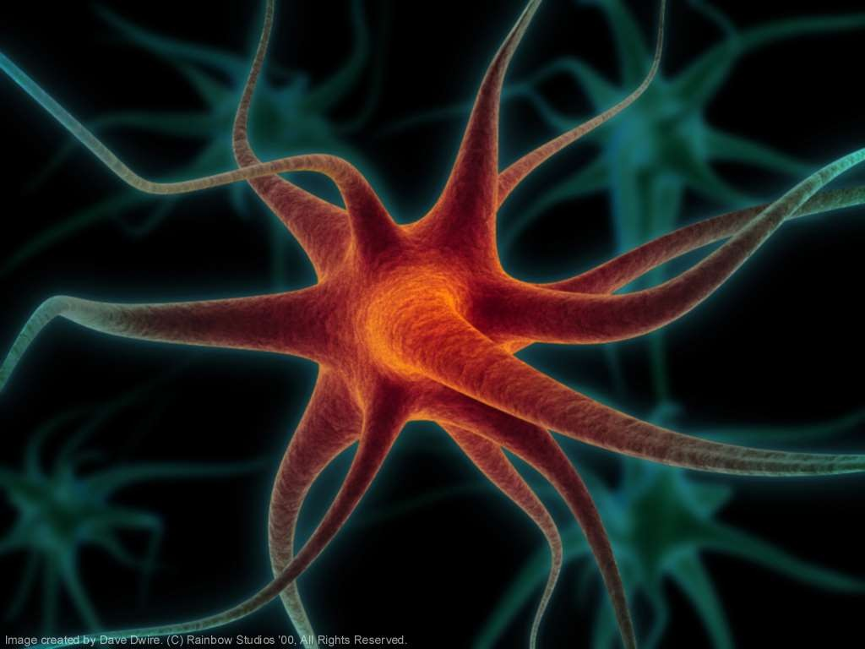
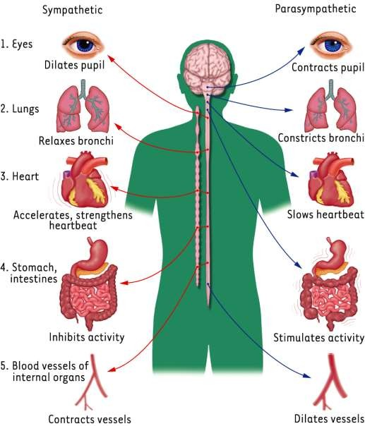






Slide 7
NEURONS:-
Is the basic functional unit of NS.
It is a cell that receive, intimate & transmits the information
Communicate with other neurons through chemical signals.
Approx. 100 billion located in the CNS

Slide 8


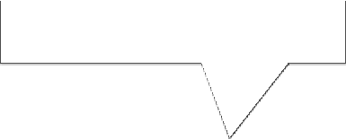


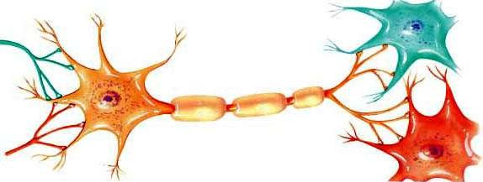







NEURONS STRUCTURE:-
Dendrites
Cell Body
Myelin Sheath
Axon of another neuron
Axon
Dendrites of another neuron

Slide 9
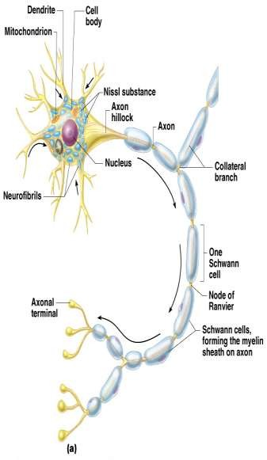
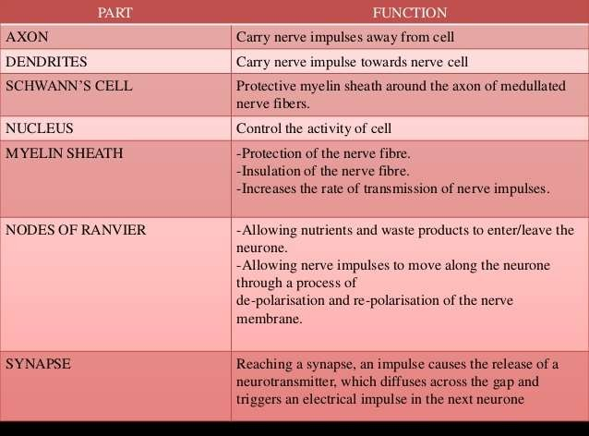

Slide 10



CLASSIFICATION OF NEURONS:-
Sensory neurons
Motor neurons
Mixed neurons

Slide 11
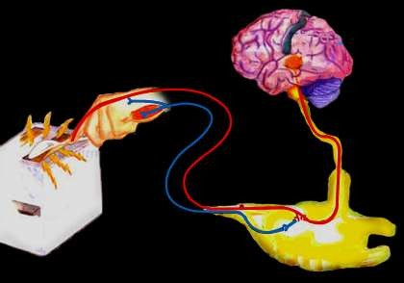
INPUT From sensory organs to the brain and spinal cord.
Sensory Neuron
Brain
Spinal Cord

Slide 12
OUTPUT: From the brain and spinal cord To the muscles and glands.
Sensory Neuron
Brain
Spinal
Cord
Motor
Neuron

Slide 13
Mixed carry information between other neurons only found in the brain and spinal cord.
Sensory Neuron
Brain
Spinal Cord
Motor
Neuron

Slide 14
Neurotransmitter:-in the brain & spinal cord
Neurotransmitters are chemicals that convey information to the target cells.

Slide 15
NEUROTRANSMITTER:-
Acetylcholine (Ach) | ment, learning, memory, Sleep
Dopamine (DA) | Attention, learning. regulation of movements and coordination, emotions, voluntary decision-making ability
Nor-epihephrine (NE) | Affects eating,Regulation of mood, cognition, perception, locomotion, cardiovascular functioning, and sleep.
Epinephrine | Affects metabolism of glucose, energy release during exercise.
Serotonin | Affects mood, sleep, appetite,aggression

Slide 16
Glutamate | Active in areas of the brain involved in learning good emotion
GABA (Gamma-amino butyric Acid) | Facilitates neural inhibition in the central nervous system (Too much action potential)
Endorphins | Provide relief from pain and feelings of pleasure and well- being

