Slide 1
PHARMACOTHERAPEUTICS- III
NEURALGIAS

Slide 2
NEURALGIA
Neuralgia is a stabbing, burning, and often quite severe pain that occurs along a damaged nerve. The damaged nerve may be anywhere in the body, but is most common in the face and neck. The cause of a damaged nerve may be a disease like diabetes or multiple sclerosis, an infection like shingles, or the result of old age.

Slide 3
CAUSES OF NEURALGIA
Infection
An infection can affect your nerves. For example, the cause of postherpetic neuralgia is shingles, an infection caused by the chickenpox virus. The likelihood of having this infection increases with age. An infection in a specific part of the body may also affect a nearby nerve. For example, if you have an infection in a tooth, it may affect the nerve and cause pain.
Multiple sclerosis
Multiple sclerosis (MS) is a disease caused by the deterioration of myelin, the covering of nerves. Trigeminal neuralgia may occur in someone with MS.
Pressure on nerves
Pressure or compression of nerves may cause neuralgia. The pressure may come from a:
bone
ligament
blood vessel
tumor

Slide 4
The pressure of a swollen blood vessel is a common cause of trigeminal neuralgia.
Diabetes
Many people with diabetes have problems with their nerves, including neuralgia. The excess glucose in the bloodstream may damage nerves. This damage is most common in the hands, arms, feet, and legs.
Less common causes
If the cause of neuralgia isn’t infection, MS, diabetes, or pressure on the nerves, it may be from one of many less-common factors. These include:
chronic kidney disease
medications prescribed for cancer
fluoroquinolone antibiotics, used to treat some infections
trauma, such as from surgery
chemical irritation

Slide 5
TYPES OF NEURALGIA
Postherpetic Neuralgia (PHN)
Trigeminal Neuralgia
Glossopharyngeal Neuralgia
Swimmer's headache, or supraorbital neuralgia
Occipital Neuralgia

Slide 6
POSTHERPETIC NEURALGIA
Postherpetic neuralgia (PHN) is a neuropathic pain syndrome characterized by pain that persists for months to years after resolution of the herpes zoster (HZ) rash.
HZ, also known as shingles, is a distinctive clinical condition caused by the reactivation of varicella zoster virus (VZV), which starts residing latently in the body after a primary varicella (chickenpox) infection, which may have occurred decades earlier.
Reactivation of VZV can also produce chronic neuropathic pain without rash (zoster sine herpete), which can be more challenging to diagnose and may involve testing the cerebrospinal fluid.

Slide 7
EPIDEMIOLOGY
In a survey conducted between 1988 and 1994 in the US, over 99% of adults aged ≥40 years had serologic evidence of prior VZV infection and are therefore at risk of developing HZ.
Approximately 1 million cases of HZ occur annually in the US, and one in every three persons develops HZ during their lifetime.
It is estimated that 5%–20% of those with HZ go on to develop PHN.
The frequency and severity of PHN increase with advancing age, occurring in 20% of people aged 60–65 years who have had acute HZ, and in more than 30% of people aged >80 years.
In addition to age, risk factors for developing PHN after HZ include the presence of a prodrome (defined as pain and/or abnormal sensations before rash onset), severe rash (defined as >50 lesions: papules, vesicles, or crusted vesicles), and severe pain during the acute phase.
A recent systematic review and meta-analysis also identified ophthalmic involvement as a risk factor.
Additional possible risk factors included systemic lupus erythematosus, diabetes, and recent trauma.
Immunocompromised patients are at increased risk of VZV reactivation as well as neurological complications

Slide 8
PATHOPHYSIOLOGY
PHN occurs in the same dermatomes as the HZ rash, and stems from damage to peripheral and central neurons that may be a byproduct of the immune/inflammatory response that accompanied VZV reactivation and migration.
When damaged, peripheral and central nerve fibers may develop a lower threshold for action potentials, discharge spontaneously, and exhibit disproportionate responses to stimuli, resulting in peripheral sensitization and pain without painful stimuli (allodynia).
Patients with PHN experience three major types of pain:
  constant pain without a stimulus (often described as burning, aching, or throbbing),
  intermittent pain without a stimulus (often described as stabbing, shooting, or electric shock-like), and
  pain brought on by a stimulus but is disproportionate to the stimulus (hyperalgesia), enduring for at least 3 months after healing of the HZ-related skin rash.
In addition, patients may experience a variety of abnormal sensations (dysesthesias or paresthesias).
Patients with PHN report decreased quality of life and interference with activities of daily living that may affect physical, psychological, and social aspects of their lives as well as their ability to function.

Slide 9
DIAGNOSIS
A history of HZ and the nature of the pain are critical parameters of a PHN diagnosis. Thus, obtaining a detailed medical history and including symptoms and vaccination history are very important, as is performing a careful physical examination with a focus on qualifying the pain and its impact on daily life.
Areas previously affected by HZ may show evidence of cutaneous scarring, and the site of the pain should be inspected for rash, color changes, and edema.
Areas of sensory abnormalities, including allodynia (painful response to normally innocuous stimuli), hyperalgesia (heightened pain response), or dysesthesia (unpleasant and abnormal sensation), in the affected area should be assessed for sensitivity to touch (eg, light touch with a cotton swab or small paintbrush; pinprick with a safety pin or a wooden toothpick), for thermal response to warm or cold objects (eg, metal thermorollers), and/or for response to vibration (eg, using a 128 Hz tuning fork)

Slide 10
Pain intensity and quality should be assessed using an appropriate pain scale, based on the patient’s ability to communicate – a numerical rating scale (usually an 11-point scale: from 0, no pain, to 10, severe pain), a visual analog scale, or verbal descriptor scale (eg, mcgill pain questionnaire).
The impact of pain on the quality of life should be evaluated, usually by interview, but structured questionnaires can also be used.

Slide 11
PREVENTION
The use of antiviral drugs in acute HZ phase raises the hypothesis of interrupting viral replication, reducing nervous injuries and, by consequence, the appearance of PHN.
PHN prevention is closely related to HZ prevention. Preventive measures include children vaccination against varicella-zoster virus, passive immunization against varicella (varicella-zoster immune globulin – VZIG) and vaccination against herpes-zoster for adults.

Slide 12
Children vaccination: Children should be vaccined in two doses, being the first at one year of age and the second between four and six years of age. Anti-varicella vaccine comes from attenuated vírus, being developed in human diploid cells, derived from the OKA virus (OKAv) strain, which remains latent in sensory ganglia.
Adult vaccination: Anti-HZ vaccine has high doses of attenuated live varicella virus, is well tolerated and has few adverse effects, the most common of which is pain at application site.

Slide 13
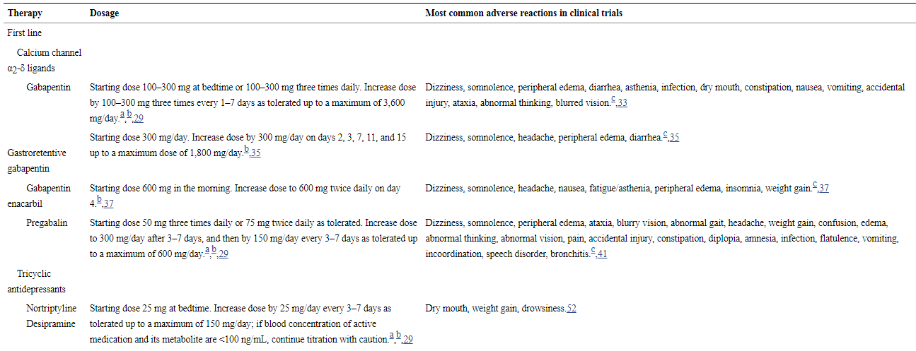
TREATMENT

Slide 14
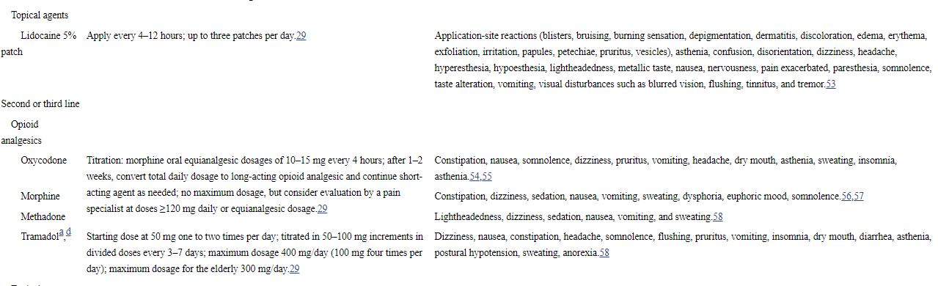

Slide 15
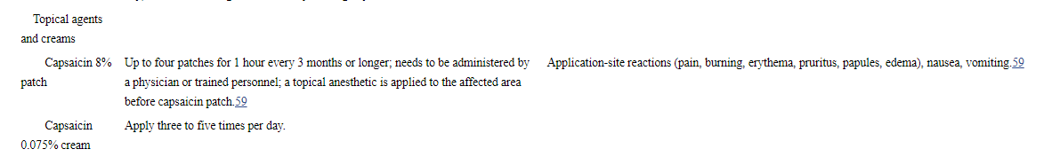

Slide 16
TRIGEMINAL NEURALGIA
Trigeminal neuralgia (TN) is sudden, usually unilateral, severe, brief, stabbing, recurrent episodes of pain in the distribution of one or more branches of the trigeminal nerve.

Slide 17
ETOIOLOGY
INTRACRANIAL CAUSES
  Petrous ridge compression-internal carotid artey pulsations
  Multiple sclerosis
  Intracranial tumors- at the cerebellopontine angle
  Intracranial vascular abnormalities-basilar artery aneurysm, superior cerebellar artery abnormality

Slide 18
EXTRACRANIAL CAUSES
  Vascular factors
  Dental etiology
  Post traumatic neuralgia
  Infections
  Viral etiology

Slide 19
Other disorders that may affect the trigeminal nerve include :
Neuralgias and neuritis
Syphilis
Tuberculosis
Tumor of the brain
Basilar meningitis
Pontine diseases.
Skull fracture
Aneurysm of the carotid artery or circle of willis
Psychoneuroses, and
Cavernous sinus thrombosis

Slide 20
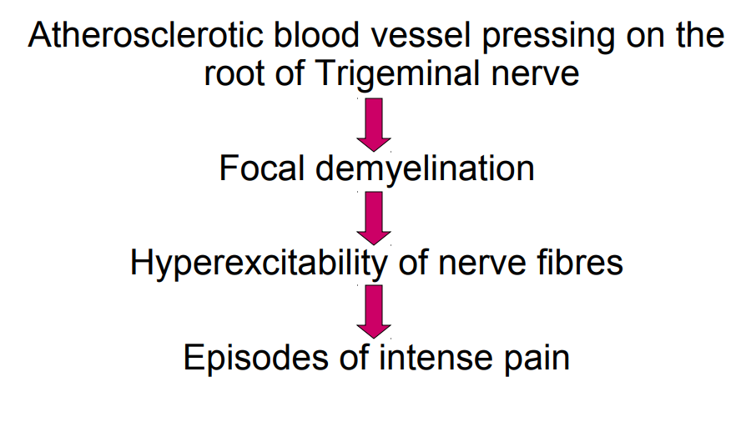
PATHOPHYSIOLOGY

Slide 21
TYPES OF TRIGEMINAL NEURALGIA
Pre Trigeminal neuralgia
Idiopathic Trigeminal neuralgia
Symptomatic neuralgia

Slide 22
Pre trigeminal neuralgia: dull aching pain usually observed before appearance of trigeminal neuralgia
Idopathic neuralgia: where the etiology remains unknown
Symptomatic neuralgia: the type in which the etiology is known

Slide 23
CLINICAL FEATURES
Incidence : 4 in 1,00,000
Age : 4th to 5th decade
Sex : F>M
60% on the right side, 3% bilateral.
Mean age of onset-52-58yrs
Involvement : maxillary-60%, mandibular-49%, ophthalmic-16%, all 3 divisions-1%

Slide 24
Manifests as sudden, unilateral, intermittent, paroxysmal, sharp, shooting, lancinating pain, elicited by slight touch.
Patient usually complains of electric shock/lightening like pain
Usually confined to one part.
Lasts for few seconds to minutes.
Motionless or mask like face.
Rarely crosses the midline.
Trigger points - Spontaneous attack or triggered by trigger zone or movement of the face as in chewing, talking, brushing or yawning
This leads patient frequently go unshaven or unwashed
Paroxysms occur in cycles.
Depression and weight loss

Slide 25
DIAGNOSIS
History
Trigeminal nerve examination
Diagnostic nerve blocking
MRI (brain)
EEG
Microneurography

Slide 26
MANAGEMENT
Pharmacological
Surgical
Others

Slide 27
PHARMACOLOGICAL
FIRST LINE OF APPROACH
  Carbamazepine 100, 200mg.
SECOND LINE OF APPROACH
  Phenytoin 100mg
  Baclofen 5-80 mg/day
  Lamotrigine 25 mg/day
THIRD LINE OF APPROACH
  Clonazepam 4-8 mg
  Valproic acid 250-500 mg
  Oxcarbazepine 1200mg/day

Slide 28
Other methods used are
Trichloro ethylene inhalation
Topical capsaicin cream application
Proparacaine 0.5% anaesthetic drops in eye
Anti inflammatory drug-Indomethacin & short courses of steroids are found useful in some cases.

Slide 29
SURGICAL
Stereo tactically controlled thermo coagulation of V cranial nerve
Vascular decompression( through posterior fossa craniotomy)
Repositioning of the basilar artery( compressing the V nerve)
Micro vascular decompression
Gamma knife radio surgery
Cryotherapy
Injection of the nerve with alcohol
Local anaesthetic injection of the nerve
Nerve sectioning & avulsion
Percutaneous radiofrequency trigeminal neurolysis
Bulbar trigeminal tractotomy
Glycerol rhizotomy

Slide 30
PARATRIGEMINAL NEURALGIA
Also called as raeder’s syndrome
Characterized by severe headache or pain in the distribution of trigeminal nerve with signs of ocular sympathetic paralysis
Homolateral pain in the head or eye
Sudden appearance of signs and symptoms
Most common in males
Generally occurs in middle aged people
It can be differentiated from horner’s syndrome by presence of pain and no change in sweating activity

Slide 31
SPHENOPALATINE NEURALGIA
Also called as vidian nerve neuralgia or hortons’s syndrome
An idiopathic sydrome consisiting of recurrent brief attack of sudden severe unilateral periorbital pain.
Typical periodicity has been attributed to hypothalamic harmonal influences.
Pain is thought to be generated at the level of pericarotid/ cavernous sinus complex
Characterized by unilateral paroxysms of intense pain in the region of the eyes, maxilla, ear , mastoid, base of the nose, and beneath the zygoma.
Sometimes the pain extends into the occipital area as well.

Slide 32
The paroxysms of pain hava a rapid onset, persist for about 15 min, and to several hours, and then disappears as rapidly as they begin
There is no trigger zone
The attacks develop regularly, usually atleast once a day, over a prolonged period of time.
The onset of paroxysm occur exactly in the same time of the day, and for this
reason, the disease is referred to as “alarm clock headache”
After some weeks or months, the trauma disappears completely and this period of freedom and may persist for month or even for years

Slide 33
Sneezing , swelling of nasal mucosa and severe nasal discharge often appears simultaneously with the painful attacks as epiphohra or watering of eyes and blood shoot eyes
Paraesthestic senstation over the skin of lower half of the face also are reported
Men are more effected more commonly than women (5:1).
Treatment:
Cocainization of sphenopalatine ganglion or alcohol injection of this structure
Resection of ganglion
Surgical corrections of septal defects

Slide 34
GLOSSOPHARYNGEAL NEURALGIA
It is a pain similar to trigeminal neuralgia
Not as common as trigeminal neuralgia, but when it occurs, the pain may be as severe
The pain is sharp, shooting pain in the ear, commonly in the nasopharynx, tonsils, posterior portion of the tongue
Etiology is unknown
It occurs at any age period without age predilection
Numerous mild attacks may be interspreaded by occassional severe one
The patient usually has trigger zone in the posterior oropharynx or tonsillar fossa

Slide 35
Treatment:
Resection of extra carnial portion of nerve or intra cranial portion
Injection of alcohol is not widely accepted

