Slide 1

PHARMACOTHERAPEUTICS-III
SLEEP DISORDER

Slide 2
OVERVIEW
Introduction
Neurobiology of Sleep & Wakefulness
Stages of Sleep
Assessment
Classification of sleep disorder
Common Sleep disorders and management
References

Slide 3
INTRODUCTION
Sleep is a regularly recurring, rapidly reversible neurobehavioral state characterized by quiescence, postural recumbence, and reduced awareness of the environment
Sleep is considered to be a psychiatric “vital sign,” requiring routine evaluation and treatment whenever sleep disorders are encountered.
Sleep is required for proper brain function

Slide 4
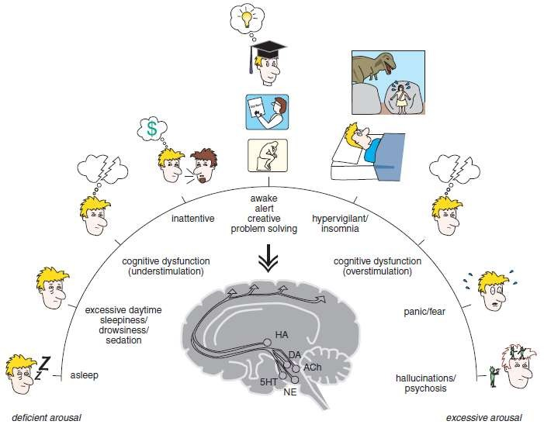
NEUROBIOLOGY OF SLEEP AND WAKEFULNESS
Arousal Spectrum of Sleep and Wakefulness

Slide 5
AROUSAL SPECTRUM OF SLEEP AND WAKEFULNESS
Influenced in by five key neurotransmitters:
  Histamine (HA)
  Dopamine (DA)
  Norepinephrine (NE)
  Serotonin (5HT)
  Acetylcholine (Ach).
When there is good balance between ‘too much’ and ‘too little’ arousal, one is awake, alert, and able to function well.

Slide 6
THE SLEEP/WAKE SWITCH
The hypothalamus is a key control center for sleep and wake
The “off” setting or sleep promoter, is localized within the Ventrolateral preoptic nucleus (VLPO) of the Hypothalamus
The “on” setting – the wake promoter – is localized within the Tuberomammillary nucleus (TMN) of the hypothalamus
Two key neurotransmitters regulate the sleep/wake switch: Histamine from the TMN and GABA from the VLPO

Slide 7
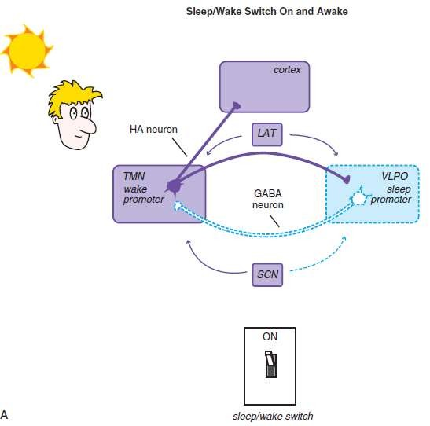
 When the TMN is active and histamine is released to the cortex and the VLPO, the wake promoter is on and the sleep promoter inhibited.

Slide 8
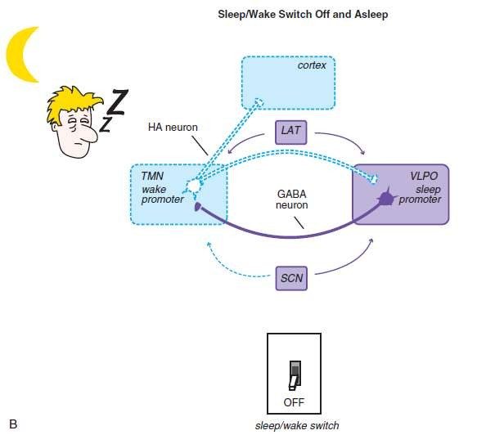
When the VLPO is active and GABA is released to the TMN, the sleep promoter is on and the wake promoter inhibited

Slide 9
The sleep/ wake switch is also regulated by orexin/ hypocretin neurons, the lateral hypothalamus (LAT) which stabilize wakefulness.

Slide 10

PROCESSES REGULATING SLEEP
The circadian wake drive is a result of input (light, melatonin, activity) to the Suprachiasmatic nucleus (SCN).
The longer one is awake – Homeostatic sleep drive increases and it decreases with sleep.
As the day progresses, circadian wake drive diminishes and homeostatic sleep drive increases until a tipping point is reached and the Ventrolateral preoptic sleep promoter (VLPO) is triggered to release GABA in the Tuberomammillary nucleus (TMN) and inhibit wakefulness

Slide 11
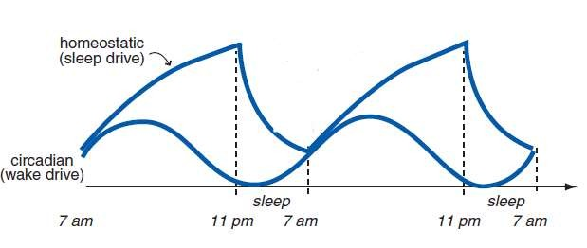
PROCESSES REGULATING SLEEP

Slide 12
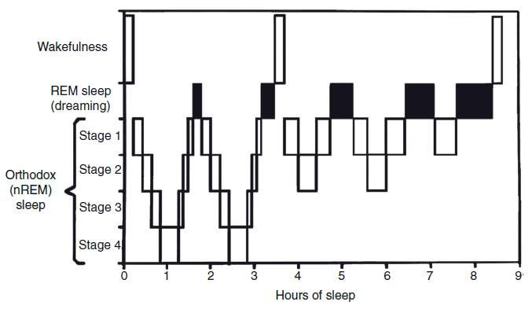
STAGES OF SLEEP

Slide 13
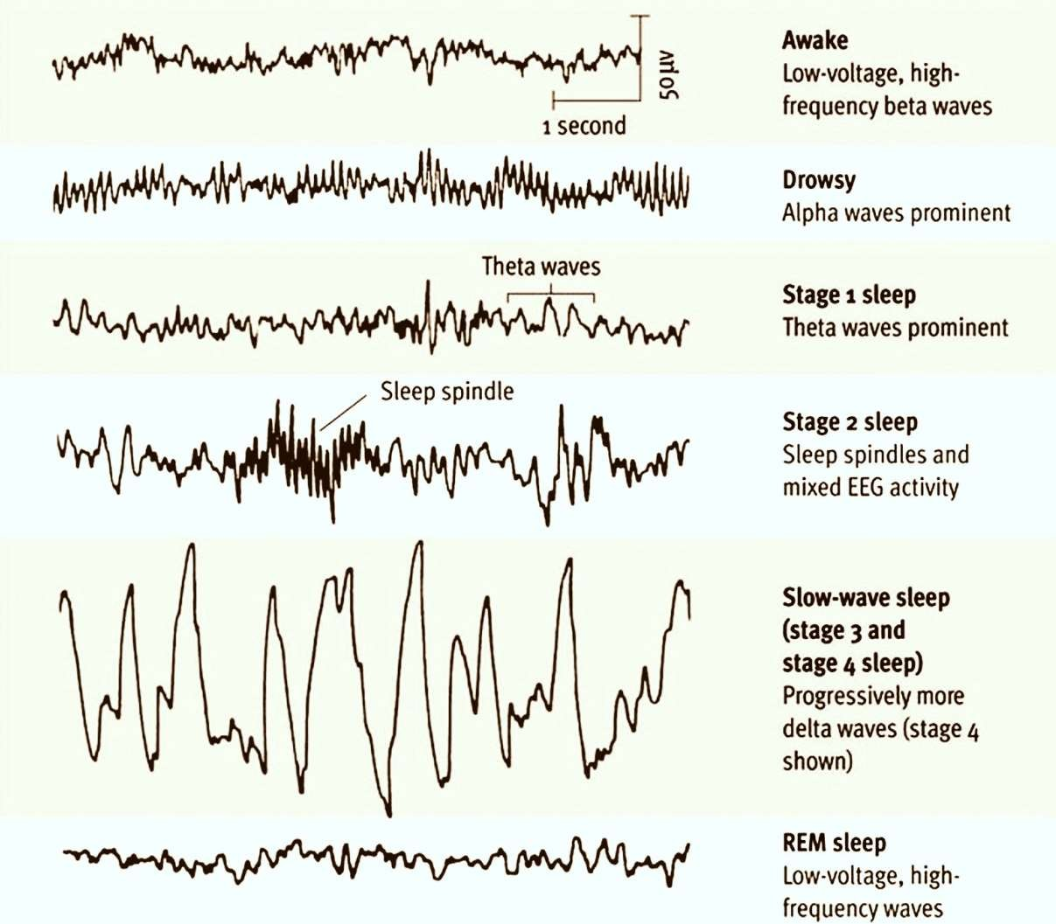
EEG activity
4 types :
beta(>12 Hz)
alpha(8–12 Hz)
theta(4–8 Hz)
delta(1–3 Hz)

Slide 14
PHYSIOLOGICAL CHARACTERISTICS OF SLEEP–WAKE STATES
 | Wake | NREM | REM
EEG | Fast, low voltage | Slow, high voltage | Fast, low voltage
Eye movement | Vision-related | Slow-irregular | Rapid
Muscle tone | ++ | + | -
Neuronal activity in Hypocretin / orexin neurons | ++ | - | -
Heart rate, blood pressure, respiratory rate | Variable | Slow/ low, regular | Variable, higher than NREM
Responses to hypoxia and hypercarbia | Active | Reduced responsiveness | Lowest responsiveness
Thermoregulation | Behavioral and physiological regulation | Physiological regulation only | Reduced physiological regulation
Mental activity | Full | None or limited | Story-like dreams

Slide 15
ASSESSMENT
Sleep history and accurate history of concurrent medical and psychiatric disorders
Evaluation of current medications
Retrospective self-report:
  Pittsburgh Sleep Quality Index (Buysse et al., 1989)
  Epworth Sleepiness Scale (Johns, 1991)
  Insomnia Severity Index (Bastien et al., 2001)
  Berlin Sleep Apnea Questionnaire (Netzer et al., 1999)
Prospective self-report: sleep–wake diaries or sleep logs

Slide 16
Behavioral measurements (Actigraphy) Polysomnography (PSG) : EEG, electro-oculograms (EOG), electomyogram (EMG), ECG, airflow, oral nasal pressure, ribcage and abdominal movement and oximetry. PSG is Gold standard for sleep assessment
 Functional imaging methods: PET, SPECT and fMRI.

Slide 17
SLEEP DISORDER CLASSIFICATIONS
Diagnostic & Statistical Manual of Mental Disorders (DSM 5)
International Classification of Diseases (ICD 10)
International Classification of Sleep Disorders (ICSD-3)

Slide 18
DSM-5 CLASSIFICATION
Insomnia Disorder
Hypersomnolence Disorder
Narcolepsy
Breathing-Related Sleep Disorders
  Obstructive Sleep Apnea Hypopnea
  Central Sleep Apnea
  Sleep Related Hypoventilation
Circadian Rhythm Sleep–Wake Disorders
Parasomnias
  Non-REM Sleep Arousal Disorders
  Nightmare Disorder and REM Sleep Behavior Disorder
Restless Legs Syndrome
Substance/Medication-Induced Sleep Disorder

Slide 19
ICD 10 CLASSIFICATION
G47 Sleep disorders
  G47.0 Disorders of initiating and maintaining sleep [insomnias]
  G47.1 Disorders of excessive somnolence [hypersomnias]
  G47.2 Disorders of the sleep-wake schedule
  G47.3 Sleep apnoea
  G47.4 Narcolepsy and cataplexy
  G47.8 Other sleep disorders
  G47.9 Sleep disorder, unspecified

Slide 20
INTERNATIONAL CLASSIFICATION DISORDERS (ICSD 3)
MAJOR DIAGNOSTIC SECTION:
Insomnia
Sleep-related breathing disorders
Central disorders of hypersomnolence
Circadian rhythm sleep-wake disorders
Parasomnias
Sleep-related movement disorders
Other sleep disorders

Slide 21
INSOMNIA DISORDER
DIAGNOSIS: The essential feature of Insomnia Disorder is dissatisfaction with sleep, characterized by difficulty falling asleep, difficulty maintaining sleep, or difficulty returning to sleep after awakenings during the night (American Psychiatric Association, 2013).
Quantitative criteria for Insomnia Disorder include frequency (at least 3 nights per week) and duration (at least 3 months).

Slide 22
Insomnia Disorder is diagnosed when the sleep problem is not better explained by, and does not occur exclusively during the course of, another mental, medical, or sleep disorder, and is not attributable to the physiologic effects of a drug or medication.
Often accompanied by symptoms of physical or cognitive “hyperarousal” at bedtime, such as muscle tension, inability to relax, or feeling more awake after going to bed.

Slide 23
EPIDEMIOLOGY:
most common sleep disorder.
~ 30–50% of the adult population may experience insomnia symptoms during the course of a year
 M:F = 1.5:1
Age effect is not universally observed

Slide 24
 MEDICAL DISORDERS AND CONDITIONS ASSOCIATED WITH INSOMNIA:
Congestive heart failure
COPD, asthma
Chronic renal failure, prostatic hypertrophy
Gastroesophageal reflux disease
Fibromyalgia, osteoarthritis, rheumatoid arthritis
Hyperthyroidism, diabetes
Parkinson’s disease, cerebrovascular disease
Menopause

Slide 25

PSYCHIATRIC DISORDERS AND CONDITIONS ASSOCIATED WITH INSOMNIA:
Major depression, dysthymic disorder, Bipolar disorder
Generalized anxiety disorder, panic disorder, PTSD
Schizophrenia
Substance use disorders
 MEDICATIONS AND SUBSTANCES ASSOCIATED WITH INSOMNIA: Alcohol (acute use, withdrawal), Caffeine, Nicotine, Cannabis, Antidepressants, Corticosteroids,
𝛽 agonists, theophylline derivatives, 𝛽 antagonists, Statins, Stimulants, Dopamine agonists

Slide 26
ETIOLOGY AND PATHOPHYSIOLOGY
 Genetic Factors: Increased prevalence of insomnia has been observed among monozygotic twins and first-degree family members.
 Neurobiological Factors: associated with physiological hyperarousal. Patients with insomnia have increased whole body metabolic rate, increased cortisol and ACTH (particularly in the evening and early sleep hours), altered heart rate variability, and altered secretion of norepinephrine and cytokines.

Slide 27
 Psychological Factors: Individuals with insomnia often have minor elevations in depressive and anxiety symptoms
 Social/Environmental Factors: Insomnia is often precipitated by social or environmental stressors.

Slide 28
TREATMENT
TREATMENT GOALS: to improve qualitative and quantitative aspects of sleep, to reduce sleep-related distress, and to improve daytime function.
SOMATIC TREATMENTS: Currently approved drugs include benzodiazepine receptor agonists, tricyclic drug, melatonin receptor agonist, antihistamines, and barbiturates
PSYCHOSOCIAL TREATMENTS: Stimulus control, Sleep restriction therapy, Relaxation training, Cognitive restructuring of irrational sleep-related beliefs and sleep hygiene.

Slide 29
SLEEP HYGIENE: Promote behaviors that improve sleep; limit behaviors that harm sleep:
Avoid naps
Get regular exercise
Maintain a regular sleep schedule
Avoid stimulants (caffeine, nicotine)
Limit alcohol intake
Do not look at the clock when awake in bed

Slide 30
NARCOLEPSY
The hallmark of Narcolepsy is extreme daytime sleepiness, marked by recurrent episodes of an irresistible need to sleep, unintentional sleep episodes, or napping. (at least 3 times per week for at least 3 months)
 In addition, Narcolepsy requires one of three additional findings:
1. EPISODES OF CATAPLEXY: Sudden and bilateral loss of muscle tone with preserved consciousness, and often precipitated by strong emotions such as laughter

Slide 31
Hypocretin (orexin) deficiency in cerebrospinal fluid
Specific PSG findings: reduced latency to REM sleep during nocturnal PSG (15 minutes or less)
Narcolepsy is associated with sleep-related hallucinations at sleep onset (hypnagogic) or sleep offset (hynpnopompic) in 20–60% of patients.
Sleep paralysis at sleep onset or offset is also typical of narcolepsy, and consists of episodes of alertness with an inability to move skeletal muscles
Nightmares and vivid dreams also occur frequently

Slide 32
Prevalence: 0.02–0.04% of the general population
Narcolepsy follows chronic persistent courses.
ETIOLOGY AND PATHOPHYSIOLOGY:
Genetic Factors:
Strong association with HLA marker DQB 1*0602
Neurobiological Factors:
Narcolepsy is associated with deficiency of Hypocretin (orexin) in central nervous system
Postmortem studies of humans with narcolepsy show loss of orexinergic cells and reduced orexin immuno- reactivity in the lateral hypothalamus

Slide 33
TREATMENT:
TREATMENT GOALS: to reduce daytime sleepiness and to manage the symptoms of cataplexy, sleep paralysis, and sleep-related hallucinations when present
SOMATIC TREATMENTS: Monoaminergic stimulants (Methylphenidate, Dextroamphetamine, and mixed Amphetamine salts), Modafinil and Armodafinil, Atomoxetine, Bupropion, Anti-cataplectic drugs (Venlafaxine, Desmethylvenlafaxine, Duloxetine, or Fluoxetine, TCAs)
PSYCHOSOCIAL TREATMENTS: Scheduling regular brief nap

Slide 34
HYPERSOMNOLENCE DISORDER
Main feature of Hypersomnolence Disorder is excessive sleepiness despite a normal sleep duration at night.
Repeated episodes of sleep during daytime hours; prolonged night time sleep, typically 9 hours or longer; and/or difficulty transitioning from sleep to wakefulness, often called sleep inertia.
Must be present at least 3 days per week for at least 3 months.
Significant distress or impairment in important daytime functions

Slide 35
Prevalence: 0.005–0.06% of Western populations
Comorbidity: Autonomic dysfunction such as orthostatic hypotension. Depression is also common.
Equal distribution among men and women
Insidious onset innthe second or third decade with a chronic persistent courses.

Slide 36

TYPES OF HYPERSOMNIA:
Kleine-Levin Syndrome
Menstrual-Related Hypersomnia
Idiopathic Hypersomnia
Behaviorally Induced Insufficient Sleep Syndrome
Hypersomnia Due to a Medical Condition
Hypersomnia Due to Drug or Substance Use

Slide 37
ETIOLOGY AND PATHOPHYSIOLOGY
Genetic Factors:
Familial aggregation in approximately 50% of cases, with a suggestion of autosomal dominant inheritance
20-fold risk in first-degree family members
Neurobiological Factors:
Dysfunction of monoaminergic arousal systems have been suggested by studies showing reduced CSF dopamine and/or norepinephrine metabolites

Slide 38
TREATMENT:
TREATMENT GOALS: to reduce the impact of long night time sleep and excessive daytime sleepiness
SOMATIC TREATMENTS: Monoaminergic stimulants (methylphenidate, dextroamphetamine, and mixed amphetamine salts), Modafinil and armodafinil, Atomoxetine, Bupropion.
PSYCHOSOCIAL TREATMENTS: setting regular sleep–wake schedules and using multiple alarms (including social interactions or bright light) may help to ease the sleep–wake transition.

Slide 39
BREATHING-RELATED SLEEP DISORDERS
Obstructive Sleep Apnea Hypopnea (OSAH)
Central Sleep Apnea (CSA)
Sleep-Related Hypoventilation (SRH).
 All are associated with impaired ventilation during sleep, often associated with intermittent or sustained hypoxemia, as well as with sleep disruption that may result in awakenings as well as daytime sleepiness or fatigue.

Slide 40
 Reductions in airflow lasting at least 10 seconds are classified as either apnea (absent airflow) or hypopnea (reduced airflow), and the frequency of these events per hour of sleep, termed the apnea hypopnea index (AHI)
 AHI is an important measure of the severity of OSAH and CSA.

Slide 41
OBSTRUCTIVE SLEEP APNEA HYPOPNEA (OSAH)
Most common
Characterized by repetitive pharyngeal airway obstruction during sleep
Diagnosis: In the absence of symptoms, PSG documenting at least an AHI of 15
Or
AHI > 5 with predominantly obstructive respiratory events, accompanied by symptoms

Slide 42
Nocturnal breathing disturbances: snoring, snorting/gasping, or breathing pauses, or
Daytime sleepiness, fatigue, or unrefreshing sleep despite sufficient sleep opportunity
Habitual snoring is a sensitive indicator
Increasing loudness of snoring is associated with higher risk
Snoring may be interrupted by silent periods (apneas), which are often terminated by resuscitative breathing.

Slide 43
Memory disturbances, poor concentration, irritability, and personality changes
OSAH affects multiple organs and may cause hypertension, heartburn, nocturia, morning headaches, and sexual dysfunction
Age (>55), gender (male), BMI (>30) and neck circumference (>16 inches women, >17 inches men) identify higher risk groups.
Male: Female = 2:1 to 4:1

Slide 44
TREATMENT:
 TREATMENT GOALS: to improve symptoms and quality of life and minimize risks of comorbidity
Somatic treatments: continuous positive airway pressure (CPAP) and Mandibular advancement and devices (MAD) surgical procedures like uvulopapatopharyngoplasty.
 PSYCHOSOCIAL TREATMENTS: Weight loss, avoiding the supine sleep position, reducing evening alcohol consumption, and getting adequate sleep duration.

Slide 45
CENTRAL SLEEP APNEA
Characterized by variability in respiratory effort that leads to episodes of apnea and hypopnea during sleep
Diagnostic criteria require at least five central apneas per hour
Subtypes:
Cheyne–Stokes Breathing (CSB) - heart failure, stroke, or renal failure.
Central Sleep Apnea Comorbid with Opioid Use - Chronic use of long-acting opioid medications, such as methadone.
Idiopathic Central Sleep Apnea.

Slide 46
TREATMENT:
The goals of treatment are to improve symptoms and quality of life and minimize cardiopulmonary risks
CPAP therapy is effective
Adaptive servo-ventilation (ASV)
Low-flow oxygen therapy
CSA comorbid with opioid use may improve with reduction in opioid dosage

Slide 47
SLEEP RELATED HYPOVENTILATION
Characterized by inadequate ventilation during sleep.
Diagnosis is made by PSG, which demonstrates abnormal elevation of CO2 levels, unassociated with apneas or hypopneas.
Patients may report fatigue, sleepiness, awakenings during sleep, morning headaches, or insomnia.
Most commonly SRH is seen with medical or neurological disorders or medications that depress ventilation.

Slide 48
Rarely, SRH can occur independently (Idiopathic Sleep-Related Hypoventilation or Congenital Central Alveolar Hypoventilation).
Obesity Hypoventilation Syndrome requires the presence of obesity (BMI > 30 kg/m²), awake hypercapnia (pCO2 > 45 mmHg) and the exclusion of other causes of hypoventilation.

Slide 49
Severity is determined by the amount of blood gas abnormalities measured during sleep (elevation of CO2 and decrease in SpO2) and evidence of end organ dysfunction, which may include pulmonary hypertension, cor pulmonale, polycythemia, and neurocognitive abnormalities.
Congenital Central Alveolar Hypoventilation is caused by mutations of PHOX2B.

Slide 50
TREATMENT:
The goal of therapy is to provide adequate ventilation in order to normalize blood gases during sleep and wakefulness.
Bi-level positive airway pressure: provides higher inspiratory pressures relative to expiratory pressures to augment tidal volume of spontaneous breaths.

Slide 51
CIRCADIAN RHYTHM SLEEP–WAKE DISORDERS
The essential feature is a persistent or recurrent pattern of sleep–wake disturbance characterized by abnormal timing of sleep or sleep propensity relative to the physical environment.
Manifest as insomnia, excessive sleepiness, or some combination of both.

Slide 52
DELAYED SLEEP PHASE TYPE:
 Individuals exhibit a sleep–wake cycle that is delayed by around 3 hours when compared to the general population
 If allowed to sleep at times that are consistent with their endogenous biological night, sleep duration and quality are typically normal

Slide 53
ADVANCED SLEEP PHASE TYPE:
 Individuals exhibit a stable sleep–wake cycle that is advanced in relation to conventional times.
 Patients present with symptoms of difficulty staying awake in the evening and early morning awakening, typically with a history of falling asleep between 6 and 9 p.m., and waking up between 2 and 5 a.m.

Slide 54
IRREGULAR SLEEP–WAKE TYPE:
 Characterized by an irregular pattern of sleep, with at least three distinct sleep periods occurring during a 24-hour period.
 Patients or their caregivers report symptoms of insomnia, excessive sleepiness, or both.

Slide 55
NON-24-HOUR SLEEP–WAKE DISORDER:
This results when an individual’s sleep–wake pattern is no longer entrained to the 24-hour physical environment, instead following the endogenous circadian rhythm that is usually slightly more than 24 hours.
Daytime napping is common, and is associated with impairment of function, particularly in blind individuals.

Slide 56
SHIFT WORK DISORDER:
 Characterized by sleep and wake disturbances for at least 3 months in the context of chronic shift work.
 Complaints include excessive sleepiness while at work, or of difficulty falling asleep during the time allowed for rest

Slide 57
JET LAG TYPE:
With the advent of highspeed air travel, an induced desynchrony between circadian and environmental clocks became possible. Thus, the term jet lag came into use
When an individual rapidly travels across many time zones, either a circadian phase advance or a phase delay is induced, depending on the direction of travel.
Normally, healthy individuals can easily adapt to one to two time zone changes per day; therefore, natural adjustment to an 8-hour translocation may take 4 or more days

Slide 58
ASSESSMENT:
 Sleep logs and/or actigraphy measurements for 7–14 days.
 Biological markers of circadian phase: Dim-light melatonin onset (DLMO) or core body temperature

Slide 59
TREATMENT:
Both light and melatonin, when given at specific times, can act to reset the circadian clock.
Modafinil is FDA-approved for use in shift workers with excessive daytime sleepiness.
Behavioural interventions (regular sleep scheduling).

Slide 60
PARASOMNIAS
Parasomnias are unpleasant or undesirable behavioral or experiential phenomena which occur predominately or exclusively during the sleep period.
Contrary to popular belief, most parasomnias are not the manifestation of underlying psychiatric disease.
Two broad categories: those occurring in association with Non-REM sleep, and those occurring in association with REM sleep.

Slide 61
NON-REM SLEEP AROUSAL DISORDERS
Diagnosis:
They are a set of parasomnias with varying clinical manifestations, linked by a common mechanism of arousal from Non-REM sleep.
The essential feature of these disorders is recurrent episodes of partial arousals from sleep, usually during the first third of the night.
Regardless of the specific behavioral manifestation, the individual recalls little, if any dream imagery, and has little or no recall for the event.

Slide 62
SLEEP WALKING:
 Characterized by repeated episodes of rising from bed during sleep and walking about.The individual’s eyes are open with a blank, staring face.
The sleepwalker is relatively unresponsive to the efforts of others to communicate with him or her, and can be awakened only with great difficulty.

Slide 63
SLEEP TERRORS:
Initiated by a loud scream associated with extreme panic and signs of intense fear.
The individual may have signs of autonomic arousal, such as mydriasis, tachycardia, tachypnea, and diaphoresis.
This is followed by prominent motor activity such as hitting the wall, or running around or out of the bedroom, occasionally resulting in personal injury or property damage
Complete amnesia for the activity is typical

Slide 64
CONFUSIONAL AROUSALS:
Often seen in children
Characterized by movements in bed, occasionally thrashing about, or inconsolable crying.
SLEEP-RELATED EATING DISORDER:
DSM-5 – subtype of sleepwalking.
It is characterized by frequent episodes of nocturnal eating, generally without full conscious awareness.

Slide 65
SLEEP-RELATED SEXUAL BEHAVIOR (SEXSOMNIA):
 A SUBTYPE OF SLEEPWALKING.
Consists of inappropriate sexual behaviors occurring during the sleep state without conscious awareness.
Such behaviors may result in feelings of guilt, shame, or depression and may have medico-legal implications.

Slide 66
TREATMENT:
TREATMENT GOALS: environmental safety: heavy curtains over windows, alarms at bedroom doors, and sleeping on the ground floor.
SOMATIC TREATMENTS:
Tricyclic antidepressants such as imipramine, and benzodiazepines such as clonazepam, may be effective.
Dopaminergic agents, opiates, or topirimate has been reportedly effective in sleep-related eating disorder
Sleep-related sexual behaviors may respond to clonazepam

Slide 67
REM-SLEEP RELATED PARASOMNIAS
Nightmare Disorder and REM Sleep Behavior Disorder (RBD).
Normal REM sleep is characterized by increased physiological activation, active mentation (dreams), and muscle atonia.
Nightmare Disorder and RBD are characterized by heightened mental activity and, in the case of RBD, absence of usual muscle atonia.

Slide 68
NIGHTMARE DISORDER
Bad dreams and nightmares are normal.
What differentiates Nightmare Disorder from normal bad dreams or nightmares is the frequency of events, degree of dysphoria, and the extent of distress or impairment in social, occupational, or other important areas of functioning.
Usually remembered in great detail, and immediately upon awakening, the individual is completely alert and oriented.

Slide 69
More commonly seen in the setting of physical/sexual abuse and posttraumatic stress disorder (PTSD).
May be comorbid with a number of medical or psychiatric conditions and may be induced by medication, notably beta- adrenergic from antagonists or withdrawal alcohol or other sedating medications.

Slide 70
TREATMENT:
Somatic Treatments:
Prazosin 10–16mg reduces nightmare frequency in PTSD.
Cyproheptadine, Guanfacine, and Clonidine have been reportedly helpful.
Psychosocial Treatments:
Dream rehearsal therapy - scripting and rehearsal of a new dream scenario to replace a common dream.

Slide 71

REM SLEEP BEHAVIOR DISORDER
Defined by repeated episodes of awakening from sleep accompanied by agitated or violent behaviors, such as shouting, screaming, kicking, and punching.
Commonly occur in the second half of the sleep period and usually accompany vivid, action-packed dreams.
Following an event, arousal from sleep to alertness and orientation is usually rapid and accompanied by complete dream recall.

Slide 72
Patient may have repeated injury, including ecchymosis, lacerations, and fractures.
The resulting injuries to the patient or bed partner may result in legal issues, such as charges for assault.
Many patients adopt self-protection measures such as tethering themselves to the bed, using sleeping bags or pillow barricades, or sleeping on a mattress in an empty room.

Slide 73
RBD is a frequent harbinger of neurodegenerative disorders.
Upto 70% of affected individuals will eventually develop a neurodegenerative disorders (most commonly Parkinson’s disease).

Slide 74
TREATMENT:
Somatic Treatments:
About 90% of patients respond well to clonazepam 0.5– 2.0mg.
Melatonin at doses up to 12 mg at bedtime or Pramipexole may also be effective.
Psychosocial Treatments:
Environment safety- potentially dangerous objects should be removed from the bedroom, cushions put around the bed or the mattress placed on the floor, and windows protected.

Slide 75
RESTLESS LEGS SYNDROME (RLS)
Neurological sensorimotor disorder characterized by uncomfortable leg sensations described as aching, grabbing, burning, tingling, creeping, crawling, or electric sensations that occur deep in the leg.
Symptoms occur in one or both of the legs, most often between the ankle and the knee, but may also extend to the arms or even trunk.
Typically worse in the evening, may occur prior to sleep onset, and are exclusively present at rest.

Slide 76
Generally relieved by motor activity, such as walking, pacing, shaking, stretching, or simply standing and bearing weight.
Associated features include sleep disturbance, daytime fatigue/sleepiness, and involuntary, repetitive, and jerking limb movements.
Several medications can either evoke or aggravate RLS, including Antihistamines, Lithium, Tricyclic antidepressants, Serotonin reuptake inhibitors, and Monoamine oxidase inhibitors.

Slide 77
Sleep deprivation/ fatigue, use of alcohol, tobacco and caffeine, lack of or excessive exercise and exposure to extremes of temperature (either hot or cold) may also worsen symptoms.
ASSESSMENT:
Neurological examination, including peripheral nerve function and peripheral vascular examination.
Laboratory studies - a complete blood count with RBC indices, iron binding capacity, ferritin, B12, folate, thyroid function tests, electrolytes and renal and liver function tests.

Slide 78
PREVALENCE – between 5% and 15% in the general population.
Slightly more common in women.
DIFFERENTIAL DIAGNOSIS
  Hypnic myoclonus (sleep starts)
  Phasic twitches (normal muscle twitches that occur during REM sleep)
  Nocturnal leg cramps
  Akathisia (neuroleptic-induced)

Slide 79
TREATMENT:
Dopamine precursors, such as regular or sustained-release carbidopa/levodopa.
Dopamine agonists Pergolide, Pramipexole, and Ropinirole.
Benzodiazepines decrease nocturnal arousals and improve the quality of sleep.
When nutritional deficiencies are present, replacement with iron, folate, B12, or magnesium may be indicated.

Slide 80
SUBSTANCE/MEDICATION-INDUCED SLEEP DISORDER
This is a prominent sleep disturbance associated with use, intoxication, or withdrawal from a medication or substance.
May be associated with Mood symptoms ranging from depression and anxiety to irritability and excitement.
Physical symptoms may also be present.

Slide 81
 Medications and Substances Associated With Insomnia: Alcohol (acute use, withdrawal), Caffeine, Nicotine, Cannabis, Antidepressants, Corticosteroids,
𝛽 agonists, theophylline derivatives, 𝛽 antagonists, Statins, Stimulants, Dopamine agonists

Slide 82
REFERENCES
Sadock BJ, Sadock VA, Ruiz P. Kaplan and Sadock’s Comprehensive textbook of Psychiatry. 9th edition.
Philadelphia: Lippincott Williams and Wilkins; 2009.
David AS, Fleminger S, et al. Lishman’s Organic Psychiatry. 4th edition. John Wiley & Sons Ltd. Publication; 2009.
Stahl SM. Stahl’s Essential Psychopharmacology. 4th edition. Cambridge University Press; 2014.
Tasman A, Kay J, Lieberman JA, First MB, Riba MB. Psychiatry. 4th ed. West Sussex: John Wiley & Sons Ltd; 2015.

Slide 83
REFERENCES
American Psychiatric Association, Diagnostic and Statistical Manual of Mental Disorders. 5th ed. Washington DC: New School Library; 2013.
World Health Organisation. The International Classification of Diseases, 10th edition. Geneva. WHO; 1996.
Satela MJ. International Classification of Sleep Disorders. 3rd Edition. American Academy of Sleep Medicine; 2014.

Slide 84
THANK YOU.....

