Slide 1

SUBSTANCE ABUSE

Slide 2
DEFINITION
Substance Dependence
Substance dependence arises out of a maladaptive pattern of substance use, leading to a cluster of behavioural, cognitive, and physiological phenomena that develop after repeated intake. It includes a strong desire to take the drug, difficulties in controlling its use, persisting in its use despite harmful consequences, a higher priority given to drug use than to other activities and obligations, increased tolerance, and sometimes a physical withdrawal state.

Slide 3
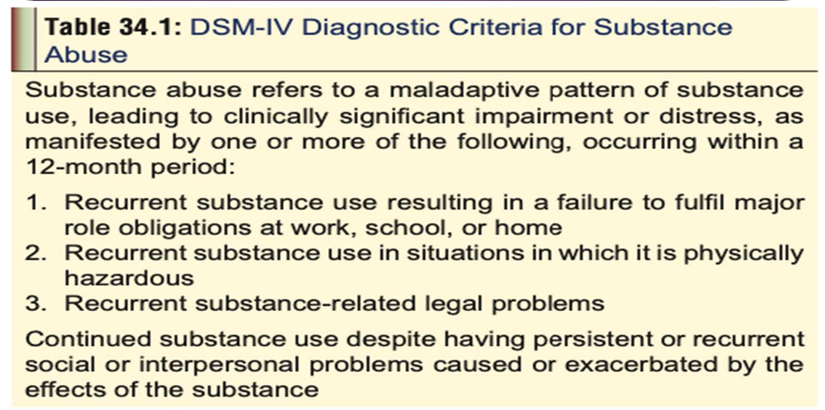
DIAGNOSTIC CRITERIA FOR SUBSTANCE ABUSE

Slide 4
SUBSTANCE INTOXIFICATION
This term refers to unwanted physiological or psychological effects that cause maladaptive behaviour. The Intoxication must produce disturbances in the level of consciousness, cognition, perception, affect, or behaviour that are clinically significant.
SUBSTANCE INDUCED DISORDERS
Use of certain psychoactive substances can induce syndromes (formerly called “organic mental disorders”) which include the following: substance intoxication, substance withdrawal, intoxication delirium, withdrawal delirium, dementia, amnestic disorders, psychotic disorders, mood disorders, anxiety disorders, sexual dysfunctions, and sleep disorders.
SUBSTANCE WITHDRAWAL
“substance withdrawal” should be restricted to major symptoms resulting from the cessation of substance abuse, accompanied by a maladaptive behaviour change. There should be clinically significant distress or impairment in social, occupational, or other important areas of functioning.

Slide 5
PHYSICAL DEPENDENCE
The term “physical” or “physiological” dependence is defined as an alteration in neural systems which is manifested by tolerance and the appearance of withdrawal phenomena when a chronically administered drug is discontinued or displaced from its receptor.
ADDICTION
The term “addiction” denotes a chronic disorder characterised by compulsive use of drugs (craving) resulting in physical, psychological, and social harm, and continued use despite evidence of that harm (denial).

Slide 6
CLASSIFICATION
Ethanol
Tobacco
Tranquillisers and Sedatives :Barbiturates, benzodiazepines, chloral hydrate, chlormethiazole, ethchlorvynol, glutethimide, hexapropymate, meprobamate, methyprylon, methaqualone, zolpidem, zopiclone
Opiates and Opioids
Cocaine
Cannabis
Amphetamines and “Designer Drugs”
Hallucinogens :Lysergic acid diethylamide (LSD), phencyclidine, psilocybine, bufotenine, mescaline, ketamine, diethyltryptamine (DMT)
Inhalants : Fluorinated hydrocarbons (freons), ethers, ketones, aromatic and aliphatic hydrocarbons
Miscellaneous Substances :Caffeine, datura seeds, analgesics, anabolic steroids, cough syrups, laxatives

Slide 7
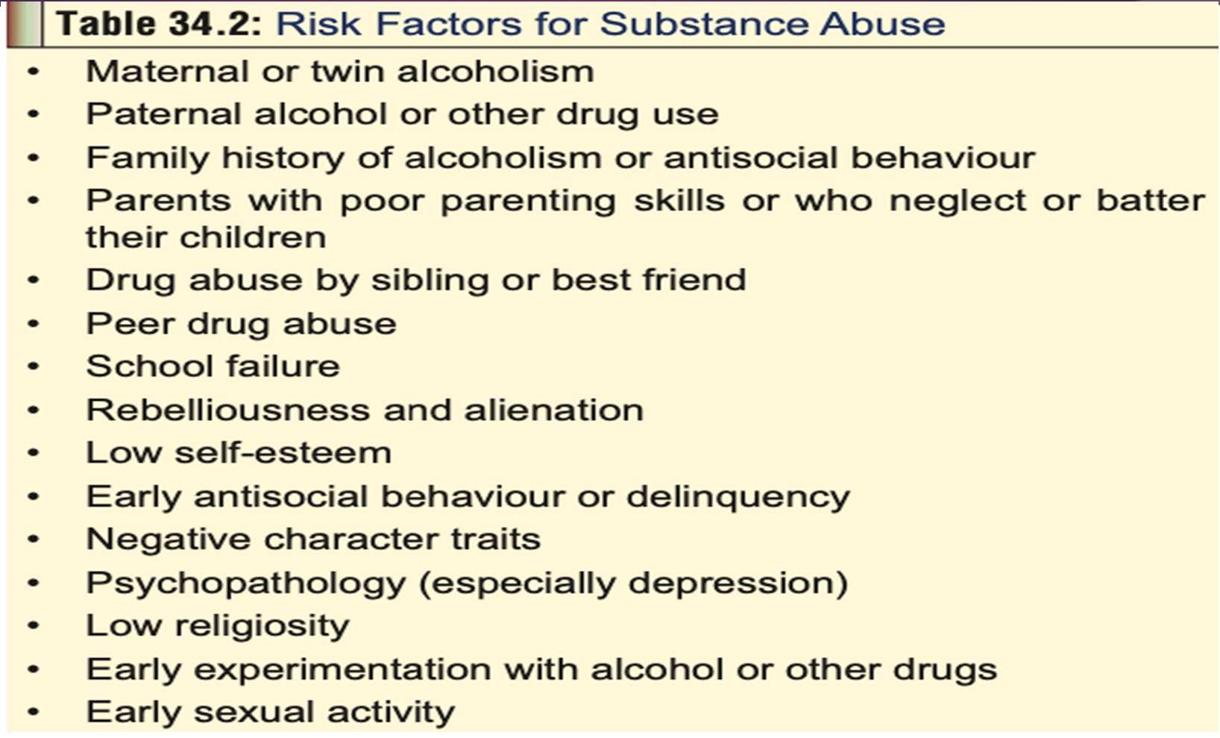
RISK FACTORS FOR SUBSTANCE ABUSE

Slide 8
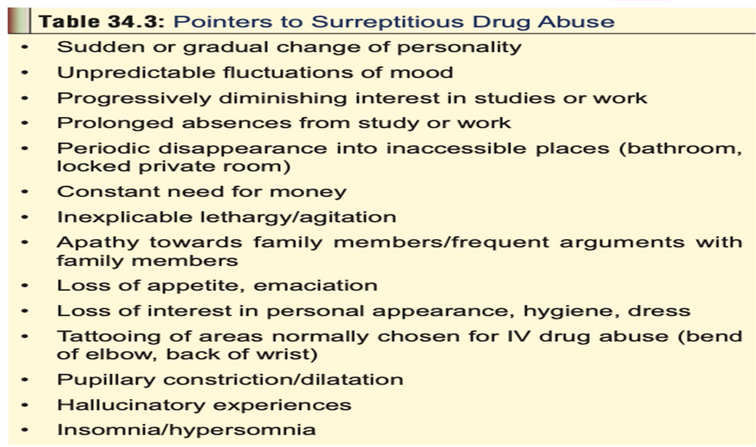
Identification Of Substance Abuse

Slide 9
TOBACCO
Sources
1. Nicotiana attenuata (Wild tobacco)
  Nicotiana glauca (Tree tobacco)
  Nicotiana longiflora (Cultivated ornamental) 4. Nicotiana rustica
Nicotiana tabacum (Commercial tobacco)
Nicotiana trigonophylla (Desert tobacco).
Active Principles
Nicotiana tabacum and N.rustica contain the following alkaoids:
  Nicotine
  Nornicotine
■ Anabasine ■ Anabatine.

Slide 10
Uses
Nicotine is a stimulant of the central nervous system, and is abused widely all over the world in the form of inhalation (cigarette, cigar, pipe, beedi), nasal insufflation (snuff), or chewing.
Nicotine is also used as an insecticide.
Mode of Action
Nicotine binds stereo-specifically to select acetylcholine receptors (nicotine receptors). These receptors are present throughout the body, particularly in the autonomic ganglia, adrenal medulla, central nervous system, spinal cord, neuromuscular junctions, and chemoreceptors of carotid and aortic bodies. In the CNS, the highest concentration of nicotine receptors is found in the limbic system, midbrain, and brainstem.
At moderate doses, nicotine stimulates the reticular activating system producing an alerting pattern on the EEG, with resultant favourable effects on memory and attention.
But higher doses cause tremor and convulsions due to a CNS disinhibition mechanism. 3.Nicotine stimulation of vagal centres in the medulla induces nausea and vomiting, while the
gastrooesophagal reflux is provoked due to a lowering of sphincter pressure and increased acid secretion. Larger doses cause diarrhoea due to both central and parasympathetic excitation.
By acting directly on nicotine receptors in endocrine glands, as well as by stimulating neurohumoral pathways in the CNS, nicotine enhances release of catecholamines, vasopressin or antidiuretic hormone, growth hormone, ACTH, cortisol, prolactin, serotonin, and beta endorphins. Nicotine also increases amylase, trypsin and chymotrypsin activity.
Nicotine suppresses appetite while increasing basal energy expenditure, resulting in weight loss. 6.Habitual use of nicotine by women results in decreased oestrogen levels (due to enhanced hydroxylation of oestradiol), thereby increasing the risk of osteoporosis.

Slide 11
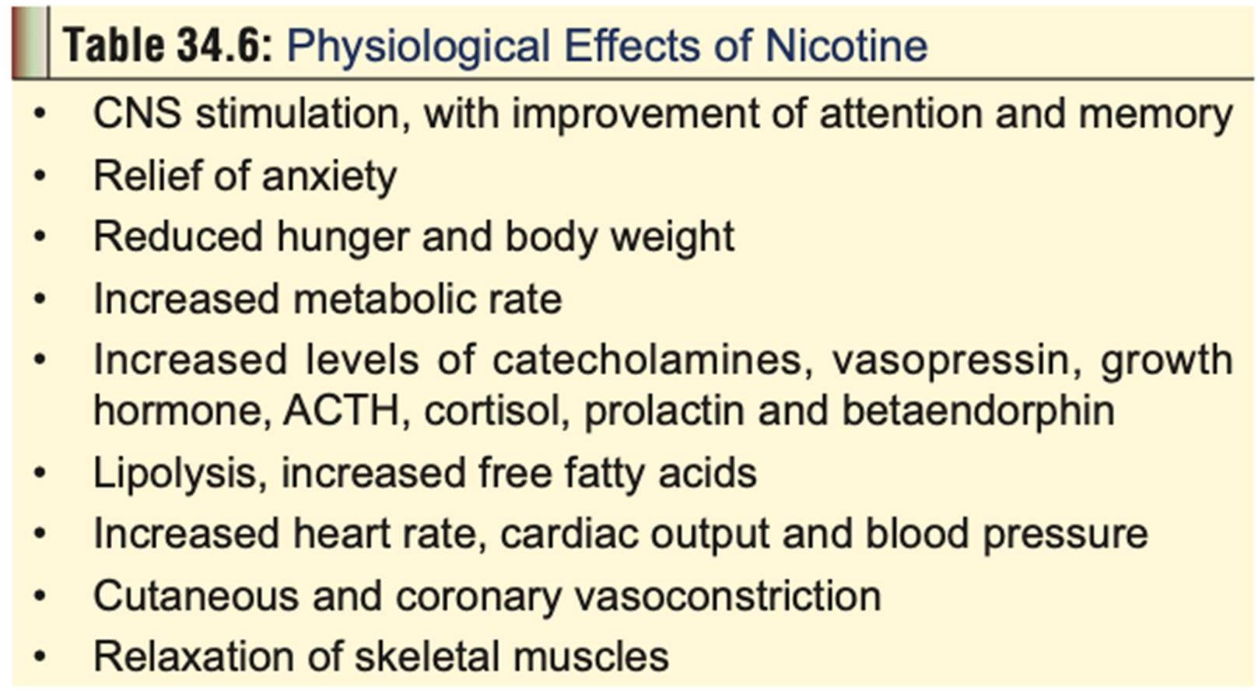

Slide 12
Clinical (Toxic) Features
1. Acute Poisoning:
Early Effects (15min to 1 hour)—
GIT: Nausea, salivation, vomiting, abdominal pain.
CVS: Tachycardia, hypertension.
RS: Tachypnoea, bronchorrhoea.
CNS: Agitation, anxiety, sweating, headache, blurred vision, confusion, vertigo, tremor, ataxia, muscle fasciculations, convulsions. Pupils are at first constricted, but may dilate later. A primary position upbeat nystagmus is seen following cigarette smoking, chewing of nicotine gum, and ingestion of nicotiana glauca leaves, and is the direct result of nicotine.
Delayed Effects (after1 hour)—
GIT: Diarrhoea.
CVS: Bradycardia, arrhythmias, hypotension, shock.
RS: Hypoventilation, apnoea.
CNS: Lethargy, weakness, hyporeflexia, hypotonia, paralysis, coma.

Slide 13
2. Chronic Poisoning (Addiction):
two nicotine-related disorders: nicotine dependence and nicotine withdrawal. The dependence-producing effects of nicotine appear to be modu- lated by dopamine which is increased in smokers. Nicotine also increases noradrenaline, adrenaline, and serotonin levels.
1.Health consequences of tobacco use:
Lung cancer.
Non-pulmonary cancers: Mouth, larynx, oesophagus, stomach, liver, pancreas, bladder, uterine ,cervix, breast, brain.
Respiratory diseases: Emphysema, bronchitis, asthma, pneumonia.
Cardiovascular diseases: Coronary heart disease, hypertension, arterial thrombosis, stroke.
Obstetric and neonatal conditions: Abortion, abruptio placenta, placenta praevia, preterm labour, pre-eclampsia, growth retardation, congenital
malformations, sudden infant death syndrome, foetal or neonatal death.
Other conditions: Peptic ulcer, osteoporosis, Alzheimer’s disease.

Slide 14
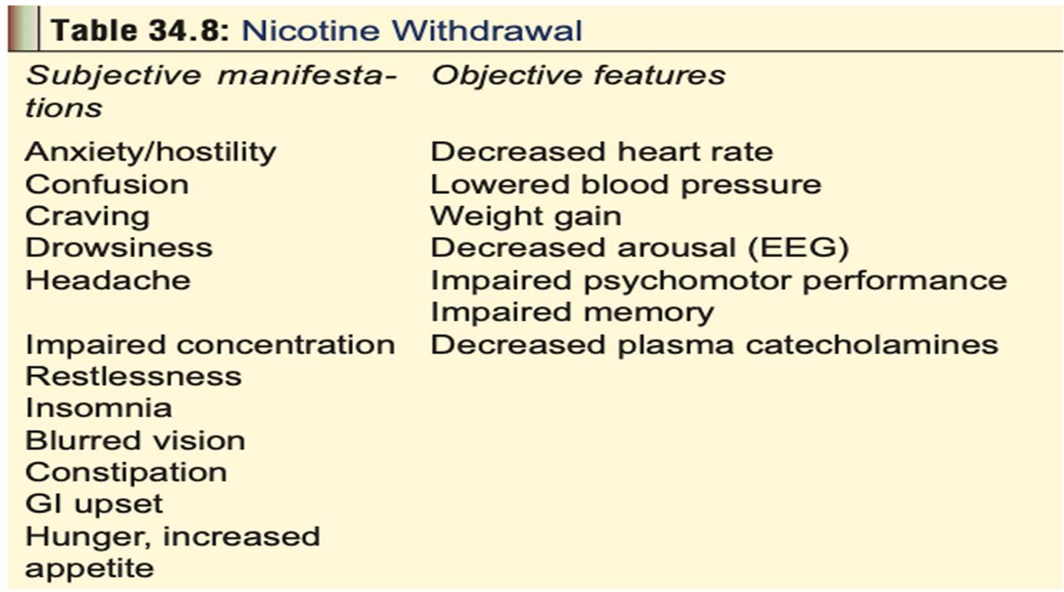
1.Nicotine withdrawal: Manifestations of nicotine withdrawal can occur within 4 to 8 hours of the last cigarette.

Slide 15
Diagnosis
Acute poisoning can be confirmed by estimating plasma nicotine level; but the short half-life of nicotine necessitates early withdrawal of blood. High pressure liquid chromatography is generally utilised to assay nicotine levels. Plasma level greater than 40 to 50 ng/ml indicates serious toxicity.
Polymorphonuclear leucocytosis and glycosuria are often encountered in nicotine overdose.
Passive tobacco smoke exposure is usually determined by estimating cotinine levels in plasma, urine, or saliva. Urine cotinine is also used as an index to nicotine exposure in tobacco workers (especially harvesters).

Slide 16
Treatment
Acute Poisoning
Mild overdose (with spontaneous vomiting) requires only observation for 4 to 6 hours, after which the patient can be discharged. Serious overdose must be treated as follows:
a. Decontamination by stomach wash. Emesis is contraindicated. Activated charcoal is effective and must be administered in the usual manner. In cases of dermal exposure
(e.g. wet tobacco leaves, spillage of nicotine liquid), clothing should be removed, and skin thoroughly washed.
b Since nicotine is weakly alkaline, excretion can be enhanced by acidification of
urine.
c. Animal experiments indicate that drugs such as pempidine and mecamylamine may have antidotal effects against nicotine. Hexamethonium (a ganglionic blocking agent) has prevented nicotine-induced convulsions in animals.
d. Symptomatic and supportive measures—
Benzodiazepines for convulsions.
Atropine for bradycardia.
IV fluids and vasopressors (dopamine or noradrena- line) for hypotension.
Respiratory compromise is managed by oxygen, intubation, and positive pressure ventilation.

Slide 17
2. Chronic Poisoning (Addiction)
Nicotine withdrawal must be treated by a combination of therapies including psychosocial, psychopharmacological, and nicotine replacement. A psychiatrist’s help is crucial to effective management of withdrawal and prevention of relapse.
Nicotine replacement therapy—
The rationale behind nicotine replacement is to prevent or relieve nicotine withdrawal symptoms while stopping smoking behaviour by replacing it with another behaviour. Pharmacological nicotine is of various forms and dosages.
Nicotine gum (Polacrilex): The first nicotine preparation that was made available for use is the nicotine gum. It is designed to be chewed slowly and intermittently. Approximately 50 to 70% of the nicotine is absorbed through the buccal mucosa, while additional amounts are absorbed through swallowed saliva. Peak plasma
concentration is reached 15 to 30 minutes after starting to chew the gum, as compared with 1 to 2 minutes after initiating smoking.
SIDE EFFECTS: Chewing the gum too rapidly and vigorously can raise nicotine concentrations to uncomfortable levels producing adverse effects (especially if the patient is also smoking at the same time).

Slide 18
Nicotine transdermal patch: The disadvantages of nicotine gum (frequent administrations, unsightly chewing, bad taste, nausea, and dyspepsia) are mostly avoided by transdermal nicotine, which is available as nicotine-releasing adhesive patches of varying sizes and delivery rates.
The nicotine patch is generally available in 3 sizes, 30 cm2, 20 cm2, and 10 cm2, which deliver 21 mg, 14 mg, and 7 mg of nicotine respectively, over 16 or 24 hours.
The nicotine is released either directly through the skin or through a membrane system in contact with the skin.
Side effects are mild and include dose- related sleep disturbances,
dyspepsias, myalgias, and increased cough.

Slide 19
Nicotine spray: It is available as a metered dose inhaler containing 100 mg of nicotine at 10 mg/ml, designed to deliver 200 equivalent puffs each releasing
0.5 mg of nicotine. Absorption occurs through the nasal mucosa which may be affected to some extent in the presence of rhinitis. The recommended dose is 2 sprays (one in each nostril) every 1Ú2 or 1 hour, subject to a maximum of 40 doses (80 puffs) in any 24-hour period
b. Other therapies—
– Clonidine: Clonidine is an alpha2-adrenergic agonist
that has been found useful in the treatment of alcohol and opiate withdrawal. Antidepressants: Since it is well known that smokers who stop smoking have a high incidence of depression, antidepressants such as doxepin and sertraline have been tried with varying degrees of success in combating nicotine withdrawal.
Nicotine agonists and antagonists: These drugs have the potential to block the effect of nicotine, i.e. removing its reinforcing effect on smoking behaviour.
Lobeline, the first of these drugs to be studied in this regard, is a partial agonist
that binds weakly and competitively to nicotine receptor sites. Mecamylamine is a nicotine receptor antagonist that is said to reduce the craving for cigarettes if administered for more than 6 weeks, though it can
produce unpleasant side effects including abdominal cramps, constipation, and urinary retention. Adverse effects can be minimised by combining mecamylamine with nicotine skin patch.
•

Slide 20
cocaine
Mode of Intake
Cocaine is usually abused by either chewing coca leaves, smoking coca paste, or “snorting” cocaine hydrochloride. The last mentioned is the most popular form of cocaine intake, i.e. the drug is inhaled in powder form through the nostrils. Occasionally, cocaine hydrochloride is injected intravenously.
Uses
Topical anaesthetic (4 to 10% solution) for intranasal and bronchoscopic procedures.
Ophthalmologic anaesthesia.
Relief of severe (oncologic) pain: Cocaine is one component of Brompton’s cocktail, (the others being morphine, chlorpromazine, and alcohol), which is popular in Europe for the control of intractable pain associated with some forms of cancer.
Cocaine is one of the components of TAC (the others being tetracaine and adrenaline) which is sometimes used as a topical anaesthetic in children with scalp and facial lacerations.

Slide 21
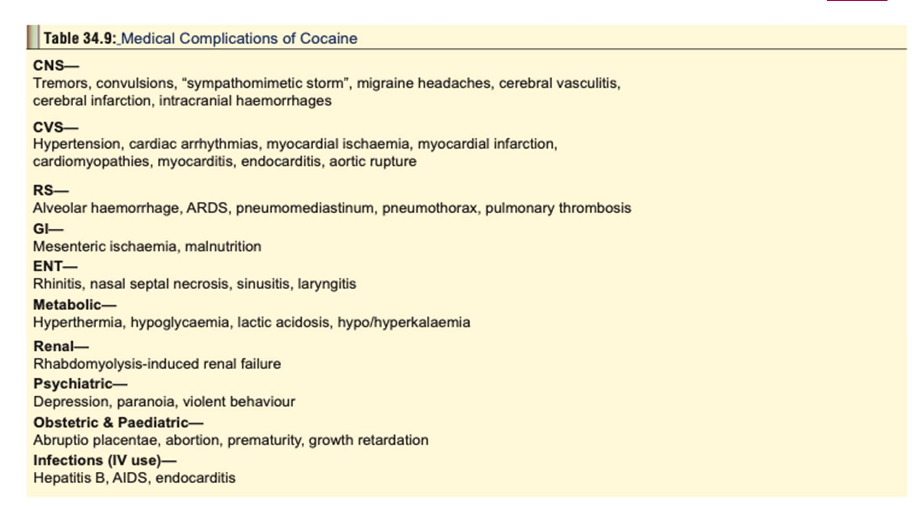

Slide 22
Chronic Poisoning
Cocaine dependence
  – Cocaine dependence is defined in as a cluster of physiological, behavioural, and cognitive symptoms that, taken together, indicate that the person continues to use cocaine despite significant problems related to such use.
  – Some cocaine users can use cocaine intermittently without becoming dependant, though it is not clear how long such intermittent, non-dependant use can
continue. Intermittent use consists of episodes or binges of use, often starting on weekends and paydays, and lasting until the drug supply is exhausted or toxicity develops. Such binges, during which the drug may be used every 15 to 30 minutes, can last 7 or more consecutive days (though usually this extends to only 3 or 4 days). When the binge comes to an end, a “cocaine crash” occurs.
Cocaine abuse
  – Some cocaine abusers develop problems or adverse effects related to their drug use (i.e. their use is mala- daptive). Examples of such recurrent maladaptive
patterns include use that leads to multiple legal problems, failure to meet major social, school, or work- related obligations, and continued use despite social or vocational difficulties caused by, or aggravated by cocaine use. When one or more such substance- related problems occur in a 12-month period, the diagnosis of cocaine abuse is made.
  Chronic use of cocaine leads to CNS dopamine depletion and increases in the number and sensitivity of dopamine receptors. The dysphoric state associated with cocaine withdrawal (vide infra) and craving for cocaine appears to be a result of the dopamine-depleted condition.
  Features of chronic cocaine use:
    Anorexia, emaciation.
    Mydriasis.
    Agitation, restlessness: A cocaine-associated agitated delirium syndrome has been identified, comprising the following in sequence: hyperthermia, delirium with agitation, respiratory arrest and death.
  Hallucinations, especially tactile, characterised by a crawling sensation under the skin (“cocaine bugs”) with resultant excoriation, leading to irregular scratches and ulcers (Magnan’s sign). Perceptual disturbances or pseudo-hallucinations involving vision (“snow lights”, geometric patterns), smell, hearing and taste have also been reported.
  - Tremor.
    Recurrent chest pain.
    Cardiomyopathy.
    Psychiatric changes: depression, psychosis, panic disorders, attention deficit disorders, and eating disorders.
Decreased libido, impotence, gynaecomastia, galactorrhoea, amenorrhoea, and sexual dysfunction are common with chronic cocaine abuse.
Cocaine abuse may be associated with cerebral atrophy.
- “Crack hands”: A syndrome of multiple, blackened, hyperkeratotic lesions (linear or circular), of the fingers and palms has been described in crack cocaine smokers. These lesions probably result from the heat of the glass cocaine pipe.
- Maternal chronic cocaine use during pregnancy has been suggested as a possible factor in Sudden Infant Death Syndrome. Cocaine readily passes into breast milk and can cause adverse effects in the nursing infant.
- Evidence of medical complications

Slide 23
c. Cocaine withdrawal
– Conventionally, cocaine withdrawal is said to occur in 3 phases:
Phase I (“Crash”): The total duration of this phase lasts for anywhere between 9 hours and 4 days, and is subdivided further into the following stages
» Early: Agitation depression, anorexia, intense craving for cocaine.
» Intermediate: Fatigue, tendency to sleep, decreased craving.
» Late: Exhaustion, hypersomnia, hyperphagia, absence of craving.
Phase II: Normalised sleep, improved mood, followed subsequently by return of anergia, anhedonia, anxiety, and increased craving.
Phase III: (“Extinction”): Increased tendency to relapse. The extinction phase may be prolonged and consists of brief, episodically evoked cravings that occur months to years after withdrawal.
impaired colour vision (blue-yellow), which may persist for up to 2 months or more, has been reported in some patients with cocaine withdrawal. A dysregulation of blue cone function has been suggested, since significantly reduced blue cone
electroretinogram responses have been observed in recently withdrawn cocaine- dependant patients.
- Silent ischaemia has occurred upon cocaine withdrawal, and acute myocardial infarction may occur up to 2 weeks after the last cocaine use.
- ECG changes: Increased PR intervals have been found to correlate with length of abstinence, which is thought to reflect
the remediation of a depolarisation variant. Chronic cocaine users may be subject to rapid cardiac depolarisation (decreased PR intervals) that gradually returns to normal over 20–30 days.
- EEG changes: Evaluation of quantitative EEGs in cocaine-dependant persons after a 10-day drug free interval revealed increased power in the beta-2 band that correlated with the frequency of cocaine use during the last 30 days before hospital
admission

Slide 24
1.Diagnosis
1 Blood or plasma cocaine levels are not clinically useful, although they may be advisable to be done in medicolegal cases. Qualitative urine tests using kits may be helpful in clinical diagnosis (by utilising chromatography, radioimmunoassay, enzyme immunoassay, fluorescence polarisation immunoassay, and enzyme multiplied immunoassay technique). Cocaine metabolites can be identified in the urine and provide a method for qualitatively identifying suspected cocaine poisoning or abuse. Benzoylecgonine, the major metabolite of cocaine, can usually be detected in urine for 48 to 72 hours after cocaine use.
Other diagnostic clues—
  Hair analysis: Cocaine benzoylecgonine and ecgonine methylester can be analysed in hair samples by GC-MS and RIA.
  ECG: Non-Q-wave myocardial infarction, with the presence of a T-wave infarct ECG pattern is often seen in cocaine users. During acute cocaine use abnormalities are more prevalent, and the QT interval is prolonged.
  Troponin levels may be more useful in evaluating potential myocardial injury than creatinine kinase.
  Acid-base abnormalities: Arterial blood gases in cocaine abusers show a pH varying from 7.35 to 7.5. Alkalosis (pH > 7.45) is caused by hyperventilation, and is manifested by tachypnoea and low PaCO2.
f. X-ray: Body packer syndrome can be diagnosed by plain films of the abdomen in the supine and upright positions.

Slide 25
Treatment
Acute Poisoning
Activated charcoal adsorbs cocaine in vitro under both acidic and alkaline conditions, and can be administered in cases of ingestion.
a. Hyperthermia:
– Minimise physical activity and sedate with benzodiazepines.
– Ice baths, packs, cool water with fans, etc.
– Oxygen D50W (as necessary).
– Diazepam 5 mg IV or lorazepam 2–4 mg IV titrated to effect.
– Paracetamol 2000 mg (in the form of 500 mg rectal suppositories).
– Severe, intractable cases may respond to dantrolene (1 mg/kg) every 6 hours. Alternatively, bromocriptine can be administered orally in a nasogastric tube.
Anxiety and agitation:
  Diazepam 5–10 mg IV, or lorazepam 2–4 mg IV titrated to effect.
  Physical restraints.
  Antipsychotics such as haloperidol or droperidol, and phenothiazines are not recommended since they can induce malignant hyperthermia and convulsions.
Convulsions:
  Diazepam 5–10 mg IV, or lorazepam 2–4 mg IV titrated to effect.
  Phenobarbitone 25–50 mg/min up to 10–20 mg/kg.
  If seizures are not controlled by the above measures, consider continuous infusion of midazolam (0.2 mg/ kg slow bolus, or 0.75 to 10 mcg/kg/min as infusion), or propofol (1 to 2 mg/kg, followed by 2 to 10 mg/kg/hr) or
pentobarbitone (10 to 15 mg/kg at a rate of 50 mg/min, followed by 0.5 to 1 mg/kg/hr).
  Intractable convulsions may require neuromuscular paralysis with intubation and mechanical ventilaion.

Slide 26
Cerebrovascular accidents: Neurosurgical consultation is mandatory.
Hypertension: It is usually short-lived and often followed by significant hypotension. Mild hypertension generally responds to sedation with benzodiazepines.
For severe hypertension without tachycardia:
  Phentolamine 0.02 to 0.1 mg/kg IV
  Nifedipine 0.1 to 0.2 mg/kg IV
  Nitroprusside 2 to 10 mcg/kg/min IV
With tachycardia: If the above measures are not effective, the following may be used—
- Labetolol 10 to 20 mg IV, repeated every 10 minutes (max: 300 mg).
- Nitroglycerine IV titrated to effect.
With chest pain—
  Nitroglycerine drip.
  Oxygen by nasal cannula (5 L/min).
  Monitor cardiac status.
  If systolic BP is higher than 120 mmHg, administer nitroglycerine sublingually (up to 3 tablets or 3 sprays of 0.4 mg each).
  If pain does not respond to nitroglycerine, use morphine (2 mg IV titrated to pain relief).
  Obtain ECG.
  If chest pain is strongly suggestive of a myocardial infarction, consider thrombolytic therapy. - Diazepam 5 mg IV, or lorazepam 2–4 mg IV titrated to effect can prevent excess production of catecholamines by the CNS.
  Mechanical reperfusion (angioplasty).

Slide 27
Arrhythmias:
– Sinus tachycardia
Oxygen D50W (as necessary)
Diazepam 5–10 mg IV, or lorazepam 2–4 mg IV titrated to effect (if indicated). Supraventricular tachycardia
Oxygen D50W ( as neccesary)
- Diltiazem 20 mg IV, or verapamil 5 mg IV
  Adenosine 6–12 mg IV for AV node re-entry
  Cardioversion (if necessary).
Ventricular arrhythmias: Obtain an ECG, institute continuous cardiac monitoring and administer oxygen. Evaluate for hypoxia, acidosis, and electrolyte disorders (particularly hypokalaemia, hypocalcaemia, and hypomagnesaemia).
  Oxygen D50W (as necessary)
  Hypertonic sodium bicarbonate: Sodium
bicarbonate may be useful in the treatment of QRS widening and ventricular arrhythmias associated with acute cocaine use. A reason- able starting dose is 1 to 2 mEq/kg repeated as needed. Monitor arterial blood gases, maintain pH 7.45 to 7.55.
- Diazepam 5 mg IV, or lorazepam 2–4 mg IV.
- Lignocaine 1.5 mg/kg IV bolus, followed by 2 mg/min infusion.
Myocardial infarction: Acute myocardial infarction due to cocaine toxicity must be treated on the same lines as myocardial infarction in non- cocaine users, except for the use of beta blockers. The following measures are recommended:
IV line
Oxygen
Aspirin to inhibit platelet aggregation. Watch out for increased thyroxine levels.
For systolic BP higher than 100 mmHg, administer sublingual nitroglycerine or nifedipine 10 mg orally, or phentolamine 1 to 5 mg IV (followed by a drip of 10 mg in 1 litre of D5W at 10 ml/min).
- For life-threatening arrhythmias, use of type IA antiarrhythmic agents may be considered (with caution).
- Thrombolytic therapy may be necessary if myocardial infarction is not amenable to relief by nitrates, calcium channel blockers, or phentolamine. Caution about the use of thrombolytics in cocaine-associated acute myocardial infarction (AMI) is generally advocated. Thrombolytics should be avoided in patients with cocaine-induced myocardial infarction and uncontrolled hypertension, because of the increased risk of intracranial haemorrhage.
-

Slide 28
Aortic dissection: nitroprusside and calcium channel blockers.
Pulmonary oedema:
  Frusemide 20–40 mg IV.
  Morphine sulfate 2 mg IV titrated to pain relief.
  Nitroglycerine drip titrated to blood pressure or
respiratory status.
  Phentolamine or nitroprusside (if necessary). – Incubate and ventilate.
  Monitor fluids with pulmonary artery catheter.
Rhabdomyolysis: Early aggressive fluid replacement. Diuretics such as mannitol or furosemide may be needed to maintain urine output.
Cardiac monitoring.
  Serial potassium determinations.
  Serial serum creatine kinase and urine myoglobin studies.
  IV hydration (urine output must be maintained at
8.3 ml/kg/hr).
– Dopamine (3 mcg/kg/day) and frusemide (60 mg three times a day) may reduce renal vascular resistance and help in reducing the number of haemodialysis required to reverse oliguria.
Acidosis: Correction of acidaemia through supportive care measures such as hyperventilation, sedation, active cooling, and sodium bicarbonate infusion can have beneficial effects on conduction defects.
Elimination enhancement measures: Cocaine is rapidly metabolised. Forced diuresis, urine acidification, dialysis, and haemoperfusion are
ineffective in significantly altering elimination. Increasing the level of butyrylcholinesterase in the blood (which metabolises cocaine to inactive compounds) could help in rapidly inactivating cocaine in acute intoxications.

Slide 29
Chronic Poisoning
a. Psychotherapy: This involves cognitive-behavioural, psychodynamic, and general supportive techniques. b.Group psychotherapy:
– Interpersonal group therapy focuses on relationships, and uses the group interactions to illustrate the interpersonal causes of individual distress, and to offer alternative behaviours.
c. Group counselling: The most widely used form of psychosocial treatment for cocaine dependence is group counselling, in which the group is open-ended with rolling admissions; the group leaders are drug counsellors, many of whom are recovering from addiction, and the emphasis is on providing a supportive atmosphere, discussing problems in recovery, and encouraging participation in multistep programmes.
d. Pharmacotherapy:
– Several drugs have been tried to help ameliorate the manifestations of cocaine withdrawal. Many of these (fenfluramine, trazodone, neuroleptic agents, etc.) have either not demonstrated clinical efficacy, or have produced serious side effects.
– Bromocriptine has successfully reduced cocaine craving and decreased withdrawal symptoms in several studies. Oral doses of 0.625 mg
given 4 times daily may produce a rapid decrease in psychiatric symptoms. When given in a single dose of 1.25 mg, bromocriptine has been found to decrease cocaine craving.
– Amantadine, a dopamimetic agent, increases dopaminergic transmission and has been found to be useful in the treatment of early withdrawal symptoms and short-term abstinence. The usual dose recommended is 200 mg to 400 mg orally, daily, for up to 12 days.
– Tricyclic antidepressants may be useful for selected cocaine users with comorbid depression or intra- nasal use.

Slide 30
cannabis
Mode of Intake
Marijuana: The term “marijuana” refers to any part of the plant or its extract that is used to induce psychotomimetic or therapeutic effects. Synonyms include Mary Jane, MJ, maconha, pot, weed, grass, puff, and dagga.
Ganja: Although some texts refer to ganja as being synonymous with marijuana, it is used to refer to crushed leaves and inflorescences of female plants. It is usually smoked in a pipe (“chillum”) or in the form of cigarettes (“reefer” or “joint” or “number”). Ganja is said to contain 1 to 2% THC.
Bhang: Bhang consists of dried mature leaves and flower stems that are ground with water and mixed with milk or fruit juice. It is consumed by Hindus in India during festivals such as Holi and Shiv Ratri.
Hashish (Charas) (This preparation is made out of dried resin collected from flower tops, and contains varying concentrations of THC up to 10%.
Marijuana “Blunts”: This is nothing but cheap cigars sliced open, packed with cannabis, and resealed.

Slide 31
Clinical Features
1. Acute Poisoning
Euphoria with increased garrulity and hilarity, especially when smoked in a social group setting.
Temporal and spatial disorientation with intensification of sensation (colours become brighter, sounds become more distinct, music is heard with heightened fidelity) and increased clarity of perception.
At high doses, the user experiences ataxia, dizziness, hallucinations, sedation, and sometimes dysphoria characterised by unpleasant sensations, fear, and panic.
Sometimes an acute toxic psychosis is precipitated with suicidal ideation, anxiety, and paranoia. Occasionally, schizophrenic symptoms occur. Flashback phenomena have been reported.
e. Tachycardia, palpitations, hypertension (high doses). Large doses can also cause postural hypotension.
f. Stimulation of appetite (especially for sweets).
  Reduced bowel motility and urinary retention have occasionally been observed.
  Bloodshot eyes due to conjunctival congestion.
  Pupils are usually not affected. Occasionally, mydriasis and nystagmus may occur.
  Coma has been reported in children.

Slide 32
chronic Poisoning
Amotivational Syndrome: Chronic indulgence is said to induce an a motivational syndrome characterised by apathy, poor concentration, social withdrawal, and lack of motivation to study or work.
Heavy cannabis users demonstrate an increased tendency to develop manic, schizophreniform, and confusional psychoses over a period of time. The development of acute psychosis after chronic use is controversial because of questions about the contribution of premorbid personalities and multiple-drug use.
Medical complications: Chronic heavy cannabis use is associated with an increased incidence of the following conditions:
  – Chronic lung disease and carcinogenesis: Long term smoking of cannabis has been associated with chronic sore throat, rhinitis, bronchitis, and deterioration of pulmonary function suggesting airway narrowing.
  – Cancers of mouth and larynx.
  – Non-specific ST wave changes have been reported. Prolonged intake of high doses of THC may result in bradycardia and congestive heart failure. .
  – Digital clubbing has been reported in chronic hashish users.
  – Gynaecomastia has been observed in males. Chronic use may also decrease sperm count and fertility.
  – Abrupt discontinuation of chronic cannabis use can cause a mild abstinence syndrome consisting of agitation, aggressiveness, tremulousness, insomnia, sweating, and recurrent migraine headaches.

Slide 33
Diagnosis
  Clinical:
    Symptomatology
    Characteristic ‘burnt rope’ odour in the breath of a recent smoker.
  Identification of suspected specimen: Suspend leaf or stem fragments in several drops of chloral hydrate (10%) on a microscope slide and examine under low power for characteristic “cystolith hairs”. These hairs look like bear claws or elephant tusks. At the base of these claws is a wart-like cluster composed of calcium carbonate deposit.
Add a drop of 20% HCl and note the gentle effervescent release of carbon dioxide gas in tiny bubbles.
  Urine levels of cannabinoids: THC is hydrophobic and accumulates in adipose tissue. Concomitant testing of urine specific gravity, pH, temperature, and creatinine could help in eliminating these confounders. Screening tests
usually employ EMIT or RIA, while confirmation is done by using GCMS. A semiquantitative EMIT homogenous enzyme immunoassay is available for measurement of cannabinoids in urine. Hair analysis can detect drug usage up to 90 days after cessation, and cut-off values are lower for hair than urine.

Slide 34
Treatment
Acute Poisoning:
  Decontamination measures in cases of ingestion. Activated charcoal is beneficial.
  Acute psychotic reactions respond to benzodiazepines. 5 to 10 milligrams of diazepam orally is usually sufficient.
  Patients suffering from postural hypotension should be placed in the Trendelenberg position until the blood pressure stabilises.
  Supportive measures.
2. Chronic Poisoning:
Psychosocial therapy consisting of attempts to promote realistic and rewarding alternatives to the drug and associated life styles, along with a commitment to abstinence from self-administered or unprescribed psychotropic drugs.
A combination of interventions is recommended, including urine testing, participation in multi-step programmes, education about drug effects, drug counselling, psychotherapy and family therapy.
Drug-focussed group therapy comprising strategies such as social pressure to reinforce abstinence, teaching socialisation and problem solving skills, reducing stress and the sense of isolation common with drug abuse, relapse prevention exercises
and varying degrees of confrontation.
Short-term use of anxiolytic agents such as benzodiazepines may be necessary in some cases when anxiety symptoms are severe.
Short-term use of antipsychotic medication may be required if there are persistent delusional ideas or frightening flash backs.

Slide 35
Amphetamines
Clinical Features
1. Acute Poisoning:
a. CNS– Euphoria ,Agitation ,Headache, Paranoia, Anorexia
  Hyperthermia: can be severe, and may result from hypothalamic dysfunction, metabolic and muscle hyperactivity, or prolonged seizures.
  Hyperreflexia
  Choreoathetoid movements
  Convulsions: Seizures are associated with a high mortality rate
  Intracerebral haemorrhage: Abuse of amphetamine and related drugs can increase the risk for cerebro- vascular incidents in young adults
  Coma: If it occurs, is associated with a high mortality rate.

Slide 36
b. CVS
Tachycardia:
reflex bradycardia secondary to hypertension can occur.
– Hypertension: Hypertension is common following amphetamine use and may result in end organ damage. Pulmonary hypertension has been associated with methamphetamine use. Hypotension and cardiovascular collapse may result from severe toxicity, and is associated with a high fatality rate.
– Arrhythmias.
– Vasospasm.
– Myocardial ischaemia:
– Cardiomyopathy: Acute and chronic cardiomyopathy can result from hypertension, necrosis, or ischaemia.
c. Sympathetic Effects: – Mydriasis
Sweating
Tremor
Tachypnoea – Nausea.
d. Other Effects:
Muscle rigidity
Pulmonary oedema
Ischaemic colitis: More common in chronic poisoning (vide infra).
Rhabdomyolysis: Develops in patients with severe agitation, muscular hyperactivity, hyperthermia, or seizures.
- Metabolic acidosis: This occurs with severe poisoning, and has even been reported after smoking crystal methamphetamine.
e. Complications:
Psychosis with visual and tactile hallucinations.
Cerebral infarction
Myocardial infarction
Aortic dissection: Several cases of fatal aortic dissection associated with chronic amphetamine use have been reported.
Ventricular fibrillation
Acute renal failure: Renal failure may develop secondary to dehydration or rhabdomyolysis in
patients with severe amphetamine poisoning. Death due to amphetamine toxicity most commonly results from arrhythmias, hyperthermia, or intracerebral haemorrhage.

Slide 37
2. Chronic Poisoning: Amphetamines can be taken orally,
by injection, by absorption through nasal and buccal membranes; or by heating, inhalation of the vapours, and absorption through the pulmonary alveoli.
Manifestations of heavy chronic amphetamine use: – Hyperactivity, hyperexcitability.
– Anorexia, loss of weight, emaciation:.
– Vomiting and diarrhoea are common. Ischaemic colitis may occur.
– Stereotyped behaviour (skin picking, pacing, inter- minable chattering). 6.– Dyskinesias: bruxism, tics.
– Paranoid psychosis, unpredictable violence: In
They also demonstrated a high tendency for major depressive disorder, alcohol dependence, and antisocial personality disorder.
– Heightened sexual activity initially, followed by impotence and sexual dysfunction.
– Occasionally, very rapid IV injection of a large dose produces a condition called “overamped”, characterised by inability to speak or move even though consciousness is fully retained. Blood pressure and temperature are usually elevated. There
may be respiratory distress.
– Deterioration of social (family problems), physical (slovenly, unkempt appearance), and economic (loss of job, bankruptcy) status.
– Adverse psychological reactions—anxiety reactions, amphetamine psychosis, exhaustion syndrome, depression and hallucinosis.
Withdrawal syndrome: Withdrawal after prolonged amphetamine abuse may precipitate severe depression and suicide attempts. Anxiety, abdominal cramps, gastroenteritis, headache, diaphoresis, lethargy, and dyspnoea may result. Increased
appetite is common.

Slide 38
DIAGNOSIS
Urine is the specimen of choice. Levels above 2 mg/100 ml indicate acute toxicity. Methods of analysis include TLC, RIA, HPLC, and GC-MS. The first three methods often give false positive results, and hence confirmation of a positive test must always be done by GC-MS.
A new method (electron-impact mass fragmentography) enables detection and even quantitation of methamphetamine in hair, nails, sweat and saliva.
Hair analysis may provide documentation of methamphetamine or other drug exposure for several months or longer.

Slide 39
Treatment
1.
Acute Poisoning:
1.Stabilisation:
IV line, cardiac monitoring.
Oxygen.
Evaluate blood glucose, BUN, and electrolyte levels.
Consider the necessity of a CBC, urinalysis, coagulation profile, chest X-ray, CT scan of head, and lumbar puncture, depending on the presentation.
2.Supportive Measures:
Airway management, ventilatory support.
Rapid rehydration.
Mannitol diuresis promotes myoglobin clearance to prevent renal failure.
Assess psychological and neurological status.
Gastric decontamination (in cases of ingestion) with 3.appropriate tracheal protection. Activated charcoal is beneficial. 4.Specific Measures:
  – Anxiety, agitation, and hyperactivity can usually be controlled with benzodiazepines. Diazepam is the drug of choice, and is administered in a dose of 10 mg IV at intervals (up to a maximum of 100 mg). Much larger doses (hundreds of milligrams) may be required to obtain adequate sedation. Titrate dose to clinical response. Control of agitation is an important aspect to the treatment of amphetamine overdose, since it often leads to hyperthermia, a common cause of mortality in amphetamine overdose. Neuroleptics are generally not preferred since they may aggravate hyperthermia, convulsions, and cardiac arrhythmias. Physical restraint is inadvisable, since resistance against such measures will aggravate rhabdomyolysis and hyperthermia.
  – Extreme agitation and hallucinations may require the administration of IV droperidol (up to 0.1 mg/ kg). Since haloperidol lowers the seizures threshold, and is associated with neuroleptic malignant syndrome, it is not advisable.
  – Convulsions can be managed with benzodiazepines (IV diazepam), phenytoin, or barbiturates. Refractory cases may require curarisation.
  – Hyperthermia should be tackled aggressively with hypothermic blankets, ice baths, and dantrolene infusions. Large IV doses of benzodiazepines can help. Refractory cases must be subjected to neuromuscular paralysis and mechanical ventilation.

Slide 40
Tachycardia can be managed with beta blockers (atenolol). Labetolol which has combined alpha and beta blocking effects, may be preferable if tachycardia is associated with hypertension. Sedation with intravenous benzodiazepines (diazepam 5 to 10 mg IV repeated every 5 to 10 minutes as needed) is usually sufficient for treating hypertension. A short acting, titratable agent such as sodium nitroprusside should be considered if unresponsive to benzodiazepines.
– For ventricular arrhythmias: Lignocaine and amiodarone are generally first line agents for stable monomorphic ventricular tachycardia. Sotalol is a good alternative. Amiodarone and sotalol should be used with caution if the QT interval is prolonged, Atropine may be used when severe bradycardia is present, and PVCs are thought to represent an escape complex.
– For rhabdomyolysis: Early aggressive fluid replacement is the mainstay of therapy, and may help prevent renal insufficiency. Diuretics such as mannitol or furosemide may be needed to maintain urine output. Urinary alkalinisation is not routinely recommended.
– Diazepam and chlorpromazine have been effective in treating amphetamine induced chorea.
– Other complications should be anticipated and treated as and when they arise.
– Although peritoneal dialysis and haemodialysis have been demonstrated to enhance elimination of amphetamine.
Chronic Poisoning:
a Most casual users of amphetamines do not need treatment. Those with moderately severe dependence can be treated on an outpatient basis without using drugs.
It is preferable to provide a structured and manualised cognitive behavioural treatment, making use of a combination of group and individual
counselling.
b. A wide variety of pharmacological agents have been tried as adjuncts to (or major elements in) the treatment of amphetamine dependence. These include drugs such as imipramine and fluoxetine, but results have been disappointing.
c. In some European countries, low-dose amphetamines are administered to addicts as part of the detoxification programme in the initial
stages, to assist the subject over- come the phase of “craving”.

Slide 41
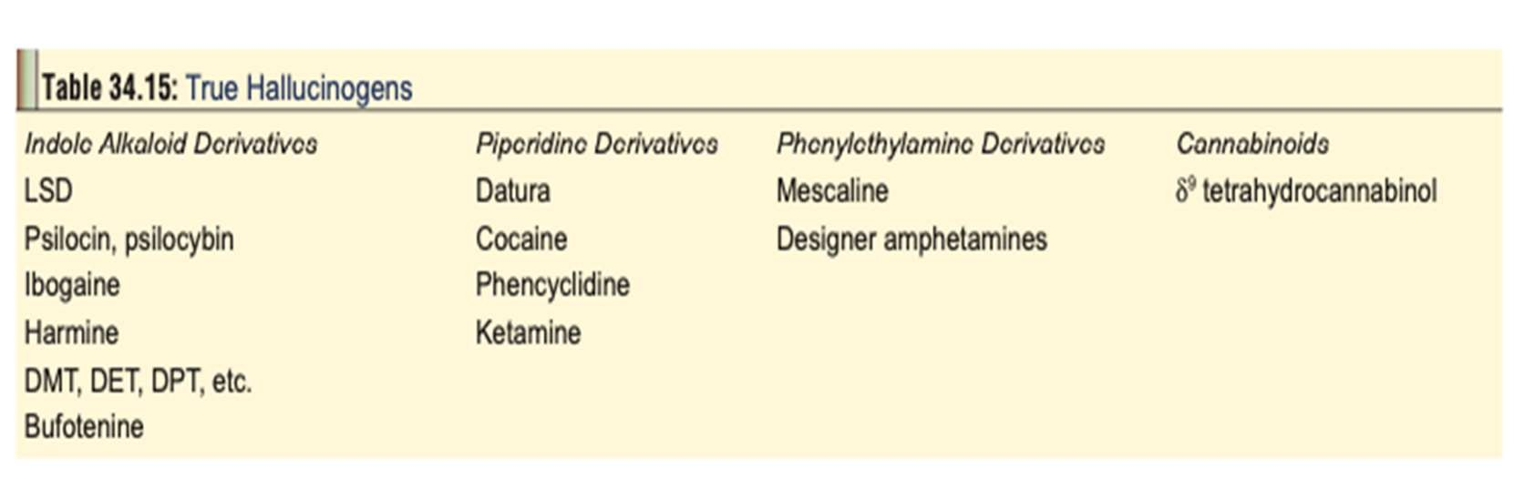
HALLUCINOGENS (PSYCHEDELICS, PSYCHOTOMIMETICS
Hallucinogens are substances that induce changes in thought, perception, and mood, without causing major disturbances in the autonomic nervous system. Perceptual alterations can take the form of illusions, synaesthesias, or hallucinations. An illusion is the result of misinterpretation of an actual experience, while synaesthesias are sensory misperceptions (e.g. hearing colour or seeing sounds). Both require external stimuli for their institution.

Slide 42
Lysergic Acid Diethylamide
Lysergic acid diethylamide (LSD) is the synthetic diethylamide derivative of ergot alkaloids, LSD is said to be the most powerful of all hallucinogens, and is active in doses of 50 to 100 mg. It occurs as a water-soluble, colourless, tasteless and odourless powder.
Mode of Intake
The LSD is almost always ingested. Other less common routes of intake include intranasal, sublingual, smoking, conjuctival instillation, and very rarely injection.
Clinical (Toxic) Features
Acute Poisoning:
  Physical
    Mydriasis, hippus.
    Vertigo.
    Tachycardia, hypertension. – Sweating, piloerection.
    Hyperthermia.
    Tachypnoea.
    Muscle weakness, ataxia. – Hyperactivity.
    Coma.
  Psychological
    Euphoria or dysphoria.
    Vivid hallucinations, synaesthesias.
    Bizarre perceptual changes: People’s faces and body parts appear distorted, objects undulate, sounds may be magnified and distorted, colours seem brighter with halos around objects.

Slide 43
Chronic Poisoning:
  Prolonged psychotic reactions which are mainly schizophrenic in nature.
  Severe depression.
  Flashback phenomena: The person relives the LSD experience periodically in the absence of drug intake for months or years.
  Post-hallucinogen perception disorder: A persistent perceptual disorder often described by the person as if he is residing in a bubble under water in a “purple haze”, with trailing of lights and images. Associated anxiety, panic, and
depression are common. The following unusual phenomena have also been reported:
    – Pareidolias: images of faces on floor and walls,
    floating faces hovering in space.
    – Aeropsia: visualisation of air in the form of numerous vibrating pinpoint-sized dots (“mole- cules”).
Diagnosis
Radioimmunoassay of serum or urine (limit of detection 0.1ng/ml).
HPTLC (high performance thin layer chromatography) can detect LSD in urine in concentrations less than 1 mcg/litre.
HPLC (high pressure/performance liquid chromatography) of serum and urine.
GC-MS (gas chromatography–mass spectrometry) can confirm positive LSD urine levels to a lower limit of 5 pg/ml.
•

Slide 44
Treatment
Avoid gut decontamination as LSD is ingested in micro- quantities and rapidly absorbed
Do not use restraints in agitated patients; it will only exacerbate the condition.
Treat acute panic attacks with quiet environment, reassurance, supportive care, and administration of diazepam (5–10 mg IV) or haloperidol (in severe cases).
Treat acute psychotic reactions with cautious administration of neuroleptics such as haloperidol. Avoid phenothiazines which can cause hypotension, sedation, extrapyramidal reactions, lowered seizure threshold, and potentiation of
anticholinergic effects.
Treat flashbacks with psychotherapy, anti-anxiety agents, and neuroleptics.
Treat post-hallucinogen perception disorder with long- lasting benzodiazepines such as clonazepam, and to a lesser extent
anticonvulsants such as valproic acid and carbamazepine. This approach must be combined with behavioural therapy. The patient must be instructed not to consume alcohol, cannabis, caffeine, and other drugs which can intensify the disorder.

Slide 45
CNS DEPPRESANT
Central nervous system (CNS) depressants, a category that includes tranquilizers, sedatives, and hypnotics, are substances that can slow brain activity. This property makes them useful for treating anxiety and sleep disorders. the medications commonly prescribed for these purposes are benzodiazepines(diazepam, clonazepam,alprazolam), non-benzodiazepine sleep medicine (zolpidem, eszopiclone, zaleplone), Barbiturates (mephobarbital, phenobarbital and phentobarbital sodium)

Slide 46
BARBITURATES
Uses
1.Sedative-hypnotic. 2.Pre-operative sedation.
3.Treatment of seizure disorders.
Clinical (Toxic) Features
Slurred speech, ataxia, lethargy, confusion, headache, nystagmus.
CNS depression, coma, shock.
Pupils are at first constricted, but later dilate because of hypoxia.
Hypothermia.
Cutaneous bullae (“barb burns”, barbiturate blisters):
Death may occur from respiratory arrest or cardiovascular collapse. Delayed death may be due to acute renal failure, pneumonia, pulmonary oedema, or cerebral oedema.
Chronic barbiturate (ab)use is associated with the development of tolerance which is responsible for
decreasing the therapeutic to toxic index. An addict may obtain therapeutic benefit only with 5 to 6 times the normal dose. Abrupt withdrawal results in anorexia, tremor, insomnia, cramps, seizures, delirium, and orthostatic hypotension.
Diagnosis
Serial plasma levels may be useful in the management of phenobarbitone overdose. Plasma levels exceeding 8 mg/ dL (80 mcg/mL) (344 mcmol/L) are generally associated with some degree of coma. In the absence of tolerance, plasma levels exceeding 2 to 3 mg/dL may be associated with CNS depression.
EEG: alpha coma* indicates poor prognosis.

Slide 47
Treatment
Monitor CBC, serum electrolytes, glucose, blood urea nitrogen, creatinine, and urine myoglobin in patients with significant intoxication.
Gastric lavage (preferably with a large-bore, double-lumen tube), can be done with benefit upto 12 to 24 hours post- ingestion.
Activated charcoal in the usual dose.
Forced alkaline diuresis is said to be particularly useful in phenobarbitone poisoning .
Haemodialysis or haemoperfusion: Barbiturate elimination can be increased by haemodialysis or charcoal haemoperfusion.
Exchange transfusion may be beneficial in severe cases.
For hypotension: First administer 10 to 20 ml/kg of isotonic intravenous fluids and place in Trendelenburg position. Repeat boluses of isotonic intravenous fluids should be administered prior to initiating vasopressor therapy. If the patient is unresponsive to isotonic fluid therapy administer a vasopressor. Dopamine or noradrenaline should be titrated
to desired response.
Supportive measures: supplemental oxygen, intubation,
assisted ventilation, IV fluids.
Withdrawal may be treated by reinstitution of phenobarbitone, and a programme of gradual reduction over three weeks. A tapering schedule of 10 percent every 3 days has been used successfully.

Slide 48
Benzodiazepines
Examples
Alprazolam, brotizolam, chlordiazepoxide, chlorazepate, clobazam, clonazepam, diazepam, estazolam, flunitrazepam, flurazepam, halazepam, lorazepam, lormetazepam, medaz- epam, midazolam, nitrazepam, oxazepam, pinazepam, praz- epam, quazepam, temazepam, triazolam and zolazepam.
Uses
1.Anxiety disorders 2.Seizure disorders 3.Insomnia
4.Movement disorders (adjunctive therapy) 5.Mania (adjunctive therapy)
6.Some of these drugs are also used for inducing skeletal muscle relaxation, as pre-anaesthetic medication, and for the treatment of alcohol withdrawal.
MOA
Benzodiazepines act by stimulating the GABAb (gamma aminobutyric acid b) receptors, thereby opening up the chloride ion channel in the receptor complex, resulting in the increased conductance of chloride ion across the nerve cell membrane. This lowers the potential difference between the interior and exterior of the cell, blocking the ability of the cell to conduct nerve impulses.

Slide 49
Clinical (Toxic) Features
Acute Poisoning:
  Mild—Drowsiness, ataxia, weakness.
  Moderate to Severe—
– Vertigo, slurred speech, nystagmus, partial ptosis, lethargy, coma.
– Hypotension and respiratory depression supervene in potentially lethal ingestions: Respiratory depression is the primary clinical concern in benzodiazepine overdose. Overdose may depress respiratory rate and tidal volume and airway protective
reflexes.
– Both miosis and mydriasis have been reported. Nystagmus may also occur.
– Analysis of acute benzodiazepine overdoses in relation to the incidence of coma indicate that short acting
benzodiazepines (midazolam and triazolam) and intermediate acting (flunitrazepam) have a higher acute toxicity, as compared to diazepam, lorazepam and nitrazepam. Flurazepam and temazepam may also have greater toxicity.
– Triazolam, as well as other benzodiazepines, have been implicated in next-day memory impairment/ amnesia in a significant number of patients.
– Administration of benzodiazepines to a pregnant woman prior to delivery may produce signs of poisoning in the neonate. A condition called “floppy infant syndrome”, characterised by hypotonia that may last several days, may occur following maternal diazepam use.
Chronic Poisoning:
Long-term use of benzodiazepines is associated with the development of tolerance. Abrupt cessation provokes a mild withdrawal reaction characterised by anxiety, insomnia, headache, tremor, and paraesthesia. Restlessness, encephalopathy, and hallucinations may occur after abrupt withdrawal from high daily doses. Convulsions may occur after a lapse of 3 to 10
days.

Slide 50
1.Diagnosis
Estimation of plasma levels of benzodiazepines is usually not necessary. Qualitative testing for presence of benzodiazepine is helpful to confirm presence, especially when overdose history is sketchy. Quantitative levels are not usually clinically useful. Blisters of skin (bullae) can occur following overdose with nitrazepam, oxazepam, and temazepam.
Treatment
1. Acute Poisoning:
1.Decontamination: Stomach wash may be helpful if the patient is seen within 6 to 12 hours after the ingestion. Cuffed endotracheal intubation is a prerequisite in comatose patients. Activated charcoal adsorbs benzodiazepines and can be administered in the usual manner. 2.Establish clear airway. Oxygen and assisted ventilation are often necessary.
IV fluids (Ringer’s lactate at a rate of 150 ml/hr for adults).
Correction of hypotension: Begin by infusing 10 to 20 ml/kg of isotonic fluid, and place patient in Trendelenburg position. If hypotension persists, administer dopamine or noradrenaline. Consider central venous pressure monitoring to guide further fluid therapy.
Antidote— Flumazenil is effective in reversing the coma induced by benzodiazepines as well as zolpidem.
Chronic Poisoning:
Phenobarbitone-substitution technique is recommended for benzodiazepine withdrawal which employs propranolol for acute somatic symptoms, while phenobarbitone is used for detoxification.
However the most frequently used method among clinicians is the replacement of a short half-life benzodiazepine (such as alprazolam) with a long half-life benzodiazepine (such as clonazepam), before initiating a taper and final discontinuation.

Slide 51
opioids
opioids are euphoriants that, in high doses, cause sedation and respiratory depression. Withdrawal manifests initially as anxiety and drug craving, followed by increased respiratory rate, diaphoresis, yawning, lacrimation, rhinorrhoea, mydriasis, and stomach cramps and later by piloerection, tremors, muscle twitches, tachycardia, hypertension, fever, chills, anorexia, nausea, vomiting, and diarrhoea. Diagnosis is clinical plus with urine tests.
Acute effects
Acute opioid intoxication is characterized by euphoria and drowsiness. Mast cell effects (eg, flushing, itching) are common, particularly with morphine. Gastrointestinal effects include nausea, vomiting, decreased bowel sounds, and constipation.
Toxicity or overdose
The main toxic effect is decreased respiratory rate and depth, which can progress to apnea. Other complications (eg, pulmonary oedema, which usually develops within minutes to a few hours after opioid overdose) and death result primarily from hypoxia. Pupils are miotic. Delirium, hypotension, bradycardia, decreased body temperature, and urinary retention may also occur.
Normeperidine, a metabolite of meperidine, accumulates with repeated use (including therapeutic); it stimulates the central nervous system and may cause seizure activity.
Serotonin syndrome occasionally occurs when fentanyl, meperidine, tramadol, methadone, codeine, or oxycodone is taken concomitantly with other drugs that have serotonergic effects. Serotonin syndrome consists of one or more of the following:
Hypertonia
Tremor and hyperreflexia
Spontaneous, inducible, or ocular clonus Diaphoresis and autonomic instability Agitation
Temperature > 38° plus ocular or inducible clonus
Withdrawal Anxiety and a craving for the drug are followed by increased resting respiratory rate (> 16 breaths/minute), usually with diaphoresis, yawning, lacrimation, rhinorrhea, mydriasis, and stomach cramps. Later, piloerection (gooseflesh), tremors, muscle twitching, tachycardia, hypertension, fever and chills, anorexia, nausea, vomiting, and diarrhoea may develop. .
•
•
•
•
•

Slide 52
TREATMENT:
treatment to maintain the airway and support breathing is the first priority.
Naloxone 0.4 mg to 2 mg IV
Sometimes endotracheal intubation
substitution with methadone or buprenorphine
Clonidine to relieve symptoms
Long-term support and possibly naltrexone

