Slide 1
SYSTEMIC LUPUS ERYTHEMATOSUS

Slide 2
SLE is a fluctuating multisystem disease with a diversity of clinical presentations. Abnormal immunologic function and formation of antibodies against “self ” antigens underlie the pathogenesis of SLE

Slide 3
EPIDEMIOLOGY
The incidence of SLE in the United States is estimated to be 5.6 to 7.3 per 100,000 persons per year, with a prevalence of between 124 and 130 cases per 100,000 persons.
The disease occurs predominantly in women, with a reported female-to-male ratio approaching 10:1.
Those afflicted with SLE are usually diagnosed between the ages of 15 and 45

Slide 4
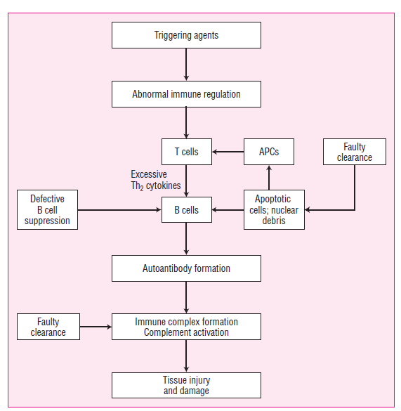

Slide 5
Environmental factors, such as infectious organisms, drugs, and chemicals, serve as triggering agents.
These abnormal immune responses lead to hyperactive T-helper-2 lymphocyte and B-lymphocyte function. Suppressor T-lymphocyte function, cytokine production, faulty clearance mechanisms, and other immune regulatory mechanisms also are abnormal and fail to down regulate autoantibody formation from hyperactive B-lymphocytes.
The autoantibodies formed from this immune dysregulation become pathogenic, form immune complexes, and activate complement that leads to damage of host tissue.

Slide 6
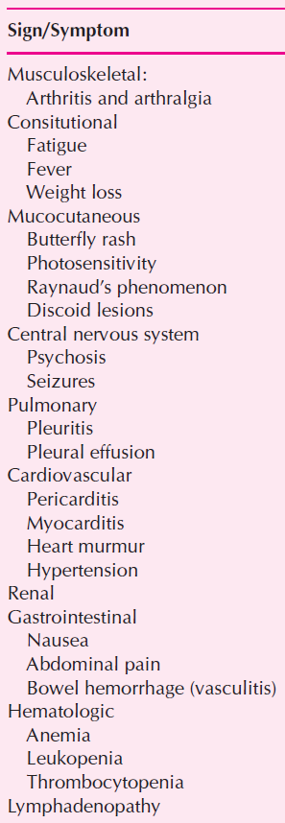

Slide 7
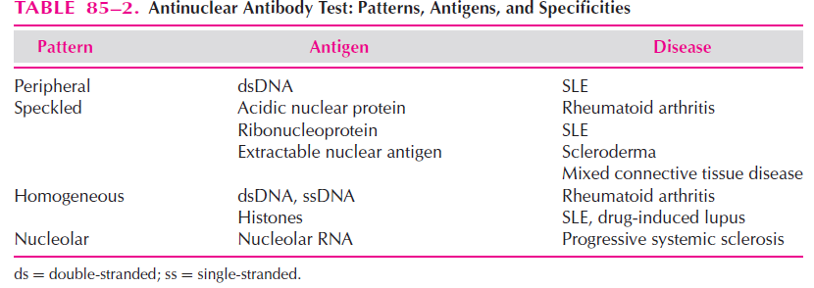
serologic tests may be helpful in making the diagnosis.

Slide 8
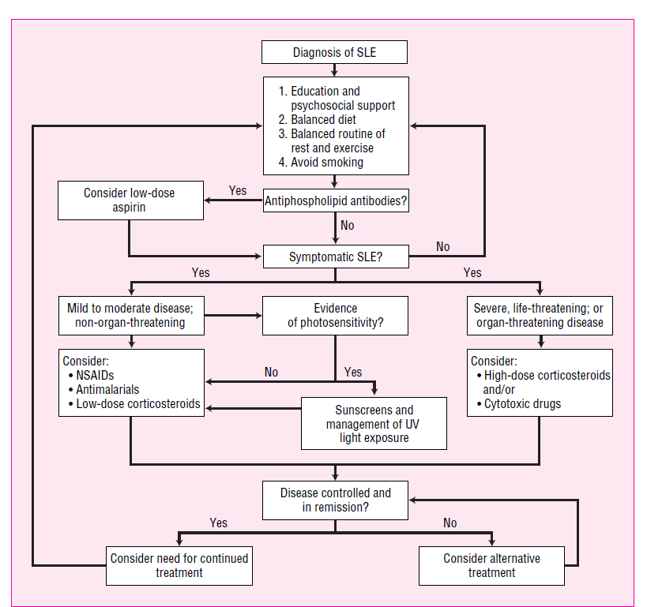

Slide 9
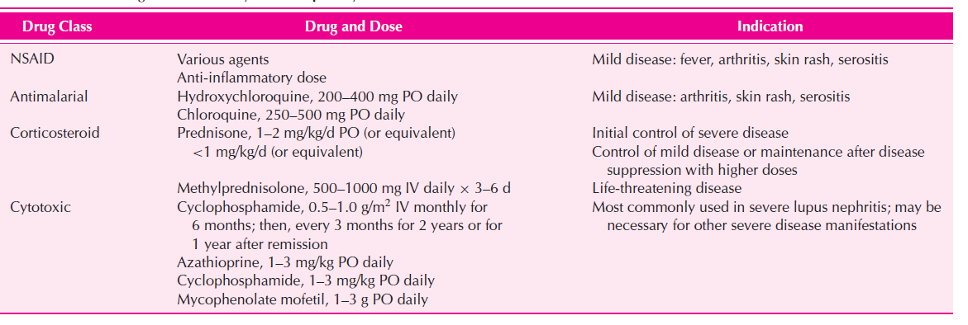

Slide 10
ANTIMALARIAL DRUGS
Antimalarial agents such as chloroquine and hydroxychloroquine have been used successfully in the management of discoid lupus and SLE.
It has been proposed that antimalarials interfere with T-lymphocyte activation.
antimalarials that may benefit patients with SLE include inhibition of cytokines, decreased sensitivity to ultraviolet light, anti-inflammatory activity, antiplatelet effects, and antihyperlipidemic activity

Slide 11
CORTICOSTEROIDS
The goal of treatment when using corticosteroids in SLE is to suppress and maintain suppression of active disease with the lowest dose possible. In patients with mild disease, low-dose therapy (prednisone
10–20 mg/day) is adequate.
but in patients with more severe disease (severe hemolytic anemia or cardiac involvement), higher doses, such as prednisone 1–2 mg/kg daily, may be required.

Slide 12
CYTOTOXIC DRUGS
These agents, usually used in combination with corticosteroids, have been the mainstays of immunosuppressive therapy. Although both are known to suppress and stabilize extrarenal disease activity, much of the evaluation of these agents has focused on lupus nephritis, a major factor associated with morbidity and mortality in SLE.

