Slide 1

TDM OF DRUGS USED IN THE FOLLOWING DISEASE CONDITIONS: CARDIOVASCULAR DISEASE, SEIZURE DISORDERS, PSYCHIATRIC CONDITIONS, AND ORGAN TRANSPLANTATIONS.

Slide 2
TDM for Cardiac Medications
Inotropics (drugs used to increase the pumping ability of the heart) and antiarrhythmics may need TDM. The cardiac glycoside inotropics digoxin and digitoxin have narrow therapeutic windows. Overdose can cause vomiting, diarrhea, confusion, visual disturbances, and cardiac arryhthmias. A difficulty with these medications is that overdose produces the same symptoms that the drug is used to treat. For example, procainamide is used for arrythmyia, but an overdose of procainamide can produce an arrythmia. Thus, without TDM the physician will not know whether to give more drug or less, since both states can lead to the same presentation.
Examples of cardiac medications that are monitored by TDM include:
Digoxin
Digitoxin
Procainamide
N-acetylprocainamide (NAPA) -the metabolite of procainamide
Quinidine

Slide 3
The principle of pharmacotherapy is maximizing the pharmacological effect while minimizing adverse reactions.
Therapeutic drug monitoring (TDM) is a strategy to individualize drug treatment through monitoring various factors that affect the efficacy and adverse effects of drugs. Antiarrhythmic drugs have long been investigated for their pharmacokinetic behaviors in the body and efficacy, and are used in the clinical setting on the basis of TDM findings.
Blood concentrations of antiarrhythmic drugs should be interpreted according to not only expertise in pharmacokinetics, pharmacodynamics, and drug interactions, but also patient adherence to treatment. However, it is unclear whether TDM of antiarrhythmic drugs may improve the clinical outcome of patients with arrhythmia.
The effects of antiarrhythmic drugs cannot be predicted based only on their blood concentrations.
The dosage regimen of antiarrhythmic drugs should be determined comprehensively according to the patient's signs and symptoms, ECG findings, and results of exercise testing, among other findings indicating the response of the drugs. The dose should not be set only to achieve the therapeutic range.

Slide 4
Recently, TDM is increasingly being expected to play a role as a safety index especially in the pharmacotherapy of
cardiovascular diseases such as arrhythmia and heart failure.
Drug effects are affected by a variety of factors such as age, gender, genetic differences, environmental factors, meals, life styles, underlying diseases, and drug interactions.
Blood concentrations of renally excreted drugs, i.e., drugs with high urinary concentrations of the unchanged drug,
are prone to be affected easily by changes in renal function.
On the other hand, blood concentrations of hepatically eliminated drugs (hepatically metabolized drugs) are affected
by individual differences in the activity of drug-metabolizing enzymes.
Confirming the range of blood drug concentrations appropriate for each patient helps physicians prescribe the drug at
an optimal dose and thereby avoid adverse drug reactions (ADRs).
In addition to conventional monitoring, TDM is a beneficial monitoring in ensuring the safety of cardiovascular drug therapy

Slide 5
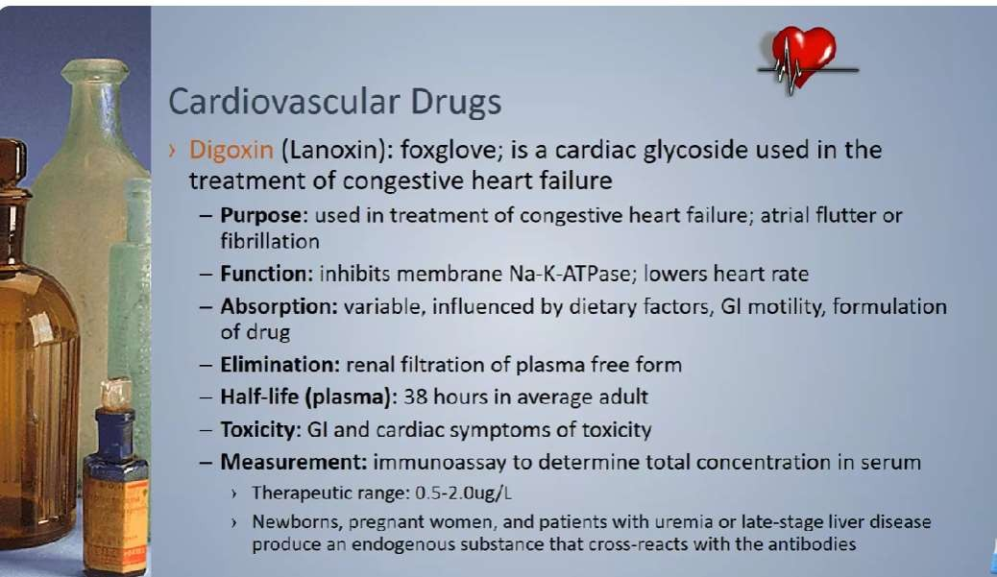

Slide 6
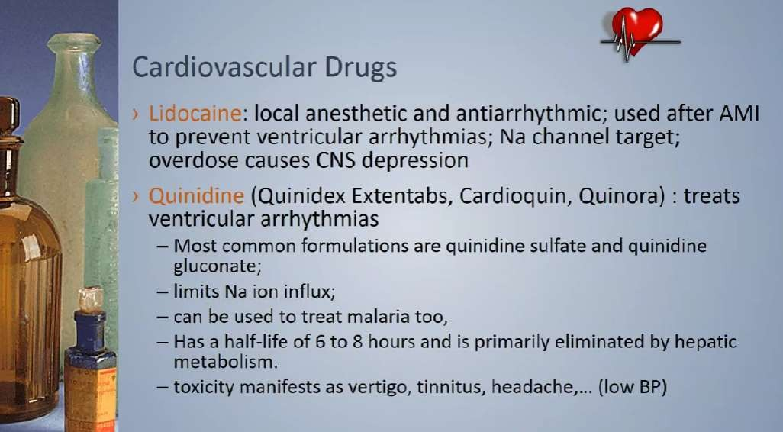

Slide 7
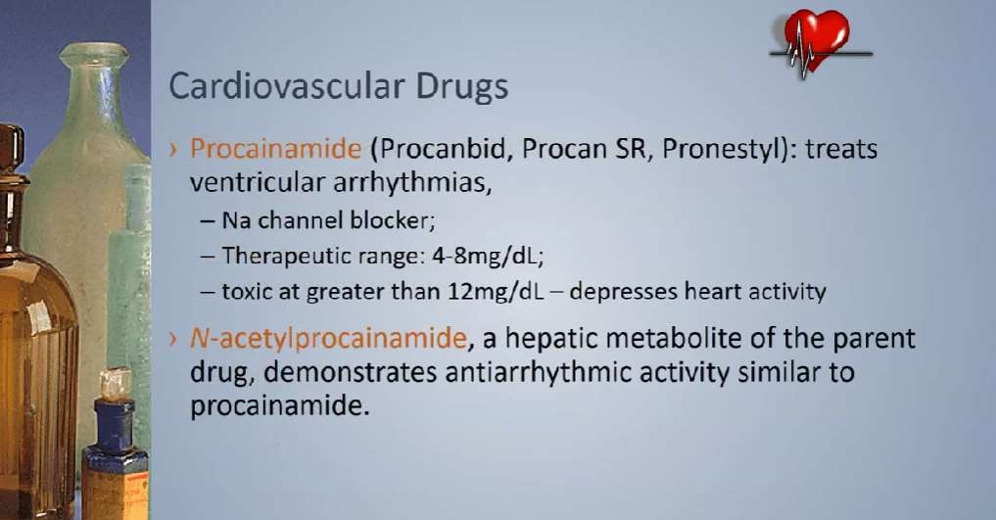

Slide 8
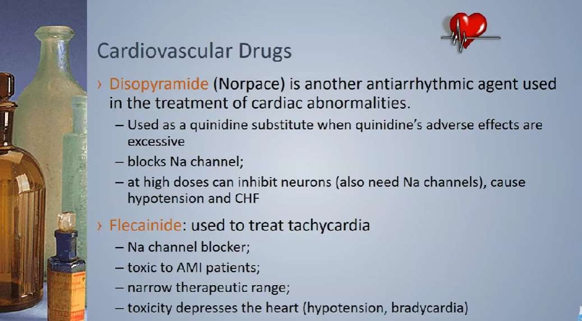

Slide 9
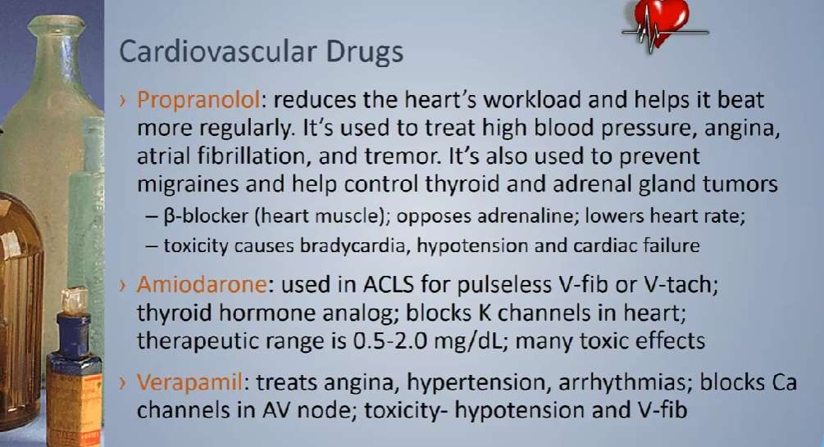

Slide 10
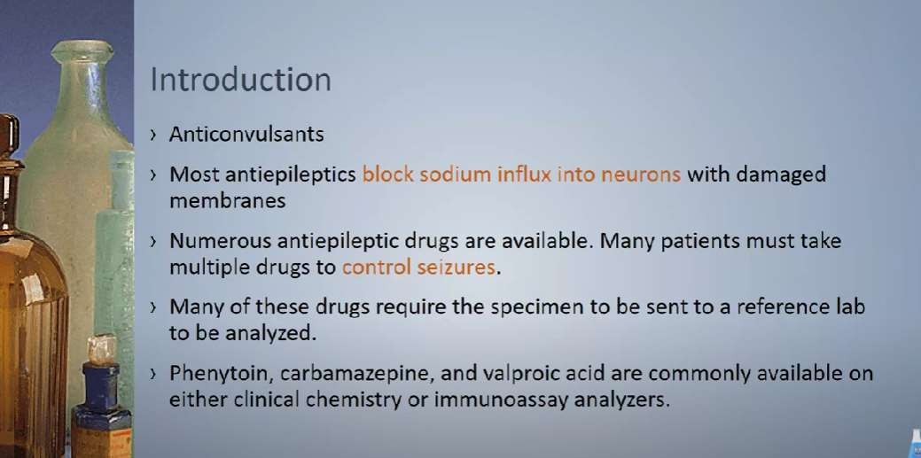
Seizure disorders

Slide 11
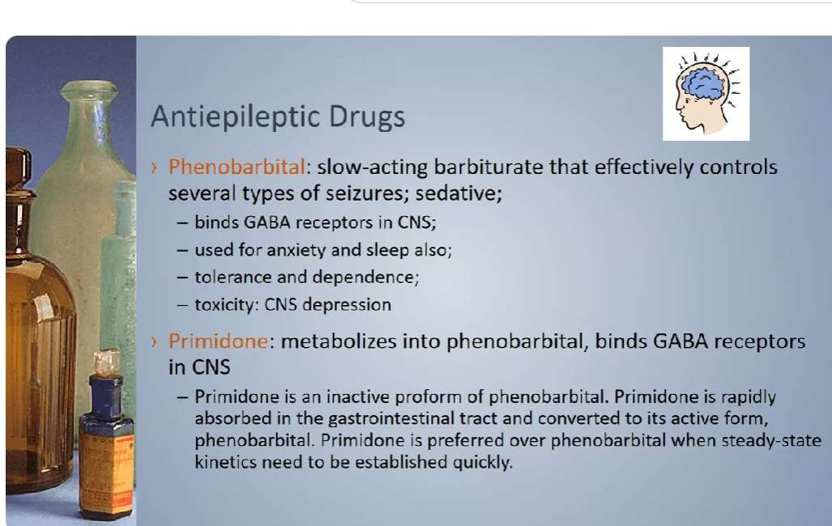

Slide 12
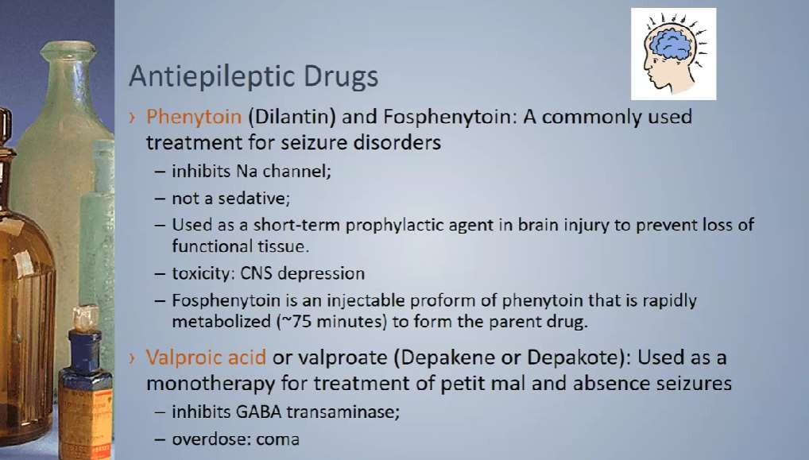

Slide 13
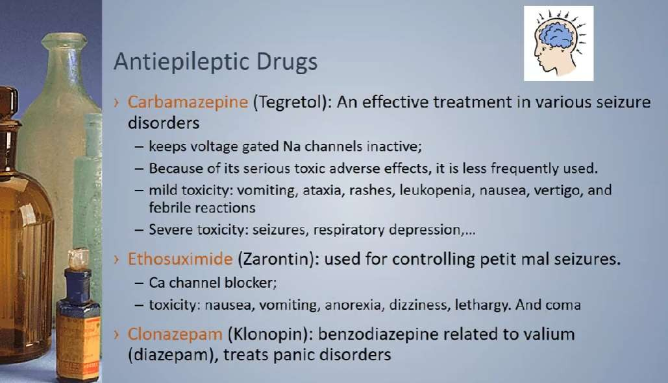

Slide 14
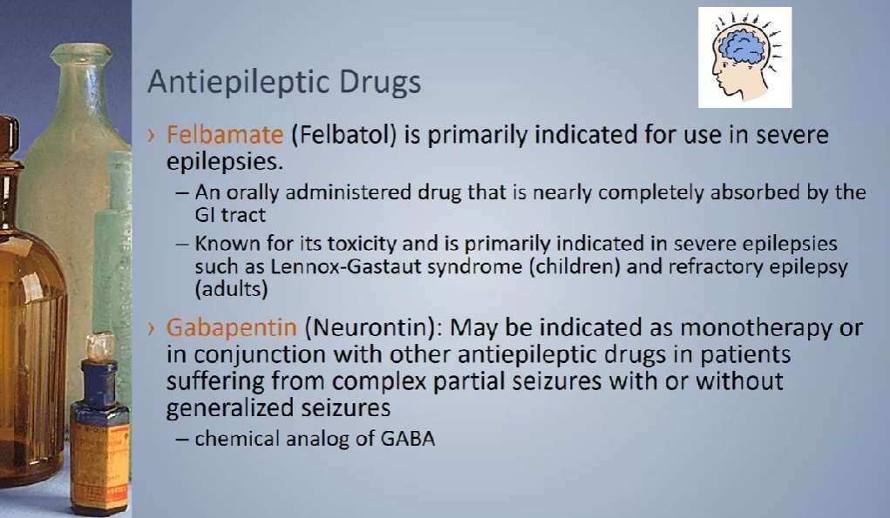

Slide 15
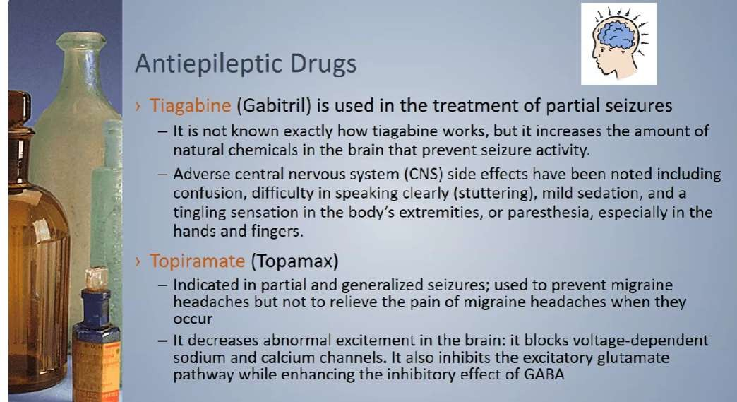

Slide 16
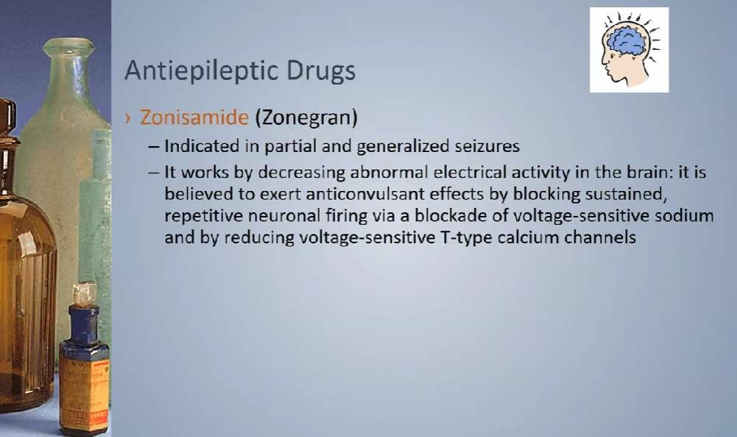

Slide 17
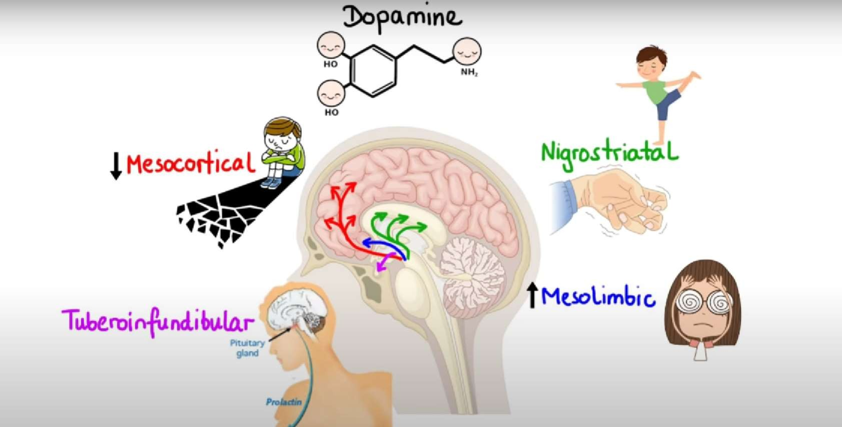
Psychiatric conditions

Slide 18
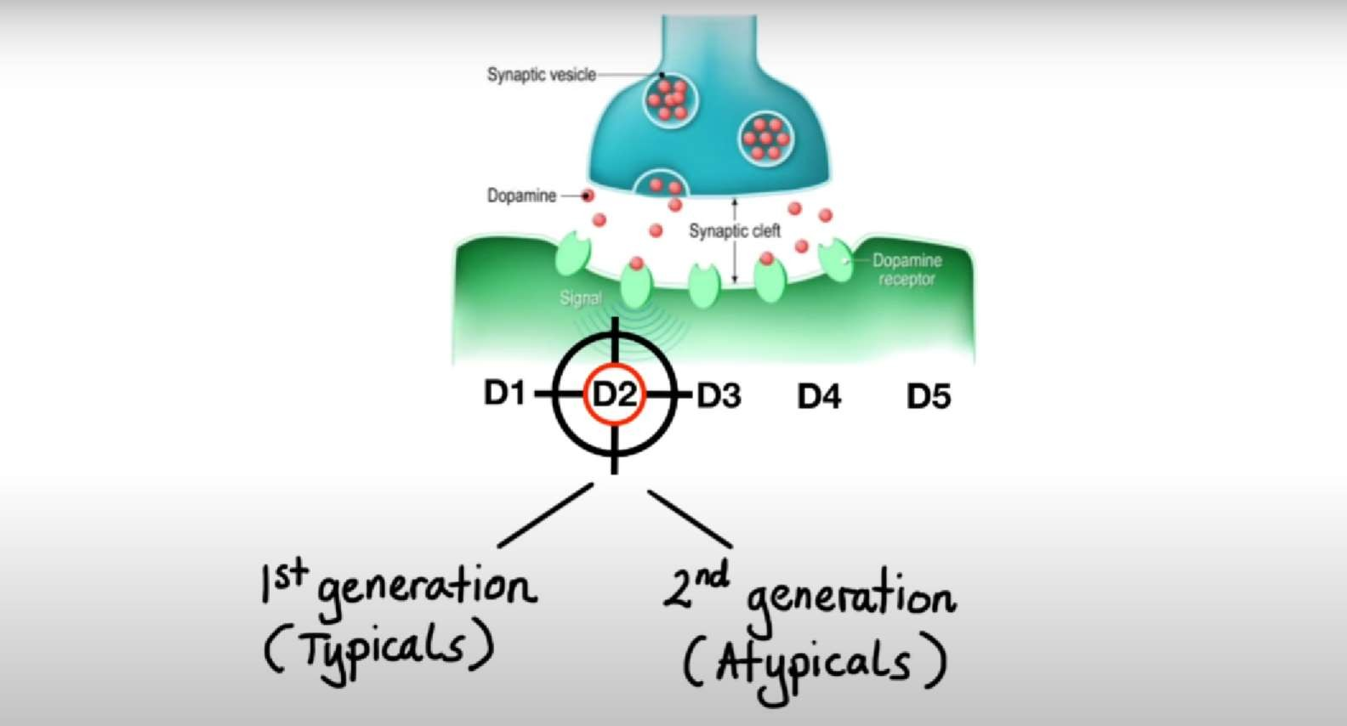

Slide 19
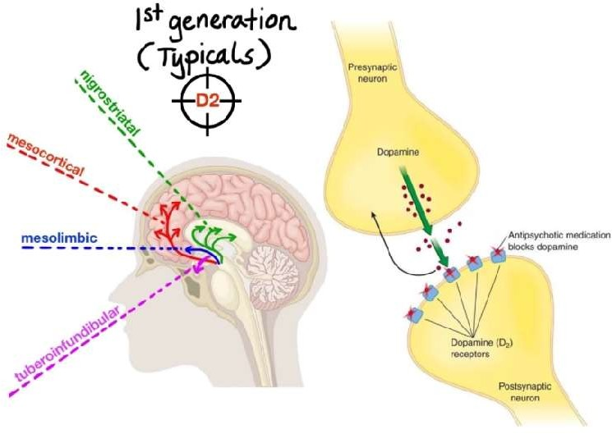

Slide 20
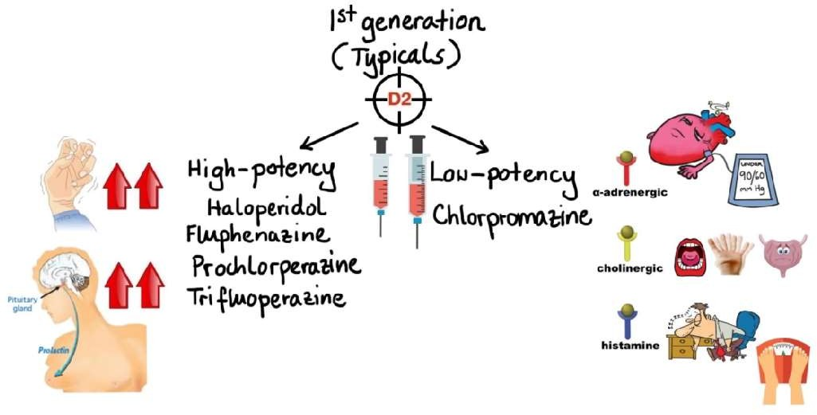

Slide 21
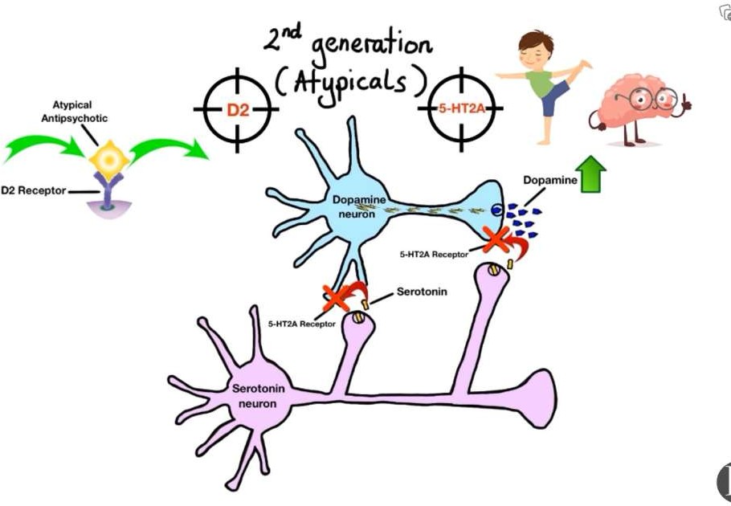

Slide 22
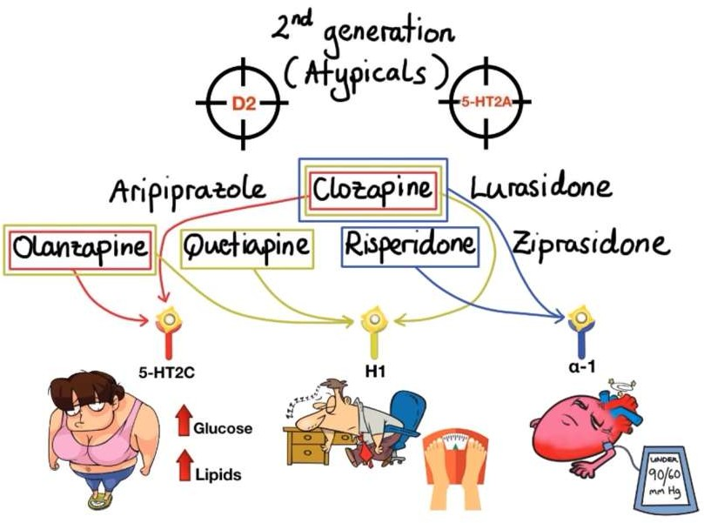

Slide 23

The pharmacokinetic phenotype of an individual can be measured by analysis of drug concentrations in blood plasma or serum, by TDM. TDM is well established for mood stabilizers, especially for lithium. For other neuropsychiatric drugs, routine TDM is rare. TDM will be useful if the following criteria are met:
the drug in question has a narrow therapeutic range,
a direct relationship exists between the drug or drug metabolite levels in plasma and the
pharmacological or toxic effects,
the therapeutic effect cannot be readily assessed by the clinical observation,
large individual variability in steady state plasma concentration exits at any given dose
appropriate analytic techniques are available to determine the drug and metabolite levels.
TDM is a method used to provide optimal pharmaceutical therapy. Knowing the plasma concentration of psychoactive medication helps monitor the side effects of the medication in order to prevent toxicity and increase the responsiveness of the medication. In therapeutic drug monitoring, psychoactive drugs are divided into 4 groups:
  The most recommended group consists of: lithium and carbamazepine. Monitoring the levels of valproic
acid is important in order to prevent toxicity from occurring.
  Clozapine and similar medications are considered one group of medication whose side effects
should be monitored.
  On the other hand, medications that should be closely observed but have an elapsed response rate are
included into the group monitored for response time.
  This group of medication is often monitored in order to place a pre-diagnosis for treatment-resistant patients who may have genetic polymorphism and choose the correct medication.

Slide 24
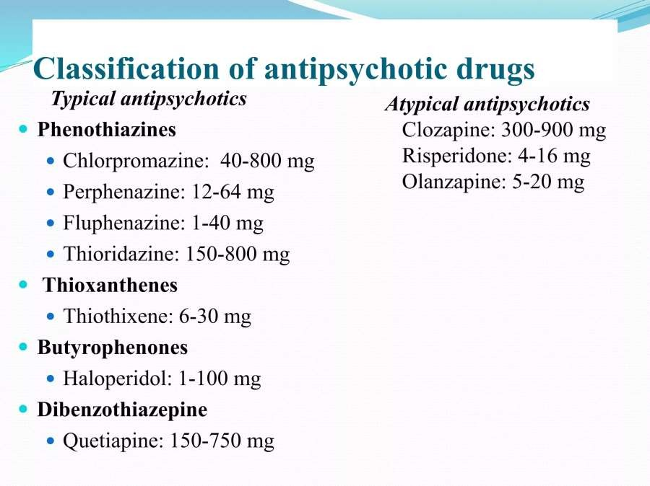

Slide 25
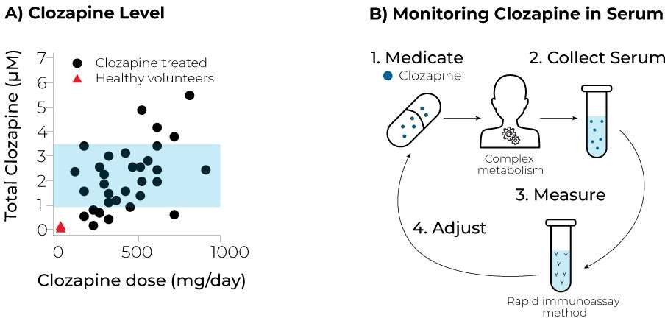

Slide 26
Mood stabilisers
Mood stabilisers are defined as medications which are both prophylactic for bipolar disorder and effective in the acute treatment of mania. The first mood stabiliser to be recognized was lithium Carbamazepine has also been demonstrated to be effective for bipolar disorder, both acutely and prophylactically . Sodium valproate is clearly antimanic acutely but prophylactic effectiveness has yet to be confirmed in controlled studies. In most countries, lithium is the most commonly prescribed mood stabiliser, though recently this drug has been recently overtaken by sodium valproate.
Lithium
Lithium is a monovalent cation that shares many of the physico-chemical properties of other alkaline metals such as sodium and potassium. It is mainly used for acute and prophylactic treatment of bipolar disorder, but is also of value in the augmentation of failed antidepressant courses for unipolar depression and (though less commonly used in clinical practice) for the prophylaxis of unipolar depression.

Slide 27
Clinical issues
Rates of noncompliance with lithium are high, with the range from various studies being 18–53%
In a survey of reasons for poor compliance, identified four major issues as articulated by patients: a dislike of medication controlling mood; a dislike of the idea of having a chronic illness; feeling depressed; and side-effects, particularly lethargy, decreased coordination and ‘dulling’ of the senses. In the same study, the three most important reasons for noncompliance as identified by clinicians were: when patients felt well they saw no need to continue medication; patients missed the ‘highs’ of hypomania; and patients were bothered by the idea of having a chronic illness.
It has been recognized that one of the consequences of noncompliance peculiar to lithium is that rapid
discontinuation leads to a very high rate of relapse, greater than the patient's ‘natural’ pattern. Fifty percent of patients experience relapse within 5 months of rapid discontinuation, with most relapsing into mania rather than depression.

Slide 28
Methods of analysis
Lithium concentrations are measured by either flame emission photometry or atomic absorption spectrophotometry. It is preferable to use clotted blood, from which serum can be separated, rather than anticoagulated blood to avoid any confusion in cases in which lithium heparin is used as an anticoagulant. As lithium moves rapidly into erythrocytes, serum should be separated quickly, preferably within 1 h
Sampling times and intervals
Lithium is available in both standard and slow release preparations. It is readily absorbed after oral administration. Standard preparations lead to peak levels in about 4–4.5 h Lithium is excreted virtually entirely by the kidneys and has a half-life varying from 8 to 55 h, with a right-skewed distribution and an arithmetic mean of 18–24 h . While the use of slow-release (sustained, controlled-release) preparations has been proposed as a means of diminishing postdose variation in serum concentrations and associated adverse effects, this has yet to be established empirically [19].
The need to monitor lithium levels was first advocated by Talbott after his demonstration that lithium-related deaths in cardiac patients (for whom lithium was being used as a salt substitute) were due to extremely high serum levels. The recognition of substantial variations in lithium levels over a 24 h period, however, awaited the work of Amdisen . Amdisen proposed the use of a standardized 12 h serum lithium concentration, which subsequently became the universally accepted mode of monitoring lithium levels. The sample is taken 12 h (± 30 min) after the last dose of lithium in patients who have been taking the drug in two or more divided dosages, and who have taken all their prescribed tablets at the scheduled hours for the previous 48 h.

Slide 29
Because of the relatively long half-life of lithium, steady state levels do not occur for 5–7 days. As the standardized concentration was determined for divided dosages, a 10% to 26% increase in levels can be expected if there is a change to once daily (usually nighttime) dosing.
There have been advocates of the use of a nomogram to predict the appropriate daily dose of lithium on the basis of the serum concentration 24 h after a single test dose [24]. Most commonly, however, lithium is commenced in divided dose (e.g. 750–1000 mg daily) and the dose titrated to the appropriate concentration.
Serum concentrations necessary for adequate prophylaxis of bipolar disorder are less than those required for the acute treatment of mania. After a first episode of mania, it is a common practice to continue lithium for about six months to prevent early relapse.

Slide 30

Therapeutic ranges
The American Psychiatric Association Practice Guidelines for the treatment of patients with bipolar disorder recommend that levels be titrated to serum concentrations of 0.5–1.2 mmol l⁻¹ for the acute treatment of mania. For prophylaxis the guidelines are less prescriptive, stating that serum concentrations, ‘may be, in some cases, as high as those required for treatment of the acute episode.’ It is then stated that the range of 0.6–0.8 mmol l⁻¹ ‘is commonly chosen by patients and their psychiatrists’, and that ‘for many patients increases in maintenance serum levels will result in a trade-off between greater protection from episodes at the cost of increased side-effects.’
Such divergence of views reflects the inadequacy of the research data base. Only six studies have randomly assigned patients to either dosage or serum concentration groups (with earlier studies being reviewed well by. In the one such study in acute mania, allocated patients to either placebo, high dose (0.72 mEq
kg⁻¹ day⁻¹), medium dose (0.5 mEq kg⁻¹ day^{–1}) or low dose (0.24 mEq kg⁻¹ day⁻¹) lithium with consequent serum levels of 0.62–2.00 mmol l⁻¹, 0.29–1.62 mmol l⁻¹, and 0.20–1.05 mmol l⁻¹, respectively. While high and medium doses were more effective than placebo, the low dose was not.

Slide 31

Carbamazepine
No therapeutic serum concentrations for carbamazepine in bipolar disorder have been established, although in one research setting CSF levels of the −10,11-epoxide metabolite of carbamazepine correlated with the antidepressant efficacy of carbamazepine in a mixed group of patients with unipolar and bipolar disorders [50]. In a randomised controlled trial in recurrent affective disorder,found no difference in recurrence rates in bipolar disorder patients between those with low (15–25 µmol l⁻¹) or high (28–40 µmol l⁻¹) carbamazepine levels. In practice, as for sodium valproate, therapeutic concentration levels established for epilepsy (6–12 mg l⁻¹; 20–50 µmol l⁻¹) are used as a general guideline for patients with bipolar disorder

Slide 32

Clinical issues
There are a number of clinical issues which militate against the demonstration of any relationship between TCA concentrations and therapeutic response. Depression is considered by many to be a heterogeneous disorder, with some subtypes – such as melancholia – probably responding more predictably to antidepressants. Furthermore, rates of spontaneous remission and placebo response are high in depression, confounding the demonstration of therapeutic concentrations. Despite this, such ranges have been demonstrated for a number of the TCAs. The strongest evidence for therapeutic ranges is for imipramine, desmethylimipramine (desipramine) and nortriptyline.
Methods of analysis
While TCAs can be monitored using serum or plasma, serum is preferred as it allows greater ease of extraction and involves no fibrin clots . Serum TCA concentration is stable for up to one week at room temperature. A number of different collection techniques have been shown to reduce measured TCA concentrations and should therefore be avoided: heparin-containing tubes; gel separator tubes; and tris-2- butoxyethylphosphate in tube stoppers .The methods available for quantitatively analysing TCAs include immunoassay, h.p.l.c. and gas-liquid chromatography . H.p.l.c. with absorbance detection is the most commonly used method. Most reversed-phase methods allow simultaneous measurement of both tertiary and secondary amines. Two main immunoassay forms are available: individual methods using the enzyme-multiplied immunoassay technique (EMIT); and fluorescence polarization immunoassay (FPIA) technology, which measures total tricyclic levels and is commonly used for urine drug screening rather than blood concentration monitoring.

Slide 33

The EMIT assay involves a solid-phase sample extraction followed by analysis with monoclonal or polyclonal antibodies. While this technique has a dynamic range consistent with therapeutic concentrations of the TCAs, a limitation is the considerable cross-reactivity of tertiary and secondary amine TCAs, as well as with structurally similar drugs such as the antipsychotic chlorpromazine.
Though the FPIA technique was originally developed for urine toxicology screening, its advantage is that no extraction of serum samples is involved. Compared with h.p.l.c., there are considerable negative or positive biases for various TCAs, and there is also considerable cross-reactivity with various antidepressants and antipsychotics

Slide 34

The half-lives of the TCAs are approximately 24 h. The specific half-lives (and days to steady state) of the TCAs for which therapeutic ranges are accepted are: imipramine 6–28 h (2–5 days), desipramine 12– 28 h (3–6 days) and nortriptyline 18–56 h (4–11) days . Because of the long half-lives, most patients take a single evening dose of TCA. Blood samples are taken about 12–14 h after the last dose for those on once daily treatment, and 4–6 h after dosing if the patient is on divided dose regimen.
Specimens should be taken only once steady state concentrations are likely to have been achieved.
Sampling times and intervals
Therapeutic ranges
The American Psychiatric Association Task Force on the Use of Laboratory Tests in Psychiatry concluded that there was strong evidence for plasma concentration measurements of imipramine, desmethylimipramine (desipramine) and nortriptyline, but not other TCAs. Subsequent authorities have come to similar conclusions.

Slide 35

Studies of both nortriptyline and desipramine have, in general, demonstrated curvilinear con-centration-response relationships, with optimum ranges of 50–150 ng ml⁻¹ (200–600 nmol l⁻¹) and 100–160 ng ml⁻¹ (400–650 nmol l⁻¹), respectively, and response rates of 70% and 59%, respectively, within these ranges
. A recent double-blind 3 year maintenance study of two fixed plasma concentration groups, i.e. 80–120 ng ml⁻¹ (300– 450 nmol l⁻¹) and 40–60 ng ml⁻¹ (150–230 nmol l⁻¹), in elderly patients with recurrent depression, found no difference in recurrence rates. The higher level was, however, associated with less residual symptoms, but more constipation.

Slide 36
Organ transplantations
For TDM of tacrolimus the pre-dose (or trough concentration (C0)) is most widely used in every day clinical practice. Ideally, the measurement of tacrolimus exposure should be performed by measuring the 12-h (the dosing interval) area under the concentration versus time curve (AUC). However, measuring a full AUC is impractical. For tacrolimus, the correlation coefficient between C0 and AUC in general is acceptable with an r of 0.7 and higher. However, this correlation ranges between 0.34 and 0.60 in some patients
. The problem is that such patients may be considered to have an adequate exposure to tacrolimus if only a C0 is measured, whereas the true exposure is off target. Vice versa some patients may have a C0 that is outside the target range, whereas their exposure (measured by AUC) is in fact adequate.
Reports have been published of patients experiencing acute rejection from inadequate exposure despite having a C0 within the target range. In clinical practice, C0 is generally used for TDM because of its feasibility and simplicity, although the correlation with total tacrolimus exposure is not perfect. To better estimate tacrolimus exposure, limited sampling strategies (LSS) have been developed. LSS utilize tacrolimus concentrations measured at 2–3 time points (rather than ≥8 time-points in the full 12-h AUC), to estimate an AUC. The correlation coefficient between the full AUC and its estimation by LSS (using multiple linear regression) is good with r ≥ 0.90. Moreover, when LSS is combined with Bayesian estimation, which uses information from a priori estimated population pharmacokinetic parameters (such as drug clearance

Slide 37
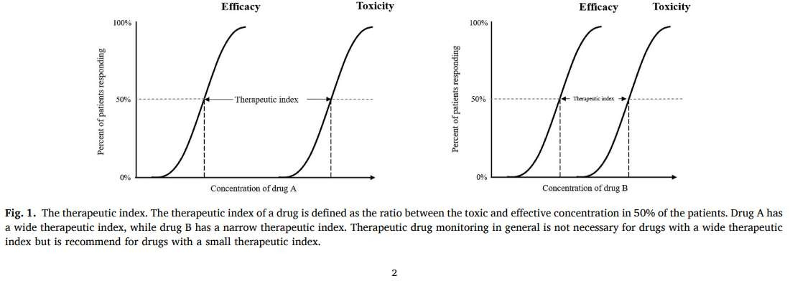

Slide 38
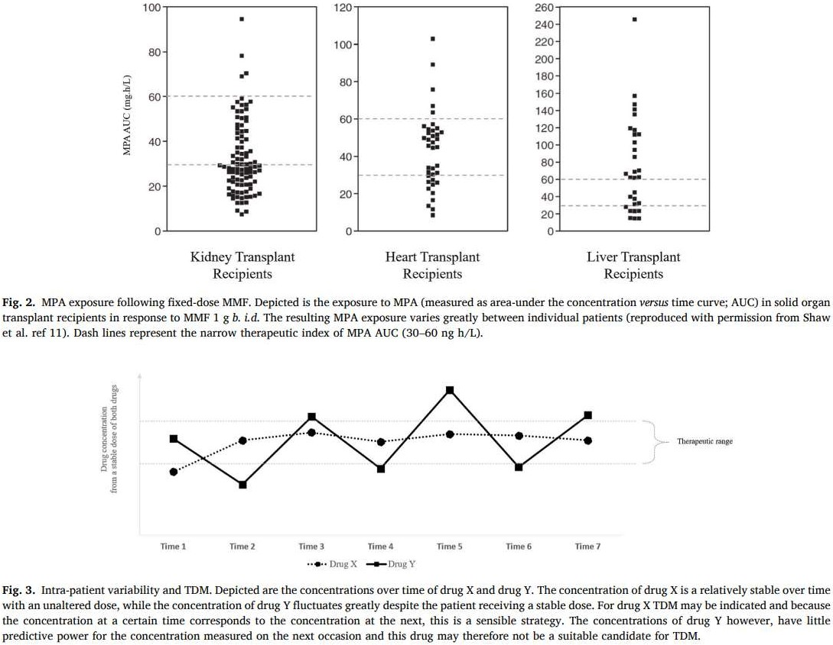

Slide 39

and volume of distribution), the individualized AUC for each patient can be generated after fitting the LSS to
the population-based model.
This enhances the predictive value of LSS for tacrolimus exposure in an individual patient to r ≥ 0.95 . Ideally, the AUC should be evaluated in every patient before hospital discharge but this might not be practical in all transplant centers. Clinicians can select patients who are suspected of having a poor correlation between their tacrolimus C0 and AUC, i.e. patients who develop toxicity or rejection despite an C0 within the target concentration range, and these may have an indication for an (abbreviated) AUC measurement. A number of studies has been conducted to identify pharmacodynamic biomarkers that can be used in combination with classic pharmacokinetic TDM of tacrolimus.
These biomarkers are molecules that form part of the pathway targeted by tacrolimus, and include the phosphatase activity of calcineurin, the nuclear translocation of the nuclear factor of activated T cells (NFAT; measured by flow cytometry), NFAT-regulated gene expression, NFAT cytoplasmic 1 (NFATc1) amplification, and interleukin (IL)-2 concentration (measured either by the IL-2 concentration or IL-2 messenger RNA expression). The results from these studies are limited by their relatively small study populations and the fact that these were not controlled clinical studies Most importantly, measuring the tacrolimus concentration is much easier to perform compared to the measurement of these pharmacodynamic biomarkers which requires sophisticated analytic procedures and which have no demonstrated clinical benefits (yet). As a result, none of the markers for pharmacodynamic TDM has currently been implemented in outine clinical practice, although this is a subject of active and ongoing research.

Slide 40
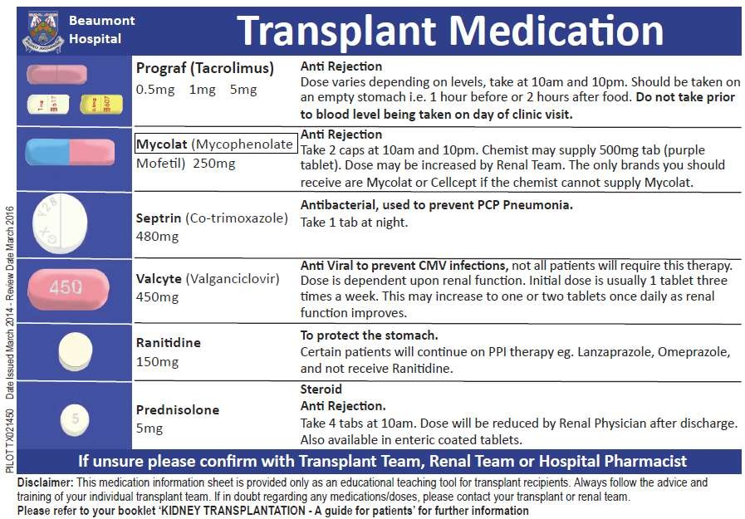

Slide 41
Immunosuppressants are medications that help prevent rejection of your transplanted kidney. They are called immunosuppressants, use they work by suppressing your immune system. These are powerful medications that affect other parts of your body.
The goal of immunosuppressant therapy is to find the right balance, between preventing rejection while minimising side effects, and reducing the risk of infection. Many of the sideeffects are more severe when the dosage of the anti-rejection medication is highest, just after the transplant. In the weeks and months following your transplant, the dosage may be reduced, and some of the side-effects may become less troublesome or might even disappear. If you experience sideeffects, tell your doctor or transplant nurse, who might be able to adjust your dosage or switch you to another medication.
Anti-rejection medications work only within a very narrow range in your body- too little, and you risk rejection; too much, and they can be poisonous or toxic to your body. That is why you must take these medications exactly as instructed. Never take more, never take less, and never, ever, skip a dose. If you do forget to take a dose, take it, if remembered, within 4-6 hours of the prescribed time, but never take a double dose, unless you are specifically told to by your doctor. In order to be certain that you are getting precisely the right amount of anti-rejection medication, you must be monitored carefully with routine blood tests, which also measure the drug level within your body. You must take these medications for the rest of your life. Even if you have had a rejection episode or your doctor has reduced your dosage, you must not stop taking these very important medications. If you stop taking your medication, you will lose your kidney transplant. It is that simple.

