Slide 1
CKIPTION

Slide 2
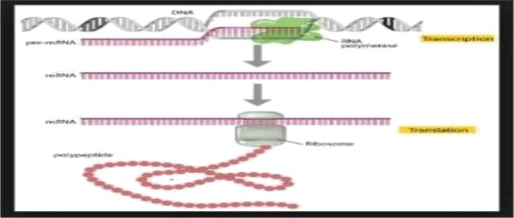
TRANSCRIPTION AND TRANSCRIPTION FACTORS
It is the synthesis Of an mRNA molecule from a DNA template
All the cellular RNAs are synthesized from the DNA templates thmugh the process the transcription, DNA regions that can be transcribed into RNA are called structural genes
template strand on which the RNA is synthesized is called as antisense code or non-sense codon, the coding strand is known as sense codon, the enzyme that catalyze the RNA synthesis is RNA Polymerase and doesn't need a primer unlike replication
Difference between Replication and Transcription
REPLICA’I“ION | ’1’RANSCRIP’1’ION
It requires a primer, enzyme that catalyze this is DNA polymerase | This doen't require primer, enzyme that catalyze the synthesis of tnRNA is RNA Polymerase
Product formed is ds DNA strand one each on the mother template and the other on the daughter strand | Product formed is one new single stranded mRNA is produced on the single stranded DNA as the template
Substrate for the synthesis are dNTPS. base pairing A pairs with T and G pairs with C | Substrate for the synthesis tire N’l’Ps. Base pairing A pairs with U and G pairs with C
lintire chmmosome is replicated | Only a small portion of the DNA molecules is transcribed to RNA, and this varies based on the cells needs at the time , physiological need and environmental changes

Slide 3
TRANSCRIPTION IN EUKARYOTICS
Transcription in eukaryotiC is undertaken by different RNA Polymerase
Eukaryotes have 3 polymemse Pol 1 lI Ill
Several initiation factors are required for efficient and pmmoter specific initiation in eukaiyotes and are called as general transcription factors GTFs
In vitro, the GTFS is required, together w ith Pol 1, to initiate transcription on a DNA
template
Sometimes GTFs are not sufficient of promotes significant expression. Rather the additional factors are required such as mediator complex , DNA binding , regulatory proteins and chmmatin modifying enzymes.
In vitro, the GTFs is required, together with Pol Il, to initiate transcription on DNA template
Transcription in eukaryoti cs can be divided into three classes. Each class is transcribed by a different RNA Polymerase
  RNA Polymerase 1 to trdilscribes r RNA
  RNA Polymerase Il transcribes lTi RNA
  RNA Polymerase III transcribes t RNA and other small RNA's
In eukaryotic cells, for all the RNA Polymerase, the factors creates and structure at the pmmoter to pmvide the target that is recogniZed by the enzyme.
e.g. RNA Polymerase 11 the factors foriTi a sizeable gmup collectively called as basal factors
TRANSCRIPTION FACTORS
Any protein that are needed for initiation of transcription, but which is not itself part of RNA Polymerase, is defined as a transcription factor
they act by recognizing cis acting sites on DNA
Binding of trailscripti on factors is not enough for the traRSCription, it may recognize another factor, or a RNA Polymerase, or it might get incorporated into an initiation complex only in the presence several proteins
Tmnscription factors are needed for initiation

Slide 4
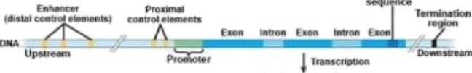


What are basal factors?
these are the factors that join with RNA Polymerase II and form a complex surrounding the start point , they determine the site of initiation.
n
Basal factors alid RNA Polymerase lI form the basal transcription apparatus
RNA Polymerase have sequence elements close to the start point that are bound by basal apparatus and that established the site of initiation . RNA Polymerase II and general transcription factors are needed to transcribe any pmmoter
the subunits of RNA Polymerase Il and the general transcription factors are conserved among eukaiyotes
WHAT IS PROMOTER
The pmmoter is defined as the shortest region that contains all the binding sites, that is those sites that can support transcription at the normal efficiency and with the pmper control.
For eukaryotic m RNA is the basiCally the site at which the transcription on factors bind
The promoter contains several short less than l0bp sequence elements that binds the transcription factors, dispersed over more than 200bp
The pmmoter for RNA Polymerase lI is located upstream of the start point and these help in initiating the transcription.

Slide 5
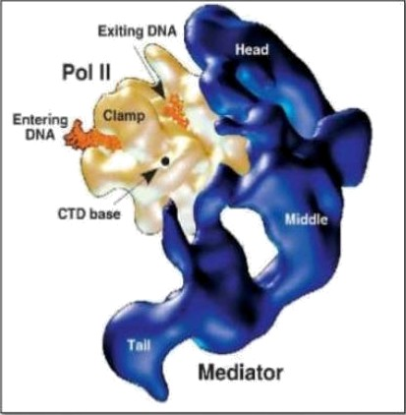
ENHANCERS-
these are the types of the sites involved in initiation.it can be defined as the sequences that stimulate initiation but are lc›cated at a considerable distance from the start point.
the components of enhancers are similar to that of the promoters
they contain several closely arranged sequence elements that binds transcription factors
the enhancer need not to be at start point
the proteins that are bound to the enhancers are also interact with the pmteins bound at promoter elements
STEPS OF TRANSCRIPTION
transcription by RNA Polymerase proceeds thmugh a series of well defined steps with are grouped into 3 phases
Initiation
Elongation
termination
RNA Polymerase II
lt is located in the nucleosome

Slide 6
It represents tTiost of the remaining activity and is responsible for synthesizing hetemgenous nuclear RNA , The precursor of m RNA
These are large proteins have large molecular weight more than 500KD
RNA Polymerase lI requires transcription factors TFII (X) to initiate the transcription
The TATA boK is Common component of RNA Polymerase 11 pmmoters and consist of A-T rich octamer located -25 bp upstream of the start point
Core promoter for RNA Polymerase II includes the InR and either a TATA box or a DPE
CORE promoter:
It refers to minimum set of sequence elements required for accurate transcription initiation by Pol lI
Function at low efficiency
A core promoter is about 40 nucleotides long extending either upstream and downstreaiTi of the transcription start site.
There are 4 elements found in Pol Il Core promoter these are the :
TFIIB Recognition site
TATA element
the initiator (InR) element
the downstream pmmoter element (DPE)
Promoter includes 2 or 3 of these 4 elements
A core pmmoter is present either with a TATA BOX and Inr or with a fur and a DPE
THE INITIATOR: At the Gtart point there is no extensive homology of Sequence , but these iG a tendency for the first base of tri RNA to be A, flanked on the either Gides of the pyrimidines
  This region is known as initiator. described in the form of Py2CAPy5. The initiator is between position -3 to -5
  Core promoter with a TATA BOX at -25 and at +1 there is transcriptional start site
  Coding start sequence up tO l00bp
  Upstream froiTi TATA BOX may regulatory elements -cis acting elements
  DNA sequences- that exert their effects only over a particular gene: eg: TATA BOX, ERhRRCers and silencers

Slide 7
TranG acting faCtOrG that bind to CiG acting factors
PROTEIN NEEDED FOR TRANSCRIPTION IN EUKARYOTIC
RNA POLYMERASE II: the enzyme that catalyze the linkage between ribonucleotides in 5- 3 direction, using DNA as a template. EukaryotiCS RNA Polymerase lI proteins are usually composed of 12 subunits . the two large subunits are stiuctiirally siiTiilar to beta and beta prime subunits found in E.coli RNA POLYMERASE.
TRANSCRIPTION FACTORS | FUNCTIONS
TFIID | Composed of TATA binding pmteins (TBP) and other asSOClfited factors (TAFs) . recognizes the TATA box of eukaryotiCs proteins, encoding gene promoters
TFIIB | Binds to TFIID and then enable RNA Polymerasell to bind to the core promoter . also promotes TFIIF binding. lt is a monomer protein slightly smaller than TBP
TFII F | A Tetrameric compter with RNA Polymerase 11 and play a role in its stabiliry to bind to TFIIB and the core pmmoter. AlsO plays a role in abiliry of TFIIE and TFIIH to bind to RNA Polymerase lI
TFIIE | Tetrameric complex that bind to the DNA and creates a dock site for TFIIH
TFIIH | lt is a multimètre faCtors containing 9 subunits. The binding of TFII H COmpl etes the asseiTibly of the transcription preinitiation complex in vitro . it has multiple roles.

