Slide 1
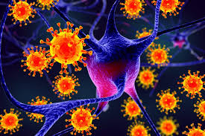
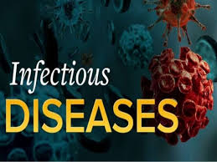
Viral Infection
Infection Disease
By Animesh Das

Slide 2
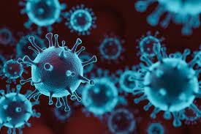
Definition
Virus --
A virus is a small infections agent that replicates only inside the living cells and organism .
viral particle also known as Virions , consist of the genetic material , the capsid .
It is the proliferation of the harmful virus within the body , symptoms of the viral illness are due to tissue damage and associated immune response of the host .

Slide 3
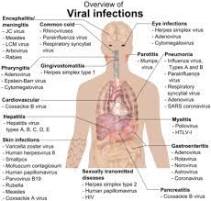
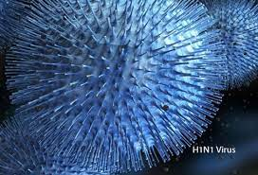
Type / Classification
The common cold, which mainly occurs due to rhinovirus, coronavirus, and adenovirus
Encephalitis and meningitis, resulting from enteroviruses and the herpes simplex virus (HSV), as well as West Nile Virus
Warts and skin infections, for which HPV and HSV are responsible

Slide 4
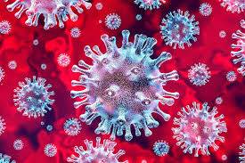
Recent viral disease
Chicken pox
Flu
Herpes virus
HIV /AIDS
Human papilloma virus [ HPV ]
Mumps
Measles
Viral Hepatitis
Viral Meningitis
Viral Pneumonia
Rubella

Slide 5
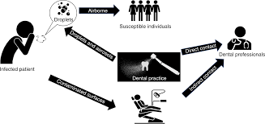
Routes of entry
Ingestion
Inoculation
Sexual
Inhalation
Blood organ / plant
Congenital / Vertical

Slide 6
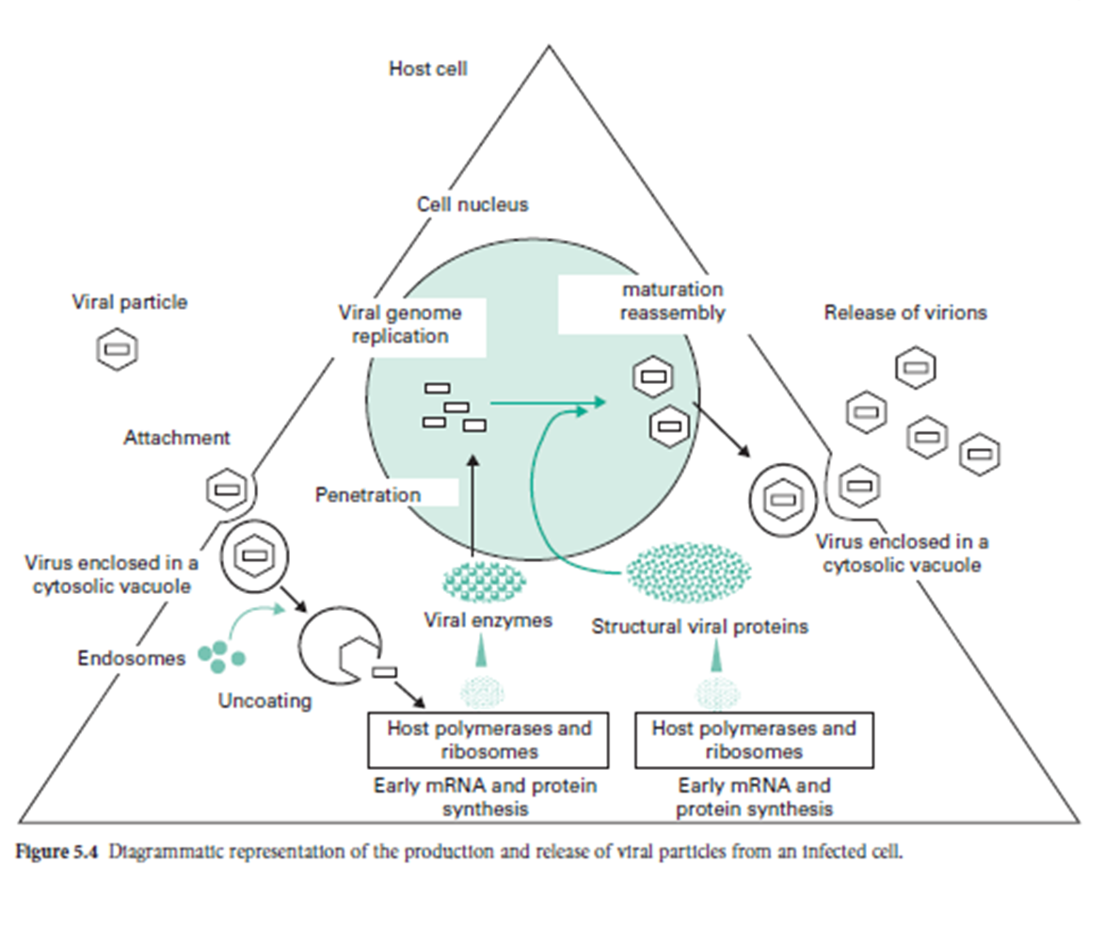
Stages of viral infection
Attachment
Penetration
Uncoating
Biosynthesis
Maturation
Release

Slide 7
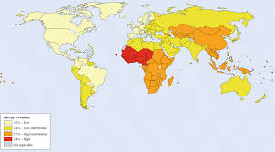
Epidemiology
A powerful approach for the investigation of transmission, diversity, and evolution and origin of viruses
it is affected any age like children , man and women .
viral zone – India , America , UK , Russia.

Slide 8
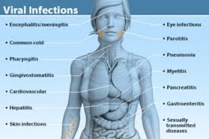
Sings and symptoms
Flu like symptoms
Malaise
Rash
Sneezing
Irritability
Nausea
vomiting
Fever
Headache
Cough
Pains
GIT disturbance
Diarrhea

Slide 9
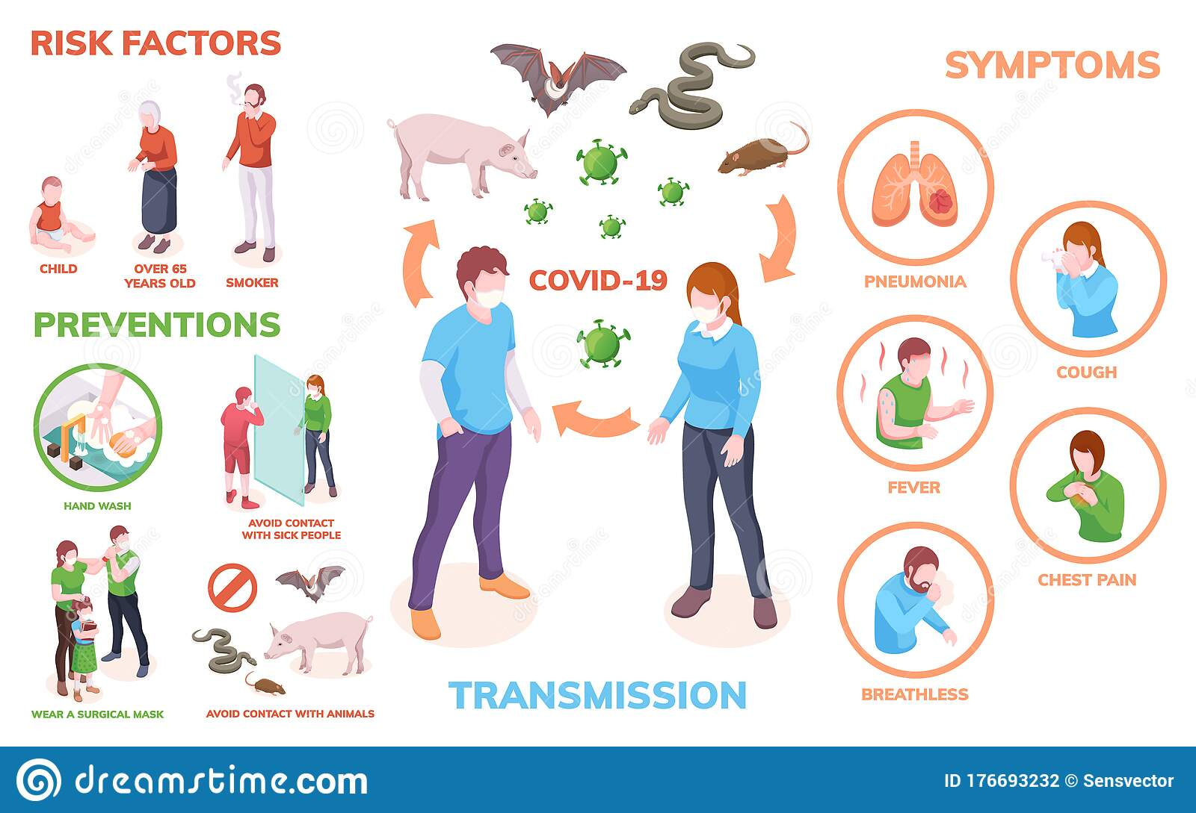
Risk factor
Environment Risk factor
Tobacco. ...
Alcohol. ...
Obesity. ...
Ultraviolet radiation. ...
Asbestos. ...
Viruses. ...
Ionizing radiation

Slide 10
Pathogenesis
Replication of the virus
Pro inflammatory response
Endothelial damage
Activation of the intrinsic coagulation cascade

Slide 11

DIC and multi organ failure
Death

Slide 12
Management
Diagnosis
Treatment

Slide 13
Diagnosis
Microscopy test
Antigen detection test
Antibody detection test
Nucleic acid detection test
Virus isolation
Cytology

Slide 14
Treatment
Category | Drug Name
Direct acting Antiviral | Ombitasvir
HCV NS5A inhibitors | Elbasvir , Ledipasvir
Antiviral | Sofosbuvir , Famcicloviral
protease inhibitors | Simeprevir , Lopinavir
Protein Inhibitor | Tecovirimat
neuraminidase inhibitors | Oseltamivir
nucleoside reverse transcriptase inhibitors | Didanosine

Slide 15
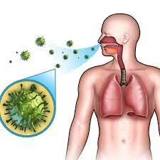
Complication
Acute bronchitis.
Cervical cancer (from human papillomavirus infection)
Dehydration.
Frequent life-threatening, opportunistic infections.
Otitis media (ear infection)
Pneumonia.
Secondary bacterial infection.
Seizures

Slide 16
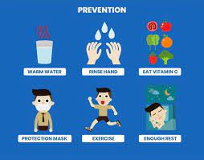
Prevention
Vaccination
Interferon
Sanitation
Abstention for STDs

Slide 17
Thank
you

